Slide 1

Charting a course to quality student learning
Poll Everywhere directions

Slide 2
Using textbook as curriculum guide
Using publisher’s test bank questions without knowing alignment of competency/objectives in course
Using publisher’s test or any test as only form of assessment; have no clue whether they have met the performance criteria; assessment is not showing mastery of competency
No formative assessment to provide feedback (no practice in the learning cycle – i.e. lecture test)
Performance criteria are not accessible; condition is the criteria (i.e. 80% pass)
No focus on student performance (product/process)
Instructors not instructional designers or have an ID experience or background/education

Slide 3




Session Outcomes
Competency: Design an aligned curriculum that meets QM standards
Learning Objectives:
  Identify course components
  Develop competencies
  Identify assessment strategies
  Develop criteria
  Develop learning objectives
  Select learning activities
Kim Vosicky – Learning Design Consultant
Andrea Schullo – Associate Dean
TODAY’S PRESENTERS

Slide 4
Learning Design Process
External Standards
DACUM
Mission
Exit learning Outcomes
Core Abilities
Gen Education
Program
Define high performance.
Establish WHAT learners will learn.
Competency
Learning
Assessment
Design learning and assessment.
Learning Plans
Performance Assessments
Learning Objective
Learning Objective
Learning Objective
Criteria
Assessment Activities
Learning Activity
Learning Activity
Learning Activity
Assessment Objects/Items
Scoring Guide/Rubrics
Learning Objects/Materials
Deliver learning and evaluate effectiveness for continual improvement.
All Levels
Notes:
Addressing the four key

Slide 5

Start the journey
What do your student need to be able to DO at the end of the journey?
How will they get there?
When will they know they’ve arrived?
Notes:
So, let’s start the journey! If you can answer these questions, you’ve addressed the essential features of performance-based learning design. You’re ready for successful trip!
We’re going to take a very condensed trip in creating an aligned course called “Fishing Trip.”

Slide 6

Let’s go fishing!
Refer to the Learning Plan Template provided in your packet.
Notes:
ANDREA: HERE IS WHERE YOU BUILD YOUR TEMPLATE OUT. I MADE A TEMPLATE FORM SO THAT WE COULD BUILD THIS RIGHT ON THE SCREEN USING PARTICIPANT INPUT. IS THIS THE MODULE YOU WANT?
Zoom in on the module you’ll be working on and use the template in their packet. Craft the module as a group. Allow participants to help you develop it out. Fill out the template on the screen for all to see it develop.

Slide 7
Feature #1 - Competencies
Competencies are identified, verified, and made public in advance
All content decisions are based on competencies
Specific Review Standard 2.1: The course learning objectives, or course/program competencies, describe outcomes that are measurable
Notes:
Competencies are the major concepts students will learn. They begin with action verbs that reflect what we want students to be able to do. Select these verbs carefully as they directly relate to the Essential Specific Review Standard 2.1. What would some of the major concepts that would need to be covered in a Fishing Trip course?

Slide 8

Outcomes Drive Learning and Assessment
Notes:
Competencies become the base for developing assessments and learning activities

Slide 9

Feature #2 – Assessment Strategies
Performance is primary evidence that learner has mastered the outcome
Specific Review Standard 3.1: The assessments measure the achievement of the stated learning objectives or competencies.
Notes:
First we consider how will we assess each competency. Look at the competency verb. This will assure that Essential Specific Review Standard 3.1 is met. When we assess, we can assess a product students create or a process they will perform. For the sake of time, let’s focus on one of our competencies. What strategy would we use to assess it?

Slide 10
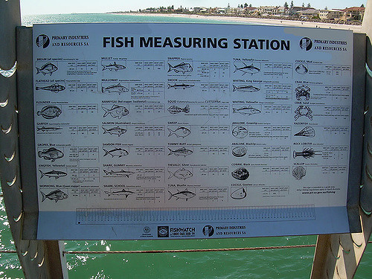
Feature #3 - Criteria
Performance standards are explicitly stated and made public in advance of assessing the performance
Learners should never wonder what is expected
Learners are assessed against a pre-set standard, not against others
Specific Review Standard 3.3: Specific and descriptive criteria are provided for the evaluation of learners’ work, and their connection to the course grading policy is clearly explained.
Notes:
Once we have identified how students will be assessed, we identify what will be assessed. What criteria will we look for in the product or process? Criteria should be specific enough to transfer into a checklist or rubric students can use to self-assess as well as the pre-defined standard an instructor uses to assess student mastery. This assures that you have met Essential Specific Review Standard 3.3. What are the criteria of our selected competency that would show mastery?

Slide 11



Feature #4 – Learning Objectives
Learning Objectives break the competency into subtopics.
Specific Review Standard 2.2: The module/unit-level objectives or competencies describe outcomes that are measurable and consistent with the course-level objectives or competencies.
Notes:
Now that we know where we want students to end up, we determine the “subtopics” that need to be taught/learned for the students to achieve the criteria we have laid out. We call these learning objectives. Often we can determine the learning objectives by looking for themes in the criteria. Writing learning objectives specific to each competency that begin with action verbs assures that Essential Specific Review Standard 2.2 is met. They also focus the module learning activities. What would the learning objective be for the criteria we have established?

Slide 12
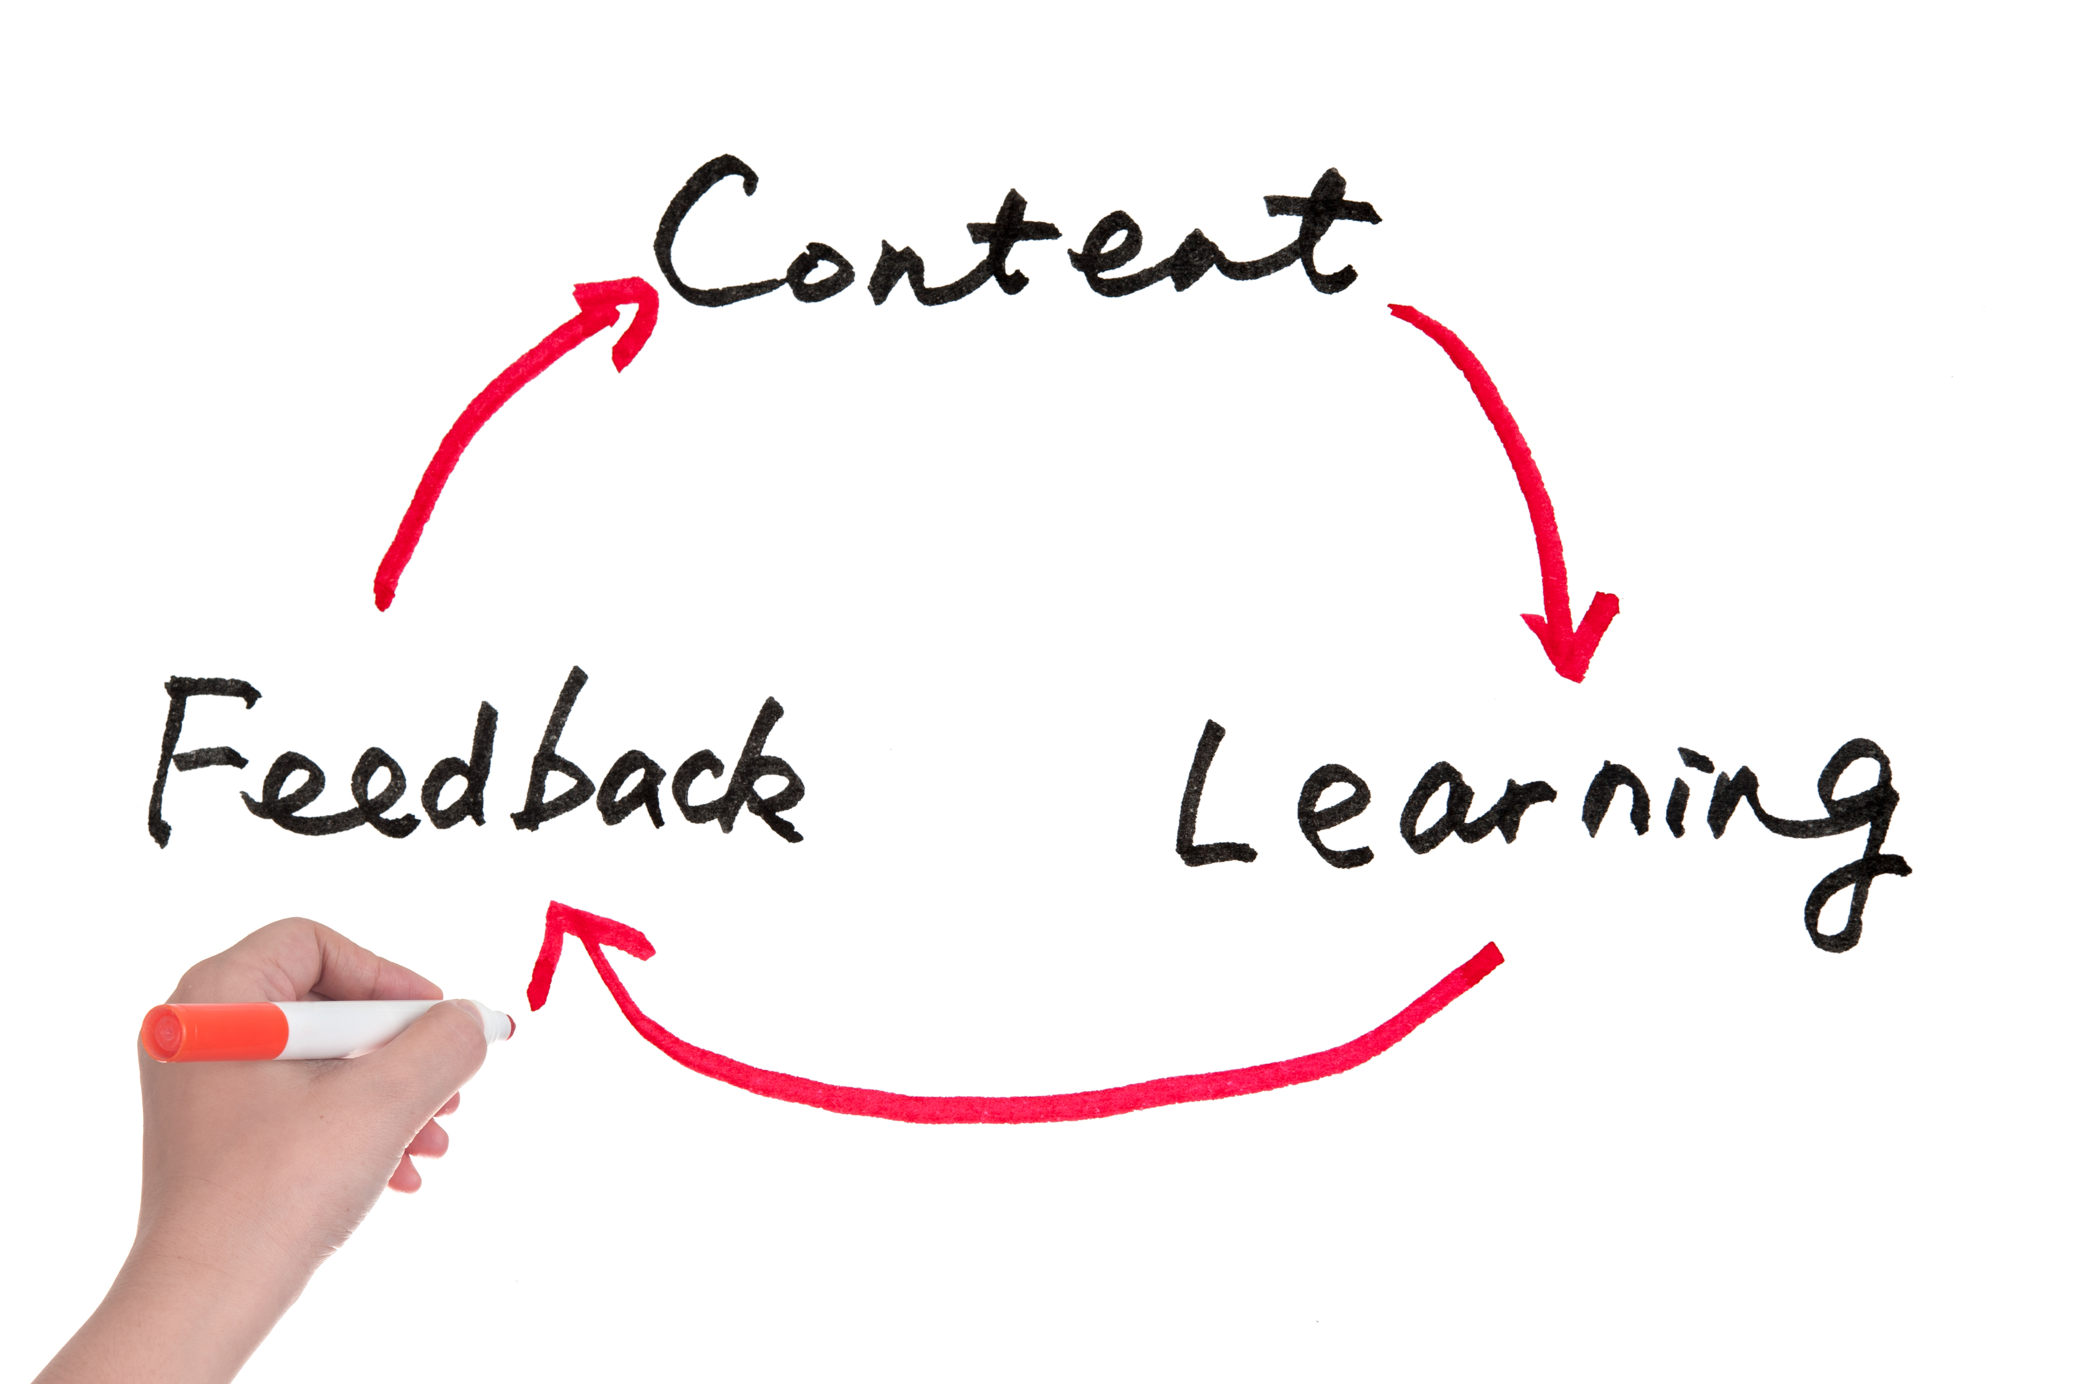
Feature #5 – Learning Activities
Learning activities and teaching strategies relate to the competencies
A variety of strategies are used
Learners are given periodic feedback
Specific Review Standard 5.1: The learning activities promote the achievement of the stated learning objectives or competencies.
Specific Review Standard 4.1: The instructional materials contribute to the achievement of the stated learning objectives or competencies.
Specific Review Standard 4.2: The relationship between the use of instructional materials in the course and completing learning activities is clearly explained.
Specific Review Standard 6.1: The tools used in the course support the learning objectives or competencies.
Notes:
Now we are ready to identify the tasks students will complete to learn the objectives. By asking, “What do students need to do to learn this objective?” we maintain the alignment assuring that Essential Specific Review Standard 5.1 is met. Using instructional materials and tools for the activities (which align with the learning objectives which align with the course competencies) we can assure that Essential Specific Review Standards 4.1, 4.2, and 6.1 are met.

Slide 13
The Learning Cycle
Application/
Assessment
Instructor = Assessor and Cheerleader
Learner = Adapting and Creating
Motivation
Instructor = Initiator
Learner = Making Connections
Comprehension
Instructor = Curator and Deliverer
Learner = Forming Concepts
Practice
Instructor = Coach
Learner = Trying and Improving
Notes:
A method to select learning activities that supports brain and learning research is the learning cycle. Minimally, we would have one motivational learning activity for each competency, one comprehension and one practice learning activity for each learning objective, and one application/assessment activity for each competency. Developing learning activities using the learning cycle creates a “balanced” approach to learning a skill or concept that results in improved understanding and retention. Sometimes instructors will say they don’t have time to use the learning cycle; there’s too much to cover. But covering content is not the same as learning content. To learn, students need to make a connection with the content and have the opportunity to practice, receive feedback, and improve before information and skills can move to long-term memory. Let’s identify the learning activities in each quadrant for our competency.
ANDREA: I just pulled in the cycle and the four simple descriptor slides. We should clean up the coloring, fonts etc. so it is easier to read. There are many different learning cycles out there, but most contain similar concepts. The squares next to each quadrant of the circle show the similar concept in Dave Meier’s Accelerated Learning model and Bernice McCarthy’s 4MAT model, two popular learning cycle models. We’re going to use the terminology used in WIDS: Motivation, Comprehension, Practice, and Application/Assessment.

Slide 14
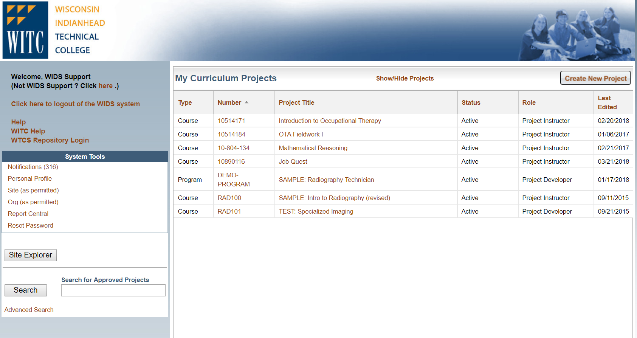
Notes:
Show that this presentation was developed in WIDS – outcomes, assessment strategies, learning plan and activities. Kim – highlight key features discussed today and mention that you’ll be there. Highlight the LA Library and that Andrea has printed off some for you to take if you desire…as a tool to help you chart your own course’s learning and assessment!

Slide 15
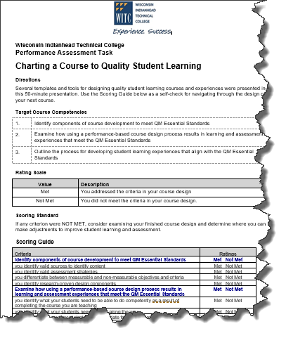

Chart your own course design
Notes:
We conclude this session reminding you that you have some new tools to help you pave the way…chart the course…toward good course design. At the end of this packet is a self-assessment and checklist to help you think through what you need to design for quality student learning. Following the steps we’ve outlined, you will meet 8 of the 23 essential standards for QM.

Slide 16


Slide 17
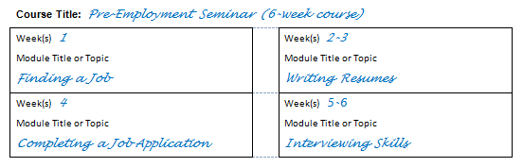
Course Maps
Notes:
There is a sample template in your packet for you to use when thinking about your own course’s design.

Slide 18
Motivation – Prepare Students to Learn
Create a positive, comfortable learning environment
State the outcomes (linked competency(ies) and learning objectives)
State how the content will benefit learners – Why am I learning this?
Identify learner’s prior knowledge of the outcomes
Create curiosity and/or interest in learning the content
Motivation
Instructor = Initiator
Learner = Making Connections
Notes:
With the goal of using the whole brain and achieving 90% retention, let’s examine each quadrant of the learning cycle. Motivation is the first quadrant. In the motivation quadrant, the role of the instructor is to be an initiator, activating the content; and the role of learner is to make connections. Motivation activities prepare students to learn and give students a personal connection to each other and to the content. There are five components to motivation activities: creating a positive environment, stating outcomes and benefits, identifying prior knowledge, and creating interest. Let’s look at each component in more detail.

Slide 19
Comprehension
Incorporate as many senses as possible into the learning experience
Incorporate opportunities for learners to work together and learn from each other
Create learning plans in 10-minute chunks to keep interest and attention
Align learning activities with outcomes stated at the beginning
Comprehension
Instructor = Curator and Deliverer
Learner = Forming Concepts
Notes:
The second quadrant of the learning cycle is comprehension. In the comprehension quadrant, the role of the instructor is to be a curator and deliverer, selecting the best learning materials and learning activities; and the role of the learner is to form concepts, or learn. This is the quadrant we usually associate with teaching. However, if we want learning to “stick,” engaging and involving the learner by incorporating senses and working together is vital. It is also important to chunk learning into 10-minute segments and have clear alignment with the outcomes stated in the motivation phase. Let’s look at each of these components in a little more detail.

Slide 20
Practice
Repetition to build skills and knowledge
Coaching with constructive feedback for improvement
Practice
Instructor = Coach
Learner = Trying and Improving
Notes:
The third quadrant of the learning cycle is practice. In the practice quadrant, the role of the instructor is to be a coach and the role of the learner is to try the new learning and improve. It is in the practice quadrant where learning activities involve creativity, critical thinking, and problem solving. These higher-level learning activities involve “conversations” between the Mammalian Brain and the Human Brain, enhancing the formation of long-term memory. Practice activities are also referred to as formative assessments, as they help students form their new learning. There are only two components in this quadrant, but they are critical in moving toward the goal of 90 percent retention: repetition to build skills and knowledge and coaching with constructive feedback. Let’s look at each of these components in a little more detail.

Slide 21
Application/Assessment
Known entity reflecting the practice activities
Authentic in how learning will be used in the field
Align with assessment strategy in course outcome summary
Application/Assessment
Instructor = Assessor and Cheerleader
Learner = Adapting and Creating
Notes:
The fourth quadrant of the learning cycle is Application/Assessment. In the application/assessment quadrant, the role of the instructor is to be the assessor and cheerleader; and the role of the learner is to adapt their learning to various scenarios and create solutions. This is the quadrant where students demonstrate what they have learned. Application/Assessment activities are also known as summative assessments, as they summarize what a student knows and can do. Assessment activities work best when students know what to expect, are authentic, and align with the assessment strategies and criteria on the course outcome summary. Let’s look at each of these components in a little more detail.

Slide 22
