Slide 1

Chief Online Learning Officers Perspectives on Management, Governance & Quality Assurance
Ron Legon
Eric Fredericksen
Richard Garrett

Slide 2
The CHLOE Survey
A partnership: Quality Matters and Eduventures Research
Co-Directors:
  Richard Garrett, Chief Research Officer, Eduventures Research
  Ron Legon, Executive Director Emeritus & Senior Adviser for Knowledge Initiatives, Quality Matters
Contributing Editor:
  Eric Fredericksen, University of Rochester

Slide 3

CHLOE = “The Changing Landscape of Online Education”
Based on mainstreaming of online learning, and emergence of online learning leaders
An annual survey of chief online officers
(280 in 2018) – in all higher ed. sectors
An opportunity to compare institutional policies, practices, and priorities
Free, downloadable, annual reports

Slide 4
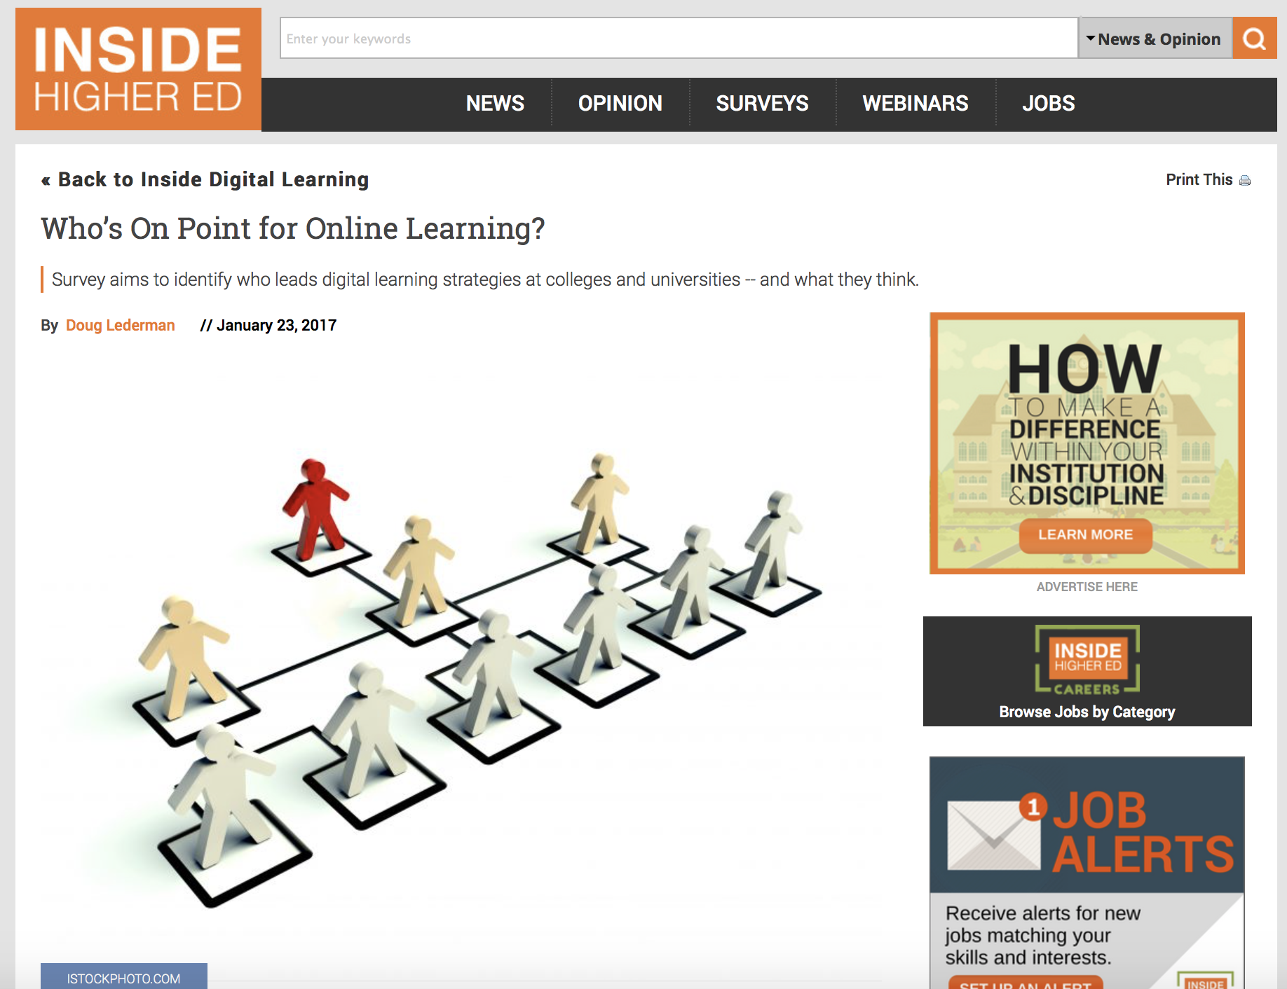
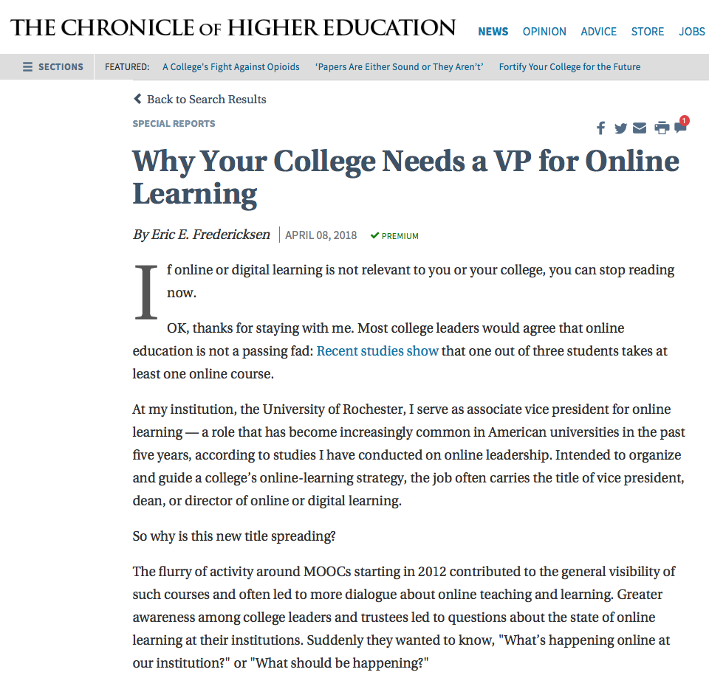
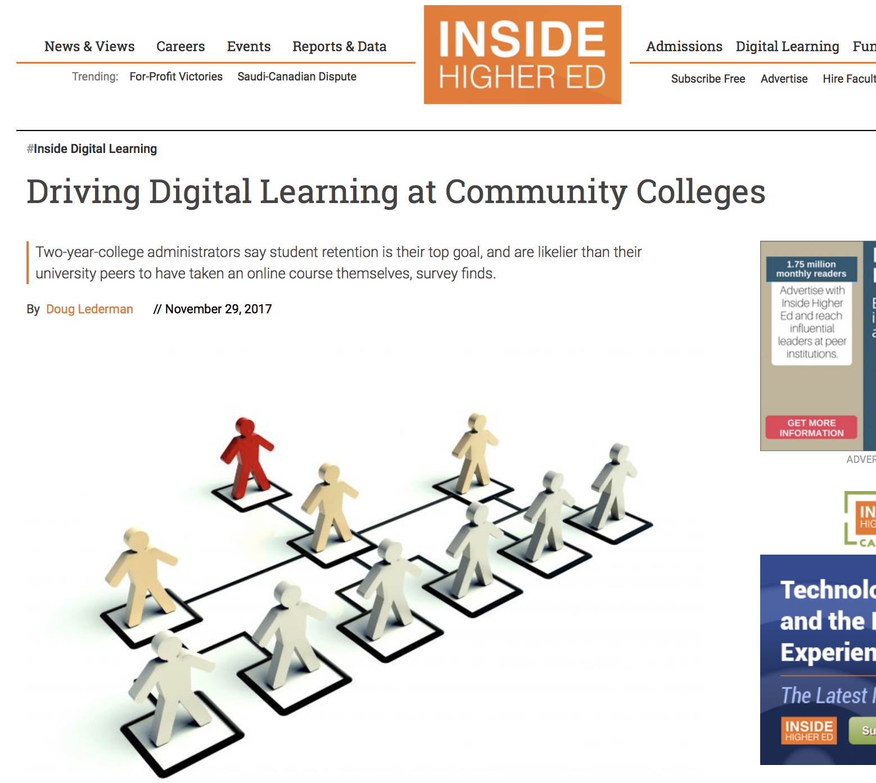
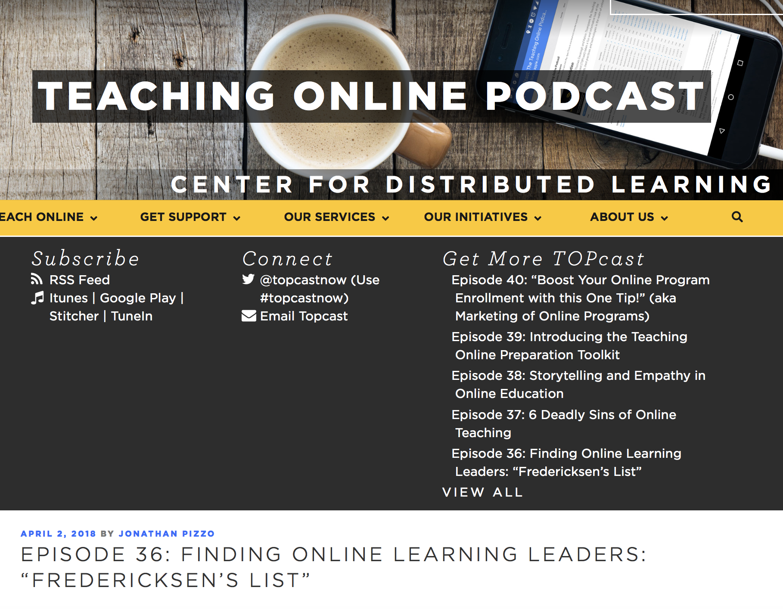
Interest in Leadership for Online Learning

Slide 5
Who is on point for online learning in US higher education? How do you find out when there is no existing list?
Review institutional web sites:
Organizational charts
President and Provost cabinets
Online learning / education
eLearning
Distance education / distance learning
Instructional / academic/ educational technology
Centers for Instructional Innovation / Teaching Excellence
Global Campus / World Campus / Virtual Campus / Extended Studies
Campus / Faculty / Staff / Office Directories
Press releases
Sometimes it takes 5-10 minutes… other times, much longer
Variation in title
Systematic approach – by Carnegie Classification (and by enrollment size for community colleges)

Slide 6
CHLOE Survey COO Respondents
Distribution of CHLOE 3 Respondents |  | IPEDS 2016
2-year public | 27% | 28.9%
4-year public | 33% | 40.6%
2-year private nonprofit | 1% | 0.3%
4-year private nonprofit | 35% | 17.1%
2-year for-profit | 1% | 0.4%
4-year for-profit | 3% | 12.6%

Slide 7
Two National Studies
Universities (2016-2017)
Community Colleges (2017-2018)
 | Total Population | Identified Population | Sample
R1 | 115 (11%) | 112 (14%) | 43 (17%)
R2 | 107 (10%) | 100 (12%) | 37 (15%)
R3 | 113 (10%) | 84 (10%) | 28 (11%)
M1 | 398 (37%) | 322 (39%) | 106 (42%)
M2 | 214 (20%) | 139 (17%) | 32 (13%)
M3 | 141 (13%) | 63 (8%) | 9 (4%)
Total | 1088 | 820 | 255
 | Total Population | Identified Population | Sample
Very Large | 74 (7%) | 72 (10%) | 25 (11%)
Large | 170 (17%) | 160 (21%) | 56 (25%)
Medium | 322 (31%) | 286 (38%) | 84 (37%)
Small | 458 (45%) | 233 (31%) | 61 (27%)
Total | 1024 | 752 | 226
https://olj.onlinelearningconsortium.org/index.php/olj/article/view/1164

Slide 8
Questions for Our Panel of Chief Online Officers
Introduce yourself:
  Name, title, institution
  New or renewed position, years in the position, report line
Prior academic and administrative experience
Range of duties & degree of influence/control

Slide 9
In what year was the current Chief Online Officer appointed?
CHLOE 3

Slide 10
Newly Created Chief Online Officer Positions
97 New COO Positions in 280 Institutions = 35%

Slide 11

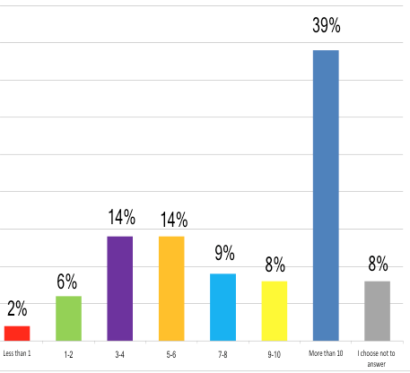
How many years ago did your institution create a leadership position for online learning?
Universities (2016-2017)
Community Colleges (2017-2018)

Slide 12
COO Report Lines

Slide 13
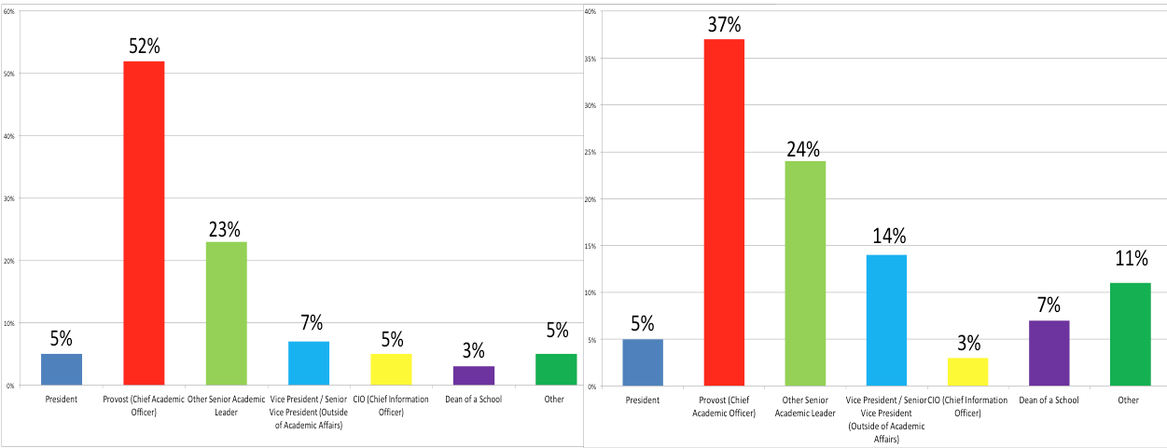
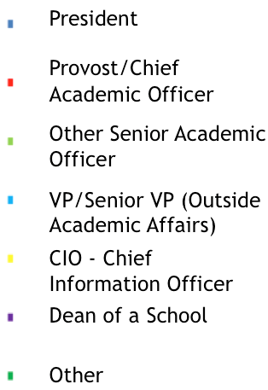
Whom do you report to?
Universities (2016-2017)
Community Colleges (2017-2018)

Slide 14
Questions for Our Panel of Chief Online Officers
Introduce yourself:
  Name, title, institution
  New or renewed position, years in the position, report line
Prior academic and administrative experience
Range of duties and degree of influence/control

Slide 15
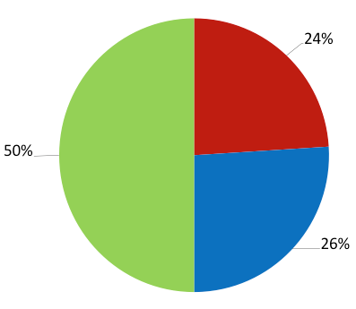
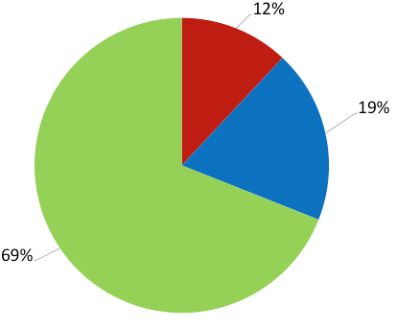
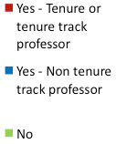
In addition to your leadership role for online learning, do you also hold a faculty appointment?
Universities (2016-2017)
Community Colleges (2017-2018)

Slide 16
Professional Background and Experience
of University Leaders
F2F classroom teaching?
Online teaching?
Educational research?
Management/leadership?
Instructional design?
IT?

Slide 17
Professional Background and Experience
of Community College Leaders
F2F classroom teaching?
Online teaching?
Educational research?
Management/leadership?
Instructional design?
IT?

Slide 18
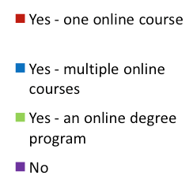
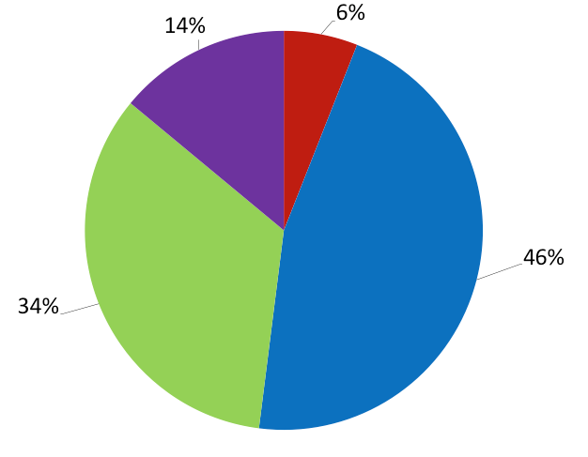
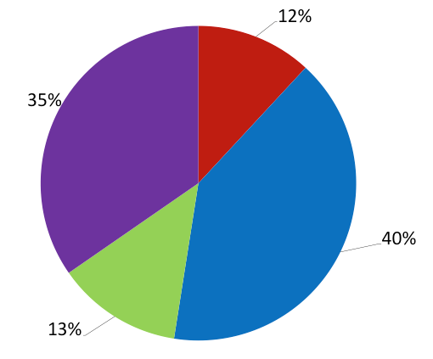
Have you been an online student? (credit bearing)?
Universities (2016-2017)
Community Colleges (2017-2018)

Slide 19
Questions for Our Panel of Chief Online Officers
Introduce yourself:
  Name, title, institution
  New or renewed position, years in the position, report line
Prior academic and administrative experience
Range of duties and degree of influence/control

Slide 20
Chief Online Officer Roles
More than 90% lead or share responsibility for the following online issues: Percent with
                Lead Responsibility
      Online Faculty Training 66%
      Instructional Design for Online Courses 65%
      Coordination with Academic Units 61%
      Online Policy Development 58%
      Online Quality Assurance 56%
      Online Course Development 51%
      Strategic Planning 43%

Slide 21
More Chief Online Officer Roles
More than 75% also lead or share responsibility for the these online issues:
External Representation 48% lead
Budgeting Online Functions 46%
LMS Support/Administration 46%
Regulatory Compliance 46%
Contracting with External Providers 41%
Orientation of Online Students 40%
Selection of LMS and Online Tools 39%
Data Gathering and Reporting 34%
Online Support Services 31%
Online Program Development 29%
Online Technical Support 27%
Accessibility 22%

Slide 22
Dedicated Online Committees & Councils

Slide 23
Roles of Online Committees/Councils
Advisory rather than determinative in most cases
4 most commonly cited issues they address:
  Setting online policies (22% determinative)
  Strategic planning for online learning (12%)
  Coordination across programs and schools (7%)
  Technology acquisition (5%)
Relationship of committees/councils with Chief Online Officers
  The COO chairs or co-chairs 60% of the time
  The COO serves as a member in a third of the remaining cases
  Several COOs report to their committee

Slide 24
Control of Online Programs & Support Services

Slide 25
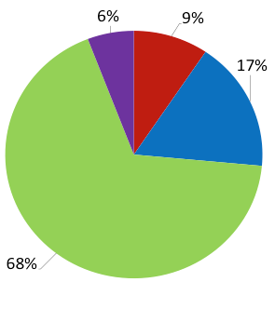
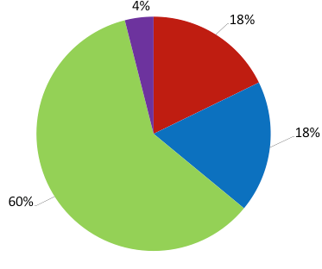

How do you and your institution define the scope of online learning for your position?
Universities (2016-2017)
Community Colleges (2017-2018)

Slide 26
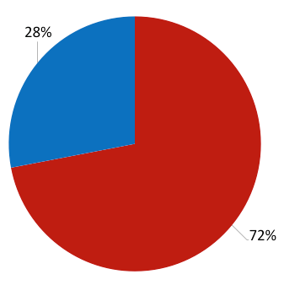
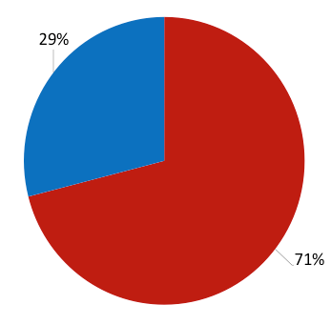

Has your institution used your online learning efforts as a catalyst for organizational changes?
Universities (2016-2017)
Community Colleges (2017-2018)

Slide 27
Where do schools turn for quality standards?

Slide 28
Who participates in quality assurance reviews?
What is the COO role?

Slide 29
Are QA reforms mandated or voluntary?

Slide 30
Your Questions and Comments
Thank You!

Slide 31



CHLOE 3 Co-Directors
Ron Legon
Executive Director Emeritus
Quality Matters
rlegon@qualitymatters.org
Eric Fredericksen
Associate VP for Online Learning
University of Rochester
eric.fredericksen@rochester.edu
Richard Garrett
Chief Research Officer
Eduventures and NRCCUA
rgarrett@eduventures.com
CHLOE 3 SPONSORS
Platinum
Gold

