Slide 1







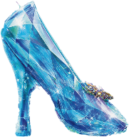


Cinderella’s Glass Slipper: Creating Collaborative Relationships to Foster Student Success & Support
Collaboration Partners
Collaboration Challenges
Collaboration Best Practices
Collaboration In-Action
Faculty
Academic Advisors
Admissions Advisors
Financial Aid Advisors
Communication
Different Objectives
Different Practices
Individualistic vs. Team
Collaboration Meetings
  Team Meetings
  Advisor/Faculty Meetings
Leverage Tools to share info real-time
In this session, we will define the best student support plan to fit the individual student
QM Criteria 1 (Online Learner Support) – Direct and indirect support for online learners should include remote access to the following services: academic advising

Slide 2
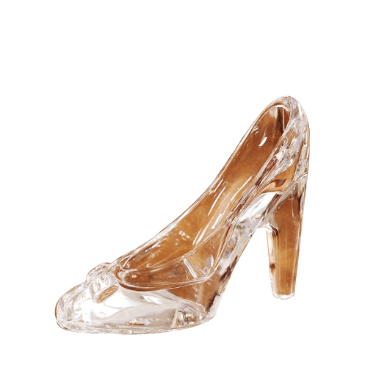

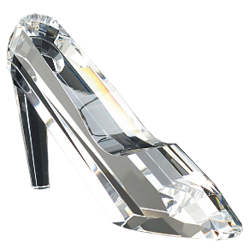

Collaboration In-Action
It is the third day of week-3. The student has not participated since week-2. She is missing half the assignments and is not passing. Which glass slipper fits the best to support this student?
Which Glass Slipper Fits?

Slide 3

Which Glass Slipper Fits?
1. Faculty member contacts the student and documents the outcome

Slide 4
Which Glass Slipper Fits?
2. Faculty member expresses concern to the Academic Advisor, and they contact the student

Slide 5
Which Glass Slipper Fits?
3. Faculty member expresses the concern during a collaboration meeting

Slide 6
Which Glass Slipper Fits?
4. Faculty member reaches out to student, and then asks the Academic Advisor to follow-up

Slide 7
Collaborate with Academic Advising to
Develop a Student Support Plan
4. Faculty member reaches out to student, and then asks the Academic Advisor to follow-up

Slide 8



Dr. Marva Brewington
Contact Information
708.573.0310
mbrewington@aiuniv.edu

