Slide 1
Coach Metacognition in
Highly Interactive Asynchronous Discussion Boards
Jon Oestreich (joestreich@cesa9.org)
Wisconsin Virtual School - a partner of the Wisconsin Digital Learning Collaborative
Quality Matters
Engagement Strategies
September 26, 2017
11:20 AM - 12:10 PM
Fort Worth, Texas

Slide 2

Hearty Hibiscus Story
Notes:
Over the summer, my wife and I planted a bunch of hearty hibiscus plants; one set near our driveway and the other in a raised garden bed opposite the driveway.
About 2 weeks or so after planting them, one by one, the plants in the raised bed started dying, while the set next to the driveway thrived. At first we thought the sickly ones weren’t getting enough water or were still recovering from being transplanted to the ground. We did notice one of the plants in the bed still looked lively, so we used it as our barometer for ground conditions in the raised bed. We monitored watering and even fed the plants fertilizer in an attempt to revive them. But as the weeks went by, the sick plants faded away, while the other set next to the driveway produced beautiful flowers. And that single plant that was healthy among the sick plants continued to flourish.

Slide 3
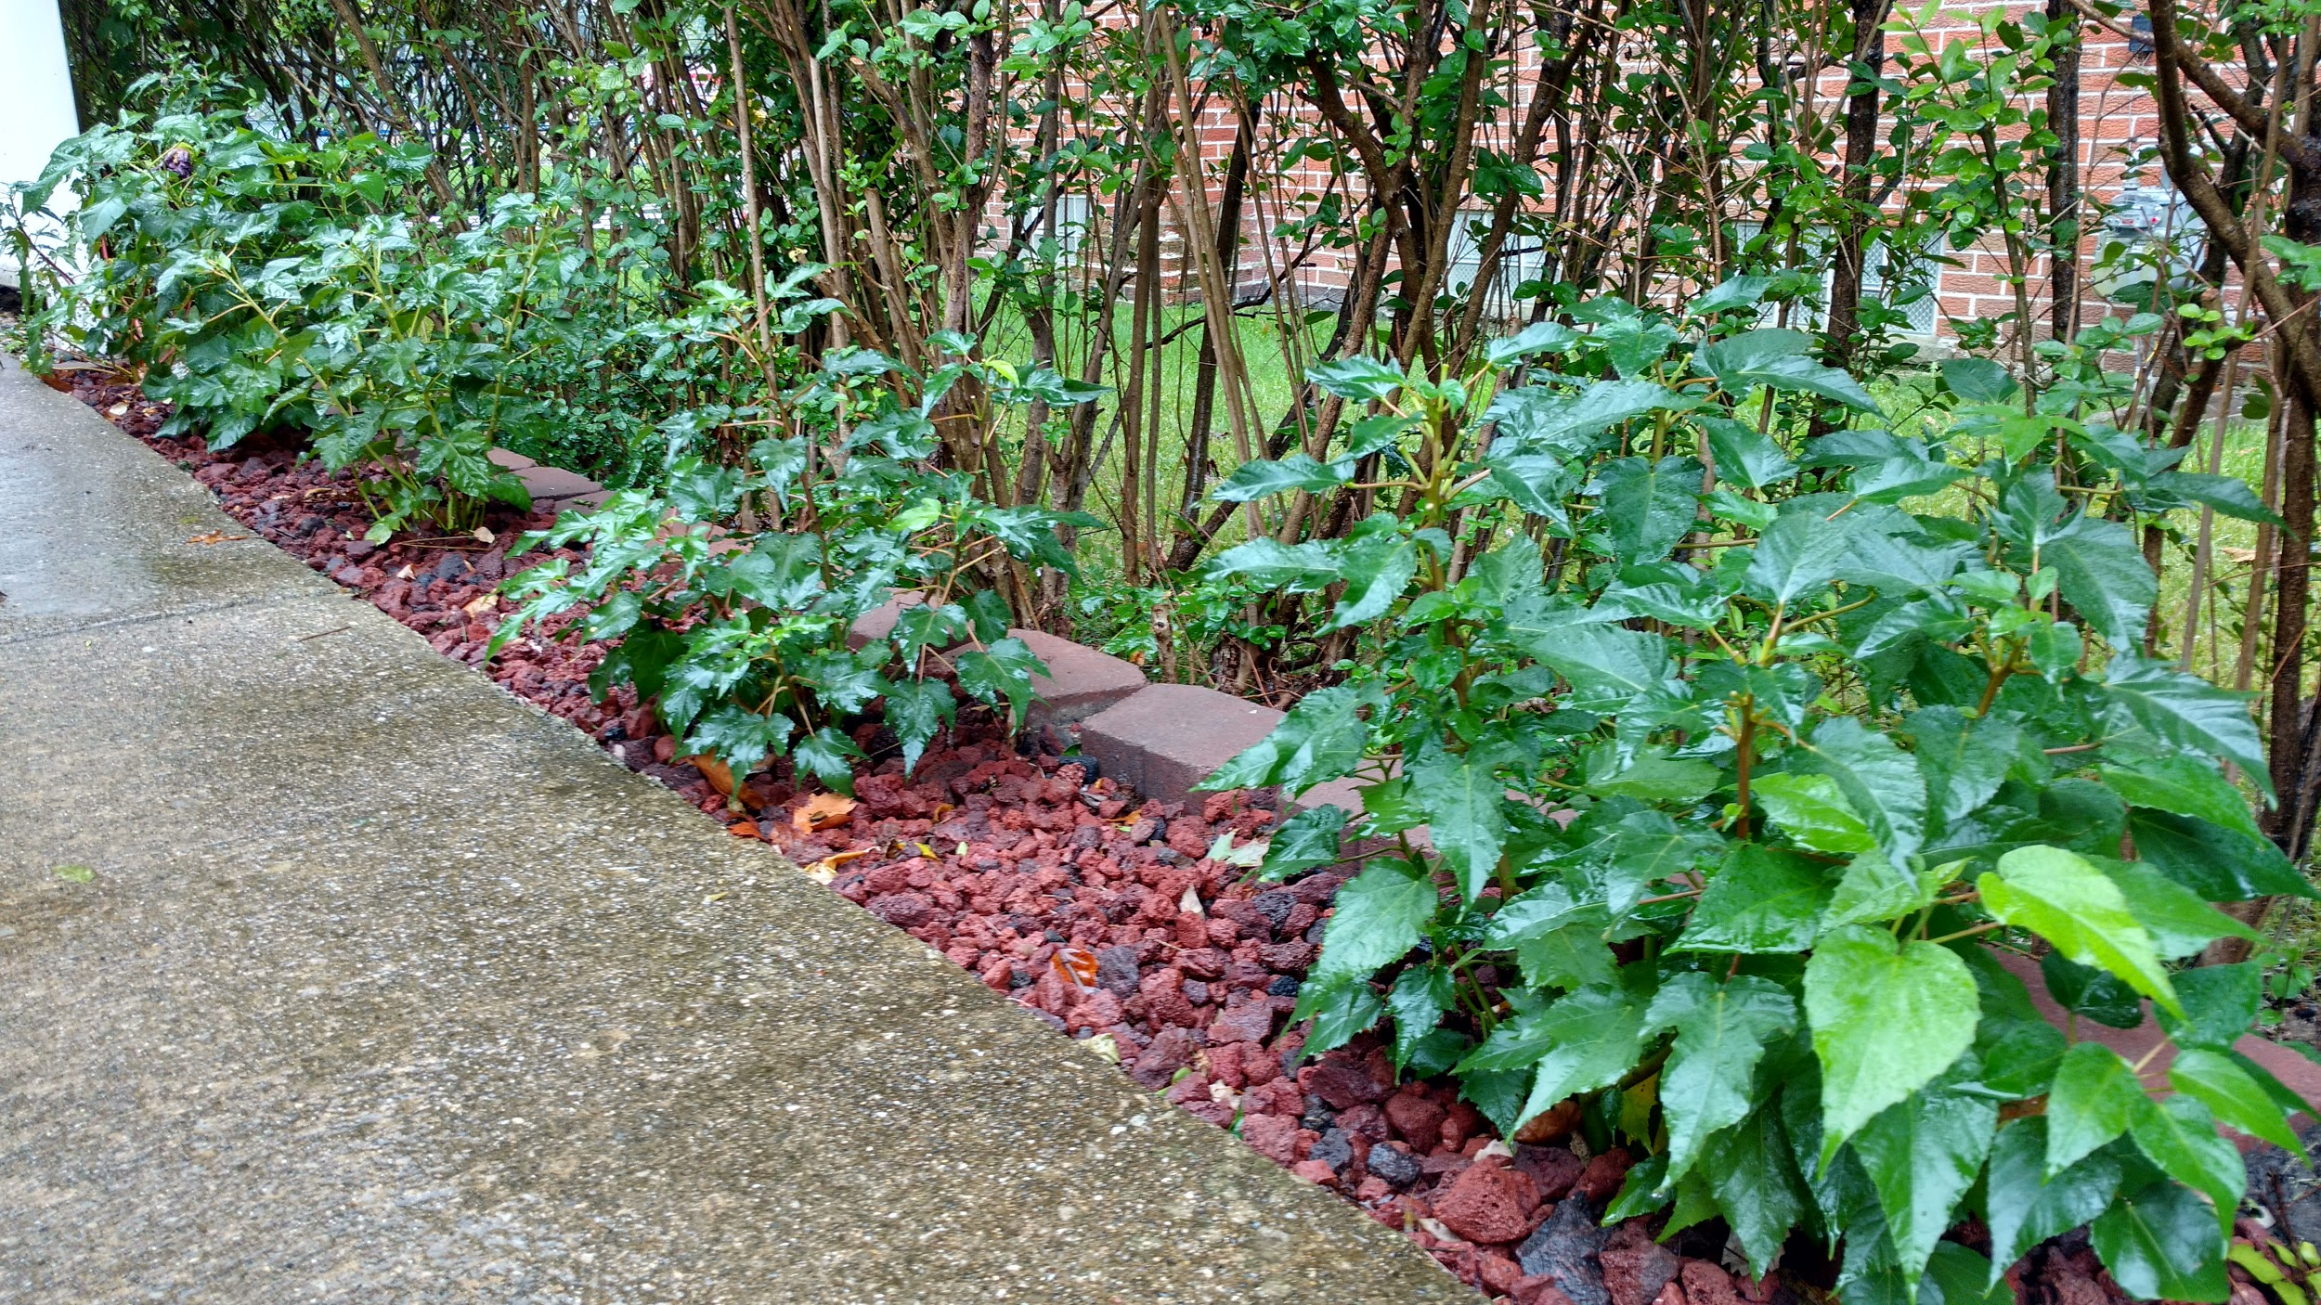
Notes:
We got the plants from the same place and my wife wanted to go back and get a refund on the plants that died because, to her, there was no reason why one set died and the other thrived. We followed the exact same procedure for planting both. Granted, one is covered with rocks and the other with mulch. But the fact that all but one of the plants covered with mulch died, this ruled out in our minds that the planting conditions caused the plants to die.

Slide 4
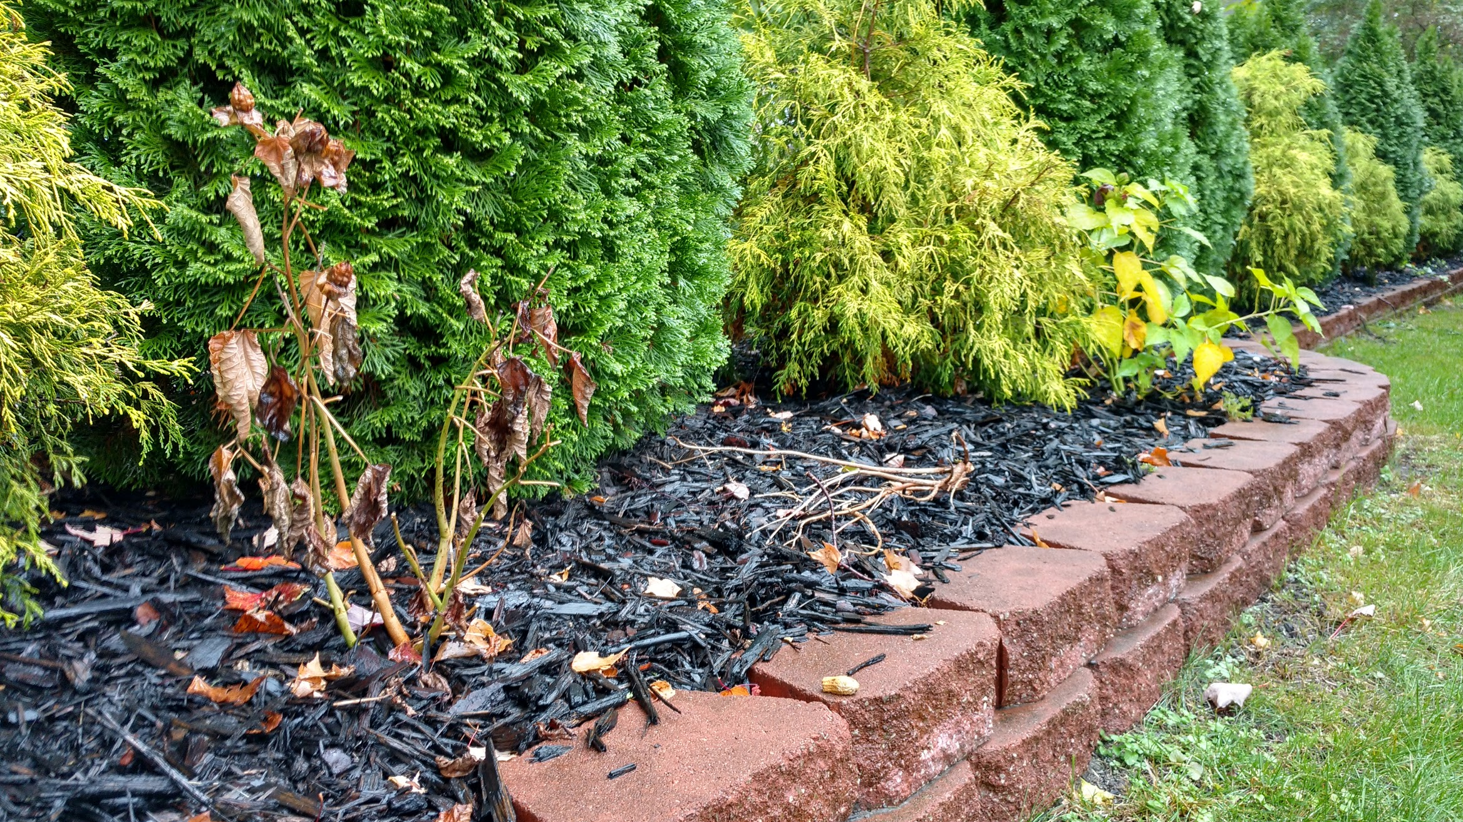
Notes:
After the affected plants died off, I went over to one and pulled at its base. Part of the base broke off. Attached to the other part was dirt and some roots where I saw a bunch of ants and pill bugs scurrying on the roots. I looked back at the area from where I pulled the stalk and saw more ants and tons more baby pill bugs. As I dug around a bit, more ants and pill bugs! What I learned later was that, while pill bugs aren’t usually destructive to plants, get enough of them underground and some young plant roots, they will kill plants from underneath. And you will never know what is actually going on with the plant because you can’t see it happening from above ground.

Slide 5
Assessment as Evidence of Learning
Teacher asks students to produce evidence of learning.
Student produces the evidence and submits to teacher.
Teacher provides feedback about evidence back to student.
Products of Learning
(visible evidence)
Assessment
Notes:
As Rick Stiggins says, assessment is used to verify what students have learned as a result of instruction AND to support students in their learning during instruction. The way in which assessment activities and opportunities are presented to students is typically in the form of:
Teacher asks students to demonstrate what they are thinking or have learned, where the demonstration is usually in the form of a product, such as a paper, a response to a discussion prompt, taking a quiz or completing a project.
Student produces something that demonstrates their thinking or what has been learned.
Teacher then provides feedback in the form of a grade and/or comments on what was on target, what needs improvement and suggestions for how to improve.
And this process is repeated over and over again throughout their K-12 educational experience.
For students, the learning process in school is about CREATING SOMETHING for the TEACHER to assess and evaluate, and then receiving feedback from the TEACHER as to how they did or where they stand. Product focused. Teacher assessed. Student knows what teacher thinks of their product. Rinse and repeat.

Slide 6
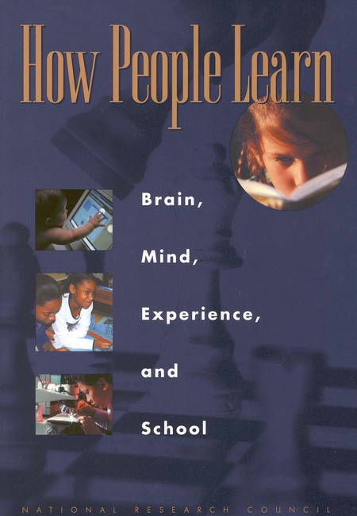
Research on Metacognition and Learning
“A ‘metacognitive’ approach to instruction can help students learn to take control of their own learning by defining learning goals and monitoring their progress in achieving them.”
Students can be taught metacognitive strategies.
https://www.nap.edu/catalog/9853/how-people-learn-brain-mind-experience-and-school-expanded-edition
Notes:
In the book How People Learn, the editors explain the three findings that research reveals as having significant impact on the learning process and how those findings can inform teaching practices in the classroom. The first deals with how previous knowledge and misunderstandings impact the ability to learn new things, the second deals with how competency is developed, and the third deals with role of metacognition as it impacts the learner and the learning process.
The research found that experts across different fields not only know a lot of information and are highly skilled, but they also demonstrate an ability to monitor their own thinking processes as they encounter new problems and situations. Experts constantly check their own understanding of their situation, constantly pulling from their knowledge and experience to make sense of their situation, and determining what more is needed to know or do to work or solve problems.
So what do experts have to do with students? We certainly don’t expect our students to be experts after taking our courses. This is true. But beyond what experts possess in terms of knowledge, skills and capabilities, they also possess a sense of ownership over their skills, knowledge and capabilities. By applying metacognitive strategies, like monitoring their own understanding and talking through their thinking processes, they take full control over their learning and level of competence. And it’s this kind of ownership that we want students to eventually get to after leaving K-12 education.
And the good news is that students can be taught metacognitive strategies.

Slide 7
Assessment as Evidence of Learning
Teacher asks students to explain the “why” of their products.
Students build their self-monitoring skills.
Students actively engage in their own learning process and demonstrate growth.
Assessment
Process of Learning
(invisible evidence)
Notes:
So if we can get students more engaged in assessing their learning process -- the invisible stuff that’s in their heads -- and utilize assessment strategies based on developing metacognition in students, the learning process begins to be about STUDENTS examining THEIR THINKING, receiving COACHING and GUIDANCE from teachers and begin assessing THEMSELVES about where they are and what they can learn next.
Student focused. Teacher guided. Student grows their awareness and ownership of their own learning process. Rinse and repeat.

Slide 8
Assessment of the Visible and Invisible
Products of Learning
(visible evidence)
Visible
Assessment
Invisible
Process of Learning
(invisible evidence)
Notes:
In today’s presentation, we would like to share with you how standard 3 -- assessment and measurement -- considers both the visible and invisible aspects of assessment and how they support each other to promote metacognition and learning in students.
We hope you will see how standard 3 is reflected in the online classroom examples Jon will share with you, recognize how some of your online course strategies align with standard 3, and see how metacognition is represented in the standard and how it can be supported in the online learning environment.

Slide 9
General Standard 3:
Assessment & Measurement
Assessments are integral to the learning process and are designed to evaluate learner progress in achieving the stated learning objectives and mastering the competencies.
Overview Statement: Assessment is implemented in a manner that corresponds to the course learning objectives or competencies and not only allows the instructor a broad perspective on learners’ mastery of content but also allows learners to track their learning progress throughout the course.

Slide 10
What do metacognitive objectives look like?
Students will be able to:
“Demonstrate effective ways to create positive interactions with peers.”
“Evaluate their own learning and growth based on their work submitted.”
“Show evidence of civil discourse and being a good digital citizen.”

Slide 11
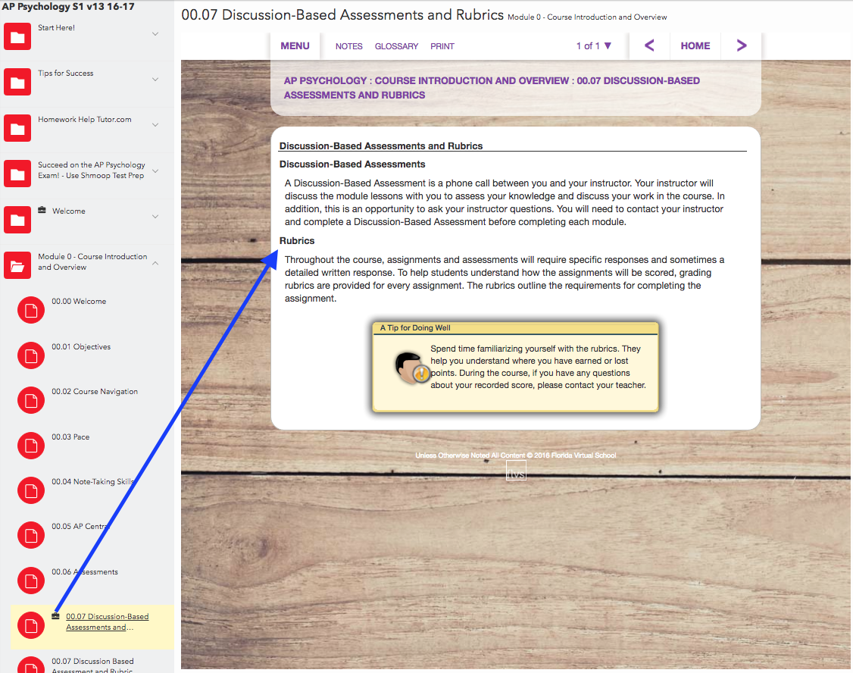
Original
Notes:
The assessment above was built into the class by the content provider. In an effort to develop a culture of highly interactive asynchronous discussions, the assessment was modified to the sample presented in the next slide to evaluate learner progress that allows learners to track their learning progress throughout the course.

Slide 12
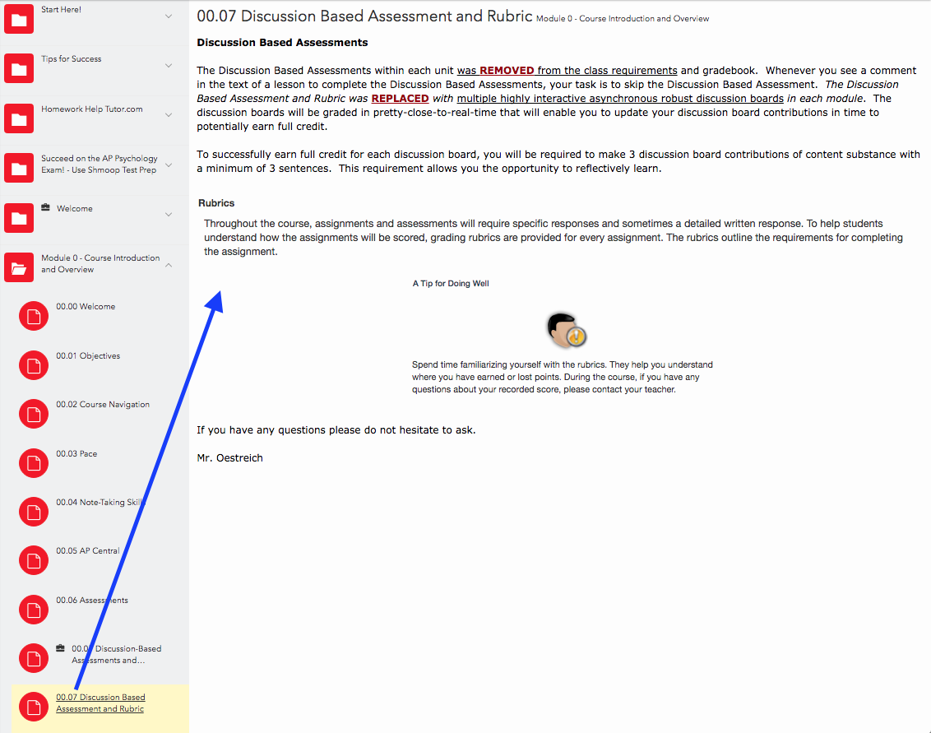
Modified
Notes:
Learners are are informed how to evaluate learner progress that allows learners to track their learning progress throughout the course (i.e., QM K-12 Rubrid General Standard #3).

Slide 13
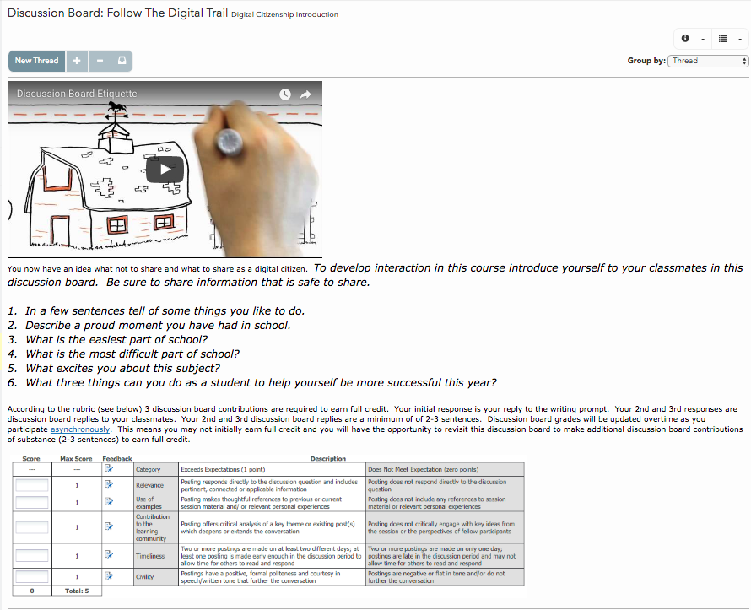
Socratic online discussions
How can we prepare students for metacognitive objectives?
Notes:
Youtube video link: https://youtu.be/tVqWcrMPxfY

Slide 14
Standard 3.1: The types of assessments in the course measure the stated learning objectives or competencies, and are consistent with course activities and resources.
Alignment: Course assessments measure evidence of course and module/unit-level objectives or competencies being met by students (see Standards 2.1 and 2.2). Instructional materials (4.1), activities (5.1), and course technologies (6.1) support the learning objectives or competencies and enable learners to meet them.
Assessments allow for evidence to confirm student mastery of the learning objectives or competencies. The breadth, depth and rigor of formative forms of assessing learning and summative examinations can be successfully completed if students have met the objectives embedded in the course materials and learning activities.
Here are examples of objective/assessment alignment:
A problem analysis confirms the application of critical thinking skills.
A multiple-choice quiz verifies vocabulary knowledge.
A composition demonstrates writing skills.
Online interactions show evidence of civil discourse and being a good digital citizen.
Notes:
QM Standard 3.1 holds learners to be accountable for asynchronous contributions that add breadth, depth, and rigor in a formative assessment to simultaneously behave in online interactions that show evidence of civil discourse and being a good digital citizen.
While on the surface this looks simple, it is a complex objective and assessment.
Metacognitive strategies must be continually reinforced and assessed (formative).

Slide 15
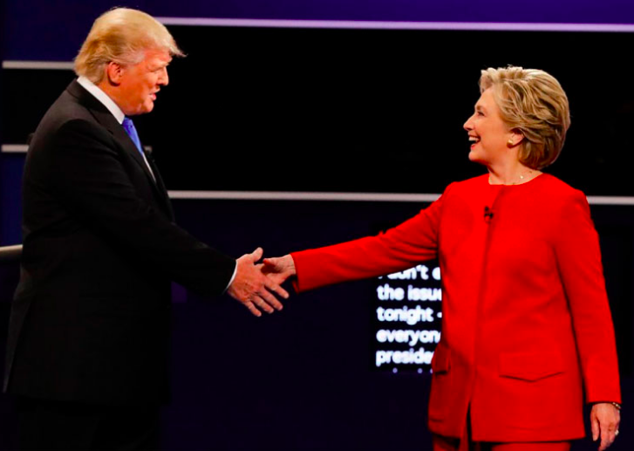
Source: Columbus Disptach http://www.dispatch.com/content/graphics/2016/09/27/clinton-trump-debate-handshake.jpg
Notes:
(http://www.dispatch.com/content/graphics/2016/09/27/clinton-trump-debate-handshake.jpg)

Slide 16
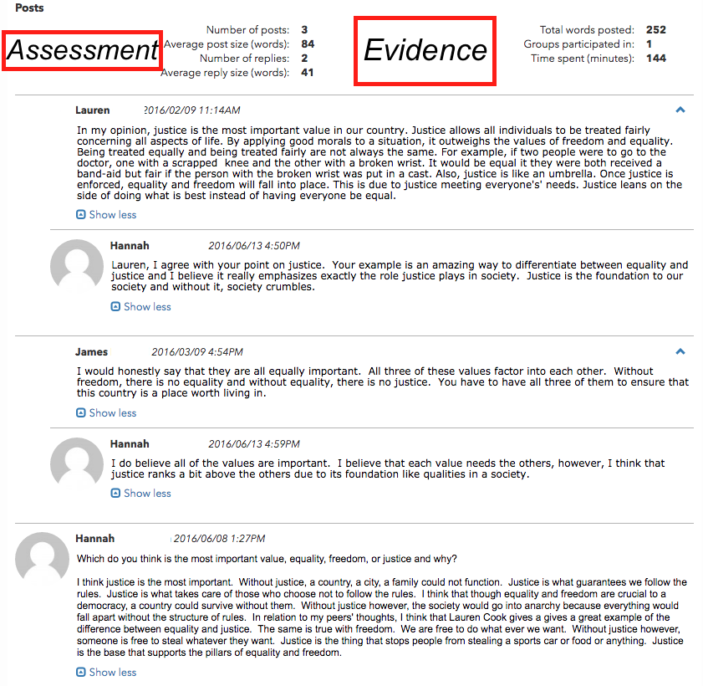
Example

Slide 17
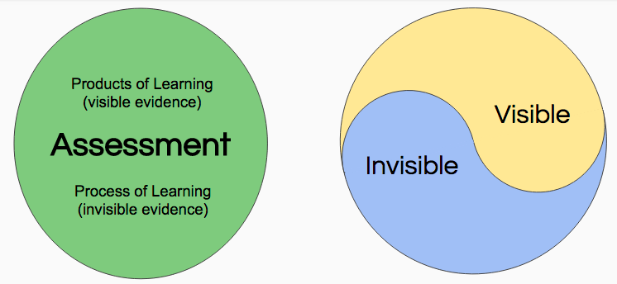
Example

Slide 18
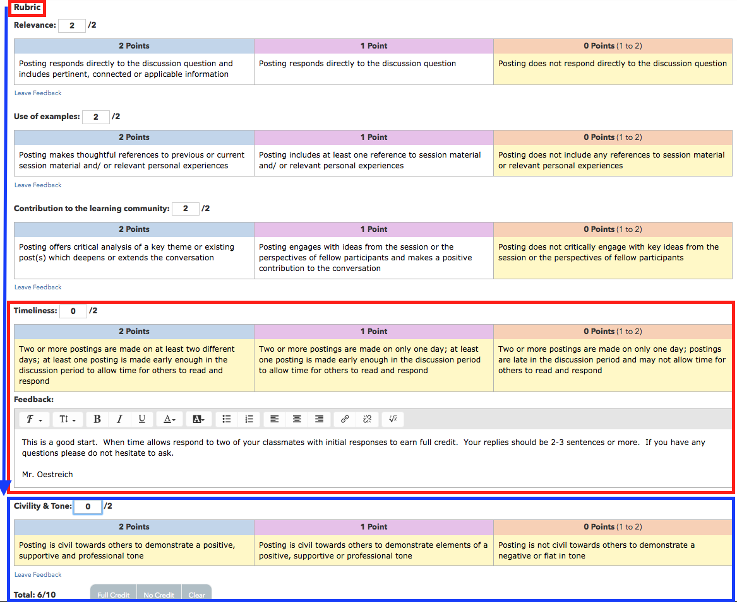
Example
Notes:
Example of learner personalized rubric in Civics class. In this example the learner earned 60% by responding to the writing prompt. To potentially earn full credit the learner is responsible to asynchronously interact with classmates in an online discussion board environment (i.e., QM General Standard #3) over time and space. Instructional feedback is provided in rubric Timeliness category or rubric.

Slide 19
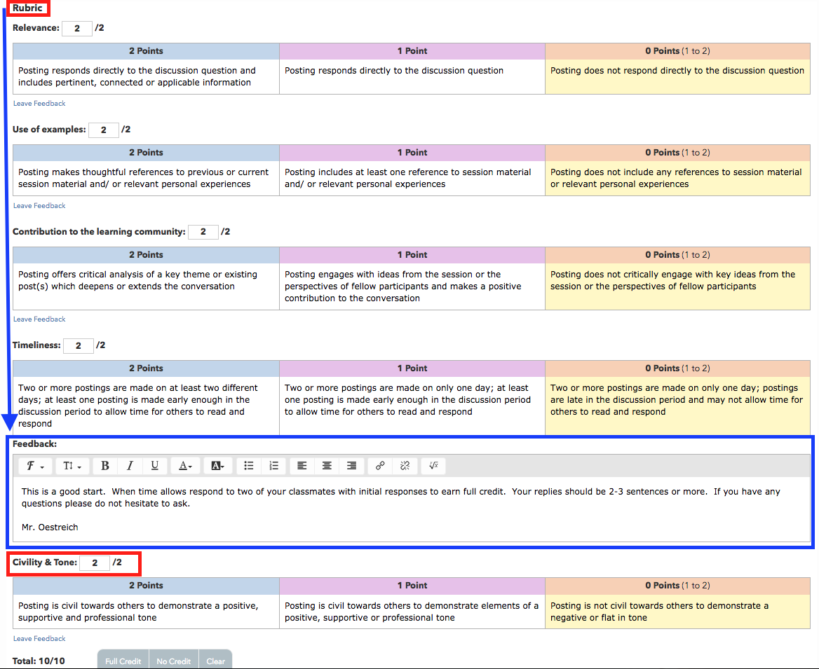
Example
Notes:
Over time and space the learner reads classmate responses to the authentic assessment writing prompt. While the student is not physically writing responses, the assumption is made that the learner is either consciously or subconsciously reflecting on the classmates initial discussion board contributions to consciously or subconsciously craft responses that demonstrate civil behavior and tone. After contributions and been posted that confirm category requirements the formative assessment grade is updated (i.e., QM GS #3 - evaluate learner progress - allows learners to track their learning progress throughout the course).

Slide 20
Standard 3.3: Assessment strategies provide students with opportunities to self-reflect on their progress towards meeting course requirements and mastering learning objectives or competencies.
Learning is more effective when learners have multiple opportunities to evaluate and measure their learning progress through ongoing, varied, and frequent formative assessments with timely feedback.
The feedback may come from the instructor directly, from assignments and assessments that have feedback built into them, or even from other learners.
Students are provided opportunities to self-reflect and engage in higher-order thinking and reasoning activities.

Slide 21
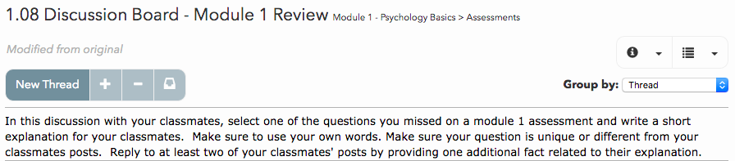
Wisconsin Virtual School - AP Psychology

Slide 22
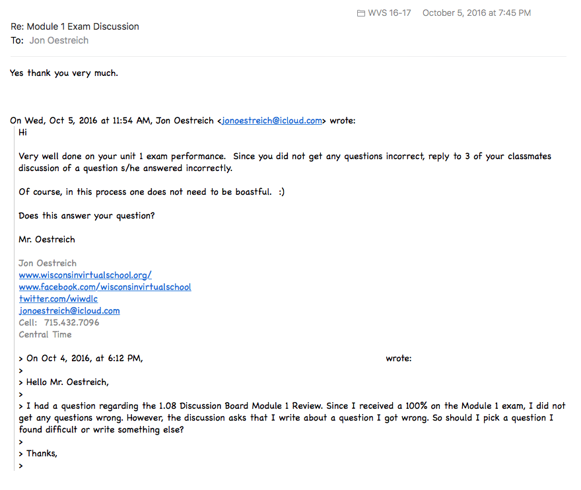
Example
Notes:
Student earned 100% on AP Psychology unit 1 exam. Now what?

Slide 23
Standard 3.4: Multiple methods of assessment strategies are selected based on the specified learning objectives or competencies and student need.
Multiple assessment strategies are appropriate to the content being measured and the format in which they are used.
Assessments are varied in order to provide differentiated pathways for students to demonstrate mastery. For example, discussion-based assessments (one-on-one meetings between teacher and student via telephone, online communication tools, or face-to-face) may be used to supplement or substitute for written tests.

Slide 24
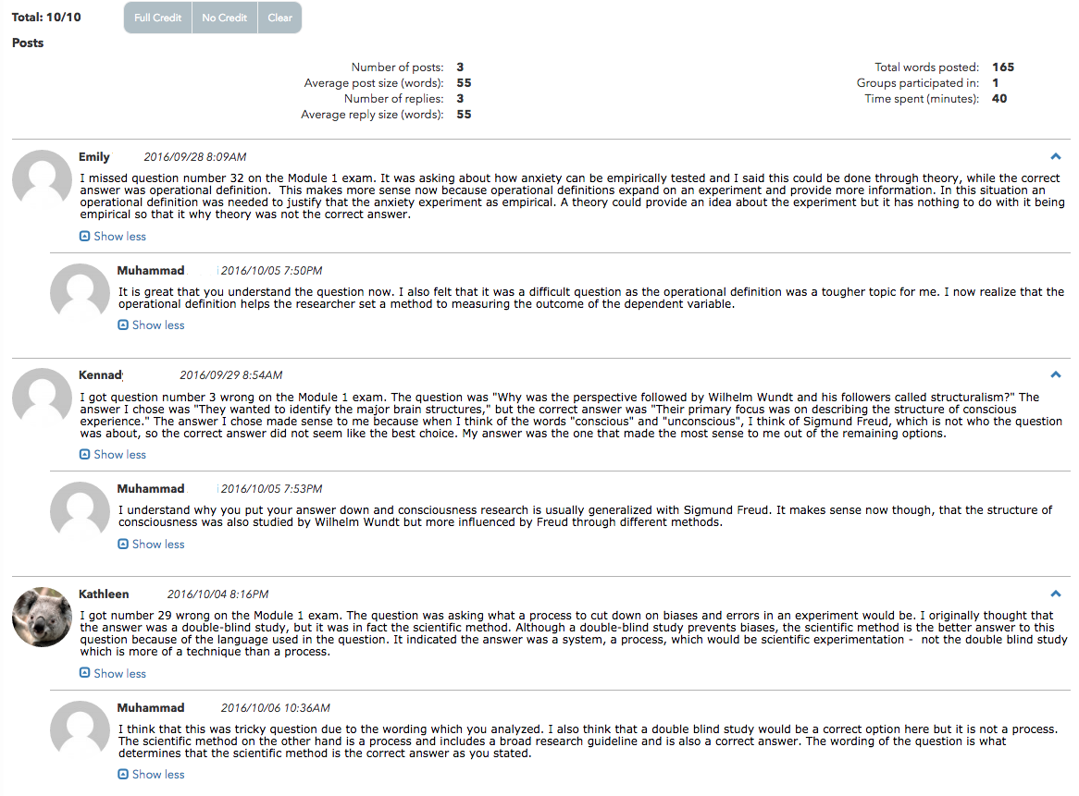
Example
Notes:
Differentiated pathway to potentially earn full credit.

Slide 25
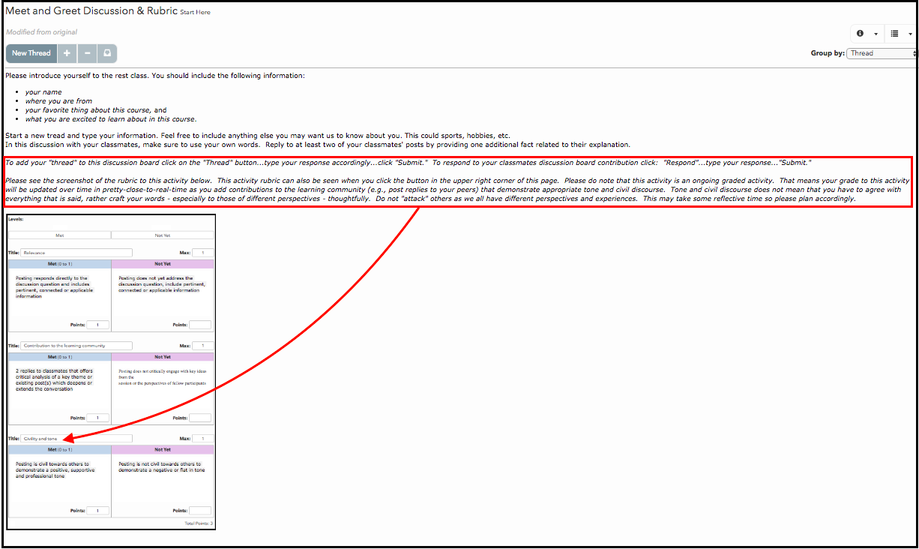
Example
Can instructional feedback coach civil interaction with appropriate tone?
Notes:
Can instructional feedback coach civil interaction with appropriate tone?

Slide 26
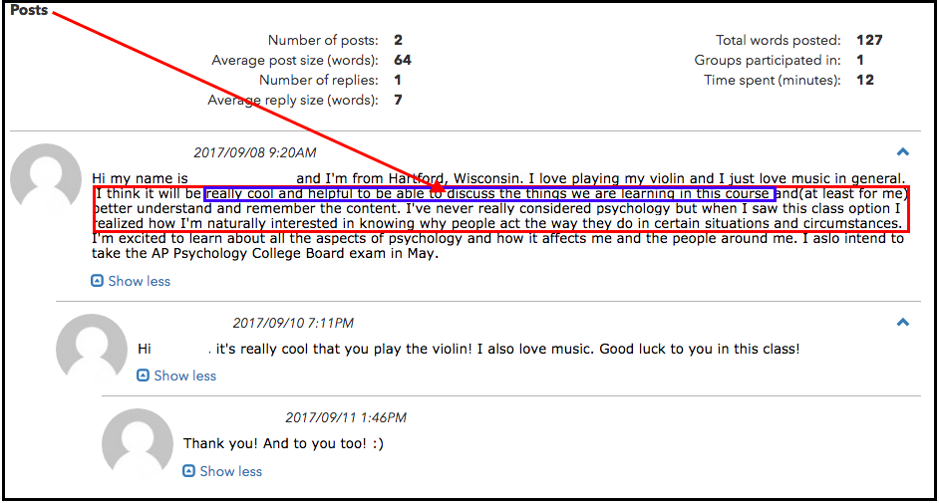
Example
What may “Demonstrate effective ways to create positive interactions with peers” look like?
Notes:
The formative assessment success of an end-of-unit reflective learning meta-cognition discussion board evaluation lead to an idea in which we wondered if “positive interactions with peers” can be assessed in a Meet and Greet discussion board prior to an end-of-unit reflective learning meta-cognition formative assessment. We have not yet been able to measure or gauge the Meet and Greet “positive interaction with peers” learning outcome effect on the end-of-unit reflective learning meta-cognition formative assessment but we do have a hunch that the learners will be more engaged in their own learning based on the instructional feedback.

Slide 27
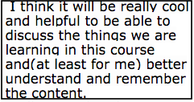
Example
What may “Demonstrate effective ways to create positive interactions with peers” look like?
Notes:
Students have been “coached” to anticipate the Socratic discussion technique in an online course.

Slide 28
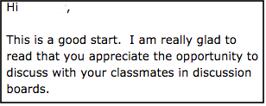
Instructional Feedback
What may “Demonstrate effective ways to create positive interactions with peers” look like?
Notes:
This is a real short example of instructional feedback in an online Socratic discussion to positively reinforce the learner’s interaction with classmates.

Slide 29
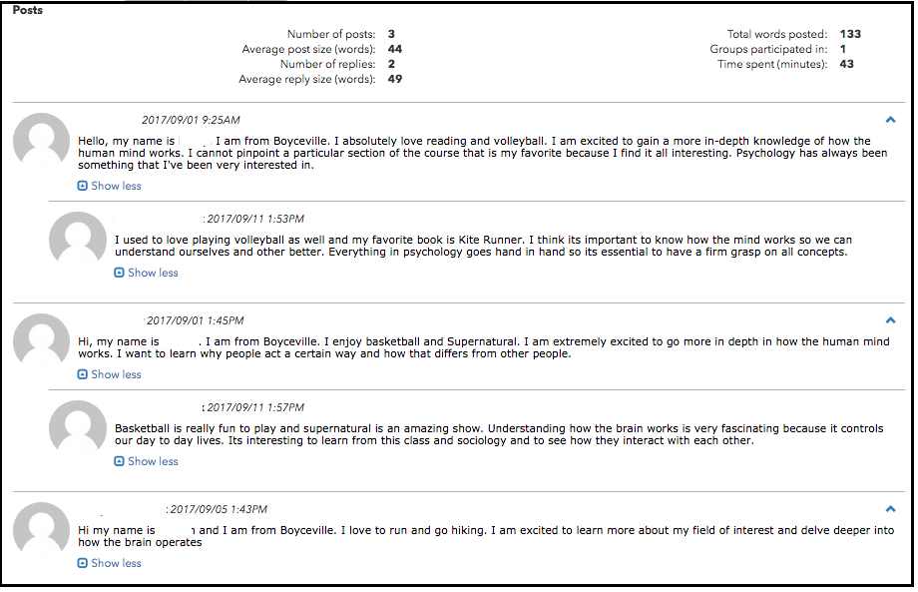
Example
Learner-learner interaction
Notes:
Can instructional feedback coach civil interaction with appropriate tone?

Slide 30
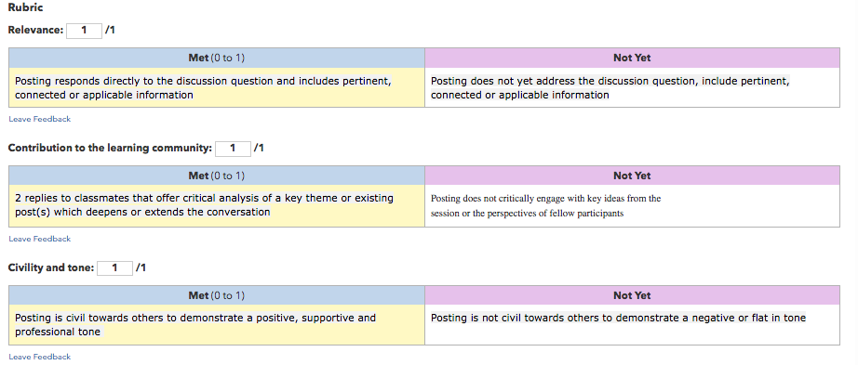
Example
Content + Learner-Learner Interaction Rubric
Notes:
This is a real basic rubric designed to coach and guide interactive behavior between learners while simultaneously empowering the learner’s meta-cognition by corresponding with peers.. We believe the result of this basic rubric paired with personalized instructional feedback lays the foundation for meta-cognition to occur in online interactive activities over time and space.

Slide 31
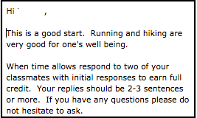
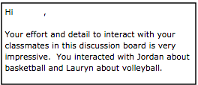
Example
Instructional Feedback (e.g., text)
Notes:
Instructional feedback that recognizes a learner’s interaction with classmates. As instructors we can not always see what is occurring inside the brains of our student learners.

Slide 32
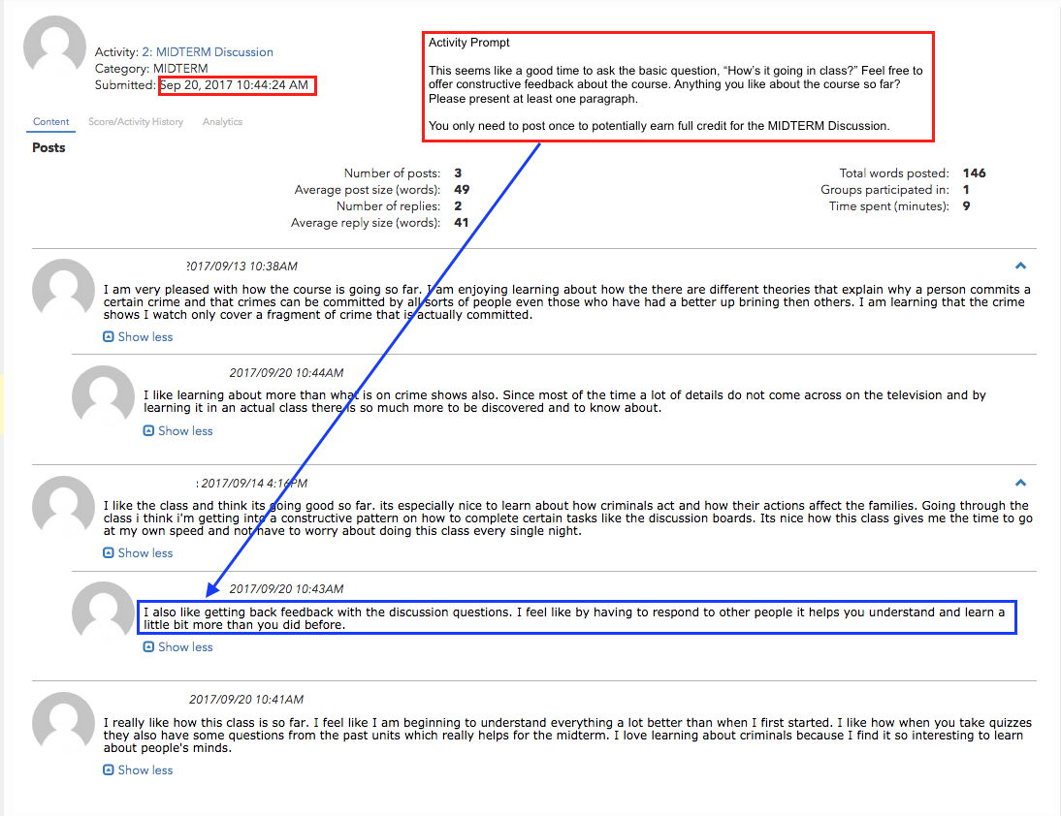
Example
Student interactive reflection (e.g., text)
Notes:
Sample of a student reflection on discussion board interaction.

Slide 33
Example
Student interactive reflection (e.g., text)
Notes:
To conclude - this student summarized the measurable objective of interactive discussion boards.

Slide 34
Your Wonderings, Challenges and Critique about Metacognition
Products of Learning
(visible evidence)
Visible
Assessment
Invisible
Process of Learning
(invisible evidence)

