Slide 1

Collect QM Activity Data as Evidence to Support Institutional Accreditation

Slide 2

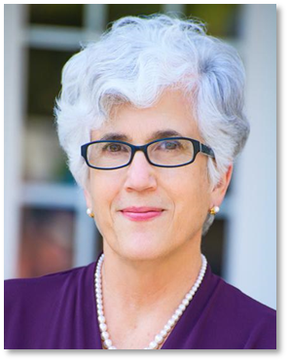
Yaping Gao, EdD
VP, Member Services & Global Partnerships
Quality Matters, USA
Deb Adair, PhD
President, INQAAHE
CEO, Quality Matters

Slide 3

Presentation Outline
Introduction: Data for QA
Overview of US institutional accreditation
Alignment of QM & accreditation
standards & criteria
Identifying QM implementation activities
& documenting evidence
Reflection & takeaways

Slide 4

My involvement with my institution’s quality assurance efforts is in:
  Institutional Accreditation
  Programmatic Accreditation
  Online teaching and/or distance learning
  QM implementation (ID work, online management etc.)
  Other role
Notes:
Icebreaker: Ask participants to type in Chat. If needed, could use two follow-up questions:
If they are involved in institutional or programmatic accreditation, in what capacity?
If they are implementing QM on the ground level, have they been asked to collect or contribute QA/QM data for accreditation work such as self-study or substantive change?

Slide 5

The questions you are seeking to answer should drive your collection and use of data.
The same is true for accreditation.
Notes:
The first half of this presentation focuses more on the “why” of collecting data and the “how” of using it to drive and demonstrate quality. The second half of the presentation is focused on collecting QM-related data that could be useful for accreditation. Your implementation of QM will never sufficiently address the broader standards of accreditation, even though we can align with them - which we will demonstrate in a bit. It will be of more immediate and practical use for you to think about the specific questions you’d like to be able to address and demonstrate with your use of QM. Are your online courses/programs meeting some level of quality? What level and how do you know? Are you evaluating your online offerings to ensure quality? Are you using these evaluations to improve practice? Are your QA efforts aligned with, and clearly supporting, institutional goals and mission, how are you integrating your digital learning QA practices to ensure sustainability?

Slide 6


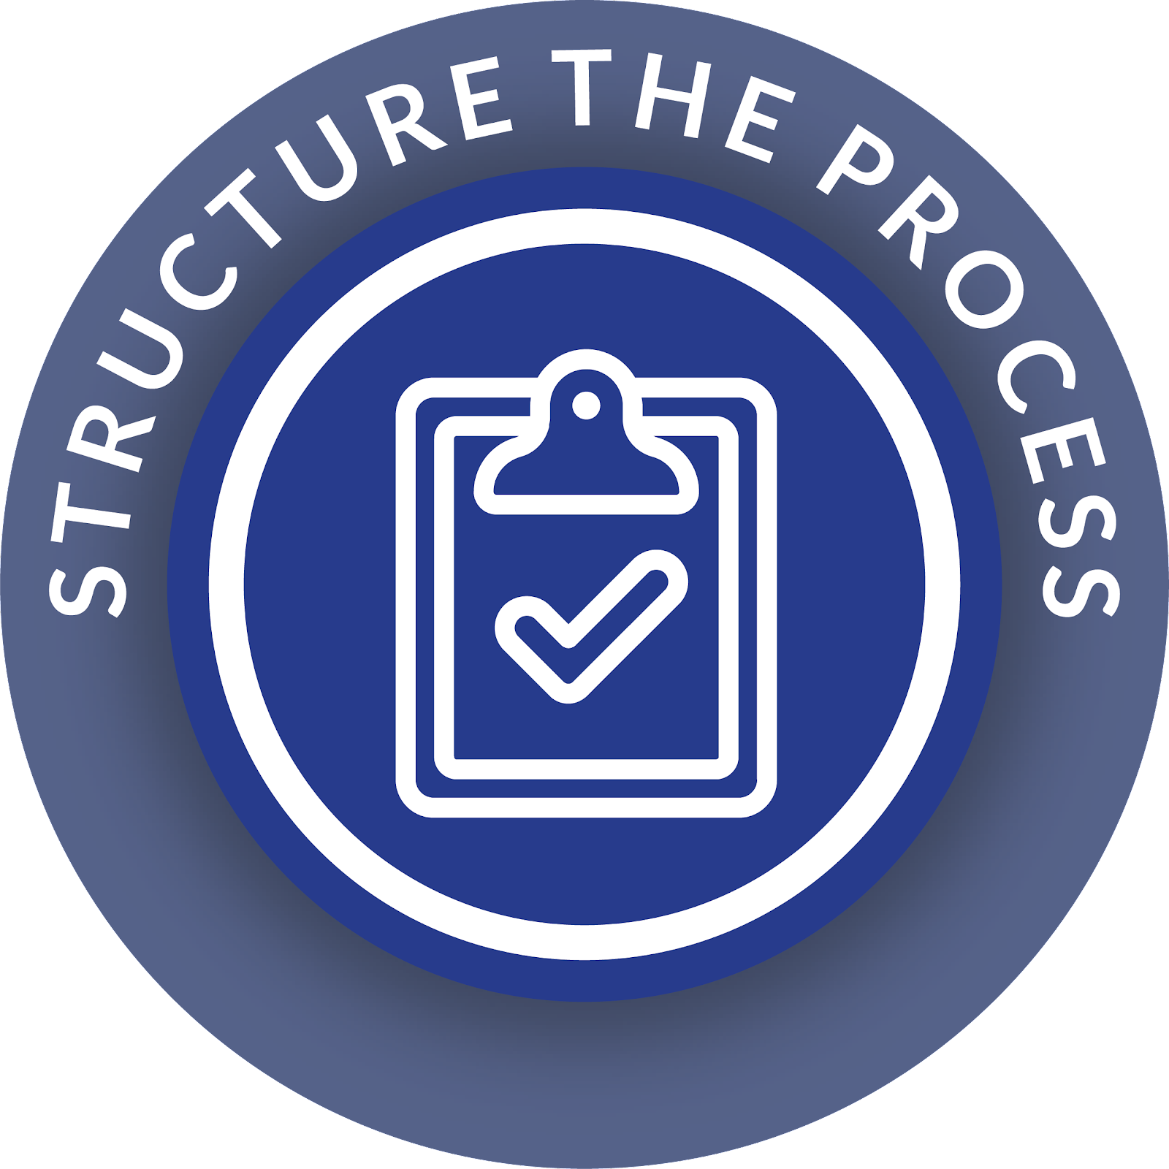



Questions QA Can Answer
and Data Can Support
CONTROL
Are you using specific standards of quality and integrity relevant for accrediting standards?
COMPLIANCE
What policies are you actually executing and who are involved?
IMPROVEMENT
Are you using feedback to implement changes, enhancing quality of education and student outcomes?
ACCOUNTABILITY
Are you evaluating performance and outcomes against mission, goals, and other key benchmarks?
TRANSFORMATION
How have you created a culture of quality, with people and systems adapting to & meeting changing needs?
Notes:
In general, what types of questions are important to answer for QA - particular for accreditors?
How are you CONTROLLING the quality of the education you provide?
Are you using specific standards of quality and integrity aligned to accrediting standards?
How are you ensuring COMPLIANCE with these standards across the institution?
What processes are you actually executing and who are involved?
How are you continually IMPROVING quality?
Are you using feedback to implement changes, enhancing quality of education and student outcomes?
How are you demonstrating ACCOUNTABILITY to public, students, employers, etc?
Are you evaluating performance and outcomes against mission, goals, and other key benchmarks?
Are you sustaining improvements to achieve TRANSFORMATIVE impact?
How have you created a culture of quality, with people and systems adapting to & meeting changing needs?

Slide 7
Continuum of Excellence for QA (CEQA)
INSTITUTIONAL CHANGE
Sustaining Quality Culture
BENCHMARK
Demonstrating ROI: Meeting internal goals and external expectations
CONTINUOUS IMPROVEMENT
Going beyond quality thresholds to change practice
QUALITY EVALUATION
System in place to review against standards
AD-HOC
Identification, dissemination, episodic/variable use of standards
Transformation
Change Mgmt: resources, incentives, structure
Accountability
Improvement
Compliance
Evidence quality to stakeholders
Control
Data for quality improvement
Review policies and protocols
Standards & Training
Adair, D., & Shattuck, K. (2019). Ensuring quality while creating and innovating. In K. E. Linder (Ed.),
The business of innovating online: Practical tips and advice from industry leaders (pp. 97-112). Sterling, VA: Stylus.
Notes:
Three things going on in this graphic, to show the alignment of QA work from three different perspectives: 1) The CEQA, which is essentially a logic model for implementation of robust quality assurance systems that can drive org change. This is about INTERNAL QA, from an institutional lens.; 2) Categories of questions QA can answer. This is from an accreditation or external QA perspective; and 3) Elements of the QM process aligned with the stages of the CEQA. I’d like to focus today on the external QA perspective - the questions you want to collect data to answer.
The reason we are embedding these questions in the CEQA graphic is because it helps us think more broadly about what we can achieve. When institutions (the people in them) think about quality assurance, especially via accreditation, they think about compliance. Since compliance is often seen as the antithesis of innovation - in the sense that a compliance-focus approach can hinder innovative, thinking out-of-the-box solutions, it can’t serve to drive the kind of positive change we want to see. Excellence in QA is about so much more than compliance - it is about continually improving practices, demonstrating ROI, and sustaining a culture of quality.

Slide 8
Evidence: Narratives & Data
Level of QA | Narratives: Policies & practices (Link out) | Data (Demonstrate execution and outcomes)
Control | Official adoption, use, promotion of quality standards | # and %: Rubric adoption, PD, roles, template adoption, alignment maps
Compliance | Use of standards to evaluate courses & programs | # courses reviewed/certified - overall and by category
Improvement | Changes in protocols or goals resulting from QA efforts | Review outcomes data influences design and PD changes. Before and after data.
Accountability | Link QA goals to strategy/mission | Data on goal achievement
Transformation | Supporting QA: resources, incentives, structures, staffing | Increasing/ broad participation in QA efforts, progress in student outcomes over time.
Notes:
Control: Faculty PD #s, with certifications/roles, rubric adoption rates across units/departments, QM’d course template adoption rates, course alignment maps & course/program alignment
Compliance: # courses reviewed (internal peer review, QM-certified, by IDs, by department chairs, self-reviews); reports on courses reviewed by categories (new, high enrollment, by department, etc)
Improvement: Link between data on review outcome patterns and changes made in course design protocols, faculty PD, etc. Show before and after data on reviews, on student performance, behavior, outcomes
Accountability: Data on goal achievement - see next slide
Transformation: Long-term record of increasing and broad participation in QA efforts, shared governance in QA decisions, progress in student outcomes over time.
Highlighted area is the sweet spot to be able to move from collecting and presenting pieces of data that demonstration intention and execution (including some outcomes that can’t really be tied back to QA, to evidence that your QA practices are effective in actually achieving institutional goals and supporting the mission.

Slide 9
Evidence Levels
Setting Expectations
Executing on Expectations
Results
Improvement
EX: QM implementation activities - meeting minutes, alignment maps, faculty PD records
EX: Policies and documented protocols
Ex: Satisfaction surveys, grades, student behavior changes, student outcomes
Ex: Use of data to drive change in policy and/or practice
1
2
3
4
Notes:
Not all levels make sense for all types of evidence, but wherever possible look for evidence that you are implementing, and implementing effectively, in addition to setting expectations.
Think about evidence that shows if: 1) you have it; 2) you are doing it; 3) you are doing it well; and 4) you are using evaluation data to improve it.
Two points to make: 1) At each stage of the CEQA, you can have different levels of evidence (for example - even at the Ad Hoc stage - is your evidence that you subscribe to QM, that most of your faculty have had QM training, that faculty/student surveys post-training have increased, and/or that you've used the survey data to change how you are training faculty or providing resources); and 2) having a robust QA process at later stages of the CEQA means you'll necessarily have deeper levels of evidence. Setting specific goals and collecting data to support it will provide more robust evidence.

Slide 10
Demonstrable QA Goals
GOAL:
Demonstrated increase in student outcomes over time
GOAL:
Demonstrated increase in student outcomes
GOAL:
Improved student learning
GOAL:
All new courses meet quality threshold
GOAL:
Acceptance/
use of quality standards
QA level to demonstrate outcomes
Notes:
I want to make a specific pitch for the criticality of setting QA-related goals - or goals you want to be able to achieve based on QA efforts and quality interventions. At QM, we frequently get asked about “The IMPACT of QM.” The answer is that institutions need to identify, specifically, what they what to achieve with QM and plan to collect appropriate data to evaluate the impact that is relevant for them. Identifying, and then determining how to measure, QA goals are important for demonstrating accountability - not just in accreditation but for all kinds of stakeholders. Being able to do this effectively can help you make the case for the resources you need to sustain and grow the culture of quality - the ultimate goal.

Slide 11

What are your Measurable QA goals?
Goal:
Measured by:
Acceptance/use of quality standards
Quality vetting for new courses before offering
Improved student learning
Demonstrated increase in student outcomes
Demonstrated increase in student outcomes over time
Faculty attitude/engagement
Documented systematic process with data/outcomes
Student evaluations of instruction; grades, faculty surveys
National exam scores, portfolios,
Lower DFW rates, increased completion & persistence (and graduation) rates, employment

Slide 12
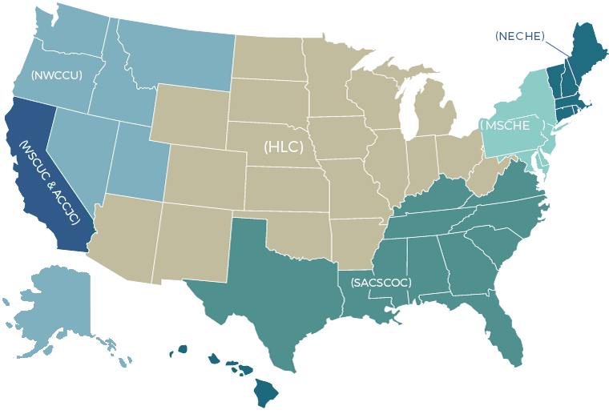
Overview of US HE Accreditation
in the Quality Assurance Landscape
Notes:
In the US, there are 7 (formerly regional) institutional accreditors for Higher Education: https://www.chea.org/regional-accrediting-organizations
Higher Learning Commission (HLC)
Middle States Commission on Higher Education (MSCHE)
New England Commission of Higher Education (NECHE)
Northwest Commission on Colleges and Universities (NWCCU)
Southern Association of Colleges and Schools Commission on Colleges (SACSCOC)
WASC Senior College and University Commission (WSCUC)
Accrediting Commission for Community and Junior Colleges (ACCJC) Western Association of Schools and Colleges

Slide 13
Accreditors’ Role in US QA Landscape
Accreditation conducted by NGO’s
  18 Institutional Accreditors
  60 Programmatic Accreditors
USDE and CHEA recognize accreditors
Accreditation enables the flow of federal financial aid
USDE ensures compliance with HEA
States license/authorize institutions within their state
NC-SARA oversees state reciprocity agreement for DE
Notes:
https://www.chea.org/chea-and-usde-recognized-accrediting-organizations
Currently there are a total of 18 accreditors:
- 7 HE accreditors shown on the map
- 5 national faith-based accreditors
- 5 career-based accreditors
- DEAC Distance Education Accrediting Commission
The Higher Education Act was passed initially in 1965 and was reauthorized every 5 years with amendments until 2008. It has failed to gain formal reauthorization since 2013 but its programs have continued to operate on temporary extensions since then.
The National Council for State Authorization Reciprocity Agreements started in 2013 and includes all states except California with 2200 HE institution members.
The point is that accreditors are one example of many bodies involved in ensuring quality; however, the responsibility for quality and quality assurance rests with the institutions themselves. What you need to demonstrate is your own internal processes for ensuring quality. How and where you use QM in digital learning, and the evidence you can show for that, is a part of your institution’s internal process for ensuring quality.

Slide 14
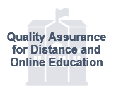
Working within the QA Triad in US
Accreditation
NC-SARA members are institutions and states.
Quality Matters members are institutions.
NC-SARA
Quality Matters
States
US D of E
Notes:
– Responsibility for quality lies with institutions. Quality Assurance (QA) is about managing the activities institutions engage in to ensure they are meeting quality goals and standards and using these to improve quality. This is internal QA. External QA is conducted by oversight bodies.
– In the US, we have the QA triad with different approaches to external QA. States license and authorize institutions to operate within their state and have consumer protection responsibility. The US Department of Education ensures compliance with the Higher Education Act and recognizes accreditors in their gatekeeping role for federal financial aid. Accreditors evaluate the internal QA systems of institutions and programs and, increasingly, their outcomes.
– QM operates within this triad by providing tools, services, resources, and frameworks to support an institution’s internal QA efforts. These tools have been designed for online education; however, institutions are increasingly using these more broadly. QM also provides a level of third-party Quality Control with our certification of courses and programs. Both the use of the QM tools, and the QM Quality Control work provide evidence for meeting accreditation standards.

Slide 15

Accreditation Standards
Each accreditor has its own standards / principles / criteria / requirements / guidelines; however, the topics/areas addressed are similar:
Missions & Goals
Ethics & Integrity
Teaching/Learning
Student Support
Educational Effectiveness
Institutional capacity: planning & resources
Leadership & Governance
Notes:
Although each accreditor has its own standards / principles / criteria / requirements / guidelines; however, the topics/areas addressed and call for evidence are similar. For example, among the 7 HE accreditors, Northwest (NWCCU) bundles everything into two Standards only, whereas SACS spells out its long list of 14 Principles of Accreditation. QM has been doing some research in this area over the past few years, and we believe all accreditors want to see institutions demonstrate evidence for quality in these 7 categories or areas no matter what they call them or how they organize them.

Slide 16
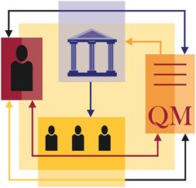
Identifying QM Implementation Activities & Documenting Evidence

Slide 17

QM Activities Support Institutional Goals
Institution
Evidence about how QA is managed throughout the institution to meet accreditation standards
1
2
QM Criteria & Certification for:
Program
Learner Success
Learner Support
Teaching Support
Program Design
Course
3
QM Design Rubrics,
Course Review
& Certification
Notes:
When we look at any institution in terms of ensuring academic quality, QM implementation and activities support institutional goals including engagement, retention, completion, outcomes etc, and provide QA data to support institutional accreditation.

Slide 18

QM Implementation Supports
Teaching & Learning
Accreditors want to see evidence of a rigorous, coherent, and well-supported learning experience. Show them how you ensure:
Courses are well-designed w/ learning objectives aligned at course and program levels.
Instructors are well-prepared and supported for the teaching modality
Course evaluation data is used to improve courses & faculty PD
Impact on student learning outcomes from your QA efforts

Slide 19

Evidence Examples
Policies for course reviews
Curriculum mapping documents
Course development plan - aligned to QM Standards
QM Course Certification
QM Program Certification

Slide 20
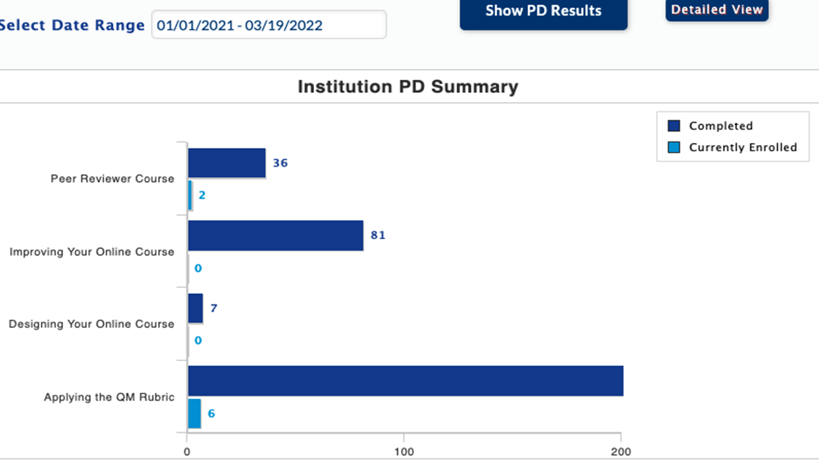
Evidence Examples
Dashboard for
QM Coordinators:
Detailed faculty training records on course design

Slide 21
Evidence Examples
Detailed plan/schedule for faculty PD
Samples of PD policies and/or structures
Practices for collection & use of student feedback
Faculty PD achievements/credentials

Slide 22
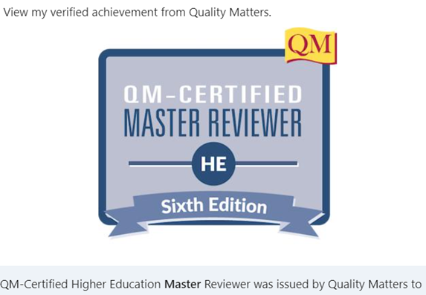
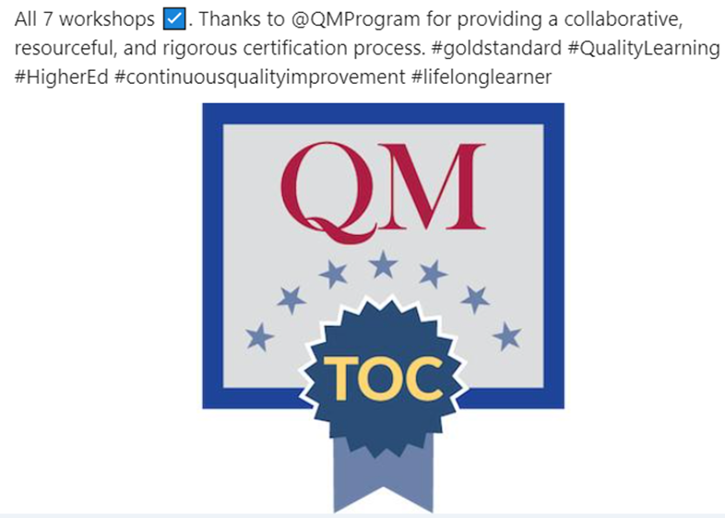
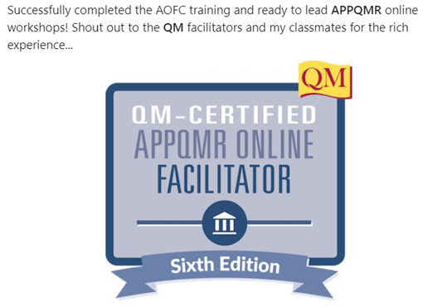
Evidence Examples

Slide 23
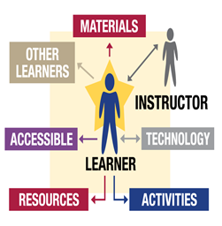
QM Implementation for
Student Support & Educational Effectiveness
Accreditors want to see evidence of how support systems and educational practices foster student success. Show them how you ensure:
Students are supported through elements of quality course design
Online student support practices are effective and valued by students
Faculty are trained in engaging students and assessing online/digital learning
Learning outcomes are tracked/used in institutional assessment
Students are completing and succeeding in achieving outcomes

Slide 24
Evidence Examples
List of services, with hours of availability
Narrative on how services support success
Student satisfaction data
Data collection, distribution, and feedback
Documentation of changes influenced by or
as a result of feedback

Slide 25
Evidence Examples
Definition of success for online students &
evidence of achievement
Institutional assessment incl. online student performance
Surveys or est. processes to collect student feedback
for improvement of instruction & support services
Documentation of improvement made based on feedback
Retention / completion / graduation rates

Slide 26

Reflection & Takeaways
How do you see QM implementation supports QA and provides data as evidence for your institutional or programmatic accreditation?
Source: AI-generated image
with MS Bing Image Creator

Slide 27
Please contact us:
Deb: dadair@qualitymatters.org
Yaping: ygao@qualitymatters.org

