Slide 1
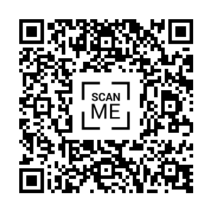
Connecting UDL Principles with QM Standards for Maximum Students Engagement
QM Connect
Tucson, 2025
Notes:
https://udlguidelines.cast.org/representation/

Slide 2




Share: Feel free to contribute at any time by…
Introduce yourself
Ask a question
Share resources with your Colleagues
Connect with your peers and share your ideas and expertise.
Notes:
Speaker Notes: I encourage everyone to actively participate during today's session! Feel free to use the chat box at any time. You can:
Introduce yourself
Ask questions
Share resources with your colleagues
And connect with your peers by sharing your ideas and expertise.
Do you have a great resource you use in your course that you’d like to share with other instructors, instructional designers, or staff? This is the place to share! I’m looking forward to hearing from all of you and making this a collaborative experience!

Slide 3
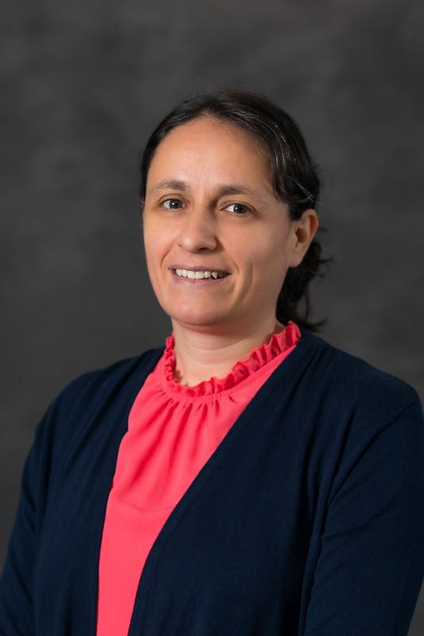
Presenter
Yasemin (YAH-seh-min) Onder (She/Her)
Instructional Designer (Kirkwood Community College, Cedar Rapids, Iowa)
Experienced educator and QM-certified peer reviewer, IYOC Facilitator and APPQMR Facilitator
Specializes in digital accessibility and course design
Focuses on creating inclusive online learning environments
Ensures courses meet high-quality standards and are accessible to all learners
Excited to connect with peers and share strategies for enhancing online education
Notes:
Speaker Notes: Hello, everyone! My name is Yasemin Onder, and I’m an Instructional Designer at Kirkwood Community College in Cedar Rapids, Iowa. I’ve been in education for quite a while, and I'm also a QM-certified peer reviewer. My work primarily focuses on digital accessibility and course design.
I’m passionate about creating inclusive online learning environments. In my role, I ensure that the courses we design meet the highest quality standards and, most importantly, are accessible to all learners. I’m really excited to connect with all of you today and share strategies that can enhance online education, ensuring it’s both effective and accessible for everyone.

Slide 4
Today’s Learning Objectives
Explain how integrating Universal Design for Learning (UDL) and Quality Matters (QM) standards can improve course design, accessibility, and student success.
Today's focus: How UDL Principle 1 (Design Options for Perception) aligns with QM standards, creating more inclusive learning experiences for maximum Students Engagement.
Notes:
Speaker Notes: Today, we’re focusing on how integrating Universal Design for Learning, or UDL, with Quality Matters standards can significantly improve course design, accessibility, and, ultimately, student success.
Our key focus today will be on UDL Principle 1, which is design Options for Perception. We’ll explore how this aligns with Quality Matters standards to create more inclusive learning experiences and maximize student engagement.
By the end of this session, you’ll see how these two frameworks work together to enhance both the design and the accessibility of your course.

Slide 5
Key Vocabularies
UDL: Universal Design for Learning (UDL) is an educational framework.
CAST: stands for the Center for Applied Special Technology. CAST created the Universal Design for Learning (UDL) framework.
Multiple Means of Engagement: Provide various ways to motivate and engage students. This involves helping learners monitor their internal and external environments, set priorities, and stay motivated.
Multiple Means of Representation: Present information in different formats (e.g., videos, text, infographics) to support various learning preferences.
Multiple Means of Action and Expression: Provide students with different ways to demonstrate their knowledge, such as papers, presentations, or creative projects, based on their strengths.
QM: Quality Matters is a nationally recognized, peer-reviewed process designed to ensure the quality of online and hybrid courses.
Notes:
Before we dive into today’s session, let’s quickly review some key terms you’ll hear throughout our discussion.
UDL stands for Universal Design for Learning. This is an educational framework that promotes creating flexible learning environments to meet the diverse needs of all students.
CAST is the Center for Applied Special Technology. They’re the organization that developed UDL and provide resources for implementing it effectively.
Multiple Means of Engagement involves providing different ways to motivate and engage students. This can include helping learners monitor their progress, set goals, and stay motivated throughout the learning process.
Multiple Means of Representation means presenting information in a variety of formats—like videos, text, or infographics—to support different learning preferences and make content more accessible.
Multiple Means of Action and Expression focuses on allowing students to demonstrate their knowledge in various ways, such as papers, presentations, or creative projects, giving them the flexibility to leverage their strengths.
Lastly, QM, or Quality Matters, is a nationally recognized, peer-reviewed process designed to ensure the quality and effectiveness of online and hybrid courses.

Slide 6
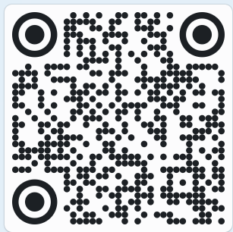
Interaction
How familiar are you with UDL and QM Standards?
What level of experience you have in UDL?
What level of experience you have in
Quality Matters (QM) Standards?
Very familiar,
Somewhat familiar,
Not familiar
Notes:
Let’s take a moment to gauge where everyone is in terms of familiarity with UDL and Quality Matters standards.
I’d like to ask:
How familiar are you with UDL and QM standards?
What level of experience do you have with UDL?
And what level of experience do you have with Quality Matters (QM) standards?
Please share in the chat whether you are:
Very familiar
Somewhat familiar
Or Not familiar
This will help me tailor today’s session to better meet your needs!
https://padlet.com/rlegaryjr/9-in-9-overtime-udl-3-0-insights-free-webinar-series-2025-s1cx4g2zaak58ny8

Slide 7
What is UDL?
Multiple Means
Universal Design for Learning (UDL) is an educational framework based on research in the learning sciences that guides the development of flexible and accessible methods, materials and environments that embrace variability, minimize barriers, and develop learner agency for all.
Cast-Universal Design for Learning
Engagement
Action & Expression
Representation
Notes:
Speaker Notes: Now, let’s take a closer look at Universal Design for Learning, or UDL. UDL is an educational framework grounded in research from the learning sciences. It guides us in designing flexible and accessible methods, materials, and environments that embrace the natural variability of learners. The core idea is to minimize barriers and develop learner agency—the ability for students to take control of their learning journey. learner agency that is purposeful and reflective, resourceful, and authentic, and strategic and action-oriented.

Slide 8
UDL 3 Key Principles
“UDL provides a blueprint for creating instructional goals, methods, materials, and assessments that work for everyone” (Meyer, Rose, & Gordon, 2014)
How learners monitor internal/external environment, set priorities, motivation.
How learners sense and perceive information and transform it to usable knowledge.
How learners plan, organize, and initiate purposeful actions in the environment.
Considerations: recruiting interest, sustaining effort and persistence, and self-regulation.
Considerations: perception, language and symbols, and comprehension.
Considerations: physical action, expression and communication, and executive function.
Resources: The Universal Design for Learning Guidelines
Notes:
Speaker Notes: Let’s explore how learners can monitor their internal and external environments, set priorities, and stay motivated. One of the key goals of Universal Design for Learning (UDL) is to support learner agency, which means giving students the tools to take control of their own learning. The new goal of UDL is to foster learner agency that is:
Purposeful and reflective – helping students understand their learning goals and how to achieve them
Resourceful and authentic – encouraging students to use resources effectively
Strategic and action-oriented – helping students apply their learning in meaningful ways
CAST breaks UDL into three core principles:
Multiple Means of Representation
Multiple Means of Expression
Multiple Means of Engagement
Together, these principles guide the design of an educational curriculum that meets the needs of all learners. The core idea is to remove or minimize barriers to learning, making education more accessible and inclusive for everyone.
You can think of UDL as the intersection of three important principles:
Access
Usability
Inclusion
To evaluate a course, resource, or activity through this lens, we can ask ourselves:
Who can access this, and who might face challenges?
Who can use this easily, and who might struggle?
Who is included, and who might feel excluded?

Slide 9
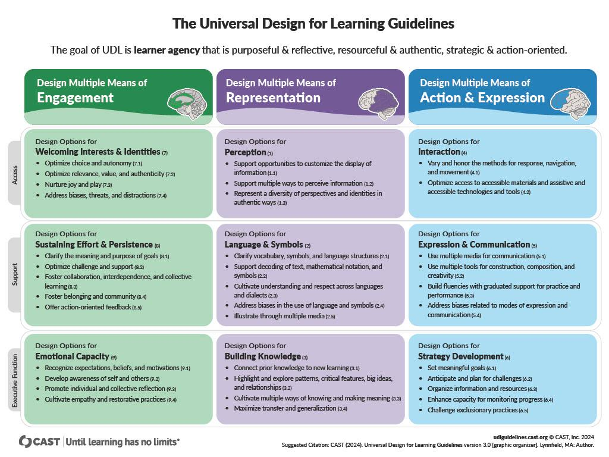
Notes:
When designing for Multiple Means of Engagement, we focus on how learners stay motivated, monitor their environment, and stay on task. By creating flexible options for how students engage with content and learning activities, we can better support them in staying interested and persistent.
Multiple Means of Representation involves how learners sense, perceive, and process information. By presenting content in various ways—like through text, video, or infographics—we help students transform that information into usable knowledge.
Finally, Multiple Means of Action and Expression means giving students different ways to demonstrate their understanding. Whether it's through writing, presentations, or creative projects, students can show what they've learned in a way that plays to their strengths.

Slide 10
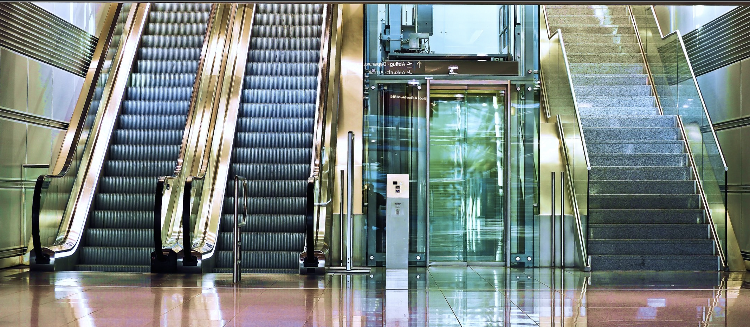
UDL: Inclusive Access for All from the Start
Notes:
Imagine a student who uses a wheelchair needing to get to the third floor of a building on campus. They find three options: an escalator, an elevator, and stairs, all designed together. The elevator provides easy access for this student to reach the third floor, while other students might use the stairs or escalator. The important part is that everyone reaches their destination smoothly and without delay.
This is Universal Design for Learning in action—creating solutions that work for as many people as possible, from the start. Instead of adapting later, UDL ensures that diverse needs are integrated into the design process from the very beginning, whether it’s about physical access to a building or access to learning materials in a classroom.
By considering multiple ways to present information, engage students, and assess their knowledge, we can create inclusive learning experiences where everyone, regardless of their abilities, can succeed.
The new goal of UDL is to foster learner agency that is:
Purposeful and reflective – helping students understand their learning goals and how to achieve them
Resourceful and authentic – encouraging students to use resources effectively
Strategic and action-oriented – helping students apply their learning in meaningful ways

Slide 11
What is QM?
Quality Matters (QM) is a set of research-based standards designed to ensure the
quality of online and blended courses.
It focuses on course design that promotes student engagement, learning outcomes, and accessibility.
QM uses a peer-review process to assess and improve course design based on the QM Rubric.
The QM Rubric includes 8 General Standards and 43 Specific Review Standards covering areas like learning objectives, assessments, and accessibility.
QM’s goal is to create clear, aligned, and supportive learning experiences for all students.
Standards from the QM Higher Education Rubric
Notes:
Let’s talk about Quality Matters, or QM.
What is QM? Quality Matters is a set of research-based standards created to ensure the quality of online and blended courses.
The focus of QM is on course design that promotes student engagement, clearly defined learning outcomes, and accessibility for all students.
QM uses a peer-review process to assess and improve course design using what’s known as the QM Rubric. This rubric is made up of 8 General Standards and 43 Specific Review Standards that cover important aspects like learning objectives, assessments, and accessibility.
The ultimate goal of QM is to create courses that are clear, well-aligned, and supportive of learning experiences for all students. By following QM standards, we can ensure that the courses we design are both effective and inclusive.

Slide 12
How can QM Framework be supported by UDL?
Multiple Means of Representation (UDL Principle 1):
Aligns with QM Standard 8: Accessibility
Provide content in various formats (text, audio, video) to ensure students with diverse needs can access information effectively.
Multiple Means of Engagement (UDL Principle 2):
Supports QM Standard 5: Learner Engagement
Offer multiple ways to interact with course materials to sustain motivation and interest, promoting active participation.
Multiple Means of Action & Expression (UDL Principle 3):
Aligns with QM Standard 3: Assessments
Provide students various ways to demonstrate their knowledge and skills, ensuring flexible and inclusive assessment methods.
Notes:
Now, let’s explore how the Quality Matters (QM) Framework is supported by Universal Design for Learning (UDL) principles.
First, we have Multiple Means of Representation, which is UDL Principle 1. This aligns with QM Standard 8: Accessibility. The idea here is to provide content in different formats—such as text, audio, and video—so that students with diverse needs can access information effectively. For example, some students may benefit more from audio resources, while others prefer visual aids like infographics or videos.
Next is Multiple Means of Engagement, which is UDL Principle 2. This supports QM Standard 5: Learner Engagement. By offering multiple ways for students to engage with course materials, we can help sustain their motivation and interest. This promotes active participation in learning. Some students might be more engaged by discussions, while others thrive in hands-on activities or interactive content.
Finally, we have Multiple Means of Action & Expression, which is UDL Principle 3. This aligns with QM Standard 3: Assessments. UDL encourages offering students various ways to demonstrate their knowledge and skills. By providing flexible and inclusive assessment methods—such as written assignments, presentations, or creative projects—we ensure that all learners can succeed based on their strengths.

Slide 13
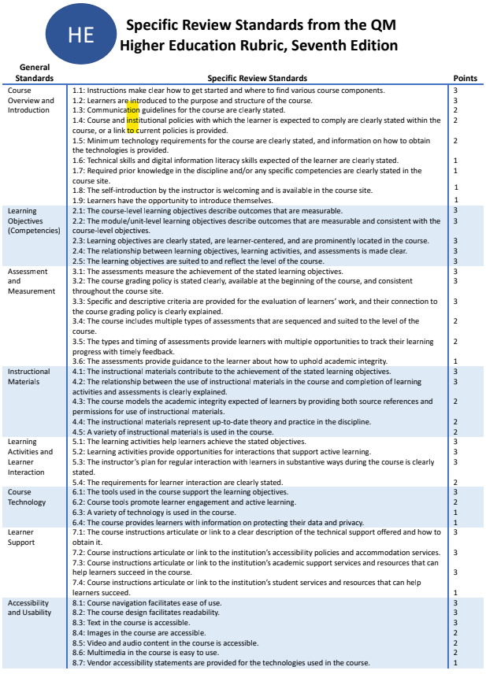
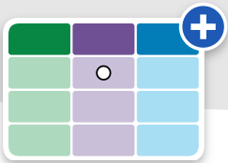
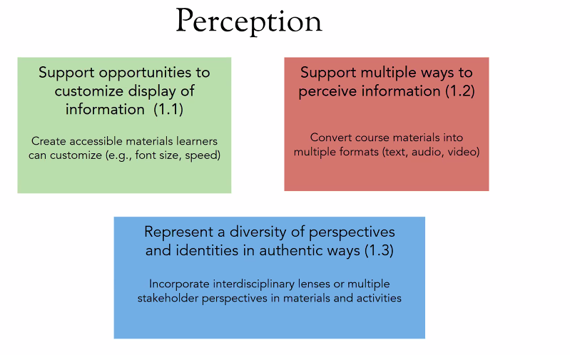
Notes:
Now, let’s explore how the Quality Matters (QM) Framework is supported by Universal Design for Learning (UDL) principles.
First, we have Multiple Means of Representation, which is UDL Principle 1. This aligns with QM Standard 8: Accessibility. The idea here is to provide content in different formats—such as text, audio, and video—so that students with diverse needs can access information effectively. For example, some students may benefit more from audio resources, while others prefer visual aids like infographics or videos.

Slide 14
UDL Principle 1 – Multiple Means of Representation Perception
Support opportunities to customize the display of information (1.1)
Support multiple ways to perceive information (1.2)
Representing a Diversity of Perspectives and Identities (1.3)
QM Standards
Course Overview and Introduction 1.1
Learning Objectives 2.1
Assessment and Measurement 3.1
Instructional Materials 4.1
Learning Activities & Learner Interaction 5.1
Course Technology 6.1
Learner Support 7.1
Accessibility (8 1, 8.2, 8.3, 8.4, 8.5, 8.6, 8.7)
QM Standards
Course Overview and Introduction 1.1
Learning Objectives 2.1
Assessment and Measurement 3.1
Instructional Materials 4.1
Learning Activities & Learner Interaction 5.1
Course Technology 6.1
Learner Support 7.1
Accessibility (8 1, 8.2, 8.3, 8.4, 8.5, 8.6, 8.7)
QM Standards
Course Overview and Introduction 1.2
Learning Objectives 2.1
Assessment and Measurement 3.2
Instructional Materials 4.2
Learning Activities & Learner Interaction 5.1
Course Technology 6.3
Learner Support 7.1
Accessibility
Allow students to adjust text size and contrast, Use consistent layout across course pages (LMS Accessibility Settings, Ally,Panorama)
Offer high-contrast color options.
Provide transcripts or closed captions for all audio/video
Enable learners to have materials read aloud with adjustable speech rate.
Verify third-party tools meet accessibility standards.
Provide alt text for visual content
Ensure all video and audio materials are captioned or transcribed.
Offer interactive diagrams or models for learners to explore information in multiple formats (e.g., tactile models, 3D visualizations).
Offer support resources in formats that cater to sensory needs (e.g., sign language videos, written guides).
Ensure course Objectives, materials and assessments include diverse cultural backgrounds and identities to foster a sense of belonging for all learners.
Provide assessment tasks like cultural reflections or historical analyses that encourage learners to incorporate and analyze multiple viewpoints.
Develop assessment rubrics that recognize and respect diverse ways of thinking, communication, and cultural perspectives in student work.
Notes:
Let’s dive into UDL Principle 1 – Multiple Means of Representation, which focuses on how we present information to learners in ways that are accessible and flexible. This principle aligns well with the Quality Matters (QM) Standards, supporting opportunities to customize the display of information for diverse learners.
QM Standard 1.1 (Course Overview and Introduction) stresses the importance of clear instructions on how to start and navigate the course.
UDL recommends offering customizable features, such as:
Adjustable text size and contrast for readability.
High-contrast color options to support learners with visual impairments.
Consistent layout across course pages, ensuring a uniform experience.
QM Standard 2.1 specifies that course-level learning objectives should be measurable and clear.
UDL suggests providing alternative formats for these objectives—text, audio, or video—ensuring they’re accessible to all learners. Students benefit from learning objectives that are presented in multiple ways, such as through diagrams, verbal explanations, or interactive formats. This ensures that everyone can access and understand the goals of the course.
QM Standard 3.1 ensures assessments measure the achievement of the stated learning objectives.
UDL suggests offering adjustable features for assessments, including text-to-speech or adjustable speech rates, and allowing learners to have assessments read aloud. Providing accessible assessment formats ensures that students can demonstrate their understanding without being limited by the format of the assessment.
QM Standard 4.1 emphasizes that instructional materials should help learners achieve the course’s stated learning objectives.
UDL recommends customizing instructional materials, such as resizable images, offering text alternatives (alt text) for all visual content, and captioning or transcribing all videos and audio materials. By offering different formats for instructional materials, we can support students who need audio descriptions, visual aids, or tactile resources.
QM Standard 5.1 requires that learning activities help learners achieve the stated objectives.
UDL aligns this by suggesting the use of interactive diagrams, models, and multiple engagement formats, including tactile models or 3D visualizations. Interactive and engaging learning activities ensure that learners of all abilities can participate and succeed. These options allow for multiple ways of experiencing and engaging with the content.
QM Standard 6.1 ensures that course technology supports the learning objectives.
UDL promotes the use of technology that offers adjustable text size, audio alternatives, and video controls. Technology tools should not only support the course content but also provide flexible access options, like audio descriptions, captions, and customizable controls.
QM Standard 7.1 ensures that learners can access appropriate technical support.
UDL recommends offering support resources in diverse formats, like sign language videos or written guides, to cater to sensory needs. Providing a variety of support materials ensures that learners, regardless of their sensory needs, can find assistance in a format that works for them.
QM Standards 8.1 to 8.7 address various accessibility requirements, ensuring the course design promotes ease of use and readability.
UDL aligns with these standards by emphasizing the need for:
Text alternatives (e.g., alt text for images and videos).
Captioning and transcripts for all multimedia.
Accessible multimedia with visual and auditory equivalents. Accessibility is not just about meeting standards; it’s about designing the course to be usable by everyone, no matter their individual needs.
By applying these tips, we ensure that every learner has access to the resources and tools they need to succeed.
Aligning UDL principles with QM standards helps create inclusive and accessible learning experiences. By offering multiple ways to perceive, engage with, and express knowledge, we empower all students to reach their full potential.
https://padlet.com/yaseminonderofficial/connecting-udl-principles-with-qm-standards-dm9nhgaf8p0ivu9s
By aligning QM standards with UDL's checkpoint 1.1, educators can design more inclusive and flexible learning environments that support a wide range of learners, ensuring equitable access to information.
What is it?
Providing different ways for learners to perceive and comprehend information.
Supporting diverse learners by offering alternative ways to engage with content (e.g., text, audio, video).
Ensures content is accessible to all students, regardless of learning preferences, language background, or abilities.
Prompt: How might we increase accessibility, flexibility, and diversity in the sharing of information?
Learning becomes a challenge when students can't perceive the material, struggle to interact with it, or are presented with content that reinforces stereotypes or deficit thinking.
To ensure learning is accessible to all, educators need to reduce these barriers through thoughtful presentation and customization of materials.
Present content in different forms, such as text, audio, or visuals. This ensures that students with varying sensory needs can access the material.
For example, reading a text aloud, providing captions for videos, or offering tactile experiences for learning concepts.
Give learners the option to adjust text size, contrast, or sound levels. This is especially important for students who may require assistive technology or personal preference in how they engage with materials.
This helps students focus on the material itself, not the barrier created by the format of the content.
Presenting information in different ways benefits all students, not just those with disabilities.
Some learners may prefer videos over text or benefit from seeing examples of real-world applications alongside theoretical concepts.
Including diverse perspectives in your curriculum allows students to see themselves reflected ("mirrors") and experience perspectives outside their own ("windows").
This enriches the learning experience and fosters stronger connections with the content.

Slide 15
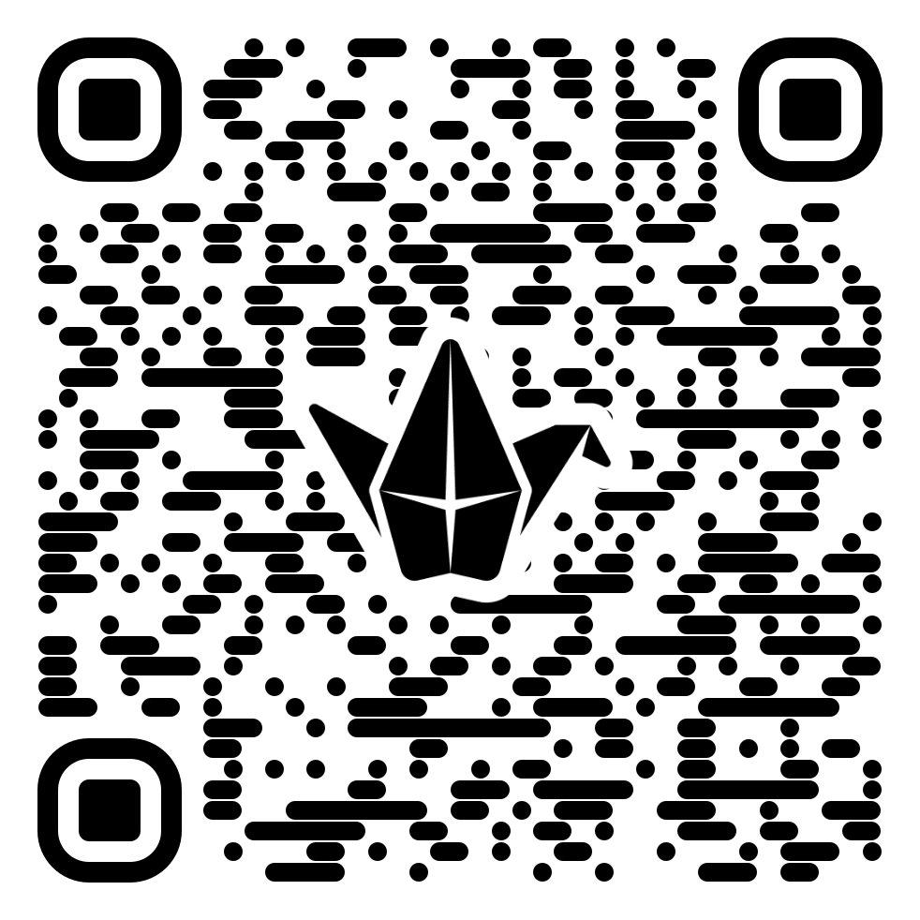
Interaction
Case Studies 1:
Case Studies 2:
Case Studies 3:
You have a student with difficulty reading long blocks of text. How can you modify the course to support them?
A student struggles with complex video content because they are hearing-impaired. How can you address their needs?
A student in your course has a visual impairment and uses a screen reader. How can you make sure the course materials and technology are accessible while following UDL principles and Quality Matters standards?
Padlet URL: https://padlet.com/yaseminonderofficial/connecting-udl-principles-with-qm-standards-dm9nhgaf8p0ivu9s
Notes:
Now, it’s time to reflect on your own experiences and consider how we can support our students in meeting QM accessibility standards while implementing design options for perception to provide multiple means of representation. We have some case scenarios to review, and there's also an area where you can share your ideas and insights.
I’ve also created a Padlet with more in-depth examples of UDL and QM standards alignment. You can access it by scanning the QR code on this slide.
Case Scenario 1: You have a student with difficulty reading long blocks of text. How can you modify the course to support them?
For this case, we align UDL's Multiple Means of Representation with QM standards for Accessibility and Usability (QM Standards 8.1, 8.2, and 8.3).
We can allow students to use text-to-speech tools, break up text into manageable chunks, and provide alternative formats, such as audio or visual aids.
This approach makes sure that information is presented in a way that the student can access and understand, while meeting QM's usability and accessibility requirements.
Case Scenario 2: A student struggles with complex video content because they are hearing-impaired. How can you address their needs?
In this case, we focus on QM Standards 8.5 and 8.6, which require that audio and video content be accessible.
We can provide captions, transcripts, and other alternatives, ensuring the learner can fully engage with the course material, regardless of their hearing ability.
This is an example of UDL’s principle of providing multiple ways to perceive information, ensuring inclusivity.
By integrating UDL principles into our courses, we ensure accessibility for all learners, and aligning these with QM standards guarantees quality course design. Both frameworks are essential for creating inclusive learning environments that cater to diverse needs.

Slide 16
Interaction
Question 1:
Do you have an example of how applied UDL to make your course more accessible?
Question 2:
What are your biggest challenges when trying to implement accessibility and UDl in your course

Slide 17
Benefits of Integrating UDL for Perception in QM Courses
Improved Accessibility
Enhanced Customization
Greater Inclusivity of Diverse Perspectives
Flexible Learning Objectives and Assessments
Increased Engagement and Motivation
Improved Learner Support
Notes:
Integrating Universal Design for Learning (UDL) for Perception into Quality Matters (QM) courses offers several benefits that enhance the learning experience for a diverse group of learners:
Improved Accessibility:
UDL principles, particularly around perception, ensure that content is accessible to learners with various sensory and cognitive abilities. By providing multiple ways to perceive information (e.g., text-to-speech, captions, and alternative text for images), courses become more inclusive, addressing the needs of learners with visual, auditory, and learning disabilities.
Enhanced Customization:
Learners can customize the display of information to suit their needs and preferences, such as adjusting text size, color contrast, and layout. This flexibility, aligned with UDL’s principles of offering multiple means of representation, allows learners to engage with the content in the format that best supports their understanding.
Greater Inclusivity of Diverse Perspectives:
When course content incorporates culturally responsive and inclusive materials, UDL supports the representation of diverse identities, histories, and viewpoints. This leads to an improved sense of belonging and validation for learners who see their experiences reflected in the learning environment. It also broadens learners' awareness by exposing them to a range of global perspectives.
Flexible Learning Objectives and Assessments:
UDL encourages the development of learning objectives and assessments that value different forms of expression and validate multiple cultural perspectives. This results in a more personalized learning experience, as students can demonstrate their knowledge and skills in ways that align with their cultural context and learning preferences.
Increased Engagement and Motivation:
UDL promotes the use of multiple modalities (visual, auditory, tactile) to present content, catering to learners' diverse preferences and improving their engagement with the material. This heightened engagement can lead to greater motivation, as learners feel empowered to choose the tools and methods that best suit their learning style.
Improved Learner Support:
By aligning UDL principles with QM standards for learner support, instructors can provide clear instructions and links to accessibility services and resources. This ensures that learners know how to access support when needed, contributing to a more seamless learning experience.

Slide 18
Conclusion and Key Takeaways
UDL Consideration for Perception support QM’s accessibility standards.
Simple changes can enhance access and inclusion in online and hybrid courses.
Faculty are key in creating learning environments that meet diverse needs.
Notes:
UDL and QM together help ensure your courses are accessible, inclusive, and engaging for all students.

Slide 19
Q&A and Discussion
How confident are you now in applying UDL principles to meet QM standards?
Very confident,
Somewhat confident,
Need more practice
Notes:
What steps can you take in your course to provide more options for perception?

Slide 20
Resources
Meyer, A., Rose, D. H., & Gordon, D. (2014). Universal design for learning: Theory and practice. CAST.
CAST. (2024). Universal design for learning guidelines. https://udlguidelines.cast.org/
Quality Matters. (2023). Quality matters rubric (7th ed.). https://www.qualitymatters.org/
Roberts, K. D., Park, H. J., Brown, S., & Cook, B. G. (2011). Universal design for instruction in postsecondary education: A systematic review of empirically based articles. Journal of Postsecondary Education and Disability, 24(1), 5–15.
McGuire, J. M., Scott, S. S., & Shaw, S. F. (2006). Universal design for instruction: The paradigm, its principles, and products for enhancing instructional access. Journal of Postsecondary Education and Disability, 19(2), 124–134.
Burgstahler, S. (2015). Universal design in higher education: From principles to practice. Harvard Education Press.
He, Y., & Wang, L. (2015). Applying quality matters standards to online courses in teacher education. Educational Technology, 55(3), 26–32.
CAST. (n.d.). UDL On Campus: Home. CAST. Retrieved February 26, 2025, from https://udloncampus.cast.org/home

Slide 21
