Slide 1
AI in Education
Assistant or Adversary
Jon Fila
bit.ly/aiassist23
Notes:
OERMN
OER, Accessibility

Slide 2
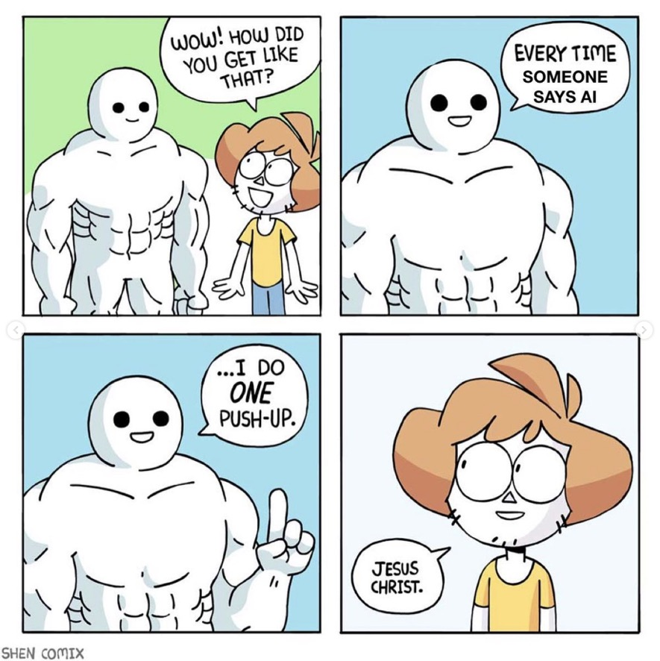

Slide 3


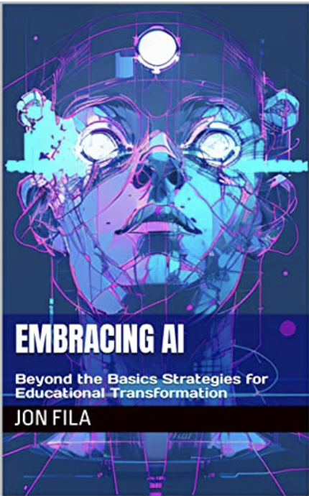
AI Guides

Slide 4
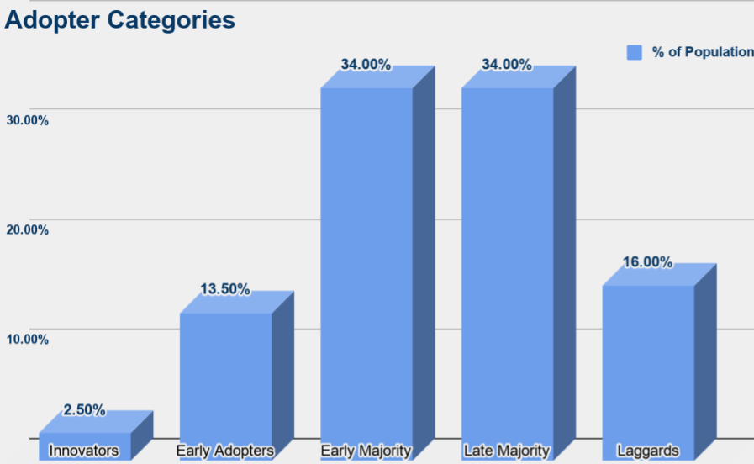
Factors of an innovative practice
Relative Advantage - Is it better than what it replaces?
Compatibility - Is it similar enough to what we are doing that the change isn’t so drastic?
Complexity - Is it relatively easy to understand?
Trialability - Can it be piloted before it is adopted?
Observability - Can we measure the results?
Notes:
Factors of an innovative practice:
Relative Advantage - Is it better than what it replaces?
*Think about why this is better than what we were doing before.
*Time it will save.
*Populations it will support.
Compatibility - Is it similar enough to what we are doing that the change isn’t so drastic?
*Calculators, cell phones, Internet, devices
Complexity - Is it relatively easy to understand?
*It’s not magic, it “wants” to please us.
Trialability - Can it be piloted before it is adopted?
*Demonstrate ways in which it’s already being used.
Observability - Can we measure the results?
*Compare student performance, interest, conversations.

Slide 5

Students & AI
Many students throughout history have tried to cheat.
Many have cheated successfully.
Students notice hypocrisy before many other things!
If we are using it, why can’t they?

Slide 6

Academic Integrity
“Detection” Support is a myth.
Consistency
Responsible Use
AI-Assisted “Original Work”
AI and Ownership/Plagiarism
Learners & Educators need training!
The Urgent Need to Update District Policies on Student Use of Artificial Intelligence in Education
Sample Policy
Notes:
HYPOCRISY!
1. AI-Assisted Original Work: If they’re going to use it, the work submitted must reflect the student's own understanding and knowledge.
2. Responsible Use of AI: Do we know what that looks like yet?
3. AI and Plagiarism: Just as copying information from websites or other resources without giving proper credit is plagiarism, using AI-generated content without due acknowledgement or understanding is also plagiarism. Students should not represent AI-generated content as their own original work.

Slide 7

Where Detection Fails
The Constitution
Religious Texts
English Language Learners
Simple Ideas/Concepts

Slide 8
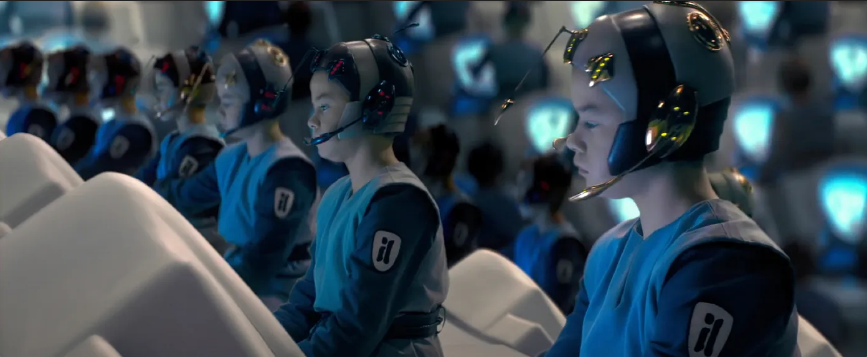
Humans are sounding more like AI (November 2018!)
Only Half of Americans Can Differentiate Between AI and Human Writing

Slide 9
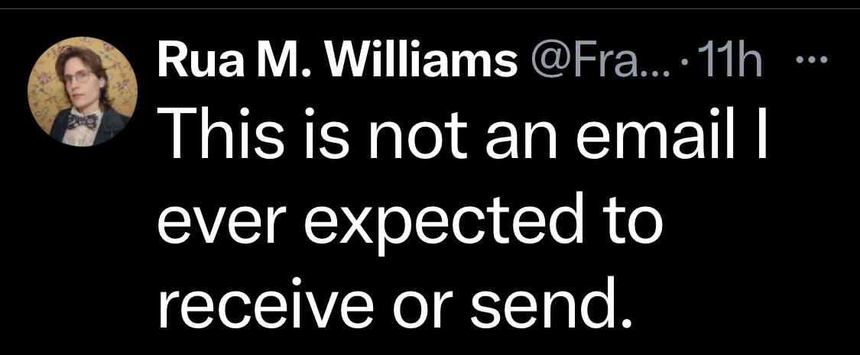

Slide 10
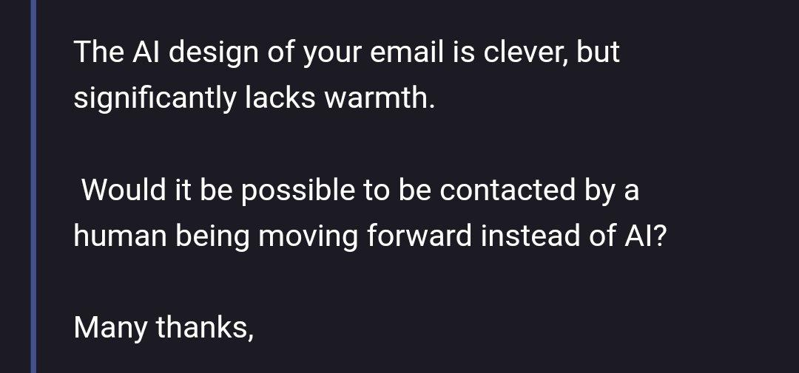

Slide 11
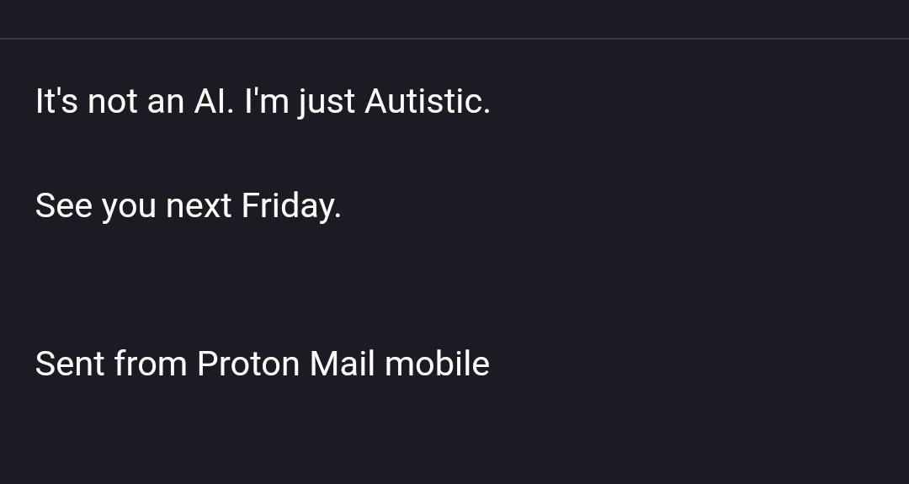

Slide 12
Equity
Access
Implicit Bias
Whose Voices are Left Out?
Real-World Examples
Why is it Important?
Student Characteristics
For Consideration:
Prompt Engineering is now part of literacy.
bit.ly/aiassist23

Slide 13
Compare with Reasons for Providing Accessible Materials
Based on a work from Council of Ontario Universities. Copyright 2017.
For Educators
Often improves student learning.
Reduces the work associated with arranging individual and specialized accommodations.
May improve student engagement as it reaches a broader audience, which could lead to improved course evaluations.
For Students
Less time spent on figuring out individual accommodations, more time focusing on course content.
Greater inclusion from a variety of backgrounds and abilities (leads to increased student retention).
Not singled out for being different.
bit.ly/aiassist23

Slide 14






Promoting Independent Learning​
Accessible technologies help students with disabilities unlock their full potential by addressing a diversity of needs:​
Learning:
Dyslexia ​
Dysgraphia ​
Dyscalculia
Visual:
Low vision​
Blind​
Colorblind​
Hearing:
Deaf​
Hard of Hearing​
Mobility:
Cerebral Palsy​
Muscle Dystrophy​
Amputation​
Neurodiversity​:
Autism​
ADD/ADHD​
Seizure​
Mental Health:
Anxiety​
Depression​
OCD​
Slide Attribution: Mike Tholfsen​
Principal Product Manager, Microsoft Education​
@mtholfsen​
See Microsoft Accessibility features for every classroom: http://aka.ms/AccessibilitySway ​

Slide 15
Why
For Consideration:
ChatGPT is capable of the same benefits that teachers have used OER and Social Media for.
Get or share ideas.
Get suggestions or help.
Re-learn something in preparation for an upcoming lesson.
Find new ways of doing something.
bit.ly/aiassist23
Notes:
Same as with OER, awareness presents challenges.
Factors of an innovative practice:
Relative Advantage - Is it better than what it replaces?
Compatibility - Is it similar enough to what we are doing that the change isn’t so drastic?
Complexity - Is it relatively easy to understand?
Trialability - Can it be piloted before it is adopted?
Observability - Can we measure the results?

Slide 16
Feedback/Support
For Consideration:
Using AI in Assignment Submissions
Keep it supportive
AI Tutor
Sounds “AI-ish”
Enhance Relationship
Provide Examples
Ideas for...
In case you are interested, here is some AI feedback that you might find useful!
bit.ly/aiassist23
Notes:
Ideas for breaking down assignments; time management; reducing anxiety; especially around academic workload; IEP accommodations; etc.

Slide 17
Curriculum
For Consideration:
Working with Standards
(Took longer to format than to write)
Assessment Development
Sample Lesson 2 versions
Course Planning
Practice/Review
Assessment
Demonstrating Care
UDL, SEL, Anti-racist
Student Friendly Language
Differentiation
bit.ly/aiassist23

Slide 18
Prompt Engineering
Teachers do this with students all the time already!
Make it specific.
Give examples if possible.
Break things down.
Order can matter.
Bring it back into focus.
Teach incrementally what you are looking for.
Tell it what it gets wrong.
Give it permission to say “answer not found”.
Have it show its work/reasoning step by step.

Slide 19
Prompt Engineering
What’s Missing?
Include Why
“Are there any more?”
Address the Bias, ask for what you want and how you want it.
For Consideration:
The Default Version Sucks!
bit.ly/aiassist23

Slide 20
Creative Uses
Give AI version first
Role Playing
Product Development & Marketing
What If...?
Agendas / PLC Tasks
Goal Setting (SMARTIE)
Strategic, Measurable, Ambitious, Realistic, Time-bound, Inclusive, and Equitable
For Consideration:
“Dungeons & Dragons”
Personalization
The future is not in writing essays or traditional responses.
bit.ly/aiassist23
Notes:
Experiment with using an AI tool for providing feedback on a student's work. Reflect on the experience, noting the advantages and disadvantages.

Slide 21
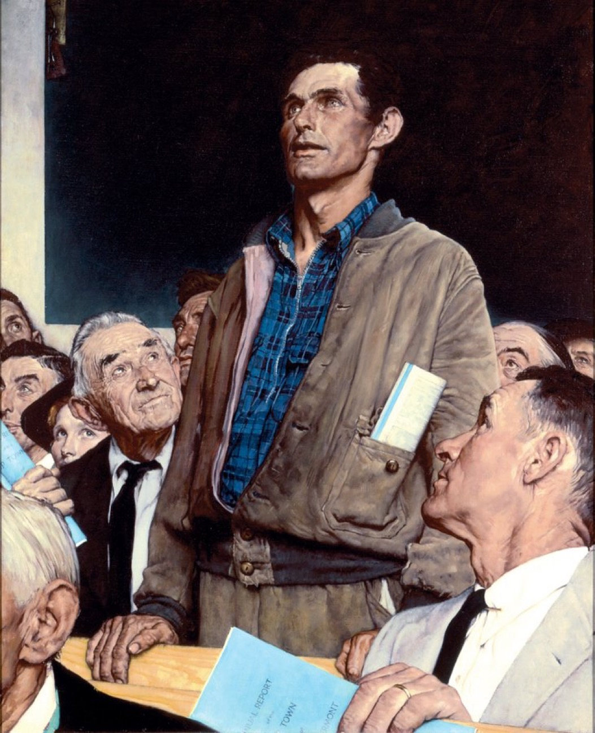
The Public...
What public perceptions must we face?
How do we educate the public about what “AI” is and what it is not?
Notes:
I’m sure everyone has seen the footage of contentious school board meetings.
Now because of some of the toxic attitudes out there and how some aspects of public life for educators are now unsafe, we might be turning to AI for more of our collaboration. That can get us stuck in our own implicit biases and feedback loops.
Cause frustration in the public (misinformation, lack of evidence for how it is used)
Dealing with Resistance: How should we approach resistance or fear towards AI from parents or community members? How can we empathize with their concerns while still advocating for the benefits of AI in education?
Transparent AI Use: How can we effectively communicate to parents and other community members about our use of AI tools? What information should we prioritize in these communications to ensure transparency, fairness, and accountability?
Factors of an innovative practice:
Relative Advantage - Is it better than what it replaces?
Compatibility - Is it similar enough to what we are doing that the change isn’t so drastic?
Complexity - Is it relatively easy to understand?
Trialability - Can it be piloted before it is adopted?
Observability - Can we measure the results?

Slide 22
Policy Language
How will it be used?
How will it be reviewed?
What are appropriate/inappropriate uses?
How have Equity & Inclusion been incorporated?
Is PD Addressed?
Oversight?
For Consideration:
Sample Policy

Slide 23
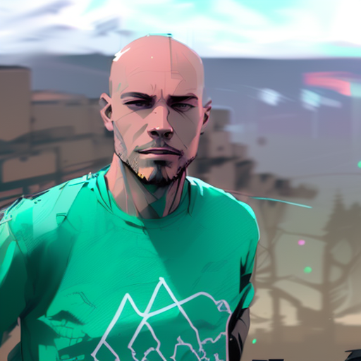
Contact Info
Jon Fila
jon.fila@gmail.com
@jontfila
jonfila.com
bit.ly/aiassist23

