Slide 1
Crafting Excellence: Empowering Faculty with a Dynamic Framework for Course Development
Title of Presentation
Date
Dr. Marcelene Cunningham
Instructional Design Specialist

Slide 2
About North Park University
A Rich History
Founded in 1891 by the Evangelical Covenant Church.
North Park University is located on Chicago’s north side and enrolls 3,200 students from around the world.
Deep tradition in the liberal arts and Christian faith, but a spirit of reaching out to serve and learn from the dynamic community around us.

Slide 3




Meet the Team – Center for Online Education
Onella Piyatilake

Slide 4
Presentation Outline
Learning Objectives
Course Design and Development Phases
Challenges
Solutions
Data
Q&A

Slide 5
Learning Objectives
At the end of this session, you will be able to:
Articulate the challenges in quality assurance implementation within your respective educational contexts.
Identify and discuss at least two actionable solutions to enhance the quality of your courses using the presented framework.

Slide 6
Phase 1: Pre- Course Development Meeting with Faculty
Syllabus
QM Rubric
QM Scoring Threshold
Timeline
Faculty In-House Resource (COE 102)

Slide 7
Syllabus
Course and Module-Level Learning Objectives
Activities and Assessments
Instructional Materials
Grading Policy
Existing Rubrics
Course Description
Prerequisites
Module Topics

Slide 8
QM Rubric & Scores
General Review Standards
Specific Review Standards
Scoring Thresholds
  Essential Standards
  86/101

Slide 9
Timeline
Design and Develop Course – 10 weeks
Pre-Review Course Internally – 3 weeks
Submit Course to QM for Official Review – 3 weeks
Amend course if needed – 14 weeks (most get done in 2 weeks)
Total time – 30 weeks

Slide 10
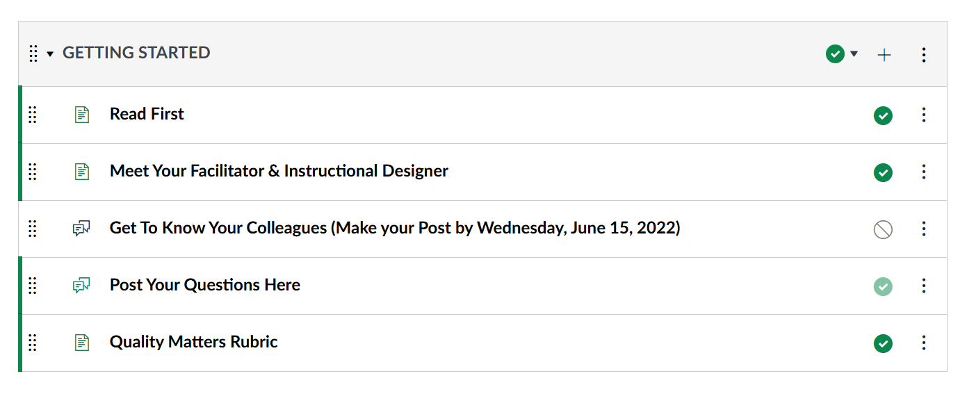
What’s in the COE 102 ?

Slide 11
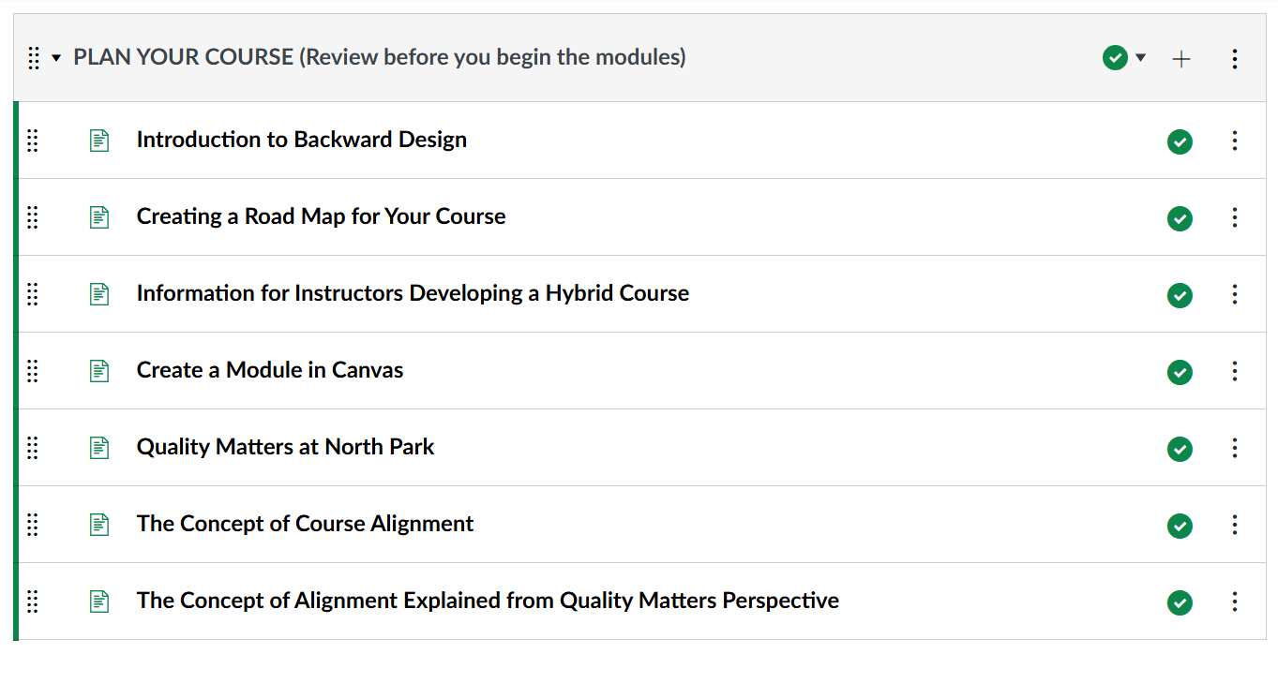

Slide 12
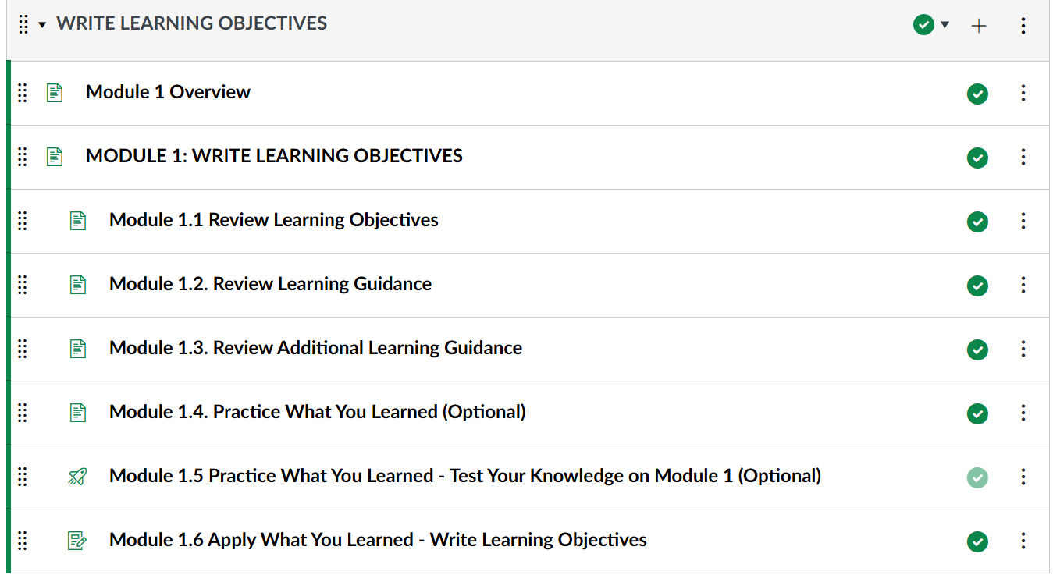
What’s in the COE 102?

Slide 13
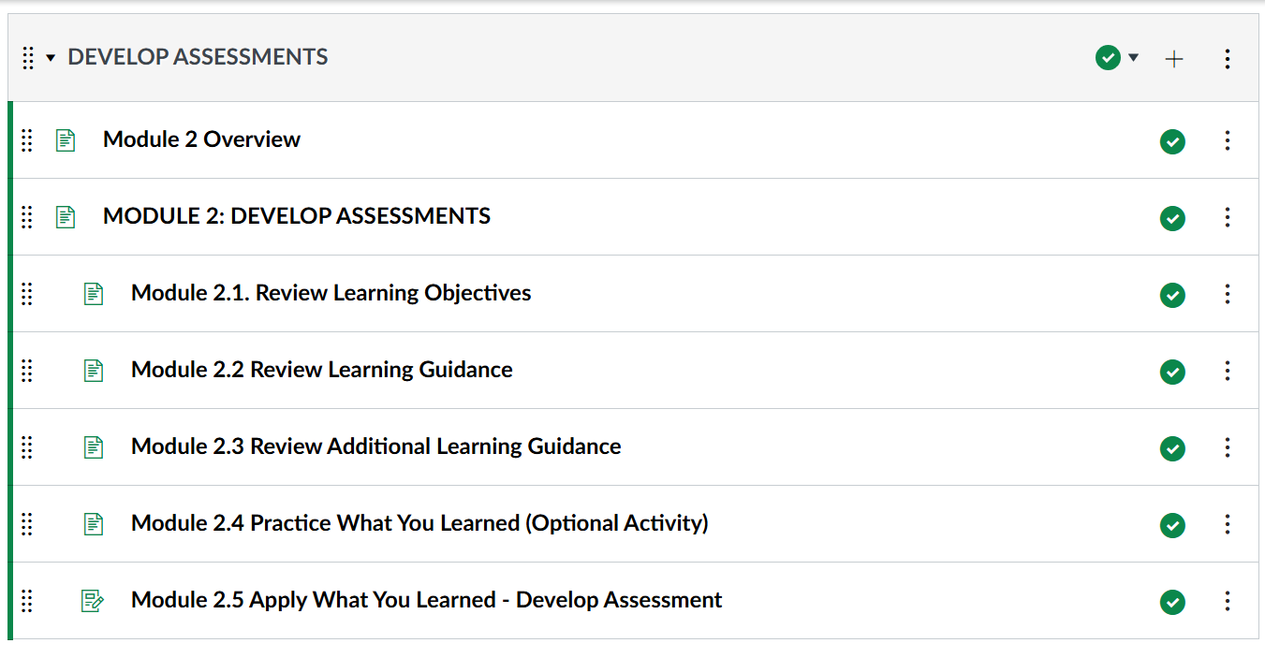

Slide 14
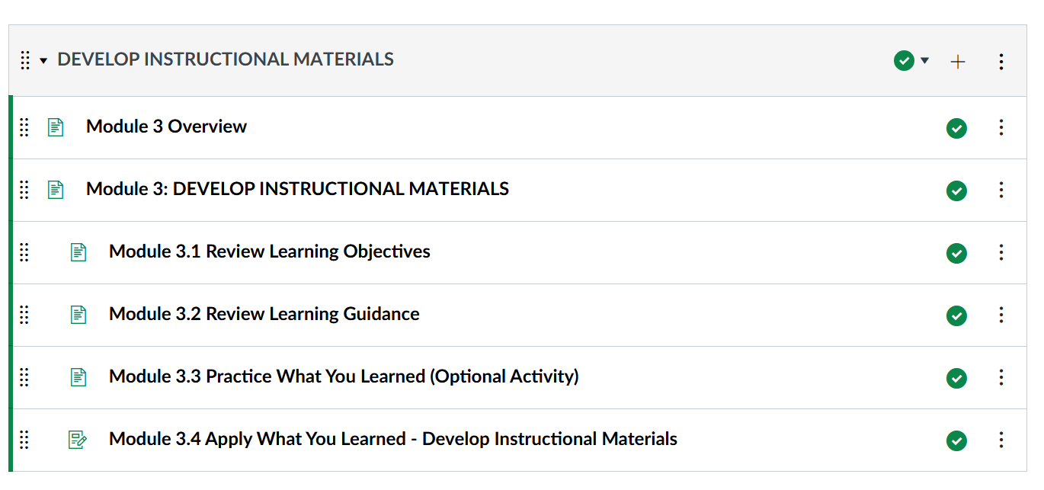

Slide 15
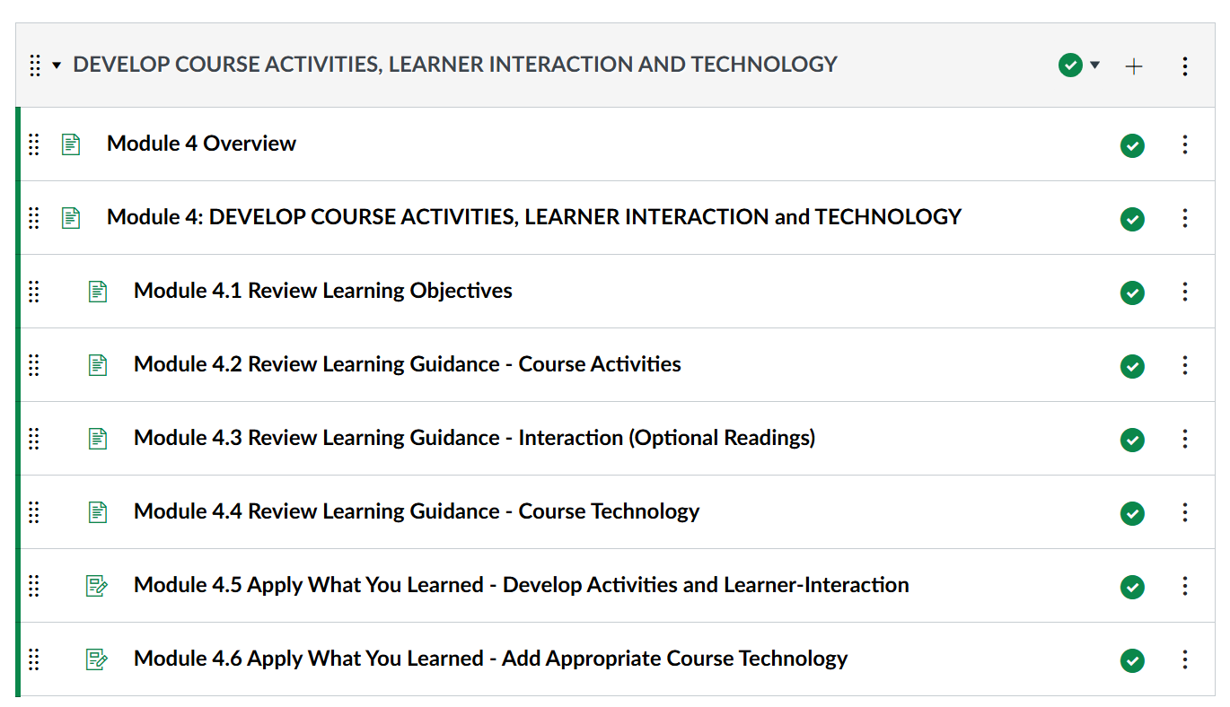

Slide 16
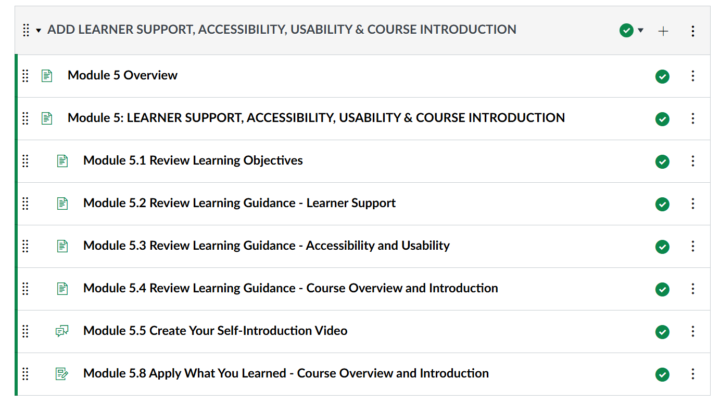

Slide 17
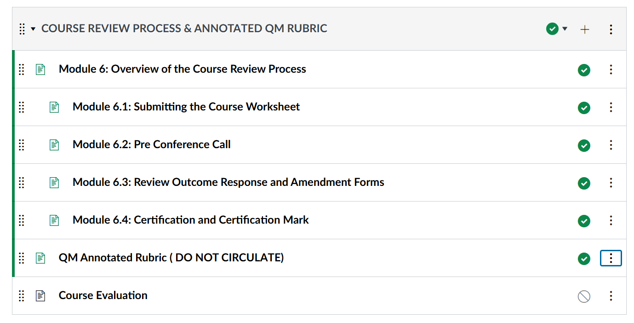

Slide 18
Phase 2: Course Design & Development
Course Mapping - Faculty work with ID
Course development using COE Fast Track Template

Slide 19
What Does Working with our IDs Look Like?
Course Planning and Alignment with QM Standards
Initial Consultation and QM Overview: The instructional designer (ID) introduces faculty to the QM standards and the QM Rubric, emphasizing the importance of alignment among course objectives, materials, activities, and assessments.
Learning Objectives: IDs collaborate with faculty to ensure that learning objectives are specific, measurable, and aligned with QM standards, forming the foundation for course content and assessments.

Slide 20
2. Organizing Content with QM Structure and Alignment Standards
Course Mapping According to QM Standards: IDs assist in creating a course map that aligns with QM’s structure standards, helping faculty organize content in a clear and accessible way. This map ensures that each module or unit includes aligned objectives, materials, and assessments.
Consistent and Clear Navigation: The ID helps set up a clear navigation structure that complies with QM’s requirements for ease of use, promoting a consistent experience for students.

Slide 21
3. Designing Engagement with a Focus on QM Learner Interaction Standards
Interactive and Engaging Learning Activities: IDs help design activities that align with QM’s interaction standards, fostering regular and substantive interaction among students, faculty, and content. This includes discussions, peer interactions, and multimedia activities.
Supporting Active Learning: The ID assists faculty in creating activities that promote critical thinking and practical application of knowledge, meeting QM standards for engaging students in active learning.

Slide 22
4. Assessment and Measurement with QM Alignment Standards
Alignment of Assessments with Learning Objectives: IDs ensure that assessments are directly aligned with the course learning objectives per QM standards, providing measurable evidence of student progress.
Formative Feedback Opportunities: Following QM guidelines, the ID collaborates with faculty to incorporate formative assessments that offer timely feedback, encouraging student self-assessment and reflection.

Slide 23
5. Integrating Technology and Accessibility Based on QM Guidelines
Incorporating Accessible and Inclusive Tools: IDs assist faculty in selecting and using technology tools that align with QM’s accessibility and usability standards, such as accessible formats and closed captions for media.
Template and Framework Customization: IDs provide COE Fast Track Course Template within Canvas, ensuring consistency, accessibility, and an organized learning experience.

Slide 24
What Are the Key Components of the Development Phase?
Content Creation and Curation
Organizing Modules
Designing and Building Assessments
Creating Engaging Learning Activities
Integrating Multimedia and Instructional Technology
Building Course Accessibility and Usability

Slide 25
Phase 3: Pre- Review & Official QM Review
Lead Instructional Designer pre- review course ( 1-2 weeks)
Faculty complete and submit Course Worksheet
Locate Review team
Course Submitted to QM Reviewers
Conference Call with Reviewers

Slide 26
Phase 4: Post Course Development
QM Certification Mark
Faculty is provided with support on how to effectively deliver courses (COE 103)
Course goes live
On going support

Slide 27
Challenges
Managing Time and Workload
Limited Buy-In for Quality Standards and Frameworks
Perception of Extra Workload Without Additional Incentives
Minimal Feedback and Recognition for Efforts

Slide 28
Solutions
Fast-Track Course Template
Peer Mentors
One-on-One ID and Tech Support
Sample Courses
COE 102 Course
Recognition
Stipend

Slide 29
What does our numbers look like?
Peer Reviewers: 4
Master Reviewers: 3
Facilitators: 0
Program Reviewer: 2

Slide 30
Courses Submitted for Review: 252
Closed Submitted Reviews: 280
  Self-Reviews: 35
  Higher Ed QM-Managed: 2
  Higher Ed Subscriber-Managed: 1
  Higher Ed Internal Review: 119
  Higher Ed Subscriber-Managed managed by CRM: 123

Slide 31
Courses Reviewed by Internal Reviewers: 183
  Higher Ed QM-Managed: 24
  Higher Ed QM-Managed Recertification: 4
  Higher Ed Subscriber-Managed: 8
  Higher Ed Internal Review: 122
  Higher Ed Subscriber-Managed managed by CRM: 24
  Higher Ed Subscriber-Managed Recertification by a certified Course Review Manager: 1

Slide 32


