Slide 1
Crafting Online Course Standards while Maintaining Academic Freedom
Eric Belt
Assistant Director, eLearning
Howard Community College
ebelt@howardcc.edu

Slide 2
Objectives
After attending this presentation, participants will be able to:
Identify areas in online courses where standardization is possible.
Analyze the sustainability of an online course template initiative.
Compare and contrast course design versus course delivery.

Slide 3
Student Experience
LMS Evolution and The Blank Canvas
Design Variations and Scattered Info
User Experience and Inconsistent Paths
Quality Assurance and Freedom of Delivery

Slide 4
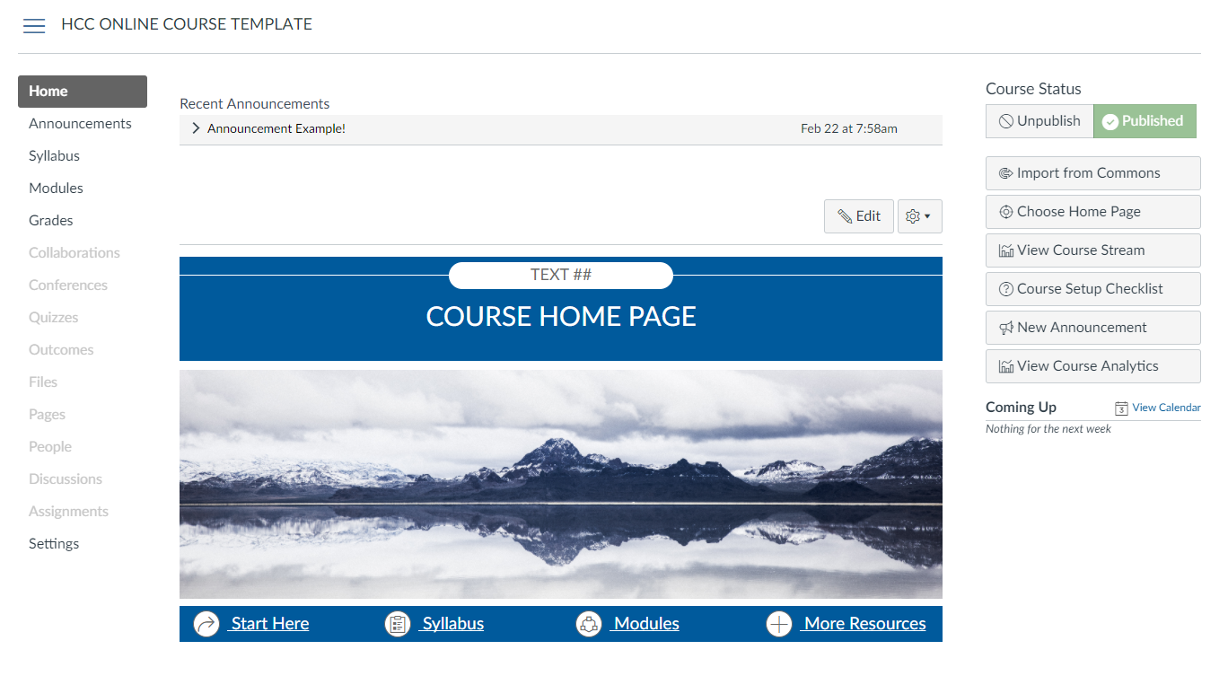
online course template
QM Higher Education Rubric 5th Edition 2014
Specific Standards 1.1, 1.2, 8.1 & 8.4

Slide 5
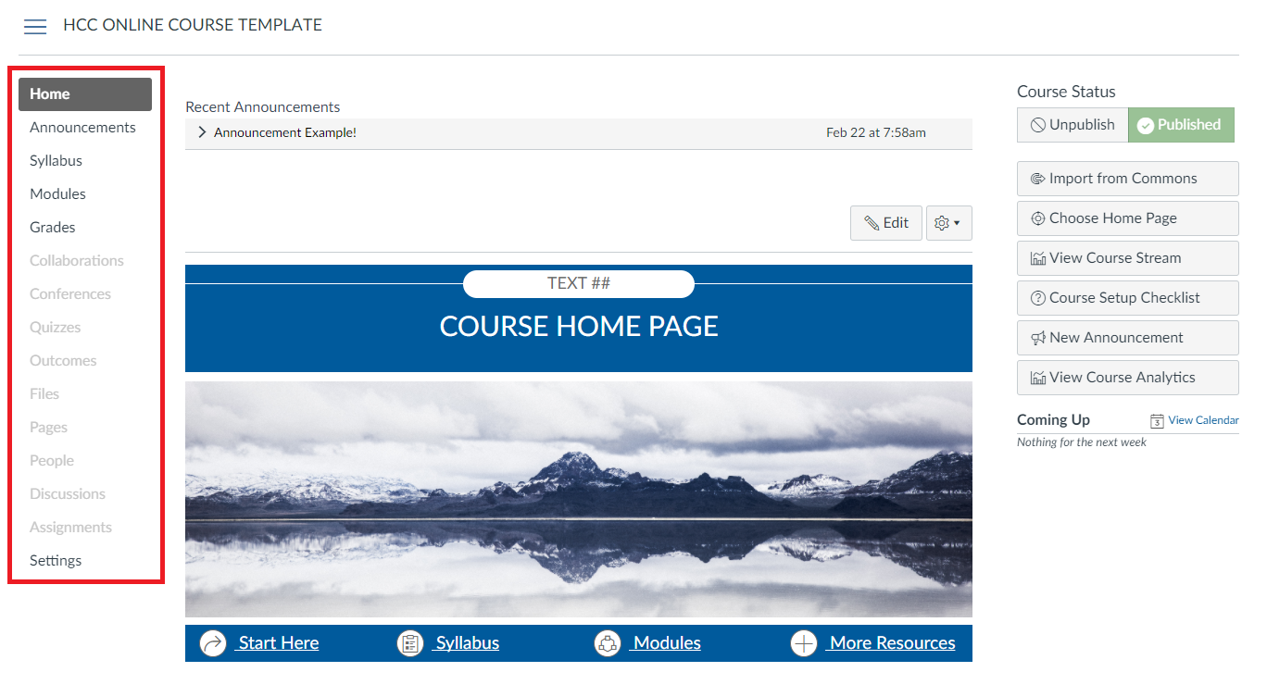
Course Navigation
QM Higher Education Rubric 5th Edition 2014
Specific Standards 1.1, 1.2, 8.1 & 8.4

Slide 6
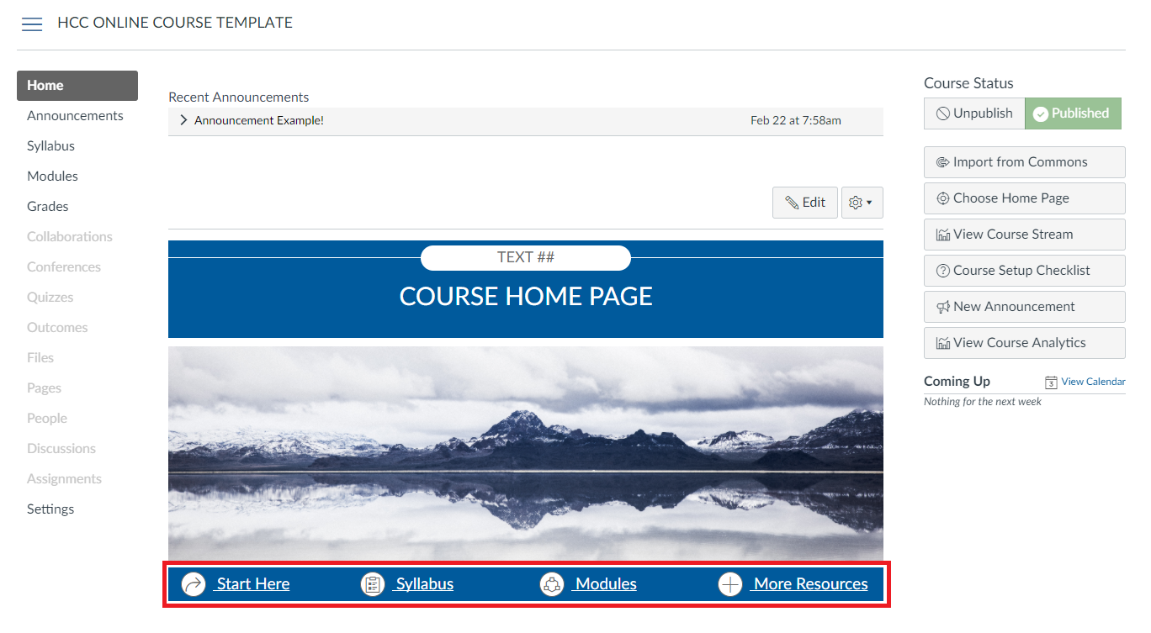
Navigation bar
QM Higher Education Rubric 5th Edition 2014
Specific Standards 1.1, 1.2, 8.1 & 8.4

Slide 7
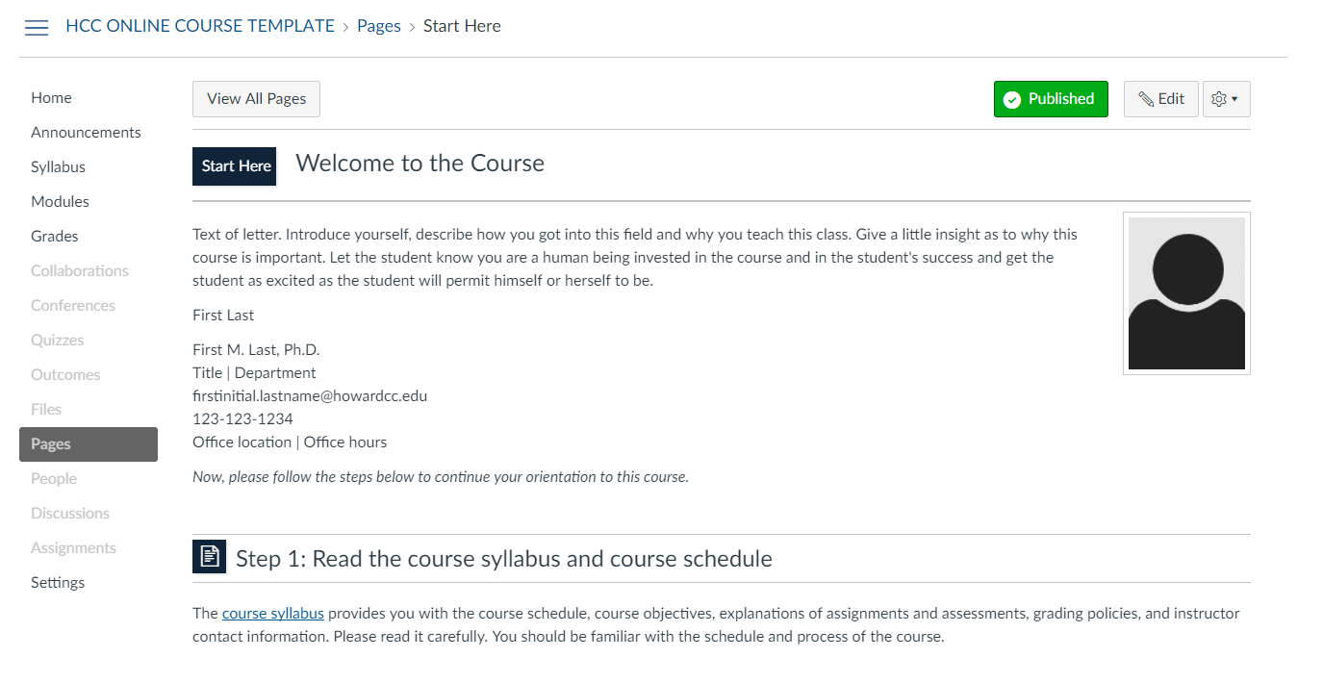
Start Here
QM Higher Education Rubric 5th Edition 2014
Specific Standards 1.1, 1.3, 1.4, 1.7, 1.8 & 7.3

Slide 8
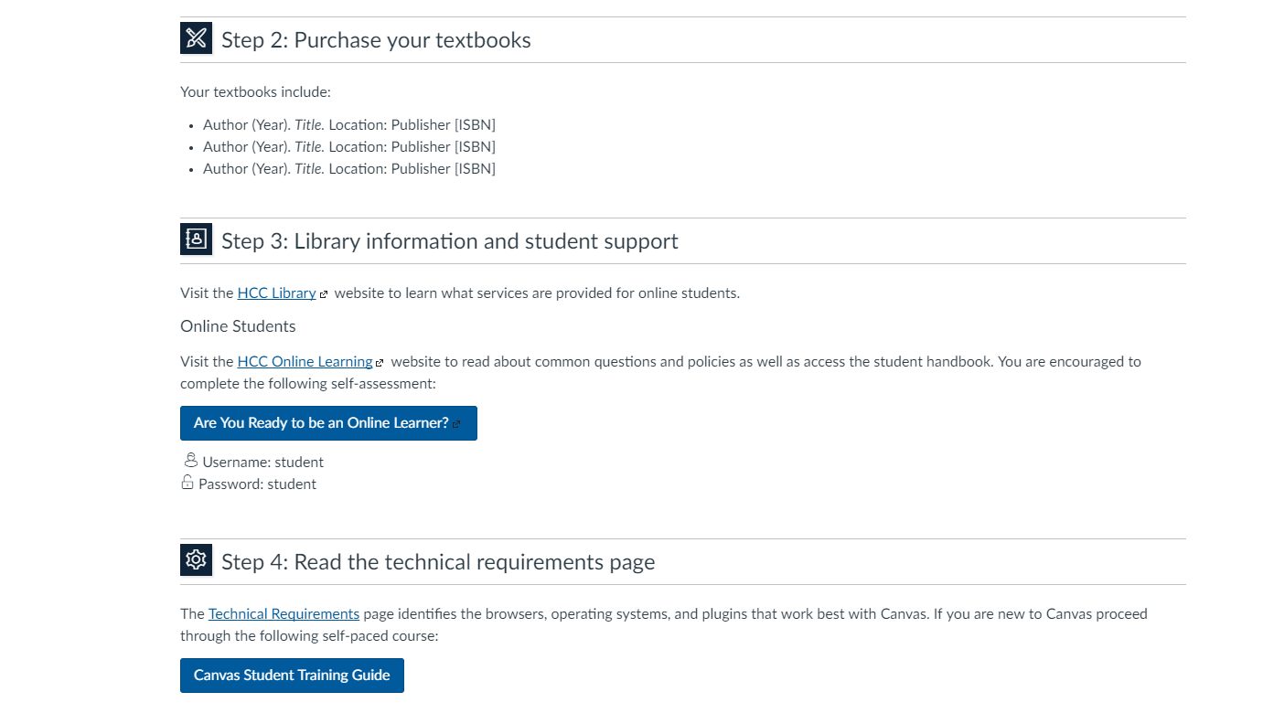
Start Here: Steps
QM Higher Education Rubric 5th Edition 2014
Specific Standards 1.1, 1.3, 1.4, 1.7, 1.8 & 7.3

Slide 9
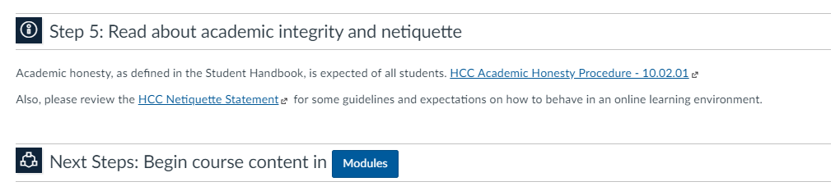
Start Here: Next Steps
QM Higher Education Rubric 5th Edition 2014
Specific Standards 1.1, 1.3, 1.4, 1.7, 1.8 & 7.3

Slide 10
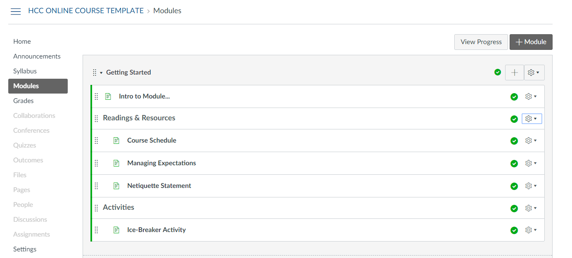
Getting Started module
QM Higher Education Rubric 5th Edition 2014
Specific Standards 1.1, 1.2, 1.3, 1.8, 2.2, 2.3, 2.4, 4.2, 4.6, 5.3, 5.4, 8.1, 8.4

Slide 11
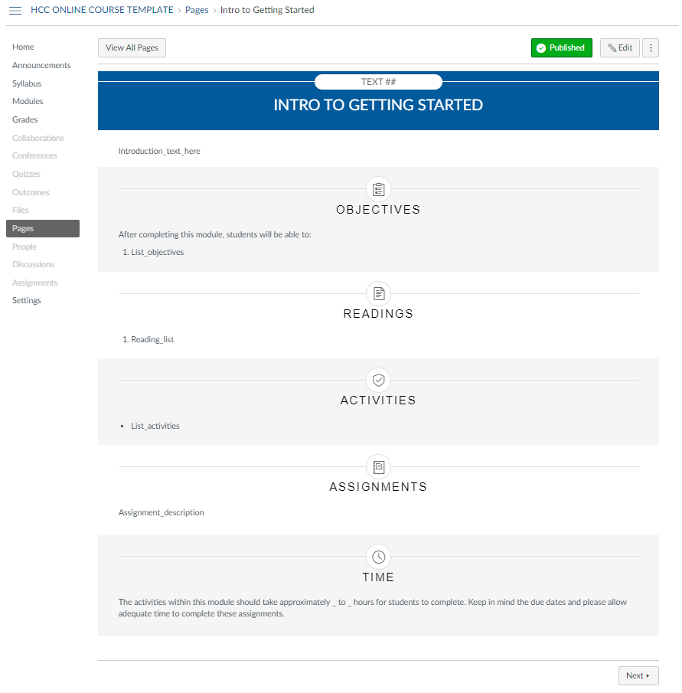
Module Introduction
QM Higher Education Rubric 5th Edition 2014
Specific Standards 2.2, 2.4, 4.2, & 4.6

Slide 12
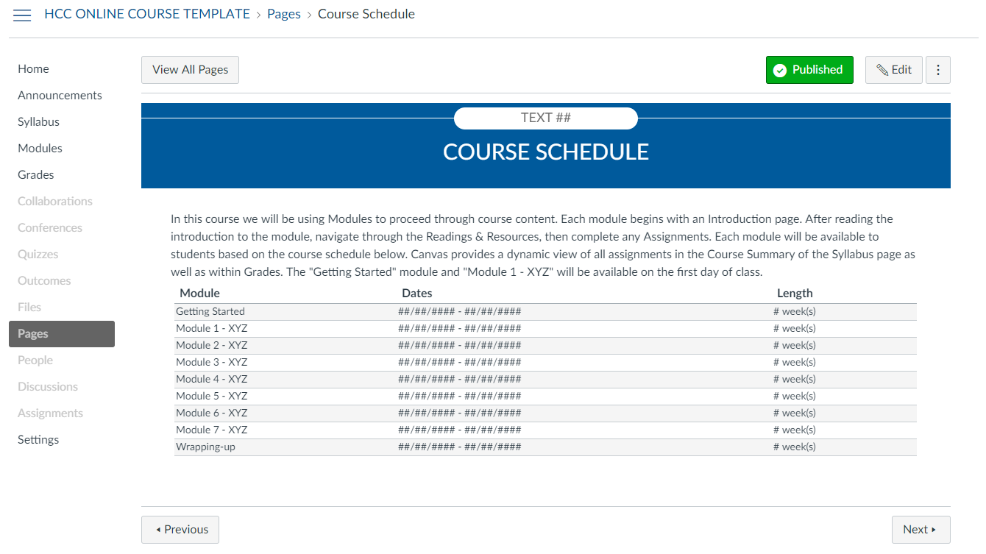
Course schedule
QM Higher Education Rubric 5th Edition 2014
Specific Standards 1.1, 1.2, 8.1, & 8.4

Slide 13
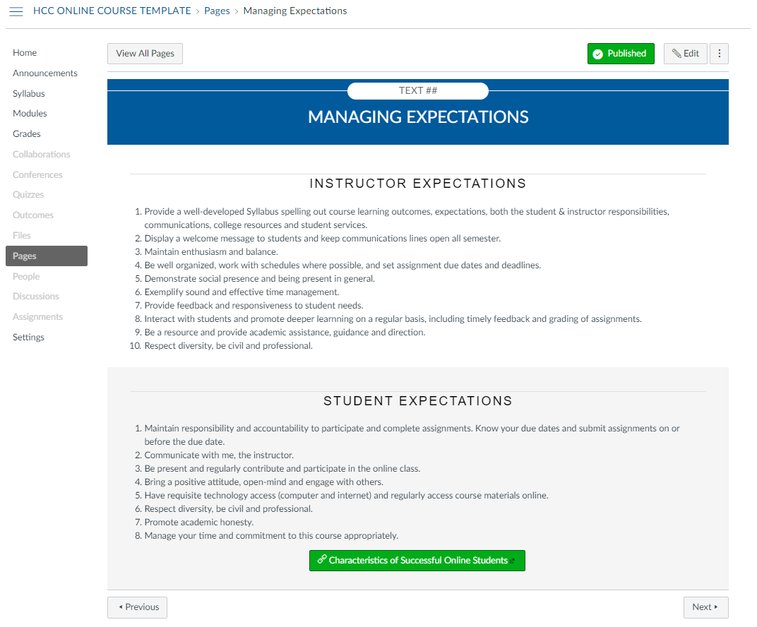
Managing Expectations
QM Higher Education Rubric 5th Edition 2014
Specific Standards 5.3, & 5.4

Slide 14
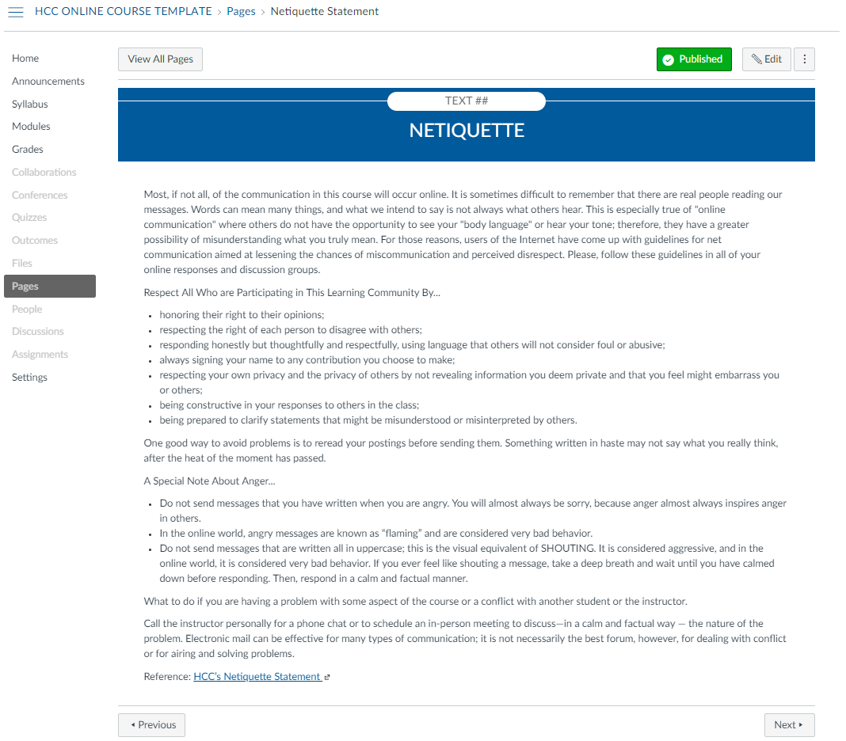
Netiquette
QM Higher Education Rubric 5th Edition 2014
Specific Standards 1.1, 1.2, 1.3, 1.8, 2.2, 2.3, 2.4, 4.2, 4.6, 5.3, 5.4, 8.1, 8.4

Slide 15
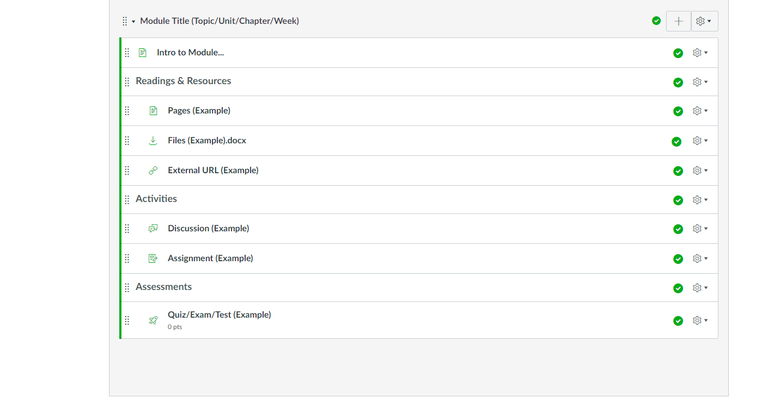
Module Structure
QM Higher Education Rubric 5th Edition 2014
Specific Standards 1.1, 1.2, 1.3, 1.8, 2.2, 2.3, 2.4, 4.2, 4.6, 5.3, 5.4, 8.1, 8.4

Slide 16
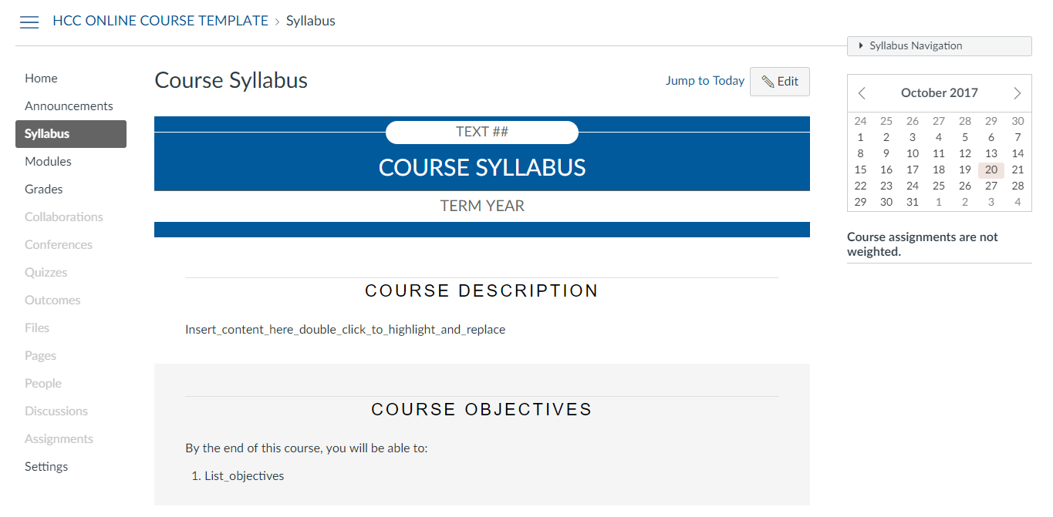
Course Syllabus
QM Higher Education Rubric 5th Edition 2014
Specific Standards 1.2, 1.4, 1.5, 1.6, 1.7, 2.1, 3.2, 3.3, 5.3, 5.4, 7.1, 7.2, 7.3, 7.4, 8.2, & 8.4

Slide 17
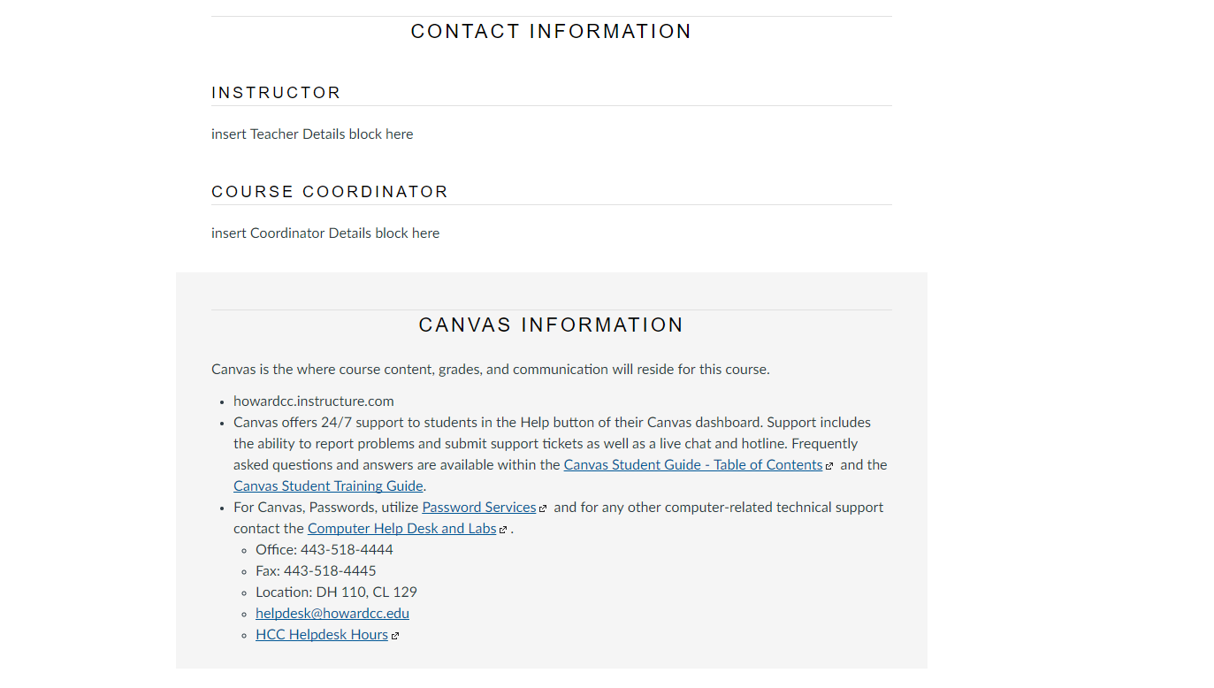
Syllabus: tech support
QM Higher Education Rubric 5th Edition 2014
Specific Standards 1.5, 1.7, 1.8, 7.1, 8.2, & 8.4

Slide 18
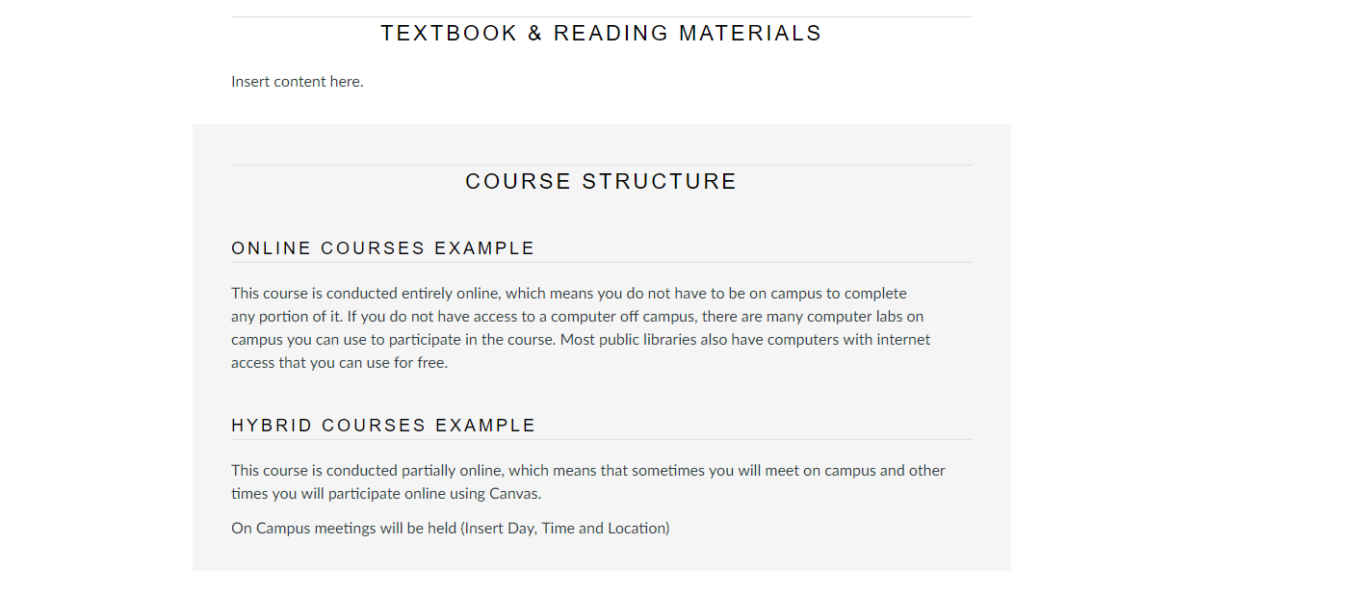
Syllabus: course flow
QM Higher Education Rubric 5th Edition 2014
Specific Standards 1.2, 1.4, 1.7, 5.3, 5.4, & 8.4

Slide 19
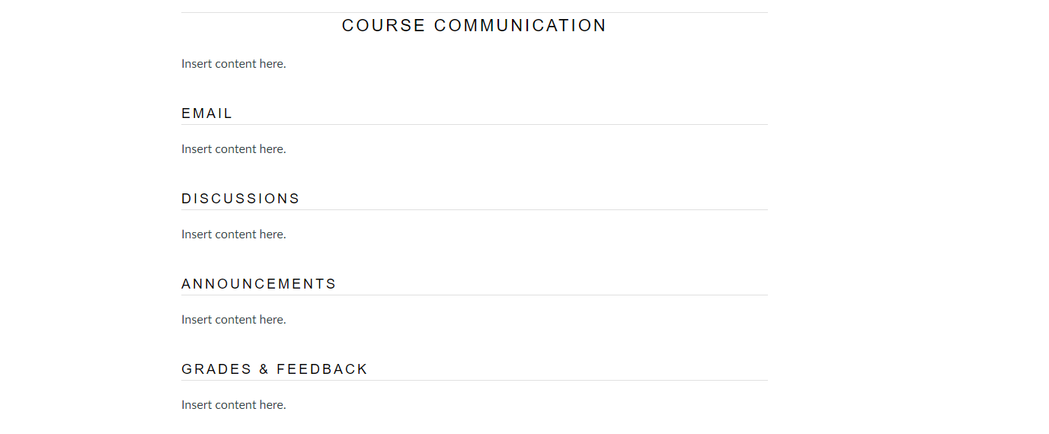
Syllabus: Communication
QM Higher Education Rubric 5th Edition 2014
Specific Standards 1.2, 1.4, 1.7, 5.3, 5.4, & 8.4

Slide 20
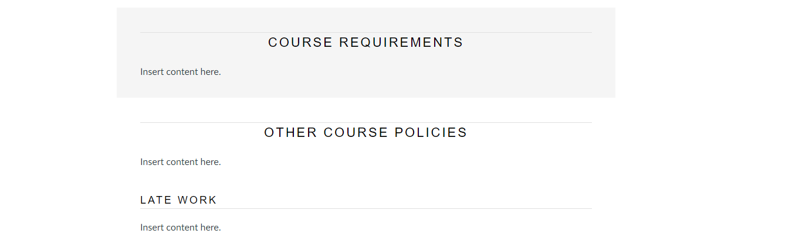
Syllabus: policies
QM Higher Education Rubric 5th Edition 2014
Specific Standards 1.2, 1.4, 1.6, 3.2, 3.3, 5.3, 5.4, & 8.4

Slide 21
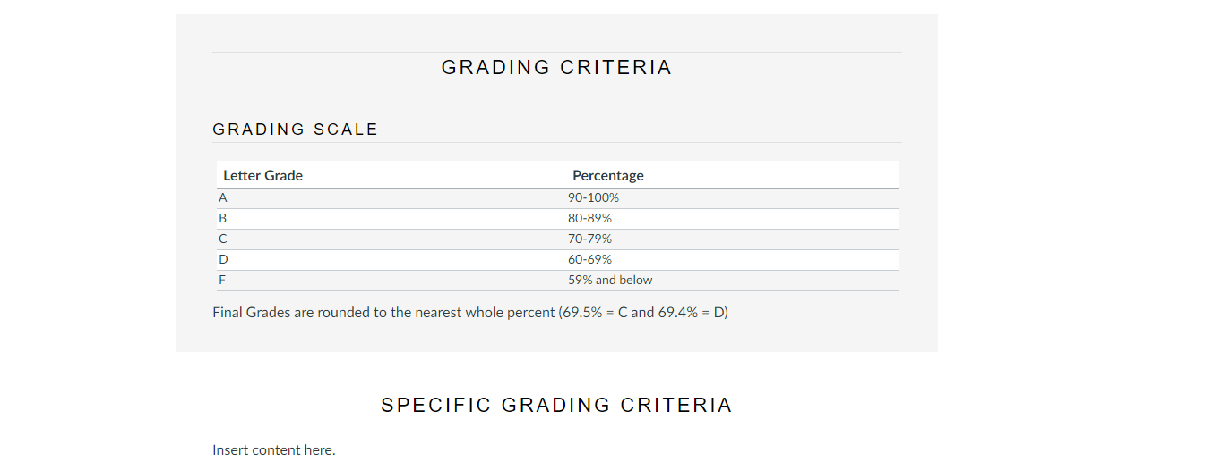
Syllabus: Grading
QM Higher Education Rubric 5th Edition 2014
Specific Standards 1.2, 1.4, 3.2, 3.3, 5.4, & 8.4

Slide 22
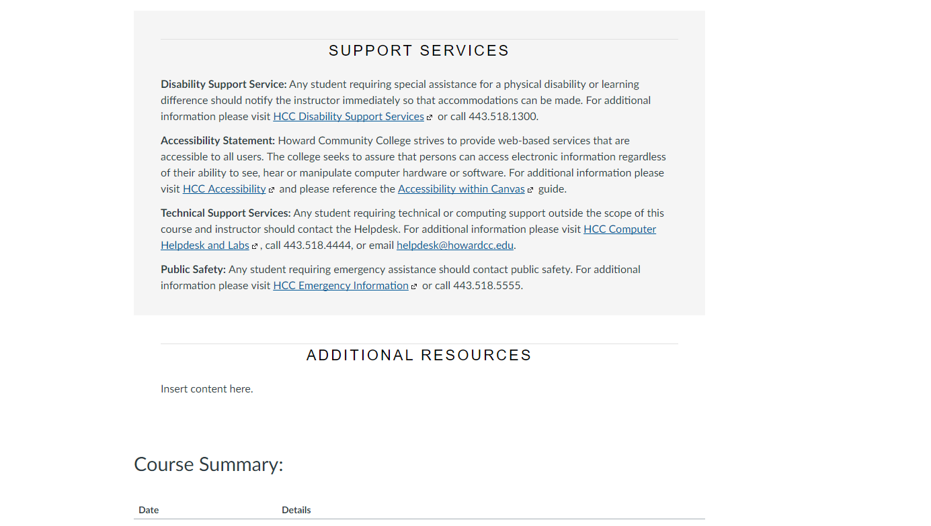
Syllabus: Support services
QM Higher Education Rubric 5th Edition 2014
Specific Standards 7.1, 7.2, 7.3, 7.4, 8.2, & 8.4

Slide 23
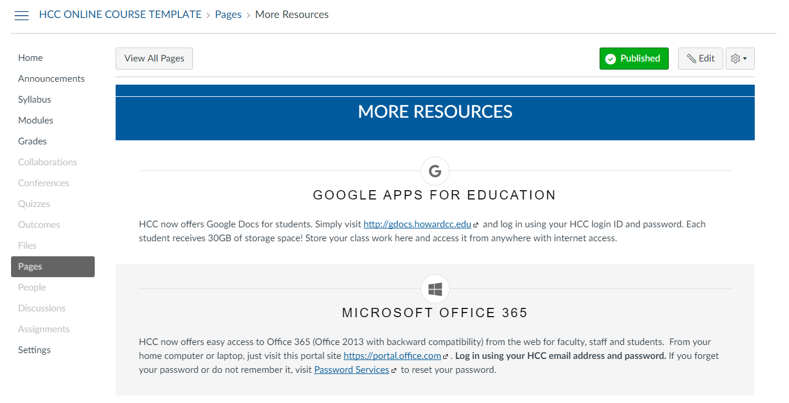
More resources
QM Higher Education Rubric 5th Edition 2014
Specific Standards 7.1 & 8.4
Notes:
Course Code, Number-Section, and Term Year
Replace "Text" with Course Code i.e. "ENGL"
Replace "##" with Course Number-Section i.e. "121-N090"
Replace “Term Year” with Semester and Year i.e. “Spring 2018"

Slide 24
Quality Matters
HCC Online Course Template Meets 25 of 43 Specific Standards
QM Standard | Description | HCC Online Course Template
General Standard 1 | The overall design of the course is made clear to the learner at the beginning of the course.
Standard 1.1 | Instructions make clear how to get started and where to find various course components. | Start Here Page/Module Structure
Standard 1.2 | Learners are introduced to the purpose and structure of the course. | Syllabus/Course Schedule
Standard 1.3 | Etiquette expectations (Sometimes called "netiquette" for online discussions, email, and other forms of communication are clearly stated). | Syllabus/Netiquette Page
Standard 1.4 | Course and/or institutional policies with which the learner is expected to comply are clearly stated, or a link to current policies is provided. | Start Here/Syllabus/More Resources
Standard 1.5 | Minimum technology requirements are clearly stated and instructions for use provided. | Start Here/Syllabus/More Resources
Standard 1.6 | Prerequisite knowledge in the discipline and/or any required competencies are clearly stated. | Syllabus
Standard 1.7 | Minimum technical skills expected of the learner are clearly stated. | Start Here/Syllabus/More Resources
Standard 1.8 | The self-introduction by the instructor is appropriate and is available online. | Start Here Page
QM Higher Education Rubric 5th Edition 2014
Specific Standards 2.1, 2.5, 3.1, 3.4, 3.5, 4.1, 4.3, 4.4, 4.5, 5.1, 5.2, 6.1, 6.2, 6.3, 6.4, 6.5, 8.3 & 8.5 Not Met

Slide 25
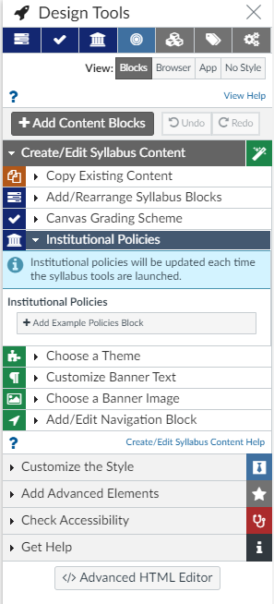
CIDI Labs: Design Tools
Centralized Design Choices
Administrative Controls
Accessibility Checker

Slide 26
Template Initiative
Stages | Semester
Presentation to Academic Deans | Summer 2017
Instructional Designer Acclimation | Summer 2017
Faculty Workshopping Template | Fall 2017
Student Focus Groups | Fall 2017
Faculty Pilot (Sixteen Online Courses) | Spring 2018
Present Findings to VPAA Staff | Summer 2018
Larger Rollout | Fall 2018

Slide 27
Approach
Course Design vs Course Delivery
  User Experience – Course Design
  Learning Experience – Course Delivery
  Student Feedback: Overwhelming majority favored “Start Here” page
  Faculty Feedback: “Students are asking fewer logistical questions”

Slide 28
Reception
Online Course Standards
  Promote consistency and orient learners
  Place an Instructional Designer in every course
  Save design and development time
  Identify specific areas for creative expression
Student Feedback
  Overwhelming majority favored the “Start Here” page
Faculty Feedback
  “Students are asking fewer logistical questions”

Slide 29
Questions?
Eric Belt
Assistant Director, eLearning
Howard Community College
ebelt@howardcc.edu

