Slide 1

Creating Readable, Accessible Visual Design That Meets Standard 8.4
Krissy Wilson | krissy@northwestern.edu | @knxnu
Notes:
Hi, everyone! I’m Krissy Wilson, a Learning Designer in the School of Professional Studies at Northwestern University. Today I’ll be talking to you about creating readable, accessible visual design that meets Standard 8.4.

Slide 2
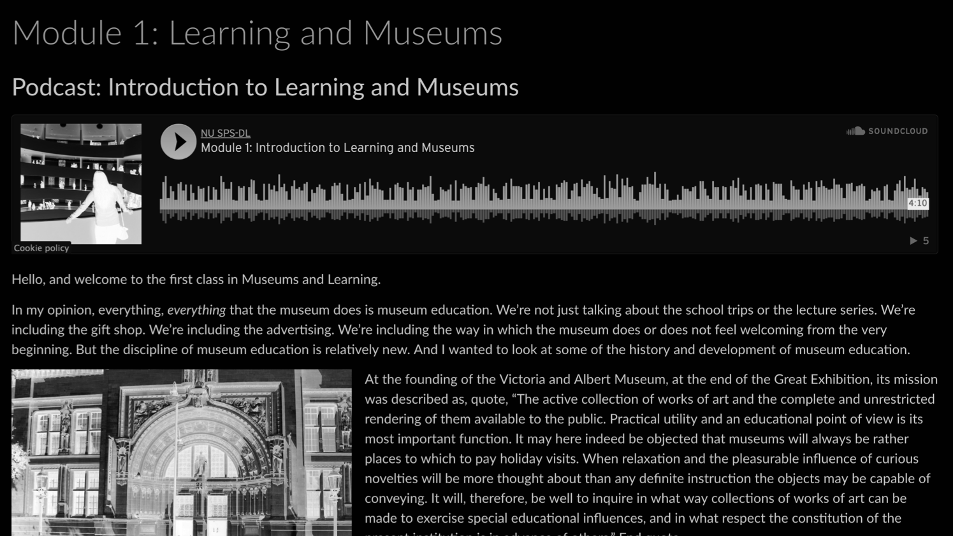
Standard 8.4
The course design facilitates readability.
Notes:
Let’s start with a quick brush-up. What is Standard 8.4? The course design facilitates readability. The annotation expands: “Course design elements maximize usability by facilitating readability and and minimizing distractions.”

Slide 3

Students with disabilities
Easier for everyone to use
Quick to implement
Any learning management system (LMS)
Notes:
Why should this standard be important to you? It helps meet the needs of students with disabilities and makes a course site easier for everyone to use. Plus, it’s quick to implement and can be accomplished on any learning management system.

Slide 4
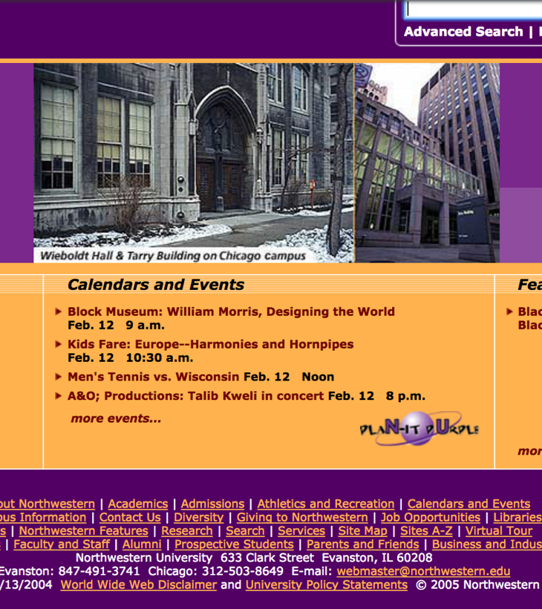
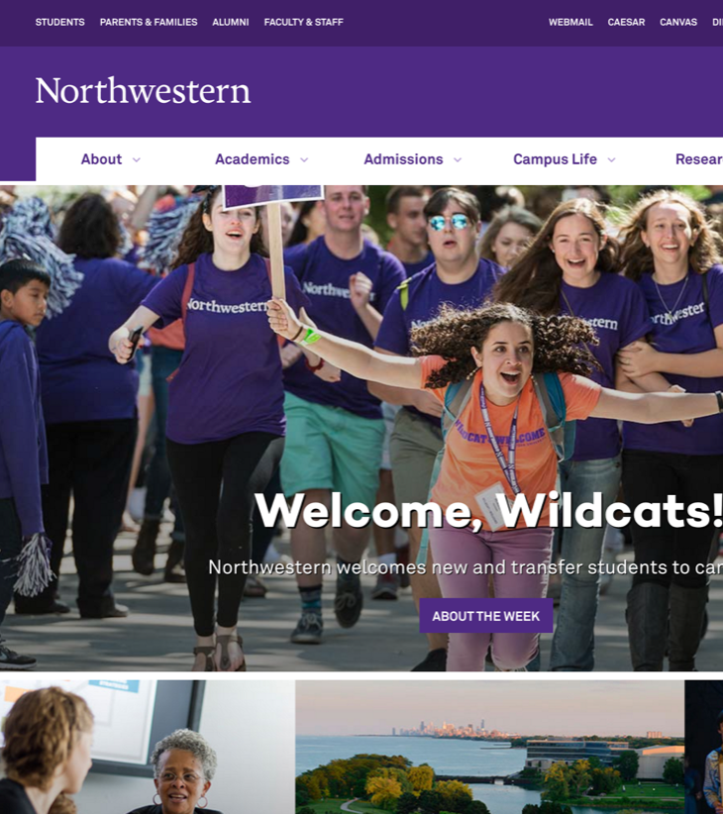
Design expectations have changed
Notes:
Let’s step even further back. Design expectations have changed! Remember best practices in the 90s and early 2000s, which included flashing page dividers and neon colors? We’re in a new era. We’re going for a sleeker, more minimalist look.

Slide 5




Styling banners
Notes:
Let’s put this into the context of page design in an online course. Use a sleek banner to orient students and provide thematic context. Bonus points for using your college or university’s branding guidelines, and Creative Commons images! These could be thematic to the program, course, or module.

Slide 6
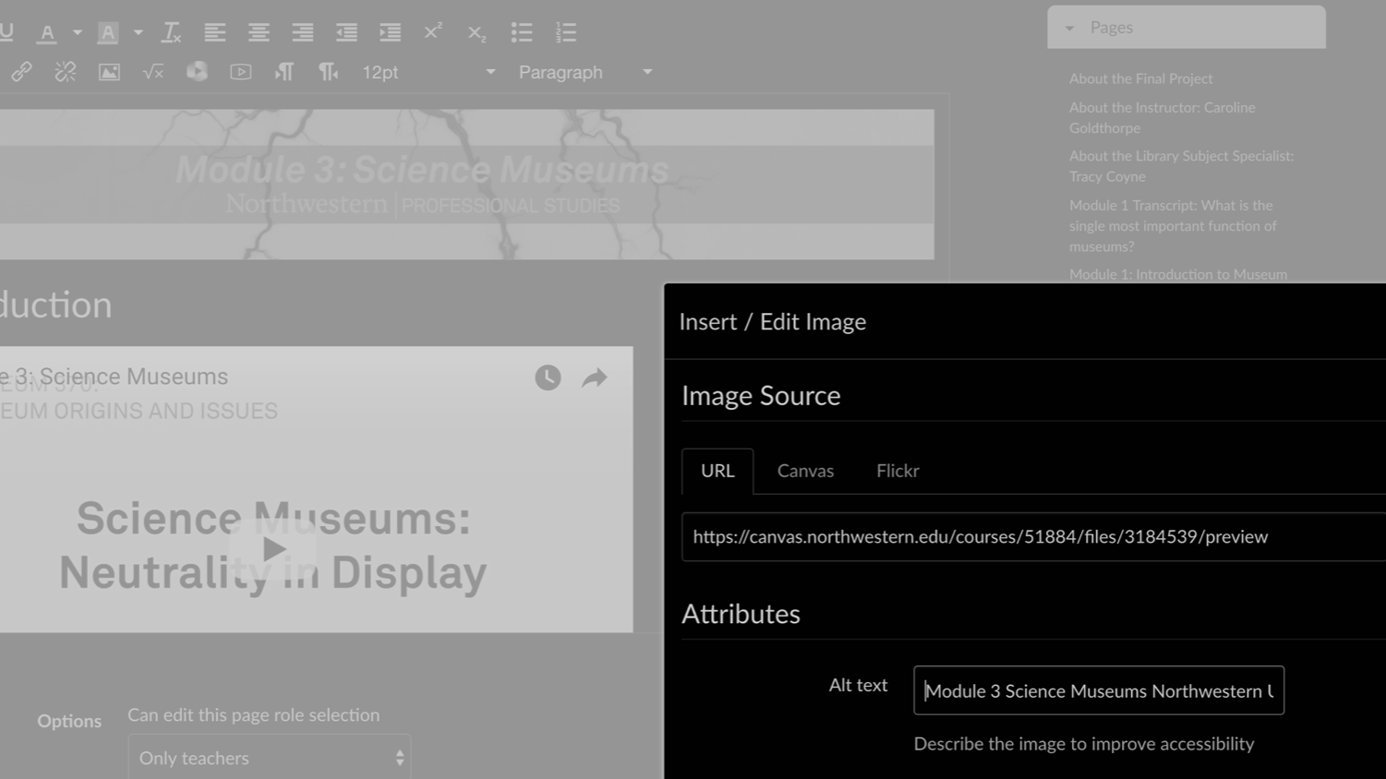
Banner accessibility
Notes:
But don’t forget about accessibility. Provide alt-text for banner images and include any text in your image directly on the page (don’t trap it inside!). Design it bigger than you need, if you can. Make sure that it scales across devices.

Slide 7
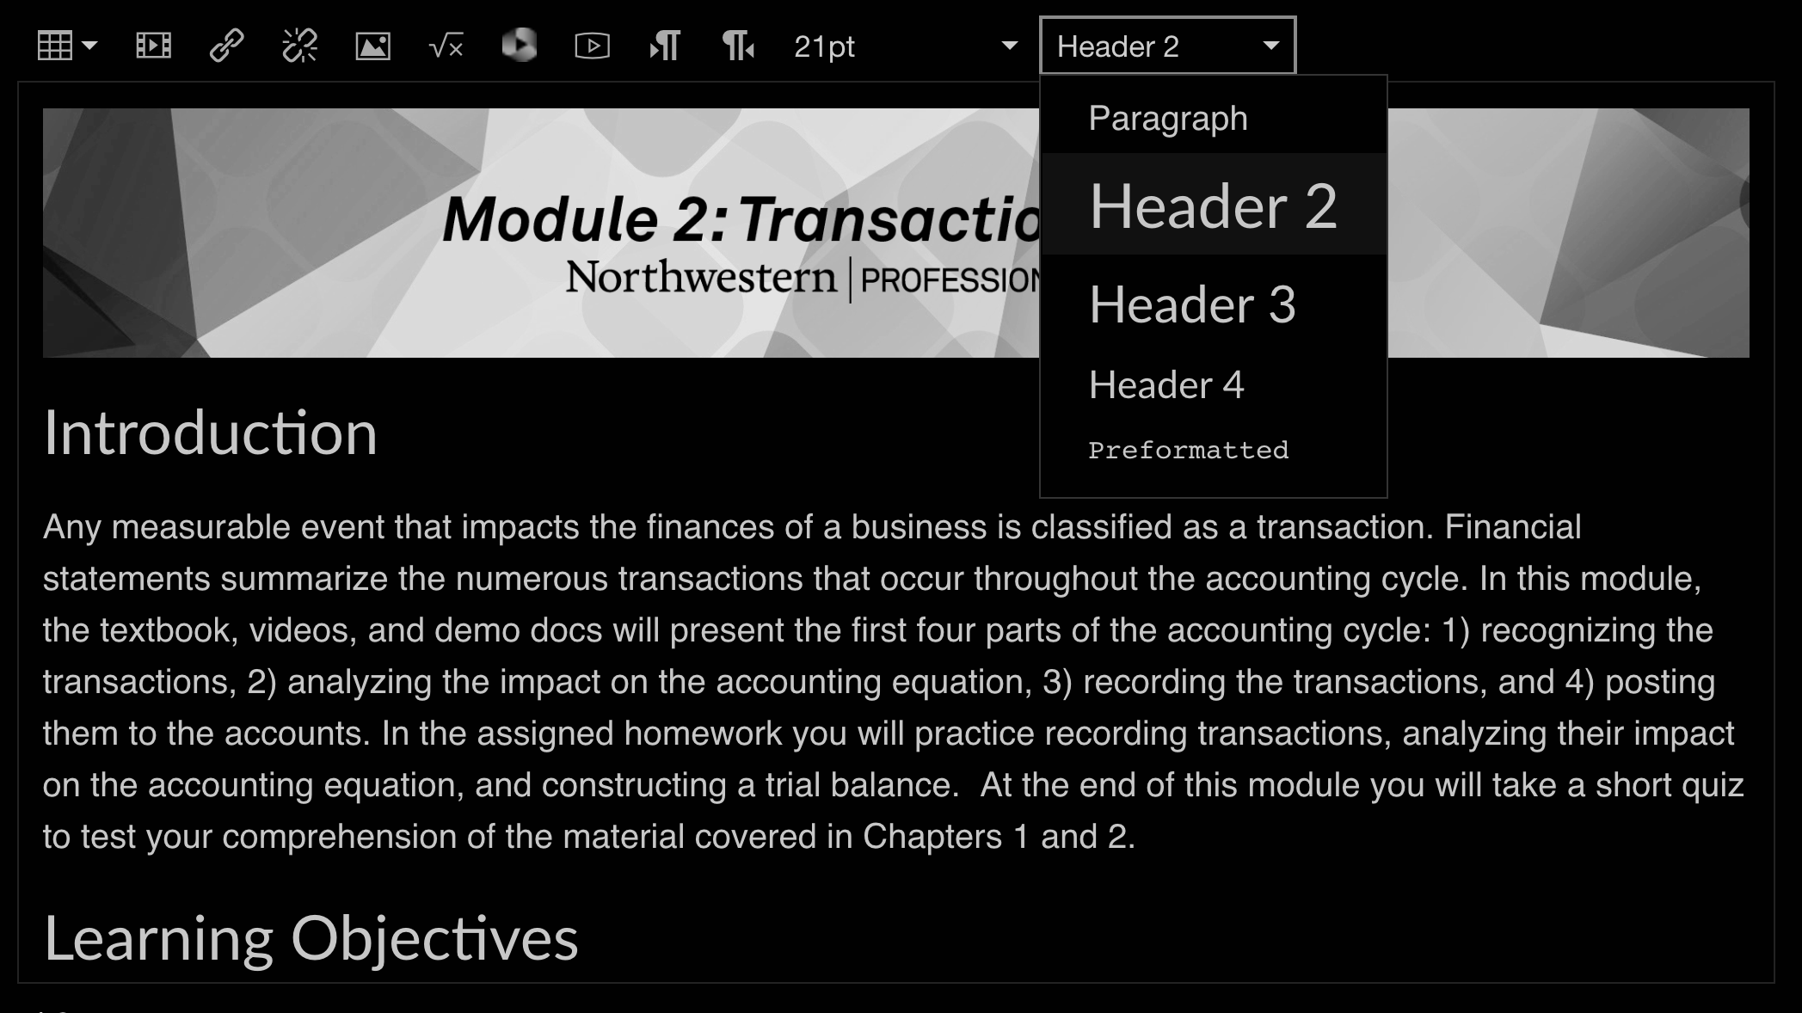
Organize with headers
Notes:
Organize your page with headers. These! Headers are typically a little larger, a little bolder, and written concisely. Usually, your LMS has a drop-down selection, which makes this a quick-as-a-flash way to format your pages consistently.

Slide 8
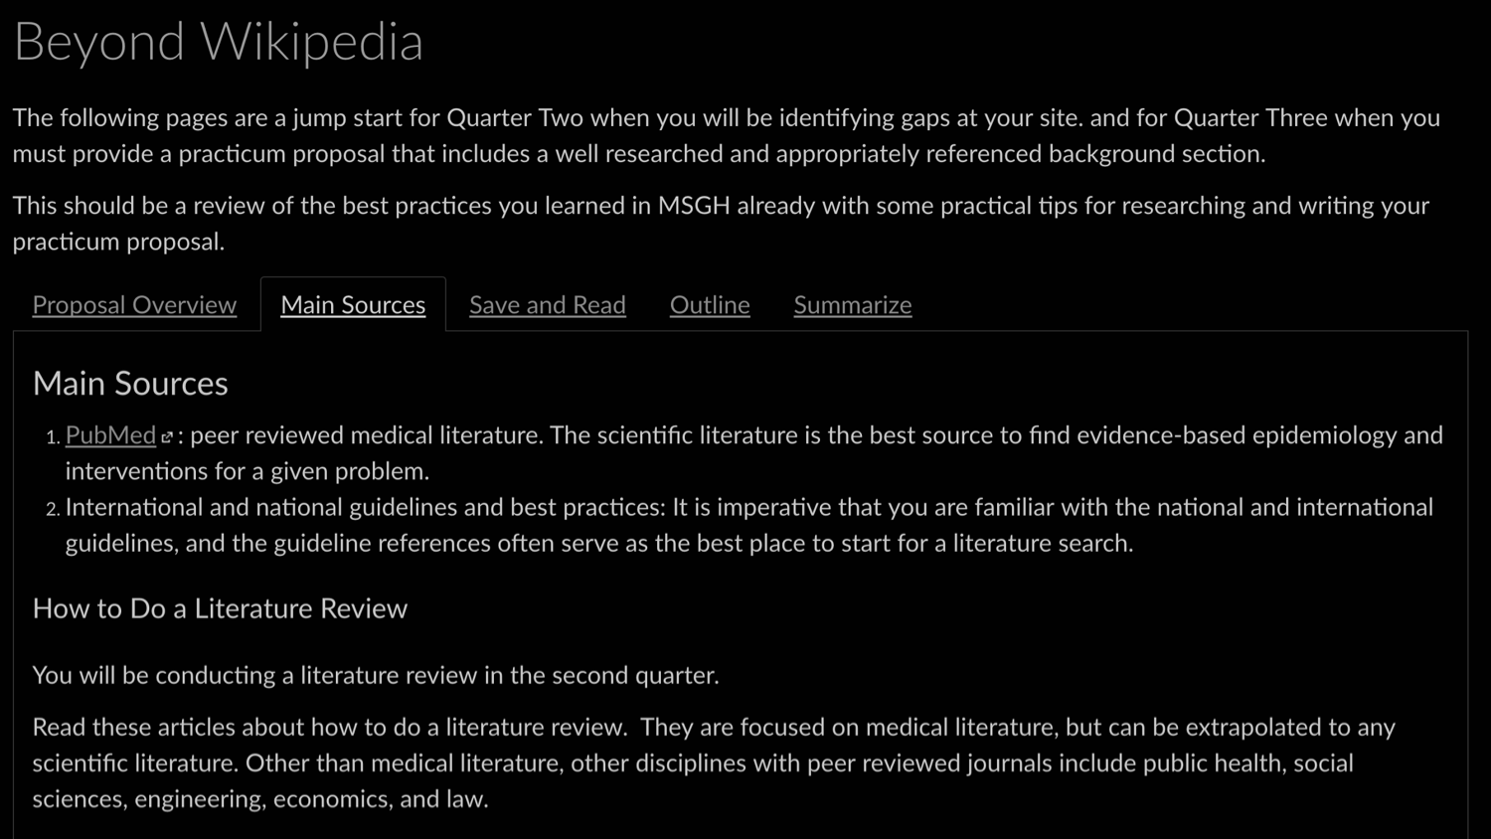
Provide hierarchy
Notes:
They also provide a critical page structure for screenreaders. Imagine needing to hear every word on the page spoken aloud just to hear the last paragraph! If you use headers in order--H1, H2, H3--screenreader users can jump to sections easily.

Slide 9


Choose your colors wisely.
Notes:
Choose your colors wisely. You’ll want to select high-contrast color combinations that are easy to perceive by people with low vision as well as everyone else. And don’t forget that about 9% of people are colorblind. You’ll want to make smart color choices to meet their needs too.

Slide 10
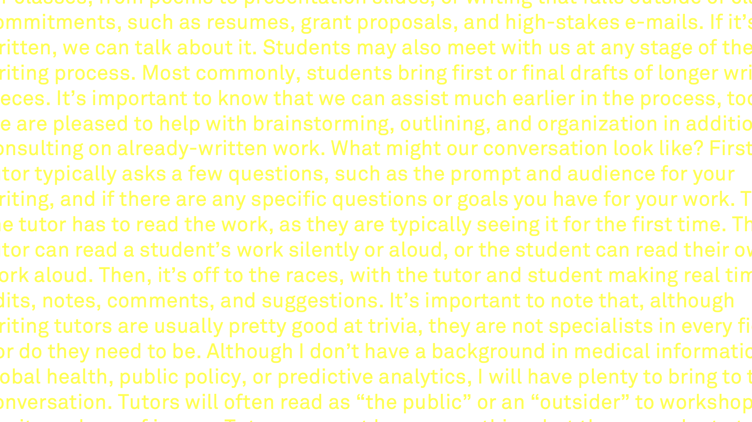
Reading stamina
Notes:
Why choose high contrast colors? It improves everyone’s reading stamina. Imagine having to squint at low-contrast text like this. You might be able to make it out, but certainly not for very long. And for some readers, it simply may not be possible.

Slide 11
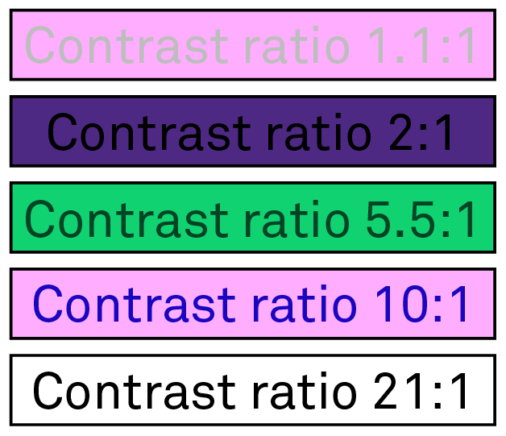
High contrast ratio
Notes:
So, what’s the best practice? Use a a high color contrast ratio, like black on white. You can still get creative with colors, but it is important to know a color combination’s contrast ratio. How do you know? Do a quick Google for a “color contrast checker” or “high contrast color palettes.”

Slide 12
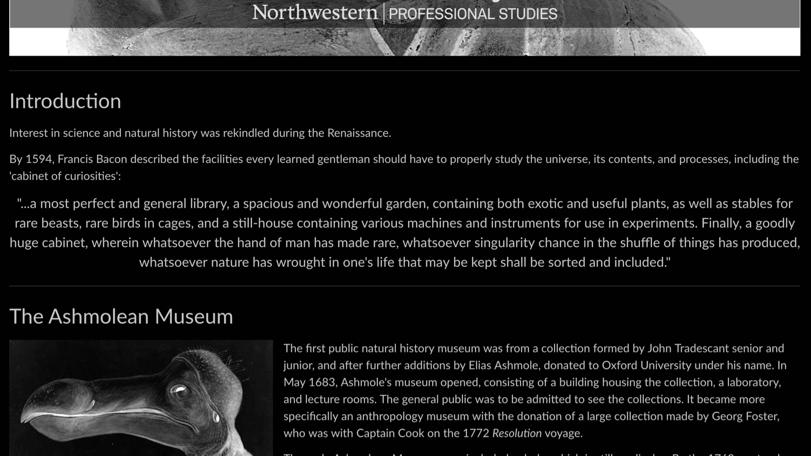
White space
Notes:
It’s also important to respect white space. Separate paragraphs visually to make it easier for all students--and especially students with attention disorders--to return to specific sections. Headers, carriage returns, and line breaks will help you accomplish that.

Slide 13
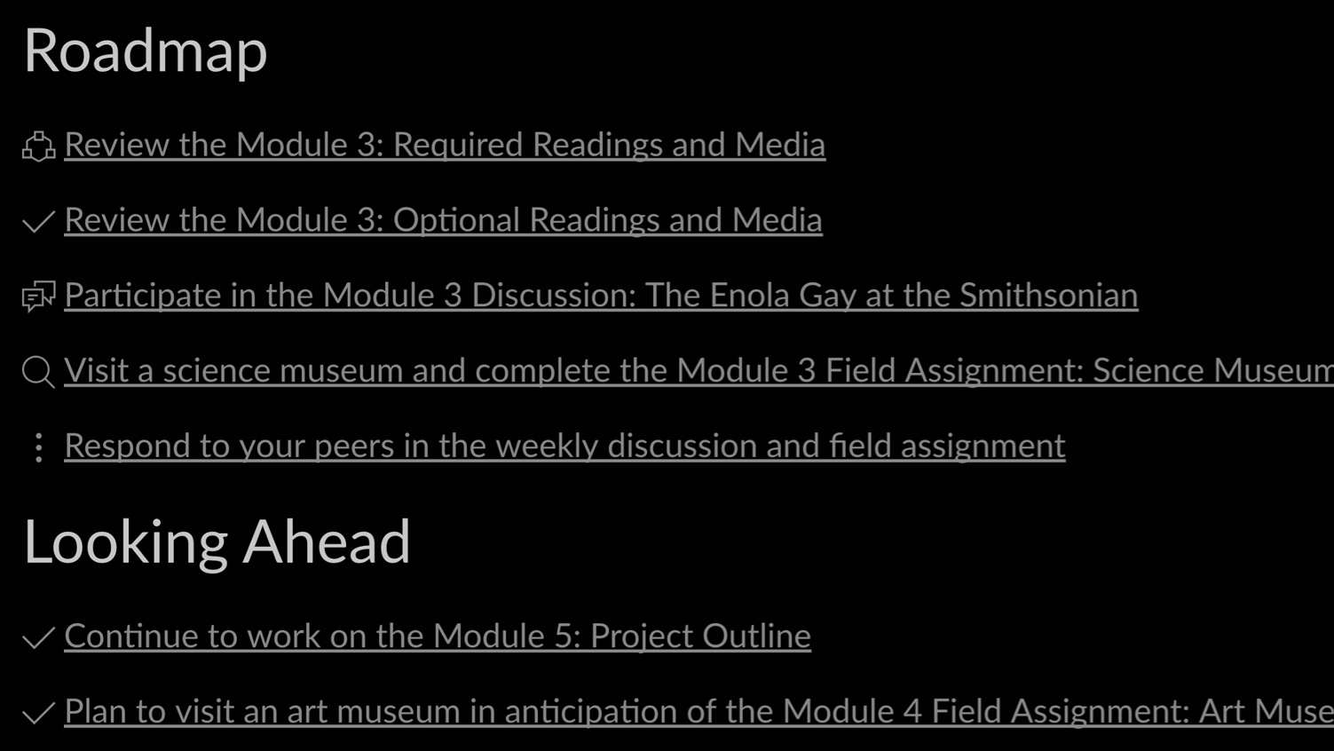
Landmarks
Notes:
Using icons can also provide students with landmarks. They provide more context than a standard bullet point, and can give students an idea of the week’s work at a glance. These are Canvas’s in-house icons, but there are lots of sleek Creative Commons icons available out there.

Slide 14

Low vision
Notes:
Students with low vision often zoom in to text and images using their browser features. Ensure that your text and images of text scale well and don’t get too fuzzy and pixellated when you zoom in on them. And always--always!--include alt text for any text within images.

Slide 15
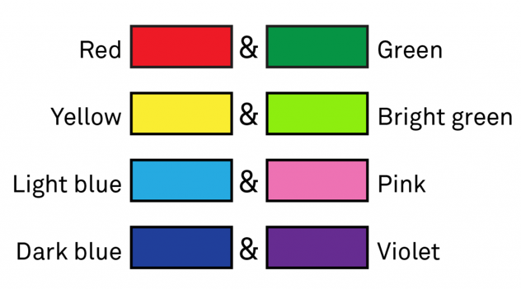
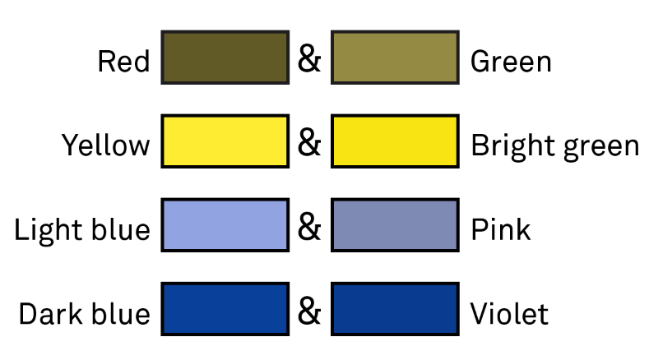
Avoid specific color pairs
Notes:
Colorblind students may find it difficult to distinguish between different color pairs, so avoid these if you can: red and green, yellow and bright green, light blue and pink, and dark blue and violet.

Slide 16
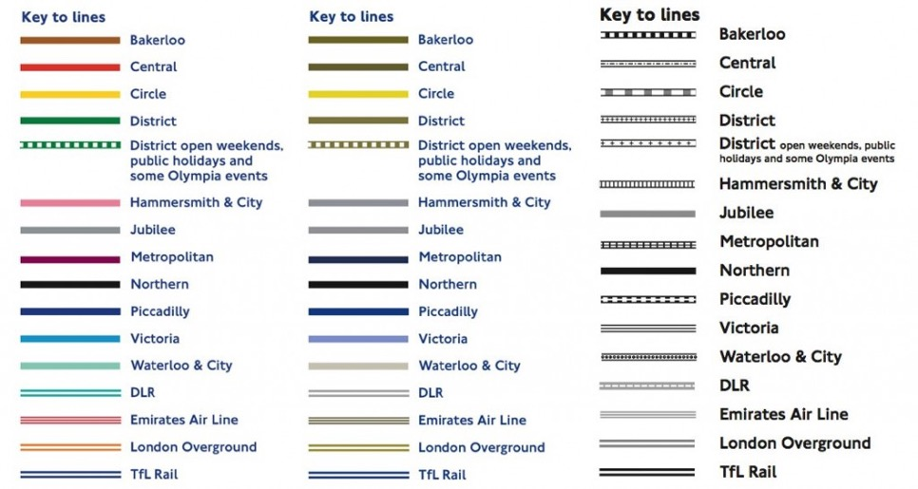
Colorblindness and texture
Notes:
This is how a person who is colorblind might perceive the London Underground map. The Hammersmith & City, Jubilee, and Waterloo & City lines are almost indistinguishable. Consider using texture as a secondary characteristic to distinguish between elements.

Slide 17

Concise prose style
Notes:
Don’t forget that readability is also related to how you write the content of your course, not just how you display it. When composing written content, keep it short and sweet, if you can. Concise language is efficient for student readers and much easier to read on a screen.

Slide 18

Clear prose style
Notes:
However, don’t sacrifice length for the sake of clarity! Keeping it too short can make a course cryptic and telegraphic. When composing the written portions of your course, make sure your writing is clear rather than convoluted. Don’t overdo it with the bullet points!

Slide 19
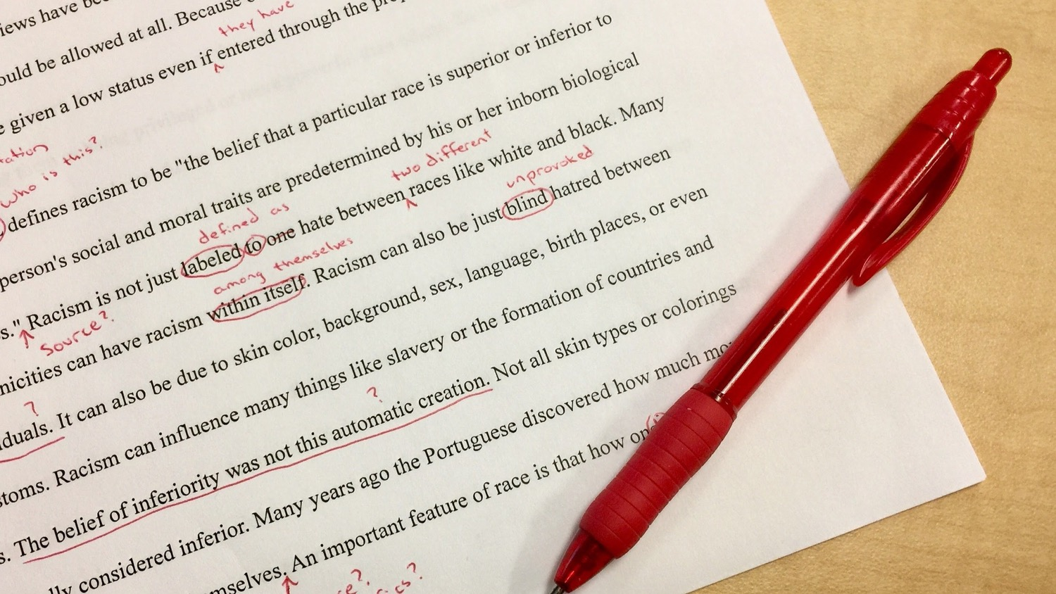
Proofread
Notes:
Finally, don’t forget to proofread the writing you add to your course site. A key component of readability is following writing conventions such as spelling and grammar. The annotation requests “minimal errors.” Have someone else read through your course site, or get in touch with someone at your Writing Center.

Slide 20
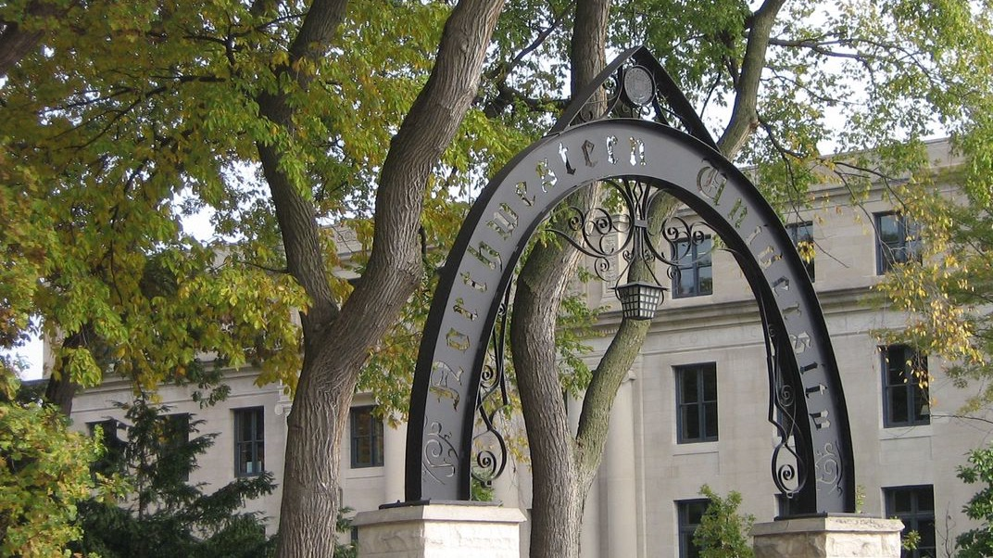
Thank you!
Krissy Wilson | krissy@northwestern.edu | @knxnu
Notes:
It’s been a pleasure to speak to you today, and I hope you’ll take these design strategies into consideration as you develop or revise your online course. If you have any questions, please feel free to reach out to me by e-mail at krissy@northwestern.edu or via Twitter, @knxnu.
Image credit: Copyright Alfonso Fernandez for Smithsonian Magazine.

