Slide 1
Creating a Course Review Process That Works
and won’t give you heartburn

Slide 2

What is YOUR Quality Matters experience with course reviews?

Slide 3
Responses

Slide 4
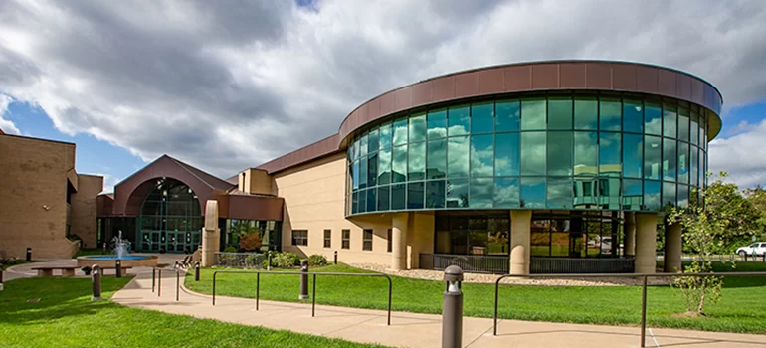
ATSU - College of Graduate Health Studies

Slide 5





QM Exemplary Program

Slide 6

Course Certifications
1st course > December 2017
15 QM-managed course reviews
57 Subscriber-managed reviews
= 72 currently certified courses
5 open reviews / 1 open recertification review as of November 4

Slide 7


Slide 8
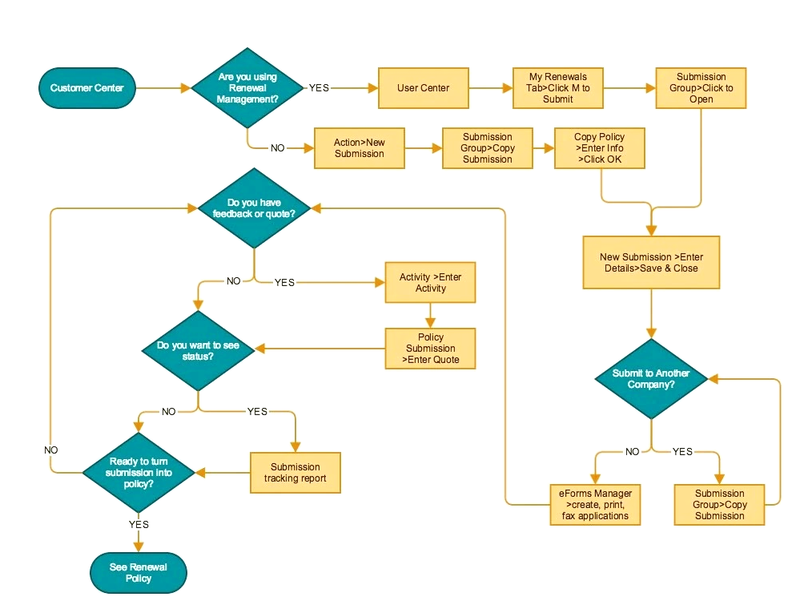
DO YOU HAVE
A FORMAL PROCESS?

Slide 9
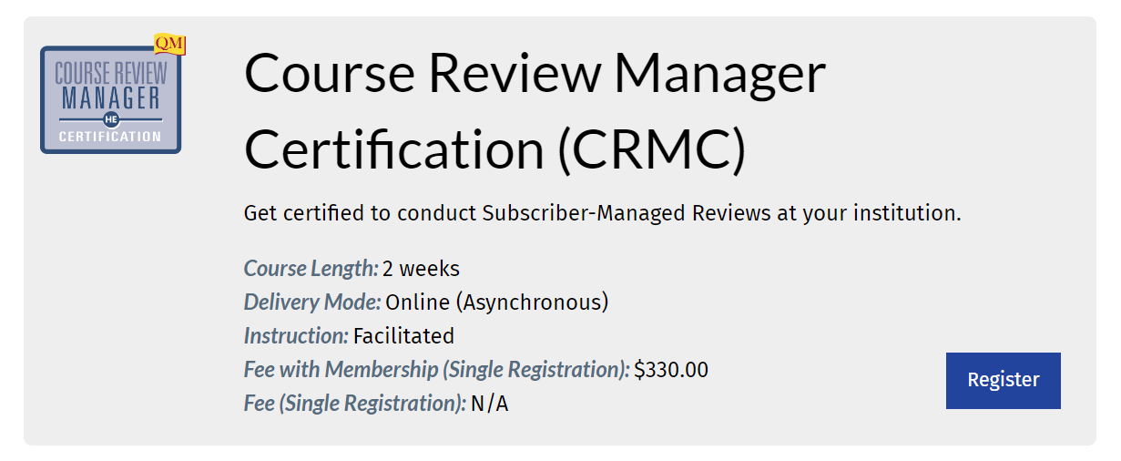
https://www.qualitymatters.org/professional-development/courses/higher-ed-crmc

Slide 10
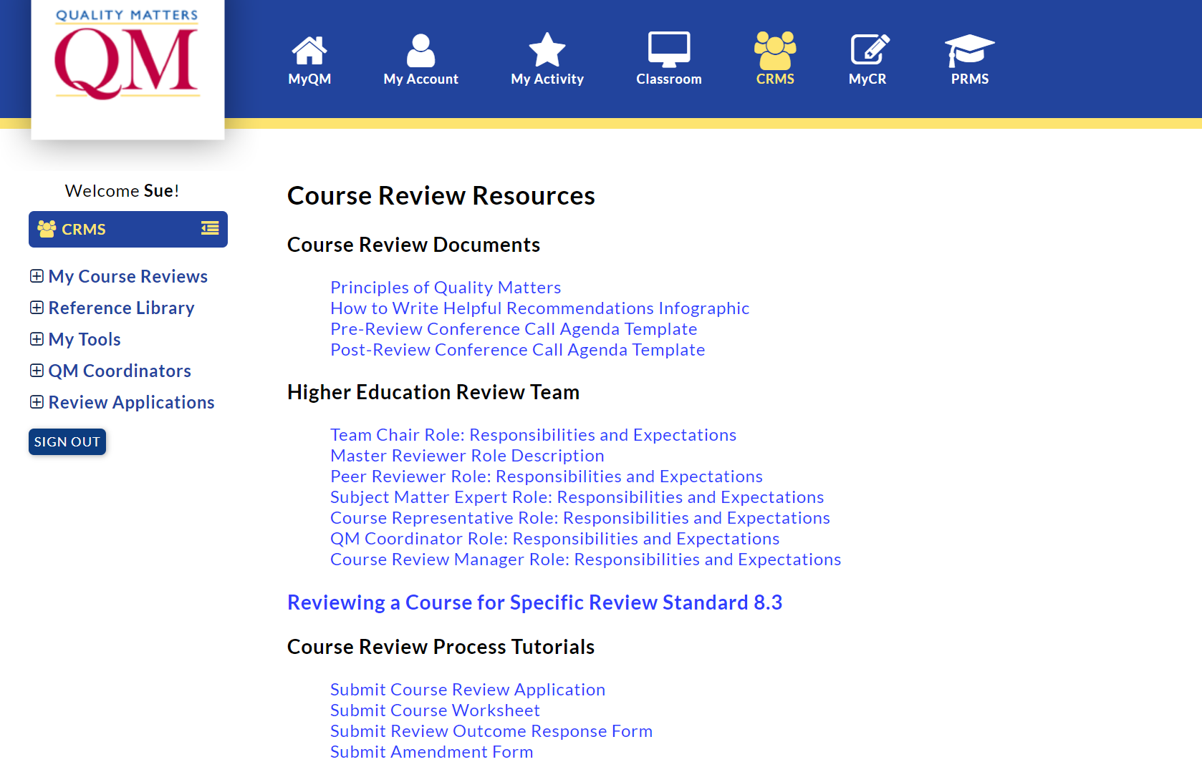
https://www.qmprogram.org/review/index.cfm?option=resources&program=2

Slide 11

Google Sheet tracking
2022 QM Presentation -
course preparation sheet

Slide 12

Process document
Google Doc version
Google Sheet version

Slide 13

Technological Considerations
To Do List
Calendar
File Sharing
Communication

Slide 14

https://bit.ly/qm_2022

Slide 15
Beth Thompson
brthompson@atsu.edu
Sue McDaniel
csmcdaniel@atsu.edu

