Slide 1
Critical Thinking in the Online Human Anatomy and Physiology Class
Ayda Basgul Martin, MD
Natural Science Department
South Louisiana Community College, Lafayette/Louisiana
ayda.martin@solacc.edu

Slide 2
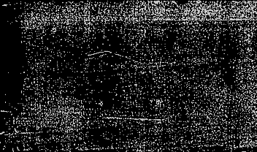

Ayda Basgul Martin, MD
Graduated from Istanbul University, Cerrahpasa Medical Faculty, Istanbul/TURKEY
Sisli Etfal Teaching and Research Hospital, Anesthesiology and Reanimation Department-Istanbul/TURKEY
Instructor at South Louisiana Community College, Natural Science Department since 2015

Slide 3
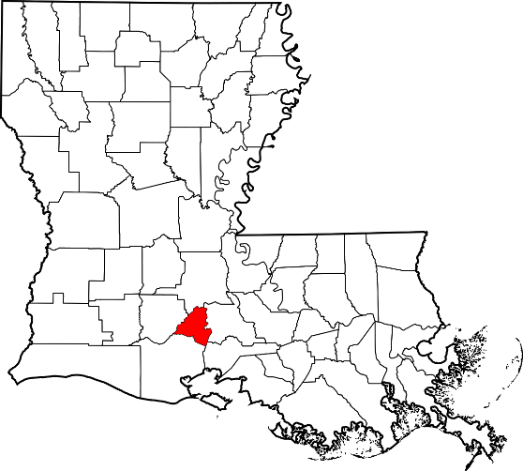

South Louisiana Community college
Lafayette/LA

Slide 5
CRITICAL THINKING
Description
Critical thinking is a vague term with many overlapping definitions.
The objective, purposeful and self- regulatory analysis and evaluation of an issue in order to understand connections between ideas and/or facts to take informed action based on evidence/experience.
Criticism is not the critical thinking
Notes:
An example to critical thinking skill is “A triage nurse analyzes the cases at hand and decides the order by which the patients should be treated”.

Slide 6
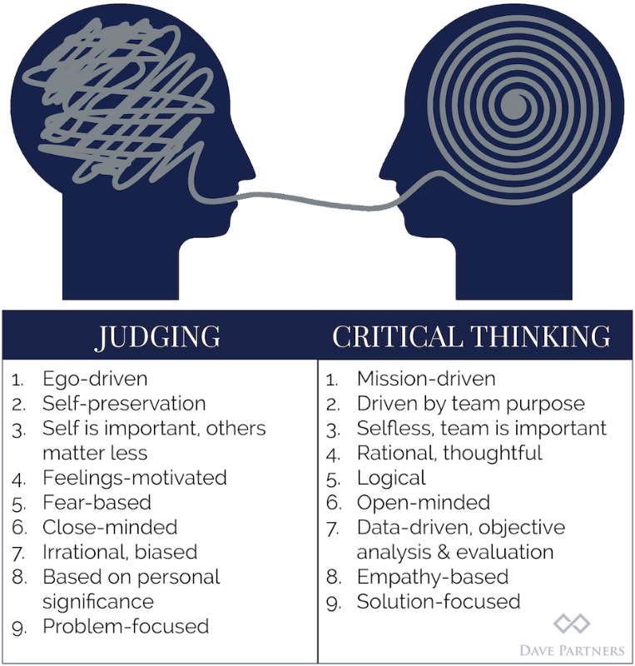
Critical thinking benefits
Foster curiosity and love for learning.
Better understanding of written subject
Increased emotional intelligence
Increase motivation and engagement
Draw appropriate conclusion from the given data
Prioritize the useful information
Develop strong research skills
Better problem solving
Improve attention
Photo courtesy by https://www.alleywatch.com/2016/10/avoid-common-pitfall-critical-thinking/

Slide 7
In 2006, a major report by a consortium of more than 400 US employers ranked “critical thinking” as the most desirable skill in new employees.
A 2015 report by the Foundation for Young Australians claims demand for critical thinking skills in new graduates has risen 158% in three years.
http://theconversation.com/what-is-critical-thinking-and-do-universities-really-teach-it-69046

Slide 8
The MindEdge conducted an online survey of critical thinking skills on April 4 - 11, 2017, the inaugural survey explored the attitudes and behaviors of 1,002 young adults, aged 19 through 30 — both current students and recent graduates.
While most studied critical thinking in college, only 36% think they are well trained in this area, and only 20% think their colleagues are skilled critical thinkers.
Almost two-of-three (64%) say that critical thinking skills are, or will be, very important to their future job prospects.
https://www2.mindedge.com/page/dig-deeper

Slide 9
The good news,
The critical thinking skills can developed and practiced over time.

Slide 10

Simple Habits to improve Your Critical Thinking
Question your assumptions
Reason through logic
Seek diverse views
Try to question all the assumptions. Think of alternatives, don’t be opiniated minded. Find facts!
Pay close attention, ask yourself is the argument supported at every point by evidence. Can you find more evidence?
Respect and seek different views on the issue at hand. Seek diverse taught.

Slide 11
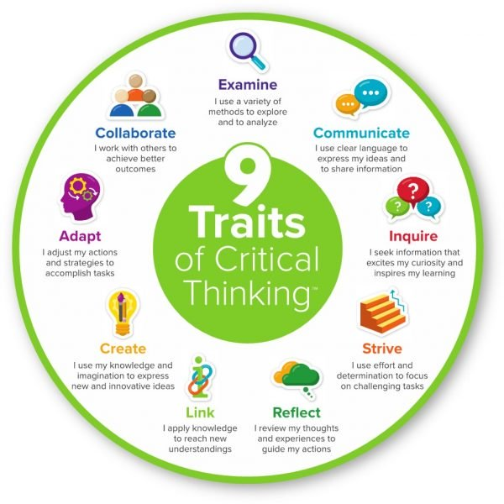
Photo courtesy by https://www.mentoringminds.com/learn/blog/principals-model-the-9-traits-of-critical-thinking/

Slide 12
Top Critical Thinking Skills
Analysis, creativity, open mindedness, problem solving, communication
Analysis
the ability to carefully examine the question.
The student require to examine information, understand what it means, and properly explain to others the implications of that information.
Critical Thinking Tools That Help Learners Analyze
Asking Thoughtful Questions
Data Analysis
Research
Interpretation
Judgment

Slide 13
Top Critical Thinking Skills analysis, creativity, open mindedness, problem solving, communication
Critical Thinking Tools for being creative
Creativity
Critical thinking often involves creativity and innovation. You might need to spot patterns in the information you are looking at or come up with a solution that no one else has thought of before.
All of this involves a creative eye that can take a different approach from all other approaches.
Flexibility
Curiosity
Imagination
Drawing Connections
Vision

Slide 14
Top Critical Thinking Skills
Analysis, creativity, open mindedness, problem solving, communication
Problem Solving
requires analyzing a problem, generating and implementing a practical solution, and assessing the solution
Critical Thinking Tools
Attention to Detail
Clarification
Decision Making
Evaluation
Identifying Patterns

Slide 15
Top Critical Thinking Skills
ANAlysis, creativity, open mindedness, problem solving, communication
Open-Mindedness
Without any assumptions or judgments, able to analyze the information that received.
The students should need to be objective and able to evaluate the ideas without bias.
Critical Thinking Tools
Humility
Inclusive
Objectivity
Observation
Reflection

Slide 16
Top Critical Thinking Skills
ANAlysis, creativity, open mindedness, problem solving, communication
Communication
The students need to share their conclusions with the instructor and their classmates
They also need to engage critical thinking by commenting at least one other student’s post to communicate effectively to figure out solutions to a complex problem.
I evaluate their use of clear language to express their ideas and to share the information.
Assessment
Collaboration
Explanation
Presentation
Written Communication

Slide 17
“In Becoming a Critically Reflected Teacher, the four lenses of critical reflection are ,
students’ eyes,
colleagues’ perceptions,
theory, and
personal experience”
Stephen Brookfield

Slide 18
Exploring multiple perspective in the classroom
BEING A GOOD EXAMPLE
By Instructors modeling, giving feedback to students.
Critical conversations with students. When your student asks you how or why, you answer first with, “what do you think?”

Slide 20
What most helps your students to think critically and/or Creatively?
End your presentations, with unanswered questions your students need to explore.
At the end of the Skeletal System Power point,
“Osteoporosis is a clinical manifestation of an imbalance between bone resorption and bone formation, resulting in weakened bones that easily fracture.
How may one design a therapeutic drug targeting specific bone cell type(s) for the treatment of Osteoporosis?”

Slide 21
Solving a Hypothetical Scenario or problem by using critical thinking skill
The student requires to explain their thought process thoroughly in their discussion question.
As an instructor, I am more focused on how the student arrive at the solution rather than the solution itself.
I would like to see my students able to present the information and use of their analyzing and evaluating skills to come out an open minded decision to solve the given scenario or problem.
Objective: Demonstrate your knowledge about the skeletal system.
Directions: For the following question, answer by leaving a comment in the discussion. You must then reply to at least 1 other student’s post. However, you will not be able to read other’s posts until you post your answer.
Case Study: You are working in a hospital and are presented with an X-ray from a 6-year-old child (on the side). Your colleague thinks that there may be a fracture present where the arrow is pointing in the X-ray. What do you think? Do you agree with your colleague? Explain your answer. Use at least 100 words to explain, apply knowledge and avoid repeating yourself for full credit.

Slide 22
IMPLEMENTING critical thinking questions into your assessments
Questions That Promote Deeper Thinking
“Open-ended” questions intentionally designed to provoke divergent thinking
(a) “What are the implications of ___________?”
(b) “Why is ______________ important?”
(c) “What is another way to look at _______________?”
When forming a bond, an atom that has 5 electrons will
A. loses 3 electrons from its second shell.
B. loses all of the electrons from its first shell.
C. loses all of the electrons from both its first and second shells.
D. gains 5 electrons in its second shell.

Slide 23
Asking questions- CLASS Café/discussion board or Backchannel chat
“what’s the most difficult concept we’ve considered today or what would you like me to re-explain or what would be helpful for me to give some more examples of”.
back channel chat
http://backchannelchat.com
Easily bring your class into the discussion, no fuss, just write the chat room code on the board or project it on the wall.
Critical Incident Questionnaire. What was the moment you engaged the most? Most helpful or distancing action? Anonymous Survey

Slide 24
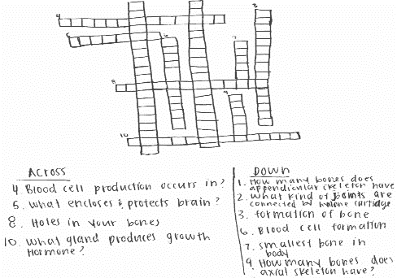
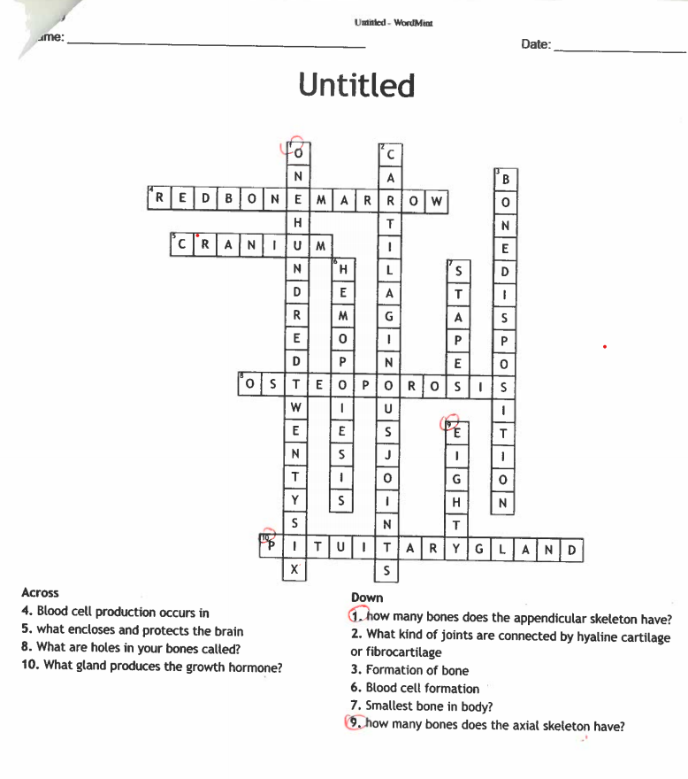
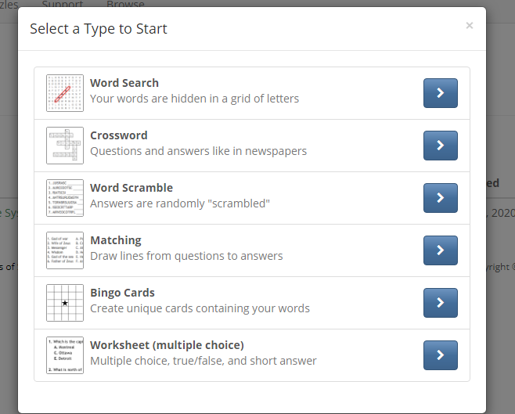
Creating a crossword puzzle
Student may use many free weblinks or apps to create a crossword puzzle.
https://wordmint.com/puzzles

Slide 25
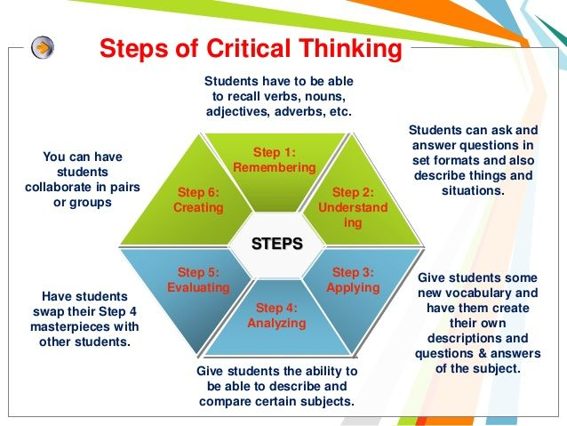
Creating their own vocabulary book
http://flashcardstash.com/
https://padlet.com/
https://www.thinglink.com/

Slide 26
Some other ideas
I am going to give you 2 answers one is what represent I think another is pure fiction. And class votes the answer and than holds 5 min discussion. Tell me why is A or B?
Rewrite the popular music with using the class information- Cranial nerve or name of the bones song.
Clashing Contradictions , What is the number of the bones of the human body?

Slide 27
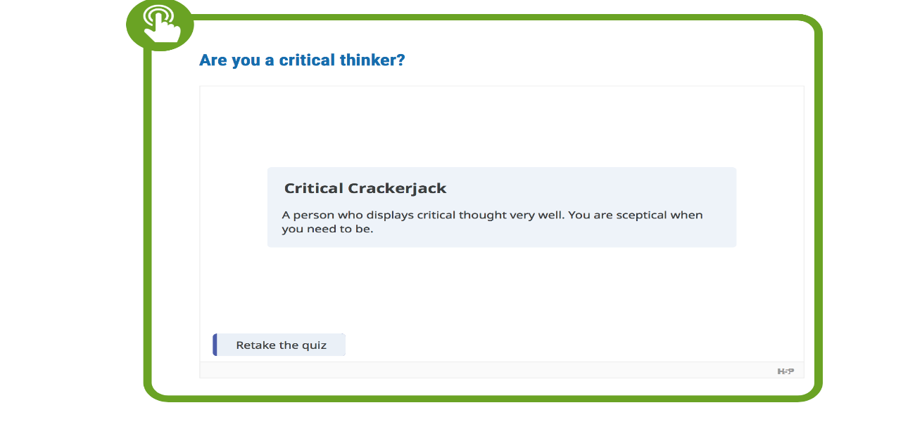
Are you a critical thinker?
https://www.monash.edu/rlo/research-writing-assignments/critical-thinking

Slide 28
Resources
https://resources.depaul.edu/teaching-commons/teaching-guides/assignment-design/Pages/critical-thinking.aspx
http://www.stephenbrookfield.com/ciq
https://www.lavc.edu/profdev/library/docs/promotethink.aspx
https://openstax.org/books/biology-ap-courses/pages/29-critical-thinking-questions
https://www.insidehighered.com/views/2016/06/07/can-colleges-truly-teach-critical-thinking-skills-essay
https://www.rasmussen.edu/student-experience/college-life/critical-thinking-skills-to-master-now/
https://www.thebalancecareers.com/critical-thinking-definition-with-examples-2063745

Slide 29

Thank you!
Questions, Answers, Open Discussions
Ayda Basgul Martin, MD
ayda.martin@solacc.edu
South Louisiana Community College

