Slide 1
Overcoming Faculty Resistance to QA for Online Learning
October 6,2023
Margaret Czart, DrPH
QM Program & Master Reviewer

Slide 2
Conflict of Interest Disclosure
No Conflict of Interest to Disclose

Slide 3
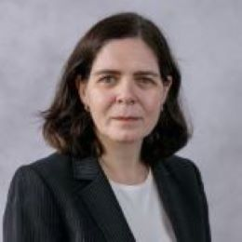
About the Presenter
Nearly twenty years of experience in higher education as both program staff and faculty with adult learners in asynchronous online, self-paced, and accelerated programs. Teaching areas of interest include health informatics, health policy, health promotion, and product management. Research Interest is in Information literacy, competency-based education, and learning outcomes.
QM Program Reviewer, QM Master & Peer Reviewer
OLC Teaching Certification in Instructional Design.
OLC Advanced Teaching Certification.

Slide 4
  There are many factors to consider when addressing resistance to quality assurance in online education. This session will identify some primary factors and strategies to consider when addressing quality assurance with faculty.
QA In Relationship with Health Informatics
  The session will highlight personal experiences and how educational field-specific frameworks have assisted in addressing quality assurance resistance. These include
    Course Design
    Course Review
    Providing individual consultations
Introduction

Slide 5
Resistance vs. Ambivalence to Change
It is critical to distinguish the difference between Resistance vs. Ambivalence to Change.
Resistance - is defined as the refusal to accept or comply with something; the attempt to prevent something by action or argument.
  Typically, due to not wanting change.
  Fear or being told they are doing something incorrectly.
Ambivalence - is defined as the state of having mixed feelings or contradictory ideas about something or someone.
  These individuals may be willing to accept change but are hesitant not to be the only one to accept change. Example LMS Updates & new tools for learning activities & assessments.
  These individuals may want to just delay a commitment from fear of what to expect.

Slide 6
Primary factors to consider for QA with Resistant Faculty
Program Accreditation- Do individual courses have specific accreditation criteria to meet.
  Introductory (Knowledge), Intermediate (Knowledge & Skills), Advanced (Independent/Group Projects)
Course Prerequisite Information – Faculty Knowledge about prerequisites may provide insight to course design, assessments, and appropriateness level needed for the course and level.
  Some graduate students may now be exposed to topics now taught at the undergraduate level.
Some programs have introductory courses without any prerequisites
    Typically to provide course schedule option or interpret prerequisites as a limitation.
Course Titles & Objectives - Provide qualitative information regarding consistency of individual Course Titles and Objectives which should align with the program.
  Course Titles may be generic and course description may not reflect what is being taught.
  Course Descriptions don’t properly reflect what is being taught.

Slide 7
Additional factors for QA with Resistant Faculty
Current Learning Activities & Assessments – Faculty members ability to explain the purpose of learning assessments in a course may just provide work to account for course credit hours.
  Early online faculty still perform many tasks as done in early 2000’s.
Current Tools Used – Online courses require a good amount of focused reading for accurate grading. Some faculty use video tools for assessments to reduce their workload.
  YouTube vs. Panopto vs. Echo 360
  LMS tools vs. External Tools
Course Evaluations – Evaluations may have bias, but some students may provide insight to issues
  May provide insight to what learning activities and assessments they liked vs. experienced challenges.

Slide 8
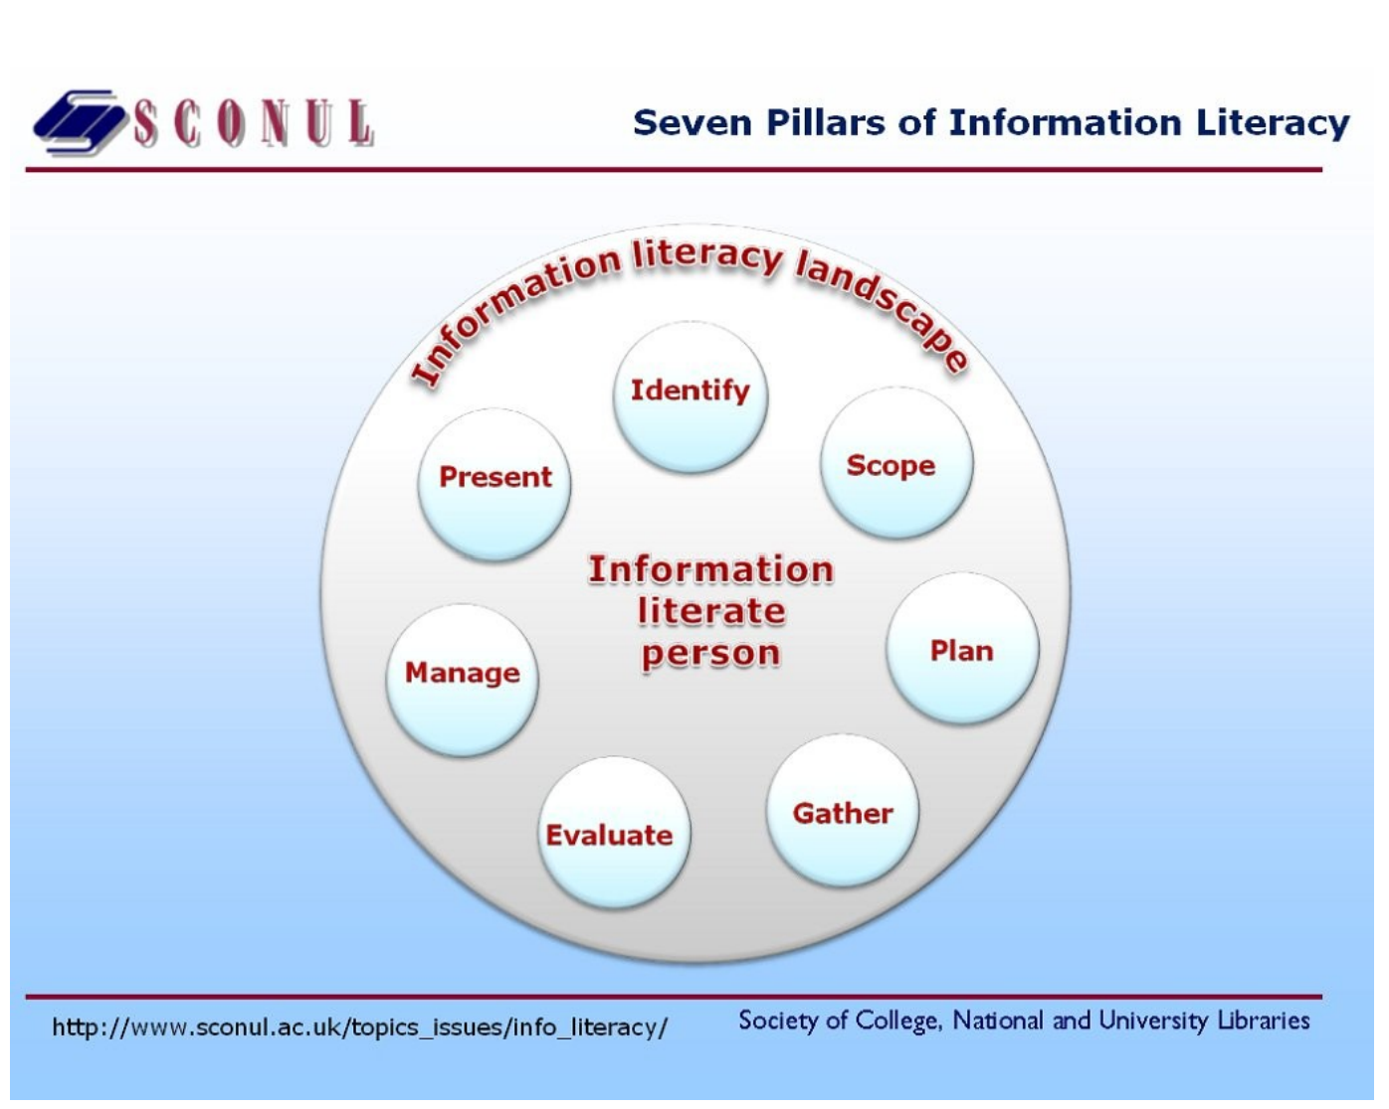
Information Literacy & QA Faculty Resistance
Information Literacy is the foundation to understanding QA and QM Rubric standards
Faculty require information literacy to:
  Identify the QA & QM Rubric Standards.
  Gather information from their course on QA to meet QM Rubric Standards (Self-Assessment).
  Evaluate how well they meet a QA & QM Standards
  Manage the results to improve QA standards not met
  Present and improvement plan timeline and improved results.

Slide 9
“I’m certified but.”
“I don’t like you”
“I don’t get it”
“I don’t like it”
“Sure! No Problem”
Lowest Level or Resistance
Levels of Resistance
A dangerous level
of resistance
Level of resistance which responds to “required”
QA activities only.
Highest Level of
Resistance

Slide 10
Determine the level of Resistance: Motivational Interviewing
Expressing empathy -understanding provides the individual with a sense of acceptance for who they are.
Developing discrepancy - to develop a discrepancy between their current and desired behavior.
Rolling with resistance - acknowledging the individual's perspective and give an opportunity to present a solution that the individual finds acceptable.
Supporting self-efficacy - needs to believe that he/she is capable of making that change
Express Empathy
Developing Discrepancy
Rolling with Resistance
Supporting Self-Efficacy

Slide 11
Motivational Interviewing: Asking Questions & Listening
Questions to Ask/ Statements to Say
Ask questions wat they like and don’t like about their course.
Ask what they would like to do in their course
Provide recommendations associated with QM Rubric Standards without saying it is QM Rubric Standard
Listening for Key Terms/Words
Listen if what they faculty/like don’t like applies to any QM Rubric standard.
Listen if they have a plan that fits into a QM Rubric Standard or if they are doing it because another program is doing it.
Listen for comments of interest, statements of contradiction or still resistant.

Slide 12
  There are many factors which determine the level of resistance. Each level requires a specific strategy.
Improving Faculty Resistance towards QA
  The approach to improving faculty resistance to QA requires careful consideration based on the institutional culture. It is vital not to set expectations that are:
    High (meeting all QA and QM Rubric Standards)
    Short timeline (Accreditation Cycle)
    Don’t allow faculty to be considered as non-subject matter experts.
Strategies to Improve Faculty Resistance

Slide 13
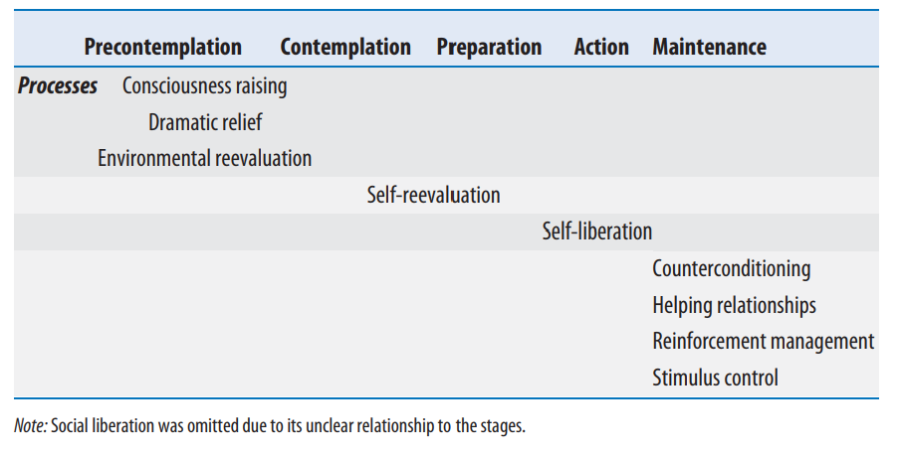
Strategies for the “I’m QM Certified but..”
Transtheoretical Model (TTM) for Behavior Change
-Precontemplation: resistance to change
-Contemplation: acknowledge the problem but must deal with their ambivalence.
- Action: individual actually changes
-Maintenance: continue new behavior
Relapse : Repeat old behaviors from time to time
(Miller and Rollnick 2002)

Slide 14
Strategies for the “I’m QM Certified but..” cont.
Precontemplation & Contemplation – I’m not ready Group
Action – Ready not sure how
Maintenance – Need support over all courses
Relapse – Need new ideas

Slide 15
Strategies for the “I don’t like you” attitude
Regardless of your role at the institution it is important to remember:
The “I don’t like you” attitude is not personal in most cases.
The “I don’t like you” attitude may be a self-confidence issue.
Faculty who are at one institution like to stay in their comfort zone.
Faculty may realize an institution will bring QA into standard practice & unsure of the future.
Know who your support group at your institution is when conversations get difficult.
QA Advocates
Faculty resistant to change

Slide 16
Strategies for the “I don’t like you” attitude cont.
Collaborate with University Level Committees & Offices (including LMS Teams)
Collaborate with Colleges and Departments.
Collaborate with Faculty Open to QA
Standardize by having one location for Course Design Assistance and references to meet all field needs.
Academic Affairs may be split to focus on courses vs. programs through separate committees.
Individual Faculty given honorary appointments/ fellowships

Slide 17
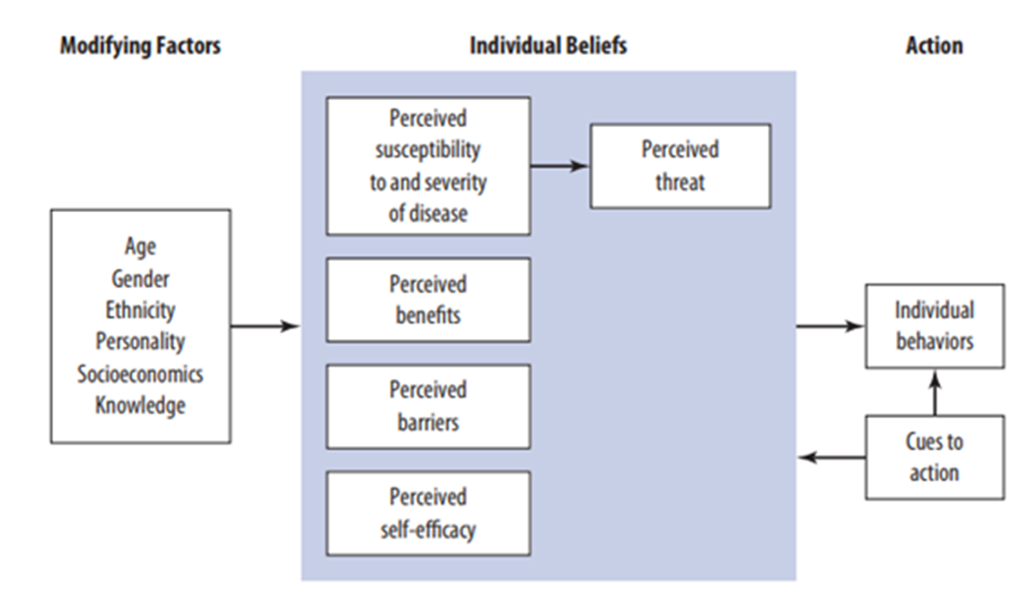
Strategies for “I don’t like it”
Faculty belief about QA and QM Rubric Standards may be influenced by factors of:
How long they have been teaching?
Faculty development in teaching/course design
How much of a learning curve is in something new?
How much work is associated if a standard is “Not Met”.
Don’t want to admit that they don’t understand the standards.
  Learning Activities vs. Assessments
Health Belief Model applied to QA standards

Slide 18
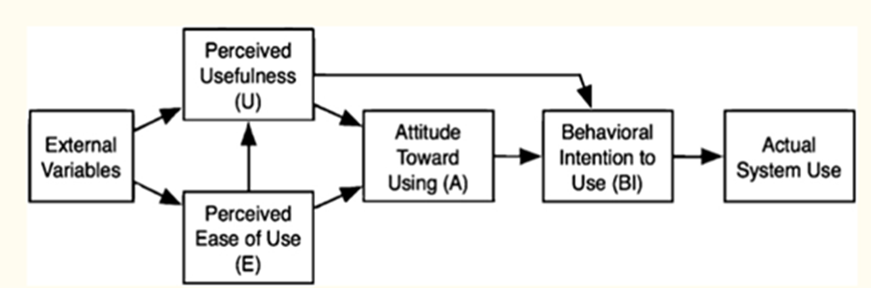
Strategies for “I don’t like it”
Technology Acceptance Model (TAM) for QA standards
Faculty need to see usefulness in QA using QM Rubric standards.
Faculty need to conclude on their own terms and pace that their perceived usefulness of QA using QM Rubric standards is potentially incorrect.
Faculty may need to start with accepting the usefulness of alignment standards vs. all standards.
The terms “Quality Matters” and “Quality Assurance” may be a mental trigger of unknown reasons.

Slide 19
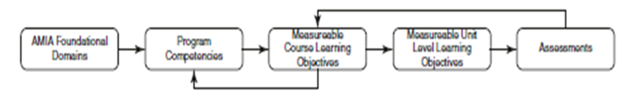
Strategies for the “I don’t get it” level of Resistance
In QA using QM Rubric Standards we should not assume “I don’t get it” = resistance
Validate foundational knowledge with alignment
  Course & Weekly Objectives
  Learning Activities vs. Assessments
  Understanding of Tools
  Understanding of Accessibility
of developing rubrics to measure learning outcomes
Evaluate how points earned in a course.
Source: Feldman, Boren, S. A., Tesch, L. H., & Valenta, A. L. (2020). Accreditation of Health Informatics Programs. In Informatics Education in Healthcare (pp. 237–248). Springer International Publishing. https://doi.org/10.1007/978-3-030-53813-2_17

Slide 20
Final Thoughts
Build a network of collaborators at all level of your institution.
Begin implementation with the QM Rubric Standards for alignment.
Collaborators should work to develop a resource page which provides a “Teaching Toolkit” which include options for all disciplines.
Develop a Self-Assessment Process with those who are least resistant.
Develop a Peer Observation Process by assessing courses from the most recent offering.
  Most Recent term should have the most recent updates not necessarily reflected in the university catalog system.
  Course with consistent low enrollment and/or canceled should be reviewed as priority.
Develop a decision roadmap assisting faculty in determining when faculty should update course catalog information.
  Determining Major update for catalog changes vs. minor changes/work in progress.

Slide 21
Questions email: mczart1@uic.edu

