Slide 1
Walking the Walk:
Assessing Curriculum for Diversity, Equity, and Inclusion
Presented by:
Alaina Pascarella, Manager of Academic Quality Services
Tricia Lauer, V.P of Office of Assessment and Curricular Affairs
Jennifer Zaur, Lead Faculty AA in Early Childhood Education

Slide 2

University of Arizona Global Campus
Agenda:
  WHY - Setting
  HOW - Development, Training, & Resourcing
  WHAT - Implementation, Practice, & Dissemination
Notes:
Alaina
We’re going to start “wide” and taper into practical examples

Slide 3
University of Arizona Global Campus
Mission Statement
To provide a community of caring and guidance for academic, financial, mental health, and career support while providing a path that makes quality college education accessible to adult learners through online, flexible degree and certificate programs.
Focusing Institutions on What Matters Most (Felton, Gardner, Schroeder et al., (2016)
Using a lens of What Matters
  Everyone LEARNS
  Purposeful cultivation of RELATIONSHIPS
  Assured ALIGNMENT of Institutional Resources
  Believing that IMPROVEMENT matters
Notes:
Tricia
Everyone Learns
Purposeful cultivation of RELATIONSHIPS – Tricia & Newt will discuss how this was core to our processes
ALIGNMENT – Systems Policies & Practices are aligned
IMPROVEMENT matters

Slide 4
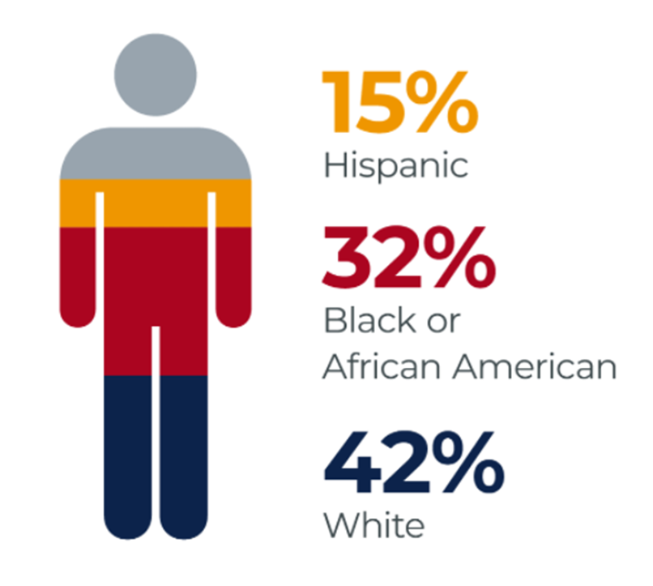
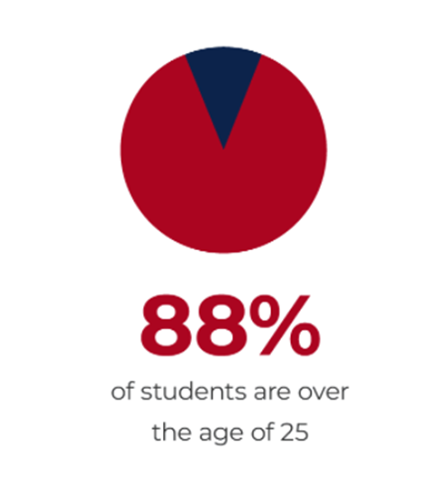
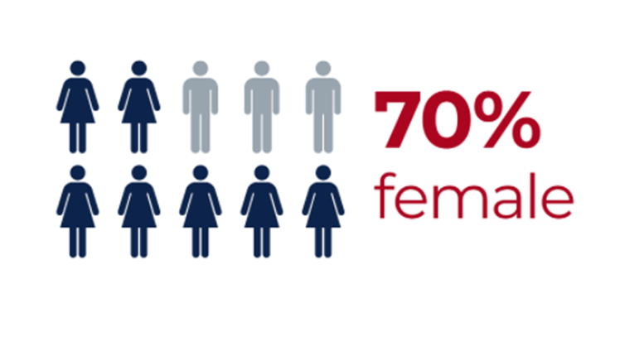
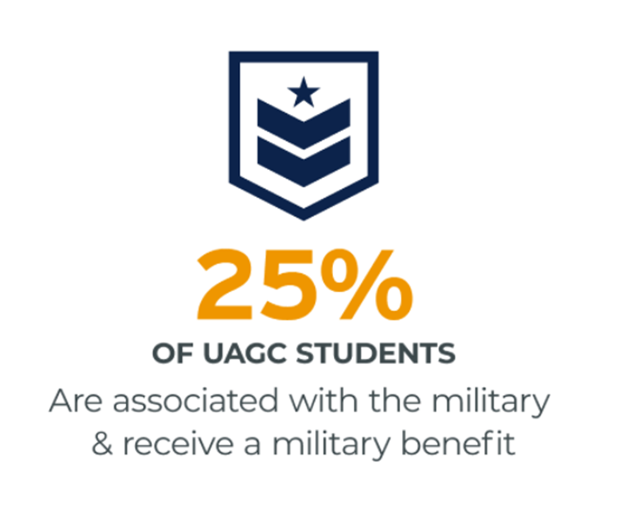
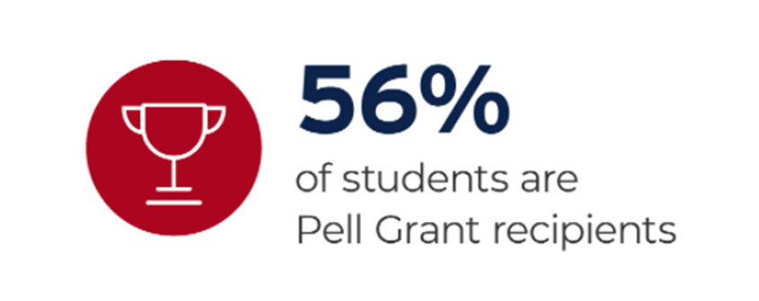
University of Arizona Global Campus
Student Demographics
Notes:
Tricia

Slide 5

Context
The Need
The Learning Anchors
Social Climate and on-going (finite v. infinite) narrative
Equity beyond Access. Drive toward Equity in Success.
Critical Learning
Sociocultural Learning
High Impact Practices (HIPs)
Notes:
Alaina
Social Climate: Social Injustices
CAG
Theory – Paolo Friere
For Freire, education must be centered upon developing critically conscious, 'humanized', learners who act to liberate themselves, and the world, from injustice. leading to social transformation. either educating to support and maintain the status quo or helping to critique and change reality.
Theory – Lev Vygotsky
Focus on culture, language, and zone of proximal development. It suggests that our environment plays a crucial part in a learner's development; hence our need to reflect the environment into the culture of the course. For example, peers have the power to influence how a learner thinks or feels about a particular subject. Similarly take into consideration how we have the power to partner with the student as learners
Diversity – educational benefits, including racial and cultural awareness, enhanced critical thinking, develops communication skills, higher levels of service to community, and a more educated citizenry and civic engagement.
Inclusion – vital for all members of a campus community, but is particularly important to historically underrepresented and marginalized populations (at-potential).
Equity – achieving parity in student educational outcomes, regardless of race or ethnicity, particularly, given the marginalization of some racial and ethnic groups in education.

Slide 6
DEI COURSE AUDIT RUBRIC
GOAL: Audit All Courses Prior to A Course Revision
DEVELOPMENT
Research and drafted rubric – DEI Course Audit Rubric Workgroup
Sought feedback from faculty
Commenced pilot project – Does the rubric do what is intended?
Curriculum and Assessment Steering Committee and Faculty Council endorsed v32 and for all courses to be reviewed by end of 2024
Notes:
Alaina
The intent of this rubric is for UAGC to develop a greater consciousness regarding DEI issues within its curriculum, so that UAGC may celebrate its DEI achievements as well as understand its DEI shortcomings. Using this rubric, a faculty reviewer can explore all aspects of a UAGC course to evaluate how much DEI representation that course manifests.
Research and rubric draft: Based on UAGC Diversity, Equity, and Inclusion Statement; UAGC Institutional Learning Outcomes; NACE Career Readiness Competencies; Department of Education description of Global and Culturally Competent Individuals
Feedback: Visited each department, sought feedback from the Change Advisory Group and the Faculty Council and its subcommittees
Pilot project: 38 faculty, reviewed 19 UAGC courses; Trained faculty on how to use rubric, including calibration

Slide 7
DEI COURSE AUDIT RUBRIC
GOAL: Audit All Courses Prior to A Course Revision
TRAINING and RESOURCES
How do we scale? Partnered with Center for Excellence in Teaching and Learning
Conducted a Needs Analysis: Sought feedback from faculty
Visited with faculty from pilot, sought feedback from the Change Advisory Group and the Faculty Council and its subcommittees
Used Rise by Articulate to create the training
Provided training and rubric in Workday so ALL employees have access
Created Additional Resources for Faculty
Course Design Café, Course Development Training, Course Guide Development Template
Development Dish with Jenn and Trish, Course Development Series
Notes:
Jenn

Slide 8

PRACTITIONER
Will it work for my students?
Will it cost me more time or cause me more work?
Is it only visiting?
Is it adaptable to my style?
Notes:
Jenn
Will it work for my students?
Multiple Intelligence approach evaluation
Reveals opportunities to scaffold design
Equitably appealing
Cultural inclusivity
Access to mastery
Highlights avenues for differentiation
HIP – Diversity & Global Learning
What is the cost (time and work)?
Upfront investment provides huge dividends on the backend
The time spent evaluating uncovers gaps and opportunities for change.
Is it only visiting?
Can be an institutional initiative.
Can be an individual initiative.
Department, Program, College
An open PLC
F2F and online course design
Is it adaptable to my style?
29 indicators promotes customization.
Collaboration / brainstorm ideas.
Promotes critical thinking.

Slide 9

The Rubric & The Process
Notes:
Tricia

Slide 10
Rubric Framework
Equity for Excellence: A Call for Action (UAGC’s Diversity, Equity & Inclusion Statement)
At the University of Arizona Global Campus, we are a global community that values diverse perspectives and actively pursues inclusive practices to support the success of our community of students, staff, and faculty. We value the dignity of the human experience. Our commitment is to champion the inclusivity of thought, belief, and choice of all populations, intentionally including the marginalized and underserved as an integral part of our mission to provide a broader and deeper educational experience.
Notes:
Tricia

Slide 11
Rubric Framework
UAGC Institutional Learning Outcomes
Apply
Apply logic and critical thinking to evaluate reasoning, explore diverse perspectives, and engage in metacognition.
Cultivate
Cultivate knowledge of and respect for people with diverse backgrounds, values, and lifestyles.
Apply
Apply knowledge of commonalities and differences across varying cultural, economic, and geographic populations as part of global citizenship.
Notes:
Tricia

Slide 12

Rubric Framework
Working Definitions of Diversity, Equity, and Inclusion
Diversity refers to all aspects of human difference, social identities, and social group differences, including but not limited to race, ethnicity, creed, color, sex, gender, gender identity, sexual identity, socio-economic status, language, culture, national origin, religion/spirituality, age, (dis)ability, military/veteran status, political perspective, and associational preferences.
Notes:
Tricia

Slide 13
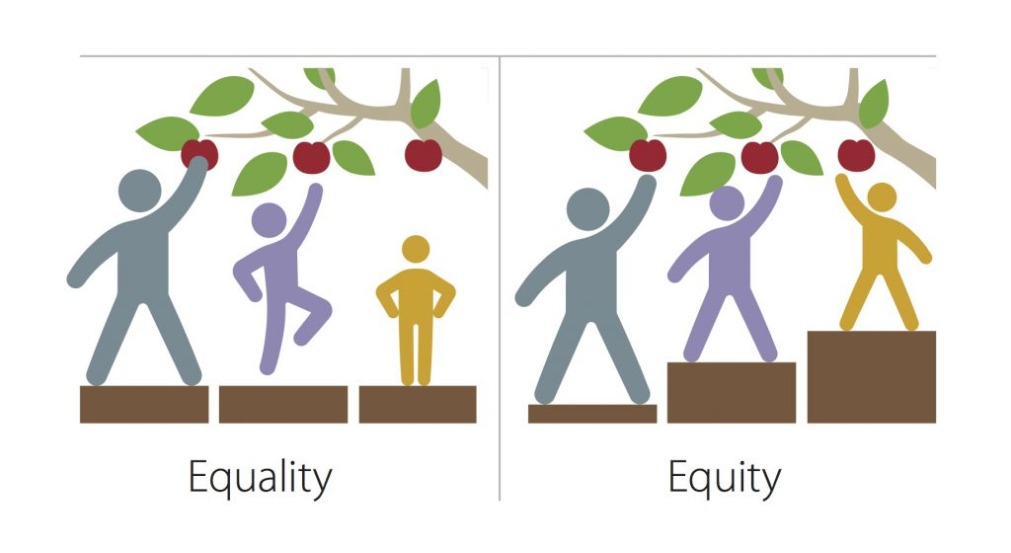
Rubric Framework
Working Definitions of Diversity, Equity, and Inclusion
Equity: Equity refers to fair and just practices and policies that ensure all community members can thrive. Equal treatment results in equity only if everyone starts with equal access to opportunities.
Thto by Unknown Author is licensed under CC BY
Notes:
Tricia

Slide 14

Rubric Framework
Working Definitions of Diversity, Equity, and Inclusion
Inclusion: Inclusion refers to an academic community where all members are and feel respected, have a sense of belonging, and are able to participate and achieve to their potential.
Notes:
Tricia

Slide 15

The Rubric – The Process
9 Standards
29 Indicators
5 Evaluation Categories
Prework - Self-Assessment
External Review
Post Review conference
Notes:
Tricia

Slide 16
9 Standards on the DEI Rubric
1. Course Support Components
2. Learning Outcomes
3. Course Learning Support
4. Academic Support
5. Course Learning Activities
6. Formative, Summative Exams and Quizzes
7. Mastery Opportunities
8. Course Learning Resources 9. Course images
Notes:
Tricia

Slide 17
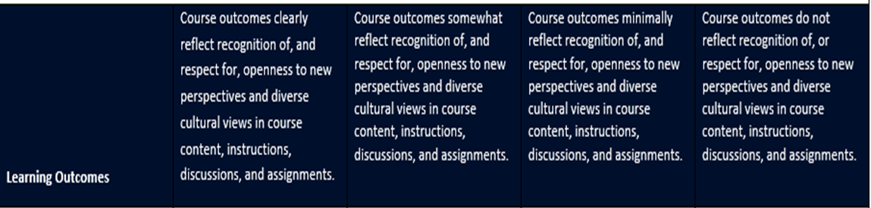
ENG225 DEI Rubric – Learning Outcomes
Notes:
Alaina

Slide 18
ENG225 DEI Rubric – Learning Outcomes
Upon successful completion of this course, students will be able to:
Evaluate the relationship between the story and plot of a film.
Assess the dramatic impact of elements of the mise-en-scène.
Appraise cinematographic and editing options employed in a film.
Classify the various types of sound in films and the effects they create.
Evaluate how we find and interpret meaning in films through the study of various film theories and criticism.
Investigate the interrelationship between film and society.
Notes:
Alaina

Slide 19

ENG225 DEI Rubric – Learning Outcomes
Notes:
Alaina

Slide 20
ENG225 DEI Rubric – Learning Outcomes
Evidence and reflections by reviewer:
While the course learning outcomes do not call out diversity, equity, and inclusion specifically, there is room to address these ideas within the course learning outcomes, particularly CLO 5 where students are asked to evaluate how we find and interpret meanings of films through various critical lenses and CLO 6 where they are asked to investigate the interrelationship between film and society.
Notes:
Alaina

Slide 21
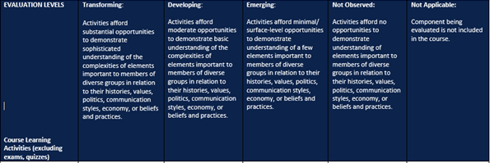
ENG225 DEI Rubric – Learning Activities
Notes:
Alaina

Slide 22
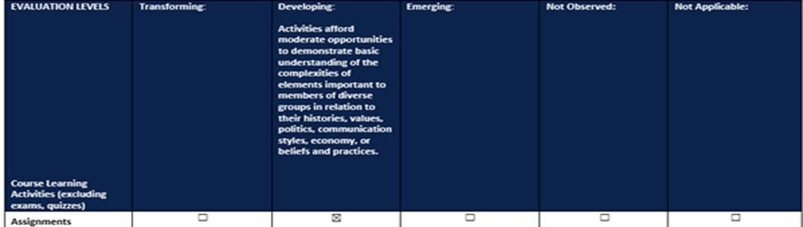
ENG225 DEI Rubric – Learning Activities
Notes:
Alaina

Slide 23
ENG225 DEI Rubric – Learning Activities
Evidence and reflections by reviewer:
The Week 3 assignment doesn’t necessarily lend itself to this lens but could do so depending on the auteur chosen as some auteurs do specifically work with stories within their communities and various identities, and there is room for this to be more specifically addressed in the Week 5 assignment where students can look at the impact of a film on society and get into some of the complexities of diverse cultural perspectives.
There is an opportunity perhaps to bring some more of this into the Week 2 assignment as certain genre tropes include stereotypes. Perhaps specifically asking students to look at the potential stereotypes in their chosen genre and its impact on audiences is a way to do this more explicitly.
Notes:
Alaina

Slide 24
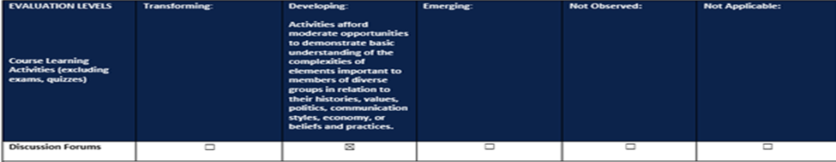
ENG225 DEI Rubric – Learning Activities
Notes:
Alaina

Slide 25
ENG225 DEI Rubric – Learning Activities
Week 1 Discussion – I like how students are being asked in the introduction to talk about how film impacted them. It allows for a lot choice for students and to examine their own cultural experience with film.
Week 2 Discussion – There are a lot of recent conversations in the film industry about lighting for different skin tones as many of the traditional techniques are specifically geared for white actors. There is an opportunity perhaps to incorporate some of this conversation into the discussion on lighting.
Week 3 Discussion – There is a nice variety of movie clips here with different groups of individuals represented in the choices.
Week 4 Discussion - Mise-en-Scène: Actors in the Frame: There is an opportunity here to add some historical context in terms of casting white actors to play non-white characters and whitewashing certain characters by changing ethnicity. This could also extend to cis-hetero actors playing individuals in the LGBTQ+ community or abled-actors playing characters with a specific disability (example: hearing actors playing deaf characters).
Week 5 Discussion – The Week 5 Discussion on the sociocultural effect of film and how it can impact our understanding of social issues and concerns. This is a place where students can really explore a variety of perspectives on culture and society and how film can impact this. What is the impact of the films we consume on our understanding of social issues and cultural differences?
Notes:
Alaina

Slide 26
ECD305 – DEI Rubric Feedback
ECD 305: Positive Learning Environments has a solid foundation in DEI components because of the scope of study. Course description, CLOs, and WLOs have some DEI verbiages. Nevertheless, it has a narrow definition of diversity and focuses on cultural diversity while the UAGC DEI Course Rubric comprises a broad definition of diversity plus equity and inclusiveness. Thus, there is big room for improvement since this course has the capacity to incorporate DEI components everywhere, which is an advantage over other UAGC courses.
Notes:
Jenn

Slide 27
Example of CLO Modifications
Before DEI Audit | After DEI Audit
1. Analyze key principles and characteristics related to developmentally appropriate practices in establishing early learning environments for diverse learners. 2. Explain effective instructional planning strategies for diverse learners. 3. Recommend strategies for classroom management and establishing expectations for childhood learning environments. 4. Create a high-quality learning environment that meets the needs of diverse learners. | 1. Analyze key principles and characteristics related to developmentally appropriate practices in establishing high quality learning environments for diverse young learners. 2. Examine effective approaches for creating learning environments that support diversity, equity, and inclusion. 3. Propose strategies for classroom management and establishing expectations for diverse, equitable, and inclusive learning environments. 4. Design high-quality learning environments that meet the needs of diverse young learners.
Notes:
Jenn

Slide 28
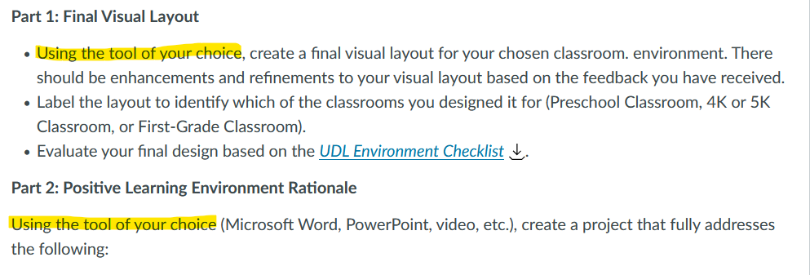
ECD305 – Variety of Options
Notes:
Jenn

Slide 29
ECD310 - DEI Rubric Feedback
As noted above, the learning outcomes focus on students with exceptional learning needs and inclusive teaching strategies. There is potential for growth in terms of being more direct regarding diversity of race/ethnicity and cultural norms, socioeconomic status, gender/gender expression and possibly LGBTQ+ students to include specific DEI language. That said, DEI language can be incorporated into the course and align with the above course learning outcomes. | Examine historical approaches for inclusion and their influence on current trends for learning environments for children with exceptionalities. Apply evidence-based instructional methods and strategies that support children with diverse needs within an inclusive setting. Analyze the collaborative models in inclusive settings that support and serve children and their families. Create a professional and ethical based philosophy of inclusion for children with exceptionalities.
Notes:
Jenn

Slide 30
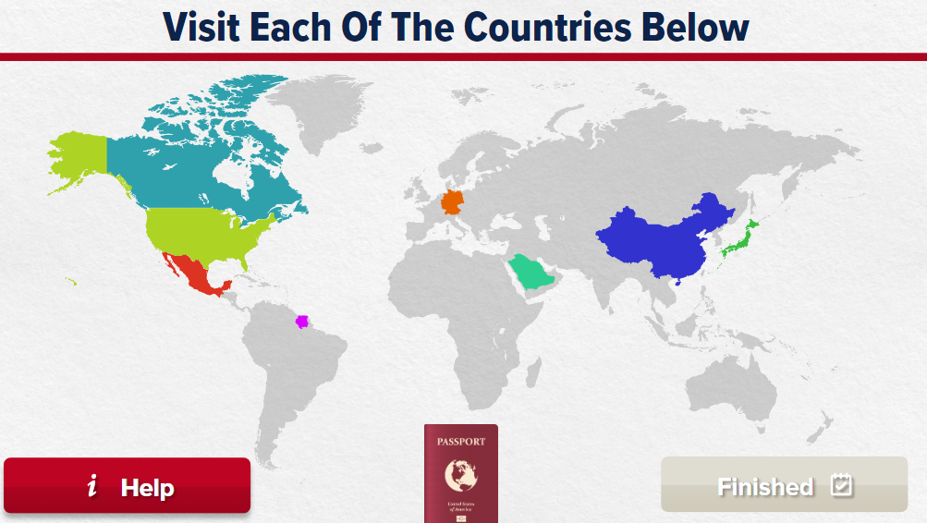
ECD310 - DEI Rubric Feedback
Week 1 Discussion 1: Discussion directions require students to describe the movement towards an inclusive education, the historical policies and laws, and their relationship to effective teaching as well as how policies and laws are influencing current trends. Recommendation: include views of special education around the world to help paint a more global picture and allow students to see influences from different lenses
Notes:
Jenn

Slide 31
DEI Course Audit Rubric – Self Reflection
Challenges/barriers to implement DEI in the course
How course relates to UAGC DEI statement, institutional learning outcomes, and other intercultural/global competencies
Relevancy of the DEI rubric to the course
What the rubric does not cover in terms of DEI as it relates to the course
What students might learn about other cultures and beliefs as a result of the course
Notes:
Jenn

Slide 32
Audit Process:
What We’ve Learned
Notes:
Alaina

Slide 33
Updates to DEI Course Audit Process
Pre-Development
Development
Learning Outcomes
Course Learning Support
Access to Academic Support
Course Support Components
Learning Outcomes (Weekly only)
Course Learning Support
Access to Academic Support
Course Learning Activities
Formative, Summative Exams and Quizzes
Mastery Opportunities
Course Learning Resources
Course Images
Notes:
Alaina

Slide 34
Identified Gaps in Faculty Knowledge and Training
Most reflections and areas of opportunity for improvement centered around specific types of diversity: gender, race/ethnicity, socioeconomic status
While mentioned in the working definition of diversity, feedback related to ability status, particularly cognitive and neurodiversity was often not included by faculty reviewers.
Identify a need for further faculty development on neurodiversity and other accessibility needs beyond closed captioning and accessibility requirements.
Notes:
Alaina

Slide 35
Faculty Perspective
Broadened my knowledge of DEI
Look at development through a different lens
Impacted not only resources but also course assessments
Created a space for dialogue about DEI amongst faculty
Notes:
Jenn

Slide 36
Unlimited Benefits
PLC – HIP for Faculty
Content structure / presentation
Cultural inclusivity / appeal
Instructional techniques and methods
Accommodate and scaffold
Ideas for ways to differentiate
Equitable access to mastery
Notes:
Tricia

Slide 37

Alaina Pascarella
Alaina.Pascarella@uagc.edu
Jennifer Zaur
Jennifer.Zaur@uagc.edu
Tricia Lauer
Tricia.Lauer@uagc.edu

