Slide 1
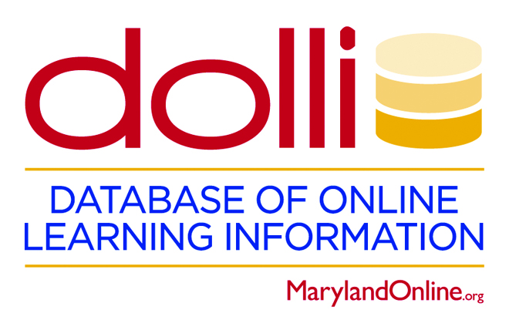
240 Things to Learn about Quality in Online Education:
Secrets of a Collaborative Database
Diana Zilberman, Ph.D.
Karen Rege, Ed.D.

Slide 2

Notes:
Who we are
MarylnadOnline created QM
!9 institutions

Slide 3
Our knowledge of building, sustaining, and growing an online program was supplemented by information about what other colleges in our consortium were doing.

Slide 4

If you had access to the “Online Oracle,” what question would you like to ask?
Please post your questions following this QR code in the Padlet.
Notes:
Explain that the Online Oracle is believed to know everything there is to know about online teaching and learning. Encourage participants to post throughout the presentation. Connect this to the QM Quality pie:
Student and faculty preparedness, online infrastructure, LMS, course content
Please focus your questions on the Online Quality Pie (per QM)
Course design, delivery, content
Institutional infrastructure and LMS
Student preparedness and faculty preparedness

Slide 5
We often wondered or were asked to find out…
In 2017, we decided to formalize that information into a searchable, dynamic database.
Notes:
How to prepare students for online courses
How to provide appropriate professional development for faculty prior to teaching online, etc..

Slide 6
History of DOLLI (Database of Online Learning Information)
Members of the MOL Board brainstormed information subjects and specific questions surrounding the landscape of online education, such as policies, processes, and practices.
MOL created a working team.
The DOLLI team selected a database software platform.

Slide 7
Prototype
Brainstormed questions
Built database structure
Revise
Tested and gathered data
Incorporated feedback
Implement
Input data
Established advisory council
Customized search
Our Design Process
Notes:
We prototyped and piloted the database.
We revised based on feedback.
We created a customized search.
We implemented it across our consortium.
We created an advisory council that included external members.

Slide 8
Let’s see what questions appeared for our Online Oracle.
The Online Oracle
Notes:
Please focus your questions on the Online Quality Pie (per QM)
Course design, delivery, content
Institutional infrastructure and LMS
Student preparedness and faculty preparedness

Slide 9
DOLLI and the Online Educational Landscape
DOLLI includes 17 subject areas and 240 questions.
All MOL institutions have input their information.
DOLLI generates interest both in the questions and in the institutional responses.
Let’s take a look!
Notes:
Input data in phases
Collaboration with MOL institutions
Taught reps how to use it
Conducted working sessions
Please enter your questions

Slide 10
  What is the modality of the orientation for online students?
Notes:
Connect orientation discussion to CHLOE
Possible responses:
Online
Face-to-face
Hybrid/Blended
Hy-Flex

Slide 11
  Are face-to-face courses required to use the LMS?
  What content must face-to-face courses post in the LMS?
Notes:
This information is relevant since the line between online and f2f courses is blurred,
Possible responses for the second question
Syllabus
Faculty contact info
Assignment due dates
Grades
Announcements
Assignments
Attendance
Other

Slide 12
  Who provides accessibility training for faculty teaching online and hybrid/blended courses?
Notes:
Possible Responses
E-Learning
Center for teaching and learning
Disability support services
A centralized disability office
Information technology (IT)
Quality Matters
External training
Human resources

Slide 13
Other information available in our database
How do institutions define online courses?
What kind of training does your institution mandate for faculty before they can teach online?
What processes are in place for ensuring course design quality prior to teaching online?
Notes:
We briefly give examples of other questions reminding that there are 240.

Slide 14
What can faculty and administrators learn from each others’ practices and processes?
A resource for online teaching and learning practices can help those new to online education understand the factors that contribute to a quality online program.
Notes:
Having information about online teaching and learning practices empowers educators to make decisions.
DOLLI’s contribution to enhancing the quality of online teaching and learning is helping online educational professionals reflect on various decisions that affect students’ experience.
A resource of online teaching and learning practices can help those new to online education understand the factors that contribute to a quality online program.

Slide 15
How can DOLLI help a consortium or a system?
Gathering information about various aspects of online offerings
Preparing for accreditation
Identifying vendors used by peer institutions
Getting new ideas for policy, process development, or quality assurance
Notes:
Comparative, aggregated database

Slide 16
For more information, contact:
Diana Zilberman
Director of DOLLI
dzilberman@marylandonline.org
Notes:
Currently, DOLLI is copyrighted by MarylandOnline.
The information in the database is proprietary
The framework is proprietary
We are in the process of developing the business model to license the framework.

