Slide 1
Offering a World of Possibilities
Supporting Digital Accessibility for World Language Courses

Slide 2
Session Objectives
Discuss design strategies to provide accessible online World Language courses.
Discuss collaborative plans to provide learning accommodations for students in online World Language programs.
Share instructional strategies to engage all learners in World Language courses.

Slide 3
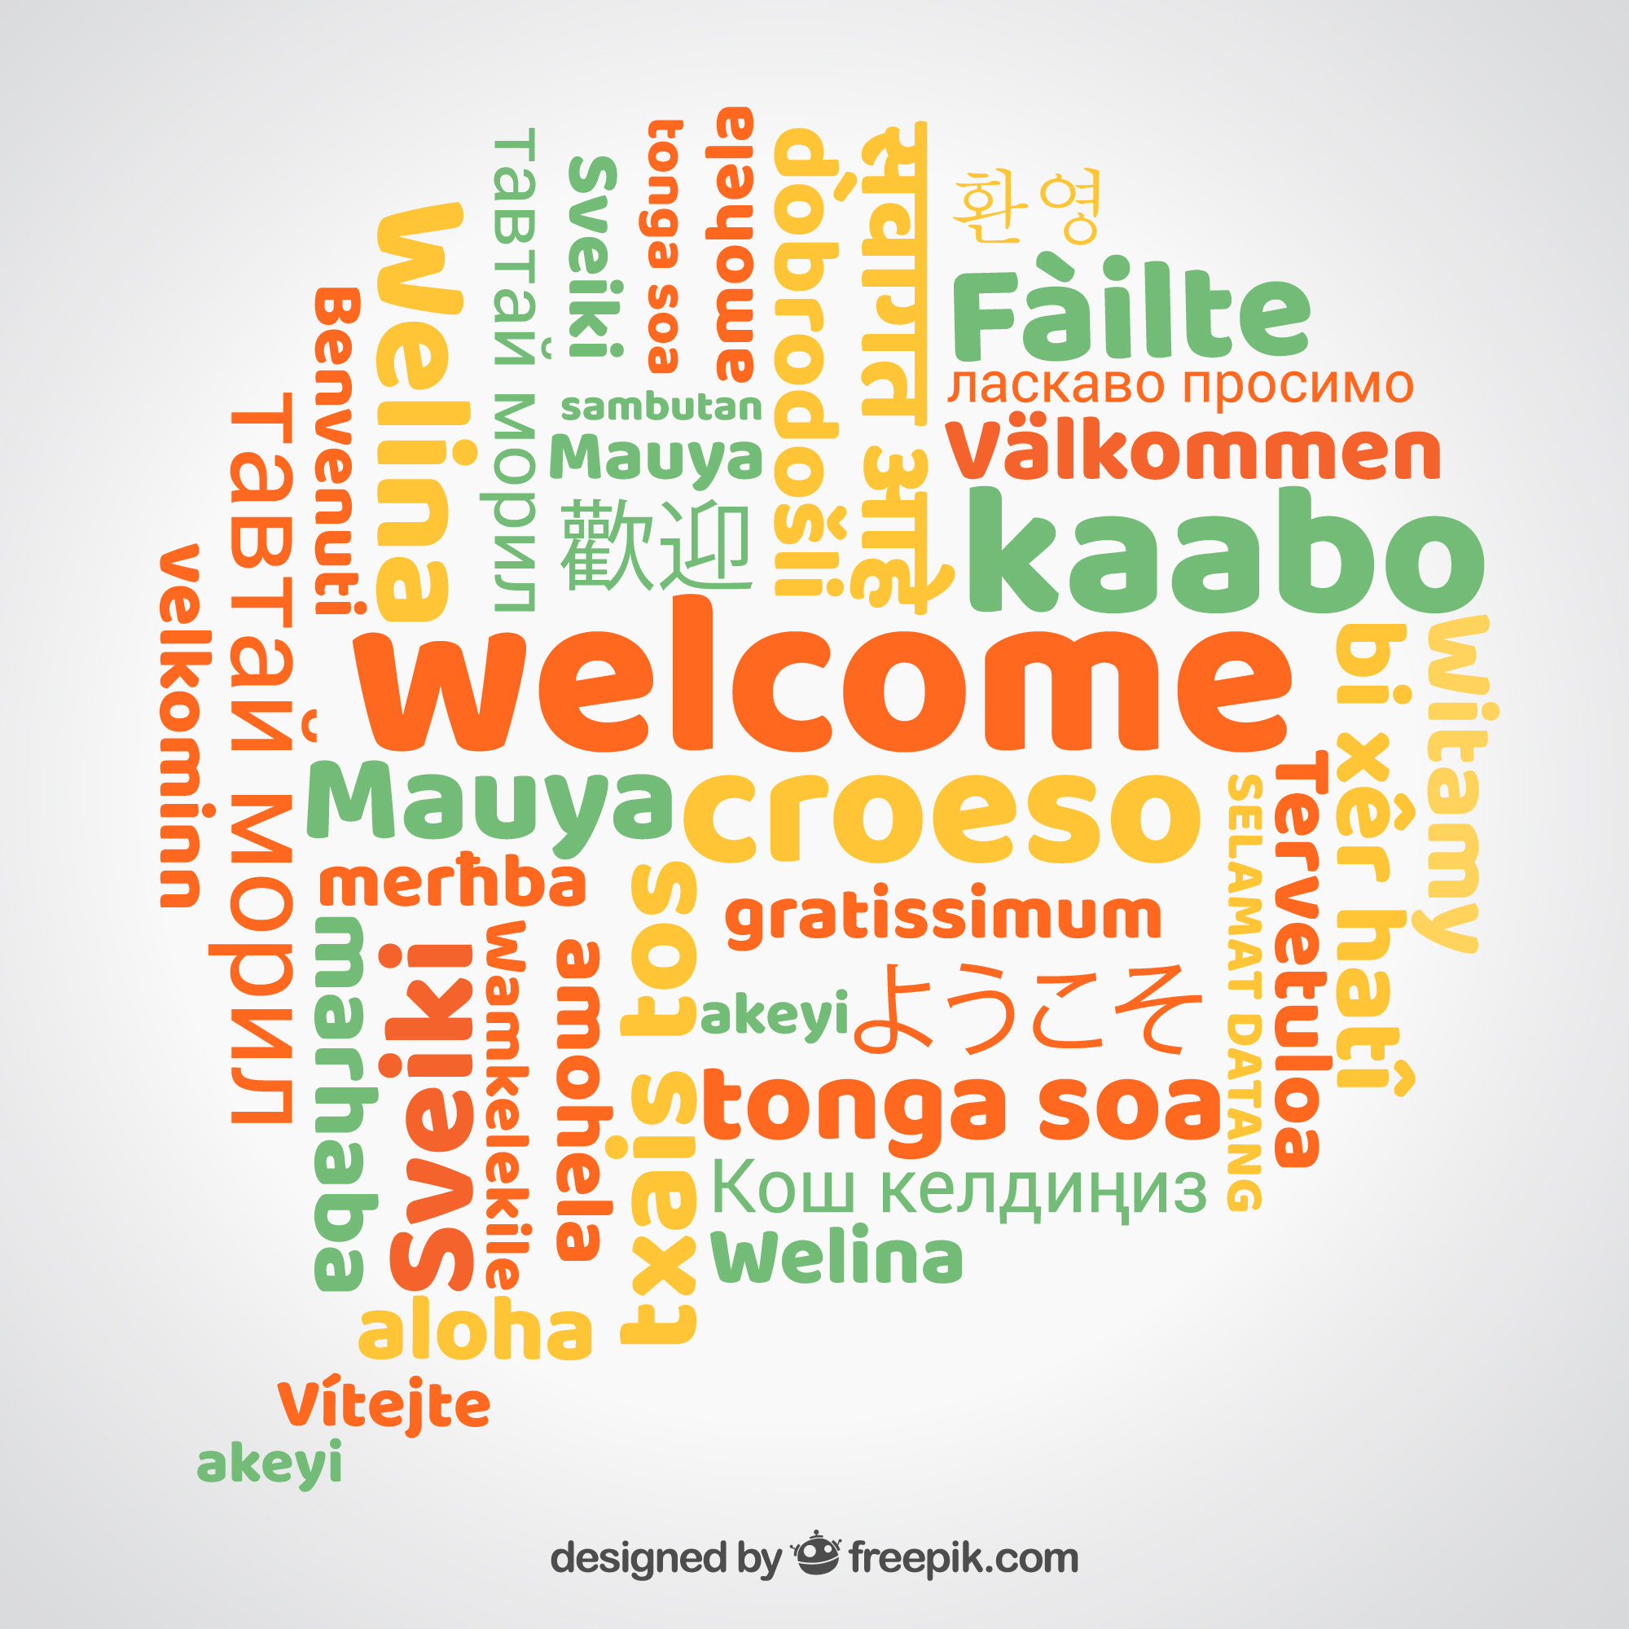
Meet Your Presenter
Darlene Schaefer
NCVPS Instructional Designer
EdD candidate at UNC Charlotte
25-year educator
Online instructor since 2006
Served as a teacher, content writer, curriculum leader, instructional leader, and curriculum coordinator for NCVPS
K-12 Master Reviewer
Live in Cornelius, NC north of Charlotte
Mom of three teens; all NCVPS students
Darlene.Schaefer@ncpublicschools.gov

Slide 4

Table Teams
Designate a discussion leader
Designate a recorder
Designate a reporter

Slide 5

Celebrations
What is your organization celebrating regarding World Language course offerings?

Slide 6
About NCVPS
Second-largest, state-lead virtual school in the country
Supplemental program providing fully online and blended learning courses with over 200 Middle and High School Course Masters
Almost 90 courses are QM certified
Offer 9 different World Languages including American Sign Language, Arabic, French, German, Japanese, Latin, Mandarin Chinese, Russian, Spanish
Collaborating with Korean grant team to design fully-online Korean courses

Slide 7

Challenges
What general challenges do you experience during World Language design?

Slide 8
Challenges
Limited SMEs
Limited resources, especially for cultural materials
Lots of multimedia
Takes time to design and move back and forth between languages
Standards are not as prescriptive as other subjects

Slide 9

Design Opportunities
In what ways does World Language provide for innovative and creative design opportunities?

Slide 10
Opportunities
Creative Design Possibilities
Lots of multimedia
Collaboration with individuals often from different cultural backgrounds
Asynchronous and synchronous learning opportunities
"Routines" in module and lesson structure

Slide 11

Systems of Support
How do you structure your design and development collaborative teams to provide optimal support for SMEs and designers involved in World Language?

Slide 12
Systems of Support
Content Writing team
Curriculum Coordinator: full time staff focused on standards alignment
Curriculum Instructional Leader who understands course authoring process
Content Reviewer who reviews content for subject accuracy (SME)
Content Writers who write apply teacher expertise (SME)
Design Team
Instructional Designer: full time staff focused on design practices, tools and technology, and digital accessibility
Contract Instructional Technology Specialists assigned to design a specific course
Contract Curriculum Specialists who provide ongoing support of master course upkeep

Slide 13
Training and Supports
Online and live training for Content Writing Teams
Online and synchronous support for Design Team
Accessibility focus for content writing team
Accessibility focus for Instructional Technology Specialists and Curriculum Specialists
Leveraging of lead teachers to support course updates and strategic alignment among various World Language levels

Slide 14

Accessibility Challenges?
What accessibility challenges do you experience during World Language design?

Slide 15
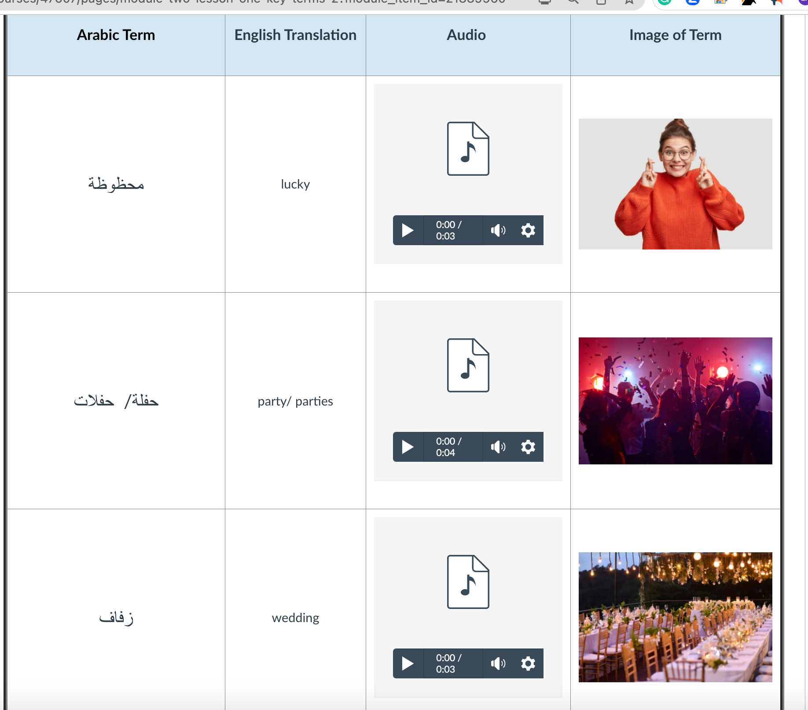
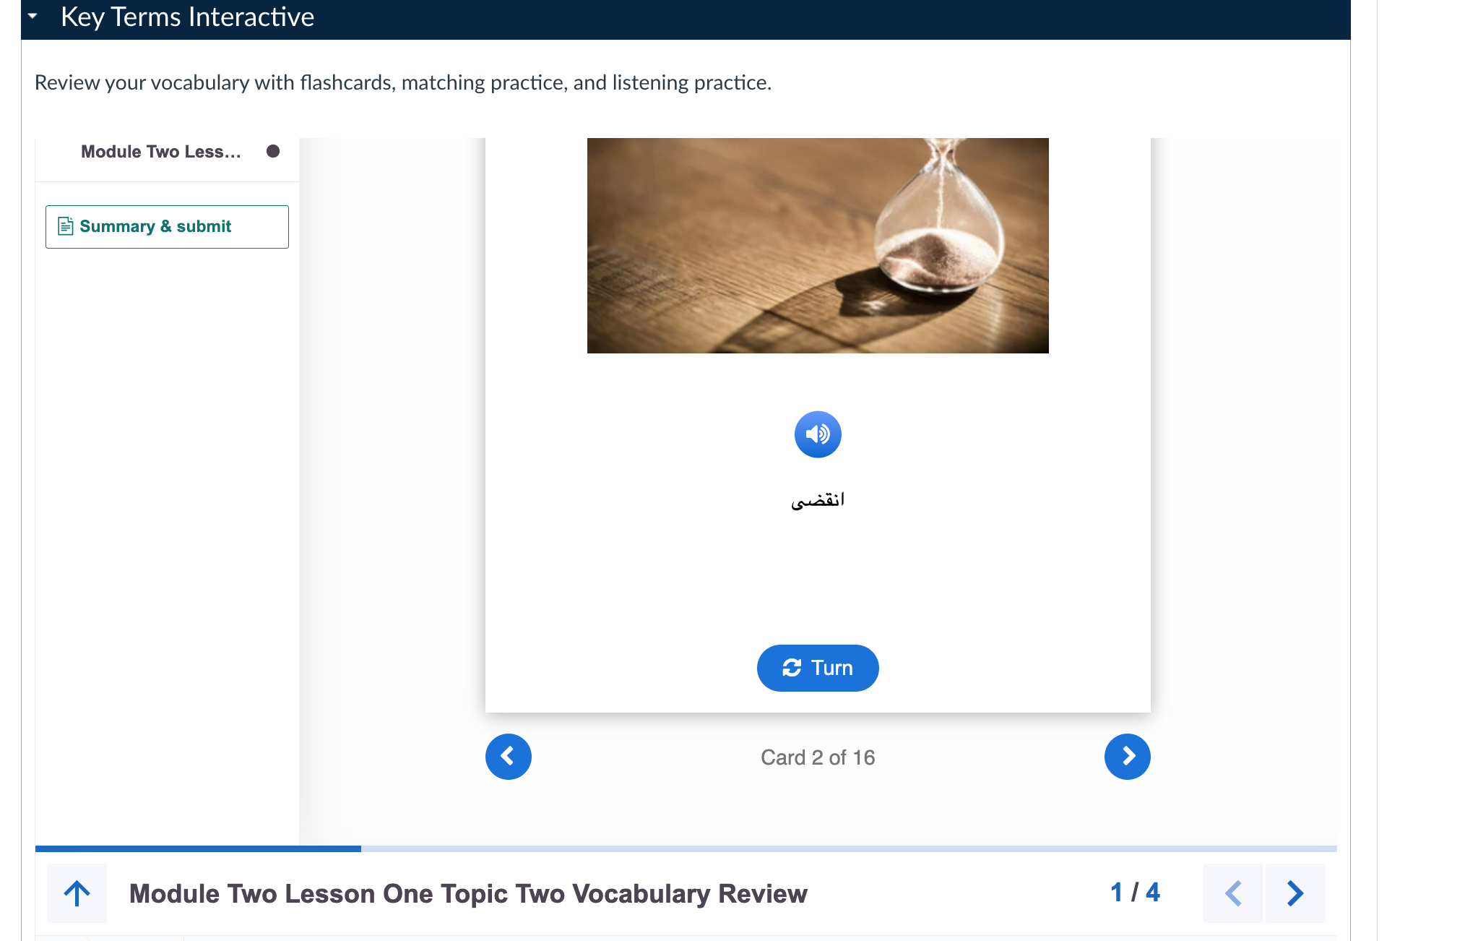

Slide 16
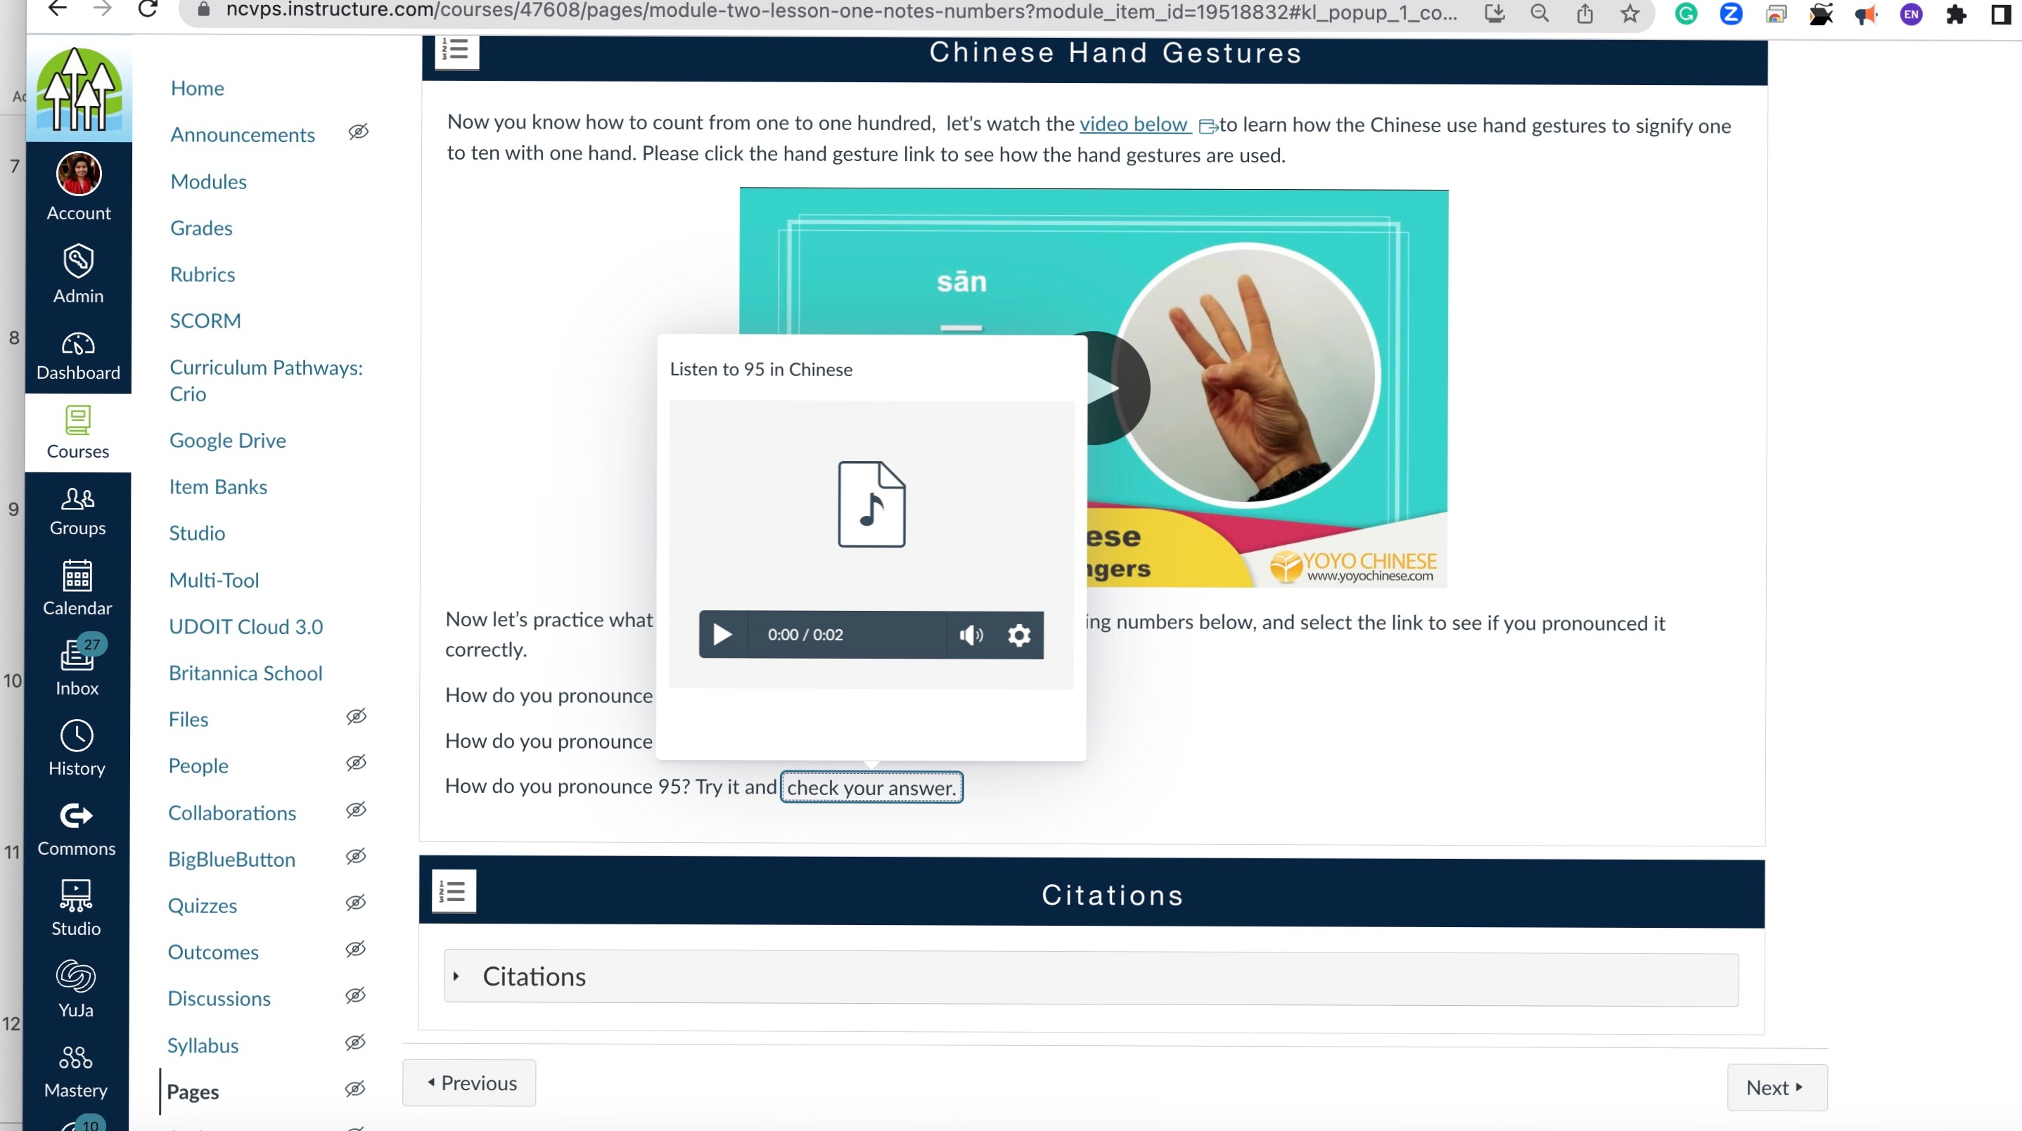
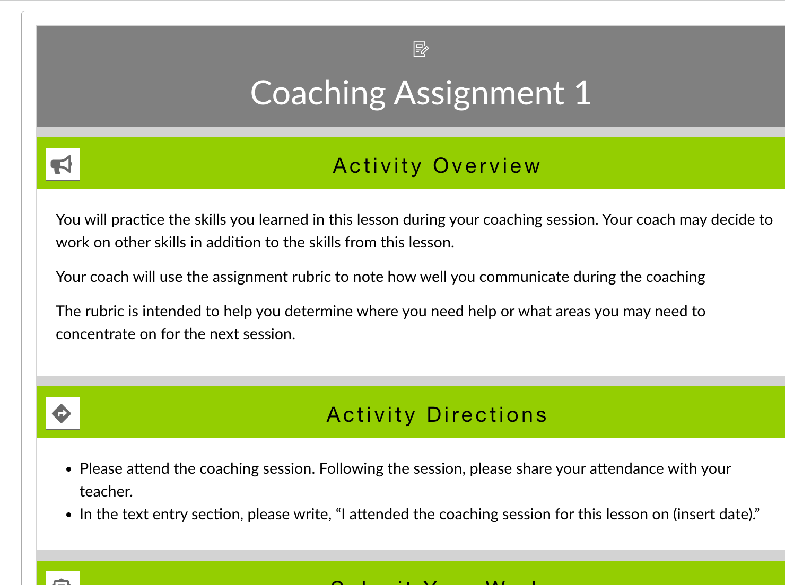

Slide 17
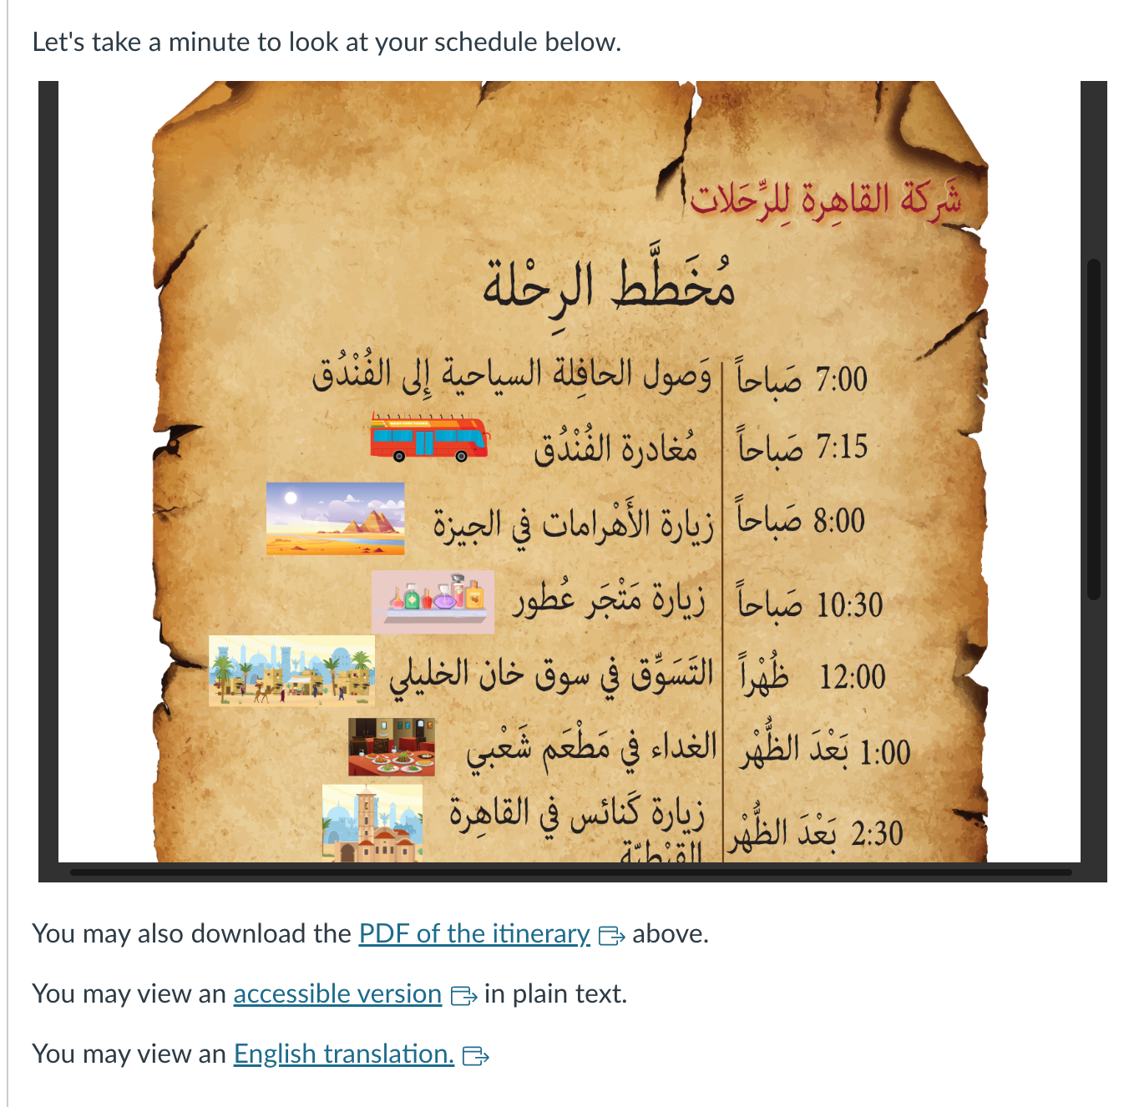

Slide 18

Negotiating State Standards
How do you negotiate speaking and listening standards with individual accessibility needs?

Slide 19
Negotiating State Standards
Provide Alternative assignments and multiple means of delivery
Leverage live instruction and language coaching support
Be mindful of "double assessments"
Involve your teachers

Slide 20

Tools and Technology
What tools or technologies have you adapted to support World Language accessibility?

Slide 21
Tools and Technologies
Accessibility scanning tools
Grackle for Google Docs
UDOIT for Canvas
Design Tools
Murf.ai for text to voice; includes multiple languages
Adobe Acrobat for text recognition
Cidilabs Design Plus
Yuja video streaming
Allows collaborators to edit auto captions

Slide 22

Other Ideas
What other practical tips do you have regarding accessibility and World Language?

