Slide 1


Data- Driven:
Using Course & Institutional Data for Continuous Improvement
@bsimunich
#QMResearch
Dr. Bethany Simunich
Director of research & Innovation
Quality matters

Slide 2
What we’ll cover
Identify types of data to collect for continuous quality improvement.
Describe common obstacles and barriers in data collection and discuss how to overcome them.
Explain how to analyze and interpret data well in order to improve online learning.

Slide 3

We’re drowning in data
Course grades
LMS data, usually on usage
Other Institutional data – DFW, enrollment, retention, etc.
Is it meaningful?
Is it the data we need?
This Photo by Unknown Author is licensed under CC BY-ND

Slide 4

Usefulness and Interpretation is key
Data are not stats or research
  Individual pieces of factual information
  Meaning often highly dependent on interpretation and analysis
Avoid a rush to judgement
  Make sure you have the full picture before using the data to make decisions
This Photo by Unknown Author is licensed under CC BY

Slide 5

Data Story: Drop/Fail/Withdraw
Michael teaches an introductory-level, larger-enrollment online chemistry course. His institution pulls data on D/F/W rates for courses and his course has been identified as having a high D/F/W rate, which impacts his performance evaluation.
What might be going on here?
Should we assume there’s an issue with Michael’s teaching?
What other information might Michael/his institution need or want before taking some action?

Slide 6

DFW data: A different approach
Look at DFW rates over time, and also by level of student preparedness
Example: WVU assigns a five-scale “institutional rating” to all entering students, based on their degree of academic preparedness (IR-1 = highest, IR-5 = lowest).
If historical data reveals students have a low-level of preparedness in courses with high DFW rates, consider orientation course to address general readiness or development course to address course preparedness
If DFW rates are not correlated with low-preparedness, what else might be going on?
  Design? Teaching? Student readiness for online?
This Photo by Unknown Author is licensed under CC BY

Slide 7

DFW data: Gather more information
Bernadette Jungblut, WVU’s Director of assessment and retention, recommended qualitative approach as well:
  Interview faculty – quantitative data alone won’t tell you why students are struggling
  Focus groups with students
Chemistry course: Adding student support and academic intervention measures did not help
Faculty interviews revealed students lack essential math skills, but are initially unaware
Result: Course split into two segments; students may be routed to skills course if they do not pass the first segment

Slide 8
Step back and Strategize
Consider:
1. What data do you have? What are the limitations of the data?
2. What new data do you need to collect? Why?
3. What is the best way to collect the data?
4. How will you approach interpreting and using the data? What factors could influence the analysis or interpretation?

Slide 9

Examples of Data to Collect for Continuous Quality Improvement
This Photo by Unknown Author is licensed under CC BY

Slide 10
What data do you have?
What do you need?
Who are your stakeholders?
Data from student assessment (formative & summative)
LMS data (usage data, early alert data, etc.)
Institutional data (retention, completion, etc.)
Student evaluations (other student feedback?)
Instructor feedback
Faculty & Professional Development attendance & feedback

Slide 11
Data Story: Student Evaluations
Pat teaches an accelerated 5-week, 100% online Sociology course that is also Writing Intensive. The SEI response rate for her Summer 2019 section was low (3 students out of 20), and the evaluations were poor to average, despite most students getting A’s and B’s. One student rated everything low and also added comments that Pat was “the worst professor he ever had”.
What might be going on here? How might this data be interpreted?
What other information would be needed to appropriately interpret the SEI data?
What might Pat do to address this data before the class is taught again? What decisions might Pat make, based on this data?

Slide 12
SEI data: A different approach
Compare accelerated format with full-term format
Examine level of preparedness for college-level writing
Look at timing and sequencing of assignments for both learners and the instructor
Augment with student feedback and instructor feedback
This Photo by Unknown Author is licensed under CC BY

Slide 13
Collecting new types of student feedback
Calculate workload when designing or
re-designing your course, but verify
Approximately how long did it take you to complete the entire module/week? Please estimate to the nearest half hour (e.g., 6.5), and only use numbers and a decimal point.
Thinking about the amount of work in this module/week, it was:
a. Too much/More than I expected
Know what students valued so you know what to trim or expand: Ask about which learning activities were least and most helpful
b. Just about right
c. Not enough/Less than I expected

Slide 14
Student feedback on design
The assignment(s) in this module/week included clear and explicit instructions that enabled me to understand what to do, how I would be evaluated, and how the assignment connected to the learning outcomes.
(Likert scale Agree – Disagree)
Relates to Standard 3.3: Specific and descriptive criteria are provided for the evaluation of learner’s work, and their connection to the course grading policy is clearly explained and Standard 2.4: The relationship between learning objectives and learning activities is clearly stated. (Also SRS 3.1!)

Slide 15
Student feedback on design
The timing of assignments allowed me to use feedback to improve my work.
(Likert Scale Agree – Disagree)
Relates to Standard 3.5: The course provides learners with multiple opportunities to track their learning progress with timely feedback, and Standard 5.3: The instructor’s plan for interacting with learners during the course is clearly stated.

Slide 16
Potential issues and obstacles
This Photo by Unknown Author is licensed under CC BY

Slide 17

Know the limitations of your data
Data are facts, usually numerical, but are dependent on your interpretation to be used wisely
Numbers alone don’t always tell us the whole story
Some data (e.g., student and instructor feedback) need a purposeful effort
If using data for independent research, consider your needs in advance.
This Photo by Unknown Author is licensed under CC BY-NC-ND

Slide 18

LMS data
Common examples of data collected in a Learning Management System include:
  Use/Course Access
  Activity Log/Views
  Activity Completion
  Early alert systems (missed deadlines, low grades, low activity, etc.)
  Reports geared toward learner engagement
This Photo by Unknown Author is licensed under CC BY

Slide 19
Example: LMS Data
Mountain Valley College wants to gather data on student engagement in online courses. They gather data from the LMS on time spent in the course, and see a very wide range, even within a single course.
What does “student engagement” mean in terms of LMS data?
How might they interpret this LMS data?
What other data might they need or want to aid interpretation?

Slide 20
LMS data: A different approach
Is there a correlation between LMS engagement and grades?
Consider more robust view of engagement
If engagement strategies are focused on active and applied learning, examine assessments
Consider GS 3 in conjunction with GS 5
This Photo by Unknown Author is licensed under CC BY

Slide 21

Using Data for CQI and OL Research
If gathering data for your own research (or institutional research), know what data you need from the start
Consider what you want to know (your Research Question), who wants to know, and why
If conducting research around QM/Quality Assurance efforts, plan in advance

Slide 22
Example:
Before & After QM
Omar has been teaching online for five years and took QM’s Improving Your Online Course workshop last Spring. Over the summer, he worked hard to revise his course to meet QM Standards, and in September, his course received QM Certification. Omar is excited to see the grades of students this semester, since they’re in the revised, QM-certified course, and hopes the grades are proof that QM ”works”.
If Omar compares student grades before the QM Certification to grades after QM Certification, what other information would he need to get the full picture of any grade changes?
Why might final grades not provide ”proof that QM works”? What other data might he analyze or collect to enable him to better understand potential effects of revising his course to meet QM Standards?

Slide 23
Before/After QM data: A different approach
Get the full picture of “Before”
Document any/all changes made
Consider confounding variables (Online Quality Pie):
  Teaching/Delivery
  Student Preparedness
  Content
  LMS & Institutional Infrastructure
Gather student feedback
This Photo by Unknown Author is licensed under CC BY

Slide 24
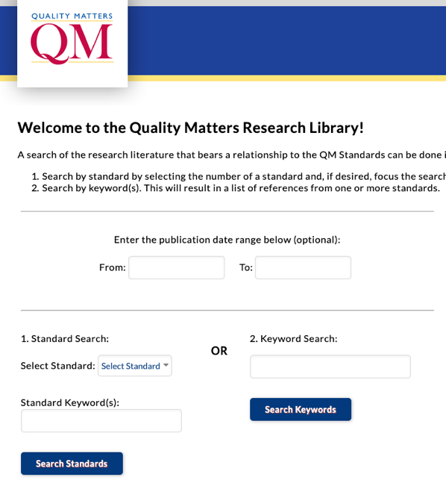


Doing research? QM is here to help!

Slide 25
Using data to inform and improve
Based on today’s discussion, what are new pieces of data you might want to collect?
What about data we might not collect at all, such as faculty development?
How can we have better institutional conversations about bridging the gap between the data we have and the data we need?

