Slide 1


Design Exams in Science Courses That Truly Measure Learning Outcomes
By:
  Dr. Amir Kessentini
  Dr. Adel Gahmesh
  Mr. Abdullah Zubain
Oct. 30 - Nov. 2, 2018
St. Louis, Missouri
E-Learning Deanship
@ King Khalid University

Slide 2
Agenda
QM implementation at King Khalid University
Strong QM Exams in Science Courses

Slide 3
Agenda
QM implementation at King Khalid University
  History
  Statistics
  Awards

Slide 4
History
Since 2010 with QM
8 Years

Slide 5
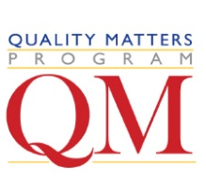
Statistics
Individuals | 795
Individuals Trained | 627
Peer Reviewers | 30
Master Reviewers | 5
Facilitators | 14
Courses Submitted for Review | 57
Closed Submitted Reviews (QM - Recognized Courses) | 48

Slide 6
Statistics
Courses Reviewed by Internal Reviewers from KKU |  | 64
 | Higher Ed QM-Managed - | 17
 | Higher Ed Subscriber-Managed - | 9
 | Higher Ed Internal Review - | 7
 | Higher Ed Subscriber-Managed managed by CRM - | 31

Slide 7

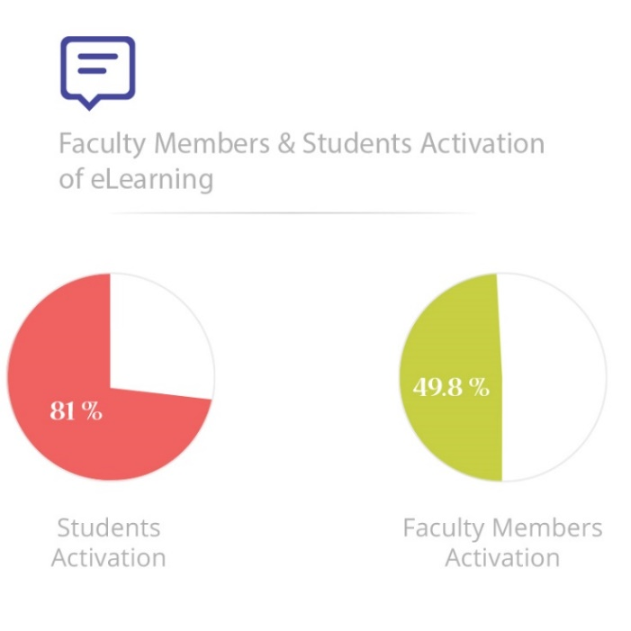
Statistics

Slide 8

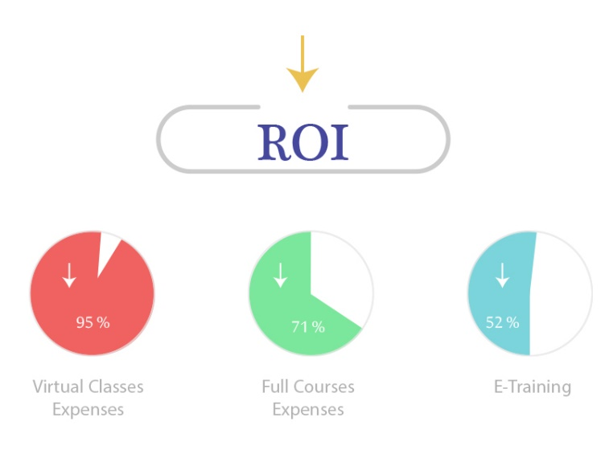
Statistics

Slide 9



Statistics
Open Channel

Slide 10
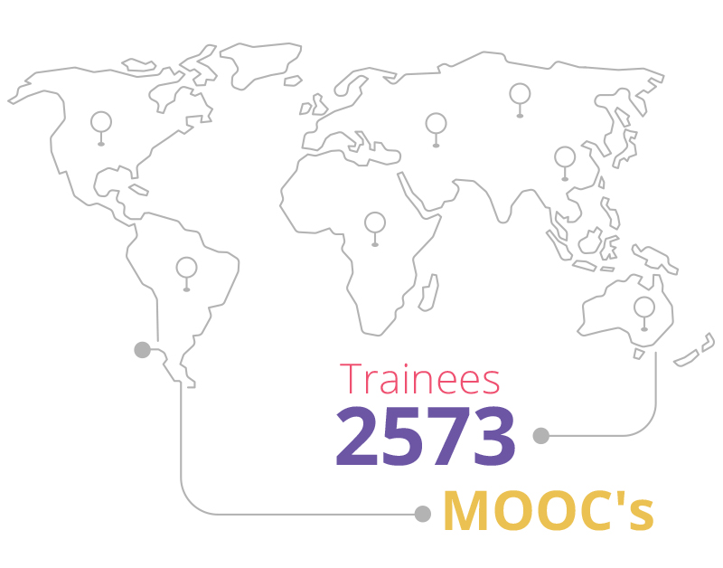
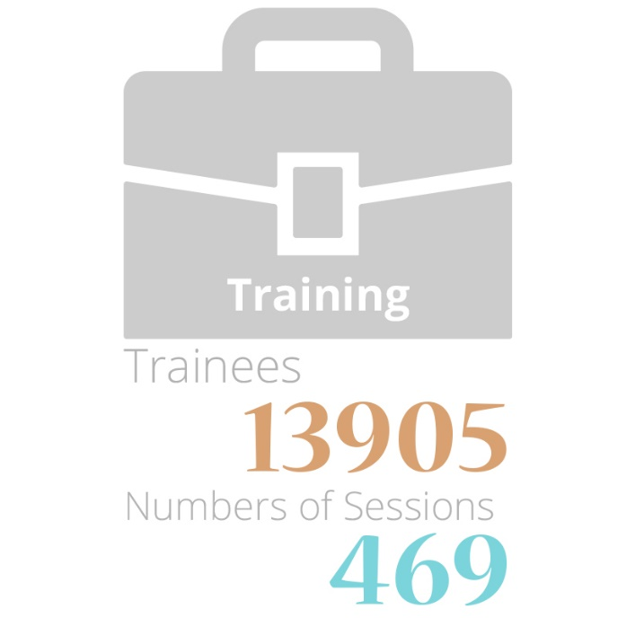
Statistics

Slide 11

Statistics

Slide 12







Awards
Local: 10
International: 4

Slide 13
Agenda
Strong QM Exams in Science Courses

Slide 14

Truly measure students' learning outcomes

Slide 15
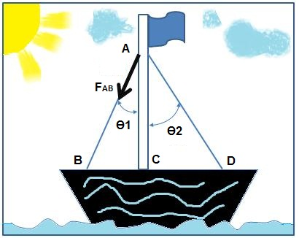
Problematic: Truly Measure Learning Outcomes
  Paper-pencil format
Given data:
A flag-pole is held in a vertical position by two wire stays attached to the same point on the pole. The two wire stays are at angles of 41Deg and 33Deg to the pole (see figure) and the resultant force is equal to 8kN along the vertical axis of the pole. The diameter of the pole is to be 10cm.
Question:
Calculate the shortening of the pole made by steel (E=200 GPa) if its original length is L0=3m

Slide 16
Problematic: Truly Measure Learning Outcomes
  Online auto-graded format
Calculate in micrometer the shortening of the pole made by steel (E=200 GPa) if its original length is L0=3m and select the right answer:
100
200
300
400

Slide 17

Problematic: Truly Measure Learning Outcomes
  Online auto-graded format
Calculate in micrometer the shortening of the pole made by steel (E=200 GPa) if its original length is L0=3m and select the right answer:
100
200
300
400

Slide 18
Problematic: Truly Measure Learning Outcomes
  Online auto-graded format
Calculate in micrometer the shortening of the pole made by steel (E=200 GPa) if its original length is L0=3m and select the right answer:
200
200
200
200

Slide 19
Problematic: Truly Measure Learning Outcomes
  Online auto-graded format
Calculate in micrometer the shortening of the pole made by steel (E=200 GPa) if its original length is L0=3m and select the right answer:
200
200
200
200

Slide 20

Problematic: Truly Measure Learning Outcomes
  Online auto-graded format
The shortening of the pole made by steel, (E=200 GPa) if its original length is L0=3m, is to be 200 micron:
True
False

Slide 21
Problematic: Truly Measure Learning Outcomes
  Online auto-graded format
The shortening of the pole made by steel, (E=200 GPa) if its original length is L0=3m, is to be 270 micron:
True
False

Slide 22
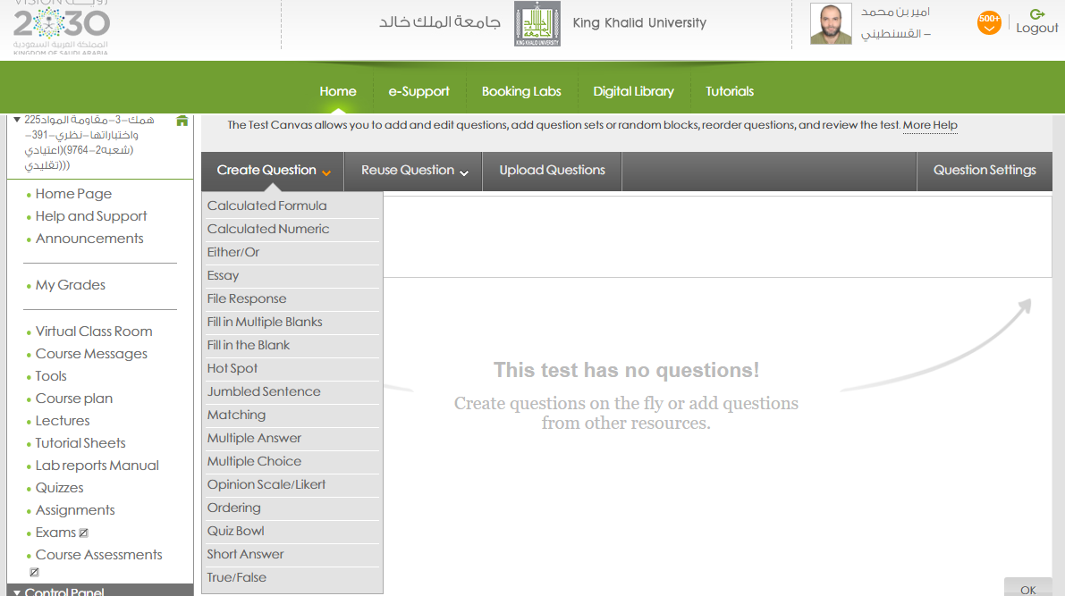
Problematic: Truly Measure Learning Outcomes
Most of questions types actually used are to be:
Multiple choice questions
Multiple answer questions
True / False questions
Big Problem in Quality Assurance
No Accuracy in LOs measurement

Slide 23
Problematic: Truly Measure Learning Outcomes
?
How online instructors can design and transform exams in science courses from the paper-pencil format to online assessments?
?
Exams made of mostly multiple-choice questions and similar are not effective to measure learning outcomes,
?
In Engineering as in many other math and science disciplines, most exams need to assess students' mastery of knowledge and skills with calculation as well as problem solving,
?
Truly measure students' learning outcomes while ensuring academic integrity and meeting QM standards.

Slide 24
Truly measure students' learning outcomes

Slide 25
Big Challenges
SRS. 3.1.
“A problem analysis demonstrates critical thinking skills”
?? How to ENSURE
1
QM alignment principle relating to measurable learning objectives and effective assessments to meet QM standards.
?? How to ENSURE
SRS 1.4.
“academic integrity”
2
Academic integrity.

Slide 26
Big Challenges
SRS. 3.1.
A problem analysis demonstrates critical thinking skills
?? How to ENSURE
1
QM alignment principle relating to measurable learning objectives and effective assessments to meet QM standards.
Starting from a paper-pencil format
You can measure each LO alone with accuracy
Build a set of calculations using Ms. Excel (unlimited)
To calculate one parameter becomes a one whole problem

Slide 27
Big Challenges
?? How to ENSURE
SRS 1.4.
academic integrity
2
Academic integrity.
build a set of calculations and pools
All Question becomes independent
Use Random Blocks
Randomize questions (in the exam options setting)
Display one question at a time (in the exam options setting)

Slide 28
Let’s move to a real case
Course: 225ME-3 Strength of Materials and their testing, QM-Recognized Course since 2015
College of Engineering
Department: Mechanical Engineering
Students: About 170 each semester, from three Academic Departments (Mechanical – Chemical - Industrial)
MLOs:
Calculate loads for static problems
Calculate normal stress and strain
Calculate Change in length using Hooke’s Law
…
---------------------------------------------
Module objectives are related to the following course general objective:
Solve Problems for solid subjected to tension

Slide 29
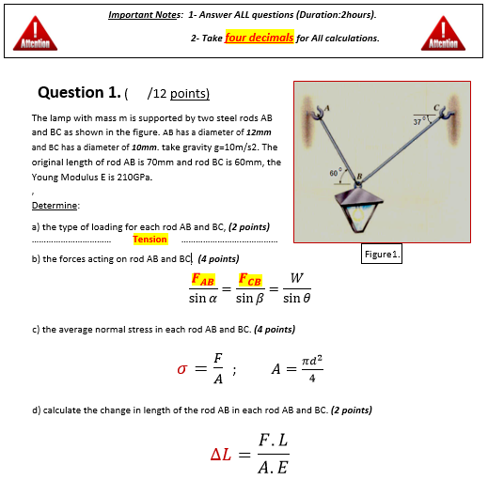
Let’s move to a real case
Paper-pencil Exam format
m=80 Kg.

Slide 30
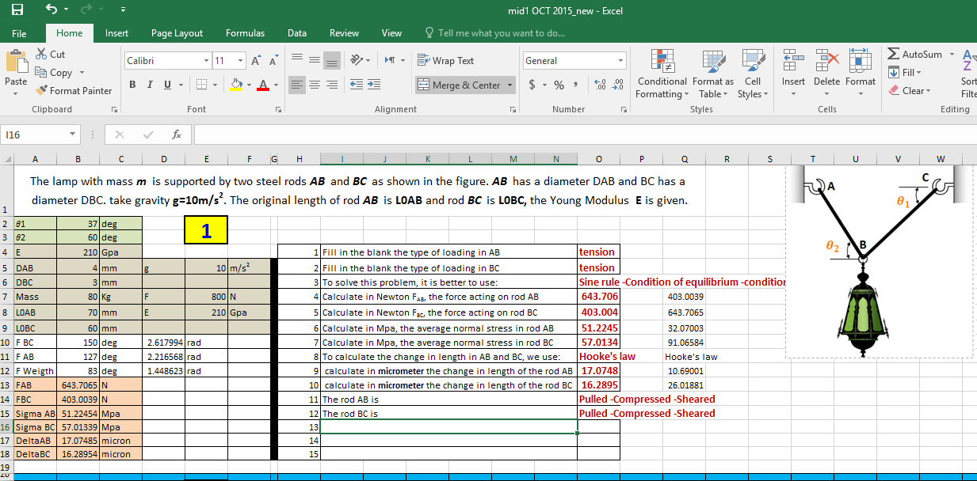
Build a set of calculations using Ms. Excel (unlimited)

Slide 31
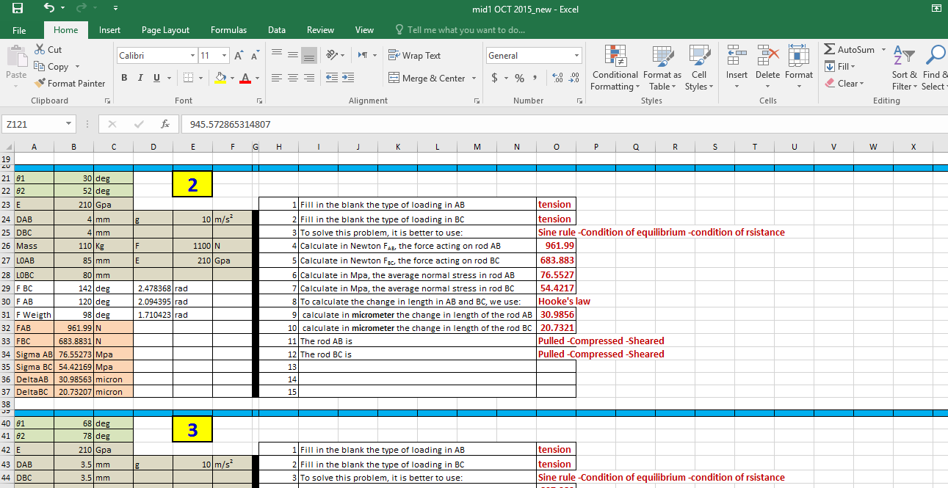
Build a set of calculations using Ms. Excel (unlimited)

Slide 32
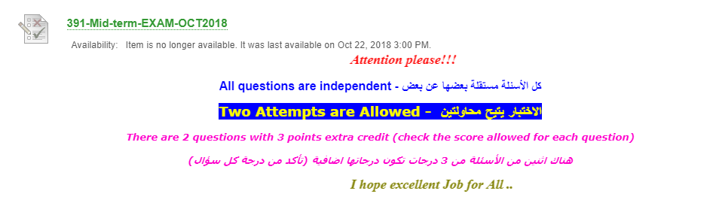
From Ms. Excel to the LMS

Slide 33
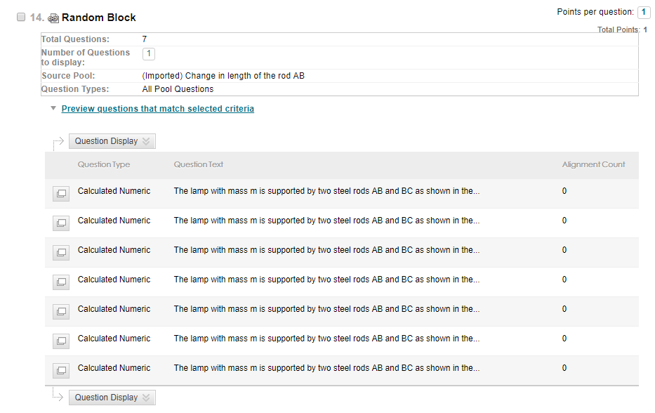

Slide 34
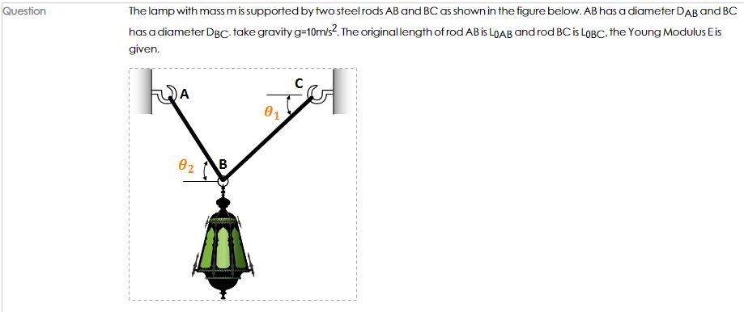
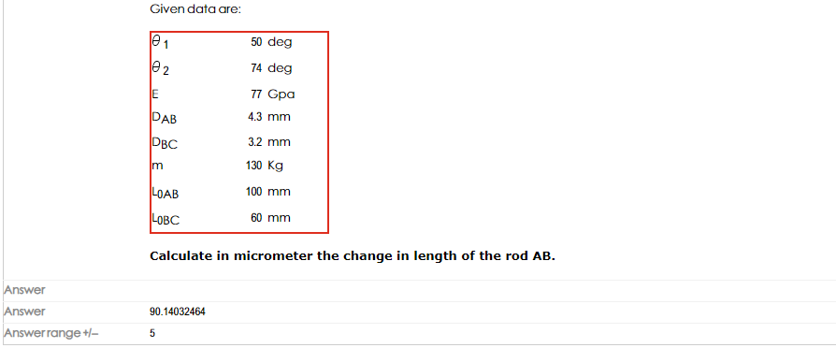

Slide 35
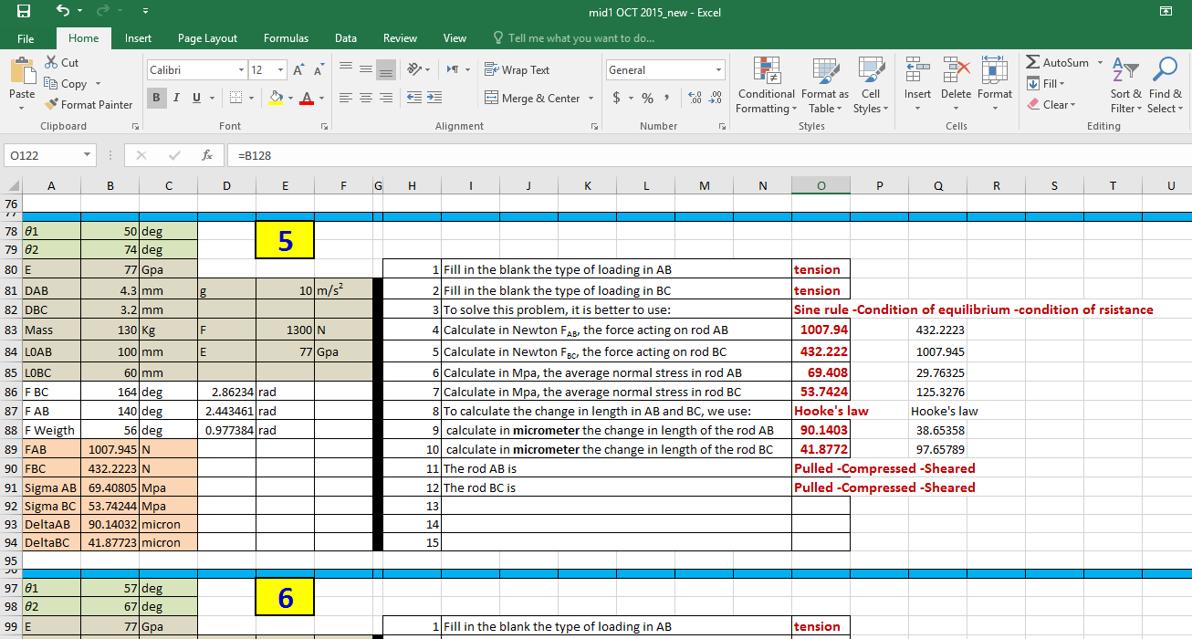

Slide 36
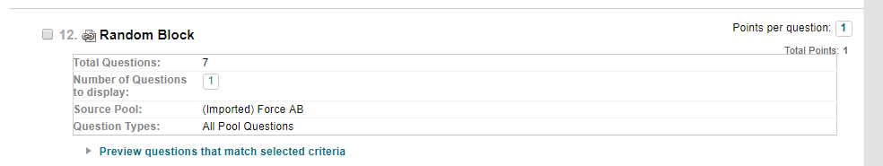

Slide 37
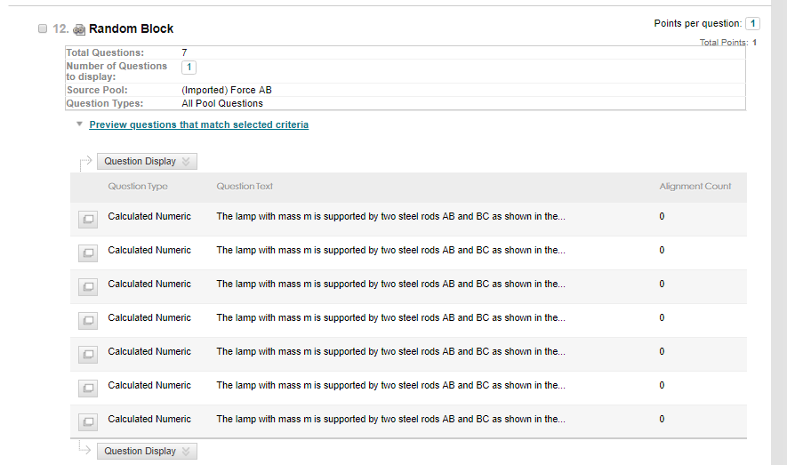

Slide 38
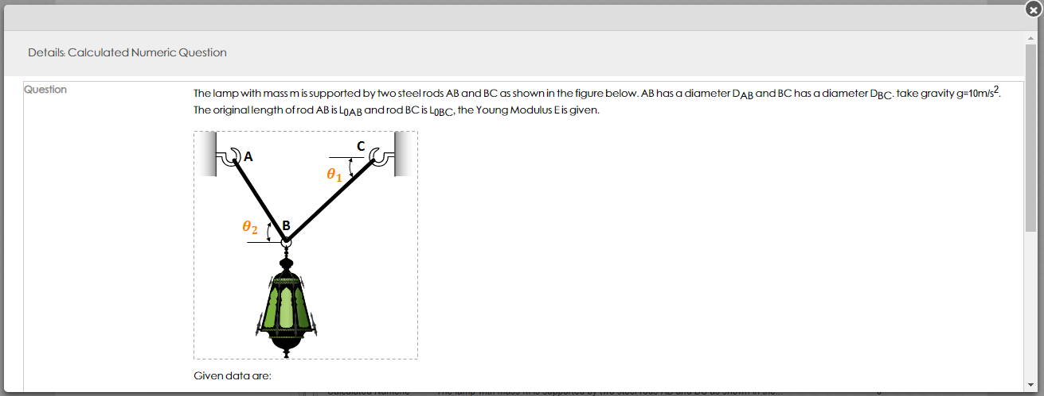
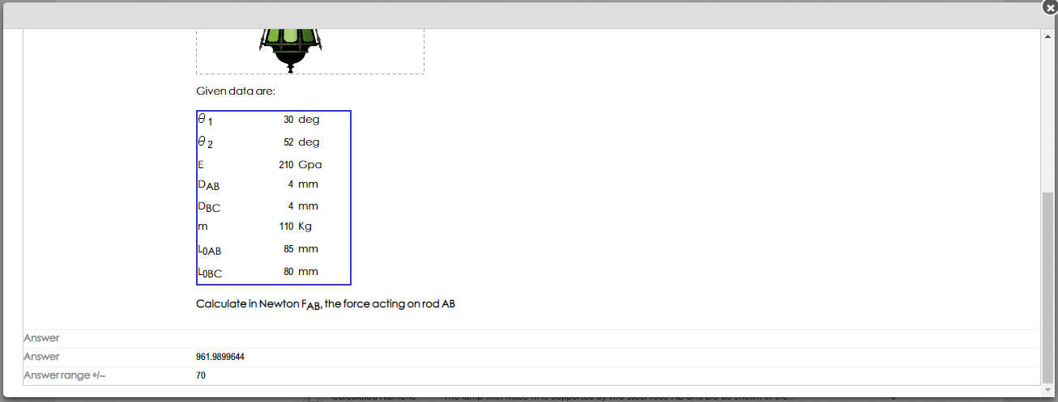

Slide 40
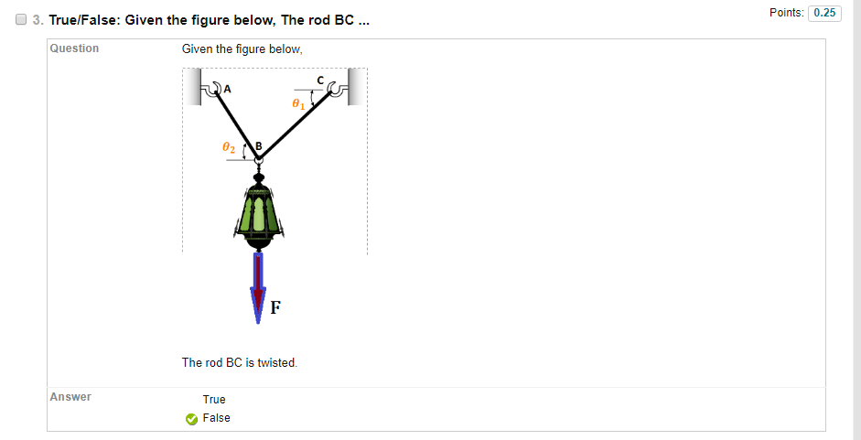

Slide 41
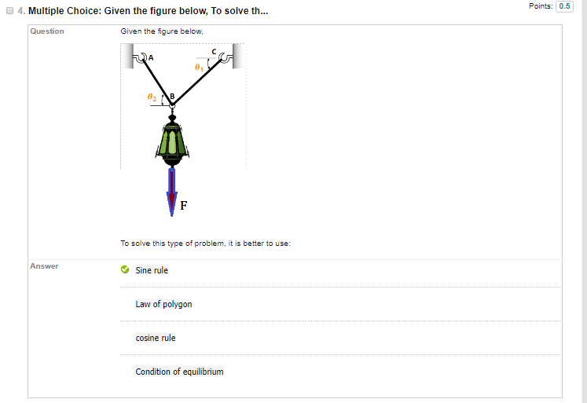

Slide 42
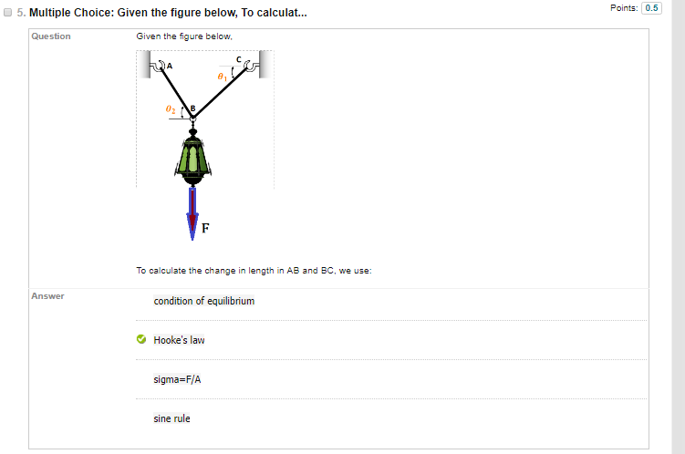

Slide 43
Conclusions
A questions Bank containing more than 1000 exercises
All these exercises are ready to be used randomly with a same level of difficulty
Number can be multiplied easily in one click
Students neighbor hasn't same question at a time
High accuracy in Los measuring
Zero minute for correction instead of 4 days – 6 hours per day
Zero Error in correction and total

Slide 44
Perspectives
Engineering Drawing 2 – 224ME, QM-Recognized Course since 2016
Fully online course
One instructor for about 180 students
Strong Exams

Slide 45
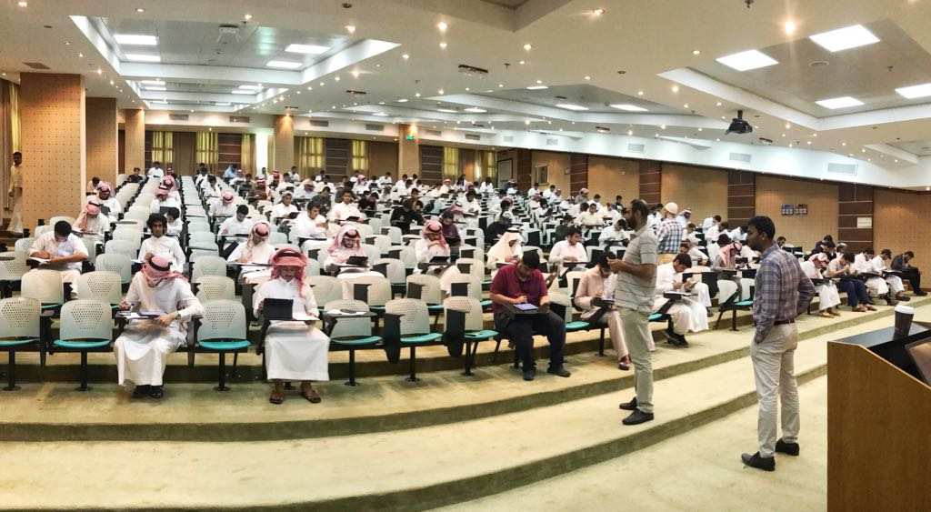

Slide 46
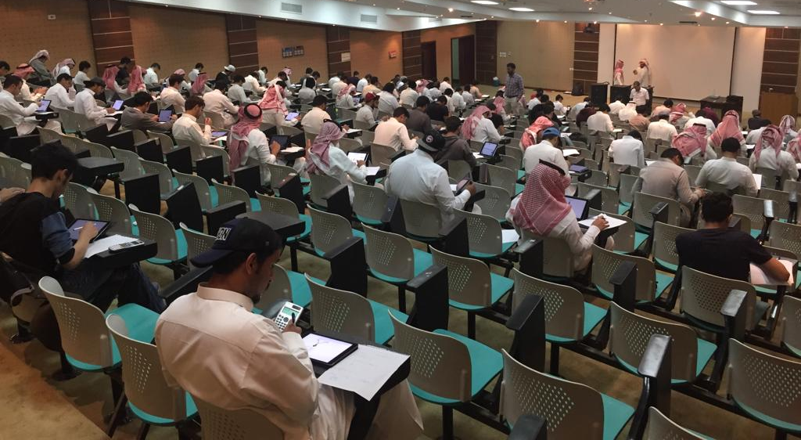

Slide 47
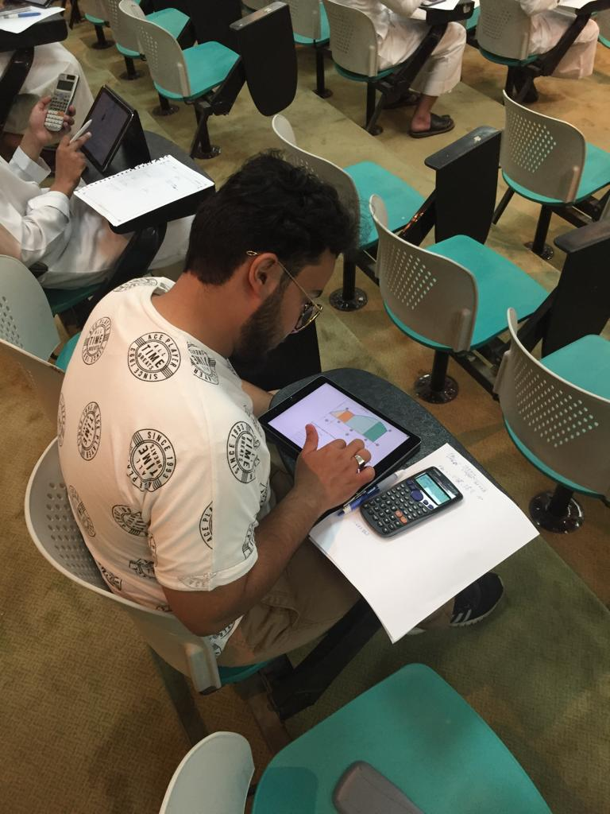


Slide 48
Thank You..
Oct. 30 - Nov. 2, 2018
St. Louis, Missouri
E-Learning Deanship
@ King Khalid University

