Slide 1
Developing a Framework for Quality Online Course Videos: What Does the Research Say?
February 9, 2021| Online

Slide 2
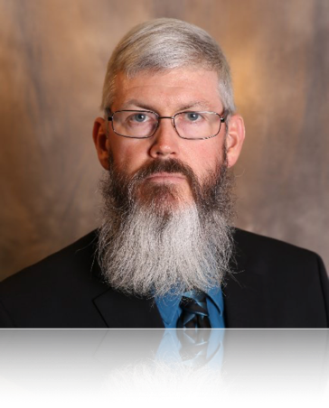
Steven R. Crawford, Ed.D.
District Director,
Maricopa Center for Learning and Innovation
steven.crawford@domail.maricopa.edu
@DrSRCrawford

Slide 3
Session objectives
After this session, you will be able to…
define the various categories and types of instructional multimedia
appraise the research that informs our practice in developing multimedia for online presentations
discuss how faculty and instructional designers can apply these emerging best practices when developing online presentations

Slide 4
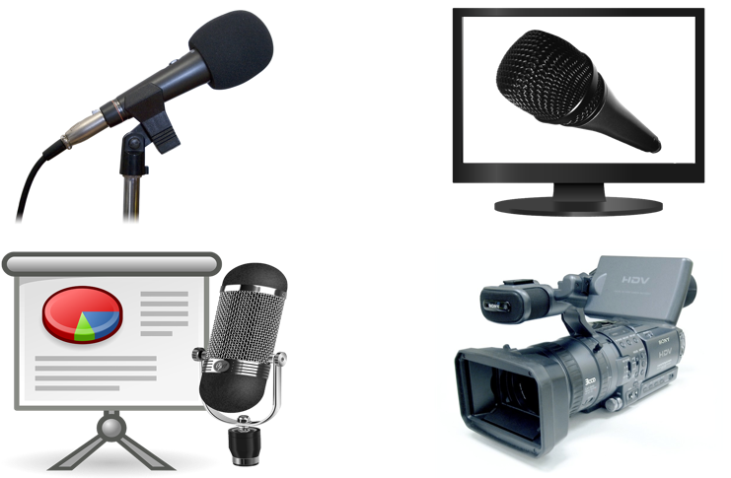
Defining types of multimedia

Slide 5
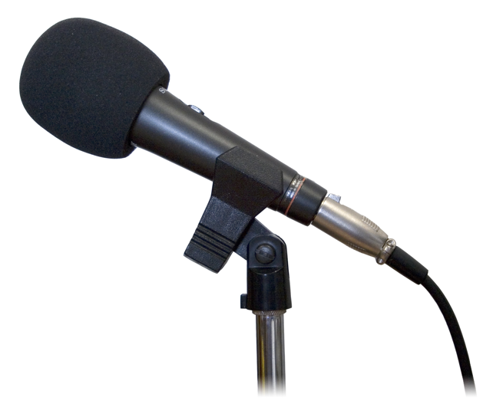
Audio presentations
Podcast
Course introduction
Personal introduction
Module introduction
“Lecture”
Student feedback
Course announcements
Interview
Event/lecture capture
Role play
Case study/Scenario/Vignette

Slide 6
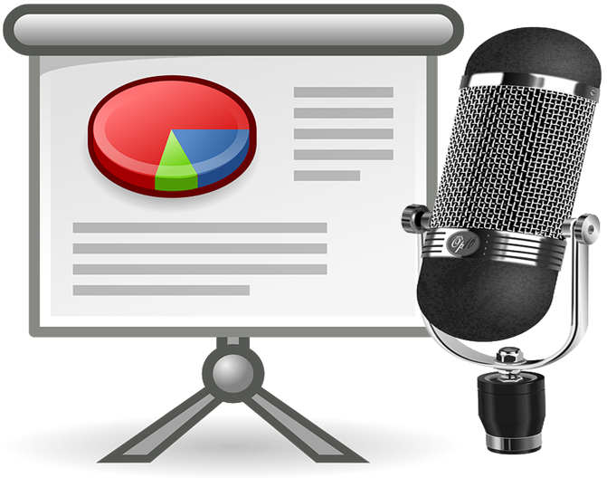
Voiceover presentations
Course introduction
Personal introduction
Module introduction
“Lecture”
Case study/ Scenario/Vignette

Slide 7

Screencasting presentations
Course introduction
Module introduction
Student feedback
Demo of application/process

Slide 8
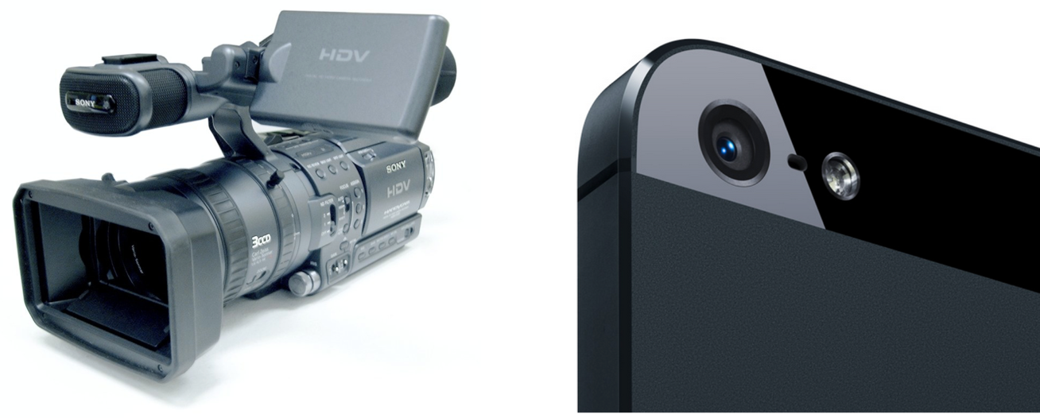
Video presentations

Slide 9

Lesson from the research

Slide 10

Caveat 1: Novelty effect

Slide 11


Caveat 2: Apples vs oranges

Slide 12

Caveat 3: Significant difference?

Slide 13

Question:
Does including video in my course make a difference for my students?

Slide 14
Question:
How long is too long?

Slide 15
Question:
Do students want to see me talk?

Slide 16
Question:
If I am not onscreen, then what do students want to see?

Slide 17
Question:
Should I include video of me tutoring students?

Slide 18
Question:
Do I need to have a studio setup with high quality video?

Slide 19
Question:
If I do not have any students that are deaf/hard of hearing, do I really need to have captions?

Slide 20
Question:
Should I require students to be on camera during a video conferencing session?

Slide 21
Resources
Designing Multimedia Presentations for Your Course
Making a First Impression With Your Introduction Videos
Strategies for Improving Video Conferences and Webinars
Discover the Power of Screencasting
Captions Help ALL Learners

Slide 22
Developing a Framework for Quality Online Course Videos:
What Does the Research Say?
Steven R. Crawford, Ed.D.

