Slide 1


Lights Camera Action: What Happens to Accessibility When a Course Goes Live?
QM West Regional Online Conference, April 3, 2020
Presenters: Rosalinda Larios, Gina Michell, and
Margaret D. Clark, PhD.
California State University, Los Angeles

Slide 2
Session Objectives
To examine the types of activities and assignments that are inclusive and accessible to students in an online course
To discuss the types of activities and assignments that are inclusive and accessible to students in an online course
To problem solve a dilemma that emerged in our online class

Slide 3
How do you truly know that every aspect of your course is accessible for all your students?

Slide 4
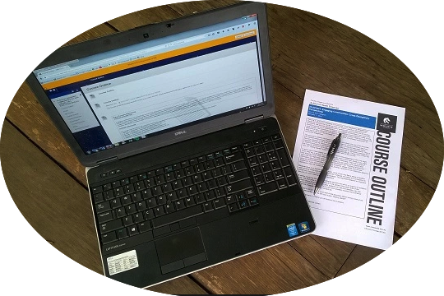
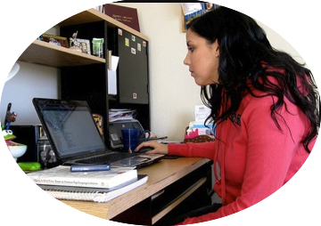

UDL
Representation
Action and Expression
Engagement

Slide 5
Representation
Principle 1: The "what" of learning
Consider what students will
  See
  Create
  Verbalize and/or Write
  Hear

Slide 6
Action and Expression
Principle II: The "how" of learning
Students will demonstrate what they know through a variety of modalities

Slide 7
Engagement
Principle III: The "why" of learning
Interest and Relevance
Persistence
Levels of Challenge and Support

Slide 8



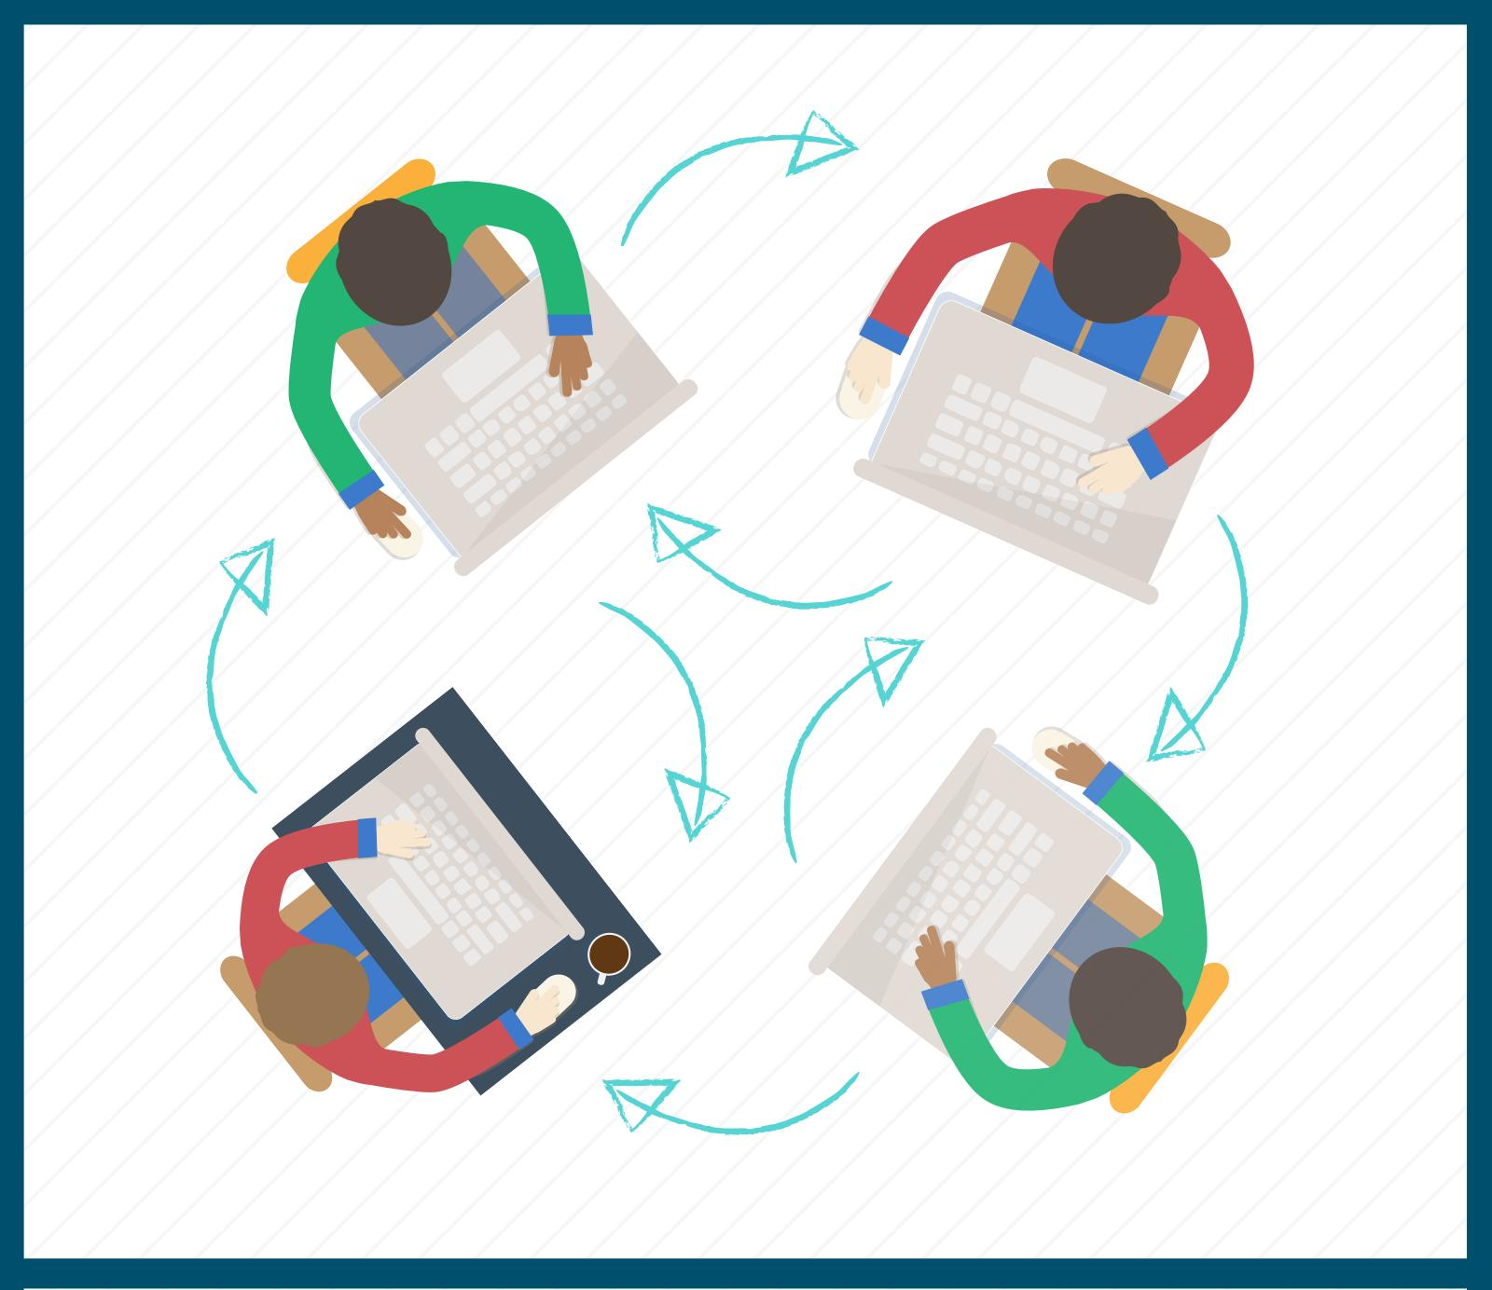




Platforms

Slide 9
Key Features of Accessible Materials
All text is available in logical order
Complete navigation is provided
Tables have headers and captions
Images are described
Page numbers are included

Slide 10
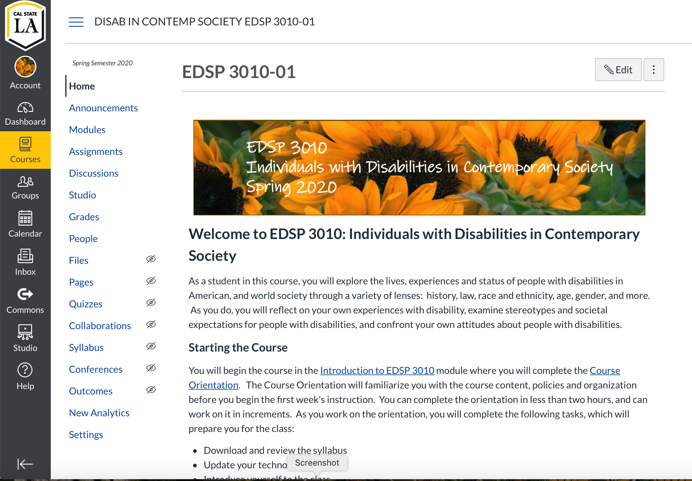
EDSP 3010
Individuals with Disabilities in Contemporary Society

Slide 11
Evolution of the Course
EDSP 301
Conversion to semester course
Approval as general education course
EDSP 3010
Development of hybrid course
Conversion to online course

Slide 12
Current status of the course
Upper Division General Education course
Offered entirely online, Asynchronous, One module per week
Four to Six offerings per semester plus one summer and one winter intersession offering
100% enrollment in all sections
Strongly favored by human-service related social science majors: public health, child development, teacher preparation (multiple majors), criminal justice, rehabilitation services, communication studies

Slide 13
Challenges Growing from Conversion to online
Offering only online
  Loss of the ability to have in-person, whole group or small group discussions
  "Too many apps!"
  Benefits of Online v. Hybrid offerings
Student issues
  Lack of skills as an online learner
  Reasonable expectations for an online class, especially time
  Adds during and after Week 1
  Keeping students on pace

Slide 14
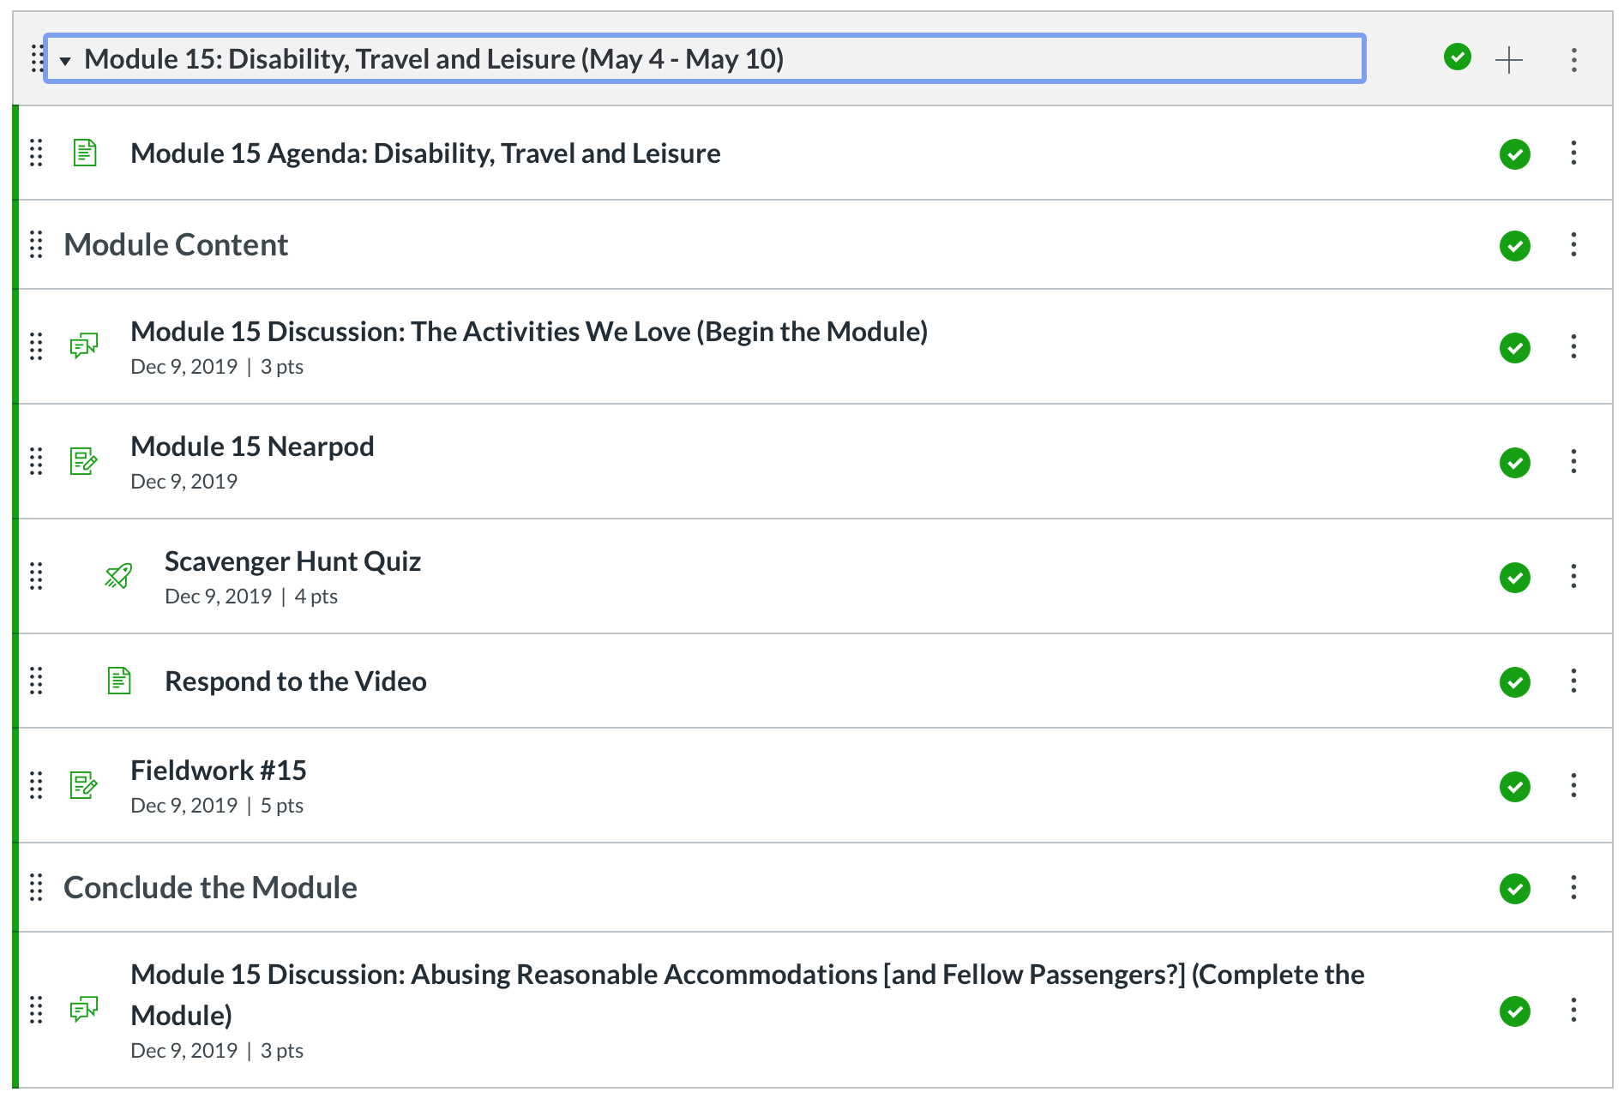
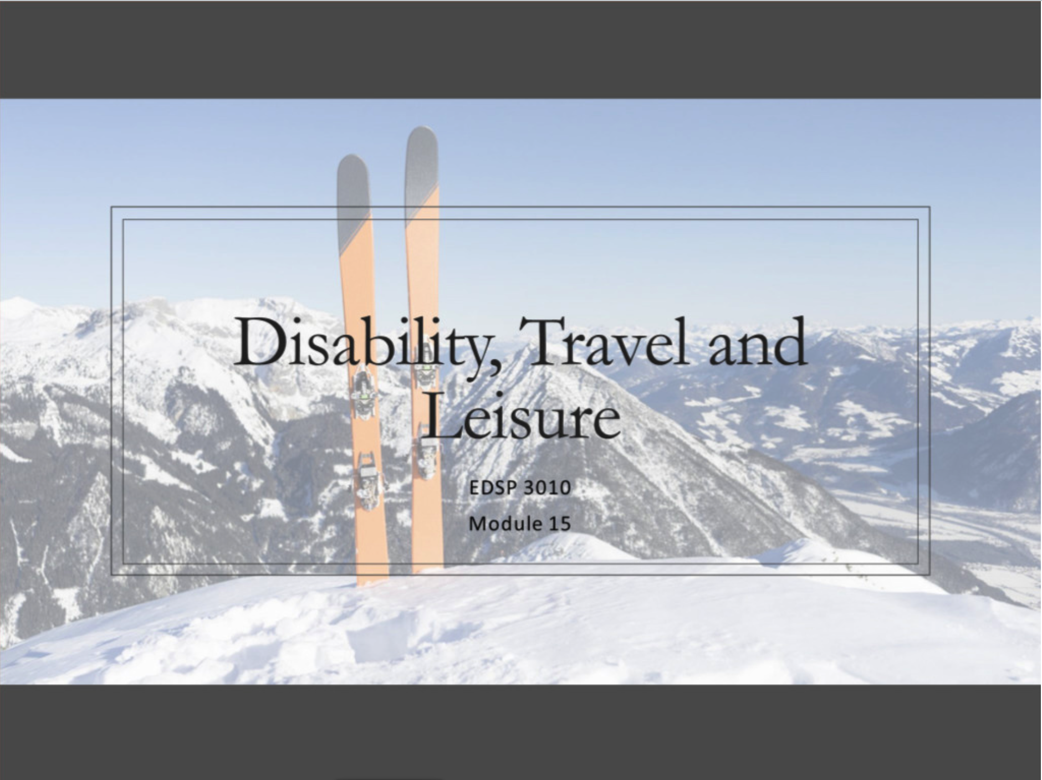
Week 15
Travel and Recreation for People with Disabilities

Slide 15
The responsibility of accessibility
    As courses are transitioned to online format, there is a new level of responsibility on faculty members to make sure their materials and classes accessible

Slide 16
General Concerns during course design
University subscriptions often dictate LMS and other tools, limiting instructor access
Inconsistency in accessibility among LMS and other tools
When varying instructional tools, must find workaround for a variety of accessibility concerns
Lack of free market described video (YouTube)
Lack of free market videos with manually added captions (not auto captioned)
Recycled resources are images, not PDF’s

Slide 17
First Iteration of the course
First accessibility check rendered these concerns:
Issues with Nearpod and accessibility.
Captioning for self-made videos not complete.
Use of videos that were auto-captioned or had no captioning
Google Doc sign-up pages will copy over every time you duplicate the course on the LMS.

Slide 18
Second iteration of the Course
Issues with Nearpod and accessibility.
  Have pre-built alternative (document with outline)
  Quizzes embedded into Canvas
  Have alternative format for submission (email or through Canvas)
Captioning for self-made videos not complete
  Use built in LMS features to record and caption videos
Use of videos that were auto-captioned or had no captioning
  Search for alternate video with same content
  Submit for university captioning service
Google Doc sign-up pages will copy over every time you duplicate the course on the LMS
  Make “read only” and share instructions on how to make copy for own course

Slide 19
Ensuring UDL
Allow advance access to course so student can review LMS and course to determine accessibility
Allow for alternate submission format (e.g. the option for video/audio recording as opposed to written submission Allow students option to leave video off during live sessions
Record live presentations so students with disabilities listed below can review at own pace
Provided extended timelines and deadlines
Allow student to suggest alternate assignments to meet their needs

Slide 20
Disability Specific Suggestions
Deaf or Hard of Hearing
Visual Impairments
Mobility Impairments
Anxiety
Learning Disabilities

Slide 21

Please join one of the three breakout rooms.
Once you are in the room, we will post a Dilemma for you all to talk through and consider
We will reconnect and share out
  3 minutes for transitions
  7 minutes for dialogue

Slide 22
We Need Encouragement!
Feedback from Students at the end of the first semester indicated they needed more encouragement. Three questions arose:
  What do they mean by encouragement?
  At what points in the course do students need encouragement?
  What are the best approaches to giving students encouragement during the course?

Slide 23
The challenge with making meaningful connections
Student feedback indicates they are struggling to feel connected to instructor and each other.
What strategies/tools can we use to increase student connection?

Slide 24
Don't Ghost US
At the beginning of the semester you notice two students only complete three of the Four first activities. One of them doesn't attend the initial class advisement session. As you go deeper into the course, you notice they reply to their classmates, but don't always post their initial response or vice versa. They're barely getting by, but when you ask students to complete a midcourse progress survey, they don't. During the next advisement session you hope they'll join the session, but this time neither of them join the session. Since it is an asynchronous class, your advisement sessions are optional. Additionally, you've emailed them when they didn't submit their assignment for the second time, but to your dismay didn't get a response. how do you genuinely promote student participation and interaction?
Notes:
At what point do you reach out?

Slide 25
Let's Recap
UDL allows for activities and assignments to be inclusive and accessible to students
A change to the course once it's up and running should not have to impact the course design
Student needs vary and accessibility extends beyond ability

Slide 26

Thank you
For more information please email us:
Rosalinda Larios rjlarios2020@gmail.com
Gina Michell gina.michell4@calstatela.edu
Margaret D. Clark mclark@calstatela.edu

