Slide 1

Impact of Quality Matters Professional Development on Course Design and Student Evaluations
Dr. Sheri Conklin; Erika Hanson, Ginu Easow & Zach Morgan

Slide 2
Quick Check!

Slide 3
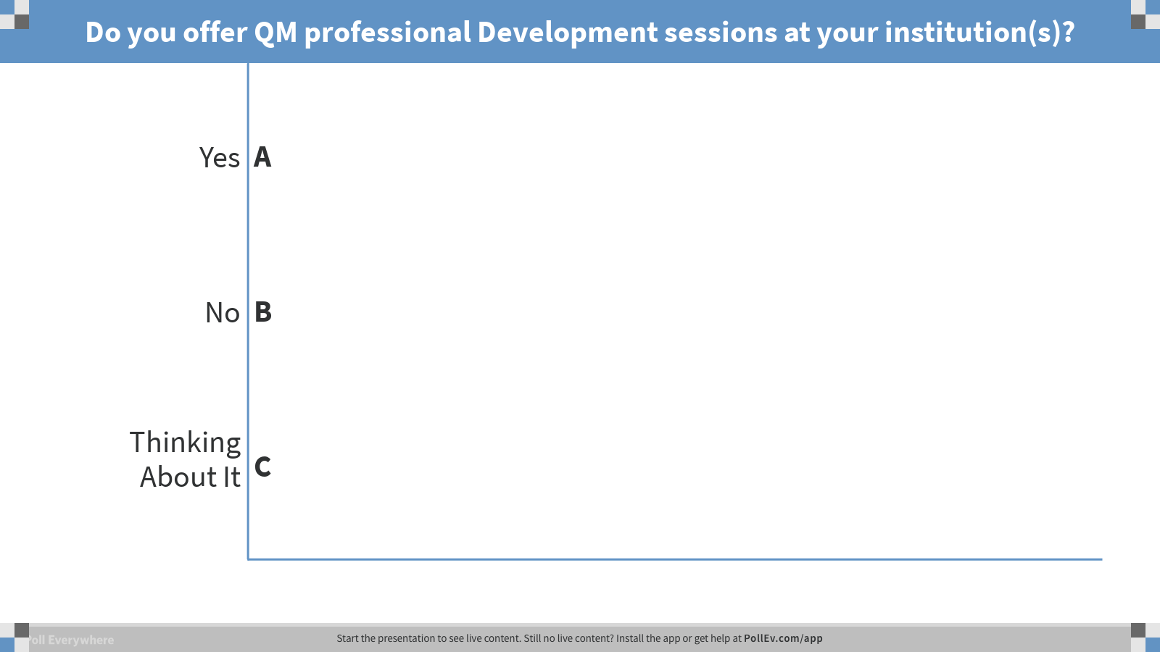
Notes:
Poll Title: Do you offer QM professional Development sessions at your institution(s)?
https://www.polleverywhere.com/multiple_choice_polls/pcnYGKKRlexFsLEh3HL1a

Slide 4

Notes:
Poll Title: What QM Professional Development opportunities are currently offered at your institution (s)?
https://www.polleverywhere.com/free_text_polls/5Z8Tj8zf6Bzu7lBxGmLqh

Slide 5
At UNCW
UNCW
APPQMR
Course Design

Slide 6
Research Question(s)

Slide 7

Research Questions
Does QM professional development have an impact on course design?
What types of changes are made as a result of developing expertise with the QM approach?
How does course design impact student evaluations?

Slide 8
Research Design

Slide 9

Participants
65 potential participants
15 peer review
6 viable participant
3 final participants

Slide 10

Exploratory Case Study
Application of QM workshop to course design
Course design
1
2
3

Slide 11
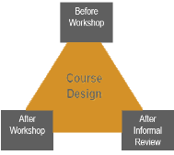
Data Collection
Content Analysis

Slide 12
Quick Check!

Slide 13
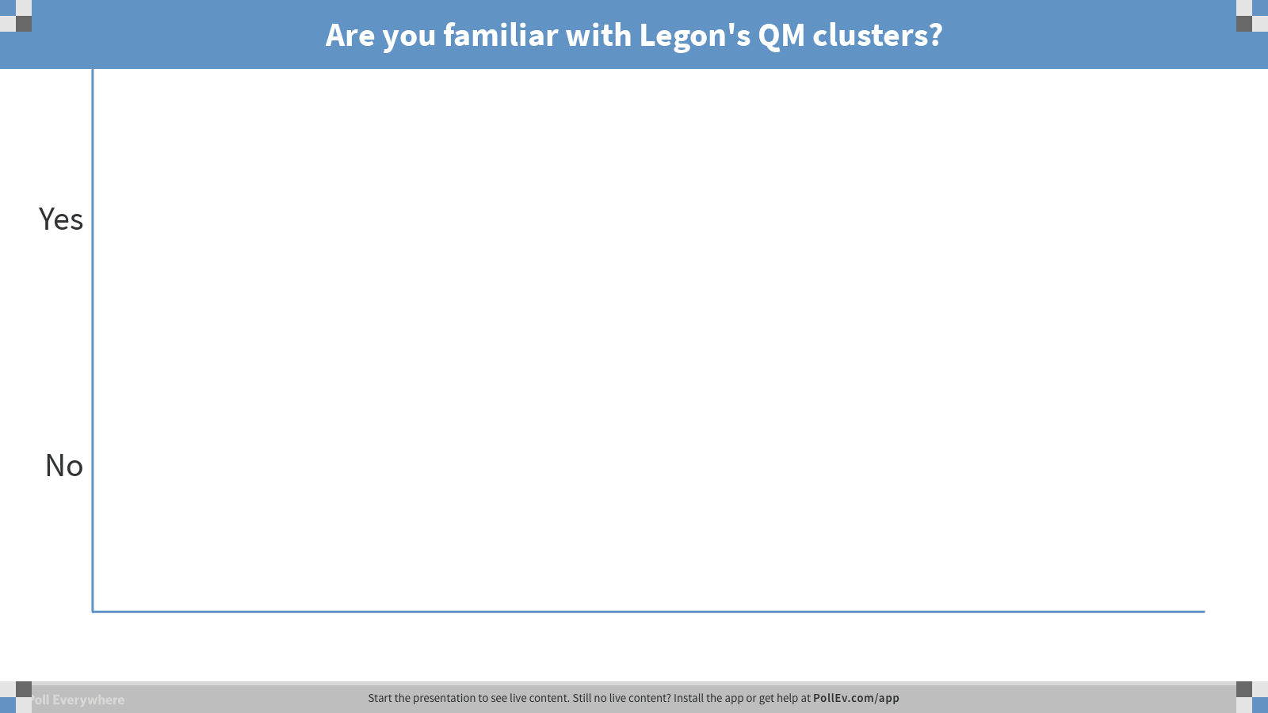
Notes:
Poll Title: Are you familiar with Legon's QM clusters?
https://www.polleverywhere.com/multiple_choice_polls/OCFhitLlMmpYAvfKeGT4e

Slide 14
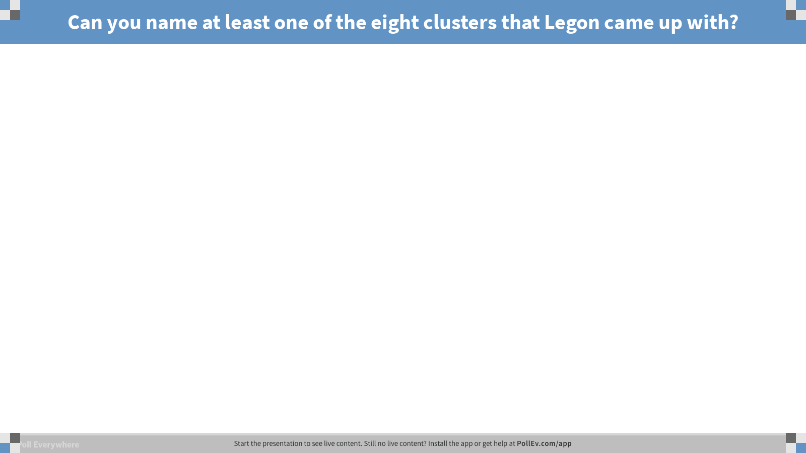
Notes:
Poll Title: Can you name at least one of the eight clusters that Legon came up with?
https://www.polleverywhere.com/free_text_polls/DH4dqhZSlOQBxFDa0TaMl

Slide 15

Quality Matters Clusters
Eight QM Clusters
Clarity of Purpose
Ease of Use
Course Alignment
Learner Engagement
Accessibility Standards
Knowledge Acquisition
Compliance
Learner Support
Legon, R. (2015). Measuring the impact of the Quality Matters Rubric: A discussion of possibilities. American Journal of Distance Education, 29(3), 166-173.

Slide 16
Quality Matters Clusters
Learner Support QM Specific Standards
1.8 Self-introduction
1.9 Learner introduction
3.5 Opportunity to track progress
5.2 Active learning
6.2 Tools promote engagement
6.3 Variety of technology

Slide 17
Cluster Index
Cluster Index=Initial Cluster Score ÷ Cluster Score Post Revision

Slide 18


Data Collection
Content Analysis
Instructor interviews
Student Evaluations

Slide 19
QM Clusters and Student Evaluations
Learner Support Student Evaluation Crosswalk
Q1 Found ways to help students answer questions
Q9 Encouraged use of multiple resources
Q20 Encouraged student-instructor interaction
Alignment Student Evaluation Crosswalk
Q6 Made it clear how each topic fit into the course
Q10 Explained course material clearly and concisely

Slide 20
Limitations

Slide 21
Limitations
Exploratory case study
Small sample
Variation in student evaluation response rate
Natural disaster
Update from 5th to 6th edition of QM rubric
Student evaluation classification to QM clusters

Slide 22
What We Found?

Slide 23
Course One Findings
Spring 2015
Spring 2016
Spring 2017
“. . . gives you a little more clarity, understanding how the course looks from the student point of view and tweaking it to make it clearer. My goal is to get almost no emails about little confused things, confusing about the assignment . . .”

Slide 24
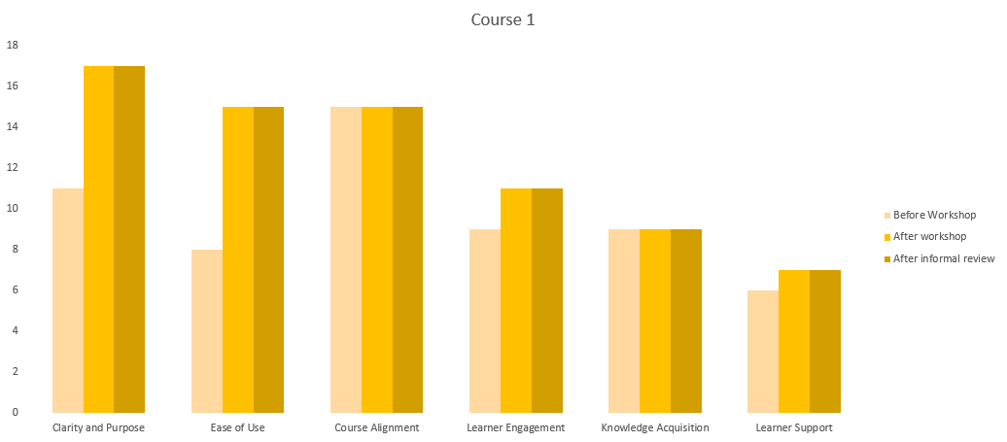
Course One Findings
Notes:
transition

Slide 25
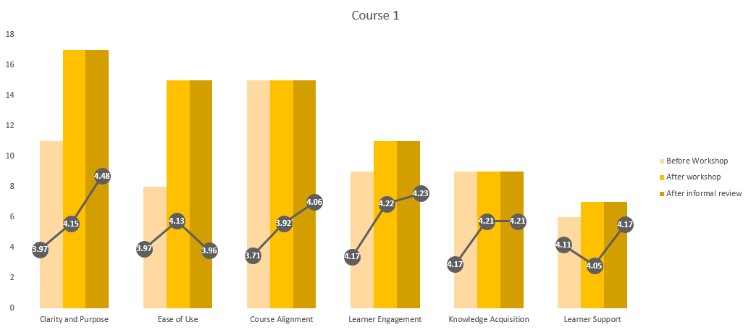
Course One Findings
Notes:
S15 – 100%, S16 81%, S17 80%

Slide 26
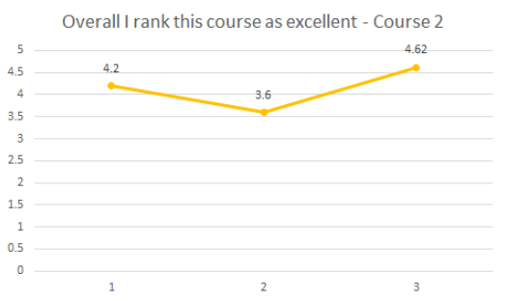
Course One Findings
2015 - “I feel that this course is definitely in need of some streamlining. The assignments were listed in an illogical, unnecessarily complicated way.”
2017 -“[Professor] has done an excellent job designing this course. . . ”

Slide 27
Course Two Findings
Spring 2017
Spring 2018
Fall 2018
“. . . I made some changes that I can make quickly before a ... you know, I don't particularly like to make huge changes right before a semester. But if I have time, I'll change what I can. I typically, when I redo bigger courses, or need to do a larger overhaul, I'll do it during the summer.”

Slide 28
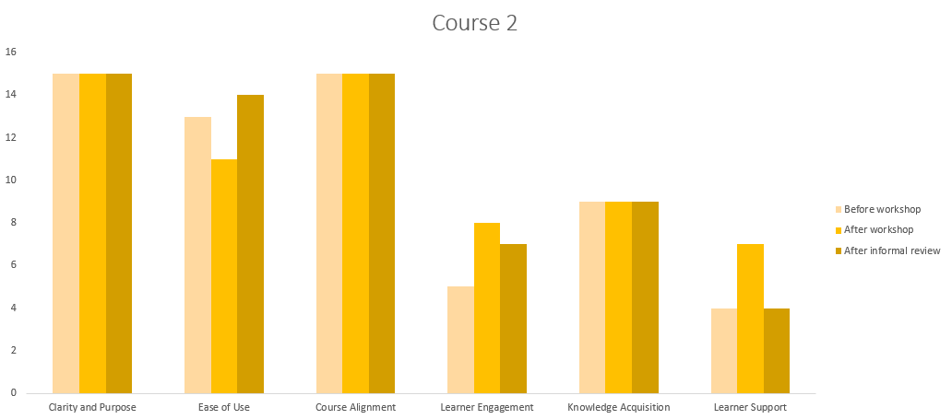
Course Two Findings

Slide 29
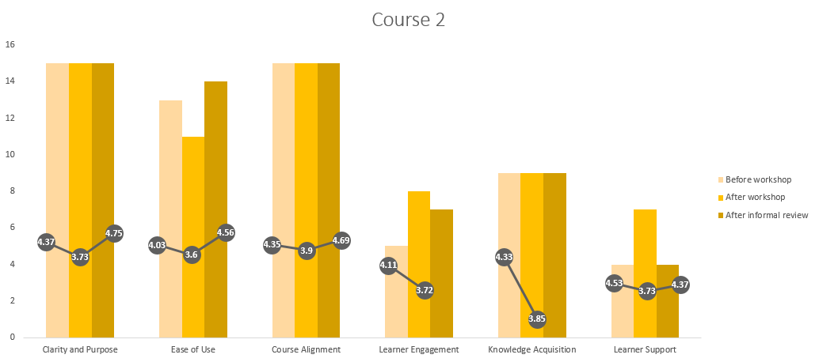
Course Two Findings

Slide 30
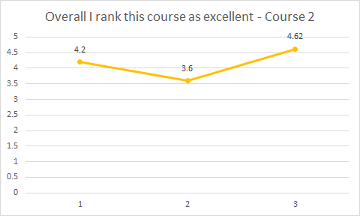
Course Two Findings
Spring 2017 - “I appreciate the clarity and the depth with which he teaches
Spring 2018 - “. . . always responding to emails and questions in a timely manner.”
Notes:
23, 23, 20

Slide 31
Course Three Findings
Spring 2017
Fall 2017
Fall 2018
“It's just forced me, I think, to really think of ways to meet those requirements, those kind of transparent things, but also not make it too, frankly, off-putting. In doing that, I think it's forced me to reexamine what I teach and how I teach because I've been doing it for a really, really, really long time, so in that sense, it was nice to get a refresh. . . .”

Slide 32
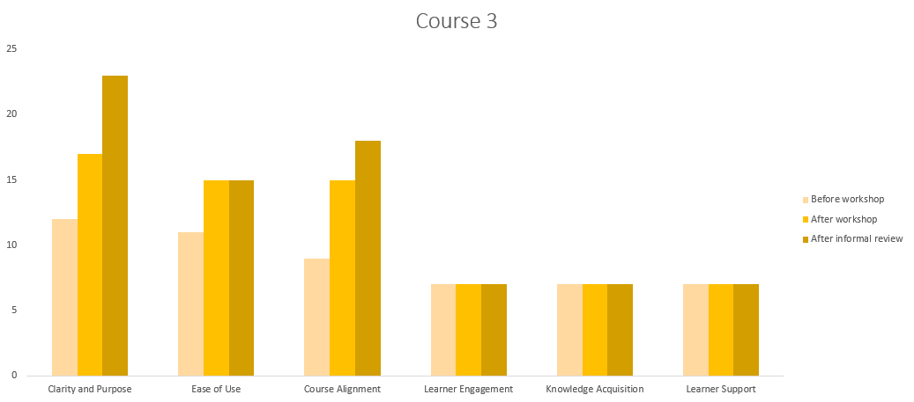
Course Three Findings

Slide 33
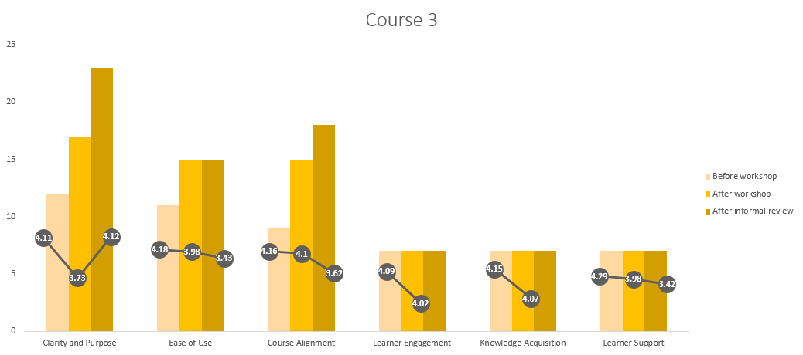
Course Three Findings

Slide 34
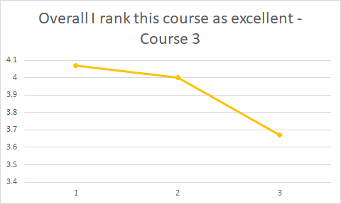
Course Three Findings
Spring 2017 - “Communicates well and responds to emails quickly.”
Fall 2018 - “. . . was very organized and helpful throughout the course.”
Notes:
20, 31, 33

Slide 35
Conclusions

Slide 36

Research Question 1
Does QM professional development workshops have an impact on course design?

Slide 37
Research Question 2
What types of changes are made as a result of developing expertise with the QM approach?
Ease of Use, Learner Engagement, and Learner Support
Minimal changes to Knowledge Acquisition

Slide 38
Research Question 3
How does course design impact student evaluations?
QM revisions not directly linked to student evaluations
No patterns among courses with student evaluations
Qualitative data from Student Evaluations referenced instructor social presence

Slide 39
Quick Check!
Notes:
Facilitator Notes:
Now that we’ve shared the findings of our study, we are opening it up to all of you-our larger QM community to suggest one way of how we can potentially enhance this study.

Slide 40
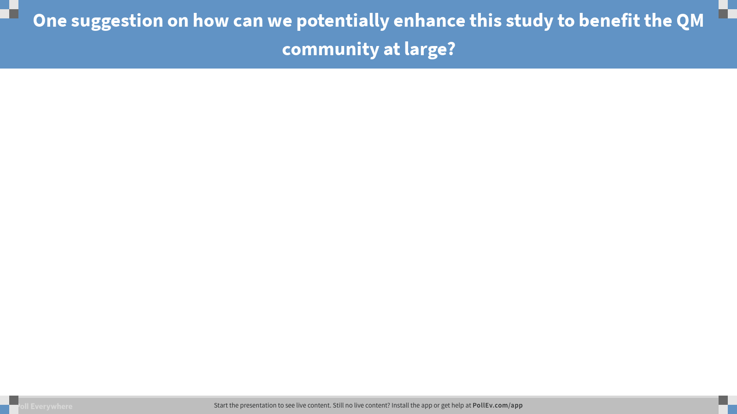
Notes:
Poll Title: One suggestion on how can we potentially enhance this study to benefit the QM community at large?
https://www.polleverywhere.com/free_text_polls/EAyOPJQW4LPyNeWvLYm1K

Slide 41
Next Steps

Slide 42


Next Steps
Expand current study
Application of QM workshop to course design
Course design
75 potential faculty

Slide 43
Next Steps
Incorporate Community of Inquiry (CoI) into research study
Cognitive Presence
Social Presence
Teaching Presence

Slide 44

Next Steps
QM Research aligning with student outcomes

Slide 45
Questions

Slide 46
Brinkley-Etzkorn, K. E. (2018). Learning to teach online: Measuring the influence of faculty development training on teaching effectiveness through a TPACK lens. The Internet in Higher Education, 38, 28-35.
Chen, K., Lowenthal, P. R., Bauer, C., Heaps, A., & Nielson, C. (2017). Moving beyond smile sheets: A case study on the evaluation and iterative improvement of an online faculty development program. Online Learning, 21(1), 85-111.
Kearns, L., & Mancilla, R. (2017). The impact of Quality Matters professional development on teaching across delivery formats. American Journal of Distance Education, 31(3), 185-197.
Legon, R. (2015). Measuring the impact of the Quality Matters Rubric: A discussion of possibilities. American Journal of Distance Education, 29(3), 166-173.
Roehrs, C., Wang, L., & Kendrick, D. (2013). Preparing faculty to use the Quality Matters model for course improvement. Journal of Online Learning and Teaching, 9(1), 52-67.
Shattuck, J., Dubins, B., & Zilberman, D. (2011). MarylandOnline’s interinstitutional project to train higher education adjunct faculty to teach online. International Review of Research in Open and Distance Learning, 12(2), 40-61.
Yang, D. (2017). Instructional strategies and course design for teaching statistics online: Perspectives from online students. International Journal of STEM Education, 4(34), 1-15.

