Slide 1
Empower Every Learner: Optimizing the LMS for Accessibility and Equity
Exploring SRS 8.3

Slide 2

Welcome and Introductions
Dr. Chris Smith
Instructional Designer
North Carolina Virtual Public School (NCVPS)
chris.smith@ncpublicschools.gov
While I introduce myself, please take a few minutes to share the following information in the chat:
Location
Professional role
Experience with QM
Prior knowledge of accessibility
Notes:
Hello, I am Dr. Chris Smith and I currently work as an Instructional Designer with North Carolina Virtual Public School (NCVPS). I began my career as an elementary school teacher 23 years ago where I taught kindergarten, 5th grade, 6th grade, and K-5 computers. Eventually, I went on to earn advanced degrees in web site development and educational technology which led me to go on to become a district-level technology facilitator, Director of Distance Education at a local community college, and eventually to my current role. I also teach community college and graduate computer, educational technology, and supporting diverse learner courses in higher education. I hold certification as a Master K-12 QM Reviewer, QM K-12 Peer Reviewer, Publisher Peer Reviewer, and Continuing Education Peer Reviewer. I am dual certified and hold the QM Higher Education Peer Reviewer certification as well. I have been studying and presenting on accessibility at the local, state, and national levels since 2012.

Slide 3
Establishing Session Norms
Embrace a culture of empathy
Focus on building capacity
Be solution oriented
Share expertise
Honor safe space for all learners to grow

Slide 4
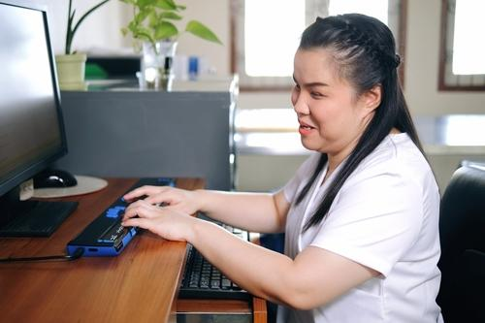
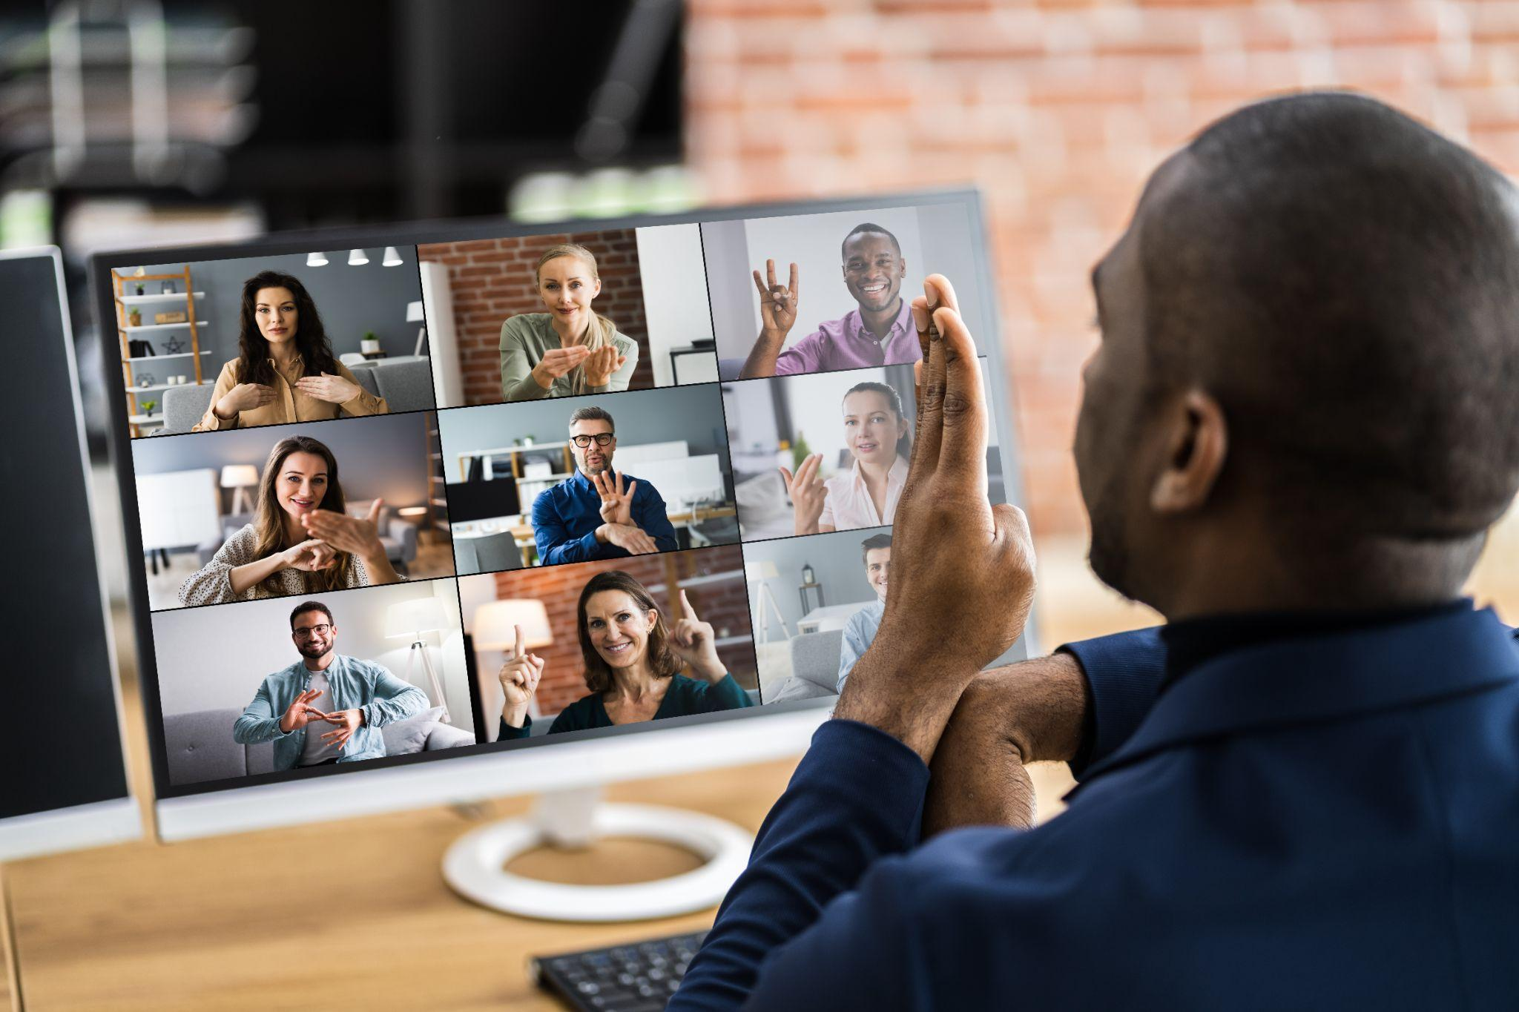
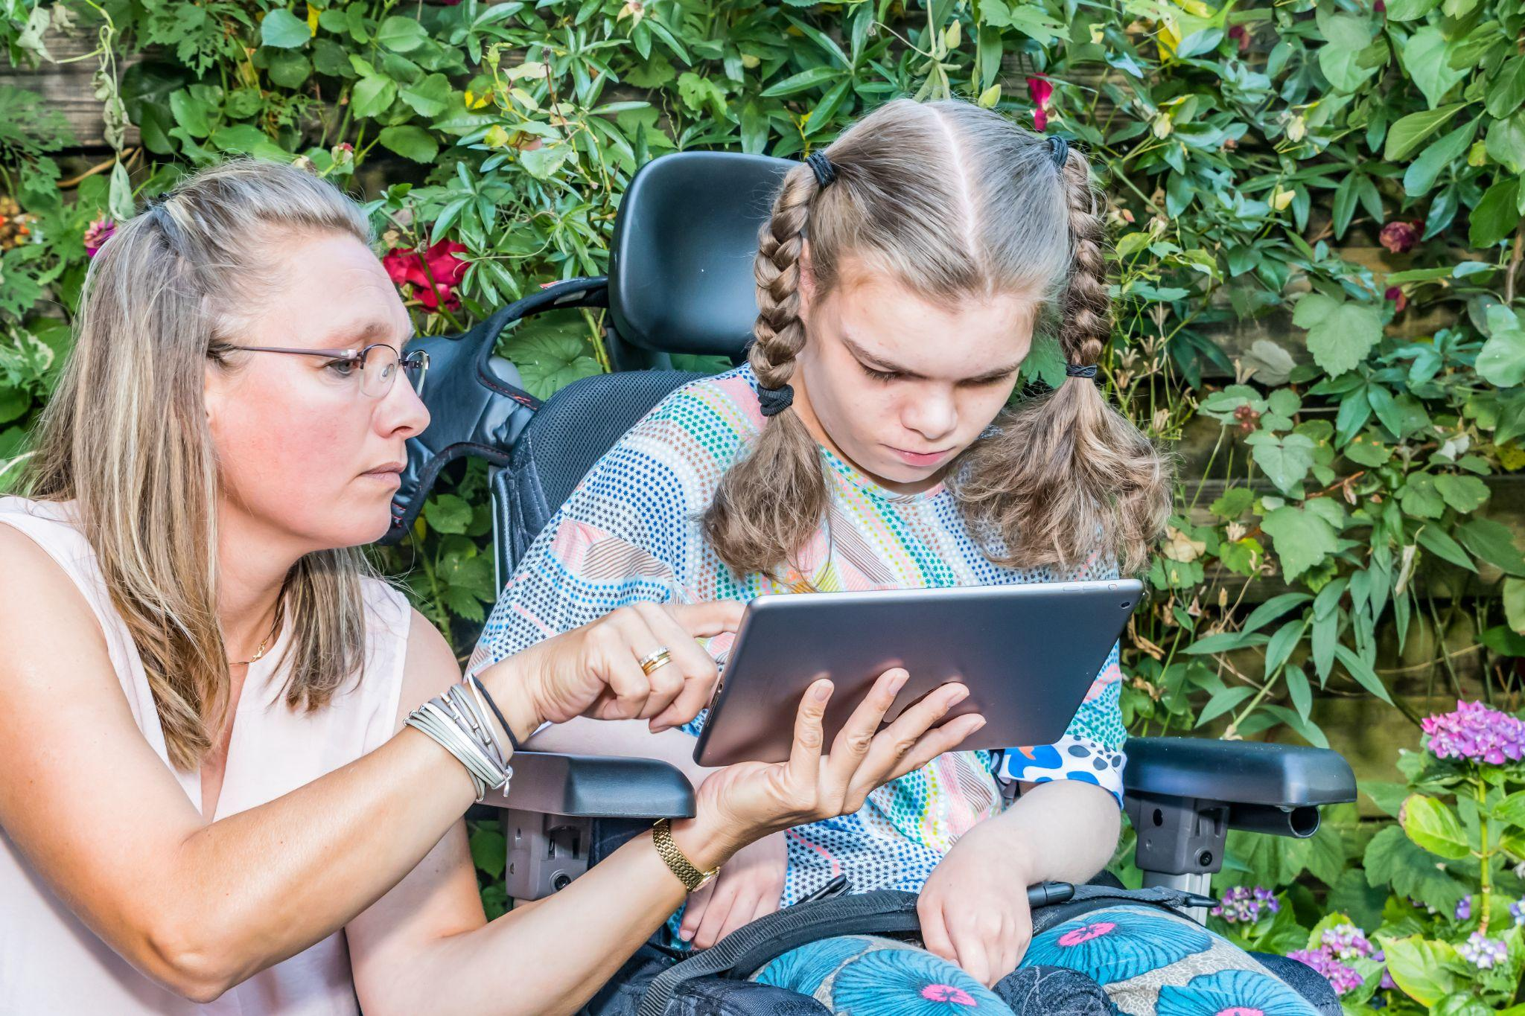
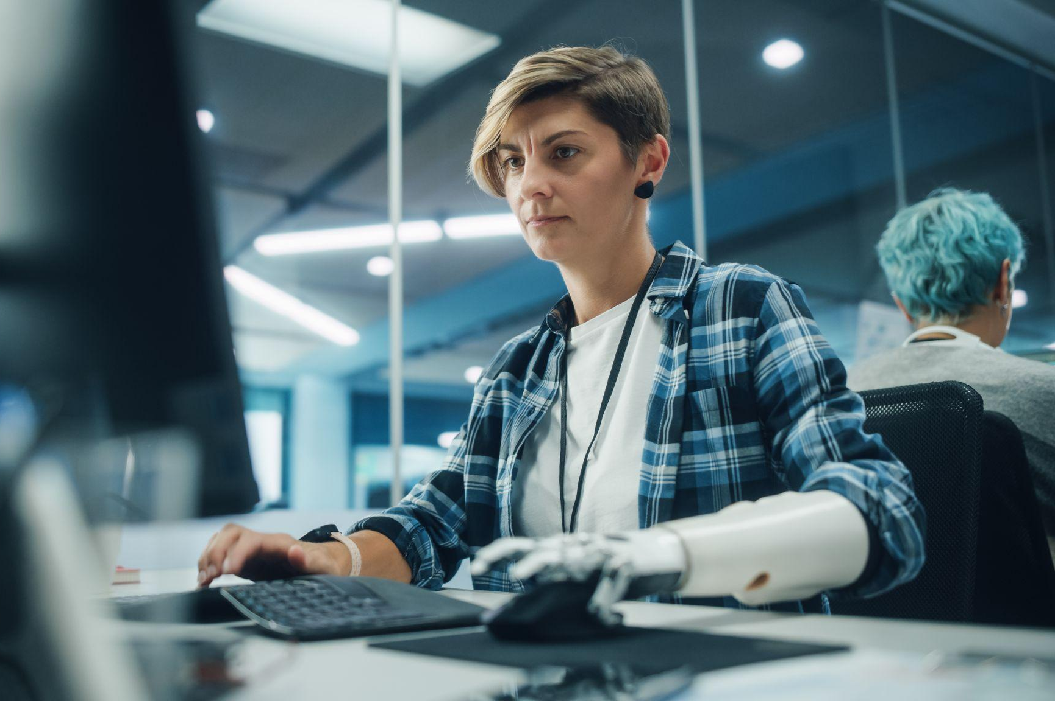
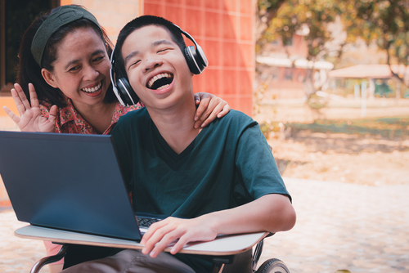
Defining Accessibility
A person with a disability can acquire the same information, engage in the same interactions, and enjoy the same services in an equally effective, equally integrated manner, with substantially equivalent ease of use as a person without a disability.
National Center on Accessible Educational Materials
Notes:
Image citation: blind student (Shutterstock ID: 2158200539), deaf student (Shutterstock ID: ), I (Shutterstock ID: 787300732), prosthetic computer user (Shutterstock ID: 2083349509), boy with headphones (Shutterstock ID: 1910719234)

Slide 5
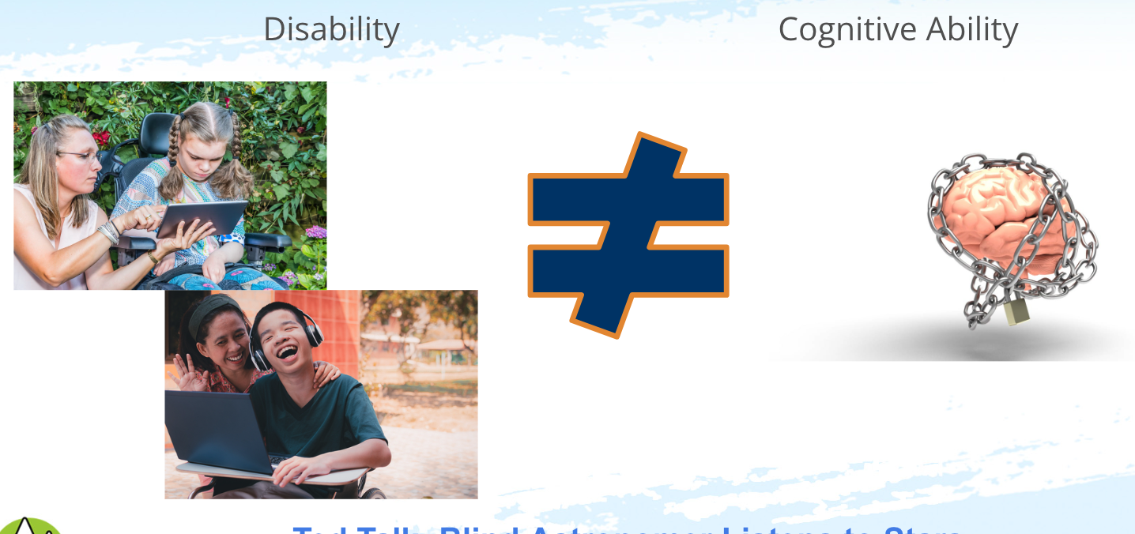
Accessibility: Busting the Myth
Ted Talk- Blind Astronomer Listens to Stars
Notes:
Image citations: girl in wheelchair ( ), boy with headphones ( ), human brain (Image by 3D Animation Production Company from Pixabay)

Slide 6
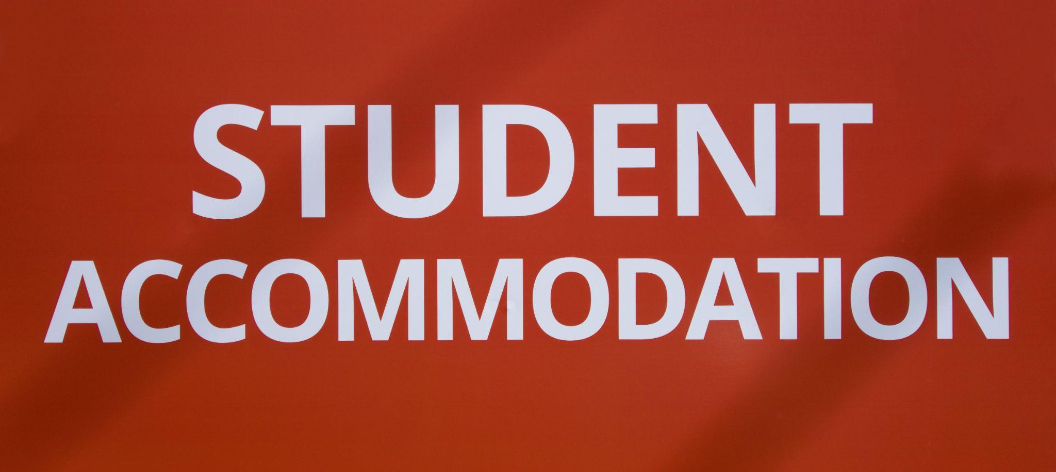
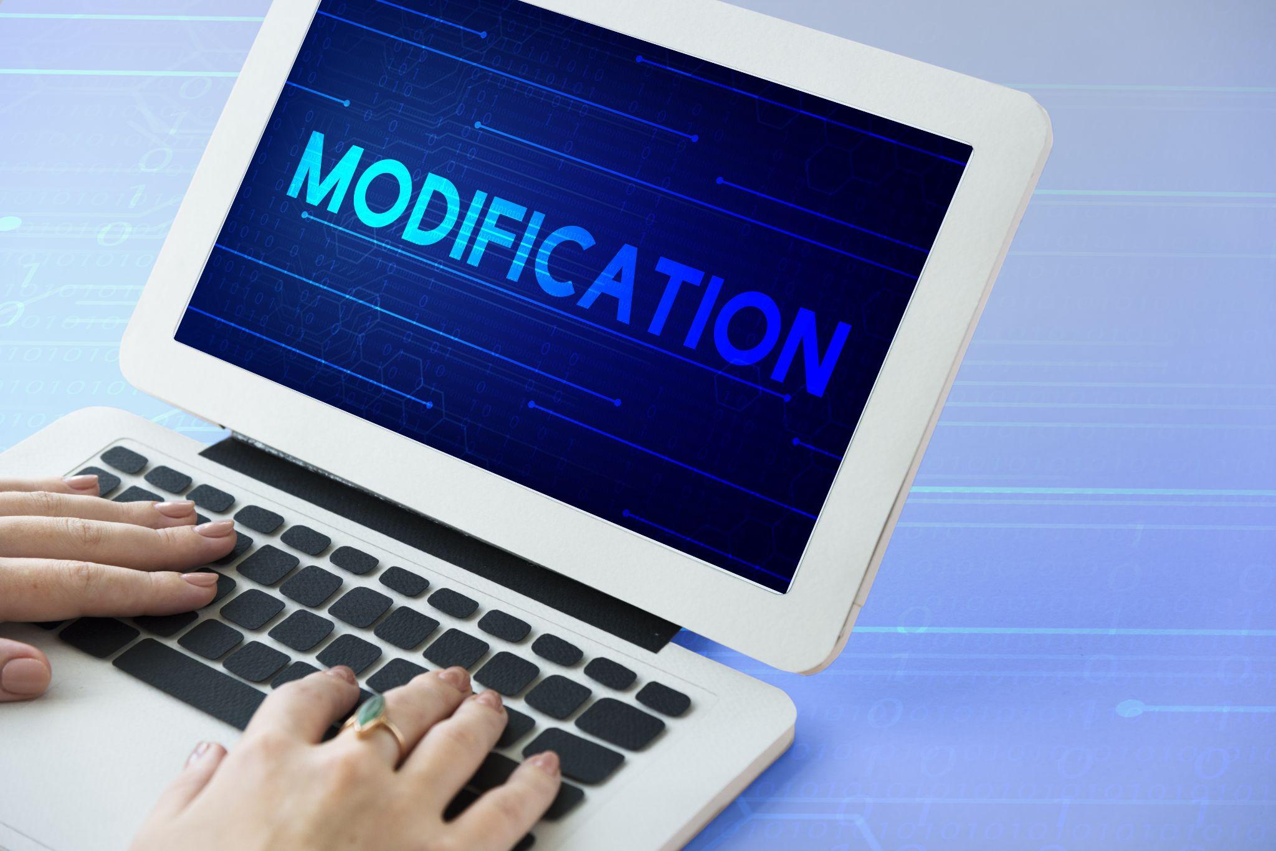
Accommodations vs Modifications
Accommodations are…
an alteration of environment, curriculum format, or equipment that allows an individual with a disability to gain access to content and/or complete assigned tasks.
Modifications are…
changes in the curriculum (what is taught or expected) that are made for students who are not doing the same level of work as other students.
Notes:
Image citations: accommodations ( ), modifications (Shutterstock image 570447277)
Resources:
https://www.washington.edu/doit/what-difference-between-accommodation-and-modification-student-disability
https://www.gadoe.org/Curriculum-Instruction-and-Assessment/Special-Education-Services/Documents/Co-Teaching%20Modules/Module%204/27%20nichcy.org-Accommodations_and_modifications_Wait_theyre_not_the_same.pdf

Slide 7
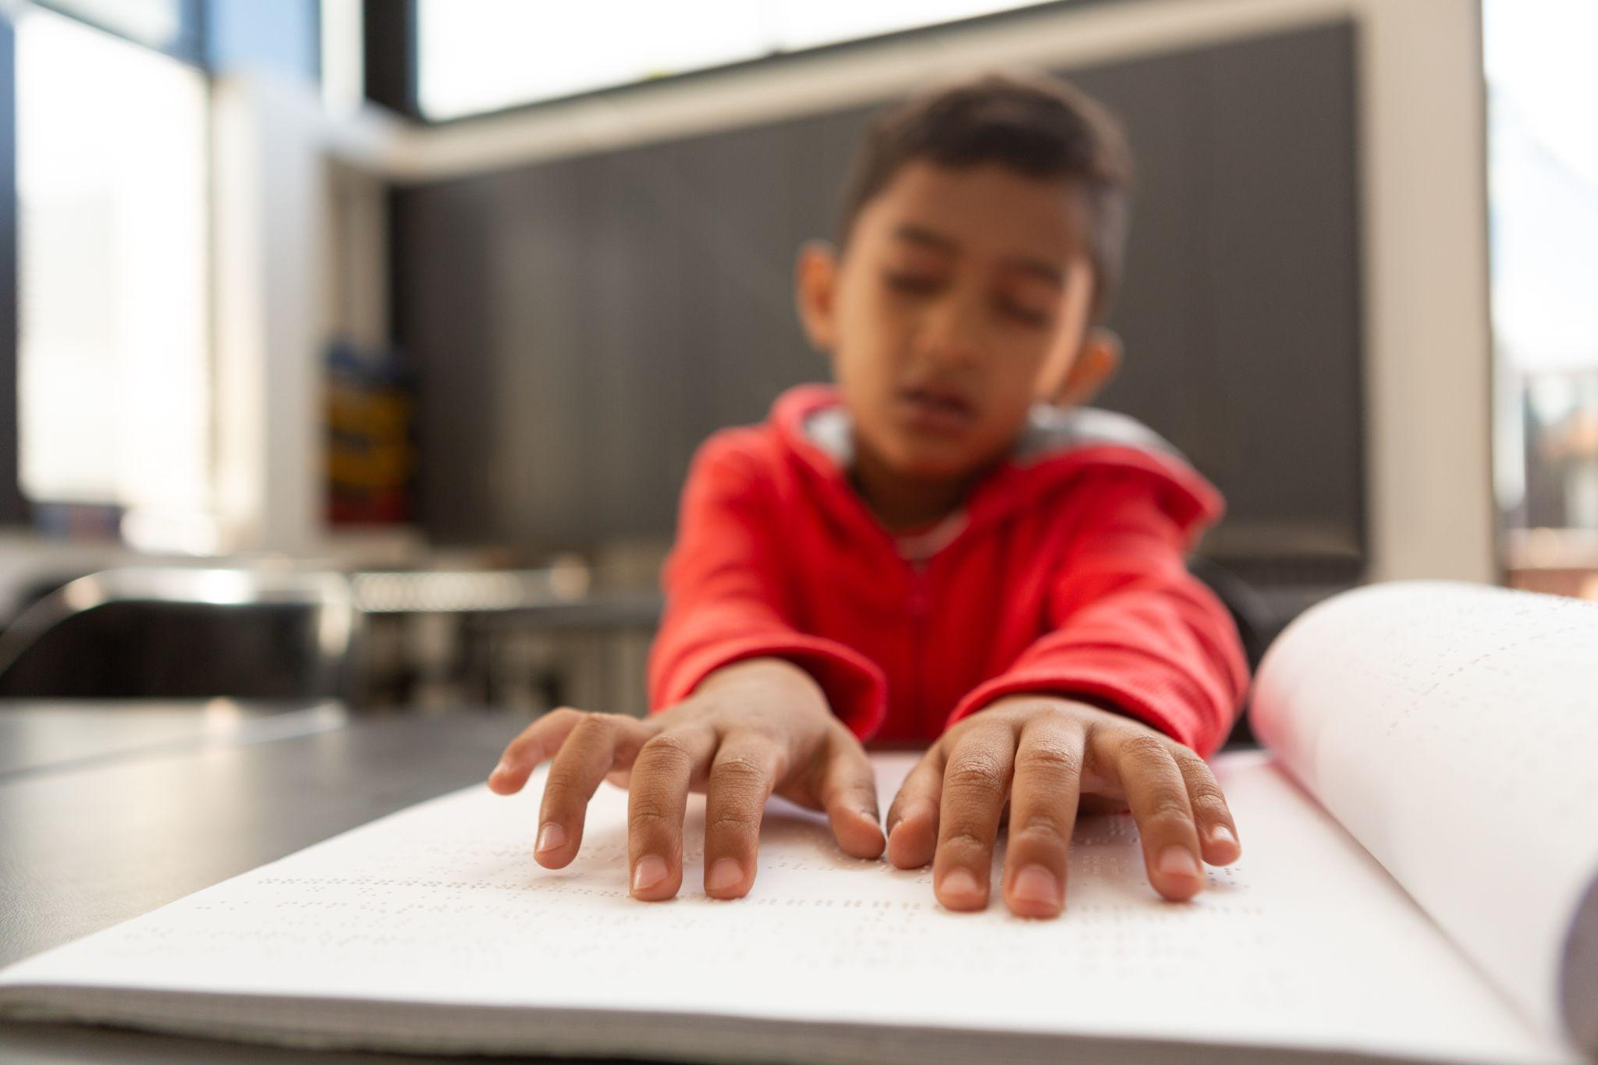


Accommodation vs Modification Activity
Please take a few minutes to complete the Accommodations vs Modifications Activity independently.
Notes:
Image citations: boy using braille (Shutterstock image 1332165941), simplify (Shutterstock image 1944408976),

Slide 8
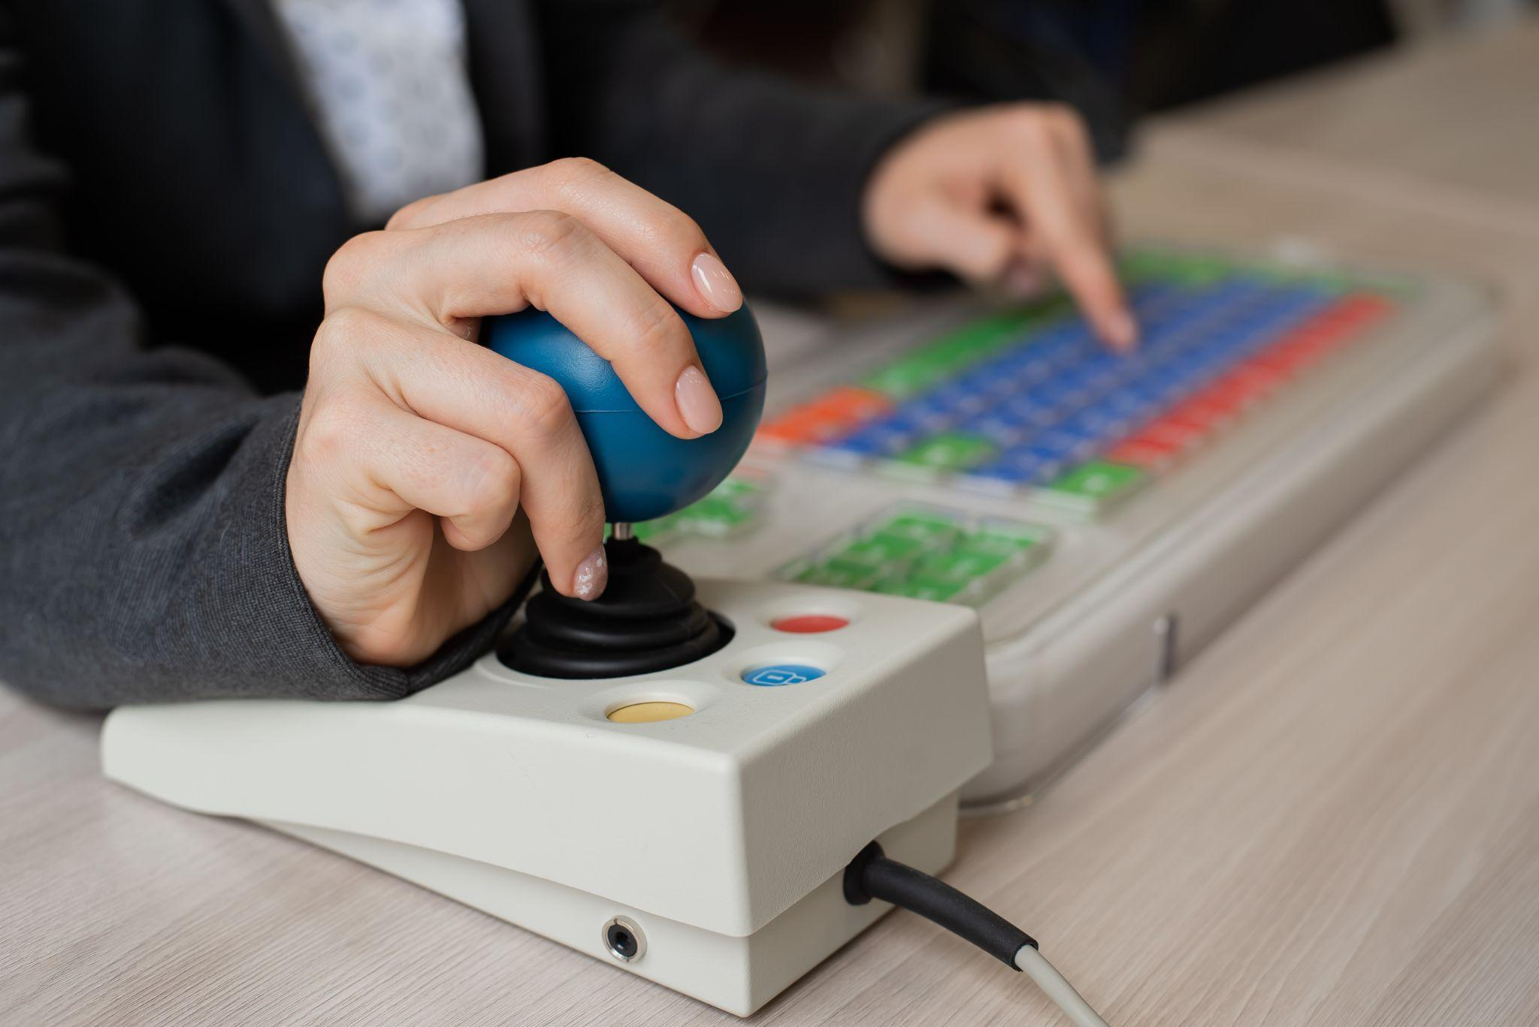
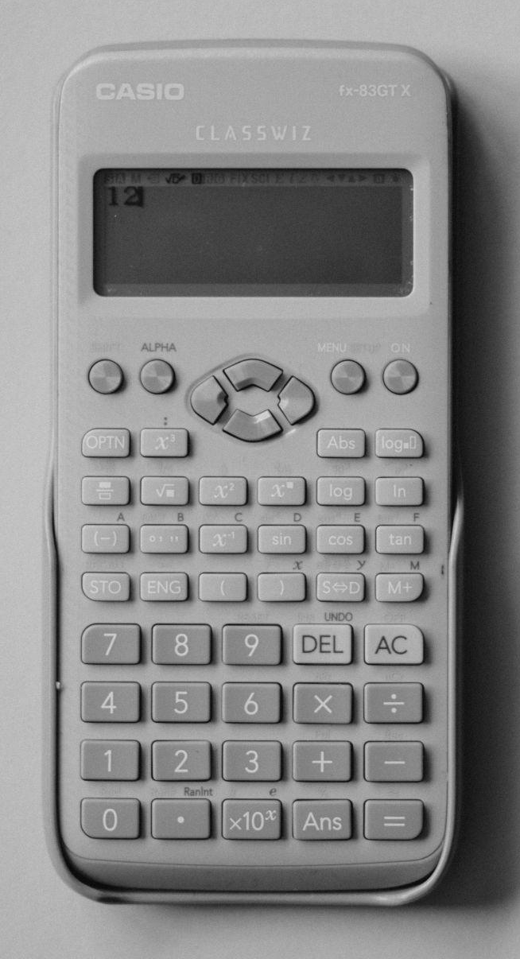
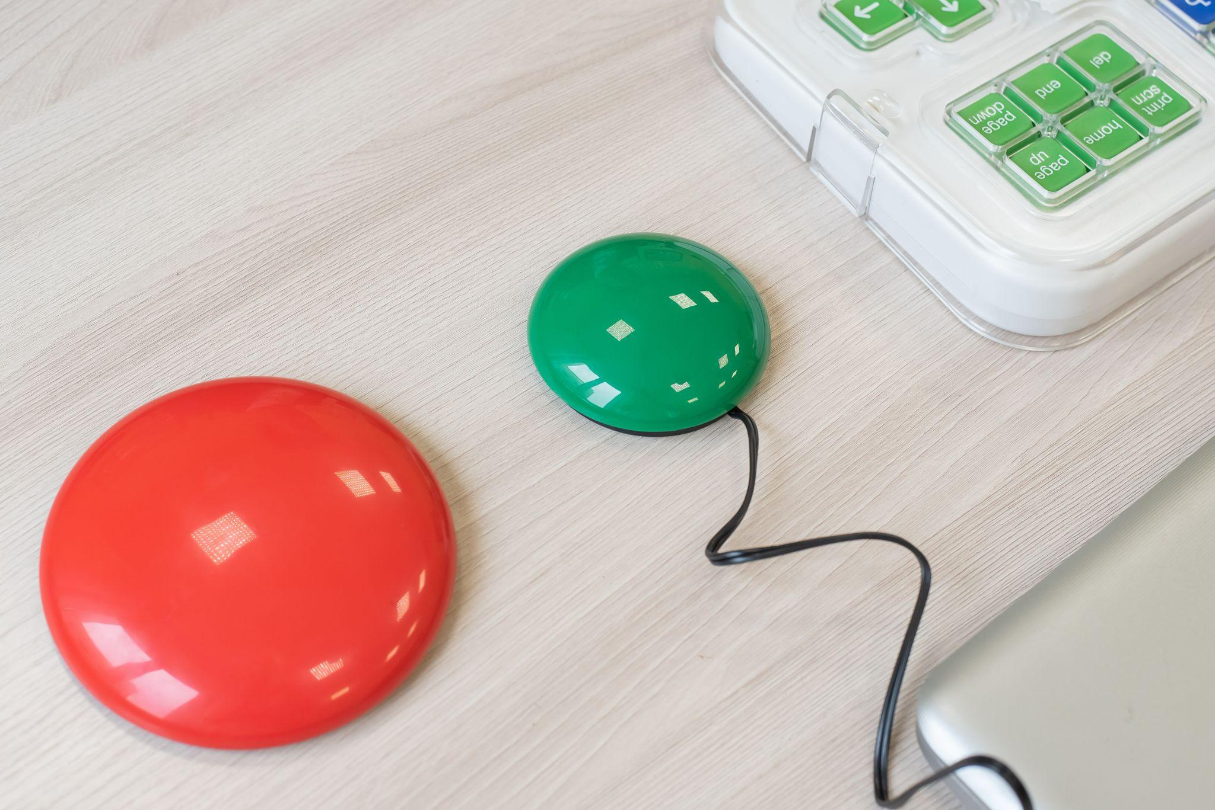
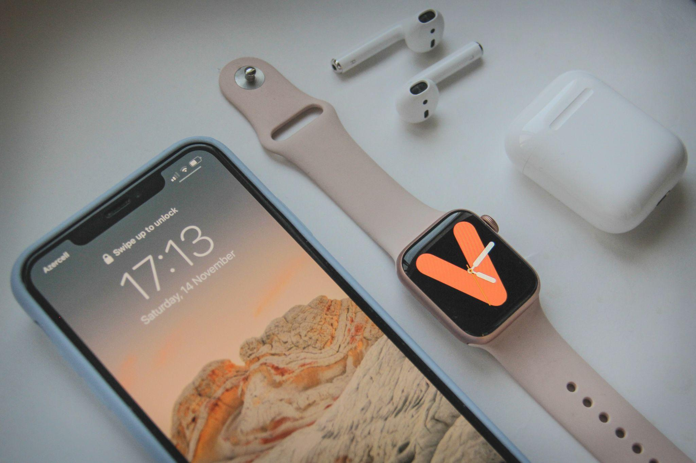
What is Assistive Technology?
Assistive technology is a set of tools that are used by individuals with disabilities to accomplish specific tasks.
Examples might include calculators, joysticks, enlarged or color coded keyboards, switches, or wearable/mobile devices

Slide 9
Access vs Accommodate vs Assistive Tech
How are accessibility, accommodations, and assistive technology similar? How are they different?
All three concepts address equal access to instructional content for diverse learners
Once access has been addressed, accommodations and assistive technology is needed to take advantage of the accessible features
Accommodations and assistive technologies address the “equally effective, equally integrated manner, with substantially equivalent ease of use”

Slide 10

Legal Considerations
When discussing the legal aspects, there are three main concerns to be aware of which include:
Individuals with Disabilities Education Act (IDEA)
Americans with Disabilities Act (ADA)
Section 508 of the Rehabilitation Act of 1973
Notes:
IDEA- IDEA mandates the creation of individualized education programs (IEPs) and a free appropriate public education for children with disabilities between 3 years and 21 years old. Inclusion is also a big part of IDEA which states that children with disabilities must be offered instruction in the least restrictive environment. The least restrictive environment involves ensuring children with disabilities are educated with children without disabilities (Lipkin et al., 2015).
ADA- ADA encompases concepts related to ensuring individuals with a disability receive accommodations to be able to complete a variety of life activities. Not all items covered under ADA relate directly to education. From an education perspective, the key points of ADA are not determining whether or not an individual is eligible for services rather it is more about providing reasonable access to academic programs at all levels (Keenan, W. R. et al., 2018). In the most basic terms, ADA looks at how learning might be impacted by functional limitations and what specific accommodations are needed to ensure an accessible learning experience. Some non-educational items include:
elevators with buttons with braille options along with audio that announces the direction the elevator is moving and the floors it is stopping on
audio jacks and braille options on ATMs
crosswalks that contain truncated domes on sidewalk corners and audio cues to alert pedestrians when it is safe to cross along with a countdown for how much time is remaining
Image citation: Image by Arek Socha from Pixabay

Slide 11
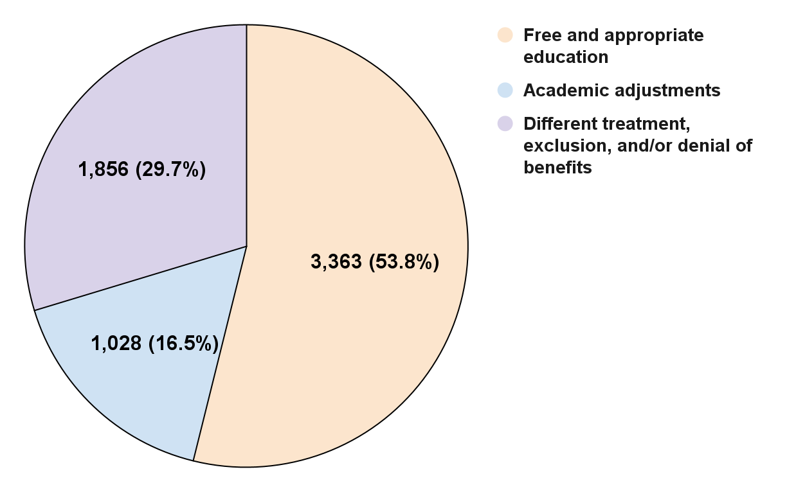
Who is the Governing Agency?
The United States Department of Education’s Office of Civil Rights is responsible for overseeing accessibility compliance.
18,804 OCR complaints filed in 2022, of which 6,467 (32%) were related to disability concerns

Slide 12
Most Common Accommodations on IEPs
Instructional Content
  Read aloud (text-to-speech)
  Dictate to scribe (speech-to-text)
  Mark in book (printable documents)
  Outline / guided notes
  Magnification
Activities and Assessments
  One question shown at a time
  Reduced answer choices
  Multiple test settings (taking breaks)
  Multiple attempts
  Extended time
Notes:
Image citation Photo by Héctor J. Rivas on Unsplash

Slide 13
Text-to-Speech (TTS) Versus Screen Readers
Text-to-Speech
Generally a built in feature in a web browser or operating system that allows users to highlight content and have it read aloud.
May or may not include the ability to customize the type of voice and speed of speech.
Screen Readers
Software that relies on a combination of keyboard shortcuts to navigate and read content
  JAWS (paid software)
  NVDA (open source)
  VoiceOver (iOS devices)
  Narrator (Microsoft OS)
  TalkBack (Android devices)
Notes:
Image citation Photo by Héctor J. Rivas on Unsplash

Slide 14

Read Aloud- Accessing Text-to-Speech
While there are third-party read aloud options, they can be expensive,have limitations, or pose privacy concerns.
When we train student to take advantage of built in text-to-speech features, we help to promote independence outside and beyond the course.
Operating System Read Aloud Tutorial
Notes:
Photo by Ben White on Unsplash

Slide 15

Dictate to Scribe- Speech-To-Text
Students who have been diagnosed with dysgraphia and possibly dyslexia may have the dictate to scribe accommodation listed on their IEP.
In an online learning environment, this could be addressed using a speech-to-text feature.
Google Voice Typing Tutorial
Microsoft Word Dictate and Transcribe Tutorials
Notes:
Photo by Rebekah Yip on Unsplash

Slide 16
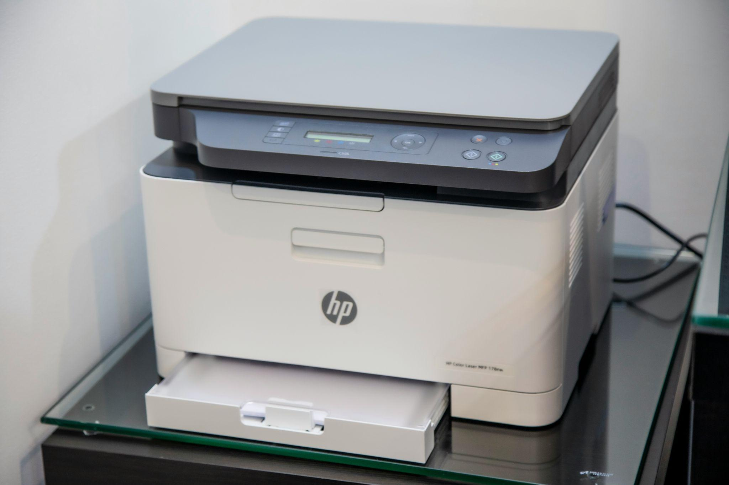
Mark in Book- Printable Documents
Some students may require access to printable versions of instructional and assessment content as an IEP accommodation.
Once the content has been designed in the LMS, there are some simple steps that can be used to generate printable versions of the content. Printable versions of the content can also be used to generate braille versions.
Notes:
Printable versions of the content can also be used to generate Braille versions of the content
Photo by Mahrous Houses on Unsplash

Slide 17

Outlines, Guided Notes, or Graphic Organizers
Students who have been diagnosed with dysgraphia and possibly dyslexia may have various forms of outlines, guided notes, or graphic organizer documents as an accommodation listed on their IEP.
Create a common template that can be used regardless of course and topic.
Cornell Notes Template
Accessible Notes Template
Notes:
Printable versions of the content can also be used to generate Braille versions of the content
Photo by Mahrous Houses on Unsplash

Slide 18

Accommodations for Activities and Assessments
For the activities and assessments accommodations, we are going to move over to Canvas to seem some example of the following in action:
Extended time
Multiple attempts
Reduced answer choices
Multiple testing sessions (breaks)
Notes:
Photo by Nguyen Dang Hoang Nhu on Unsplash

Slide 19
Questions?
Dr. Chris Smith
Instructional Designer
North Carolina Virtual Public School (NCVPS)
chris.smith@ncpublicschools.gov
Notes:
I have provided my contact information on this slide. What questions do you have about the material that was presented. Please feel free to use my email address (chris.smith@ncpublicschools.gov) to contact me with any questions you might have after this presentation has concluded.

