Slide 1

Practical Approaches
to Promote Educational Equity
but not
Engaged
Invested
Dr. Nancy Chapko, 2022 Quality in Action
https://bit.ly/EngagedQualityInAction2022

Slide 2

Who’s Engaged?

Slide 3



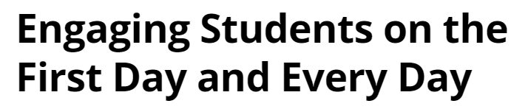



Slide 4








Slide 13
Definition | Source | Orientation
The extent to which students are engaging in activities that higher education research has shown to be linked with high-quality learning outcomes | Krause and Coates (2008) | Behavioural
The concept of student engagement is based on the constructivist assumption that learning is influenced by how an individual participates in educationally purposeful activities | Coates (2007) | Behavioural
Student engagement is concerned with the interaction between the time, effort and other relevant resources invested by both students and their institutions | Trowler (2010) | Behavioural
An observable, action-orientated subtype (behavioural) and two internal ones (cognitive and affective engagement) but then is differentiated from motivation as engagement being action (observable behaviour), motivation as intent (internal) | Christenson, Reschly and Wylie (2012) | Psychological, tricomponent
A multi-aspect construct that include effort, resiliency, and persistence while facing obstacles (vigour), passion, inspiration, and pride in academic learning (dedication), and involvement in learning activities and tasks (absorption) as the main facets of this construct | Schaufeli et al. (2002) | Psychological, tricomponent
The extent to which students feel welcomed by institutional environments and climates | Johnson et al. (2007) | Socio-cultural
The extent to which students succeed in integrating and the amount of social support received | Eggens, Van der Werf, and Bosker (2008) | Socio-cultural
A metaconstruct that includes; Behavioural engagement includes involvement in academic and social or extracurricular activities; positive conduct, absence of disruptive behaviours; effort, persistence, concentration, attention; participation in governance. Cognitive engagement incorporates thoughtfulness and willingness to exert the effort. Emotional engagement encompasses studentsâ€™ affective reactions in the classroom, including interest, boredom, happiness, sadness, and anxiety | Fredricks, Blumenfeld, and Paris (2004) | Holistic/transformational
Table 1. Selected definitions of student engagement (Bowden et al., 2021)

Slide 14
In education, student engagement refers to the degree of attention, curiosity, interest, optimism, and passion that students show when they are learning or being taught, which extends to the level of motivation they have to learn and progress in their education.
The Glossary of Education Reform
https://www.edglossary.org/student-engagement/

Slide 15
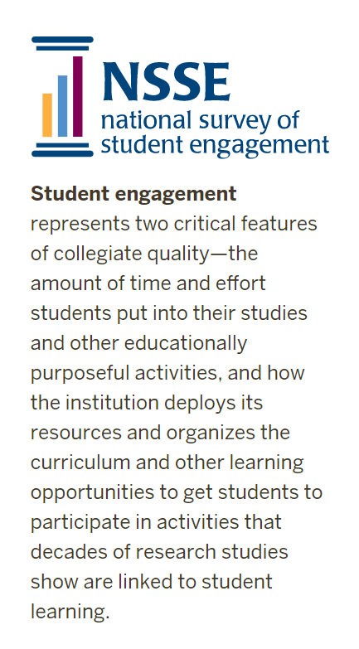
2 Critical Features of Collegiate Quality

Slide 16
When students are invested in learning, they report feeling engaged, hopeful, and able to navigate disappointments and failures to achieve their goals.
Partnering with students: Building ownership of learning
(O'Connell & Vandas, 2015)

Slide 17
Invested: Do Your Students …
Describe the relevancy of what they are learning. Do they have opportunities to explore topics of interest to challenge and deepen learning.
Reference multiple sources of evidence they use to self-assess their learning progress and plan their next steps (i.e. work products, assessments, beliefs, strategies).
Share examples to illustrate how they positively influence and contribute to the learning of their peers and their teacher.
Explain how they support the development of positive, learning-focused relationships with peers and adults.
Acknowledge missteps as a necessary part of learning. They can outline strategies that work best for them and how they address errors or mistakes to overcome challenges.
Partnering with students: Building ownership of learning
(O'Connell & Vandas, 2015)

Slide 18

Invite Students to Partner in the Responsibility of Learning
Develop collaborative relationships
Jointly establish clear expectations for learning and criteria for success
Intentionally build learner strategies that last a lifetime
Use formative assessment results to monitor progress
Harness the power of reciprocal feedback to improve teaching and learning
Empower and motivate students to set meaningful goals and prove learning
Partnering with students: Building ownership of learning
(O'Connell & Vandas, 2015)

Slide 19


What’s the link between student investment and attainment of educational equity?

Slide 20
Students have an essential voice in the process of learning. Encouraging them to advocate for methodologies that support their work as responsible agents of learning leads to two valuable outcomes.
It may be assumed that as long as a variety of options to engage in learning are provided to students, they will find one that interests them. Without essential feedback, however, there is no certainty.
Educators should encourage them to advocate for methodologies that support their work as critical thinkers and responsible agents of learning.
(Hackman & Rausher, 2004)
Designing learning experiences that are energizing, engaging, and accessible requires the inspired participation of students. They can explain best how to meet their needs in the classroom.

Slide 21
How can the role of students as primary receivers and interpreters of content influence their investment in their education?
Each student provides an invaluable insight into the dynamics of knowledge presentation and their interaction with it.
Results of a study suggested that listening to the student voice yielded tangible benefits.
Academic performance of the studied group was improved, and, by several quantitative measurements, students’ perceptions of the content presented was enhanced.
(Brooman et al., 2015)

Slide 22

Student empowerment demonstrates a commitment to social justice.
Students who are invited to participate in learning strategies may perceive themselves as stakeholders whose insight is valued (Schultz, 2011).
Perceptions shared by students may inform instructors’ broad exploration of student diversity.
Valuable student participation enables the instructor to imagine – and then create - learning experiences from which no student should be marginalized (Goff & Higbee, 2008).

Slide 23

invested
Inviting and responding to students’ input was essential to recognizing and comprehending their perspectives. By listening to students’ voices, students were able to claim a role in their learning design. A role that influenced their participation as learners. (Brooman et al., 2015)

Slide 24

Educational Equity ...
Invested
Engaged

Slide 25
References
Bowden, J. L., Tickle, L., & Naumann, K. (2021). The four pillars of tertiary student engagement and success: A holistic measurement approach. Studies in Higher Education, 46(6), 1207-1224. https://doi.org/10.1080/03075079.2019.1672647
Brooman, S., Darwent, S., & Pimor, A. (2015). The student voice in higher education curriculum design: Is there
value in listening? Innovations in Education and Teaching International, 52(6), 663-674.
https://doi.org/10.1080/14703297.2014.910128
Goff, E., & Higbee, J. L. (2008). [Introduction]. In J. L. Higbee & E. Goff (Eds.), Pedagogy and student services for
institutional transformation: Implementing Universal Design in higher education (pp. 1-8). Retrieved from
http://www.cehd.umn.edu/passit/docs/PASS-IT-Book.pdf
Hackman, H. W., & Rauscher, L. (2004). A Pathway to Access for All: Exploring the Connections Between
Universal Instructional Design and Social Justice Education. Equity & Excellence in Education, 37(2), 114–123.
https://doi-org.ezproxy.lib.uwstout.edu/10.1080/10665680490453931
O'Connell, M. J., & Vandas, K. L. (2015). Partnering with students: Building ownership of learning. Corwin.
Schultz, B. D. (2011). Listening to and learning from students: Possibilities for teaching, learning, and curriculum.
Charlotte, NC: IAP, Information Age.
Images from pixabay.com

