Slide 1



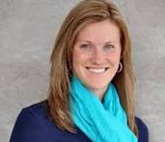

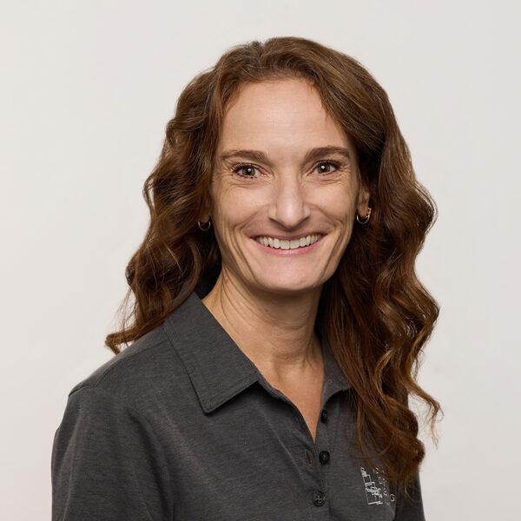



Ensuring Academic Integrity in the AI Era
Contact us:
curriculum@idla.org

Slide 2
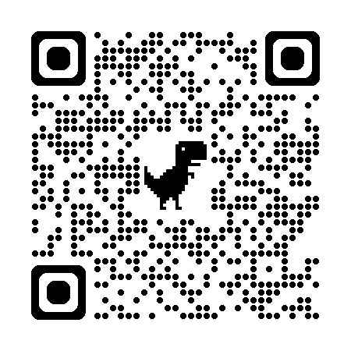
Open Content Catalog - How Not to Cheat
https://shorturl.at/DyQk4

Slide 3
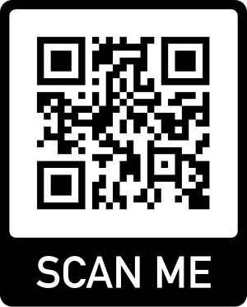
Acceptable Use Policy
https://shorturl.at/nXgaf

Slide 4
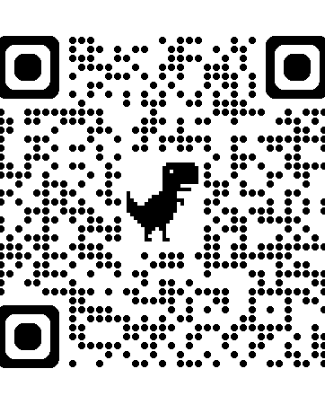
AI Assessment Scale
https://shorturl.at/PkU1m

