Slide 1
Equity in Education: The Role of AI in Supporting Diverse Learners
Exploring SRS 4.6 and 8.3

Slide 2
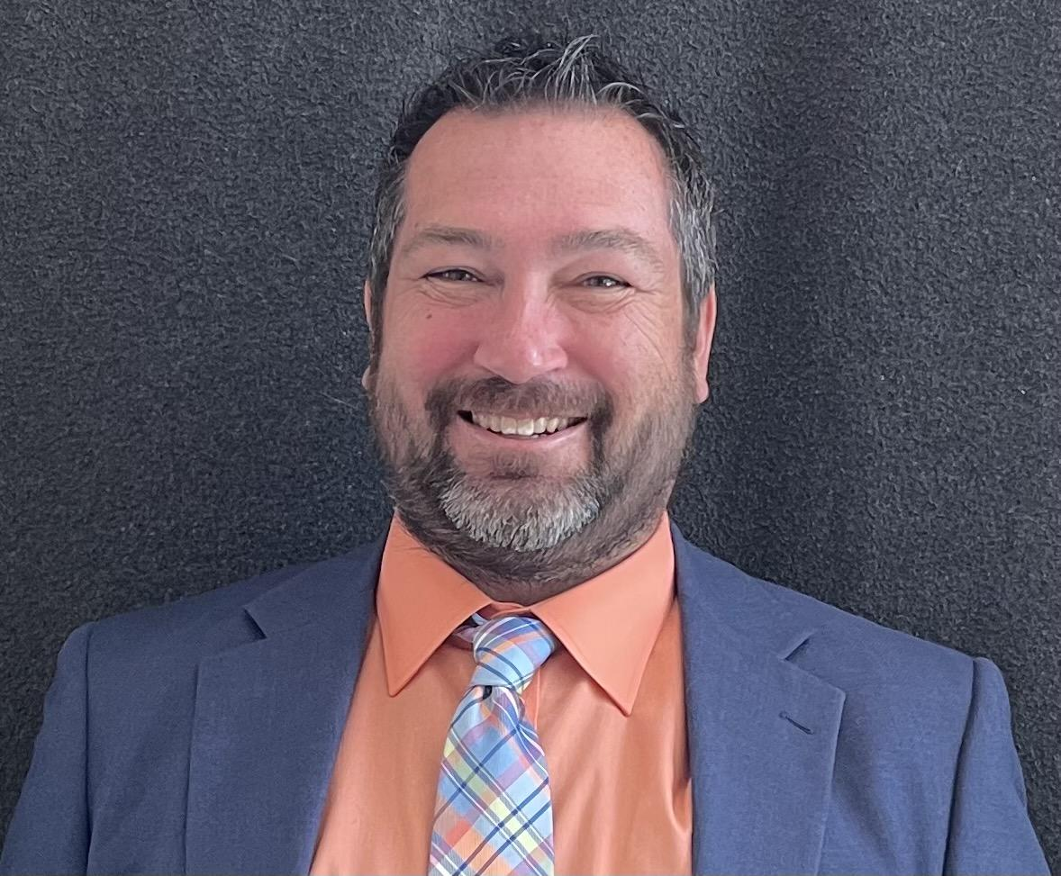
Welcome and Introductions
Dr. Chris Smith
Instructional Designer
North Carolina Virtual Public School (NCVPS)
chris.smith@ncpublicschools.gov
While I introduce myself, please take a few minutes to share the following information in the chat:
Location
Professional role
Experience with QM
Prior knowledge of accessibility
Notes:
Hello, I am Dr. Chris Smith and I currently work as an Instructional Designer with North Carolina Virtual Public School (NCVPS). I began my career as an elementary school teacher 23 years ago where I taught kindergarten, 5th grade, 6th grade, and K-5 computers. Eventually, I went on to earn advanced degrees in web site development and educational technology which led me to go on to become a district-level technology facilitator, Director of Distance Education at a local community college, and eventually to my current role. I also teach community college and graduate computer, educational technology, and supporting diverse learner courses in higher education. I hold certification as a Master K-12 QM Reviewer, QM K-12 Peer Reviewer, Publisher Peer Reviewer, and Continuing Education Peer Reviewer. I am dual certified and hold the QM Higher Education Peer Reviewer certification as well. I have been studying and presenting on accessibility at the local, state, and national levels since 2012.

Slide 3
Establishing Session Norms
Embrace a culture of empathy
Focus on building capacity
Be solution oriented
Share expertise
Honor safe space for all learners to grow

Slide 4


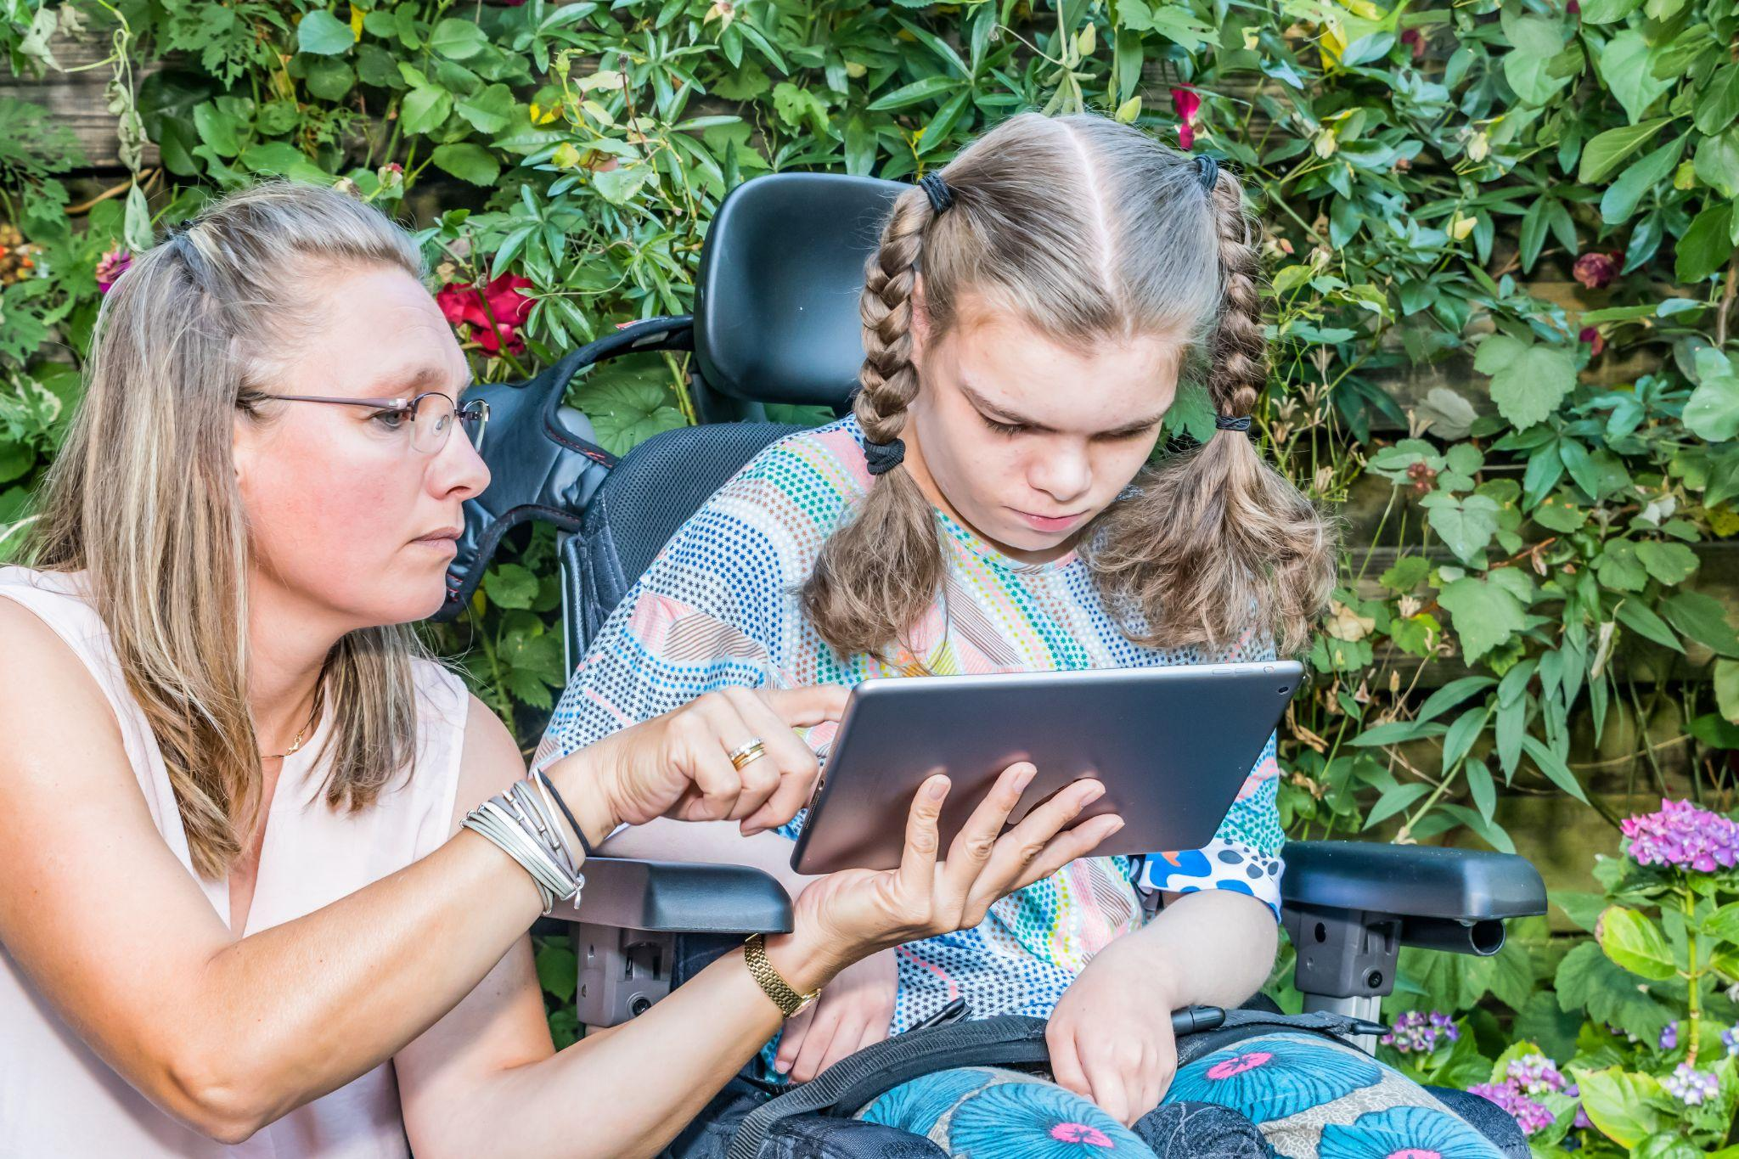


Accessibility and Usability
A person with a disability can acquire the same information, engage in the same interactions, and enjoy the same services in an equally effective, equally integrated manner, with substantially equivalent ease of use as a person without a disability.
National Center on Accessible Educational Materials
Notes:
Image citation: blind student (Shutterstock ID: 2158200539), deaf student (Shutterstock ID: ), I (Shutterstock ID: 787300732), prosthetic computer user (Shutterstock ID: 2083349509), boy with headphones (Shutterstock ID: 1910719234)

Slide 5


Equality, Equity, and Inclusive Teaching
Equality
Providing equal supports to all students: same guided instruction, scaffolded materials, etc.
Equity
Providing unique support according to individual needs through a process called differentiation
Inclusive Teaching
In an equitable and inclusive classroom every student has equal access to learning, is treated equitably by the learning community, and feels valued and supported by their instructor and peers.
University of Buffalo
Notes:
Image citation: young teen in yellow jacket (Shutterstock ID: 1974822149)

Slide 6
Five Strategies to Consider When Developing an Online Course
Know your student audience
Review course activities for cultural awareness and and sensitivity
Tap into your student’s backgrounds, cultures, and experiences
Incorporate tools to bridge the cultural and socioeconomic gap
Strive to create a safe, trustworthy, and positive rapport
Arizona State University
Notes:
Image citation Photo by Héctor J. Rivas on Unsplash

Slide 7


How Diverse are Your Personal Experiences?
Think about the learners you have worked with in the past and the diverse perspectives each had to offer.
How do your experiences compare to the experiences of those learners?
We are limited to the scope of our own experiences.

Slide 8

Artificial Intelligence (AI)
Refers to the simulation of human intelligence processes by computer systems
Designed to mimic human-like interactions and understand and generate human language
Notes:
Image citation: Photo by Markus Winkler on Unsplash

Slide 9

Mastering the Art of Prompting
Think of prompting as a process where you discuss planning/designing ideas with an individual or team of colleagues
Can you help me with (insert concept):
Great idea! Can you help me further customize by (insert concept):
Awesome! Can you make one final adjustment by (insert concept):
Notes:
Image citation Photo by Héctor J. Rivas on Unsplash

Slide 10
Scenario One- Child Welfare Placement
Situation: A Guardian Ad Litem is presented with two choices for placement of a foster child. (Implicit bias)
Option A- Larger family with many extracurricular activity opportunities
Option B- A smaller family with more limited opportunities but same ethnicity
Guardian Ad Litem AI Prompt and Results
Notes:
Image citation: Photo by Markus Winkler on Unsplash

Slide 11
Scenario Two- Generating Alternative Text
Situation: A teacher is designing a lesson on various forms of architecture around the world. One student who is in the class was born in Russia. The teacher wants to incorporate Russian architecture into the lesson but is unsure of how to describe the building.
Generating Alt Text AI Prompt and Results

Slide 12

Scenario Three- Audio/Video Language Translation
Situation: A teacher has an important message to share with students and their support systems but needs to make the content available in Spanish as well as English. How can AI be used to assist in this process?
Language Translation AI Prompt and Results

Slide 13

Scenario Four- Writing Outline
Situation: A teacher has a student who struggles in writing due to being diagnosed with dyslexia and dysgraphia. A personal narrative writing essay has been assigned. How can AI support the student through the writing process?
Writing Outline AI Prompt and Results

Slide 14

Scenario Five- You Decide
Situation: Now that we have discussed four different examples, what scenarios do you have to share that we can explore together?

Slide 15
Choose Your Own Adventure-
You Provide the Scenario
Activity: Five unique problems have been identified and you are going to work independently to solve one of the problems using AI.
Access your the problems by selecting the one of the navigation buttons on the Supporting Diverse Learners with AI Canvas course homepage.

Slide 16
Questions?
Dr. Chris Smith
Instructional Designer
North Carolina Virtual Public School (NCVPS)
chris.smith@ncpublicschools.gov
Notes:
I have provided my contact information on this slide. What questions do you have about the material that was presented. Please feel free to use my email address (chris.smith@ncpublicschools.gov) to contact me with any questions you might have after this presentation has concluded.

