Slide 1
Everything I Need to Know about
Student
Engagement
I Learned from a Rabid Sports Fan
Robert E. Lindsay
Assistant Director of Learning Solutions
Salt Lake Community College

Slide 2
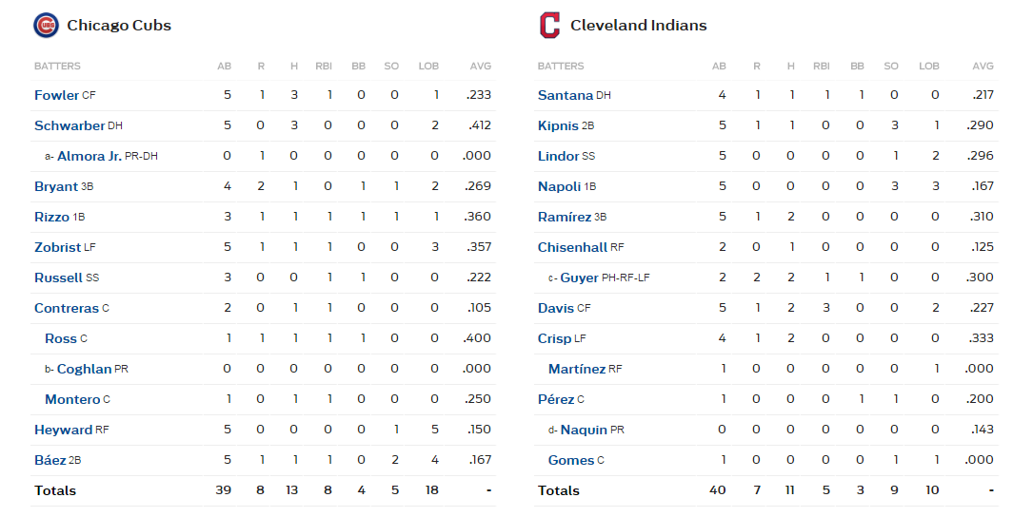

Slide 3
11/2/16

Slide 4
11/2/16

Slide 5
11/2/16

Slide 6
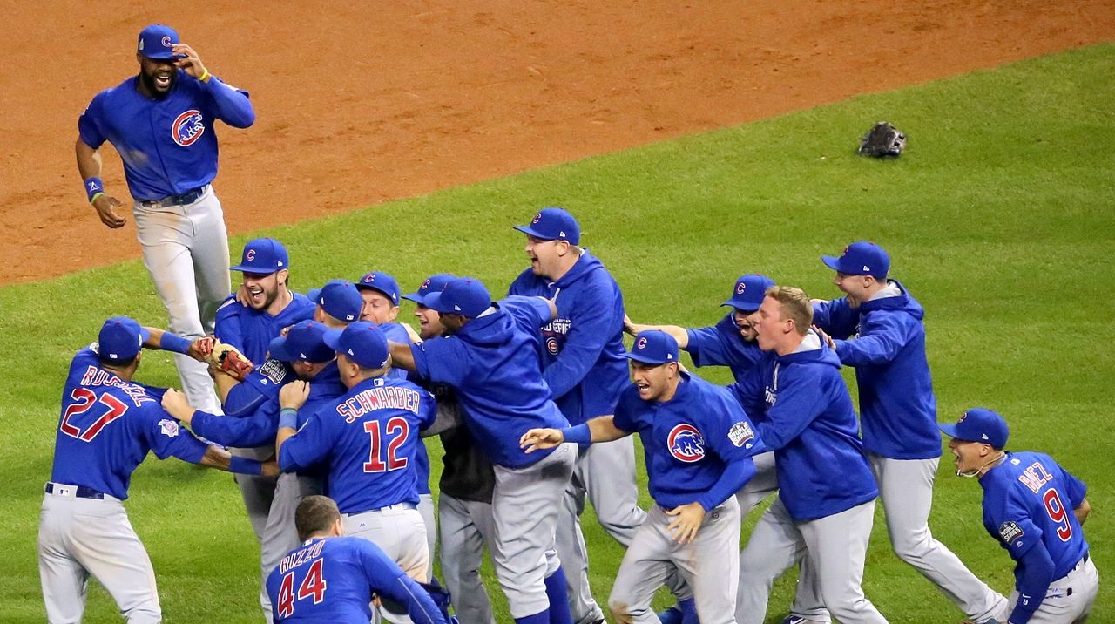
11/2/16
Game 7 of the 2016 World Series!

Slide 7


Slide 8


Slide 9
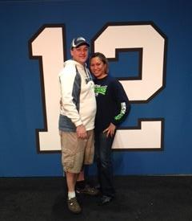
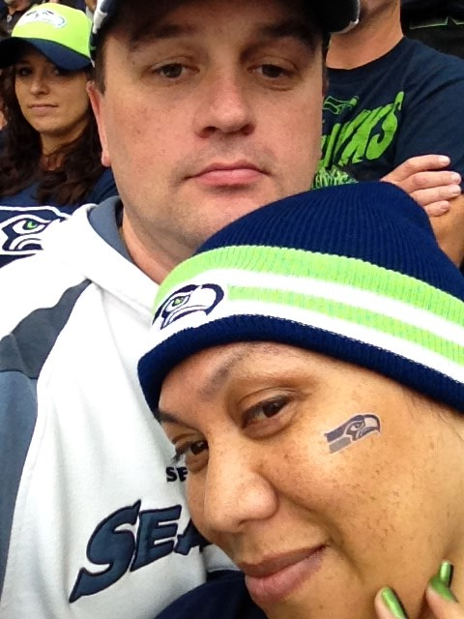

Slide 10


The University of Major League Baseball
The Trustees of Major League Baseball upon recommendation of the fans and ESPN have conferred upon
Mike Lindsay
The degree of
Bachelor of Arts
In
Baseball Studies
Minor in Chicago Cubs
With all the rights and privileges pertaining thereto.
Awarded February 7, 2017
MLB
CUBS

Slide 11
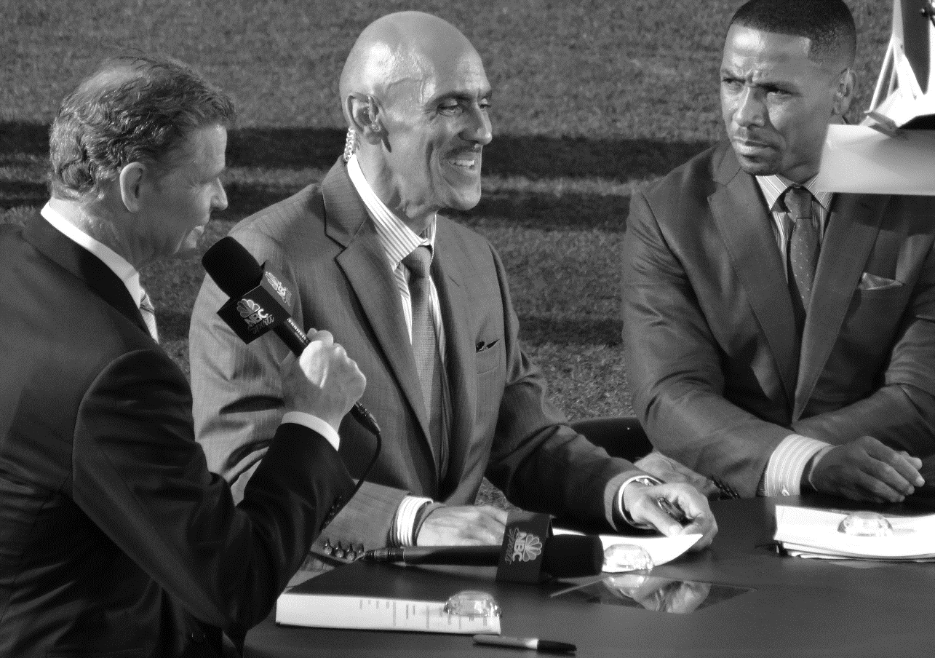
Sportscasters (professors) are
delivering content (teaching lessons) electronically (distance education)
in informative, engaging, and memorable ways to their fans (students).

Slide 12
What is Student Engagement?
In education, student engagement refers to the degree of attention, curiosity, interest, optimism, and passion that students show when they are learning or being taught, which extends to the level of motivation they have to learn and progress in their education.

Slide 13


What is Student Engagement?
Learning improves when students are “engaged” (inquisitive, interested, inspired). | Learning suffers when students are “disengaged” (bored, dispassionate, disaffected).
https://pixabay.com/en/beautiful-business-computer-female-15704/ | https://pixabay.com/en/book-bored-college-education-15584/

Slide 14
Dimensions of Student Engagement
⬧ | Intellectual Engagement | Know
 | Emotional Engagement | Feel
 | Behavioral Engagement | Do
 | Social Engagement | Do Together

Slide 15

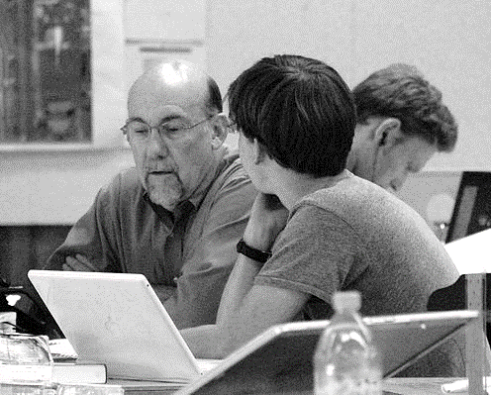

How Do Students Engage?
Student to Content | Student to Instructor | Student to Student
https://www.flickr.com/photos/56866338@N06/8726823600 | https://commons.wikimedia.org/wiki/File:UofU_-_In_the_Architecture_Studio.jpg | https://upload.wikimedia.org/wikipedia/commons/thumb/2/2a/Ashs-students-talking.jpg/640px-Ashs-students-talking.jpg

Slide 16
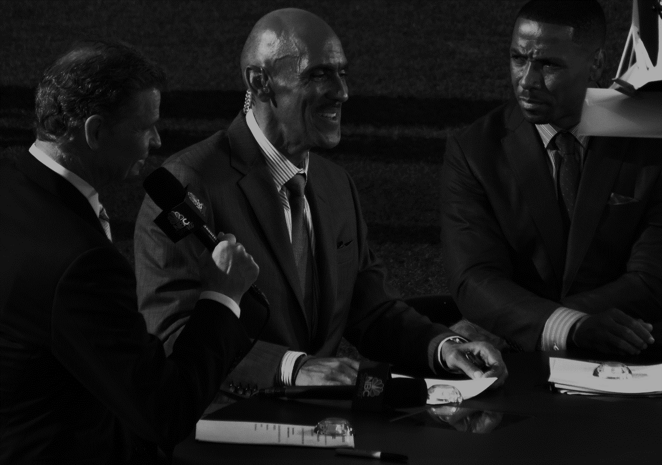
How does this increase viewer engagement?
How would we do something similar in our courses?

Slide 17
How does this increase viewer engagement?
How would we do something similar in our courses?
Broadcasts usually feature
the play-by-play announcer,
the color commentator,
the sideline reporter, and
in-studio analysts

Slide 18
How does this increase viewer engagement?
How would we do something similar in our courses?
Broadcasts usually feature a pre-game, half-time,
and post-game analysis. Analysts will often list the
“keys to the game” before the game starts, and then
discuss those same “keys to the game”
after the game is over.

Slide 19
How does this increase viewer engagement?
How would we do something similar in our courses?
Diagrams, charts, statistics,
box scores, trading cards,
player biographies,
slow-motion replays, and
multiple camera angles

Slide 20
How does this increase viewer engagement?
How would we do something similar in our courses?
There are so many storylines
(which the broadcasters highlight);
the game itself as it plays out,
but also the players, personalities,
matchups, team histories,
injuries, rivalries, comebacks

Slide 21
How does this increase viewer engagement?
How would we do something similar in our courses?
Watching the game with friends,
tailgate parties, live twitter feeds

Slide 22
How does this increase viewer engagement?
How would we do something similar in our courses?
Sports video games,
fantasy football leagues,
amateur sports leagues,
neighborhood pick-up games

Slide 23
How does this increase viewer engagement?
How would we do something similar in our courses?
Sports columns,
sports magazines,
sports documentaries

Slide 24
How does this increase viewer engagement?
How would we do something similar in our courses?
Commercial breaks (aka “promotions”)

