Slide 1



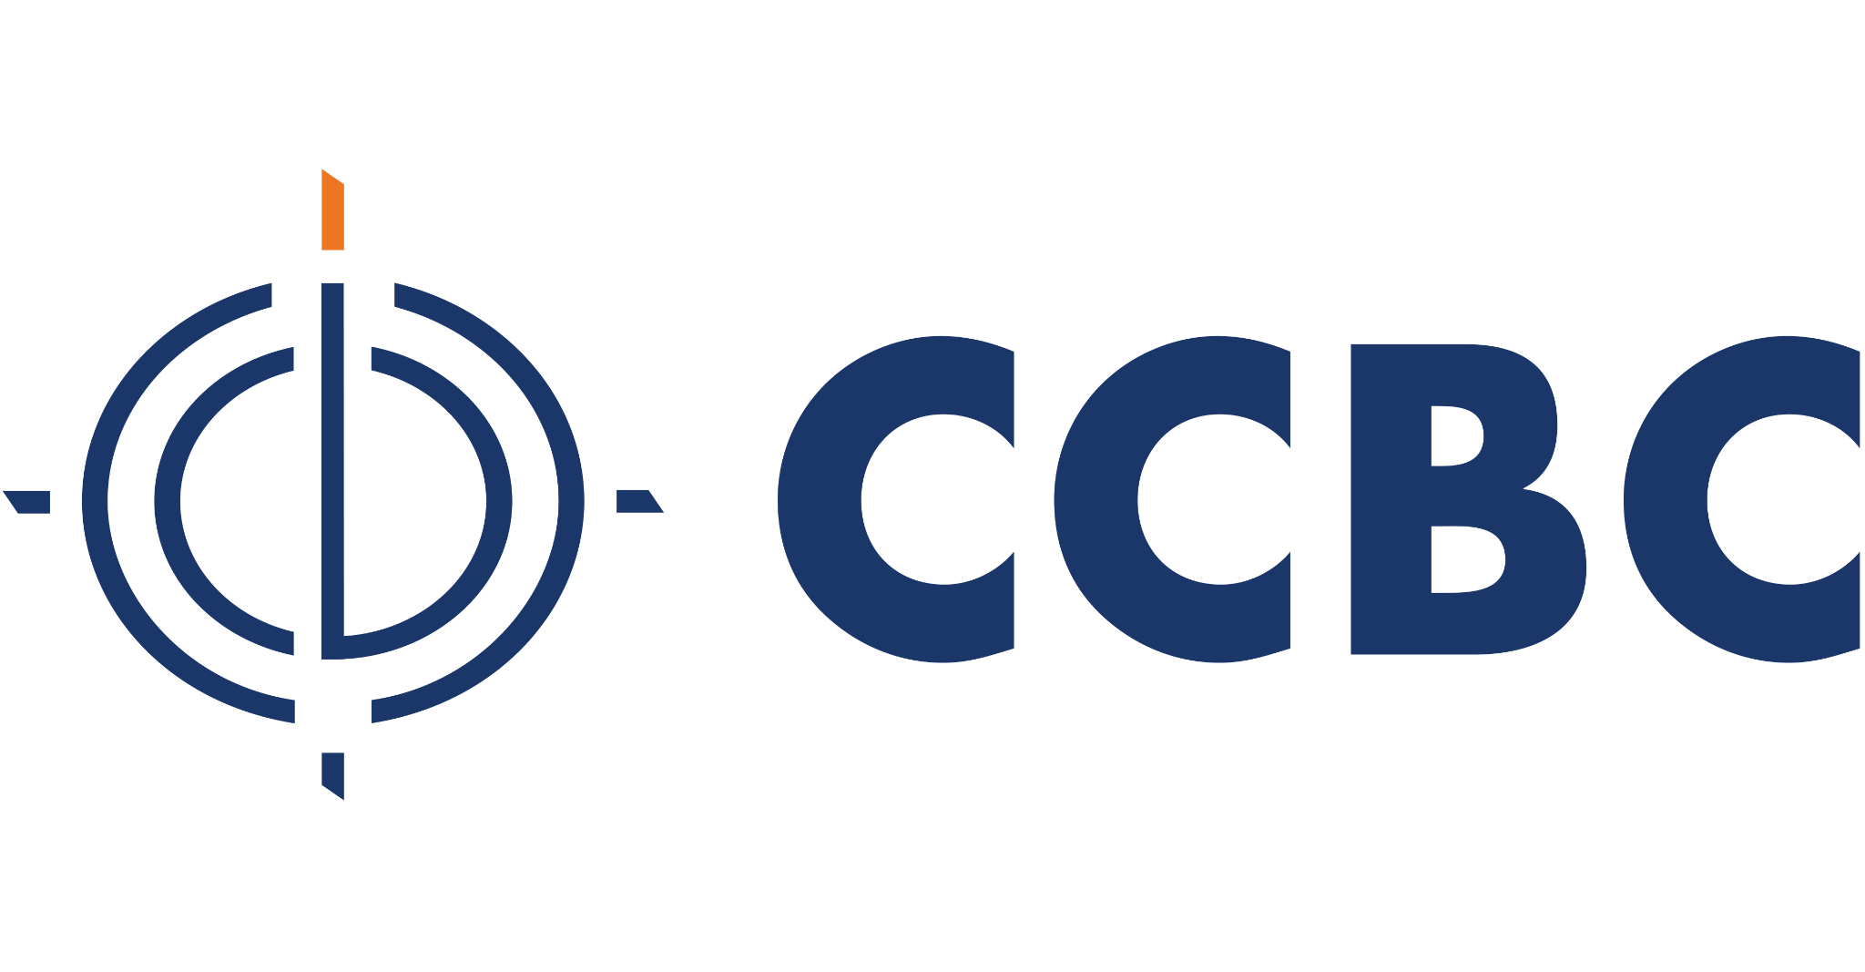
Exploring the Benefits of Dual Enrollment
QM-Recognized College Courses for High School Students
Carly Fuller
VP of Customer Experience and Product Development
Nathan Green
Chief Development Officer, Acadeum
Stephen Kabrhel
Dean, Online Learning, The Community College of Baltimore County
Notes:
40 minutes of content with 10 minutes of Q&A

Slide 2


Goals for today’s session
Introduction to our team and our partnership
Discuss impact of dual enrollment on equity and inclusion
Present best practices for implementing online dual enrollment programs
Connect Quality Matters and its impact on quality dual enrollment opportunities
Bring everything together for a larger conversation about dual enrollment and its benefits
2

Slide 3


In Partnership with Quality Matters
EdisonLearning is proud to be a K-12 Publisher Member of Quality Matters. Our team has five Certified K12 Reviewers and one Certified K12 Master Reviewer. In the last three years, EdisonLearning has successfully submitted 12 QM certified eCourses and QM best practices are integrated into curriculum development and instructional operations.
Acadeum uses a rubric based on QM’s when approving institutions to offer online courses. Most of our college and universities are QM members and many get their courses and programs QM-Certified. This year, Acadeum and QM are launching a new recognition badge for excellence in course sharing. Acadeum is honored to be in partnership with both EdisonLearning and Qualify Matters.
The Community College of Baltimore County (CCBC) is a leader in online education and a member of MarylandOnline, the parent organization of Quality Matters (QM). Offering 74 fully online degrees and certificates, CCBC also has 552 unique online and blended courses developed using QM standards. Showing dedication to meeting Quality Matters Standards, not only have 126 of these completed quality assurance reviews using QM Standards, but CCBC is the first college to earn QM’s QiCS recognition,

Slide 4
Local school district
High school seeks dual enrollment courses to offer high school students the opportunity to earn college credit and offer academic and career readiness pathways
Community College of Baltimore County
Edison Virtual Learning
Quality curriculum built for student success
CCBC offers over 900 sections per semester in their LMS for any student to enroll in for a college student experience
Edison contracts with local schools and districts to provide a wide array of digital curriculum in addition to advisement and enrollment services
Acadeum
Acadeum partners with teaching institutions (TIs) from around the country to connect students and schools with quality online college-level courses

Slide 5

Let’s get to know you!
Raise your hand if you are:
College administrator
College instructional designer
Professor
K12 administrator
K12 instructional designer
Teacher
Another Vendor
5

Slide 6





Pre-College Pathways
Dual Enrollment and
CTE Courses
Concurrent Enrollment
Tri-Credit Courses
Early College
Teacher Education
Thousands of asynchronous online dual enrollment and CTE courses from IHEs in across the US
Partnerships with Colleges that will accredit your teachers and approve your courses for credit
Coursera Certificates approved for high school and college credit, provide an industry credential and a high school and college transcript
Pathways as early as Freshman year so students can graduate high school with an Associate’s Degree in 25+ different majors
Thousands of grad courses for teacher education and alternative certification in all disciplines
College Professor
High School Teacher
Facilitator
College Professor or
High School Teacher
College Professor
6
Notes:
Nathan

Slide 7
Goals in Partnership
Commitment to Quality and Equity
Reintroduce dual enrollment programs with a renewed focus on equitable access and high-quality education for all students
Ensure that all educational options are rooted in engaging, rigorous and well-vetted programs that meet the highest standards
Grounding in Quality Matters (QM) Standards
What QM Brings: QM certification adds an extra layer of quality, ensuring that courses meet well-defined standards of rigor, accessibility, and student-centered design.
Partnership with QM-Certified Institutions: Work with institutions like CCBC and commit to providing students with top-tier, thoroughly reviewed courses that prepare them for both college and career success.
7
Notes:
K-12 audience smaller than HIED, mix of attendees, virtual school leaders, curr dev from schools and other companies, colleges in the room that may want to partner with Acadeum, slide for interested colleges, what do they need to do to work with TIs, it doesn’t end here, it can further beyond K-12, can zoom out a bit to the full ecosystem, what things do we do to collect data to ensure consistency

Slide 8

Goals in Partnership
Case Study: CCBC’s Leadership in Quality
A recognized leader in online education, CCBC has earned Quality Matters (QM) certifications and the prestigious QiCS recognition for ensuring excellence in online course delivery.
Recognition in Action: This serves as a model for quality assurance and continuous improvement in dual enrollment courses.
Supports the college’s mission to provide accessible, affordable, and high-quality education
Strongly believe in seat sharing to keep a students on pace to complete
8
Notes:
K-12 audience smaller than HIED, mix of attendees, virtual school leaders, curr dev from schools and other companies, colleges in the room that may want to partner with Acadeum, slide for interested colleges, what do they need to do to work with TIs, it doesn’t end here, it can further beyond K-12, can zoom out a bit to the full ecosystem, what things do we do to collect data to ensure consistency

Slide 9

Goals in Partnership
What does recognition mean for institutions and students?
For Partner Higher Education Institutions:
  QM recognition ensures that courses are thoroughly reviewed and adhere to best practices, giving your institution confidence that students receive high-quality learning experiences.
For K-12 Schools
  The recognition supports your goal of educational excellence, providing visibility and credibility in the education community.
  It allows you to offer courses that have undergone in-depth quality reviews, fostering higher success rates and student satisfaction.
9
Notes:
K-12 audience smaller than HIED, mix of attendees, virtual school leaders, curr dev from schools and other companies, colleges in the room that may want to partner with Acadeum, slide for interested colleges, what do they need to do to work with TIs, it doesn’t end here, it can further beyond K-12, can zoom out a bit to the full ecosystem, what things do we do to collect data to ensure consistency

Slide 10
Keep the conversation going
Feedback from your pre-college partnerships:
What’s working well?
What are the greatest challenges?
How is dual enrollment different from advanced placement?
10

Slide 11
Dual Enrollment Best Practices
For Virtual Schools
  Enroll students in college courses when they have a lighter load in their high school schedule
  Assign an advisor to each student who will check-in weekly on their progress
  Ensure advisors have direct access to faculty and staff at the partner institution
For Seated Schools
  Create a study hall where students go to take their online courses
  Assign a facilitator in the study hall to support students and do weekly check-ins
  Ensure facilitators have direct access to faculty and staff at the partner institution
For International Schools
  Ensure students are registering in asynchronous courses to account for time zone differences
  Apply credits to elective courses or against exiting IB and AP
  Consider the college’s English proficiency requirements for admission before registering students
Notes:
Briana

Slide 12
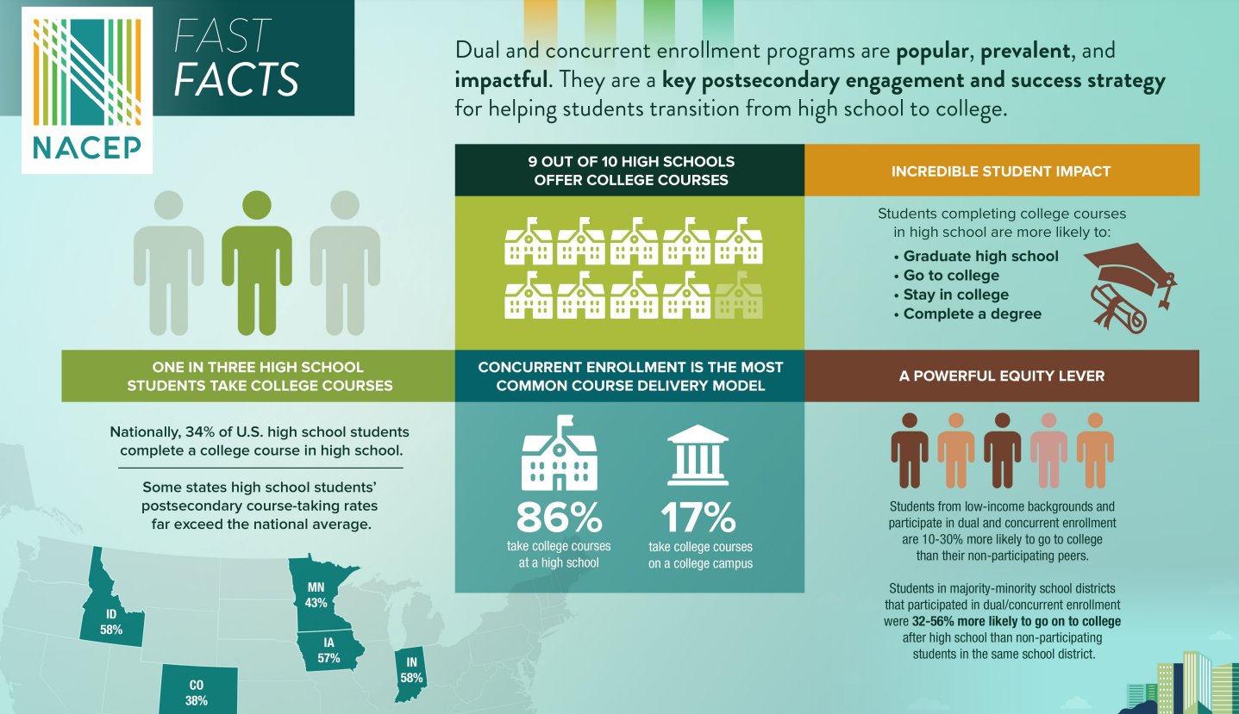
12
Notes:
Emily

Slide 13



Measuring Success
According to the College in High School Alliance, there is evidence of positive outcomes for students participating in dual enrollment programs.
Students who participate in college in high school programs are more likely to graduate high school, enroll in college, persist in college, and complete a college degree or credential.
Low-income and underrepresented students in higher education experience the biggest positive impacts on their ability to access and complete college by getting a jumpstart on taking college classes in high school, particularly in early college high schools.
College in high school programs, and especially early colleges, show a strong return on investment in those states who have examined the long-term impact.
13
https://collegeinhighschool.org/what-we-do/evidence-of-success/
Notes:
Emily

Slide 14
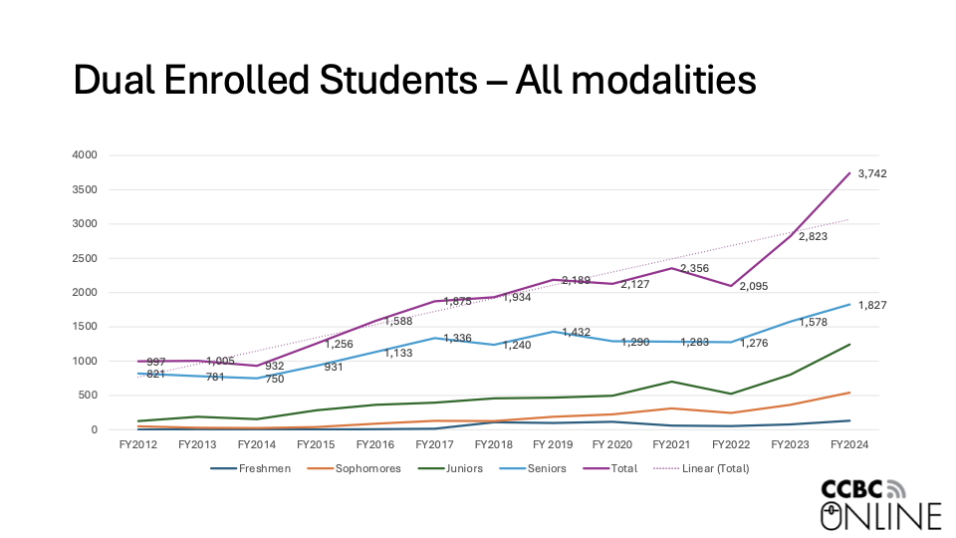

Slide 15
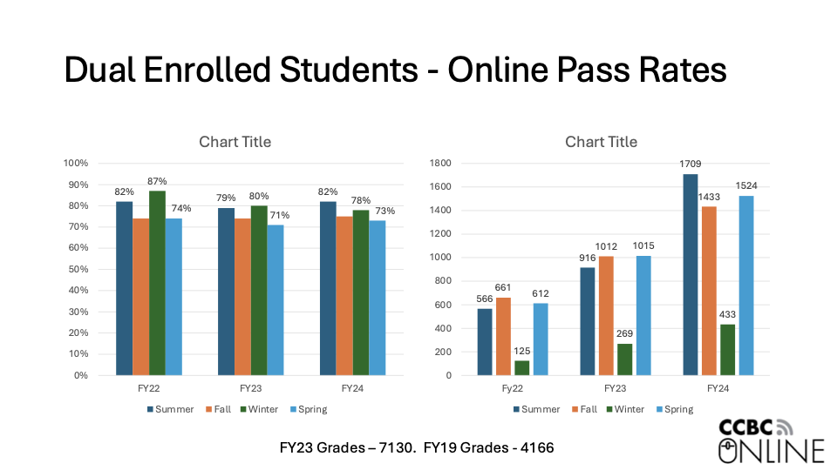

Slide 16



Equity Impact
Students get to gain confidence that they can be successful in collegiate coursework without the pressure of college applications and college tuition costs
Students and students can access courses at a cost much less than they could spend going direct to the University
Students can earn a certificate or even a degree while in high school, empowering them to graduate with workforce skills
16
Notes:
Emily

Slide 17


How well do dual-credit students do in college?
More than 40 percent of high school students who earned college credit as part of dual enrollment programs went on to earn a degree or certificate within four years of graduation
Dual enrollment programs funneled significantly more students to college in some states than others. States that have invested in expanding dual-credit teacher support and partnerships between colleges and school districts see a higher percentage of high school students enrolled
https://www.edweek.org/teaching-learning/how-well-do-dual-credit-students-do-in-college-a-look-in-charts/2024/10
17
Notes:
Emily

Slide 18

Takeaways and Next Steps
K-12 schools: Review your pre-college program. Are you offering your high school students QM-approved courses? Are your college-level courses accessible and equitable?
Higher education institutions: Review your online and dual credit programs. What more can be done to offer high quality college-level courses to high schools? How can you reach more high school students to offer your college courses?
Everyone: Consider your understanding of equity and accessibility for pre-college programs. What steps can we all take to bring high quality courses to all students, regardless of zip code?
18
Notes:
Emily

Slide 19



Thank you!
Carly Fuller
carly.fuller@edisonvirtuallearning.com
Nathan Green
nathan@acadeum.com
Stephen Kabrhel
SKabrhel@ccbcmd.edu

Slide 20
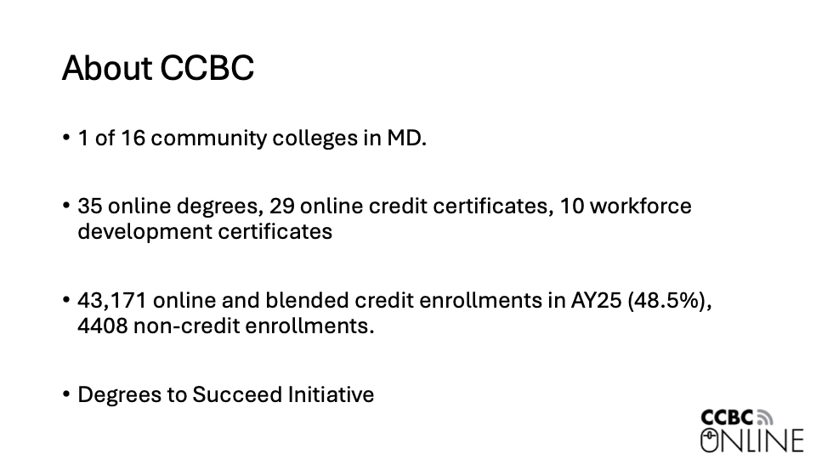

Slide 21
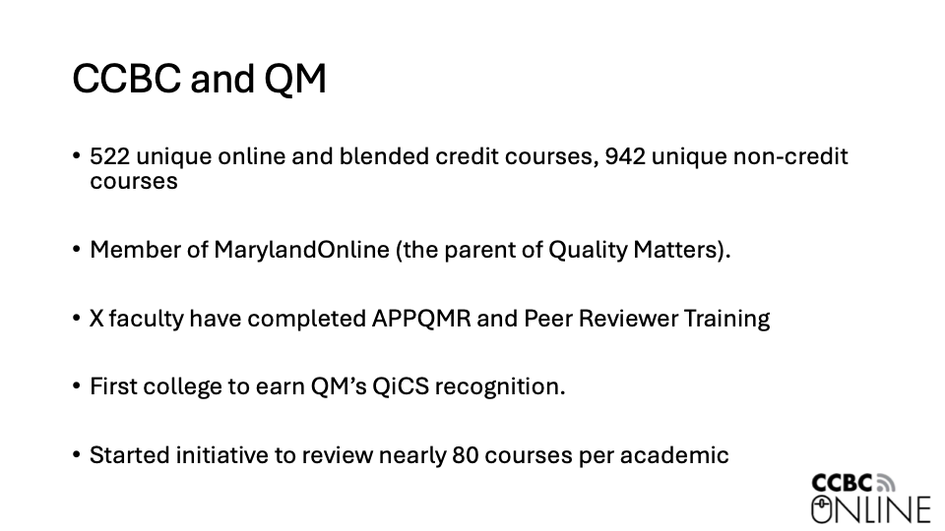

Slide 22
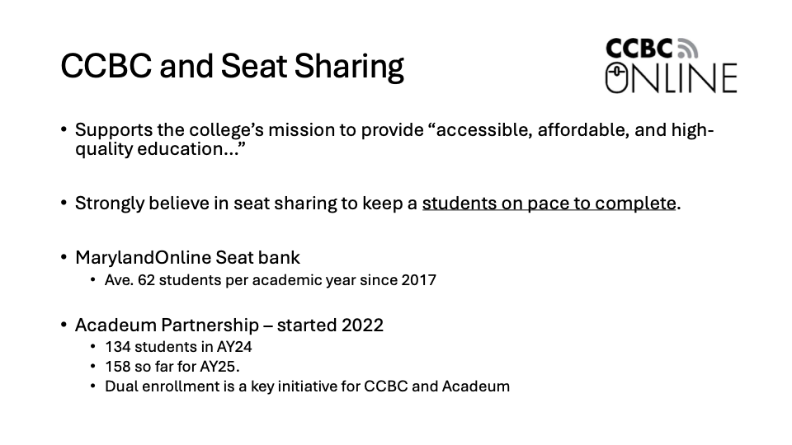

Slide 23
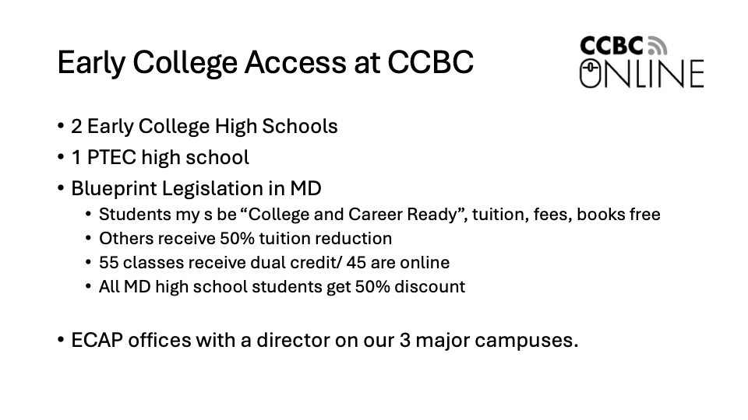

Slide 24
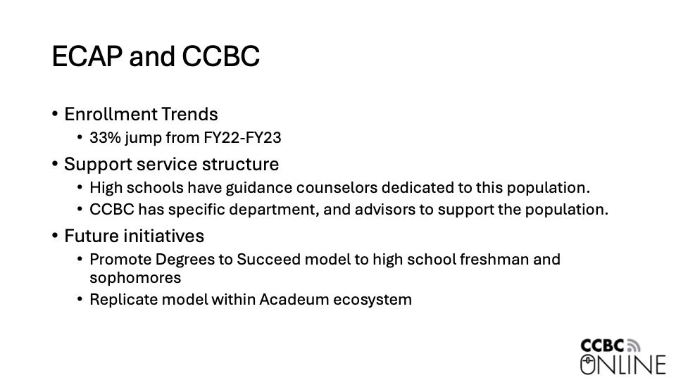

Slide 25
Outline from Proposal
Introduction: Welcome and session objectives, Overview of dual enrollment programs and their benefits, Introduction to K-12 and university partners
Understanding Equity and Inclusion: Discuss the impact of dual enrollment on equity and inclusion, Highlight case studies from rural and underserved schools, Interactive polling on participants' experiences and challenges
Best Practices and Logistics: Present best practices for implementing virtual dual enrollment programs, Discuss logistical challenges and solutions, Think-Pair-Share: Participants share experiences and brainstorm solutions
Connection to QM: Overview of QM standards and their importance in dual enrollment, Case studies demonstrating successful implementation of QM-recognized courses, Q&A session for participants to ask specific questions
Engagement and Collaboration: Bringing it all together through discussion, Q&A, and ongoing implementation
Conclusion and Next Steps: Summarize, provide resources and action items for attendees, thank K-12 partners and teaching institutions.
Engagement Strategies
Think-Pair-Share, Live Polling and Discussion
What questions can we ask to start discussion throughout the session? Utilize data point from CHLOE or other data reporting
25

Slide 26







Meeting All Learner Needs
EdisonLearning brings together best practices in instruction, developed over three decades of supporting schools, with blended solutions designed by educators to meet students where they are and deliver the education they need and deserve.
Core and Elective eCourses
Social Emotional Learning
Career and Technical Education
Dual Enrollment
Credit Recovery and Acceleration
Professional Development
Notes:
Emily

Slide 27

Defining Dual Credit
Last year, more students participated in dual credit than AP courses. But what does that mean?
https://www.nacep.org/
Dual Enrollment
Concurrent Enrollment
Early College
College courses delivered online or on campus. Dual enrollment courses are taught by college faculty and will have college and high school students in the class. Acadeum’s dual enrollment courses are entirely asynchronous.
High school courses delivered online or on campus that count for college credit (transcript). Concurrent enrollment courses are taught by a high school teacher that meets college faculty requirements.
A high school curriculum (which could include dual and concurrent enrollment) that results in the student earning an associate’s degree along with their diploma.
27
Notes:
Nathan

Slide 28
Benefits of Dual Enrollment
When compared to college preparatory and AP courses
Earn admission at many participating institutions
Gain experience as a true college student with a college professor
Reduce time and cost of completing college degree
Earn an associate degree while in high school
Earn grade based on performance in class instead of one exam
Engage in relevant and exciting course options
Explore chosen major or career paths while in high school
Access equitable academic opportunities
28
Notes:
Nathan

Slide 29
Popular Areas of Study
Sample Course Subject Areas
Algebra and College Mathematics | Introduction to Healthcare
College Writing and English | Biology, Anatomy and Physiology
Psychology and Sociology | Coding and Programming
Accounting and Economics | History and Social Sciences
Communication and Media | Philosophy and Religion
29
Notes:
Nathan

Slide 30
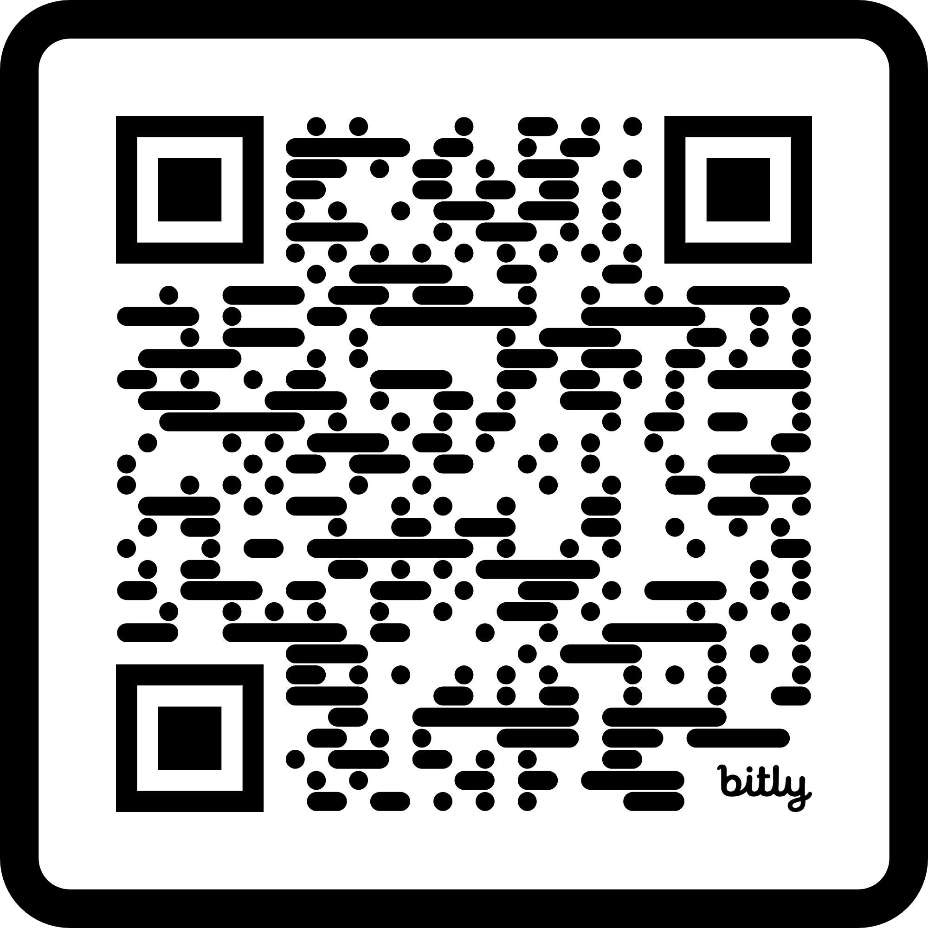
Next Steps
Submit your name and email address to express your interest
Step Two
Consult with an EdisonLearning team member to determine desired course catalog and state-related requirements
Step Three
Work with the EdisonLearning team to complete school setup in online platform
Step Four
Access custom dual enrollment landing page with desired course catalog and registration form
Not Step Five
Seamlessly add on other educational services like social emotional learning coursework, career and technical education eCourses and more
30
Notes:
Emily

Slide 31

Once prospective districts sign on with EdisonLearning dual enrollment, we make registration as easy as possible. Automated rostering is available via Clever or ClassLink, as well as manual user creation and bulk upload options
Once registered, students will be give credentials to access eSchoolware, EdisonLearning’s proprietary online learning platform
Students and administrators will have access to eSchoolware for registration and final grades
Students will take the dual enrollment course in the teaching institution LMS and with university faculty
Your institution admin, educators and students will have access to support and services from a Customer Success Manager and Technical Support team
31
Notes:
Emily

