Slide 1


Fan the Waves of Quality:
Accreditation as a Catalyst for QM Engagement
Dr. Johnette Moody and Dr. Loretta Cochran
QM Connect
St. Louis, Missouri
November 1, 2018

Slide 2
Institutional Outcomes with QM
Aiding the accreditation process
Improving learner outcomes — persistence, retention, etc.
Consistency in course design (although not necessarily course content)
Maximizing organizational resources
Showcasing the quality of online courses
Creating an evidence-based process for maintaining online learning quality

Slide 3
Arkansas Tech University’s Application
Use the QM Rubric/Framework to organize and guide the accreditation process
  Includes HLC, ABET, AACSB, CAHIIM
  Have not reviewed ACEN, ACPHA, COAPRT, CORE, CAEME, NASM or NCATE … yet
Dovetail in Assessment activities to streamline and coordinate efforts
Incorporate into Curriculum and Course Development

Slide 4


QM & HLC Accreditation
Criteria 3A: The institution’s degree programs are appropriate to higher education.
1.Courses and programs are current and require levels of performance by students appropriate to the degree or certificate awarded.
2.The institution articulates and differentiates learning goals for its undergraduate, graduate, post-baccalaureate, post-grad, and certificate programs
3.The institution’s program quality and learning goals are consistent across all modes of delivery and all locations (on the main campus, at additional locations, by distance delivery, as dual credit, through contractual or consortia arrangements, or any other modality)
Criteria 2E: The institution’s policies and procedures call for responsible acquisition, discovery and application of knowledge by its faculty, students and staff.
Criteria 3B: Institution demonstrates that the exercise of intellectual inquiry and the acquisition, application, and integration of broad learning and skills are integral to its educational programs.
1. The institution provides effective oversight and support services to ensure the integrity of research and scholarly practice conducted by its faculty, staff, and students.
2. Students are offered guidance in the ethical use of information resources.
2. …articulates purposes/content/intended learning outcomes of its undergrad general education requirements. … imparts broad knowledge & intellectual concepts to students & develops skills/attitudes institution believes every college-educated person should possess.
3. The institution has and enforces policies on academic honesty and integrity.

Slide 5
QM & HLC Accreditation
Criteria 3C: Institution has the faculty/staff needed for effective, high-quality programs & student services.
Criteria 4B: Institution demonstrates a commitment to educational achievement & improvement through ongoing assessment of student learning.
4. …has processes and resources for assuring that instructors are current in their disciplines and adept in their teaching roles; it supports their professional development.
1. …has clearly stated goals for student learning & effective processes for assessment student learning & achievement of learning goals.
Criteria 3D: Institution provides support for student learning & effective teaching.
2. …assesses achievement of the learning outcomes that it claims for its curricular … programs.
5. …provides to students guidance in the effective use of research and information resources.
ASSUMED PRACTICES: C. TEACHING & LEARNING
5. Instructors communicate course requirements to students in writing and in a timely manner.

Slide 6


Quality Matters and
AACSB Standards
Standard 3: The financial model must support high-quality degree programs for all teaching and learning delivery modes. (2013 Standards/2017 update, pg. 24)
Learning and Teaching (Standards 8-12): Educational programs are structured to ensure consistent, high-quality education for the same degree programs regardless of difference and changes in technology and delivery modes. (2013 Standards/2017 update, pg. 32)
Standard 11: Teaching/Learning Models include traditional face-to-face classroom models, distance (online) models, blended models that employ face-to-face and distance (online) components, other forms of technologically enhanced instruction, or any other form of instructional methodology. (2013 Standards/2017 update, pg. 37)
Standard 5: Students in all programs, disciplines, locations, and delivery modes have the opportunity to receive instruction from appropriately qualified faculty. (2013 Standards/2017 update, pg. 28)
Standard 10: Student-faculty interactions involve all types of faculty members… For any teaching/learning model employed, students have access to content experts (for instruction, dialogue, and feedback) in curricula and extracurricular situations for instruction. (2013 Standards/2017 update, pg. 36)
Standard 10: Curricula include opportunities for student-student and student-faculty interaction to facilitate learning across program types and delivery modes. (2013 Standards/2017 update, pg. 37)
Standard 11: Expectations for student effort for the same degree credentials are equivalent in terms of depth and rigor, regardless of delivery mode or location. (2013 Standards/2017 update, pg. 37)

Slide 7
Quality Matters and
AACSB Standards
7. Instructional Resources: Design, implementation, and assessment of distance learning programs should place additional emphasis on access to, and utilization of, learning resources. (1999 Quality Issues in Distance Learning/2007 Revision, pg. 12)
6. Curriculum and Learning Issues: The design of learning experiences will greatly influence the success of a distance learning program. ... Supplement content specialists with people who have specific expertise in learning design to create appropriate learning experiences. (1999 Quality Issues in Distance Learning/2007 Revision, pg. 10)
Standard 12: The school provides development activities focused on teaching enhancement to all faculty members, appropriate professional staff, and graduate students who have teaching responsibilities across all delivery modes. Faculty are adequately prepared to teach while employing the modalities and pedagogies of degree programs. (2013 Standards/2017 update, pg. 38)
5. Faculty: Implementing distance learning programs requires new technical and pedagogical skills. The school must provide resources to expand and develop these skills in the faculty. (1999 Quality Issues in Distance Learning/2007 Revision, pg. 9)
Standard 12: The school has policies and process to enhance the teaching effectiveness of faculty and staff involved with teaching across the range of its educational programs and delivery modes. (2013 Standards/2017 update, pg. 38)

Slide 8

Engineering
Engineering Technology
Applied & Natural Science
Computing (v. 2.0)
Baccalaureate Program Accreditation
Criterion 3. Student Outcomes
Have documented student outcomes that prepare graduates to attain program objectives.
Self Study Report: Describe mapping of program’s student outcomes to the learned capabilities and requirements listed in program criteria.
[Program criteria could include statements to add specificity to the requirements for student outcomes. Add’l statements differentiate the discipline designated by the program’s title and are included in the mapping to the program’s student outcomes.]
Criterion 4. Continuous Improvement
Must regularly use appropriate, documented processes for assessing and evaluating level that student outcomes are being attained.
Results of these evaluations must be systematically utilized as input for the continuous improvement of program.
Self-Study Report: Summarize processes for regularly assessing and evaluating extent student outcomes are being attained/used for continuous improvement of the program.
Assessment Metrics and Methods of Student Outcomes: list the metric(s), measure(s) or indicator(s) used for each student outcome. Describe the process for collecting data or making assessments for each.
Assessment Schedule and Frequency: present the schedule and frequency for each type of assessment as well as points of accountability.
Evaluation: present evaluation schedule, points of accountability, and expected level of attainment for each student outcome.
SYLLABI Requirements
Instructor’s or course coordinator’s name
Textbook information and other supplemental materials
Specific course information and prerequisites or co-requisites
Specific goals for the course/student outcomes
Brief list of topics to be covered
Criterion 1. Students
Student performance must be evaluated.
Student progress must be monitored to foster success in attaining student outcomes, thereby enabling graduates to attain program educational objectives.
Self Study Report: List the student outcomes for the program. Indicate where the student outcomes are documented.

Slide 9

QM Matters & AHIMA Standards
CAHIIM Mission Statement
CAHIIM serves the public interest in advancing the value of health informatics and health information management through quality education by…
Assessing student achievement …
Emphasizing the principle of volunteerism and peer review …
Embracing a culture of continuous quality improvement.
Content Mapping
After identifying the courses in the core curriculum, the faculty set about the task of mapping the content of each course to the CAHIIM standards. This mapping process led to a systematic way of ensuring consistency of content being taught, and also demonstrates that our student learning outcomes were both reasonable and measurable.
Public Value
By stating that a program has met established academic standards, CAHIIM accreditation provides the following values for Academic Institutions:
Provides a structured framework for ensuring sound educational practices, which involve faculty and staff in a comprehensive evaluation plan for the academic program;
Stimulates self-improvement by providing nationally acceptable standards against which the program can self evaluate to meet the needs of students, the profession, and the public;
Provides a frame of reference for the program to identify resources that may be needed to maintain or enhance the curriculum;
Provides consultative feedback on possible areas of concern and where excellence is achieved.
Useful Syllabus
Fully inform students of course expectations, timeline, how course fits into program
Prerequisite knowledge/courses
Faculty information
Course Objectives/Learning Outcomes
AHIMA Curriculum Competencies mapped
Polices: attendance, grading, other relevant institutional procedures
Course Schedule including course activities & what content they cover
Resources needed/additional costs/textbooks

Slide 10
QM Matters & AHIMA Standards
HIM Accreditation Standards
3 Program Effectiveness Measures/5 Program Planning & Assessment
systematic evaluation of mission, goals and measurable outcomes
ongoing effort to determine its effectiveness/quality improvement cycle
18 Curriculum
Teaching and assessment methods should be active, and evidence based.
19 Syllabi
must document standard curriculum competencies
be clearly written & include course objectives/evaluation methods that assess student learning outcomes
must include the entry-level competencies
Stated what is required/expected/will be experienced/evaluation for successful completion of course
22 Curriculum—Evaluation of Students
indications of the students’ progress toward and achievement of the competencies stated in the curriculum
methodologies must be conducted frequently, and must be able to test the different cognitive levels
must show students are being taught and assessed at a variety of taxonomic levels, with emphasis being placed on the use of application and problem-solving techniques
Health Informatics Standards
3 Program Effectiveness Measures/4 Program Planning
ongoing effort to determine its effectiveness/quality improvement cycle
program’s goals must be stated as educational outcomes to be achieved; made sufficiently explicit; defined with measurable target outcome statements
systematic evaluation of the mission, goals and outcomes and a process for continuous improvement
13 Program-Specific Curriculum
reflect the program’s mission, goals and objectives
must include evaluation methods used to assess student learning outcomes
curriculum must focus on program’s defined knowledge, skills and values
Requires alignment of competencies and outcome assessments with the program’s mission, goals and objectives

Slide 11
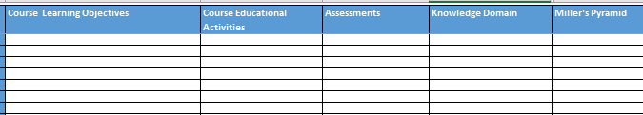
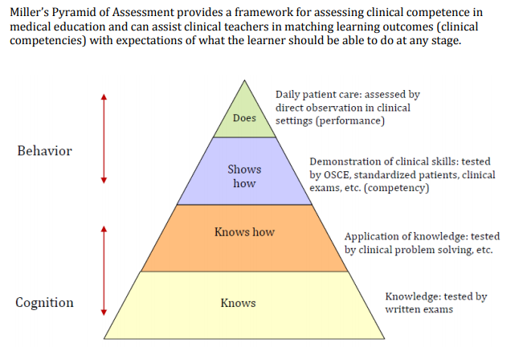
For each course:

Slide 12
Institutional Progress with QM
QMUG – 30 62 70 members strong
14 22 29 Faculty and Staff have created QM User Accounts (representing Ozark & Russellville)
12 16 9 are currently registered for QM Courses
(including APPQMR, PRC, AFFC, RCPR courses)
5 40 110 completed QM Courses
13 22 External Course Reviews Completed
6 7 are Peer Reviewers
4 are Registered for Master Reviewer Course
4 are Master Reviewers
6th Edition QM Rubric books have been distributed to users

Slide 13
Contact Us
Dr. Loretta Cochran
Arkansas Tech University
106 West O Street
Rothwell 441
Russellville, AR 72801
479.964.3250
lcochran@atu.edu
Dr. Johnette Moody
Arkansas Tech University
1811 North Boulder Avenue
Corley 238
Russellville, AR 72801
479.968.0670
jmoody@atu.edu

