Slide 1
Fast Track to K-12 Standard 8 Alignment
Kristi Peacock – Instructional Designer
Krista Tomaselli – Course Development Manager
Notes:
Welcome to “Fast Track to K12 Standard 8 Alignment.” I am Kristi Peacock, one of several instructional designers at Michigan Virtual who develops K12 courses. I am here today with our Course Development Manager, Krista Tomaselli.

Slide 2
Welcome
Description:
This session will offer a quick presentation on the hints, tips, and tricks that one organization has gleaned on its journey to accessibility.
Objective:
Discover free or low-cost tools and techniques that will help design teams build accessible courses.
Notes:
We are here to share a quick overview of what our team learned on its journey to creating accessible K12 courses. Today we will share some of the free and low-cost tools and techniques that we discovered along the way.

Slide 3

K-12 Standard 8 – Accessibility & Usability
  8.1 Navigation throughout the course is logical, consistent, efficient, and intuitive.
  8.2 Information is provided about the accessibility of all technologies required in the course.
  8.3 The course provides alternative formations of course materials that meet the needs of diverse learners in order to accommodate alternative means of access.
  8.4 The course design facilitates readability.
  8.5 Course multimedia facilitate ease of use.
Notes:
Standard 8 addresses the accessibility and usability of our courses and sets forth 5 specific standards that our courses must meet. In the next 4.5 minutes, I hope to share some hints, tips, and tricks for addressing each of them.

Slide 4

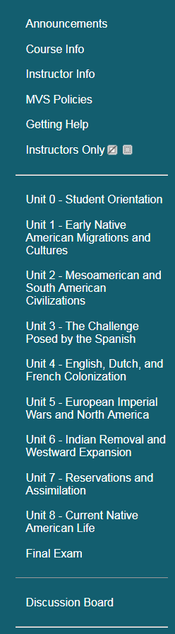

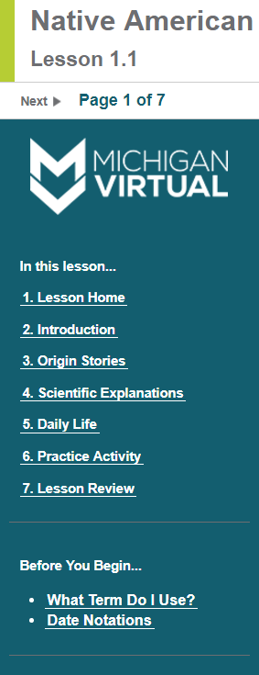



Standard 8.1
8.1 Navigation throughout the course is logical, consistent, efficient, and intuitive.
Notes:
Standard 8.1 addresses consistency in course navigation. Developing a master course shell in our LMS and a template for our course lessons, which we currently build in SoftChalk, was a great first step toward addressing several standards.

Slide 5
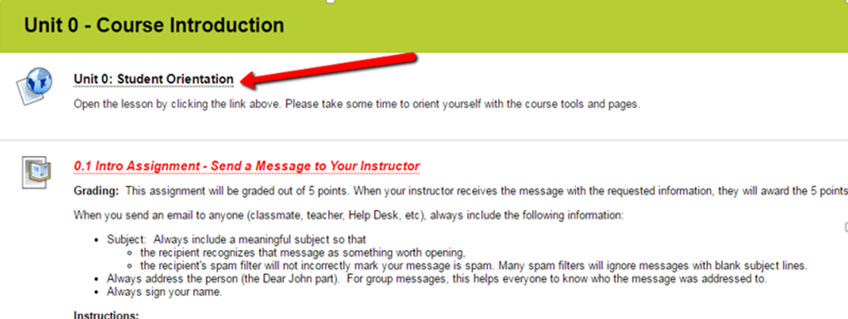
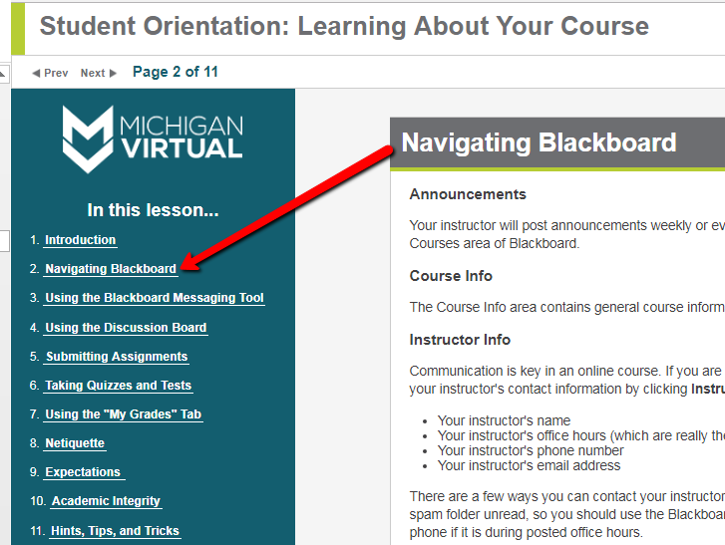
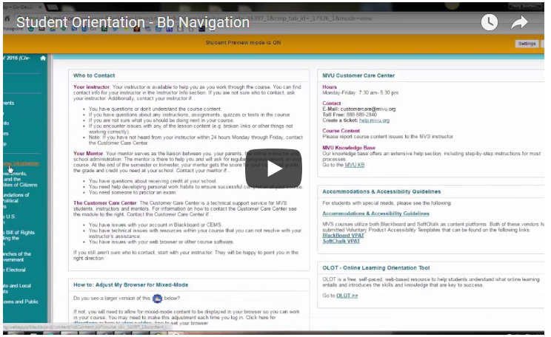
Standard 8.1
Notes:
This consistent navigation and predictability allowed us to create a Student Orientation module included in every Michigan Virtual course that provides text-based information, interactive activities, and video.

Slide 6
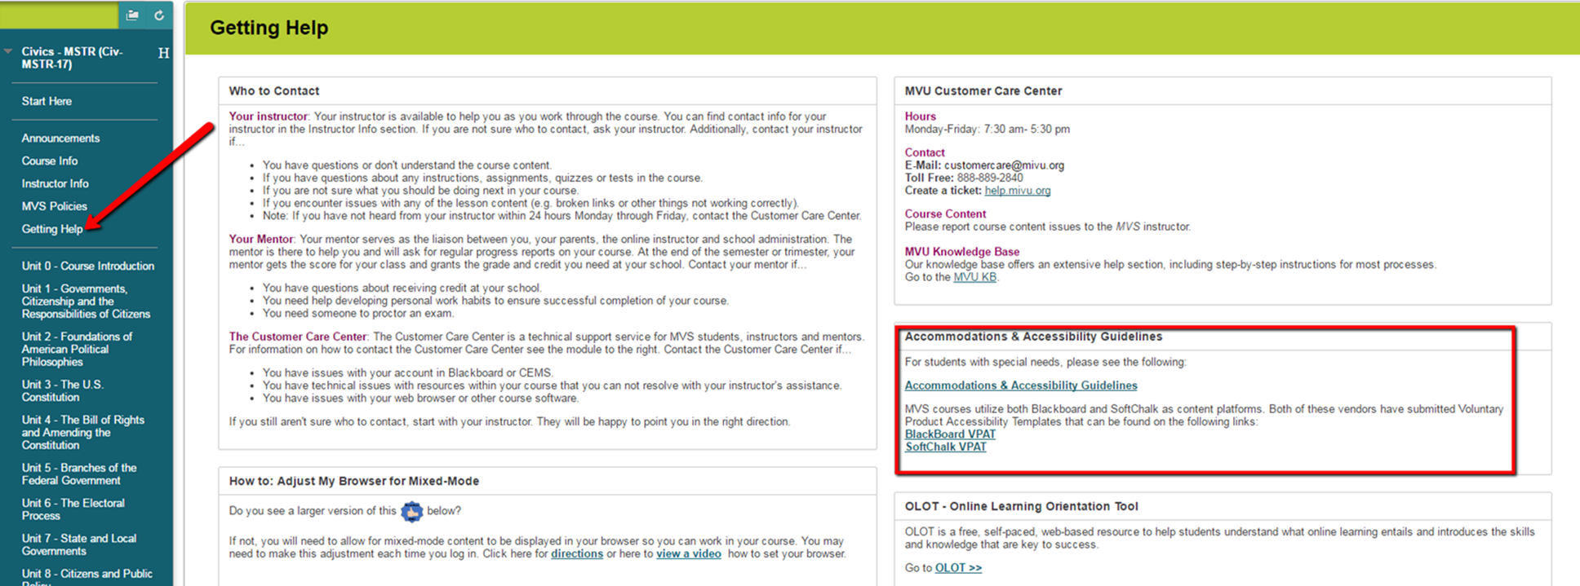
Standard 8.2
8.2 Information is provided about the accessibility of all technologies required in the course.
Notes:
Standard 8.2 was easily addressed by adding the VPATs for our LMS and any third party software in our Getting Help module. This module also includes many other resources for getting help as quickly and efficiently as possible.

Slide 7
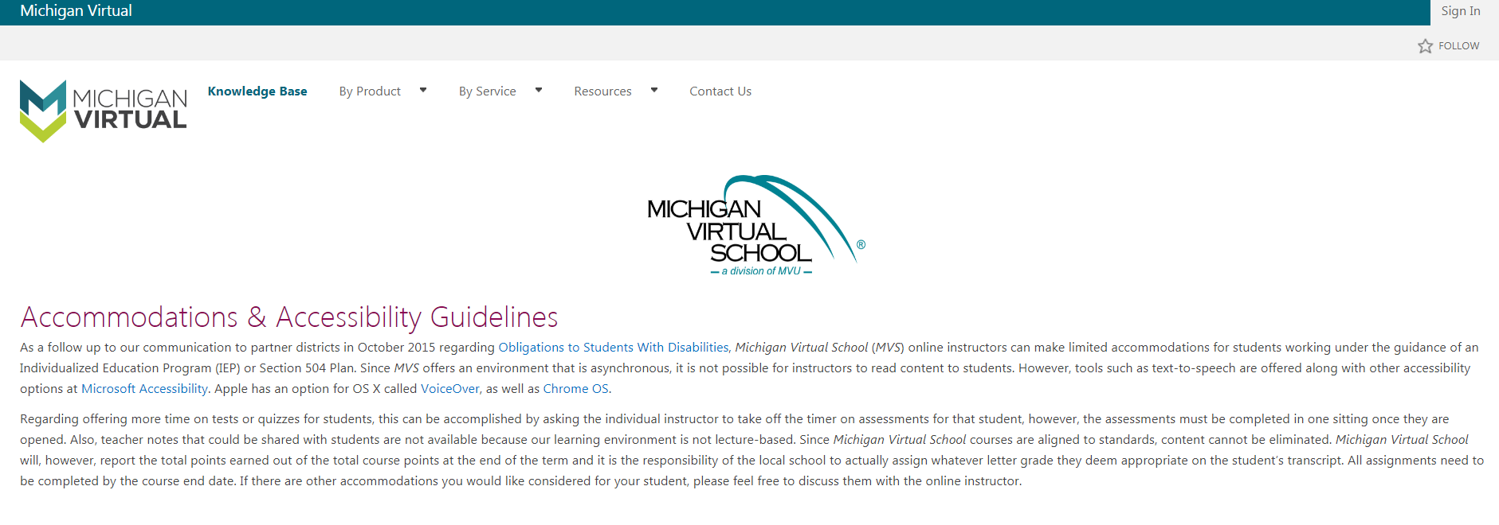
Standard 8.2
Notes:
Clicking on the Accommodations & Accessibility Guidelines link in the Getting Help module, gives students, parents, and mentors quick access to what they can expect Michigan Virtual to do to accommodate diverse learners.

Slide 8
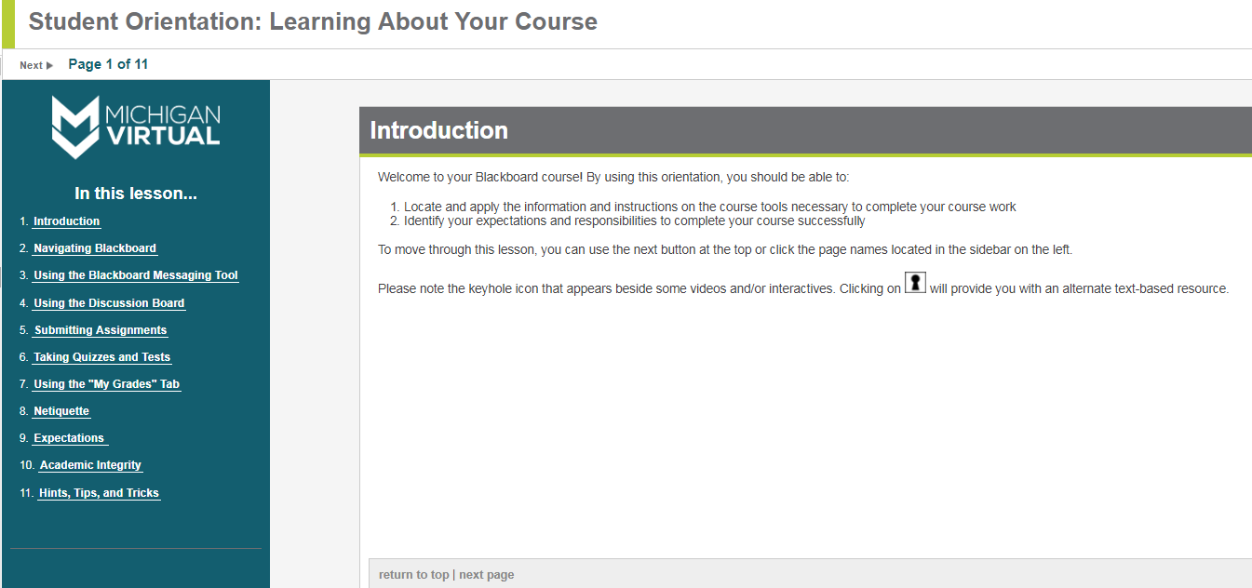
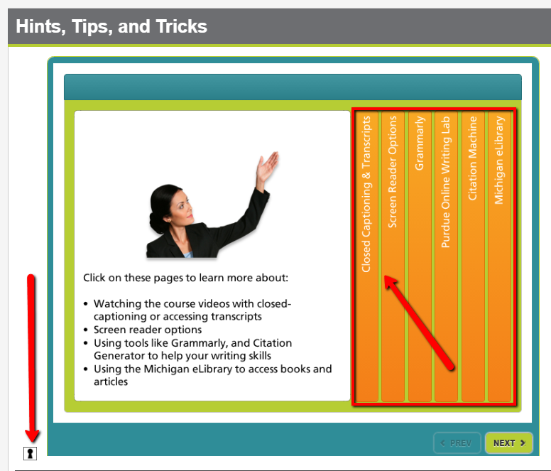
Standard 8.2
Notes:
In an effort to provide accessible activities within our courses, we choose our tools carefully. This example is how we use the keyhole icon within SoftChalk to include a text version of the information that is housed in the Articulate accordion activity.

Slide 9


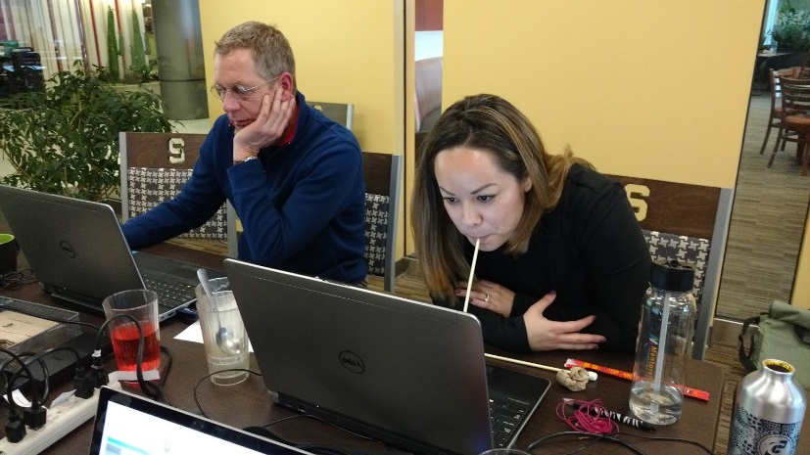
Standard 8.3
8.3 The course provides alternative formations of course materials that meet the needs of diverse learners in order to accommodate alternative means of access.
UX Design Techniques
Notes:
Standard 8.3 forced us to rethink our definition of audience. We used a handful of tools to help us do this. We did a book study, took a course on Lynda.com, and included a hands on experience in one of our quarterly get-togethers.

Slide 10
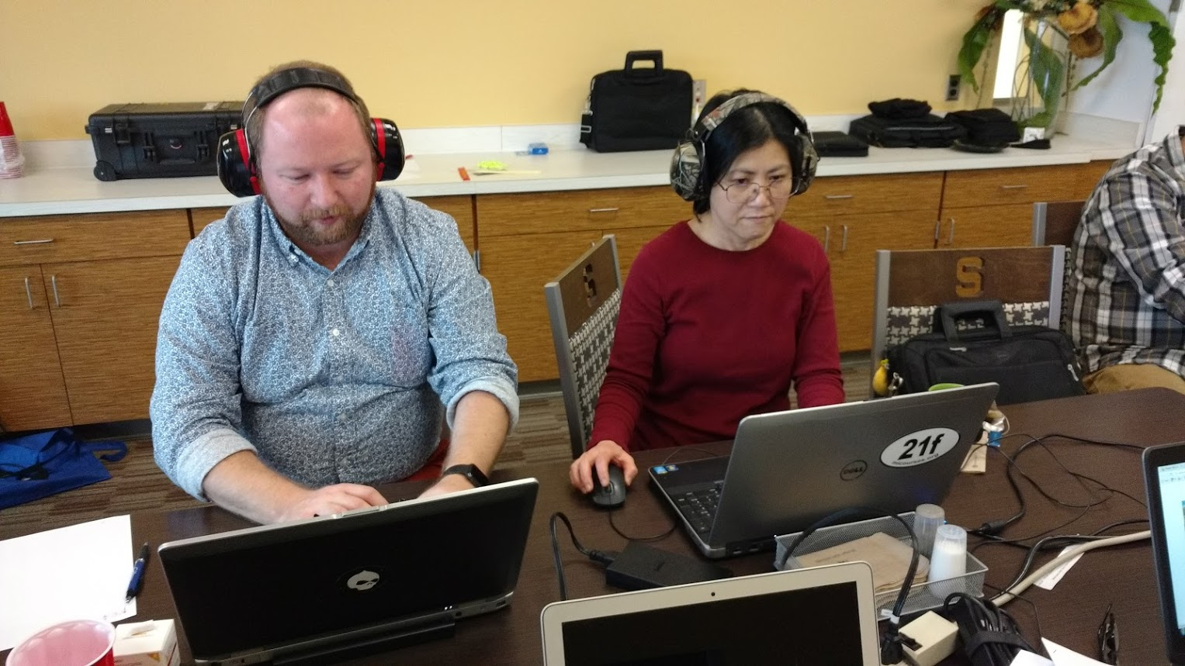
Instructional Design PD
Building empathy for students with auditory impairments.
When learning about chemistry, the difference between “atom” and “Adam” is important!
Notes:
Roman and Midori experienced one of our courses as if they were hearing impaired. They quickly found that QUALITY closed captioning was imperative to success. Most of the auto-generated captioning was not sufficient and caused confusion.

Slide 11
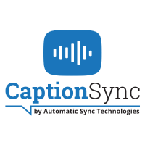
Auditory Impairment Tool
Transcripts and captioning are imperative to learning!
  Publish outside activities as text-based documents that can be added as transcripts.
  Choose video wisely so that you get quality captioning. Auto captioning is often unclear or full of errors.
  CaptionSync – Low cost
  http://www.automaticsync.com/captionsync/
Notes:
In the event that we struggle to find an appropriate video with quality captioning, CaptionSync provides a low cost alternative. They produce a captioning track file and a URL to their own smart player with captioning included on the video.

Slide 12
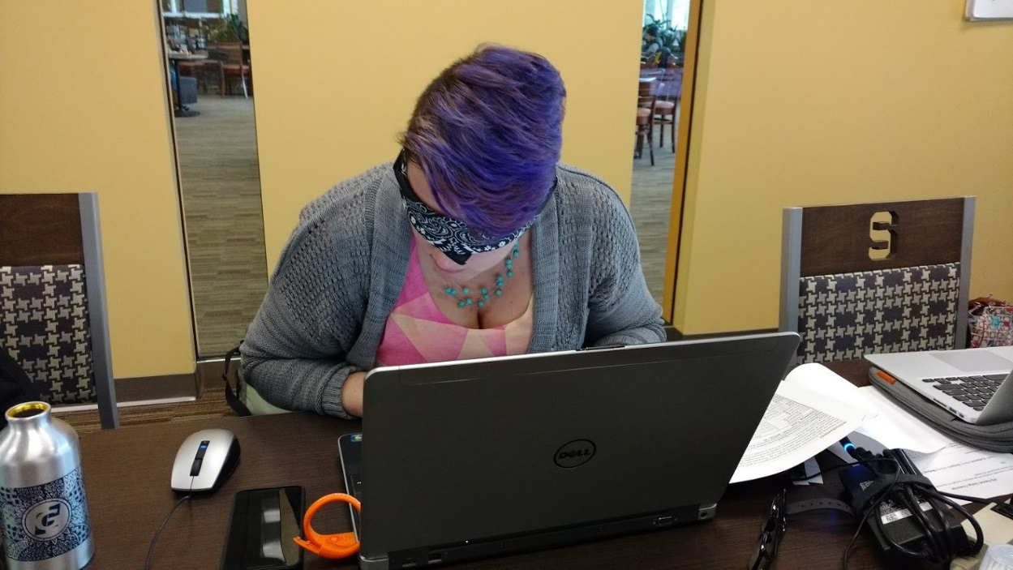
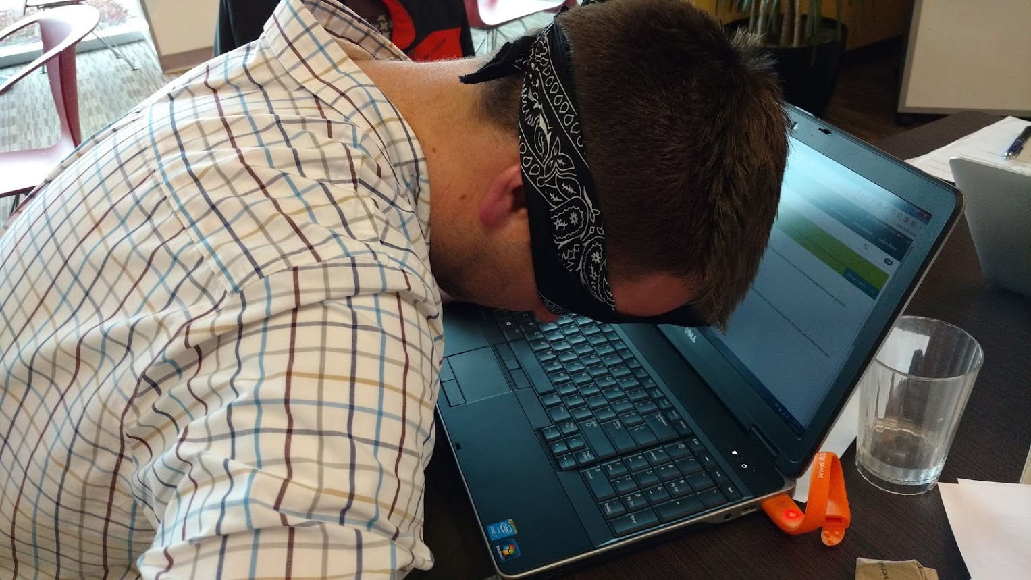
Instructional Design PD
Experiencing a course with a screen reader.
Notes:
Carla and Andrew experienced a course as screen reader users. The takeaways here are that screen readers have a learning curve and that appropriate alt-text, meaningful link titles, and proper use of headings are imperative to a meaningful experience.

Slide 13
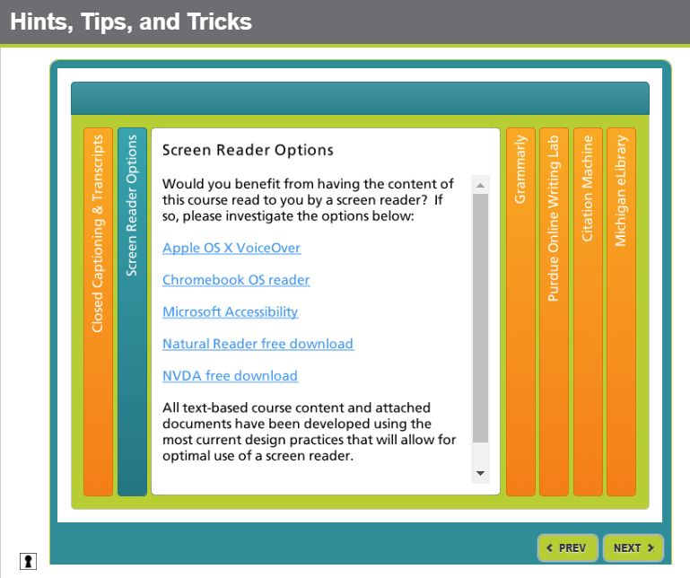

Acuity Impairment Tools
What is NVDA?
NVDA (NonVisual Desktop Access) is a free “screen reader” which enables blind and vision impaired people to use computers.
NVDA can also convert the text into braille if the computer user owns a device called a “braille display.”
https://www.nvaccess.org/download/
Notes:
For this experience NVDA was utilized. NVDA is a free download, and the nice part is, you can load it and set preferences on a removable flash drive. Within the Student Orientation, we share several options, including NVDA, with our learners.

Slide 14
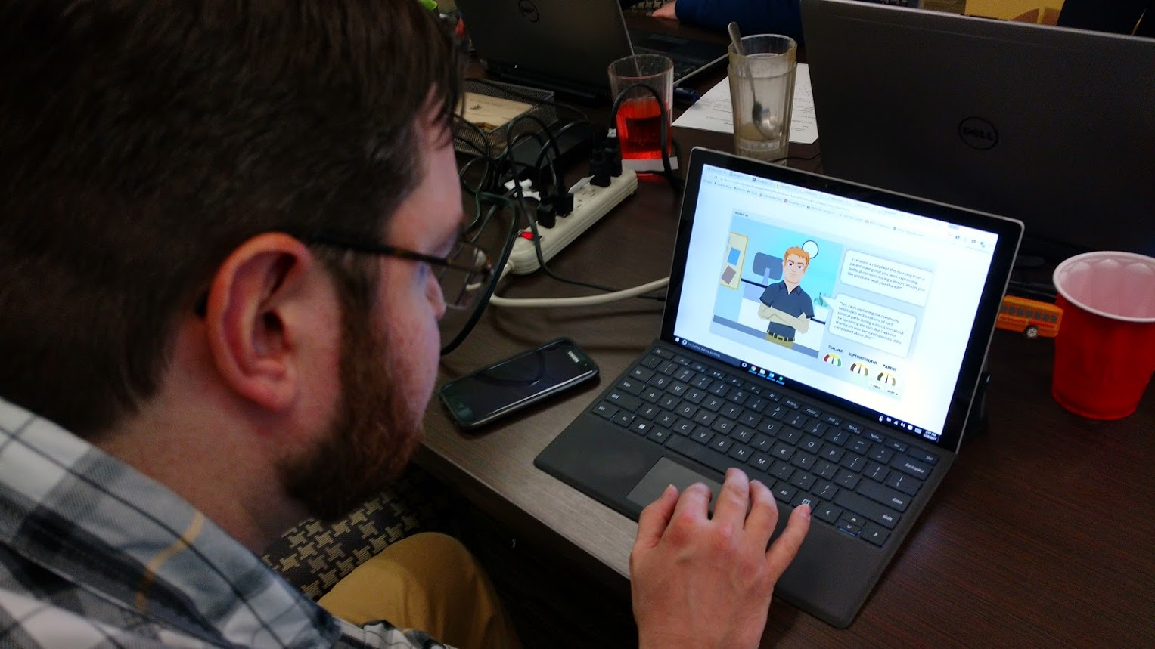
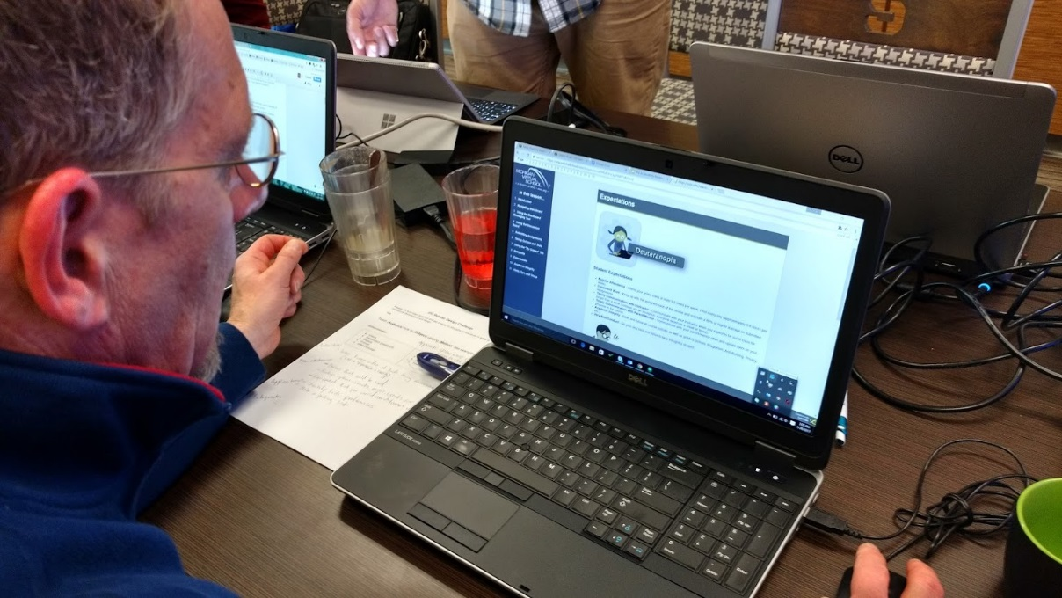
Instructional Design PD
How does color affect learning?
Notes:
David and Michael experienced a course as if they were color vision impaired. Roughly 1 in 12 males and 1 in 200 females have some form of color vision impairment. If your school has at least 12 male students, you have at least one student to consider.

Slide 15

Color Impairment Tool
Along with a new sense of awareness, Color Oracle was a huge help!
Color Oracle is a free color blindness simulator for Windows, Mac and Linux. It takes the guesswork out of designing for color blindness by showing you in real time what people with common color vision impairments will see.
http://colororacle.org/
Notes:
We can emulate the three types of color impairment by using a free tool called Color Oracle. It simply runs in the system tray and allows you to quickly and easily experience your work as if you had each of the three types of color impairment.

Slide 16
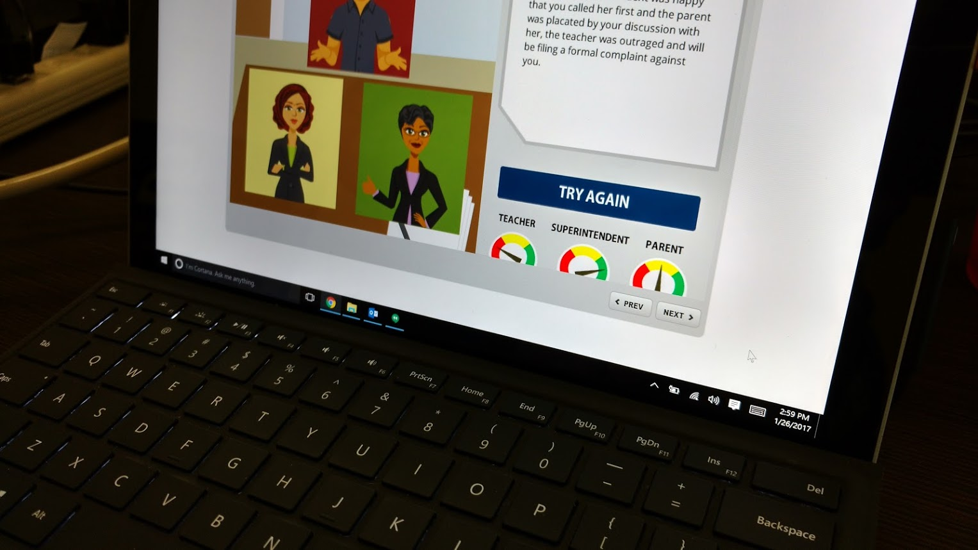
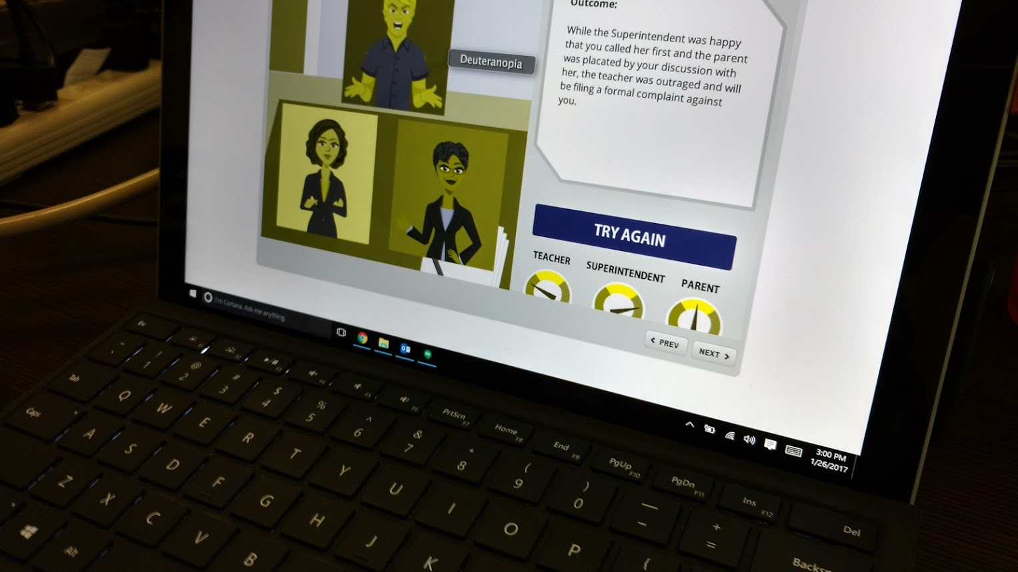
Vision Color Impairment
Look what we learned in just one little experiment!
Rest assured, - and + icons were included to add meaning for these students.
Notes:
This experience led our team to make changes to course content we were developing. Without modification, the satisfaction meters in this Storyline activity were not going to be meaningful to a learner with red-green color impairment.

Slide 17
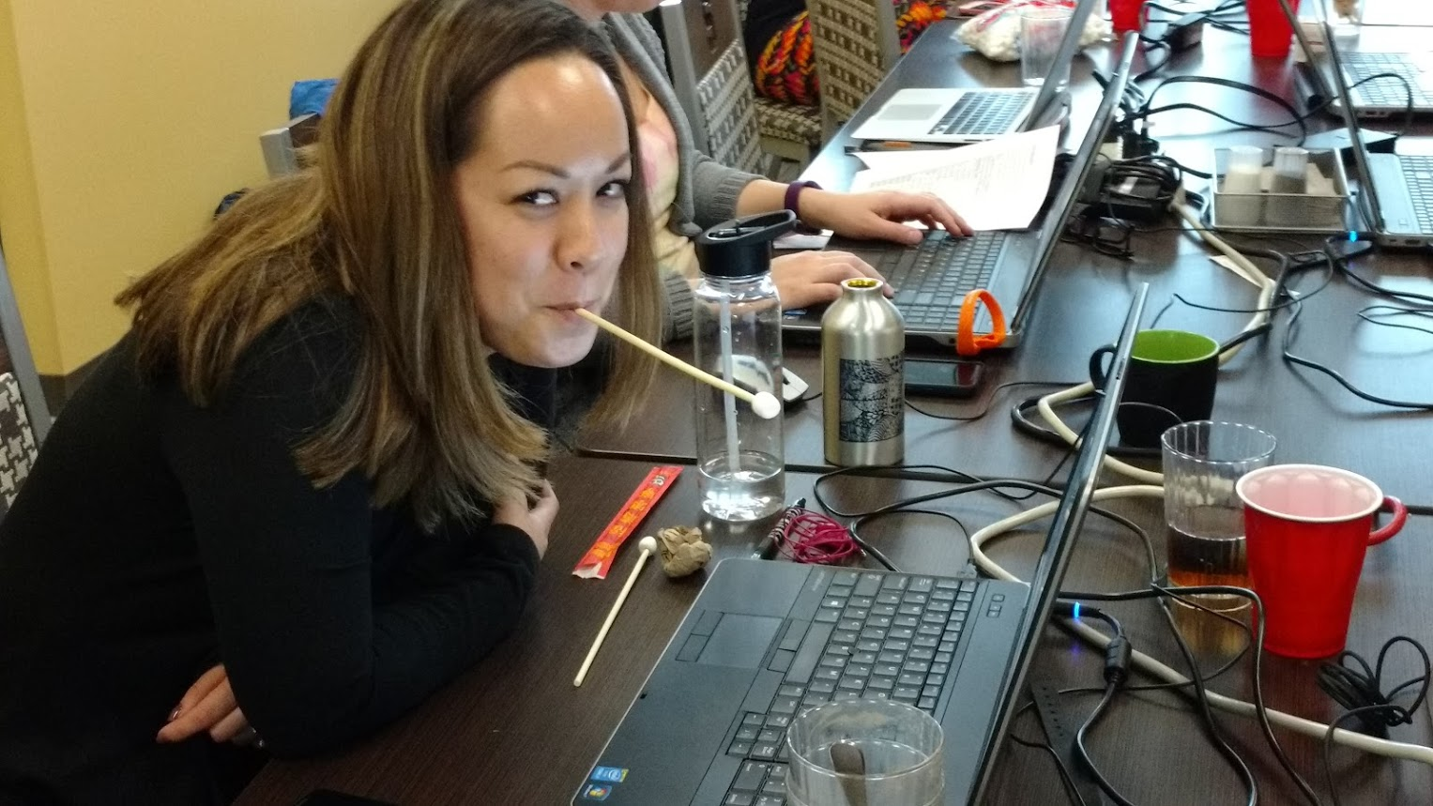
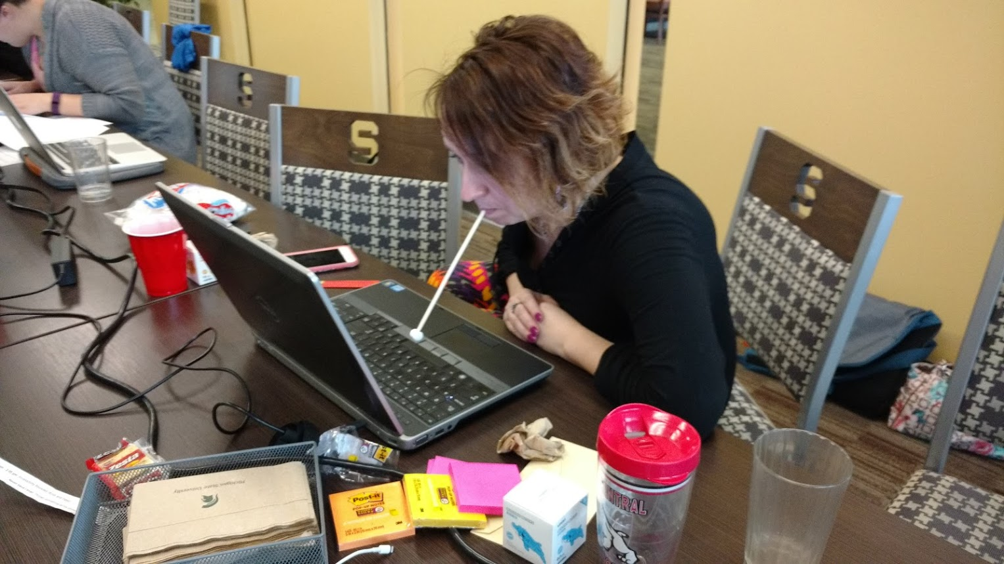
Instructional Design PD
What happens if you tab through a course without using your hands?
Notes:
Addressing Standard 8.3, we considered students with mobility impairment. Steph and Tara experienced mouth sticks. We improvised a bit and used free chopsticks, and mini-marshmallows.

Slide 18
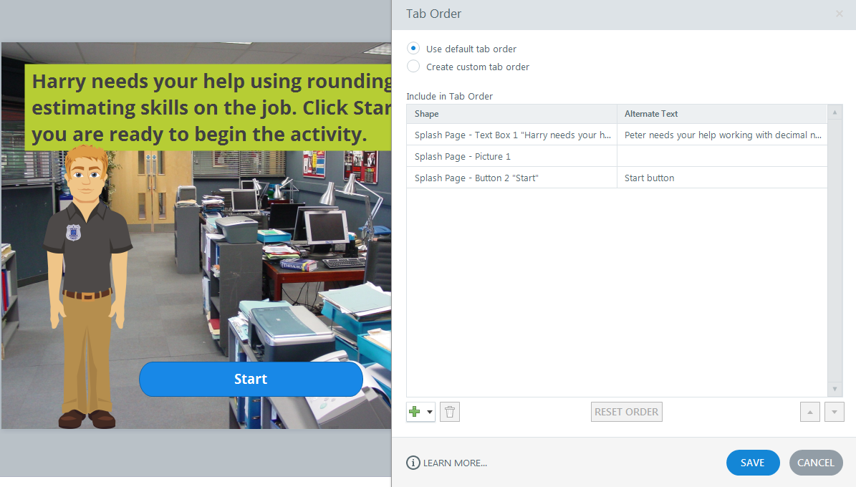
Motor Impairment Challenges & Solutions
What did we learn? Tab order is important.
Notes:
This experience reinforced the need to be cognizant of tab order! If tab order is set correctly, you can tab through the content in a meaningful way. Controlling a video with the tab key is often not possible.

Slide 19

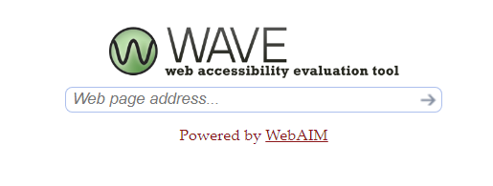
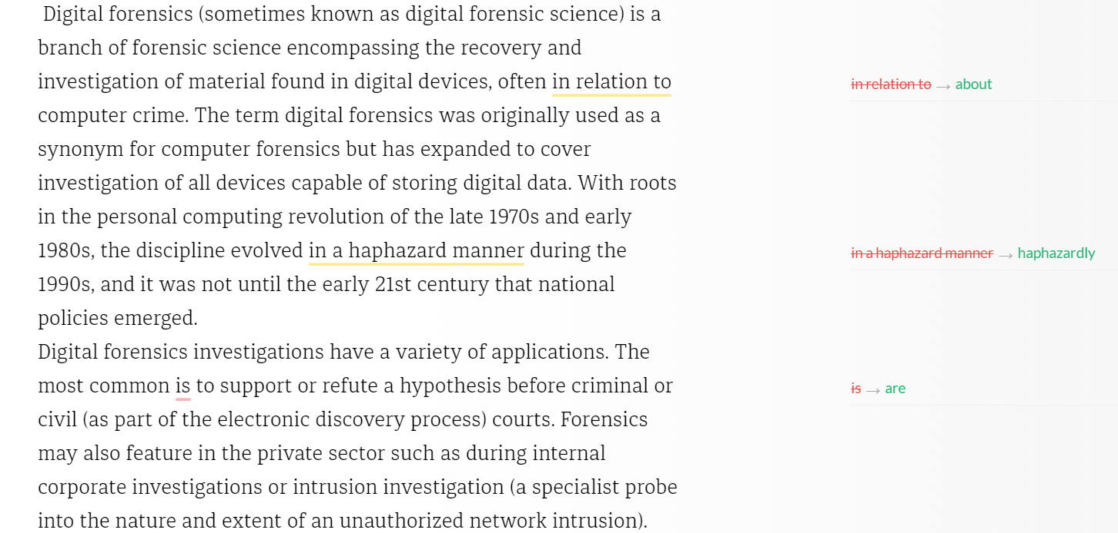
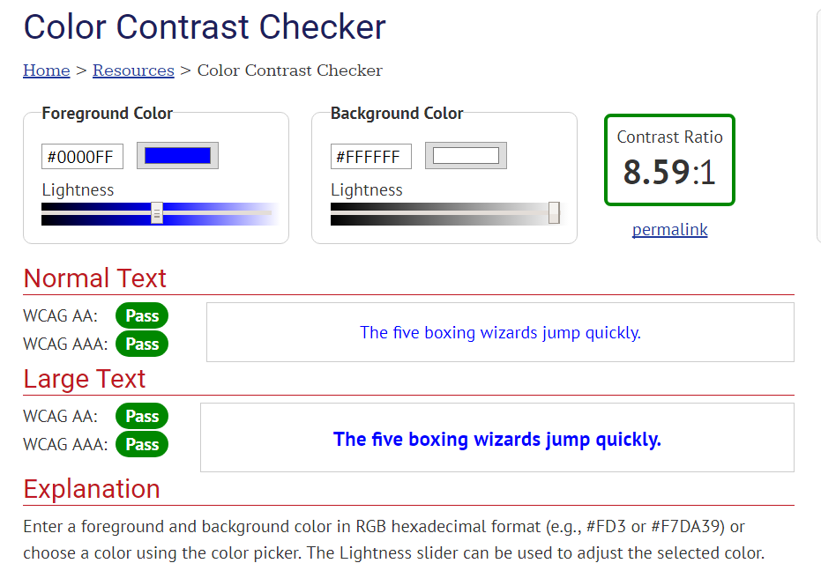
Standard 8.4
8.4 The course design facilitates readability.
Notes:
Standard 8.4 addresses the readability of the course. In addition to good design knowledge and proofreading our work, we utilize Grammarly to catch errors and WAVE to check color contrast. There is a free basic version of Grammarly. WAVE is free.

Slide 20


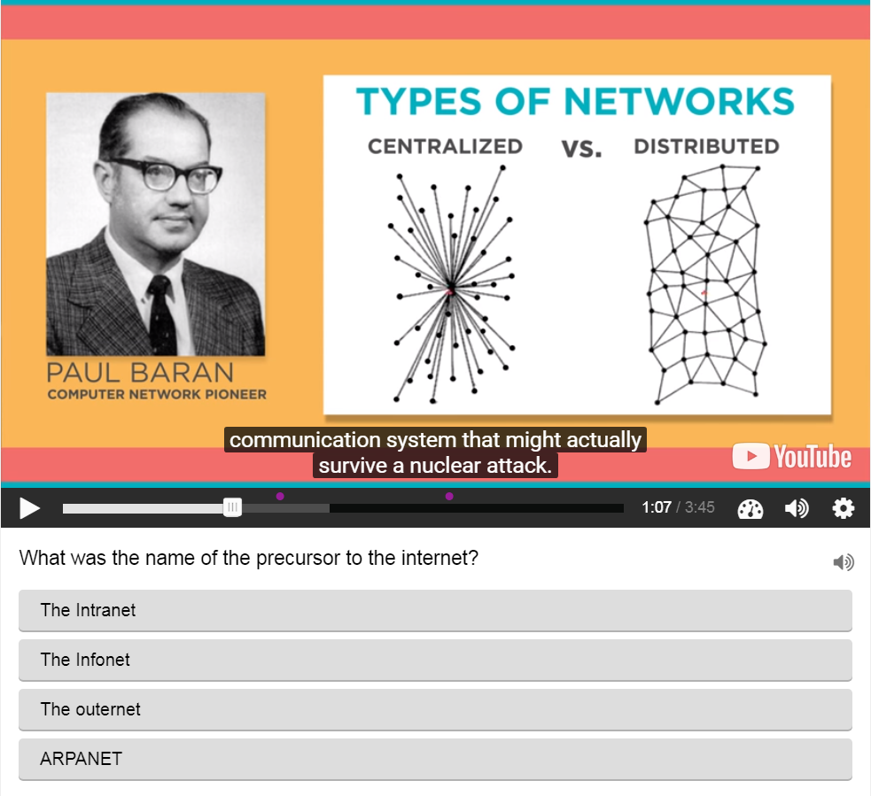

Standard 8.5
8.5 Course multimedia facilitate ease of use.
Text to Speech in 47 Voices and 24 Languages
Notes:
Last, but certainly not least. Standard 8.5 addresses course multimedia. In addition to instructional design best practices for images, one way we address this standard is with a free tool called H5P. Many times, long video content is unavoidable, but with this tool it is easy to add interactive questions.
In our quest to build courses with high-quality, clear audio, we are investigating Amazon Polly. Our work queue for this year includes several world language courses, so this may very well be a tool we can share more about at a future conference.

