Slide 1

Pathway to Excellence:
A Data-Driven Approach to Faculty Development & QM Implementation
Mingli Xiao, PhD • Lei Song, PhD • Rachel Barnes, M.Ed
Notes:
MINGLI

Slide 2
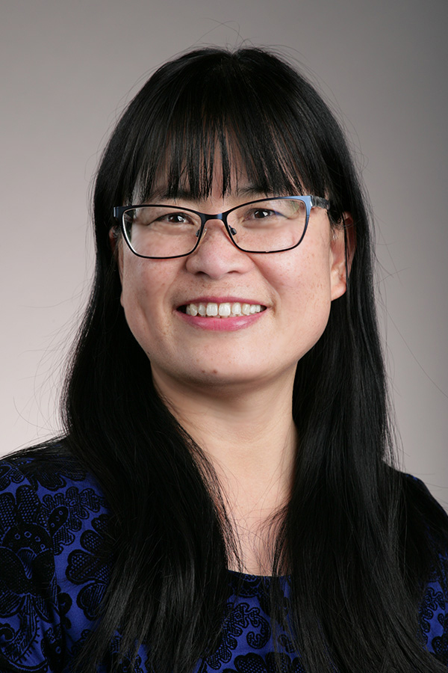


About Us
Our University
Who we are
Our roles
Notes:
MINGLI

Slide 3
Objectives
Define the concept of a data-driven approach for faculty development
Discuss the challenges and benefits of utilizing data in the decision-making process
for faculty development and QM implementation
Explain data sources for evaluating a faculty development program
Discuss strategies for integrating faculty development initiatives
with the QM framework
Provide actionable takeaways and best practices for using data to evaluate
faculty development and QM implementation
Notes:
MINGLI

Slide 4
Pathway Program
ONLINE TEACHING CERTIFICATE
ONLINE COURSE DESIGN CERTIFICATE
ADA COMPLIANCE & ONLINE COURSES
APPLYING THE QM RUBRIC
PEER REVIEWER COURSE
MASTER ONLINE INSTRUCTOR
Free professional development program for UToledo faculty
3 of 5 courses were created by UToledo Online and are QM-certified
Upon completion of all five courses, faculty are recognized as Master Online Instructors
Notes:
MINGLI
Faculty development program
5 courses (3 created by UToledo Online, 2 QM courses)
Upon completion of all 5 courses, faculty are recognized as Master Online Instructors
The 3 courses created by UToledo Online are QM-certified and incorporate best practices influenced by QM standards within the course content.

Slide 5
Data We Collect
Course Design Evaluations
Teaching Evaluations
Self-Reflections
Discussions
Other Informal Feedback
Notes:
RACHEL

Slide 6

Online Teaching Certificate
2-week online course (previously 4 weeks)
Learn to effectively facilitate teaching and learning in an online environment
Discussion, collaboration, self-reflection
Practice using online communication and assessment tools
Notes:
RACHEL

Slide 7
Online Teaching Certificate
 | Before Redesign (2013-03/2020) | After Redesign (03/2020-Present)
Course Completion Rate | 91% | 91%
Number of Participants Completed | 172 | 227
Overall Satisfaction | 93% | 97%
Notes:
RACHEL

Slide 8
Online Teaching Certificate
Data Used to Improve Course
Content focused on asynchronous only
Faculty preference for shorter courses
Redesigned to a 2-week course
Added new learning activity & assessment on best practices for facilitating synchronous online sessions
Activities were very discussion-heavy
Reduced number of discussions per week
Notes:
RACHEL

Slide 9

Online Course Design Certificate
4-week online course (previously 8 weeks)
Learn to effectively design learning objectives, instructional materials, active learning activities, and authentic assessment for online delivery
Gain insights about online pedagogy and Best Practices
Design a fully online learning module (Capstone Project)
Notes:
MINGLI

Slide 10
Online Course Design Certificate
 | Before Redesign (2015-2019 ) | After Redesign (2020- 2022)
Course Completion Rate | 78% | 91%
Number of Participants Completed | 36 | 79
Overall Satisfaction Rate | 93% | 99%
Notes:
MINGLI

Slide 11
Online Course Design Certificate
Data Used to Improve Course
Peer review activity did not elicit constructive critique
Low completion rate for
8-week course
Redesigned to a 4-week course
Focused more on feedback for
improvement from facilitator
Lack of variety in type of materials
Added lecture videos and clear how-to videos
Notes:
MINGLI

Slide 12

ADA Compliance and Online Courses
3-week online course (previously 5 weeks)
Topics include accessibility law, web accessibility guidelines, formatting and remediating documents in MS & Adobe Pro, creating multimedia web content and video captioning.
Authentic assessments that focus on hands-on practice and action plan
Notes:
LEI

Slide 13
ADA Compliance and Online Courses
 | Before Redesign Self-Paced Course (2015-2016) | After Redesign Instructor-Facilitated Course (2017-Present)
Course Completion Rate | 39% | 95%
Number of Participants Completed | 2 | 100
Overall Satisfaction | N/A | Approx. 98%
Notes:
LEI

Slide 14
ADA Compliance and Online Courses
Data Used to Improve Course
Performance in Assessment
Course Completion Rate
New hire & complete redesign focusing on “why” - motivational and cultural aspects of ADA compliance
& hands-on practices
Above-expectation completion of tasks and grades; authentic engagement
Course Evaluations
Faculty feedback that informs us what we did right and what we could continue to improve: i.e., refining assignment descriptions, flexibility with faculty/staff needs
Notes:
LEI

Slide 15
Overall Impact
Growing Awareness for Diversity/
Inclusion
Building a Community of Inquiry
Facilitating Instructors’ Professional Development
Achieving Institutional Strategic Plan & Quality Assurance
Positive Impact on Student Learning
Notes:
LEI

Slide 16
Overall Impact
Building a Community of Inquiry
Improve skills for social, teaching, and cognitive presence
Master ways to manage online workload
Improve online course design skills
Connect with other faculty members
Notes:
LEI
Improve skills for instructor presence online social, teaching, cognitive presence (OTC)
Master better ways of managing online workload (OTC)
Improve skills in online course design E.g.: Creating rubrics, and designing active learning activities (OCDC)

Slide 17
Overall Impact
Growing Awareness for Diversity/
Inclusion
Promote community advocacy for faculty, staff, and students with disabilities
Help faculty improve their own course accessibility and become self-sufficient in meeting General Standard 8
Notes:
LEI
Promoted community advocacy for faculty/staff/students with disability
Helped faculty improve own course accessibility and become self-sufficient in meeting QM standard 8 (ADA)

Slide 18
Overall Impact
Facilitating Instructors’ Professional Development
Increase in number of faculty who complete online faculty development courses
Increase in Master Online Instructors and QM-Certified Peer Reviewers
Notes:
RACHEL
Increase in number of faculty who complete faculty development courses
Increase in Master Online Instructors

Slide 19
Overall Impact
Achieving Institutional Strategic Plan & Quality Assurance
More faculty awareness of QM
More faculty pursuing QM certification of their courses
Notes:
RACHEL
Incorporating QM into all courses in this program results in more faculty awareness of QM and more faculty pursuing QM certification of their courses

Slide 20
Overall Impact
Positive Impact on Student Learning
Increased GPA in courses with QM certification
Decreased course drop rate in courses with QM certification
Notes:
MINGLI
Correlation between increased GPA in courses with QM Certification
Correlation between decreased course drop rate in courses with QM Certification

Slide 21
What’s Next?
Follow-up survey on impact of Pathway Program
Focus groups
Notes:
MINGLI
How we will continue using data

Slide 22
Tips & Takeaways
Model Best Practices
Use Data for Continuous Improvement
Celebrate Success
Notes:
MINGLI
Do what you preach & model the best practices
Using data for improvements and tell stories
Celebrate success
Email acknowledgement
Faculty recognition event
Publish on website
Report on UT News

Slide 23
Questions?

