Slide 1

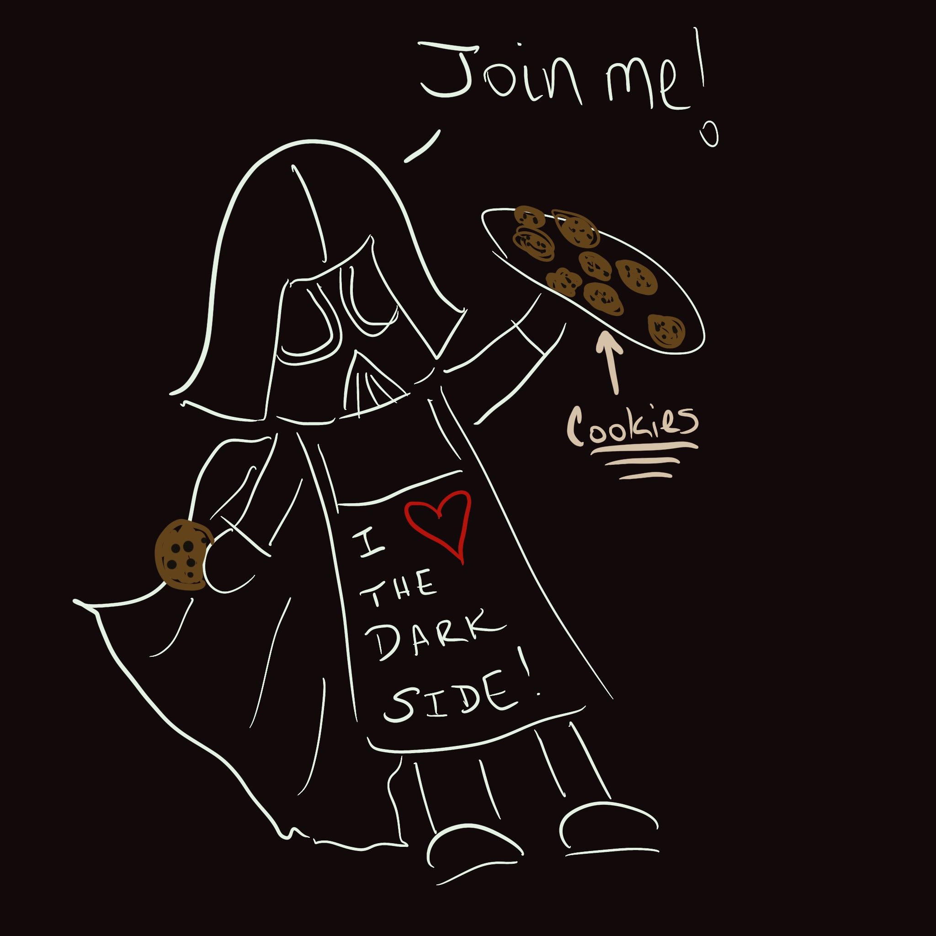
First Order: Respecting and Rescuing the Resistant
Come to the Dark Side! We have cookies!

Slide 2

About Us
Jacklyn Pierce
  Assistant Professor of English, Lake-Sumter State College
Brenda Skoczelas
  Assistant Professor of Natural Sciences, Lake-Sumter State College
Geni Wright
  Director of E-Learning, Valencia College

Slide 3

Session Outcomes
Utilize QM & Universal Design Principles in Creating Professional Development for Faculty
Connect Faculty and Distance Learning Department Personnel in Productive & Meaningful Ways
Design & Implement a Faculty Mentor Program in Conjunction with Distance Learning Departments

Slide 4

Dark Side vs. Light Side
Notes:
Audience Participation
Let’s start with the Light Side. Shout out if you’re a Jedi/Faculty Member. Share one benefit of teaching in person.
OK, now for our Sith Lords, AKA Distance Learning Folk. Share one thing you would like faculty to know about what you can do.

Slide 5

Is 2020 the Death Star, or What???
Challenges of Putting Everything Online Mid-semester?
What support did our institutions offer for the Resistance?
Ongoing support for folks not pre-disposed to love teaching online?

Slide 6
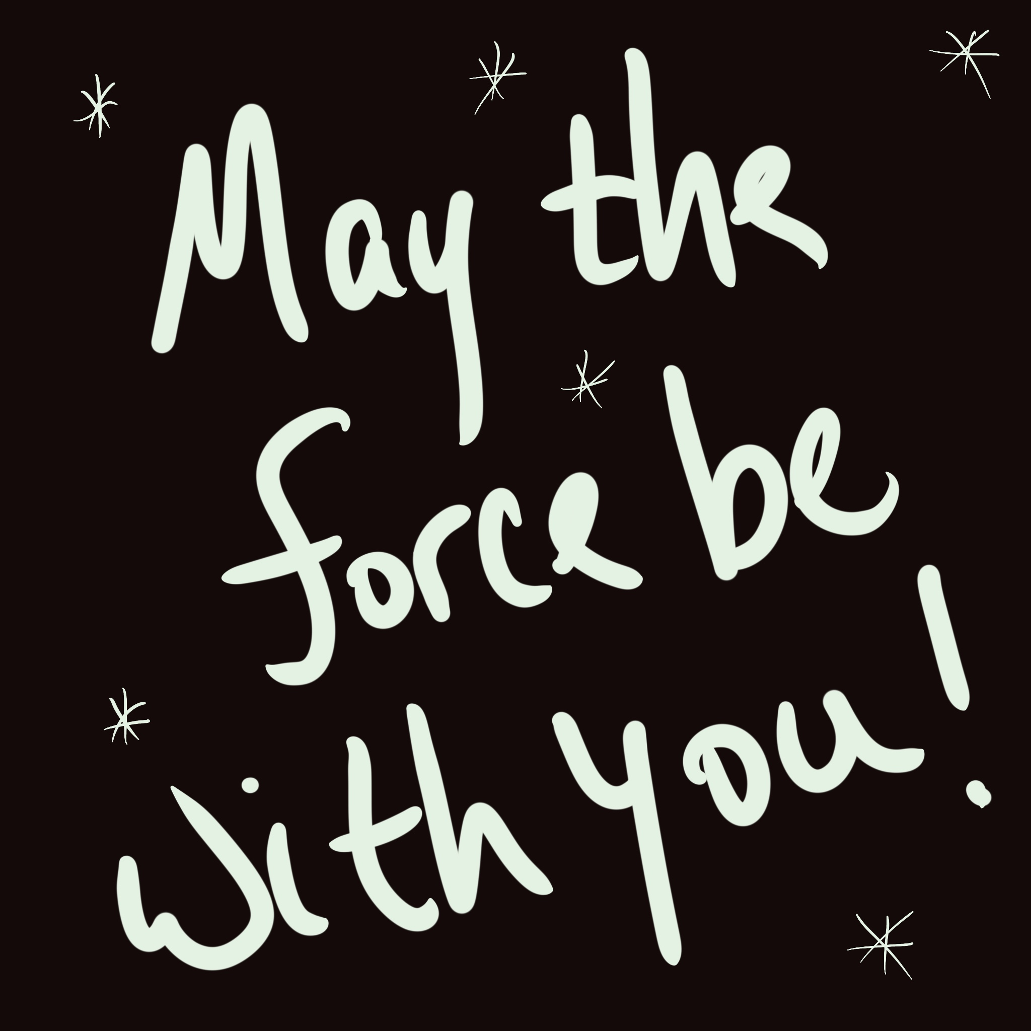
Sharing Our Story
Lake-Sumter State College
  81 full time faculty
  87 Adjunct Instructors
  2-3 Instructional Designers
Canvas Training
Faculty Mentoring Program
Internal Review Project

Slide 7
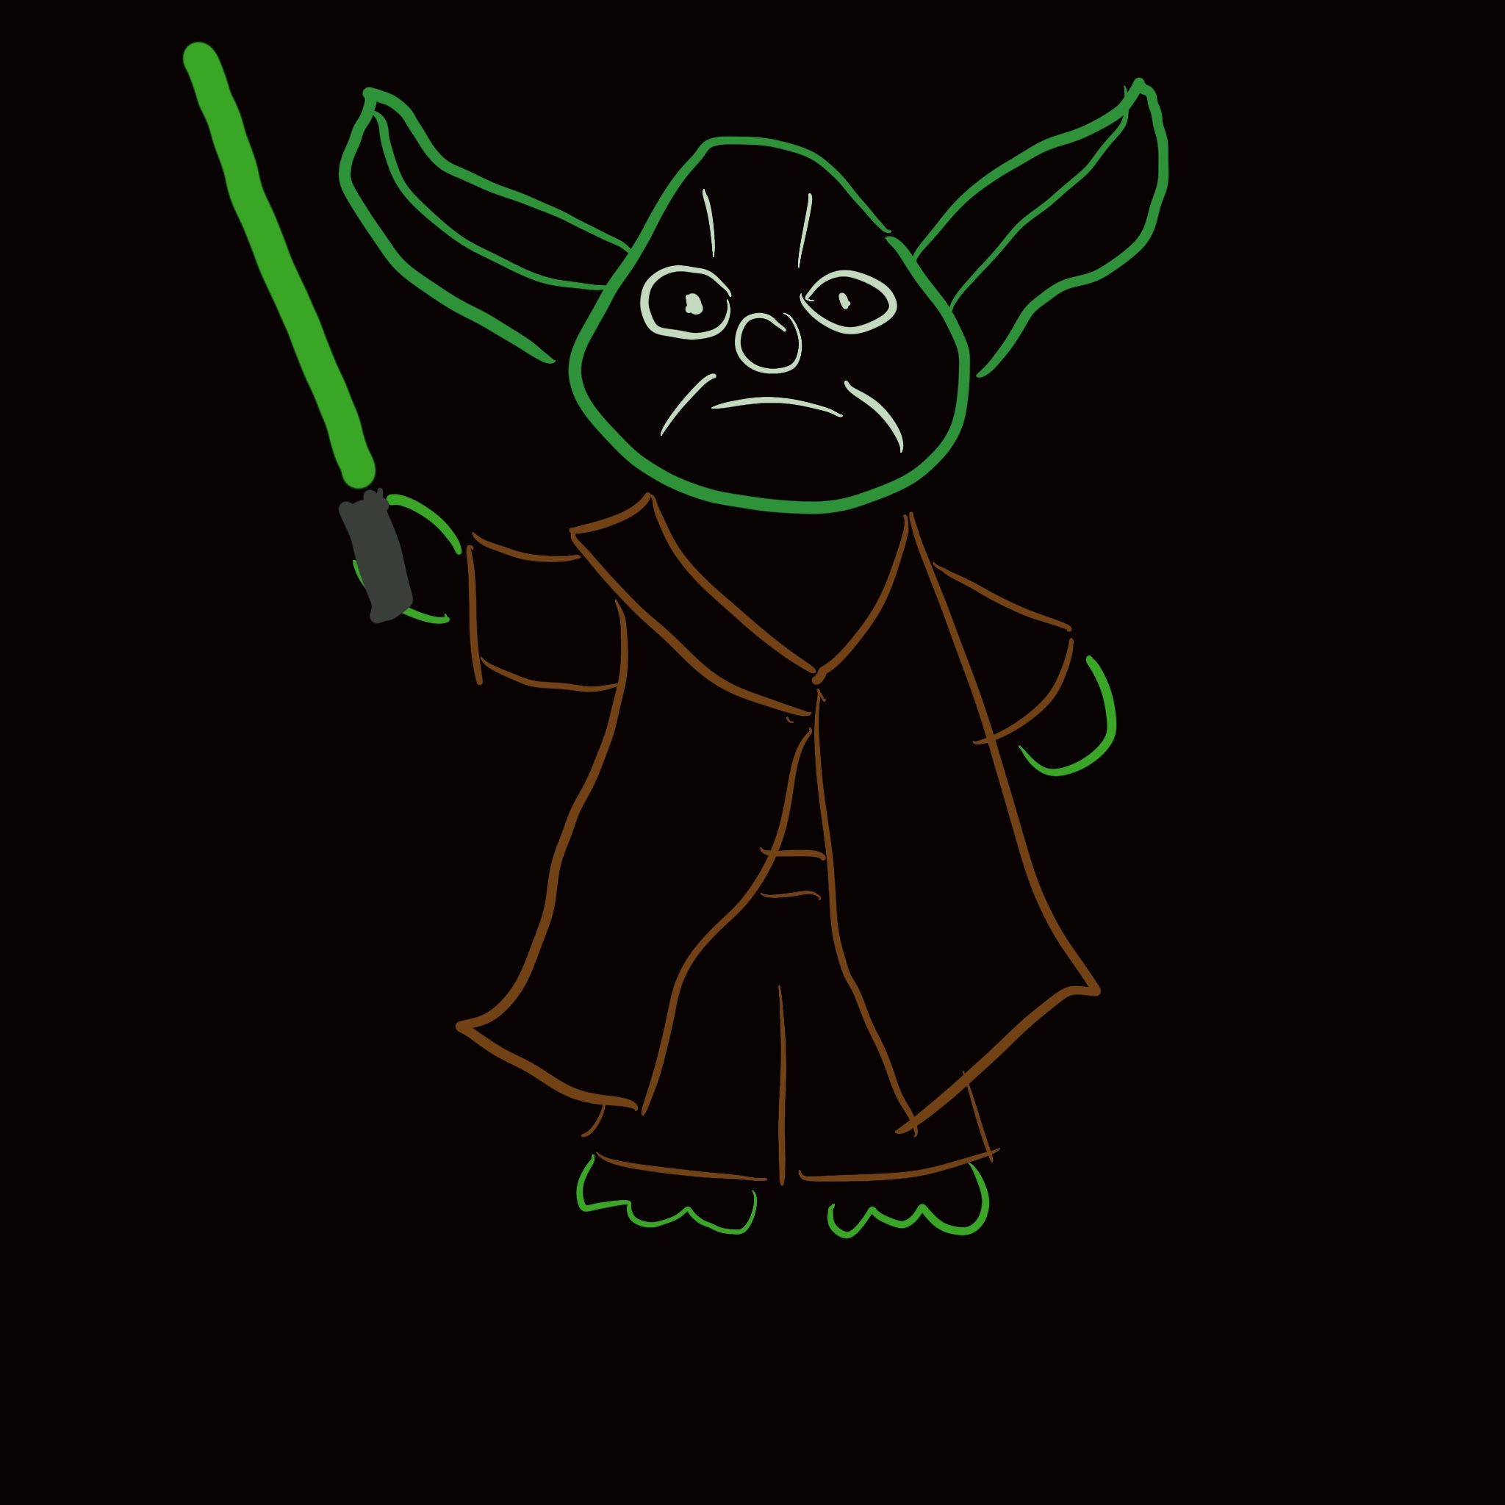
Let us Use the Force!
Share Benefits
How can our Face-to-Face Techniques be adapted?
How can Quality Design Principles enhance in-person learning?

Slide 8

The Need for Training
The COVID Crisis
Existing Faculty
New Faculty/On-Boarding
Changes in Technology/LMS

Slide 9
Who goes First, the Jedi or the Sith?
Visual
Auditory
Kinesthetic
Let’s Talk Learning Styles!

Slide 10
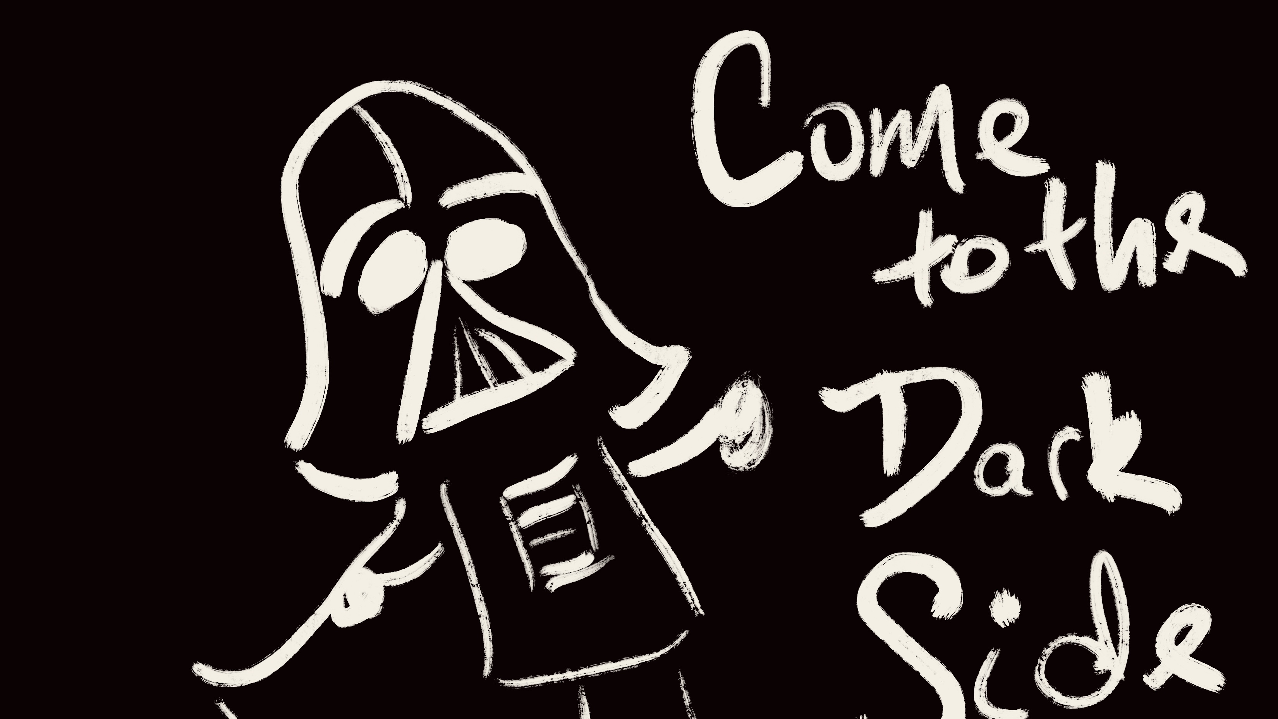
Designing The Training
Use your LMS
Make sure your training courses meet QM Standards
Incorporate QM early and Often

Slide 11
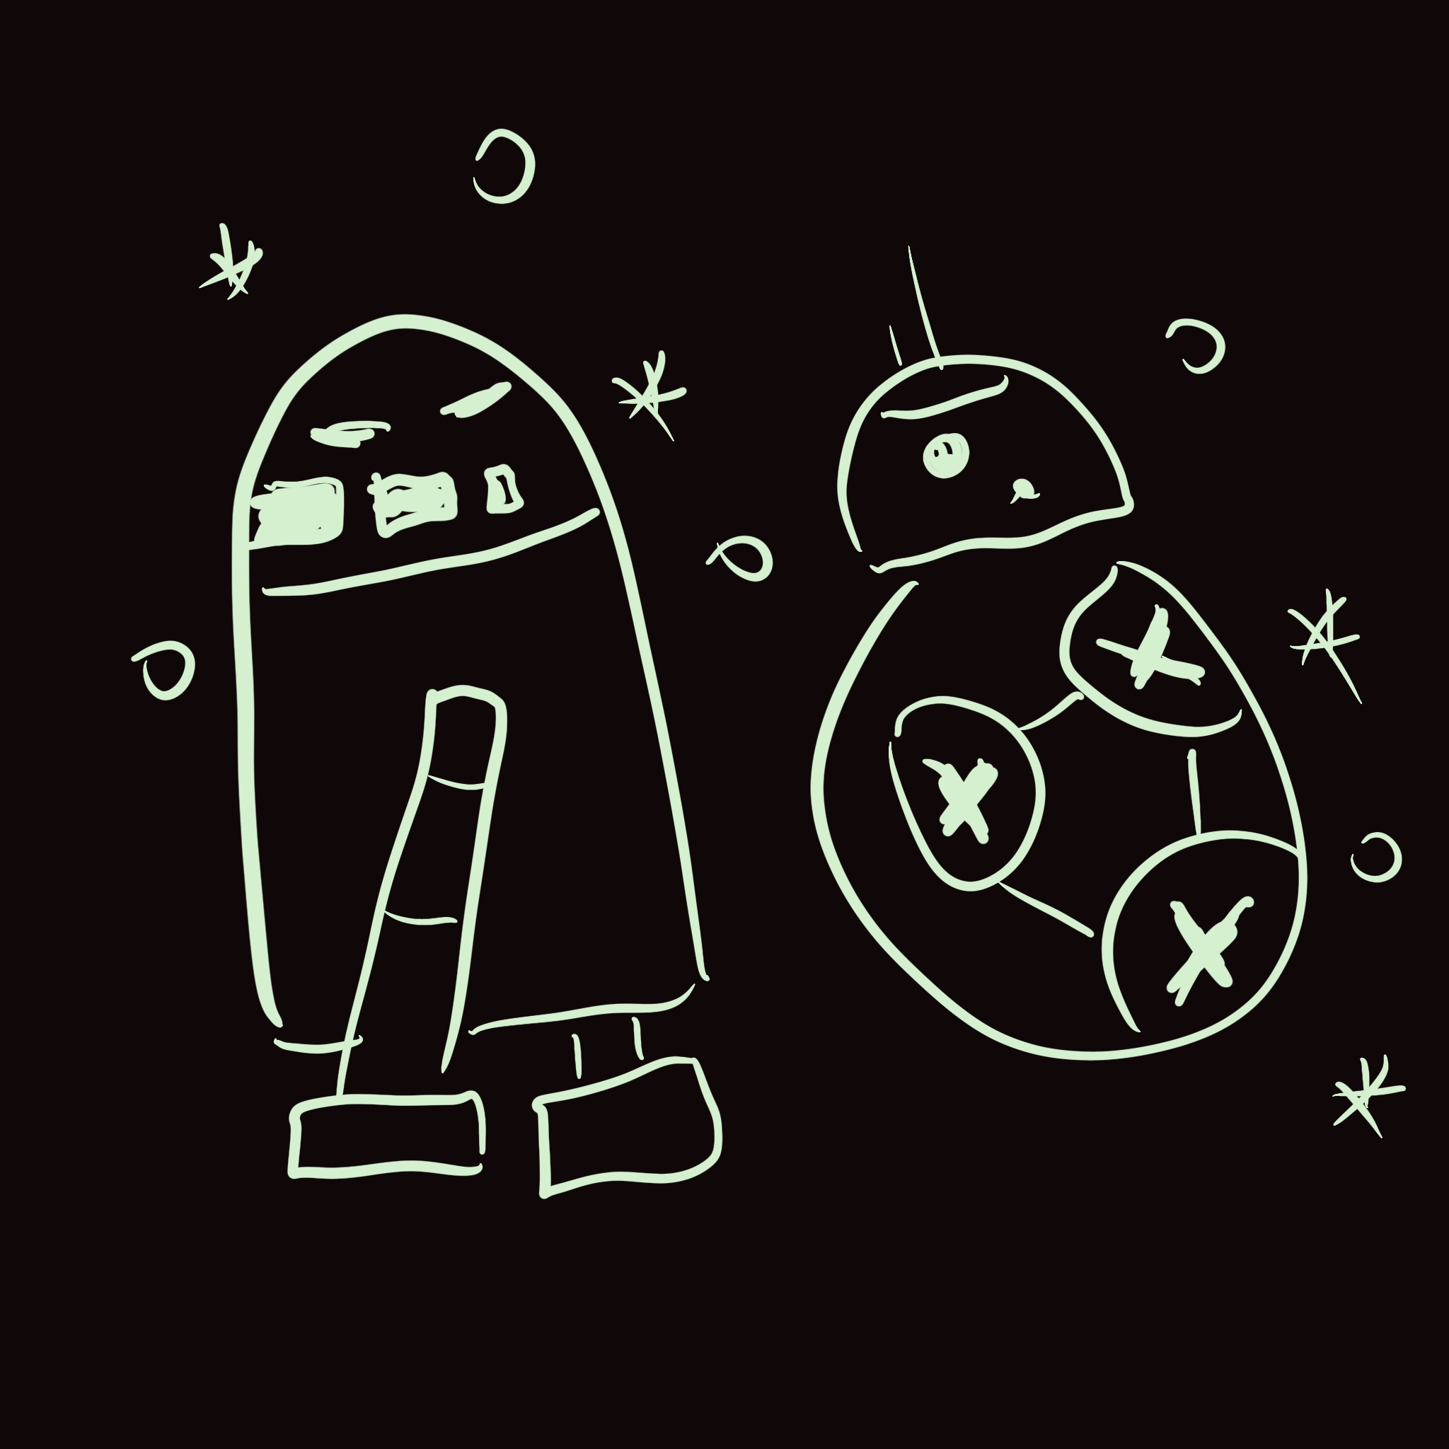
Faculty Mentors
Instructional Designers
Course Reviews

Slide 12

Thank you! Q&A

Slide 13
