Slide 1

Fishing in the Lake for Data on Quality Engagement at Community College of Philadelphia
Dr. Karen Rege, Dean of Online Learning and Media Services
Dr. Peter Margolis, Director of Online Learning
Laura Temple, ABD, Associate Director, Business Intelligence

Slide 2
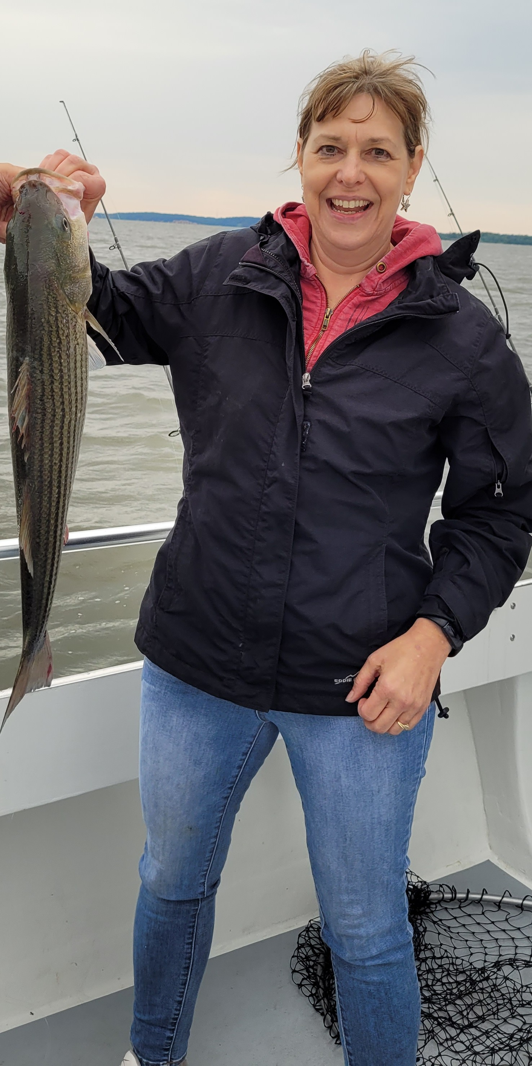
Notes:
For many years, I've been an avid fisherwoman. I can even tie my own flies. And I've fished a lot of lakes

Slide 3

Notes:
But I had never fished in a data lake before now.

Slide 4
CCP's fishing expedition in the data lake
Review CCP's data collection practices
Provide some background on the data lake
Describe our research study:selecting a hypothesis, variables, and background research
Share our findings
Discuss the benefits of using a data lake to examine student success data

Slide 5
Collecting data in online learning

Slide 6
Types of data collected
2021
2023
Number of courses, sections
Enrollment data
Faculty use of the LMS
Fill rates
Support services
Student outcomes data
  Race, gender, age
  New vs. returning
  College ready
  Program/major by pathway
  Class size
  Full-time vs. Part-time
  Test placement
  Course vs. section level
First time logins
Course activity/engagement
Notes:
.

Slide 7
3 Biggest Data Challenges:
1. What data should we be collecting?
2. Once we collect it, how do we analyze the data and use it to make improvements?
3. Where is the data coming from?
Notes:
No national standards or even norms.
Closing the loop
LMS reports or SIS reports but no way to easily combine

Slide 8
The Data Lake Story
Notes:
In 2021, we worked with Amazon Web Services (AWS) and built the data lake in only 2 weeks. Imagine if you could get data from every last little field in Canvas. And be able to collate it with data from other enterprise systems. That’s the power of creating the data lake.

Slide 9
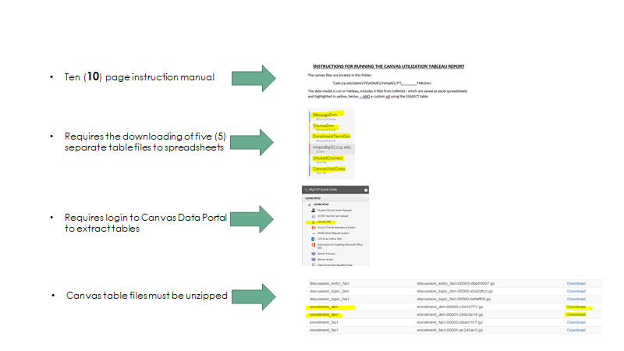
Before the Data Lake – Manual extracts from Canvas
Notes:
Reports limited to just Canvas fields, highly labor intensive, 10 pages of instruction

Slide 10
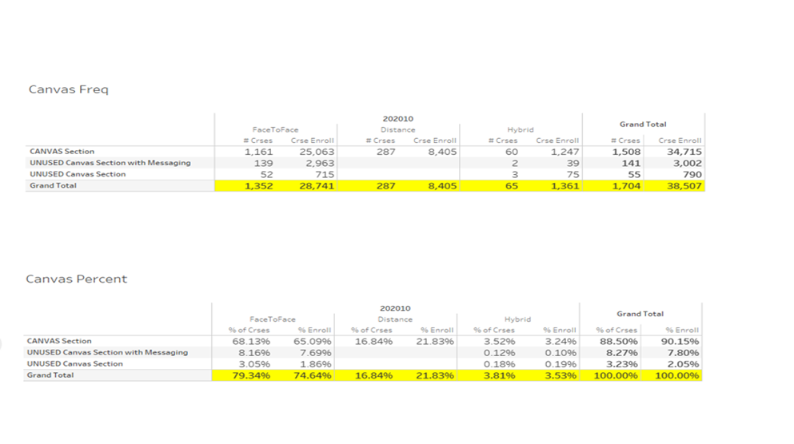
Single static 'snapshot' reports with no user interaction

Slide 11
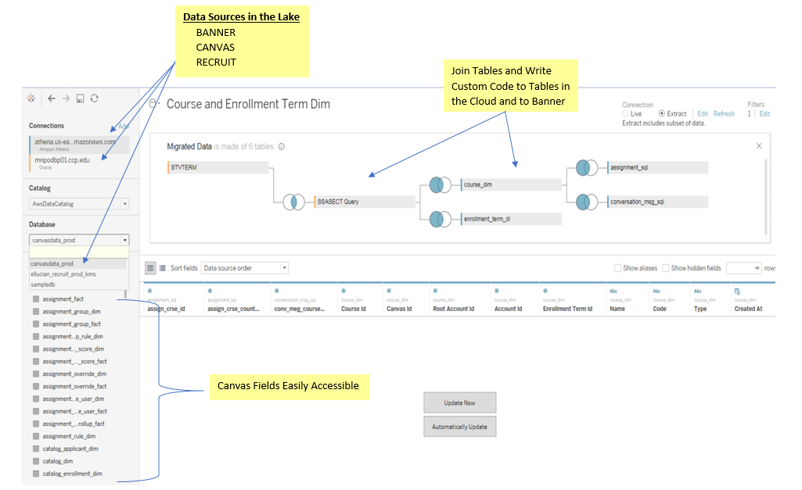
Every field in the Canvas Data Portal is viewable and accessible
Notes:
We were able to build a Canvas Datasource using AWS - Amazon Web Services - in just two weeks which gave us access to ALL and EVERY table and field element in Canvas (the fields running down the left-hand column. This is WHY we can create a 'lake' of data sources (eg BANNER, CANVAS, RECRUIT, etc.) - multiple data sources - fish - all 'swimming' in the same pond together.

Slide 12
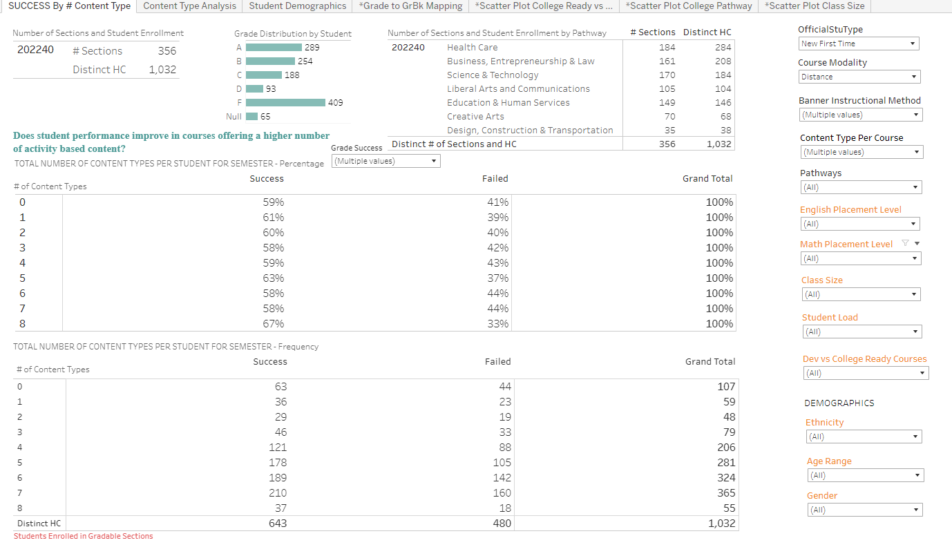
Data Lake Version – Refreshed Daily and Interactive

Slide 13
Our research study
Hypothesis
Variables
Research
Notes:
So we started fishing in the lake

Slide 14
Our Hypothesis
We wanted to confirm that student engagement in online courses leads to higher course pass rates
  Too many confounding variables
Narrowed it to the amount of activities in an online course affects student outcomes for new first-time students.
A wider variety of content types (discussions, assignments, quizzes, etc.)leads to success rates
Notes:
We couldn’t control for quality of course design, technology available to the student, etc.

Slide 15
Literature Review
Dixon, M.(2010) categorized online learning activities as active or passive and concluded that the level of interaction, not the type (passive vs active) that made a difference in learner engagement.
Miller, G. (2015) and Green et al. (2014) both associated learner interactivity and achievement in online courses.
    Types of interactions—learner/content, learner/instructor, learner/learner
Agudo-Peregrina et al. (2014) looked at the relationship between student activity and final grades based on Moodle logs and found “very little correlation” and “no predictive capability.”
Kenneth David Strang from SUNY Plattsburgh used mixed methods in a study including demographics (age, gender and culture), finding they were unrelated factors in online course outcomes.
Notes:
Dickson: Active (discussion boards, assignments, case studies, etc.) or passive (watch videos, read lectures, quizzes)– what does “level“ mean? # of interactions?
Agudo-Peregrina study is fascinating but they are using only LMS data.
Strang, specifically he looked at course logins, lesson reading, lesson quiz activity (how long does a student spend on a quiz) and lesson quiz scores. The only thing he found was that the more time students spent on a quiz, the higher the score. However, he was only using LMS data (Moodle) and demographic data was gathered from the SIS and analyzed via an Excel spreadsheet.

Slide 16
Control variables and definitions
Activities
  Grouped them by number of distinct content types
Online – asynchronous only
First–time students—does not include transfer students
Success—A, B, C, P
Failure- D, F – did not include withdrawals or incompletes

Slide 17
Caveats
We are using this data operationally, and not attempting to further scholarship
We are only looking at the number of different types of activities, not the quality
We are not taking into account other variables/barriers, e.g. access to technology, course design, or classroom management (e.g. hand raising, real-time polls, etc.)
Using only gradable course sections, not labs, non-credit, etc.
Included only enrolled (not dropped/withdrawn) students
Used final grades from SIS and not LMS

Slide 18
Findings
Notes:
This is just some preliminary work. We have not done any regression modeling so this isn't a formal research study. However, it does show you how we collect, analyze and operationalize data.

Slide 19
General success rates
New first-time students in asynchronous courses in Fall 2022 N = 1,032 unduplicated
Number of courses = 356
Number of Content Activities ranged from 0-8
Succeeded = 643
Failed =480
Avg. success rate = 60% with the number of Content Activities as the independent variable
Notes:
Data is coming from SIS

Slide 20
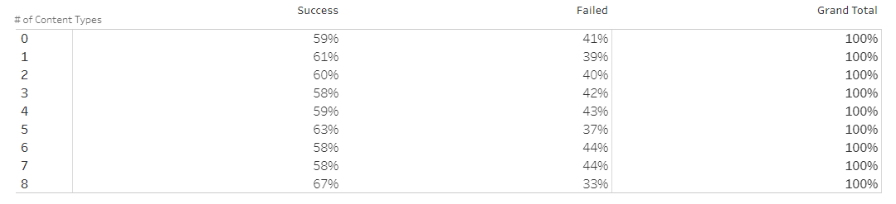
Overall success rates by number of content types
Average = 60%
Notes:
The 60% success rate is an average of these. Notice the tight range- only 9% In addition to the range, we also looked for patterns– is there a pattern of the higher number of activities having higher success rates?

Slide 21
The number of activities in a course does not correlate to final grades.
Notes:
We confirmed the Agudo-Peregrina study even with using data from the LMS (activities) and the SIS (final grades)

Slide 22
Average success rates by ethnicity
Ethnicity
  White = 75%
  Black = 47%
  Hispanic = 58%
  Asian = 75%
  Native American = 50%
  Other = 63%

Slide 23
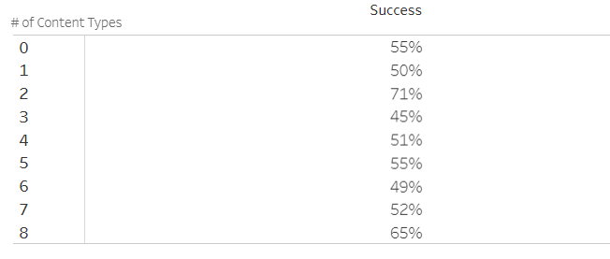
Average success rate using independent variables
Full-time (66%), Part-time (58%)
Gender - Male (57%), Female ( 65%)
Age
    ≤ 18 = 59% N=226
    19-21 = 58% N=469
    22-25 = 62% N=136
    26-30 = 77% N=87
    31-50 = 70% N=103
    ≥ 50 = 92% N=11
Part-time students
Notes:
Then we started looking at the range– the difference between the highest and the lowest success rates.
Range of % of # of activities for load Part-time = 22 (49% to 71%) FT- 15
Range of % of # of activities for Gender Female =17 Male=13

Slide 24
Average success rate by class size
Class size | Avg. Percentage Successful | Number of Students
≤5 | 58% | 14
6-10 | 61% | 86
11-15 | 67% | 390
16-20 | 53% | 137
21-25 | 72% | 217
26-30 | 47% | 107
≥30 | 62% | 492
Notes:
Range of averages= 25 but that doesn’t tell us about the numbers of activities—it's just straight demographic data

Slide 25
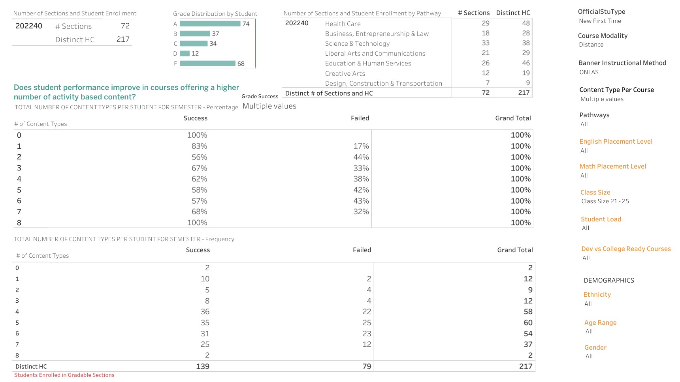

Detail of class size = 21-25 success rates by # of activities
Notes:
This is a detail of a specific class size- 21-25. Range= 44 (57%- 100%)

Slide 26
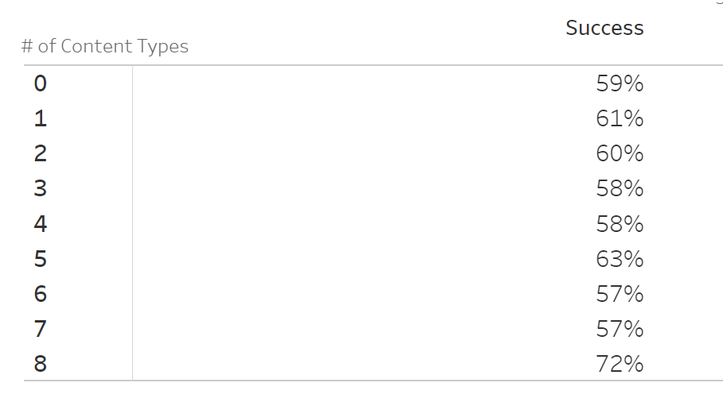
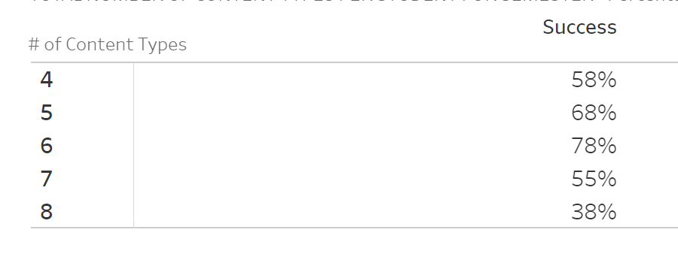
Average success rates by college level courses vs. Developmental courses
Students in ColleGe Level Courses N=991
Students in Developmental Courses N=105
Notes:
Notice the difference in range. College ready is 15 but developmental is 40. Also notice that most first-time developmental students do not take online courses (look at the N); most students in their first semester taking online are taking college level courses. Part of this is due to the lower number of developmental courses that we offer asynchronously. We generally offer more hybrid or F2F developmental courses.
We do have a variable for English and Math placement testing, but we need to look at that data separately and should include all students placing below college-ready, and not just new, first-time students in order for the data to be meaningful and useful.

Slide 27
A brief look at types of activities
Notes:
The hypothesis suggests that the more 'variety' of content in a course...the more successful a student will be.
Again, there are more types of content activities, but we are focusing on 4 (discussions, assignment, quizzes and links to external URLs) as being in the mix. The next data guarantees that that content type will be part of the course (among other types).

Slide 28
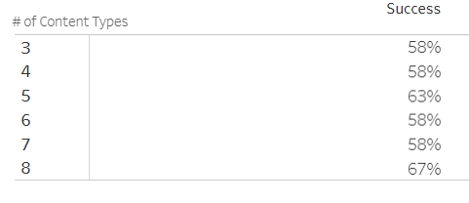
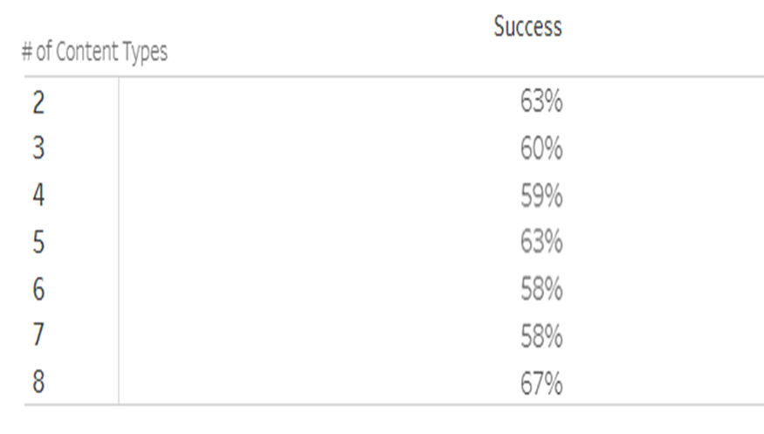
Student Success Rate by Activity Type- Active
Discussions N=290 courses of 356
Assignments N=290 courses of 356
Notes:
Using Dixon’s active vs. passive activity categorization. However, we can’t break out activity type separately. So the # of content types is at least one of this type of content that we’ve filtered for. A future study on how many each of the individual activities plays a role in student success is still needed.

Slide 29
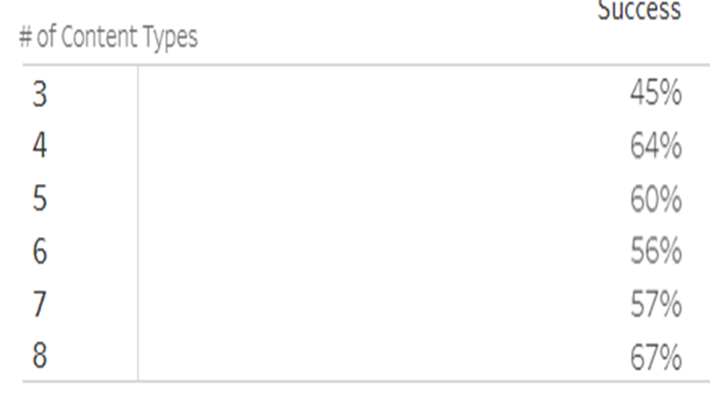
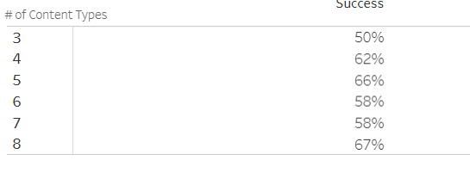
Student Success Rate by Activity Type- Passive
External URLs N=173 courses of 356
Quizzes N=216 courses of 356
Notes:
Fairly narrow ranges and no patterns.

Slide 30
Analysis and conclusions

Slide 31
Findings
Similar to the literature, we found no significant difference in overall success rates by number of activities in an online course for first-time college students.
However, once we drilled into details, we started to see more variations in success rates.
Variables influencing success rates where range is ≥40 include class size and college level courses.
Notes:
More research needs to be done around the type of activities by demographic. i.e. Do discussion boards make a difference to students over the age of 50?

Slide 32
Benefits of a data lake
Notes:
You’ve all heard the saying data rich and information poor. Having the data lake makes you not just rich, but data billionaires! However, you only become information rich as you start fishing in the lake. You have to bait the hook with the appropriate questions that use data across systems. Here are some of the benefits and the ways we’re using the data lake beyond this brief study.

Slide 33
Allows you to explore the data in a user-friendly environment in real-time
Can use filters as your variables for future data modeling
Other ways we’re using the data lake…..
    Create an effective schedule by understanding fill rates by modality
    Send automated messages from the LMS through the early alert system to the students, assisting with more logins during the first weeks of the semester.
Answer further questions, e.g. if the time of day a student logs into an asynchronous course affects success rates.
The depths of the ocean are the limit!
Notes:
The data lake in some ways makes the question of “What type of data should we be collecting?” irrelevant as all data is collected. Instead, we need to ask how do we effectively use the data lake to answer our deepest questions and make meaningful decisions around the quality design and delivery of online courses in order to move the needle of student success.

Slide 34
References
Agudo-Peregrina, A.F. et al. (2014). Can we predict success from log data in vles? Classifications of interactions for learning analytics and their relation with performance in vle-supported f2f and online learning. Computers in Human Behavior. 31 (1), 542-550.
Czerkawski, B & Lyman, E. (2016). An instructional design framework for fostering student engagement in online learning environments. Tech Trends, 60, 532-539. DOI 10.1007/s11528-016-0110-z.
Dickson, C. (2016). Consideration for introducing asynchronous discussion to enhance postgraduate online learning engagement. Nursing Educator Perspectives. 37(6), 349-351.
Dixon, M.D. (2010). Creating effective student engagement in online courses: What do student find engaging? Journal of the Scholarship of Teaching and Learning, 10 (2), 1-13.
Green, R.A., Farchione, D., Hughes, D.L., & Chan, S.P. (2014). Participation in asynchronous online discussion forums does improve student learning of gross anatomy. Anatomical Sciences Education, 7(1), 71-76.
Strang, K. D. (2017). Beyond engagement analytics: which online mixed-data factors predict student learning outcomes? Education Information Technology, 22, 917-937 DOI 10.1007/s10639-016-9464-2.
Vlachopoulos, D. & Agoritsa, M. (2019). Online communication and interaction in distance higher education: A framework study of good practice. International Review of Education, 65, 605-632. DOI 10.1007/s11159-019-09792-3.

Slide 35


Questions?
¹⁰⁰¹¹¹⁰¹⁰¹
⁰¹¹⁰¹⁰¹⁰⁰¹
¹¹⁰¹⁰⁰¹⁰¹¹

