Slide 1
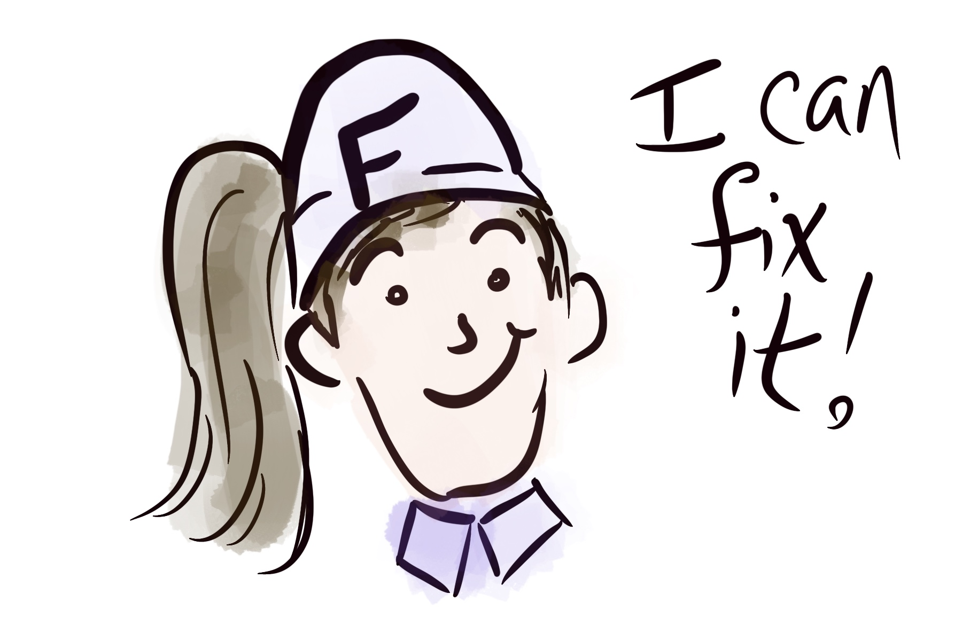
Fix-It Felicia! Fledgling Students & Forgotten Feedback
Jacklyn R. Pierce
Lake-Sumter State College
Leesburg, Florida

Slide 2
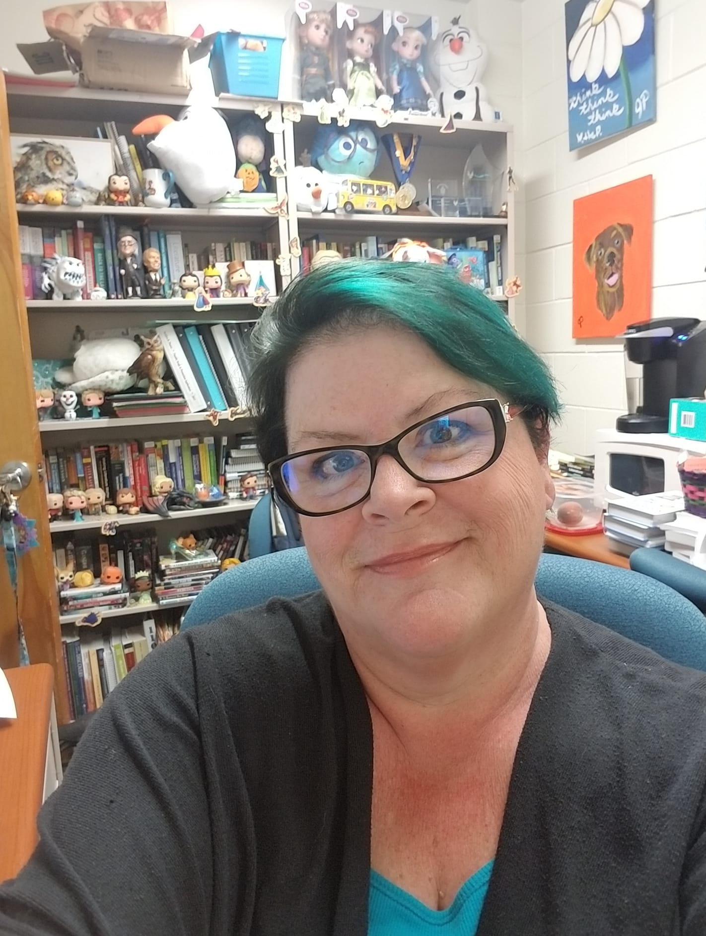
About Me
Quality Matters Certifications: Improving your Online Course; Addressing Accessibility & Usability; Applying the QM Rubric; Connecting Learning Objectives and Assessments; Peer Reviewer Course; Face-to-Face Facilitator Certification
Faculty Mentor: in this role, I work one on one with faculty members seeking to create and improve their online courses. Additionally, I train and work with additional faculty mentors to broaden the scope of departmental representation.

Slide 3
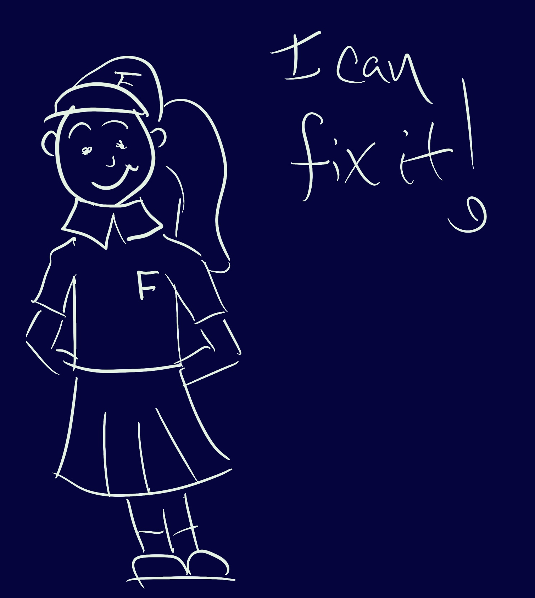
Today’s Outcomes
Define
Define various feedback styles, tools, and strategies.
Create
Create engaging feedback to student work.
Utilize
Utilize LMS tools to provide feedback and to ensure students receive feedback.

Slide 4
What is Feedback?
From Dictionary.com: “information about reactions to a product, a person's performance of a task, etc. which is used as a basis for improvement.”
From ForImpact.org: “Feedback comes in three forms: appreciation (thanks), coaching (here’s a better way to do it), and evaluation (here’s where you stand).”
Your Turn…

Slide 5
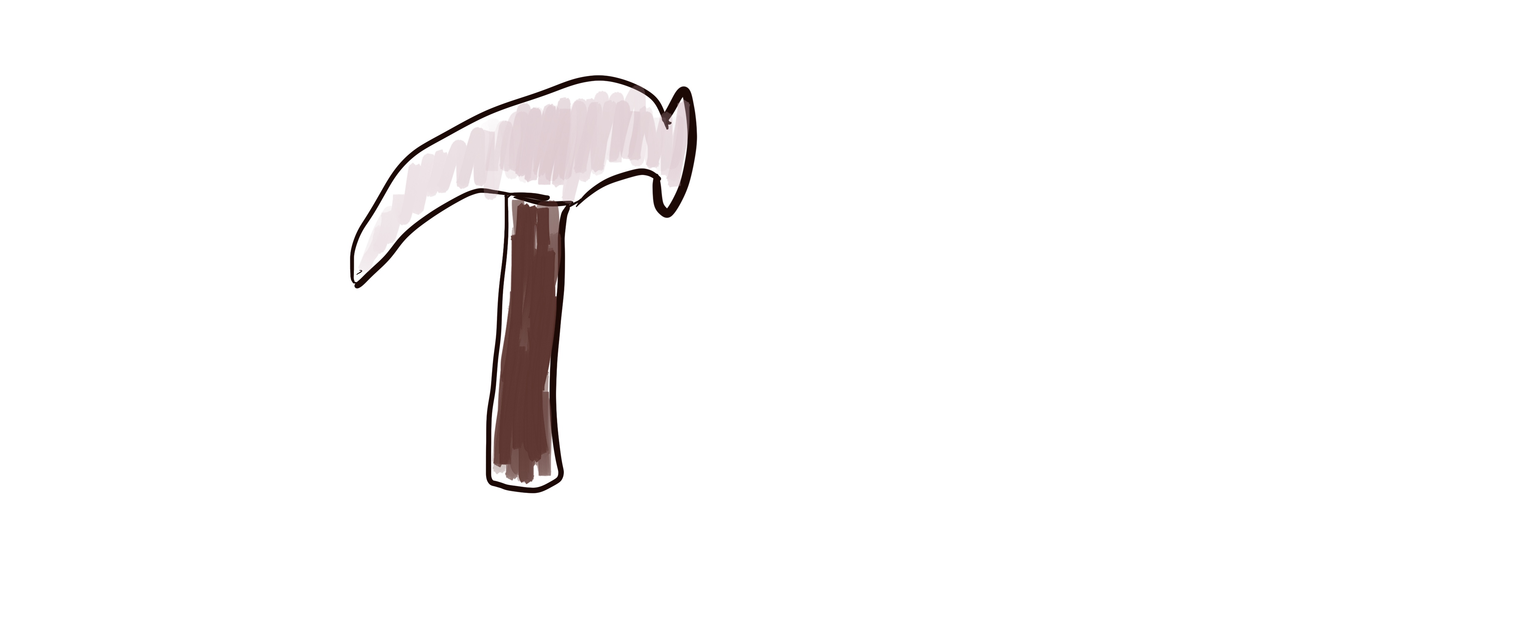
Building Assignments & Rubrics
Good Feedback Starts Before the Due Date

Slide 6

Building Blocks
Clear criteria
Rubric or scoring should give some immediate feedback
Remind students how to use a rubric before and after an assignment is graded

Slide 7
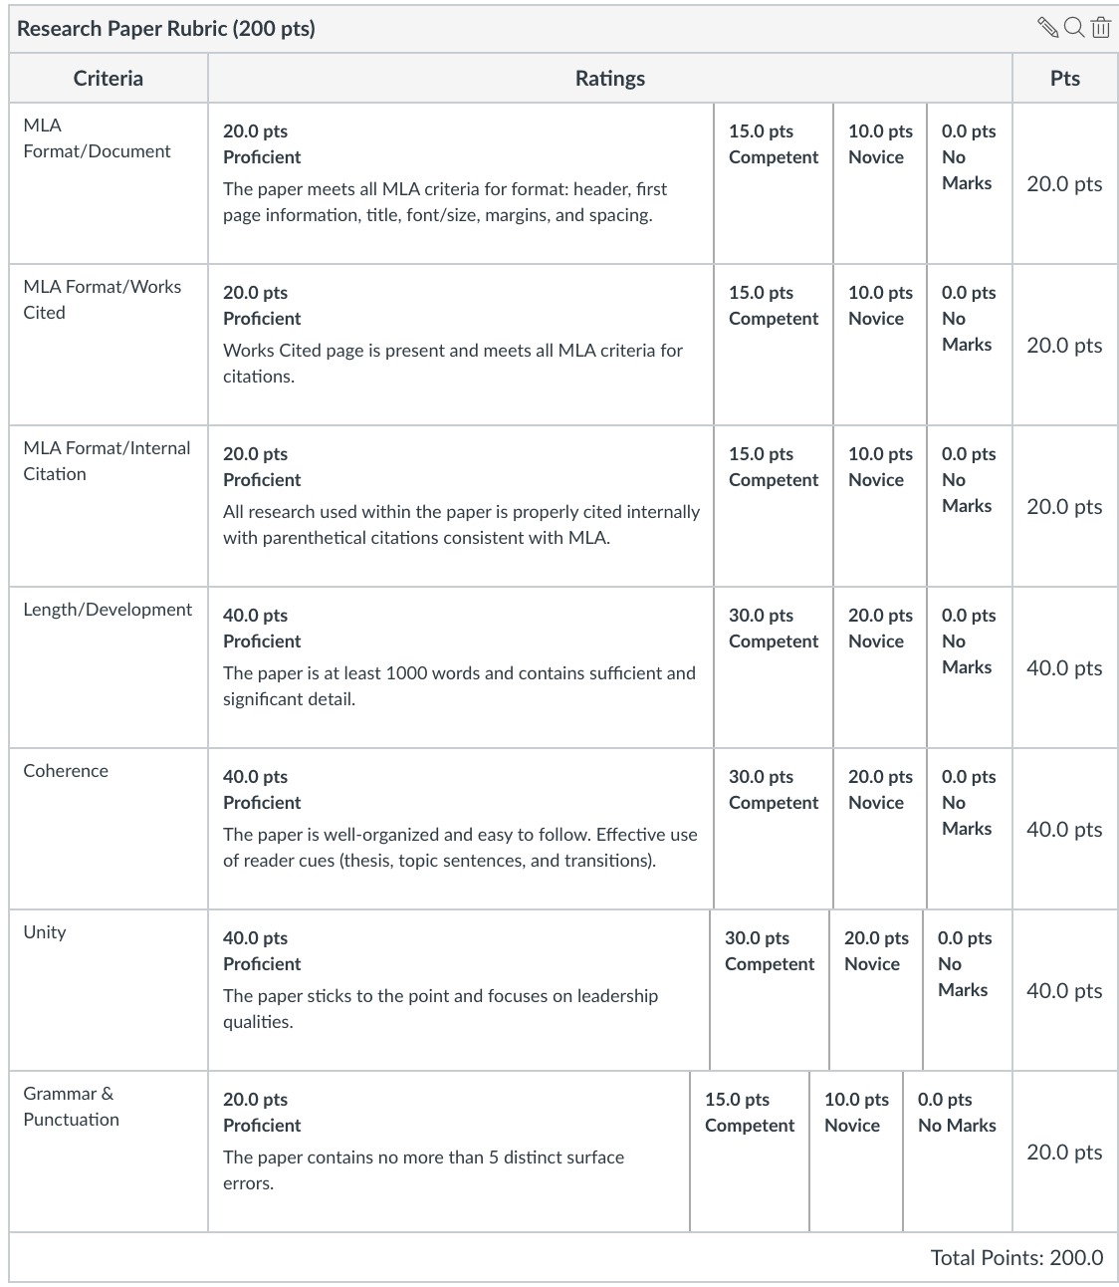
A Sample From My Class
Overview
Students will choose from a list of approved leaders (see below). Then, students will conduct credible research on their person and write a paper detailing this person's leadership philosophy.
Requirements
MLA format and documentation.
Photos and other visuals not required but must be cited if used, and these do not contribute to length requirements for the paper.
Works Cited page is also required but does not contribute to length requirements for the paper.
All quotations and paraphrased information from research must be clearly cited both on the Works Cited page and internally through the use of parenthetical citations.
Minimum of three academically sound sources required.
Actual text of the paper should be at least 4 pages typed and double spaced (approximately 1000 words).
Leadership Focus
While students will, no doubt, give a biography of their chosen leader, remember to focus not just on his or her life, but on his or her leadership philosophy. The analysis should (as much as possible) include the leader’s:
Leadership philosophy
Vision and goals for the organization
Conflict management techniques and suggestions
Methods for establishing and building trust
Methods for empowering others
Grading Info
The late penalty for this assignment is -10 for up to one week, -20 for 1-2 weeks late, and no more than half credit beyond that.
Please review the attached rubric for more information.

Slide 8

Provide Previews
Demonstrate how to Locate Feedback in the LMS

Slide 9
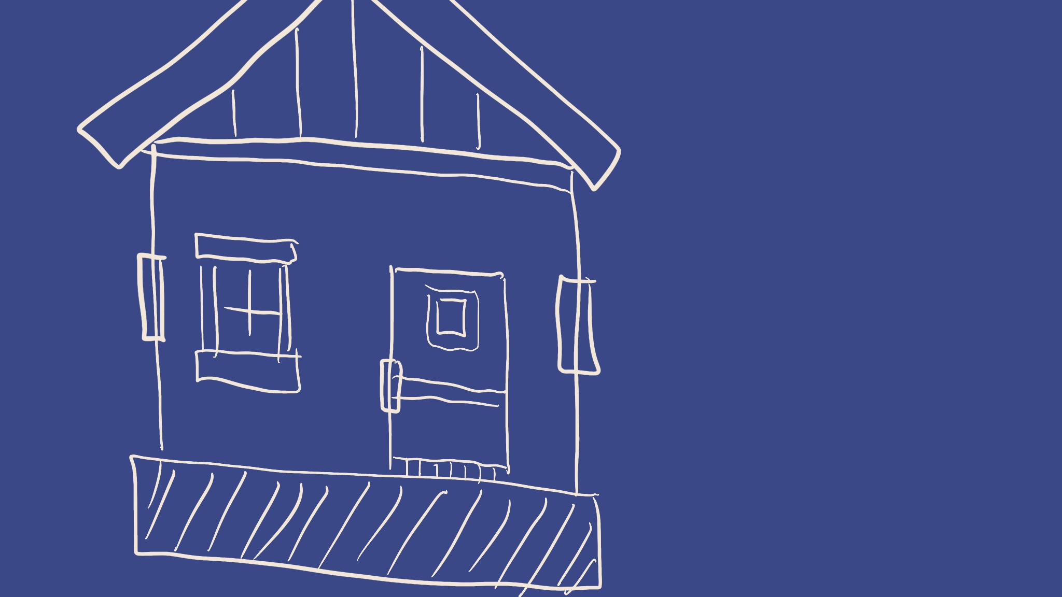
The Blueprint
Start-up Module
Student View feature
Video/screen shots

Slide 10

You Know What they Say…
Variety is the Spice of Life!

Slide 11

Switching it Up
Marked-up documents
Comments boxes
Video/audio feedback

Slide 12
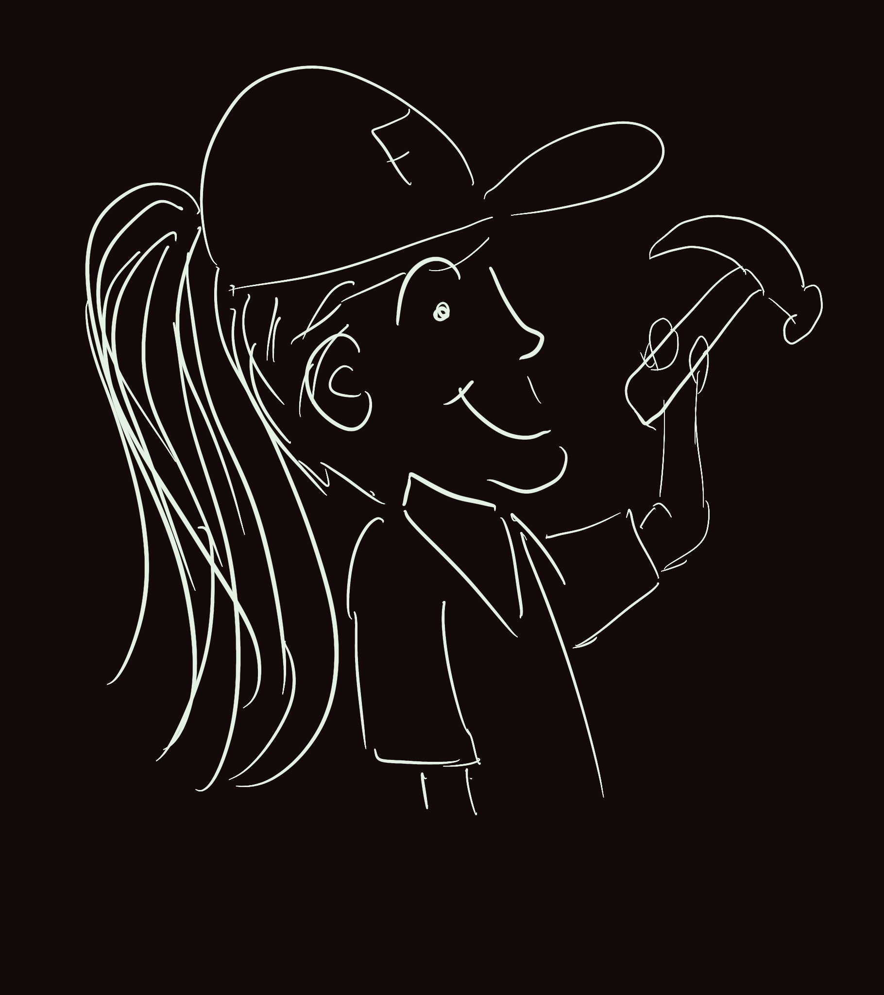
Following Up
Practice Makes Perfect

Slide 13

Hammer it Home
Feedback “quizzes”
Required revision
Self-reflection assignments

Slide 14
You Can Fix It! Never give up
If even a few students learn from and use the feedback, you’ve made an impact!
Communication is key
  Clarify how/when feedback will be provided
  Explain when it’s too late to expect detailed feedback
  Place the ball in the learner’s court

