Slide 1

Fresh Ideas with Accessibility Baked-in!
Nov. 1, 2018
Quality Matters

Slide 2
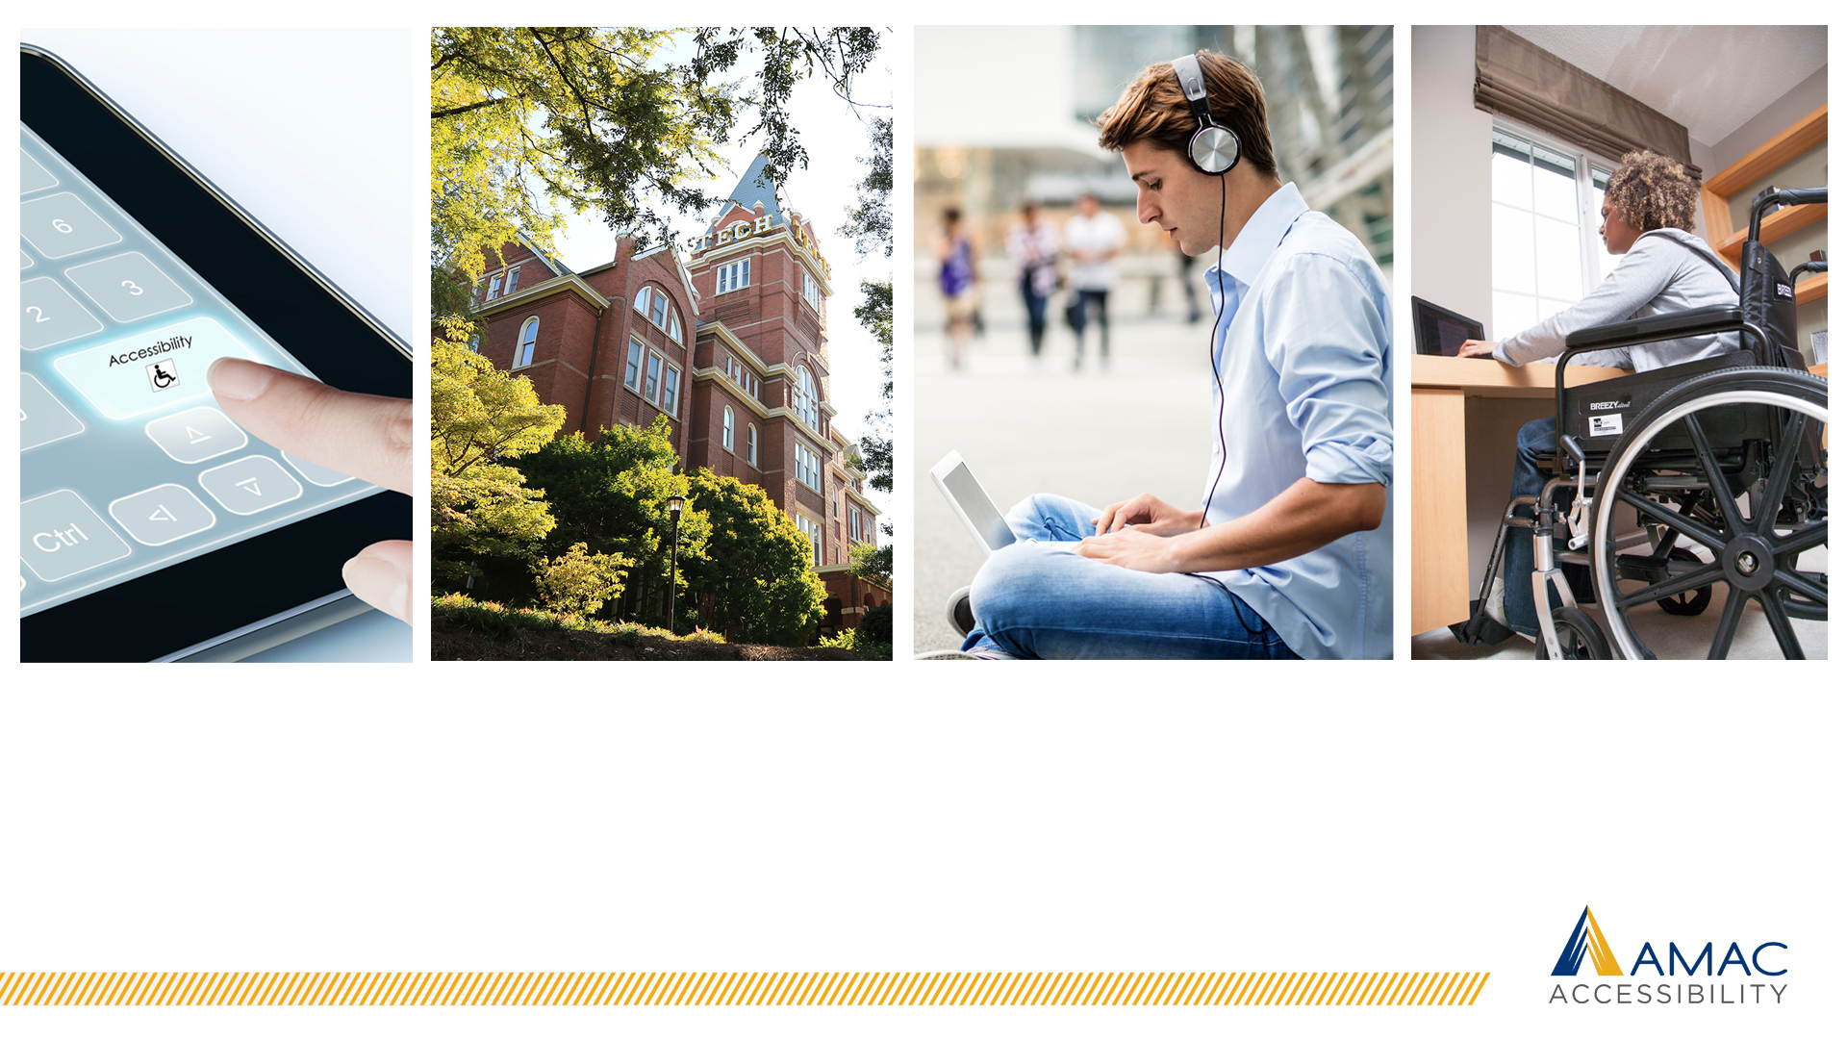
Baking in Accessibility
Notes:
Skit- Courtney: Blah what’s the point of engaging content (Portfolio)

Slide 3
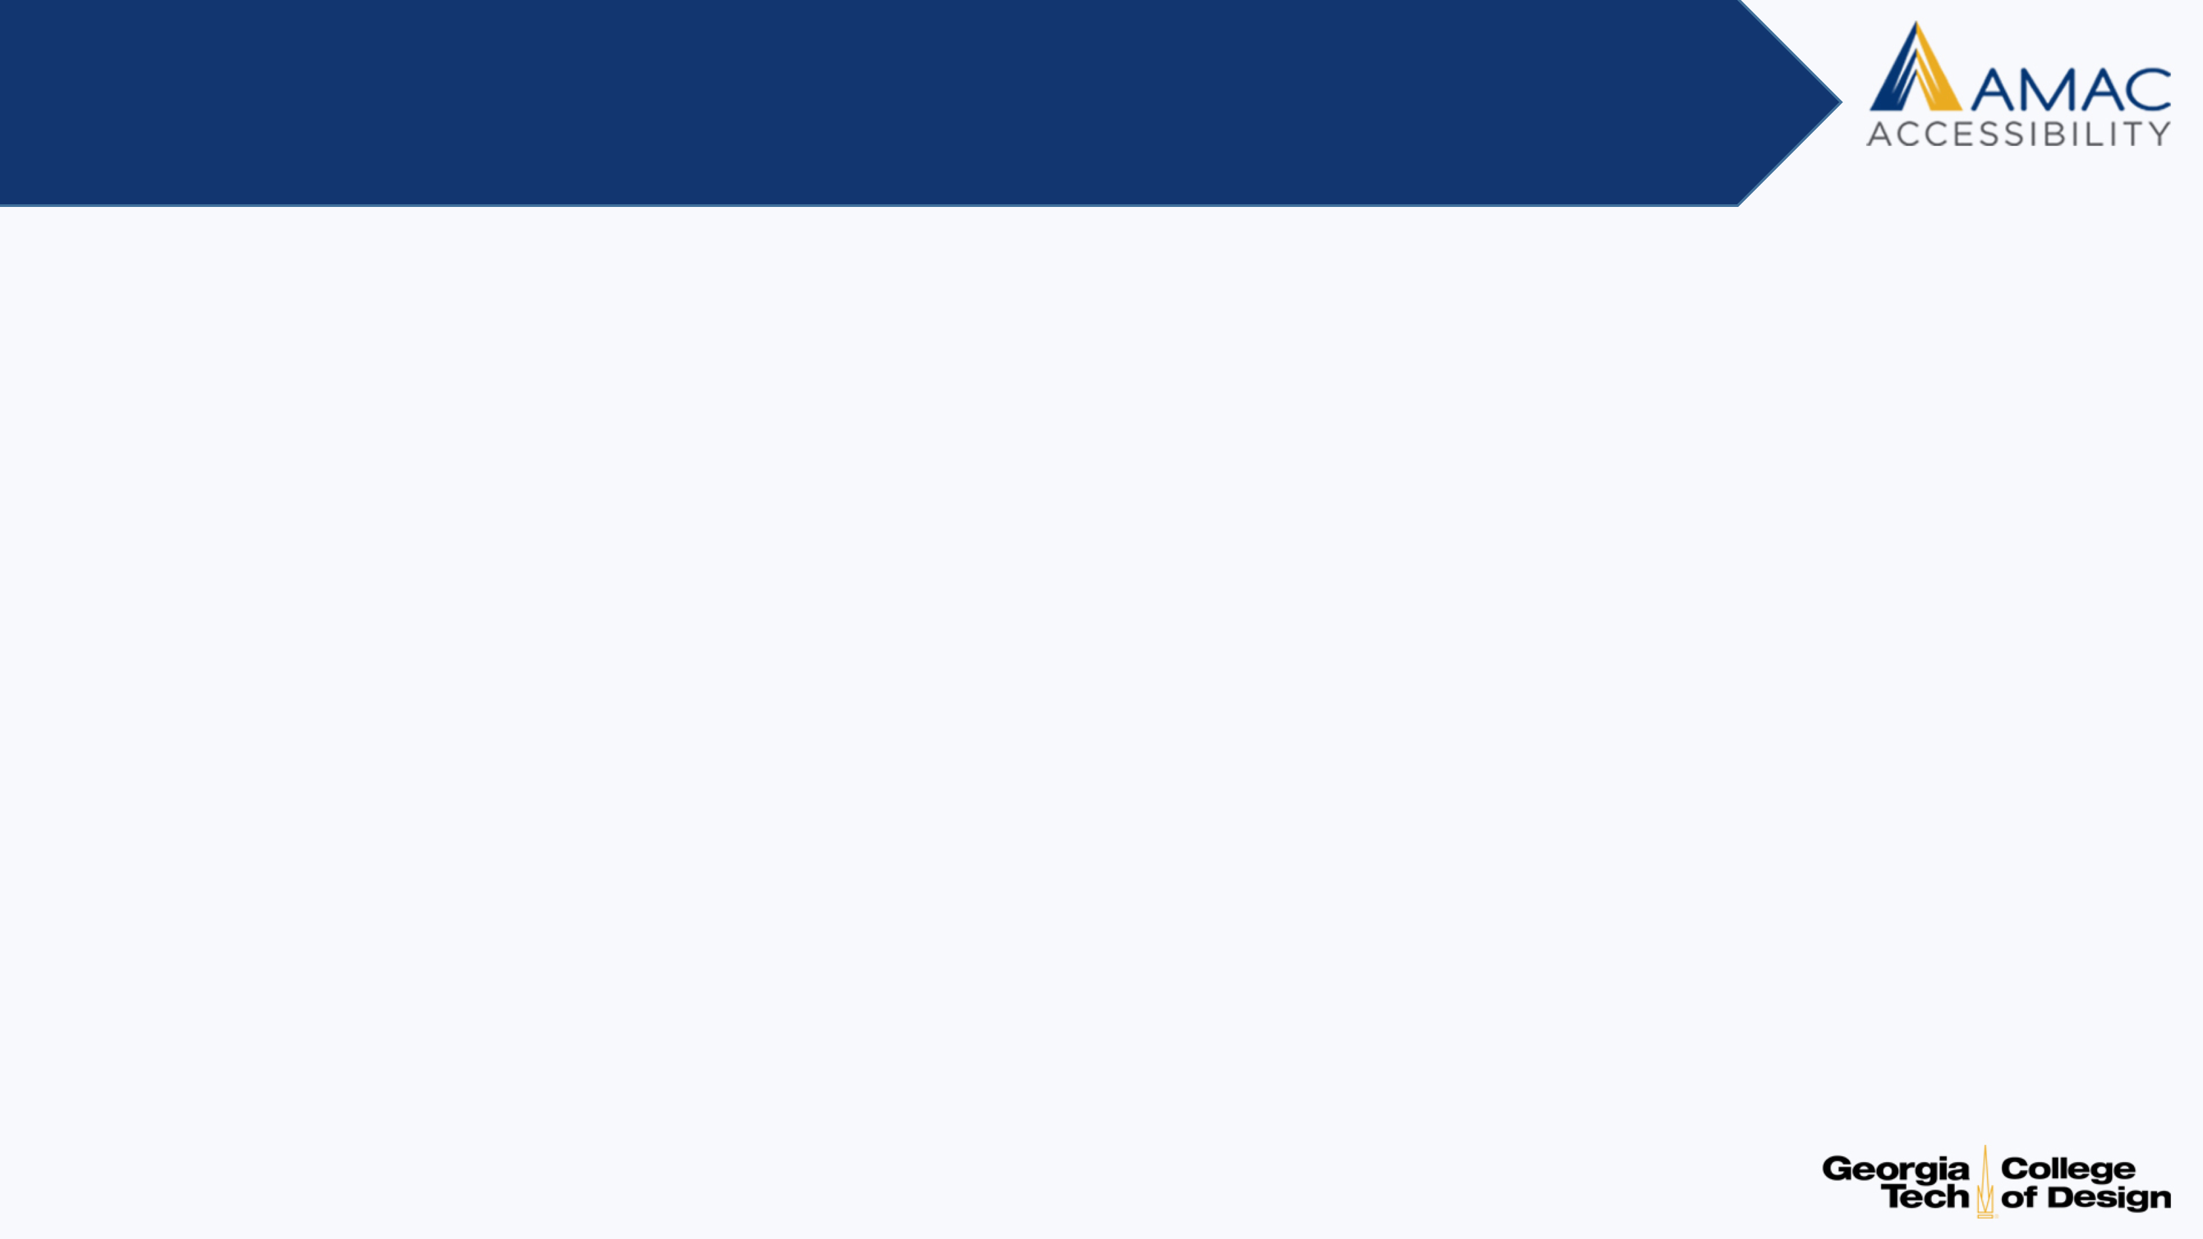
What did I just see?
Sheryl Ballenger, Ph.D.
AMAC Accessibility, College of Design, Georgia Tech
Courtney DuBois, M.S.
Center for Excellence in Learning and Teaching,
Clayton State University

Slide 4
Objectives
Learning Objective 1: Recognize the importance of proactively incorporating accessible design practices into your course(s).
Learning Objective 2: Develop a list of ways to add accessibility into your course design.
Learning Objective 3: Discuss how accessible multimedia enables users to access content.

Slide 5
So, you have a fresh idea?
Is it accessible?
Create instructional content with the
accessibility baked into the design.
Don’t wait until your students need accessible materials.
Don’t retrofit.

Slide 6

Online course- LMS
Is it accessible?
WYSIWYG
No reheated content, must be fresh-baked
Example:
Scanned documents as images
Memes
Step away from the mouse

Slide 7

Syllabus
Is it accessible?
Graphical syllabus
Interactive syllabus
Pdf
Doc
Different design is not best practice
Include description with pictures
Authoring tools should allow mark-up with proper heading structure, tab order, color contrast.
Contact info to inform of problems

Slide 8
Textbooks online
Are they accessible?
Amazon, online bookstores, publisher content, …
Different idea of accessible – online, location, searchable
Pages need reading order defined
Photos with alt description, graphs described, more.

Slide 9
Course presentation tools
Are they accessible?
PowerPoint
Voiceover PowerPoint
Synchronous learning
Interactive synchronous learning (webinar style)

Slide 10
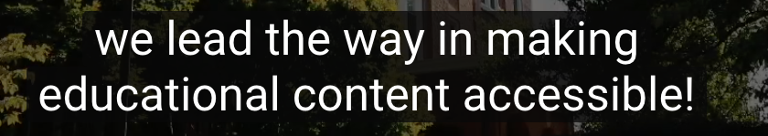
Recorded content
Is it accessible?
Videos – Are they captioned? Are captions accurate?
Videos – Do videos need audio description? Can you bake-in audio description?
YouTube (Kaltura) – Requires editing
Third party vendor – Relevant? Establish budget in advance

Slide 11
Student Interaction
Are these accessible?
Discussion boards
Email
Chat rooms
Online office hours

Slide 12
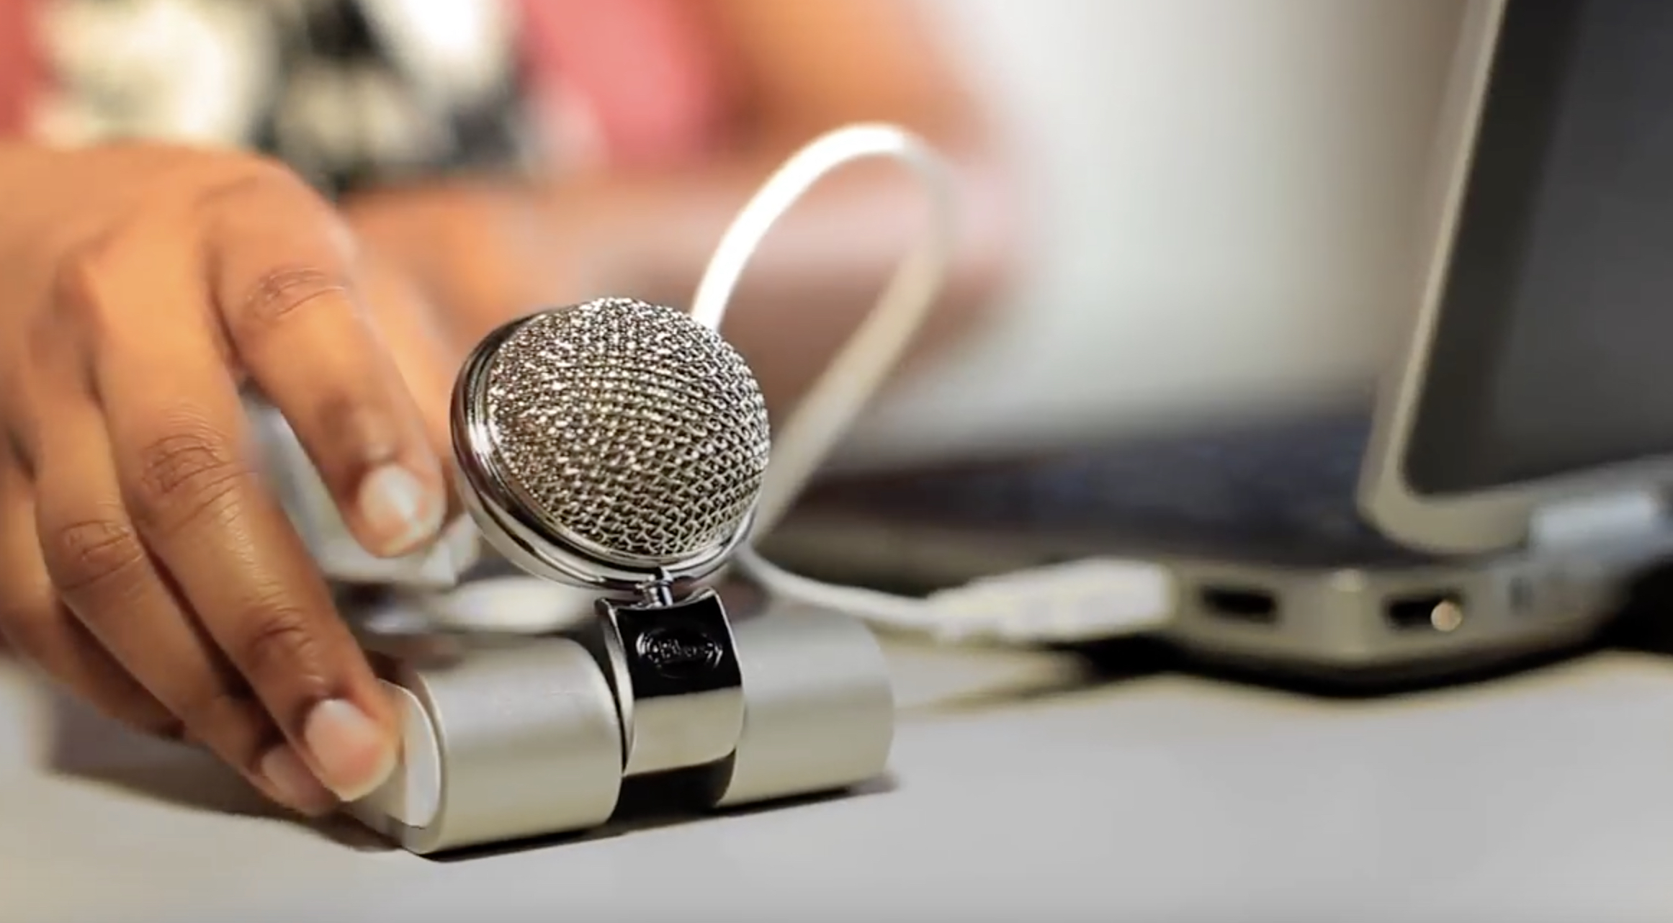
Student Assessments
Are these accessible?
Online exams/quizzes
Publisher content quizzes
Online papers
Flipped content:
Peer review assessments
Alternative assignments (online portfolio submission, video submission, infographics submission, etc.)

Slide 13
Join us for a “lunch chat”…
Are you using any of the materials discussed- are they accessible?
Tell us about a challenge you faced in creating accessible content. How did you solve it?
Presenter challenge – what instructional content do you need help with?

Slide 14
Contact us
Sheryl Ballenger, Ph.D.
AMAC Accessibility, College of Design, Georgia Tech
sheryl.Ballenger@amac.gatech.edu
Courtney DuBois, M.S.
Center for Excellence in Learning and Teaching, Clayton State University,
courtneydubois@clayton.edu

Slide 15
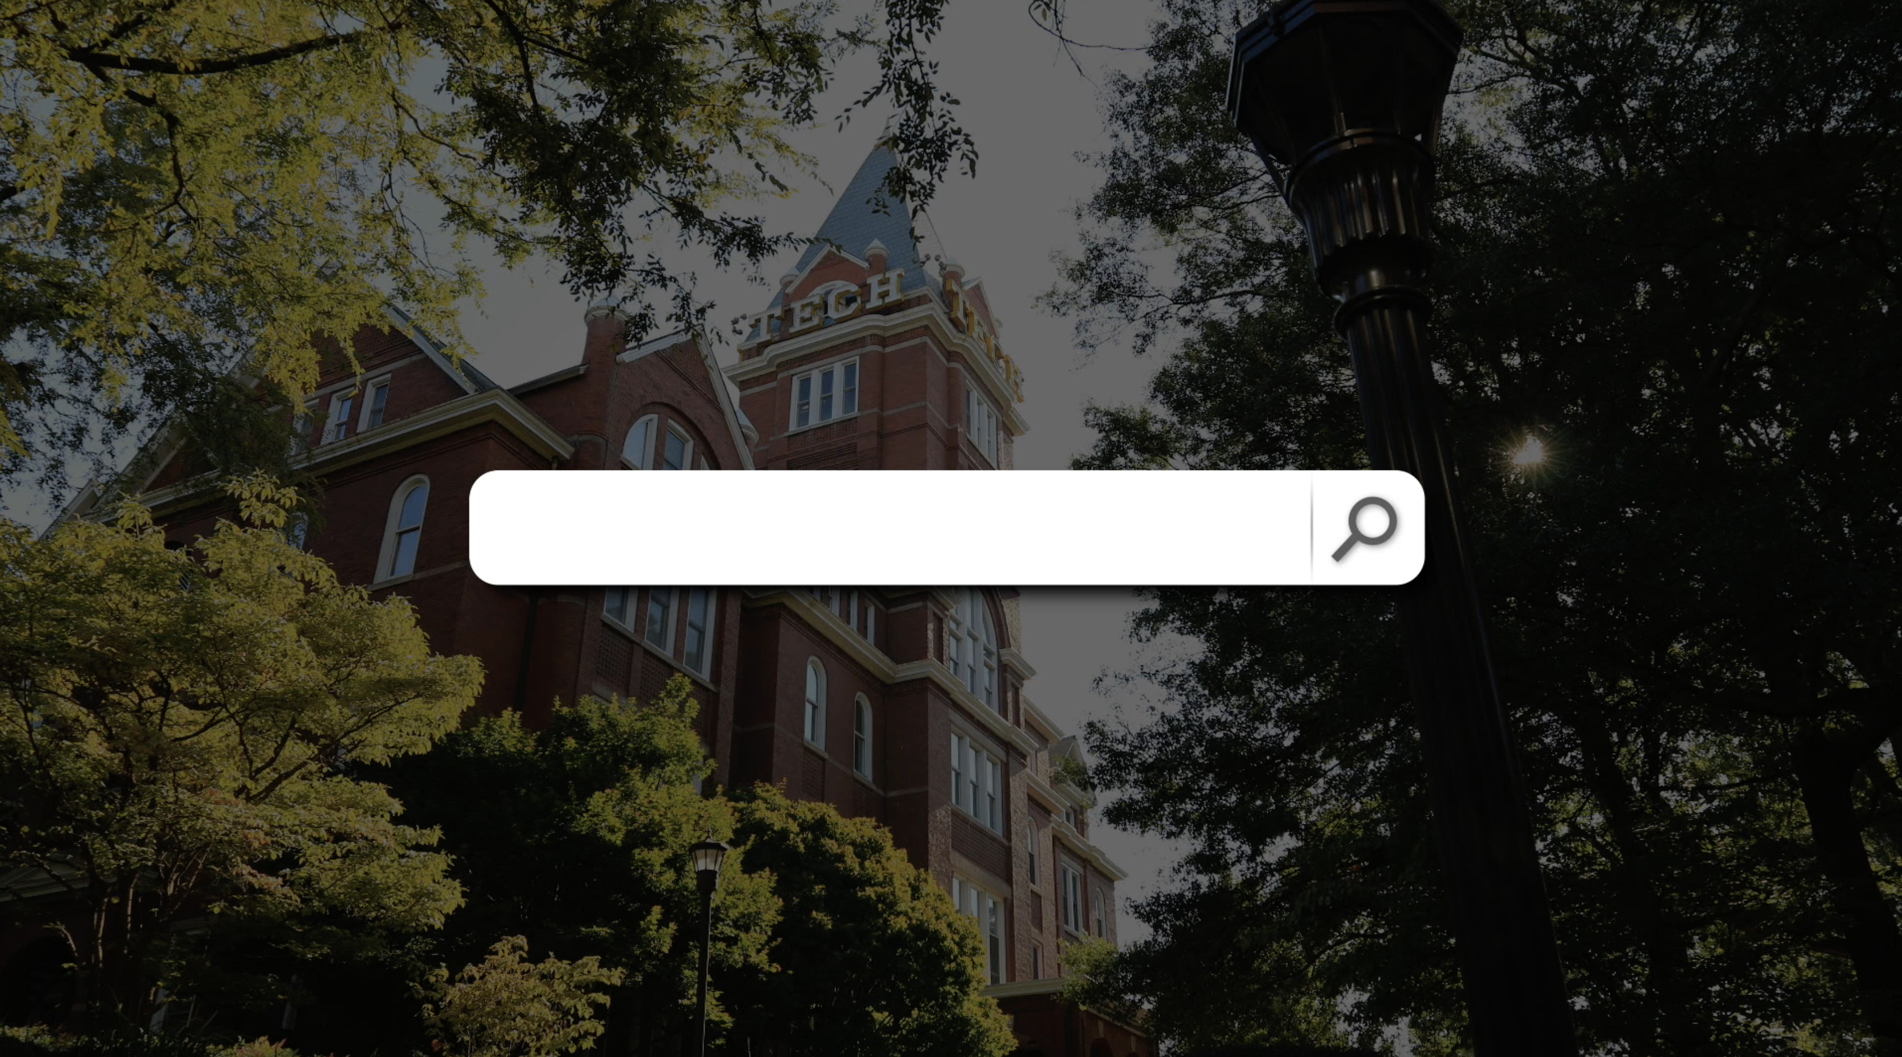
www.amacusg.org

