Slide 1

Enhancing Inclusiveness within the Quality Matters Framework
April 24, 2020
Dr. Barbara Frey, Dr. Rae Mancilla, Dr. Charline Rowland

Slide 2

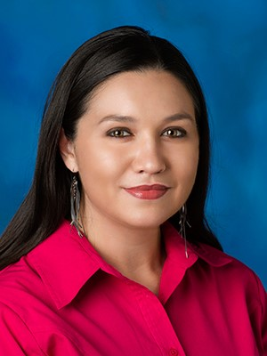
Presenters
Barbara Frey, Assistant Professor
Rae Mancilla, Senior Instructional Designer

Slide 3
Session Goals
Differentiate between key terms such as diversity, inclusion, segregation, and integration.
Analyze the inclusiveness of course materials and teaching practices.
Identify Quality Matters standards that bolster inclusive course design
Develop strategies that support Quality Matters standards and enhance inclusiveness.

Slide 4
QM Standards Addressing Inclusivity
Standard | Example
1: Course Overview and Introduction | Communication etiquette
3: Assessment and Measurement | Multiple and varied assessment strategies
4: Instructional Materials | Use of open educational resources (OER)
5: Learning Activities and Interaction | Policies or expectations for instructor interaction
7: Learner Support | Accessibility policies and accommodation statements
8: Accessibility and Usability | UDL guidelines (ex: alt text, headings)

Slide 5

Diversity Brainstorm
Image source: Rocketspace

Slide 6
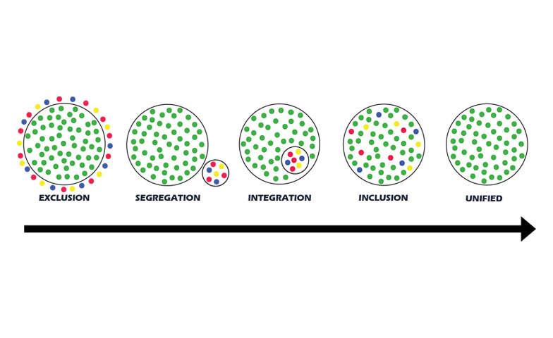
Key Terminology
Image source: AMLE.org

Slide 7
Syllabus Activity
Instructions:
  Open the course syllabus activity document
  Review the course syllabus from a student perspective
Focal questions:
  What aspects of this document promote inclusivity?
  What aspects are barriers to inclusivity?

Slide 8
Best Practices for Inclusive Design
Convenience of office hours and instructor availability
Economic and time demands related to assignments
Variety of authors, perspectives, and texts, include international sources
OER when possible
Variety of assessment types
Discussion guidelines consider linguistic diversity
Concessions for religious observances
Resources for students with disabilities, student-first terminology
Gender neutral terms
Clear and specific course schedule

Slide 9
Guidelines for Diversity Statements
Signals instructor’s commitment to creating an inclusive and supportive climate for all students
Typically found in course syllabus
Personalized to the instructor and discipline
Questions to Consider:
  How do you recognize and value diversity in the online classroom?
  How can diversity be an asset for learning?
  How will issues related to diversity be handled?
  How will you monitor student input about the classroom environment?

Slide 10
Example Diversity Statement
It is my intent that students from all diverse backgrounds and perspectives be well served by this course, that students’ learning needs be addressed both in and out of class, and that the diversity that students bring to this class be viewed as a resource, strength, and benefit.
It is my intent to present materials and activities that are respectful of diversity: gender, sexuality, disability, age, socioeconomic status, ethnicity, race, and culture. Your suggestions are encouraged and appreciated.
Please let me know ways to improve the effectiveness of the course for you personally or for other students or student groups.
In addition, if any of our class meetings conflict with your religious events, please let me know so that we can make arrangements for you.
Source: University of Iowa College of Education

Slide 11
Case Study Activity
Instructions:
  Open the case study activity document
  Read the case study from a faculty perspective
Focal questions:
  How might Dr Thomas prepare students for sensitive topics?
  Do you have any suggestions for Dr. Thomas to enhance inclusiveness in the course assessments?
  What advice do you have for Dr. Thomas as he designs and facilitates respectful online discussions?

Slide 12
Example of Discussion Guidelines
Be patient: Read thoroughly before replying
Be brief: Be direct and stay on point, avoid overly wordy sentences
Cite your sources: Give proper attribution to authors
Be personal: Address peers personally by name
Be positive: Ensure language and tone are non-offensive
Use humor with caution: Emoticons and sarcasm are difficult to interpret
Be constructive in feedback: Suggestions should be balanced and sensitive
Be aware of audience: Carefully reread before posting, posts cannot be retracted

Slide 13
QM Standards Final Take Aways
Standard | Additional Strategies
1: Course Overview and Introduction | Consider a diversity icebreaker as part of the learner introductions (e.g., Implicit Association Tests)
3: Assessment and Measurement | Provide resources on plagiarism; Explain purpose of peer reviews
4: Instructional Materials | Consider diverse ethnicities, cultures, and races when selecting materials (ex. Images, videos, readings)
5: Learning Activities and Interaction | Provide guidelines for inclusive student interactions in group projects; Assign groups and shuffle groups
7: Learner Support | Share resources for tutoring services, writing centers, math centers, technology workshops, international students, Veteran services
8: Accessibility and Usability | Use Universal Design for Learning principles: Include transcripts or closed-captions

Slide 14
Questions?
Please type your questions in the chat box.

Slide 15
Contact Us
Barbara Frey, bfrey@pointpark.edu
Rae Mancilla, ram199@pitt.edu

Slide 16

Conclusion

