Slide 1
From Compliance to Culture:
UNI’s Journey Toward Digital Accessibility
Caran Howard
Instructional Support Services Manager
Online Education and Individual Studies

Slide 2
Learning Objectives
Evaluate your current institutional strategies for digital accessibility compliance.
Explore scalable faculty development strategies that cultivate accessibility leadership across departments and support inclusive teaching practices.
Brainstorm storytelling, collaboration, and training strategies to foster a campus-wide culture of accessibility, engagement, and belonging.

Slide 3
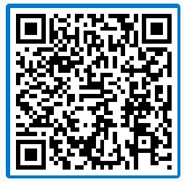
What is Your Approach?
“How would you describe your institution’s current approach to digital accessibility?”
Notes:
https://pollev.com/caranhoward559

Slide 4
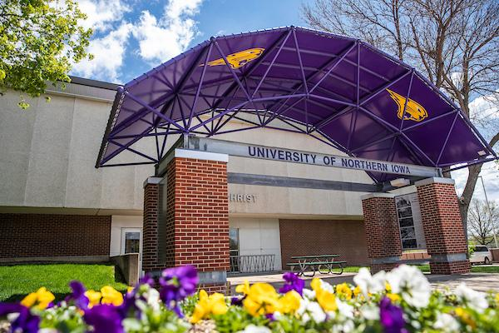
The Mandate and the Moment

Slide 5
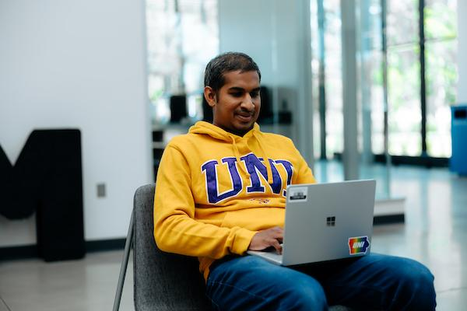
Finding Our Approach at UNI
DOJ’s 2024 ADA Rule → WCAG 2.1 AA by April 2026
Accessibility as both a legal requirement and and cultural change to support all learners.

Slide 6
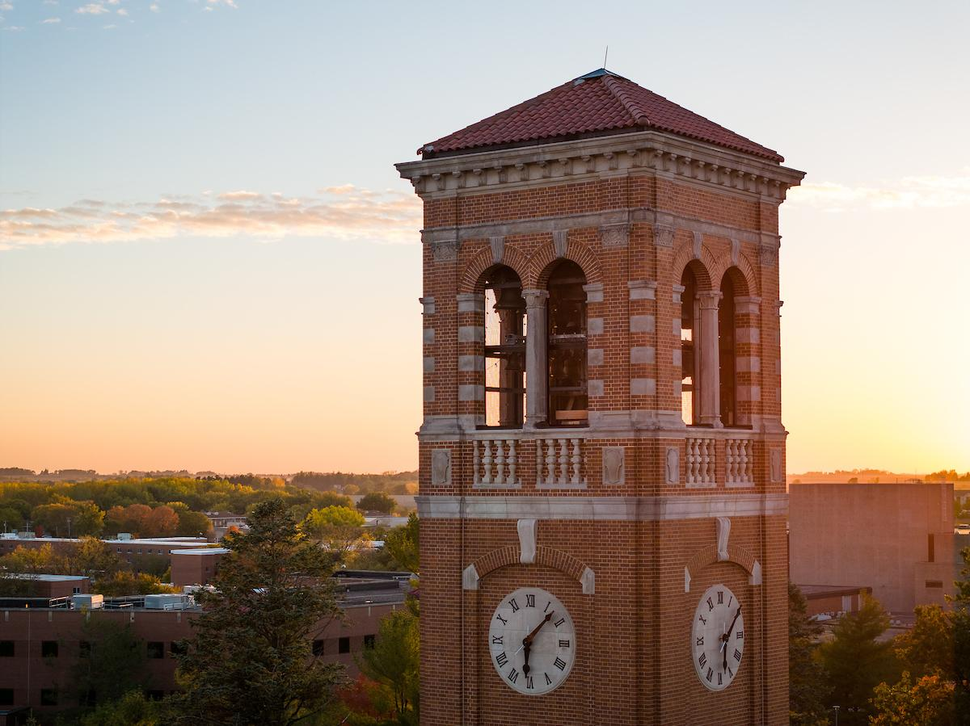
Building Infrastructure for Change
Teaching & Learning Digital Accessibility Committee
Digital Accessibility for UNI Faculty training course/hub
Faculty Leadership: PALs
Campus-wide workshops at college and department-levels

Slide 7
From Mandate to Momentum
From one of the PALs:
“Working as a PAL has immensely helped my own teaching. My training has provided me with new insights into course improvement for accessibility that also makes me aware of how I design my classes. The result is greater attention to the preparation of my course materials that not only assists those needing accessibility accommodation, but all my students. This is particularly true for my PowerPoint presentations and all materials on my Blackboard Ultra Site.”

Slide 8
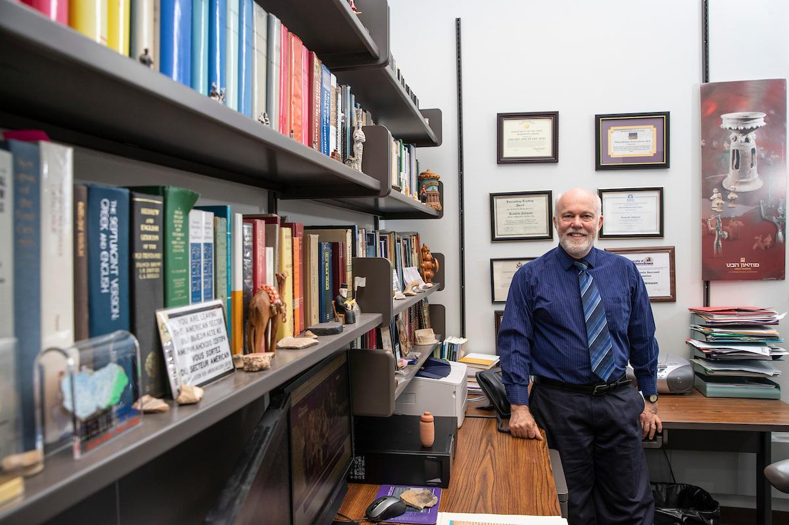
Faculty Engagement Strategies
PD offerings (asynchronous modules, workshops, 1:1 help)
Peer mentorship via PALS
Incentives: stipends, recognition, community

Slide 9
Workshop Responses from faculty
“The overview was clear and the individual work time for target help and problem solving was very helpful and informative.”
“I *really* appreciated the thought process submitted to us, to pick an accessibility "bad guy" and move on that. I know what mine is - PDFs - and looking at my classes in this way will be helpful (the headers kill me! LOL)!”
“I am feeling that this may not be as difficult as I had feared.”

Slide 10
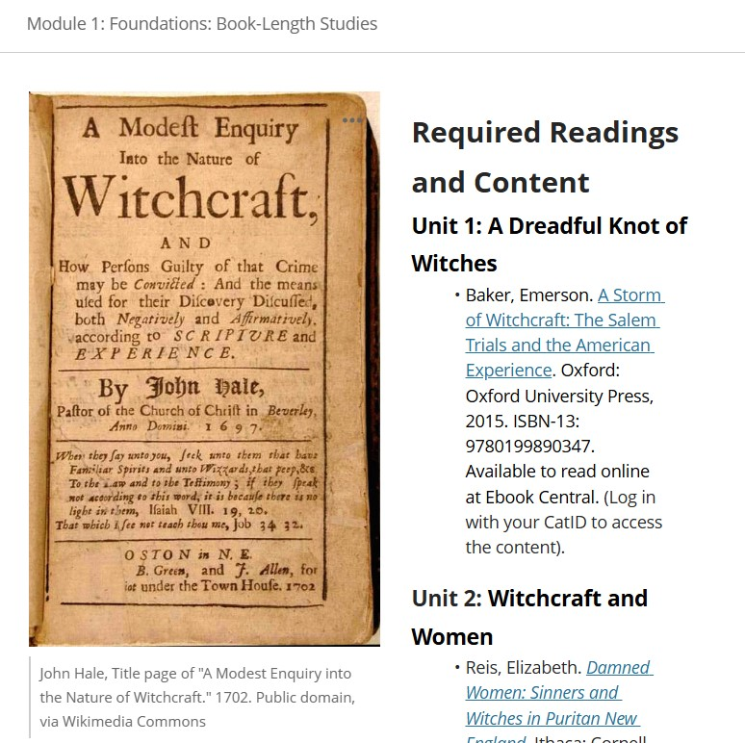
Accessibility in Action
Content remediation (e.g., alt text, captioning, document structure)
Field-specific challenges: music, math, media
Moving Forward: Accessible from the start

Slide 11
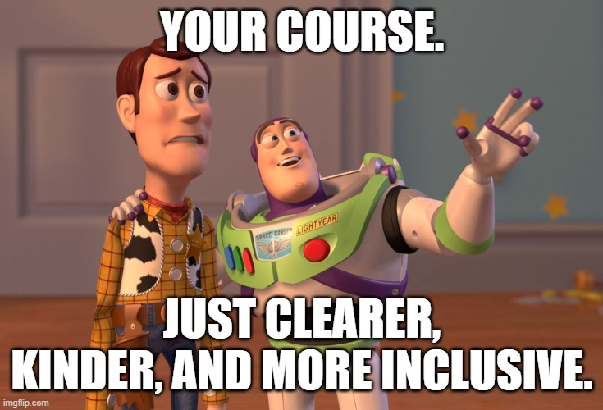
Turning Compliance into Commitment

Slide 12
Your Turn
“What’s one strategy you could take back to support accessibility efforts on your campus?”
Pair up or form small groups
Share one challenge and one idea
Jot down 1–2 practical takeaways

Slide 13
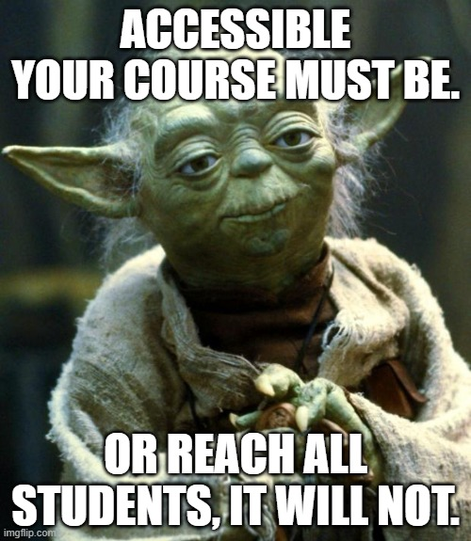
Questions, Ideas, and Shared Wisdom

Slide 14
Food for Thought
Join the conversation: What is digital accessibility? (A GAAD Post) | UsableNet, Inc.
The 10 affirmations of good digital accessibility | Deque
WebAIM: Training Others - Why Accessibility? Motivating Learners To Bring About Change
What do you believe about digital accessibility? | Mizzou Online: Teaching

Slide 15
Thank you for attending!
Caran Howard
caran.howard@uni.edu
QR code for handout

