Slide 1
GPT Smashing: AI-Enhanced Design for Science & Engineering in Preservice Teacher Education
Gwinn North and Ricardo Lumbreras
Tarleton State University
Department of Curriculum and Instruction

Slide 2
Artificial intelligence (AI) can revolutionize preservice teacher education by providing personalized instructional content and interactive blueprints for science and engineering instruction. Preservice teachers require deep theoretical knowledge and practical skills to effectively teach these complex disciplines, presenting considerable instructional challenges.

Slide 3
NGSS Science and Engineering Practices
The NGSS (Next Generation Science Standards) outlines eight Science and Engineering Practices (SEPs) that are essential for students to learn. These practices reflect the ways scientists and engineers work, and they help students develop critical thinking, collaboration, and communication skills:
Asking questions for science and defining problems for engineering
developing and using models
planning and carrying out investigations
analyzing and interpreting data
using mathematics and computational thinking
constructing explanations for science and designing solutions for engineering
engaging in argument from evidence
obtaining, evaluating, and communicating information

Slide 4
This research introduces GPT Smashing, an innovative method integrating multiple specialized AI models (e.g., GPT-4, GPT-4V) to generate dynamic, multimodal teaching materials. Unlike traditional single-model AI approaches, GPT Smashing synthesizes textual, visual, diagrammatic, and interactive content, producing customizable lessons, conceptual diagrams, experimental frameworks, and schematic illustrations.
This enables preservice teachers to actively visualize, modify, and adapt instructional resources, enhancing comprehension, instructional quality, teacher agency, and creativity in science and engineering education.
The Research:

Slide 5

Evaluate preservice teachers' perceptions of GPT Smashing's effectiveness in improving comprehension of complex science and engineering concepts.
Analyze the extent to which preservice teachers value AI-generated multimodal instructional materials for adaptive, personalized science and engineering education.
Assess preservice teachers' perceptions of how GPT Smashing influences their instructional design, implementation, and adaptation of hands-on science and engineering activities.
Research Objectives:

Slide 6

II. Why GPT Smashing?
What is GPT Smashing?
What are the benefits?
Current challenges in Pre-Service science and
engineering education:
Complexity
Gaps in theory and practice
Limited time and resources for personalized instruction

Slide 7
What is GPT Smashing?
GPT Smashing is a novel, innovative, AI-integrated instructional design process that “mashes” multiple GPT-driven techniques (e.g., brainstorming, iterative feedback, visual translation, critique) into a structured outcome process. It uses multiple AI models to generate multimodal, customizable teaching materials for science and engineering education. By combining text, visuals, diagrams, and interactive elements, it helps preservice teachers deepen understanding, enhance lesson quality, and boost creativity and agency in instructional planning.

Slide 8
What are the benefits of GPT Smashing?
After participation in two engineering based projects using GPT Smashing:
Preservice teachers reported significant growth in confidence in their ability to explain how AI-generated conceptual blueprints can support science and engineering instruction.
Preservice teachers reported feeling more confident in my ability to design and implement hands-on science and engineering investigations using AI-generated content.
Preservice teachers reported a significant increase in their beliefs that GPT Smashing can help them better visualize and manipulate instructional concepts (e.g., diagrams, experiments) in their teaching.

Slide 9
Current Challenges:
Opportunities for teachers to develop a deep understanding of engineering and the role of engineers are often limited, hindering their ability to effectively cultivate students’ engineering practices and design competencies (Irmak and Ozturk, 2022).
Lack of time dedicated to teaching science and engineering, especially in lower elementary grades (Baniflower et al., 2013; North & Rose, 2025).

Slide 10
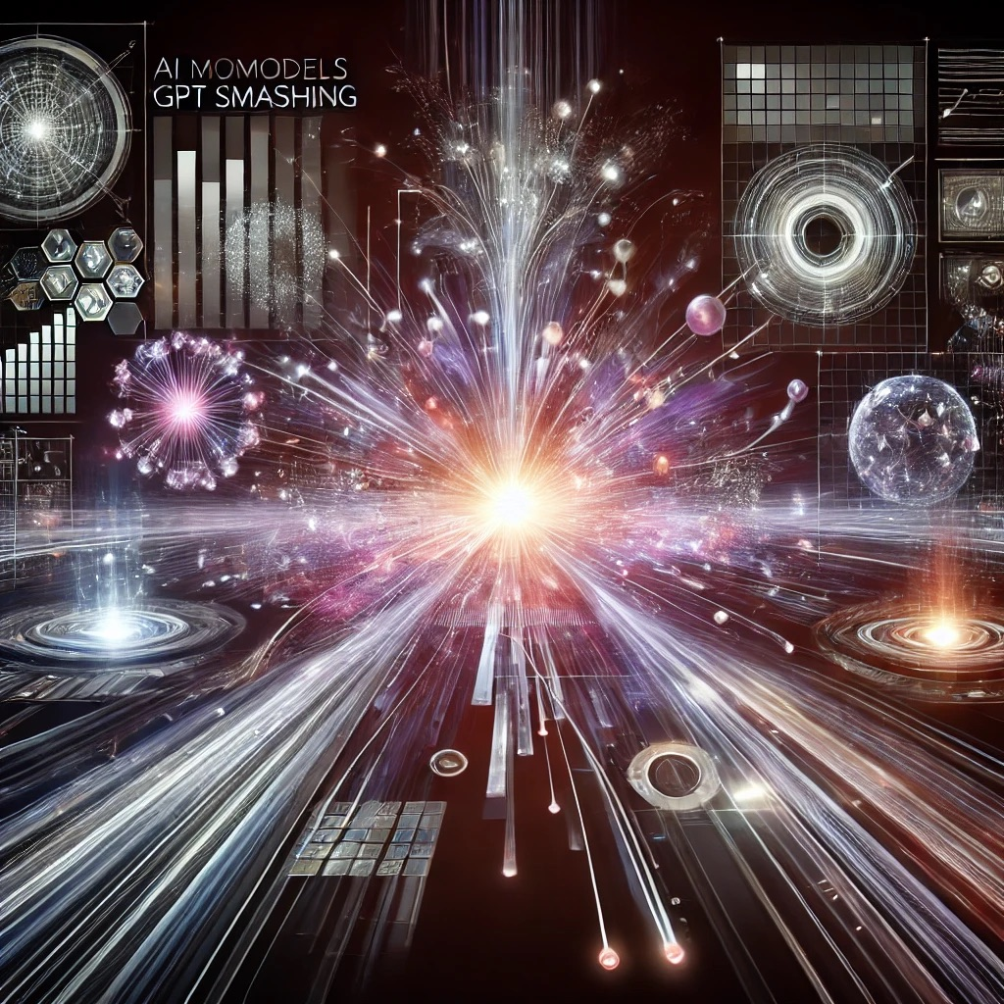
III. Live Demonstration - GPT Smashing in Action!
The Blueprint!
Inquiry based science lesson
Textual explanation
Conceptual diagrams
Interactive prompts
Materials list

Slide 11
IV: Activity: Design your own GPT Smashing Sequence!
Breakout groups (table teams)
“Give an example prompt here….”
Share 1-2 examples from the groups
Reflect on clarity, creativity, and classroom feasibility

Slide 12

V. What did we learn?
What surprised you about the process?
How might this empower your preservice educators?
Where do you see opportunities or challenges in your setting?
“Other questions to ask?”

Slide 13


VI. Wrap-up & Resources
Summarize our key takeaways
GPT Smashing
Instructional Empowerment
Support for STEM/STEAM?
Invite collaboration
Gwinn North: snorth@tarleton.edu
Ricardo Lumbreras: lumbreras@tarleton.edu

