Slide 1

Going Viral with
QM @ UMBSON
Faculty and Instructional Designers
“catch” Collaboration!

Slide 2
University of Maryland School of Nursing
Office of Learning Technologies
Presenters:
Joanne Pinna Senior Instructional Technologist
Angela Staten Instructional Technologist
Matt Rietschel Assistant Professor/Assistant Dean
Nichole Schumaker Instructional Technologist
Christopher Moore Multimedia Technician
Leah Smith Academic Program Specialist
Other Team Members:

Slide 3
Presentation Topics
How we started
Application of QM framework
Before & after
Buy in and time efficiency
Applicable to your institution
Notes:
Discovered faculty losing 2 weeks teaching time and students lost 2 weeks learning time and both increased stress time without standards
Explain implementation and application of QM framework
Timeline of implementation
Model how template and course shells depict SRSs
Course template images before and after QM design
Compare and contrast amount of time and stress before QM and after QM implementation
Discuss how QM design can be used at your institution, in course design or other faculty/ID tools and documents

Slide 4
Stages of Vaccine Development
Pre-adoption
SON identifies variation is a burden to online courses
SON faculty (two) and instructional designer attends MOL conference
SON informal use of QM standards
Adopting
Formal internal review of graduate courses
MD Higher Education Commission (MHEC) grant transitioned DNP program from face-to-face to hybrid or blended program
Post-graduate DNP courses
re-conceptualized
to align with QM
Adopted
Formal, external QM evaluation of seven DNP courses 2011-2013
Continue integration of QM into all courses
Start of the search for the “cure” to Template variation

Slide 5
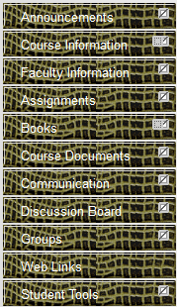
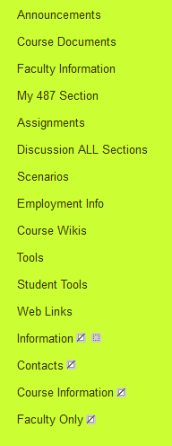
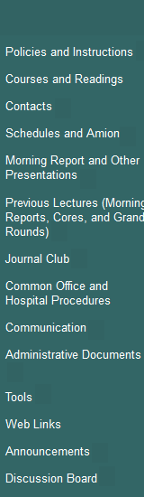
Viral Symptoms - No Template

Slide 6
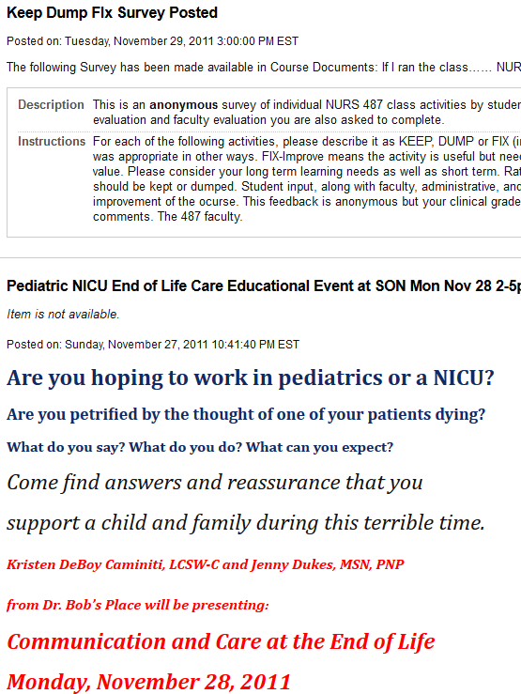
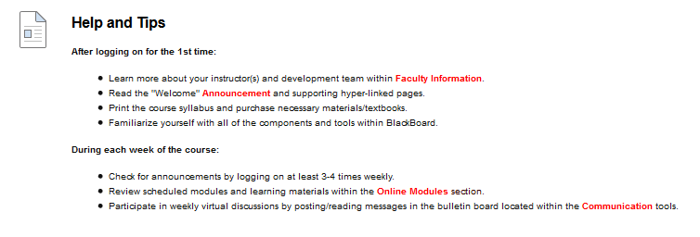
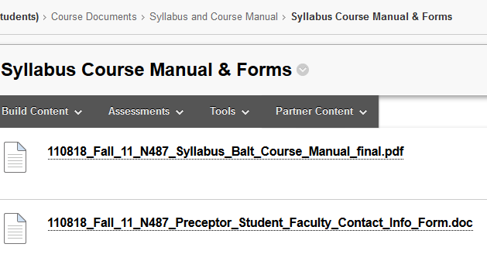

Before Template Creation
Announcements
Syllabus
Assignments

Slide 7
Session Activity:
Find that Info!
Notes:
Session Activity/Interactivity: Find That Info!
Request two volunteers
First volunteer will be asked to find pertinent course info in an old course UMSON offered before adopting QM-style course design
Second volunteer will be asked to find the same pertinent course info using QM-style course design (I.e. "new course"); both attempts will be timed and each volunteer will discuss their experiences
**consider new name: “First Day of Class”

Slide 8

Developing the Vaccine
Creation of Templates
No Template
Three
Templates
One Unified
Template
Notes:
Explain how courses were first created in Blackboard without templates, to the creation of three templates, and then how the best elements from all three templates were combined into one unified template.

Slide 9
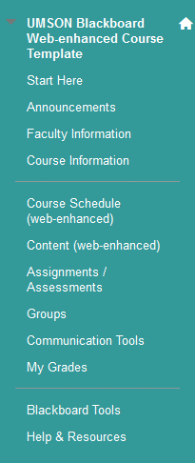
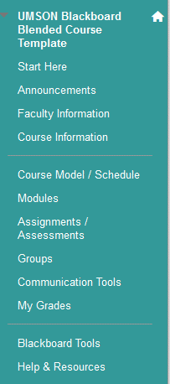
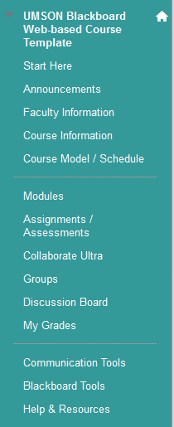
Vaccine - Phase I
Three Templates

Slide 10
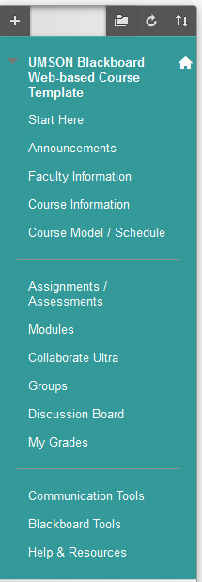
Vaccine – Phase II
One Unified Template
Notes:
Items are required to be in a course before the semester begins.

Slide 11
Unified Template with Standards
Start Here:
STANDARD 1.1 - Instructions make clear how to get started and
where to find various course components.
Welcome Announcements:
STANDARD 2.1 - The course learning objectives, or course/program competencies,
describe outcomes that are measurable.
Faculty Information:
STANDARD 1.8 - The self-introduction by the instructor is appropriate and
is available online. .
This section follows QM standards for interactivity between faculty and students.
Course Information – (syllabus, objectives, readings, evaluation and grading criteria ):
STANDARD 2.1, STANDARD 2.4, STANDARD 2.5, STANDARD 3.1, STANDARD 3.2,
STANDARD 3.3
This section follows QM standards with UMB and UMBSON technical support services and academic and student support services.
Course Model/Schedule:
STANDARD 2.4, STANDARD 2.5, STANDARD 4.4,
Notes:
Items are required to be in a course before the semester begins.

Slide 12
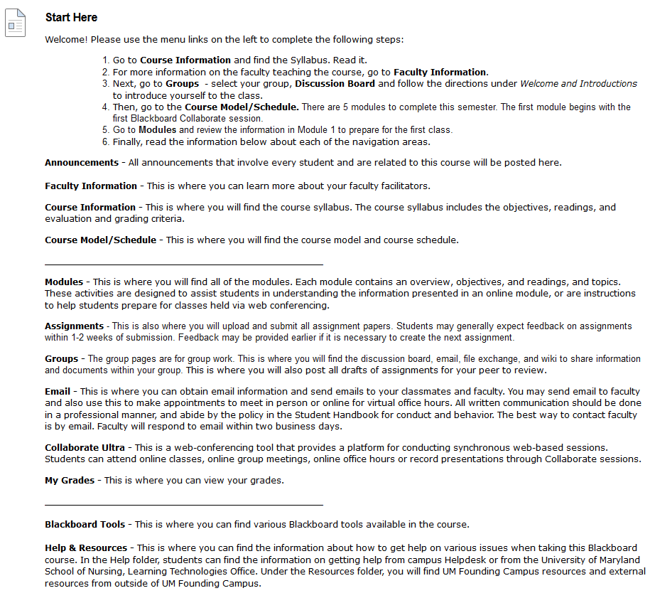
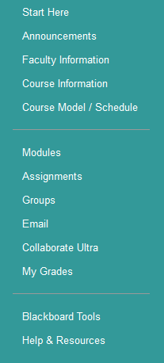
Importance of Start Here

Slide 13
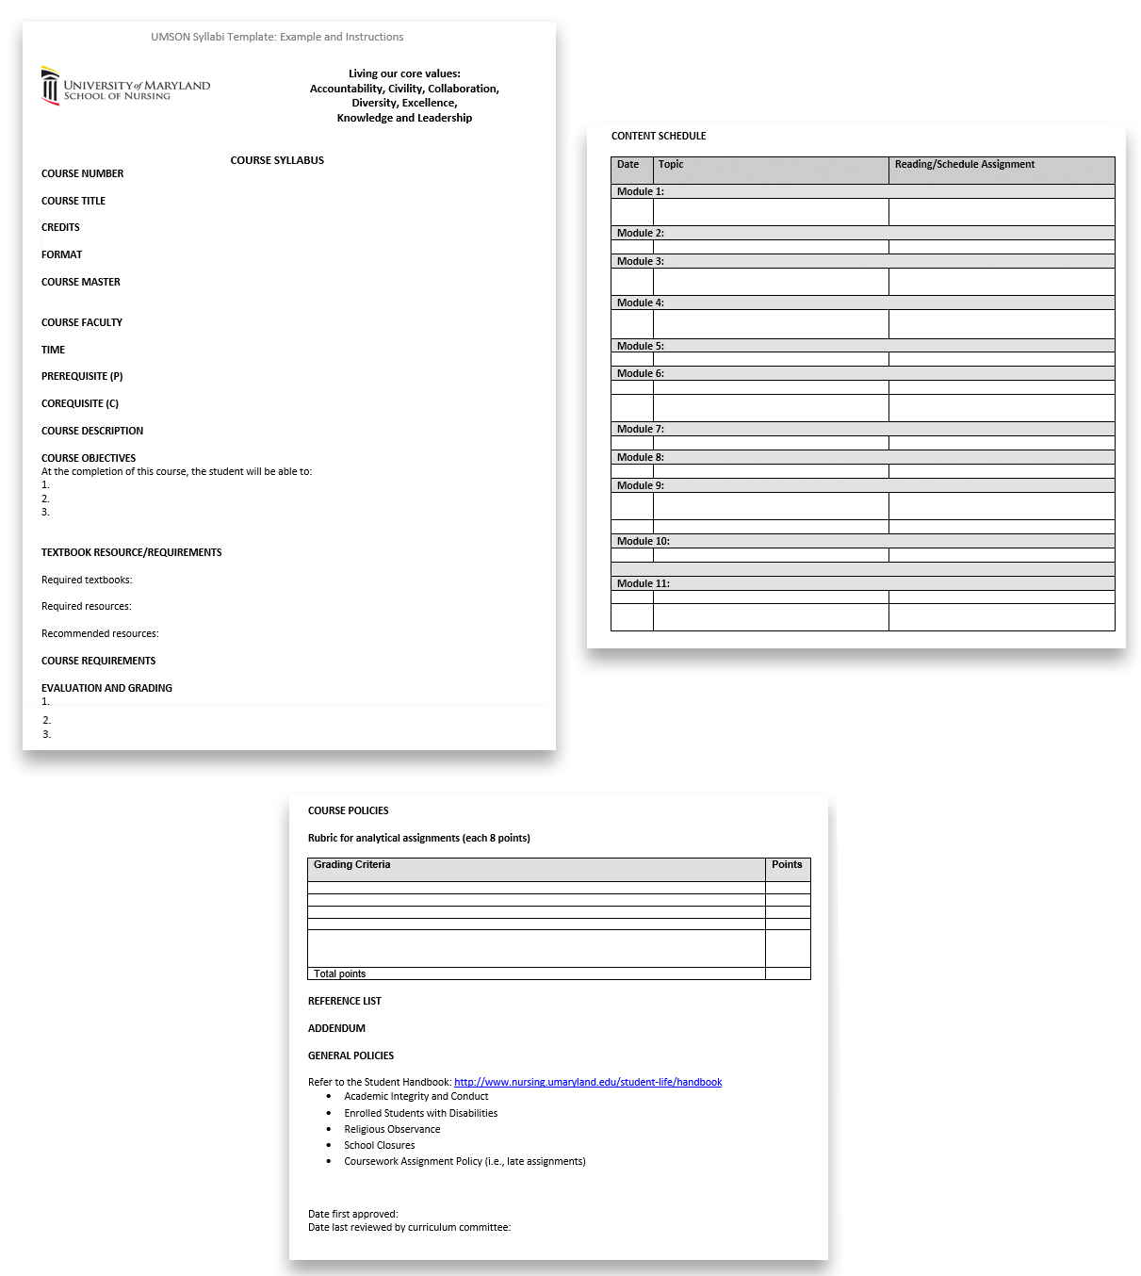
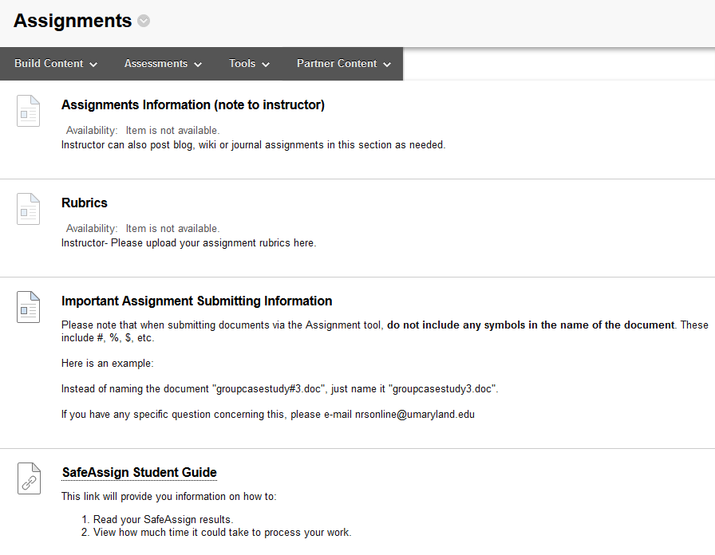
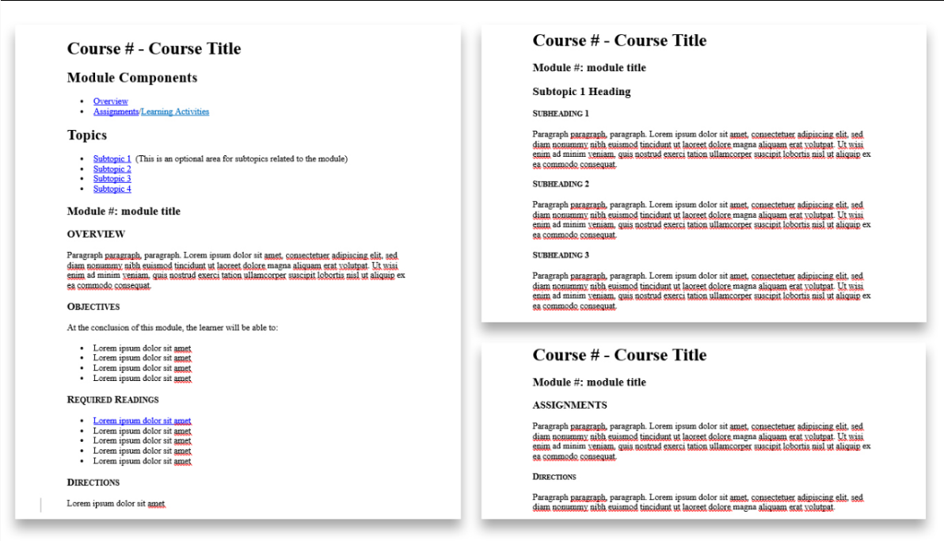
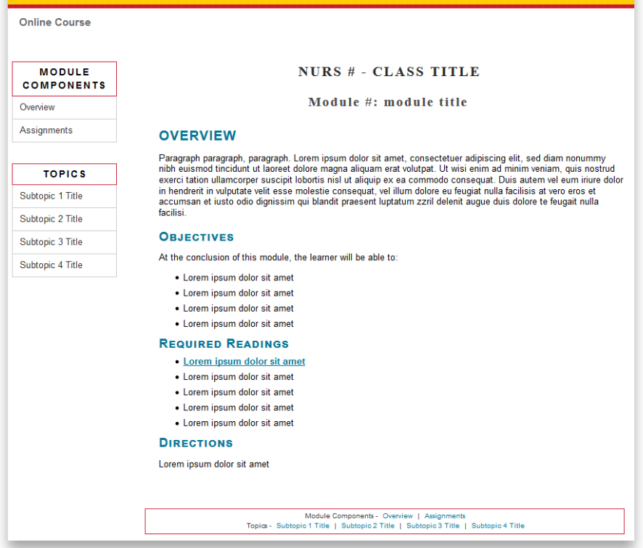
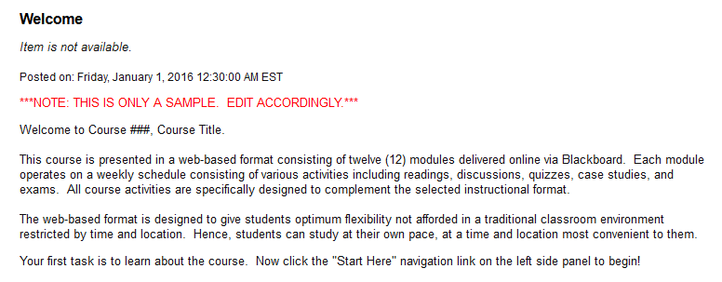
Template Creations
Announcements
Syllabus
Assignments
Modules

Slide 14

Vaccine - Phase III
How We Support Our Faculty
Source: https://acmsblog.files.wordpress.com/2015/04/one-on-one.png?w=584

Slide 15
Encourage Collaboration
Open-door policy,
8:00 a.m. – 5:00 p.m.
Dedicated main phone line and email address
Service Ticket System
Customer Service focused
Notes:
New ways your institution is encouraging successful collaboration
open office from 8 am – 5 pm
service ticket system
dedicated main phone line and exclusive email address
IDs are polite and courteous; deliver service with strong customer focus in mind (ultimately, we serve the students and we partner with faculty to do so)

Slide 16
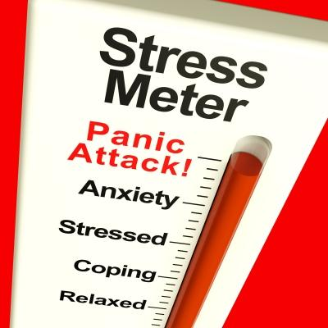
Vaccine – Phase IV
Faculty Buy-in for QM @ UMB
Course shells
follow QM
Sample course content items
Course templates for all types of courses
TIME
=
Notes:
How your institution gets faculty buy-in for QM
All course shells are created with a preset navigation menus on the left sidebar and footer of each webpage so that students can familiarize themselves with where to find pertinent course information: syllabus (SRS 1.2), course schedule, faculty information (SRS 1.8), and announcements.
Course content templates, such as practice quiz (SRS 3), sample course model (SRS 1.2), discussion board rules (SRS 1.3), web conference minimum technology specifications (SRS 1.7), etc.
Pre-made templates are included for different types of courses, such as web-based, hybrid, and traditional (face-to-face)
Survey to students asking them to find course info in reliable places

Slide 17
Build Faculty Working Relationships
Provide methods of Communication
Build confidence using Technology
Create one-on-one Opportunities
Employ elements of Collaboration
Notes:
How IDs have built working relationships with faculty
Phone, email, and in-person communications; open-office door policy; LT staff attend university functions to meet and chat with faculty
We help build faculty confidence by opening the collaboration (talking) gap between LT and Faculty; we are approachable, friendly, knowledgeable and considerate/mindful of the demands of their time and attention as faculty members; we treat them as a partner and provide excellent customer/client service
Employ elements of COLLABORATION: (communication as the key component to collaboration)
1. Cooperation
2. Assertiveness
3. Autonomy
4. Responsibility/Accountability
5. Communication
6. Coordination
7. Mutual Trust and Respect

Slide 18
Session Activity:
Find that Info Now!
Notes:
Session Activity/Interactivity: Find That Info!
Request two volunteers
First volunteer will be asked to find pertinent course info in an old course UMSON offered before adopting QM-style course design
Second volunteer will be asked to find the same pertinent course info using QM-style course design (I.e. "new course"); both attempts will be timed and each volunteer will discuss their experiences
**consider new name: “First Day of Class”

Slide 19
Summation
Created 3 Templates using QM Standards
Consolidated to 1 Unified Template
Encouraged Collaboration
Positive Faculty Feedback
Go Viral with QM @
Your Institution
Notes:
Outcomes from implementing QM design standards
Identify all possible returns on investment of implementing QM-designed templates for all course delivery formats. Apply same idea of QM design to your tasks when making course design decisions examples: gained instruction time, streamlined task list for setting up courses for faculty and IDs, students learn and trust locations in the LMS where they can find specific course items, gained confidence of students and faculty in using LMS, etc.
found main elements are valued across the board
Time and stress
Make QM go Viral @ Your Institution
Create vignettes for faculty and IDs to role-play scenarios and switch roles to identify with each other
Hold a mock QM review in each department with no-strings attached and IDs in attendance to help moderate process and offer suggestions in the final review
Tools to Use
Use web conferencing software and texting/SMS apps to provide another way for faculty and IDs to interact
“Lunch and Learn” sessions presented by IDs on top 10 questions asked each semester by faculty and students
Provide written and visual explanations, model ‘how-to’ solutions and give faculty assistance while they are using software/LMS

Slide 20
Time for Questions & Answers!
Thank you!

