Slide 1
Improving Course Design Quality through Online Graduate Student Evaluations
Amy M Grincewicz, PhD & Cathy Dubois, PhD
Kent State University - College of Business

Slide 2


Introductions
Amy M Grincewicz, PhD
Cathy DuBois, PhD
Director of Instructional Design - CoBA
agrincew@kent.edu
Associate Dean for Graduate & Online Programs
cdubois@kent.edu

Slide 3
Presentation Outcomes
Discuss quality assurances processes within an online degree program.
Identify purposes for student evaluations.
Apply student feedback to improve course and program quality.

Slide 4
MBA Background
5 Departments, 14 Faculty
College’s first online program development endeavor
  QM in Program Proposal
Faculty not knowledgeable about QM
Complicated by change from 3 to 2 credit courses
Faculty resistant
Short timeline - insufficient for development
Instructional Designer new to the College

Slide 5
Quality Assurance – Continuous Improvement
QM HE 6th Rubric
Internal Evaluation
Revision Roadmap

Slide 6

Questions

Slide 7
Student Evaluation Feedback
Promotion and Tenure (Kember, Leung, & Kwan, 2002)
Professional Development (Chulkov & Alstine, 2012)
Delivery challenges (Blair & Valdez, 2014)
Course Development (Steyn, Davies, & Sambo 2018)

Slide 8
Timing and Type of Feedback
Brief 1-7 questions
Students prefer short answer
Students prefer multiple opportunities
Students prefer early in the course
(Habnab & Jamison, 2009; Sozer, Zeybekoglu, & Kaya, 2019)

Slide 9
Module Feedback Survey
5 Multiple Choice
3 Short Answer
Approximately how long did it take to complete the module?
4 Likert Scale
  amount of work
  clear instructions
  timing of feedback
  learner-learner interaction
Feedback on Assignments
Which activities MOST helpful?
Which activities LEAST helpful?

Slide 10
Questions

Slide 11
Application to Individual Course
3 Course Examples

Slide 12
Course 1 - Internal Review
Course learning materials meet federal requirements for accessibility.
Course learning materials align to the objectives and promote active learning and engagement.
Course assessments include specific and descriptive grading criteria.
Course provide a means of interaction between students, which should be included in the most pedagogically appropriate way for the course and should focus on application and integration of course material.

Slide 13
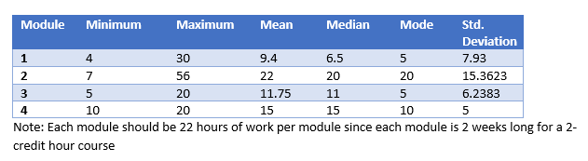
Course 1 – Student Feedback
This is a very difficult course to grasp without interaction.
It would be helpful if there were transcripts with the powerpoint presentations
Videos are too long.
The amount of work in this module is absolutely ridiculous.
Textbook reading is challenging and time consuming.

Slide 14
Course 1 - Enhancements
Learning path created
Restructuring of assignments and due dates
Narrated Presentations with accompanying slides and notes

Slide 15
Course 2 - Internal Review
Primarily a textbook course
Rethink the discussion board prompts.
Create authentic assessments
Add in supplemental materials and multimedia

Slide 16
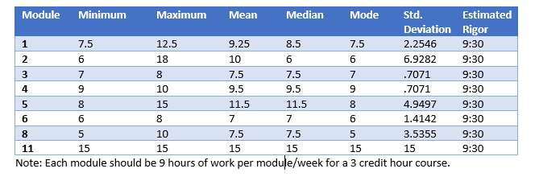
Course 2 – Student Feedback
I think a video lecture would be beneficial.
Discussion board, I understand it is important, especially for this subject, however I don't think the Board posts are working.
Like the practice activities

Slide 17
Course 2 - Enhancements
Textbook dropped, but kept direct instruction presentations
Developer created story presentations of real-world applications
Authentic discussions

Slide 18
Course 3 – Continuous Improvement
I wish initial discussion posts were due later then Wednesday.
The coaching assignments are rather vague.
I find it easier to start with the end in mind. Clearer and earlier release of the paper expectations and participation rubric (at the start of the class) would be helpful.

Slide 19
Application to Program

Slide 20
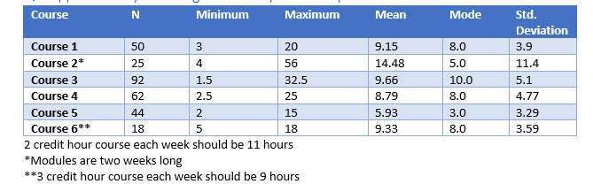
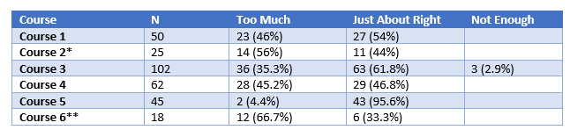
Rigor of Course
Correlation of how long to complete a module and thinking about the amount of work

Slide 21
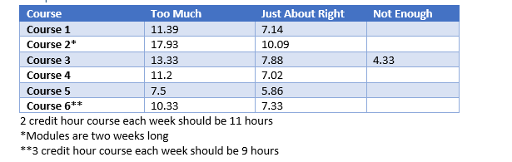
Comparison of Means

Slide 22
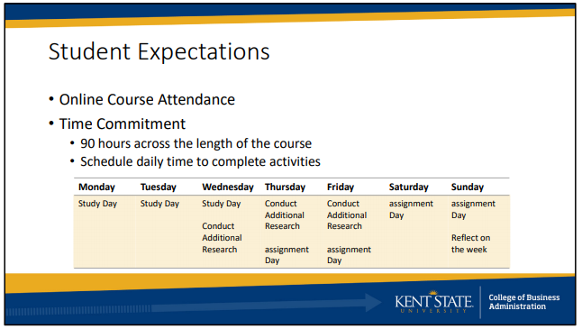
Program Enhancement
Course Introduction Presentation

Slide 23
Importance of Vowels
Alignment
Engagement
Innovation
Organization
Accessibility
Usability
YOU

Slide 24
Lessons Learned
Need for administrator support
Faculty awareness of alignment, engagement, accessibility, rigor
Improve course design and program marketing
Low response rate
Survey fatigue

Slide 25
References
Blair, E., & Valdez Noel, K. (2014). Improving higher education practice through student evaluation systems: is the student voice being heard? Assessment & Evaluation in Higher Education, 39(7), 879-894. https://doi.org/10.1080/02602938.2013.875984
Chulkov, D. V., & Alstine, J.A. (2012). Challenges in designing student teaching evaluations in a business program. International Journal of Educational Management, 26(2), 162–174. https://doi.org/10.1108/09513541211201979
Habnab. T. & Jamison, E. (2009). Student feedback: Improving the quality through timing, frequency, and format. Retrieved from https://docplayer.net/16954620-Student-feedback-improving-the-quality-through-timing-frequency-and-format.html
Kember, D., Leung, D. Y. P., & Kwan, K. P. (2002). Does the Use of Student Feedback Questionnaires Improve the Overall Quality of Teaching? Assessment & Evaluation in Higher Education, 27(5), 411–425. https://doi.org/10.1080/0260293022000009294
Sozer, E. M., Zeybekoglu, Z., & Kaya, M. (2019). Using mid-semester course evaluation as a feedback tool for improving learning and teaching in higher education. Assessment and Evaluation in Higher Education, 44(7), 1003–1016. https://doi.org/10.1080/02602938.2018.1564810
Steyn, C., Davies, C., & Sambo, A. (2019). Eliciting student feedback for course development: the application of a qualitative course evaluation tool among business research students. Assessment & Evaluation in Higher Education, 44(1), 11-24. https://doi.org/10.1080/02602938.2018.1466266

