Slide 1



Growing Professional Development During COVID and Measuring the Impact
Ashley Skylar, Ph.D.
Quality Assurance Blended-Online Program
CSU Office of the Chancellor
Mary Bennett
CSU QLT Course Manager
Instructional Designer
Center for Faculty Excellence
CSU Fresno
Jianjun Wang, Ph.D.
Professor, Statistics & Research
CSU Bakersfield
Notes:
Required Slide

Slide 2
Offered CSU Systemwide Training
April 27-May 10 (8 sections; 2 wk session; 8-10 hrs) | Introduction to Teaching Online
May 11-May 24 (9 sections; 2 wk session; 8-10 hrs) | Introduction to Teaching Online
June 8-28 (15 sections; 3 wk session; 12-15 hrs) | Introduction to Teaching Online
June 8-28 (5 sections; 3 wk session; 12-15 hrs) | QM-Improve your Online Course
July 6-26 (15 sections; 3 wk session; 12-15 hrs) | Introduction to Teaching Online
July 6-26 (5 sections; 3 wk session; 12-15 hrs) | QM-Improve your Online Course
August 3-23 (10 sections; 3 wk session; 12-15 hrs) | Introduction to Teaching Online
August 3-23 (6 sections; 3 wk session; 10-15 hrs) | QM-Applying the QM Rubric
August 3-23 (3 sections; 3 wk session; 12-15 hrs) | QM-Improve your Online Course
Offered system-wide training
77 course sections (25-35 per section); 41 facilitators
Register on a “central” website with link to enroll for FREE
Most campuses provided a stipend for training completion during COVID
Some campuses used their instructional designers to facilitate course sessions that we hosted
Overall registration was over 2,300
Some campuses also provided campus training

Slide 3

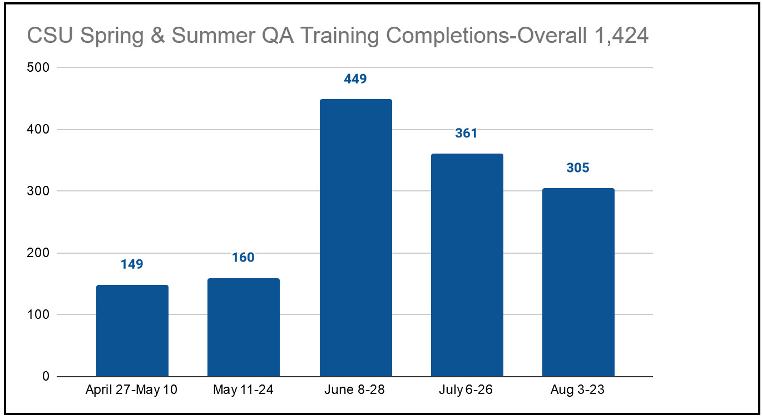


CSU QA Program Training During COVID
77 course sections, 41 facilitators

Slide 4
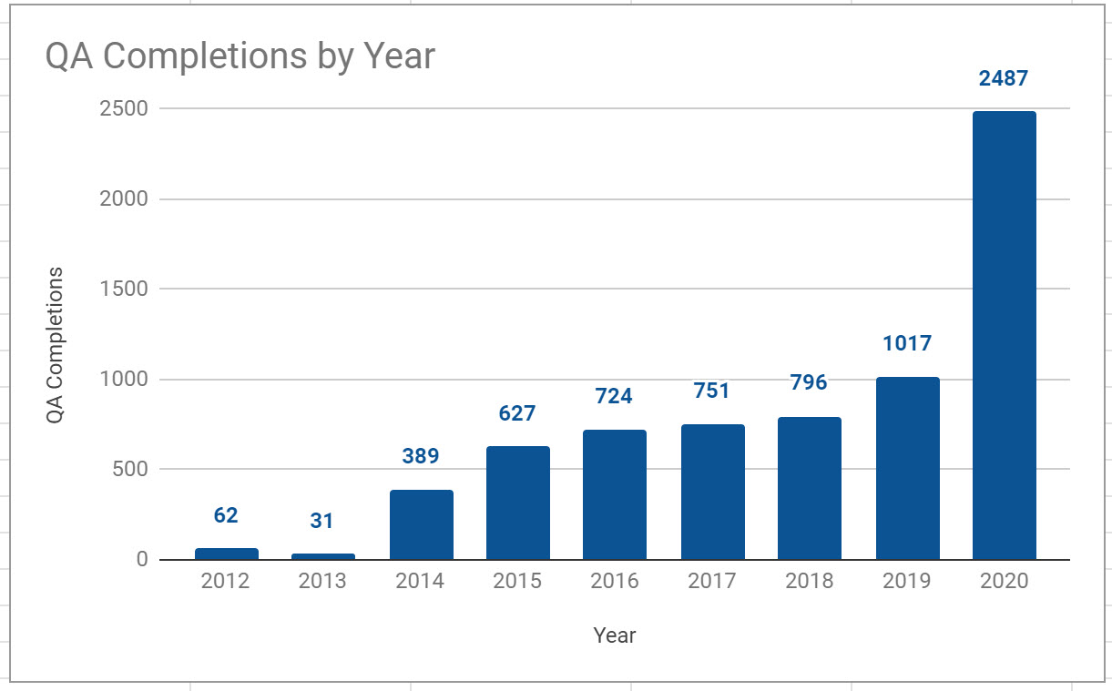
QA Training Tracking Database
6,884 Completions
Robust adoption and implementation of CSU Quality Learning & Teaching (QLT) and Quality Matters
All 23 campuses involved in QA activities (community, professional development, course reviews)
Approximately 7,000 QA training completions through today.

Slide 5
Steps for Growing PD Offerings During COVID
Identify the “course(s)” that you want to target growing
Identify your “current” facilitators and a plan to “grow” them quickly
Identify funding sources to pay facilitators
Consider hiring a “QM certified facilitator campus faculty associate” who can serve to mentor/track/ communicate with the facilitators & students & QM organization
Advertise and spread the word
Manage the registrations and enrollment into the course sections (organize by campus groups)
Recognition efforts for facilitators
Recognition for instructors completing the course and survey

Slide 6
CSU Quality Assurance COVID Survey (29 items)
820+ submissions
Faculty Demographics (9 items)
COVID Items (8 items)
Training Course Specific Items (12 items)

Slide 7
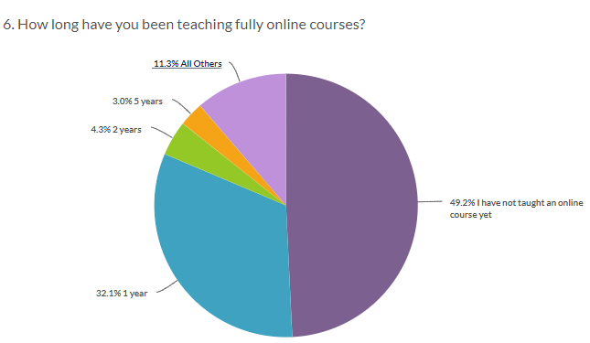
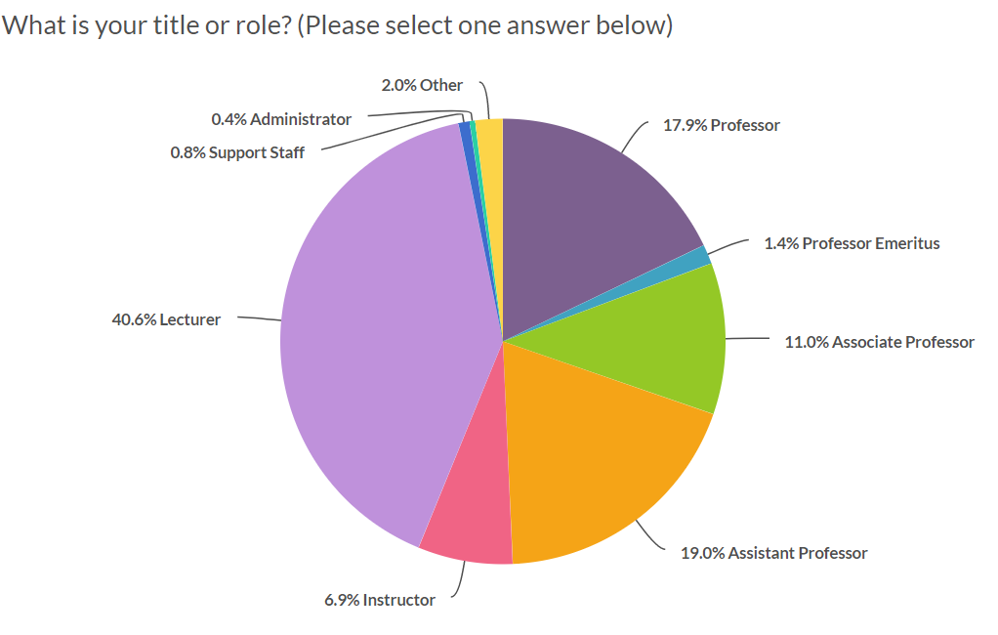
81% have not taught online and up to 1 yr experience teaching online
59% submissions are from lecturers and assistant professors

Slide 8
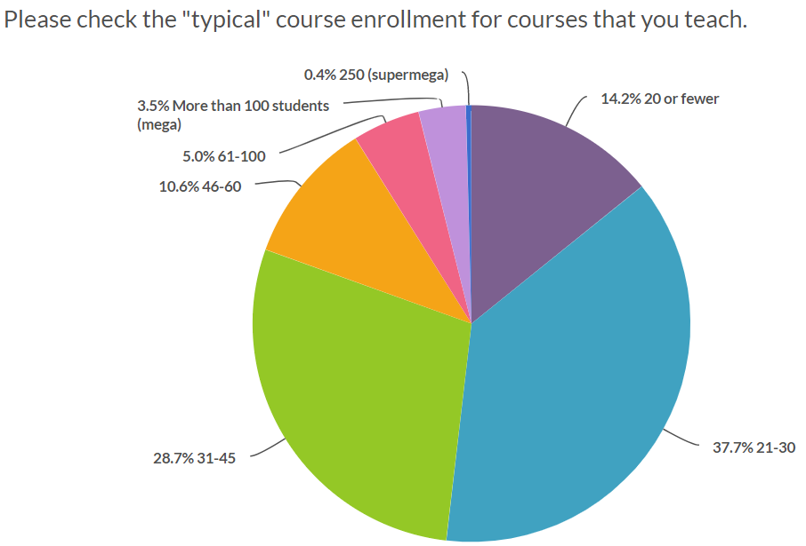
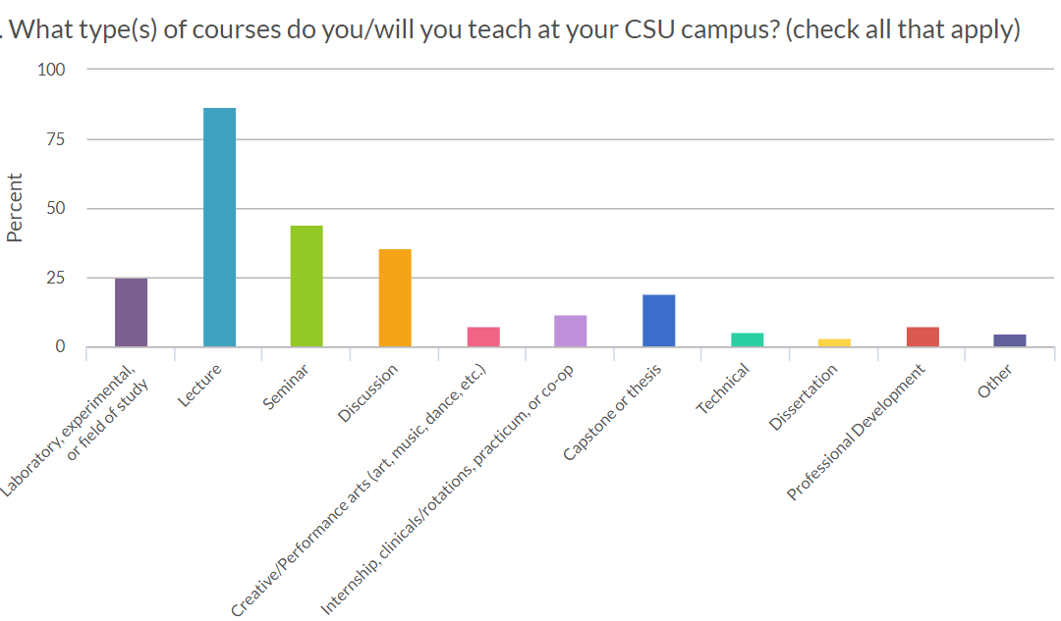
66%of the courses have a typical enrollment between 21-45 students
86% of the courses taught by faculty are lecture, followed by 44% seminar, followed by 37% discussion

Slide 9
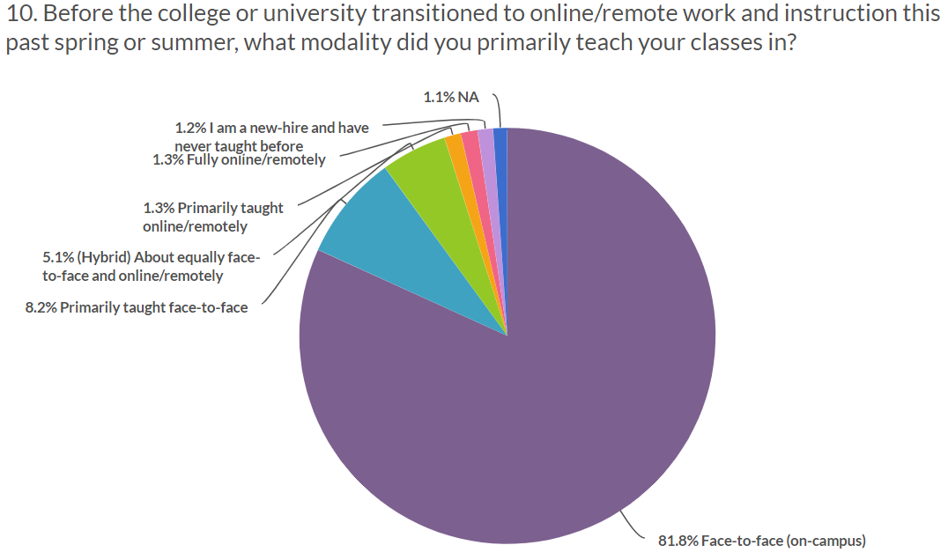
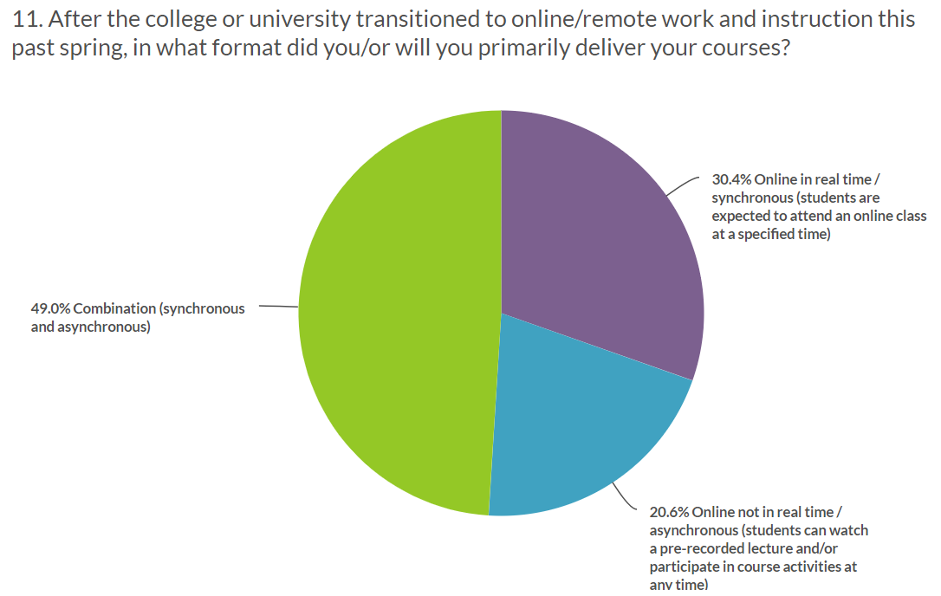
82% of the faculty enrolled have only taught F2fF; 8% teach primarily F2F
After transition: 49% taught courses combination; 30% teach 100% synchronous; 20% teach asynchronous

Slide 10
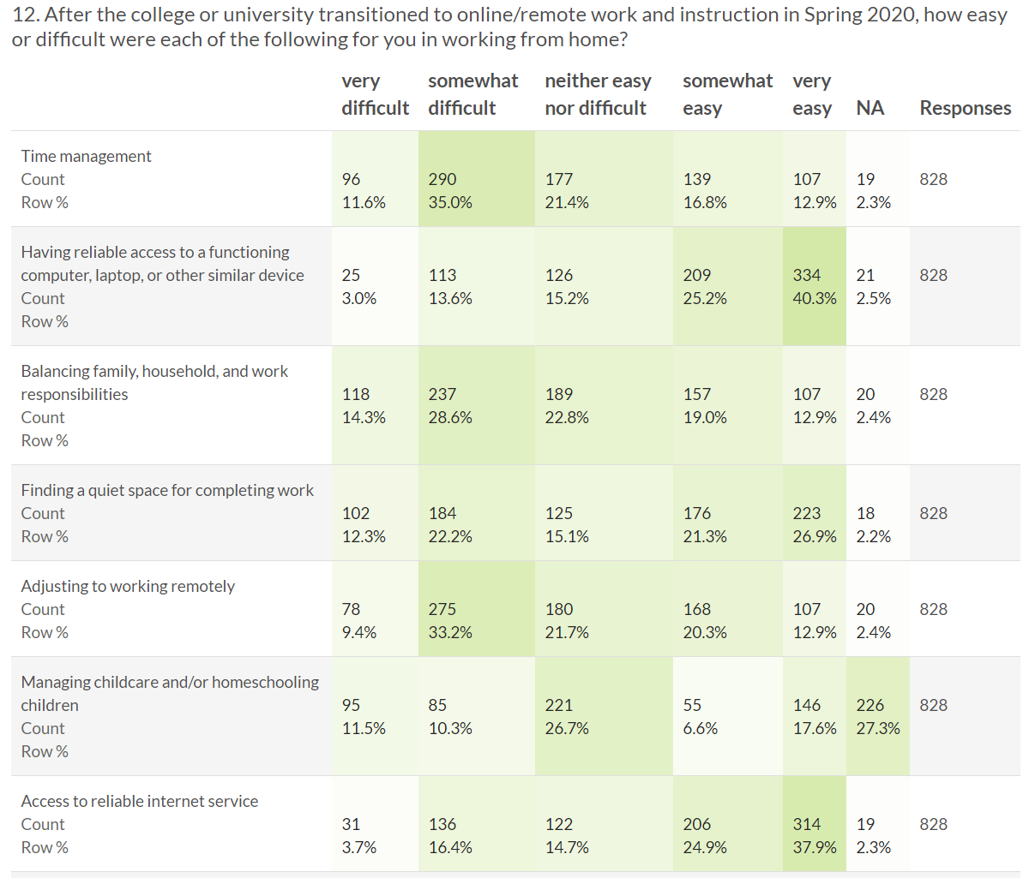
45% found time management somewhat difficult to very difficult
19% found access to a reliable computer somewhat difficult to very difficult
43% found balancing family/work somewhat difficult to very difficult
34% found finding a “quiet” place to work somewhat difficult very difficult
42% found adjusting to working remotely somewhat difficult to very difficult
22% managing childcare somewhat difficult to very difficult
20% found reliable internet somewhat difficult to very difficult

Slide 11
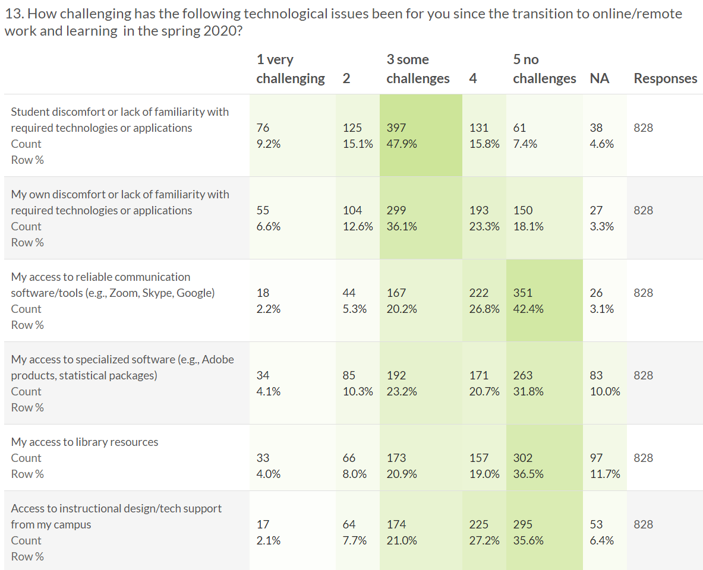
73% found student discomfort with technologies somewhat to very challenging
55% faculty found their own discomfort with technologies somewhat to very challenging
28% found access to reliable communication tools somewhat to very challenging
37% found access to specialized software somewhat to very challenging
33% found access to online library resources somewhat to very challenging
31% found access to instructional design/tech support somewhat to very challenging
Notes:
are faculty providing enough support for the students to use technology- because of the student Q&A of students is because of the the lack of “clarity” provided; my sense is taht faculty assume that students can use “xx” tech but htey still need support with tech they haven’t used before

Slide 12
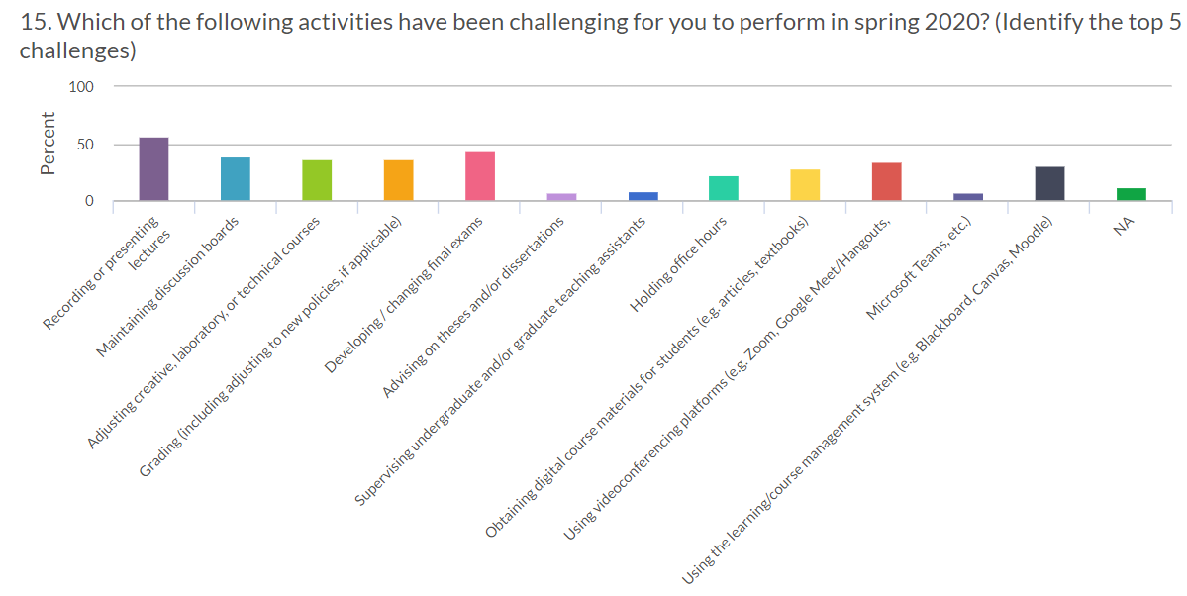
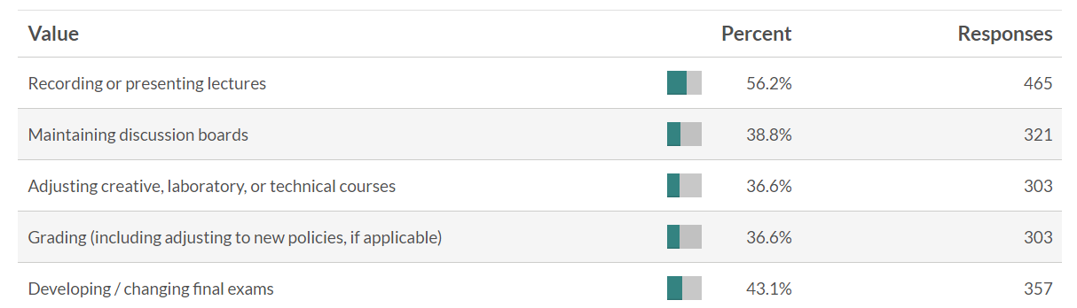
12 instructor activities to select from- cued to select 5 biggest challenges

Slide 13
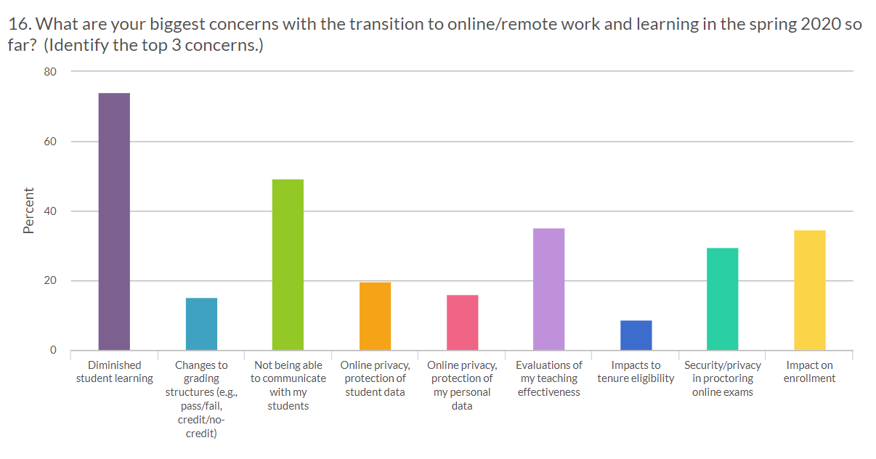
9 items to select from- cued to select just 3 biggest concerns moving to remote

Slide 14
COVID Survey Items Conclusions
50% find managing time, balancing work, and adjusting to working remotely somewhat to very difficult
  Are campus resources including counseling available to the faculty?
80% faculty say reliable computer and reliable internet is not an issue
  Is the infrastructure in place to support students working remotely?
73% of instructors feel students are not comfortable with technology
  Are students receiving enough technology training to be successful?
55% of instructors are still getting comfortable with teaching remotely
  Does your campus provide additional training for instructors?
35% feel access to specialized software, online library and instructional designers are a challenge
  Does your campus have access to these resources in place?

Slide 15
Conclusions COVID Survey Items
Most challenging activities - Need to improve support & training in the following areas:
Recording & presenting lectures
Facilitate/monitor discussion boards
Lab/tech courses
Adapting grading policies
Developing assessments/final exams
Biggest concerns with transition to online/remote work
Diminished students learning - Work with faculty on “outcomes” for course/increasing student accountability for content
Communication - Work with faculty to present options for communicating and creating “social presence”
Proctoring online exams - Work with faculty to develop alternative methods for assessment than traditional proctored/F2F exam
Ideas concern on impact enrollment & teaching evaluations- Campus decision

Slide 16
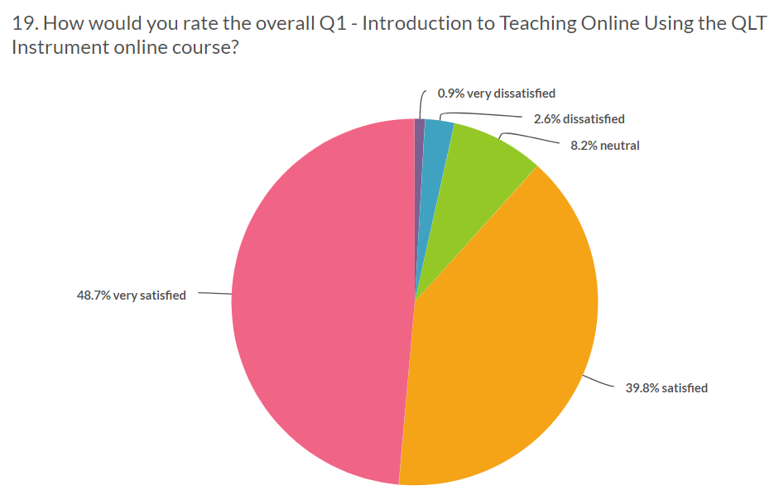
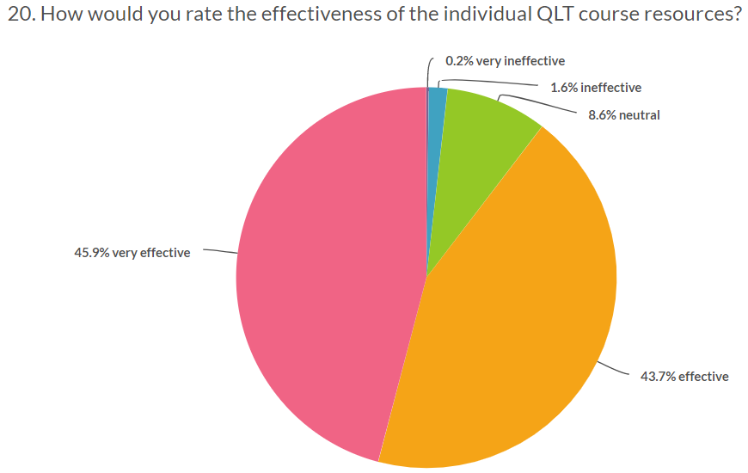
89% satisfied to very satisfied with course
90%feel courses resources were effective to very effective

Slide 17
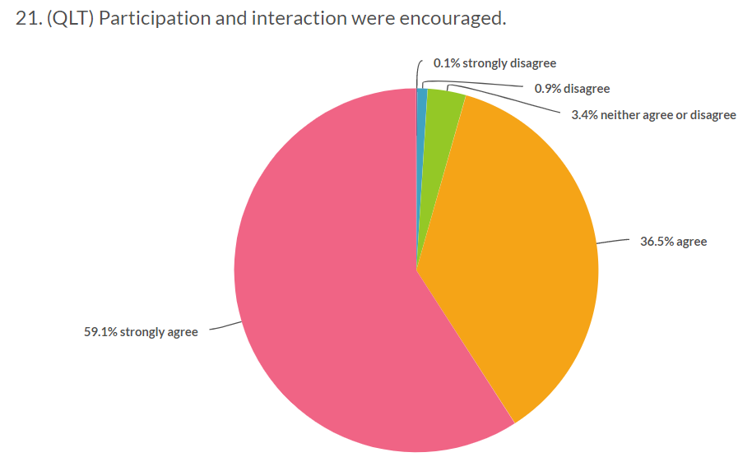
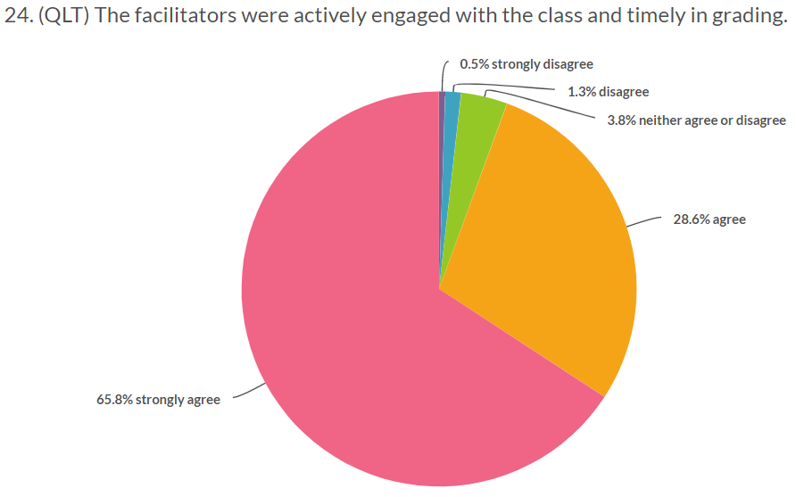
96% agree to strongly agree that interaction was encouraged in the course
95% agree to strongly agree facilitators were engaged with the class and timely in grading

Slide 18
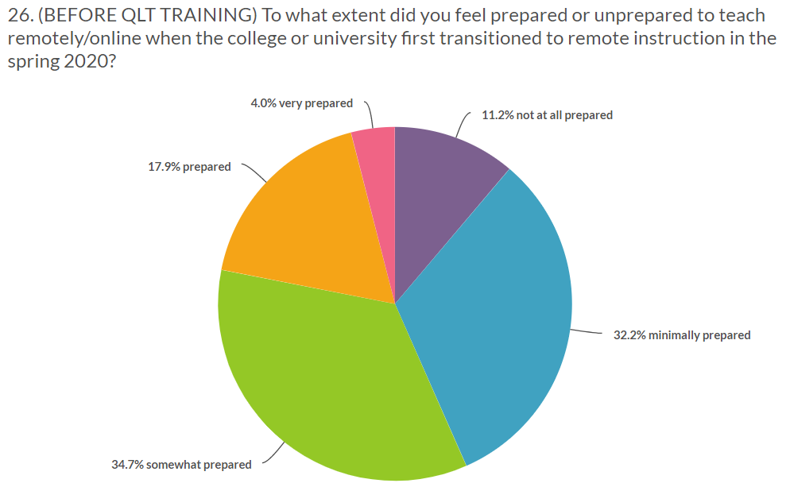
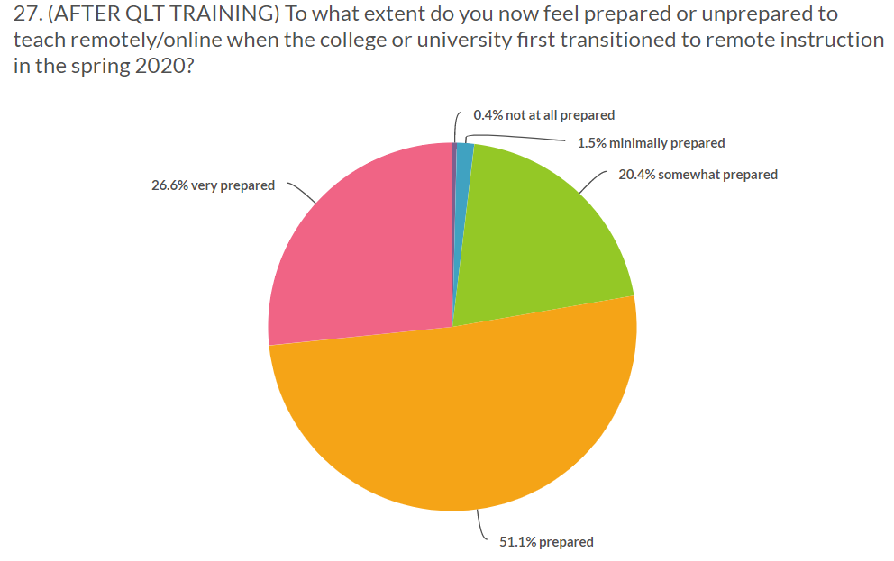
(BEFORE TRAINING) 67% feel they were somewhat to minimally prepared to teach remote
(AFTER TRAINING) 78% feel prepared to very prepared to teach remote

Slide 19
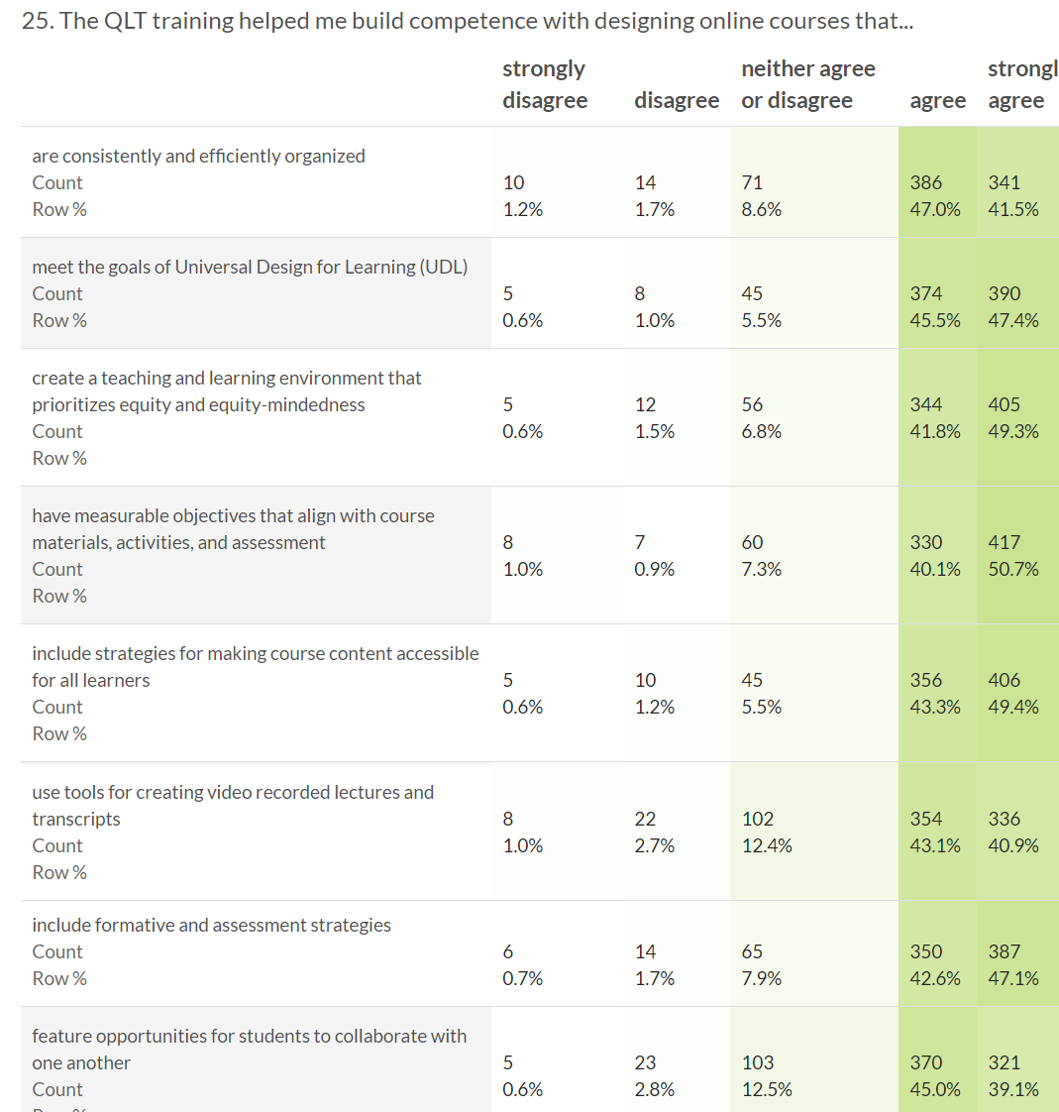
Agree to Strongly Agree-
training helped build competence in course topics
89% Course Organization
93% UDL
91% Equity
91% Course Alignment
93% Accessible Course Content
84% Creating Videos
90% Assessment
84% Collaboration

Slide 20
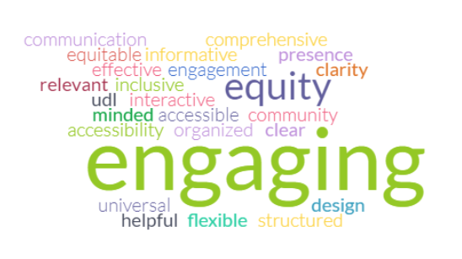
3 words to identify a “quality” online course
Notes:
equity- section in course addressing this area

Slide 21


Quality Courses Matter! Impact of QM Training and Course Certification at CSUB
Faculty Associate
JJ Wang

Slide 22
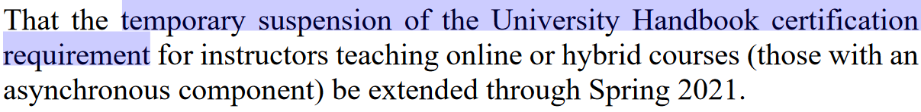
Temporary Suspension of the University Handbook Certification Requirement
https://www.csub.edu/senate/_files/Resolutions/RES-202101-Extension-of-Temporary-Suspension-of-Online-Hybrid-Training-Requirement.pdf

Slide 23
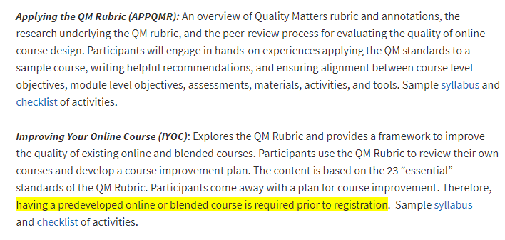
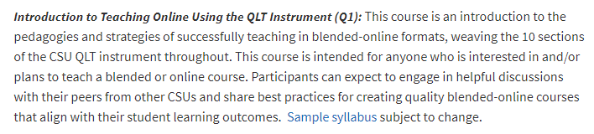
Multiple Opportunities of QM Training FREE for all campuses during COVID
3 Training courses available for faculty to complete for FREE offered by CSU Office of the Chancellor
5 completions
28 completions

Slide 24

Primary Platform of Instructional Support During Covid 19

Slide 25

Faculty-Led Training at CSUB
Twice a week throughout Summer, 2020
An average of 50-55 attendees
Webinar-“Teaching with Zoom” had over 100 participants

Slide 26
Weekly Training Topics Offered in Summer During COVID
Week of June 15 Canvas Overview
Week of June 22 Blackboard to Canvas Comparison
Week of June 29 Homepages and Modules
Week of July 6 Assignments and Grading
Week of July 13 Quizzes and Canvas
Week of July 20 Intro to Canvas
Week of July 27 Zoom for Teaching
Week of Aug 3 Techsmith Knowmia for Creating Videos
Week of Aug 10 Canvas Communications
Week of Aug 17 Facilitating Effective Discussion Boards
Week of Aug 17 Teaching with Zoom

Slide 27
Additional Professional Development Course Training Options
(A total of 364 completions in Summer, 2020)
Program | Modality | Hours | Cycles | Completers
Association of College and University Educators (ACUE) | Async | 18 | 2 | 16
Online Learning Consortium (OLC) | Sync | 10-15 | 1 | 7
Pedagogy & Psychosocial Factors Virtual Workshops (PPFW) | Sync | 7 | 1 | 18
CSU Quality Learning & Teaching (QLT) | Async | 15-20 | 4 | 28
Teaching Online with Proficiency Series (TOPS) | Both | 11-16 | 3 | 298
Notes:
ACUE & OLC are national organizations that offer these…
Who provided PPFW and TOPS courses- what organization and who funded?

Slide 28
Faculty Testimonials
“I have learned to rely more on providing useful homework assignments that will help with preparing the students for the upcoming lectures. In other words, homework that is strongly tied to the lecture content. In the past, I relied on students grasping the content from just being in the class and listening.”
“When we go back to face to face, I will focus on a positive welcome message in all my courses, have videos available for my classes, use images effectively in my Canvas modules, establish a comfortable rhythm in my courses, and, most important, build multiple modalities for student projects into my courses.”

Slide 29
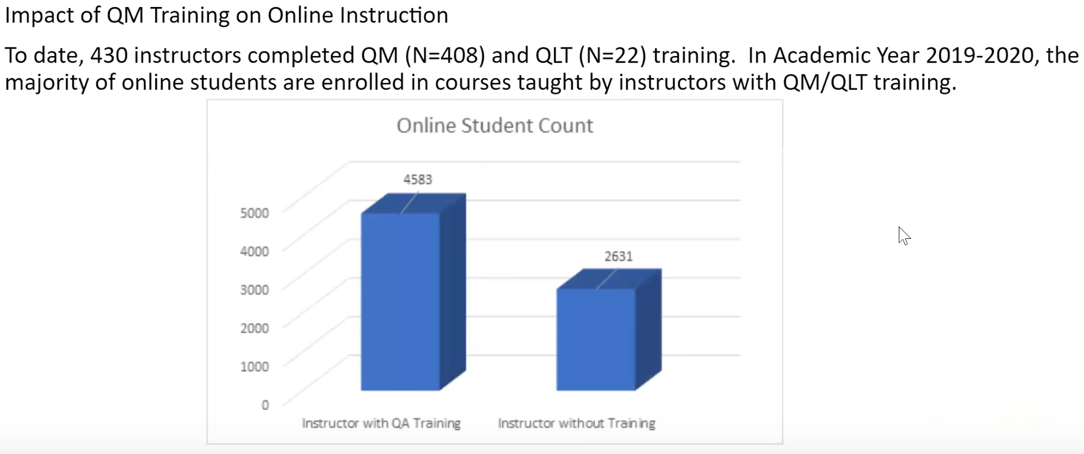
Training Support for Student Learning

Slide 30
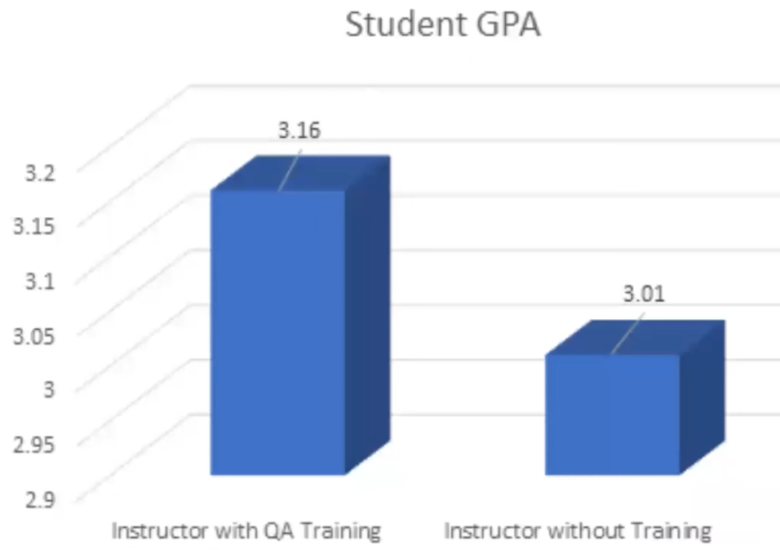
Dependency of Student GPA on QM Training

Slide 31
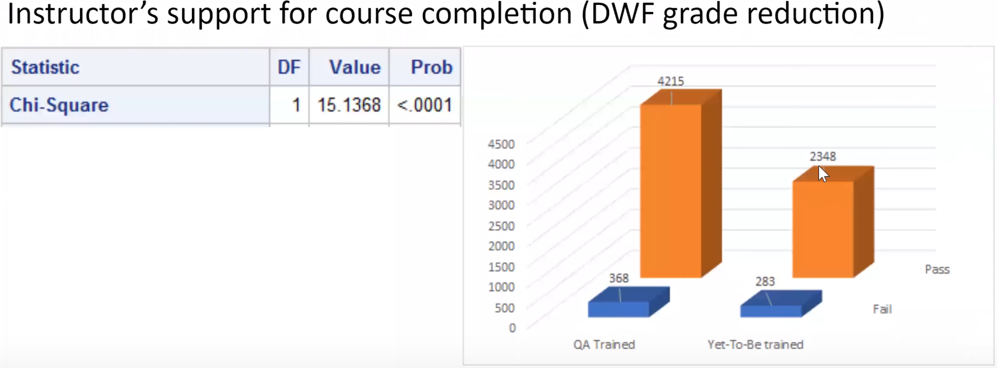
Support for CSU Graduation Initiative: D, W, F Grade Reduction

Slide 32
Student Satisfaction Survey Instrument
(25 Items – QM alignment: www.csub.edu/~jwang/SQuAIR.pdf)
Student Engagement (Rating: Questions 1-8; Comment: Question 9)
Course Overview & Introduction; Assessment & Evaluation of Student Learning
Online Education (Rating: Questions 10-17; Comment: Question 18)
Instructional Materials & Resources Utilized; Student Interaction & Community; Facilitation & Instruction
Support Platform (Rating: Questions 19-25; Final Comment)
Technology for Teaching/Learning; Support/Resources; Accessibility/Design

Slide 33
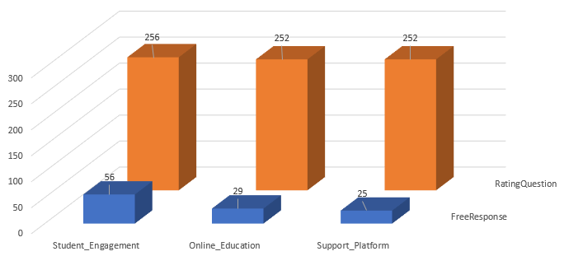
Sample Size of Student Satisfaction Survey

Slide 34
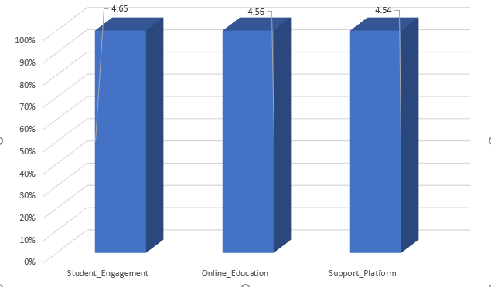
Average Ratings of the Survey Responses

Slide 35
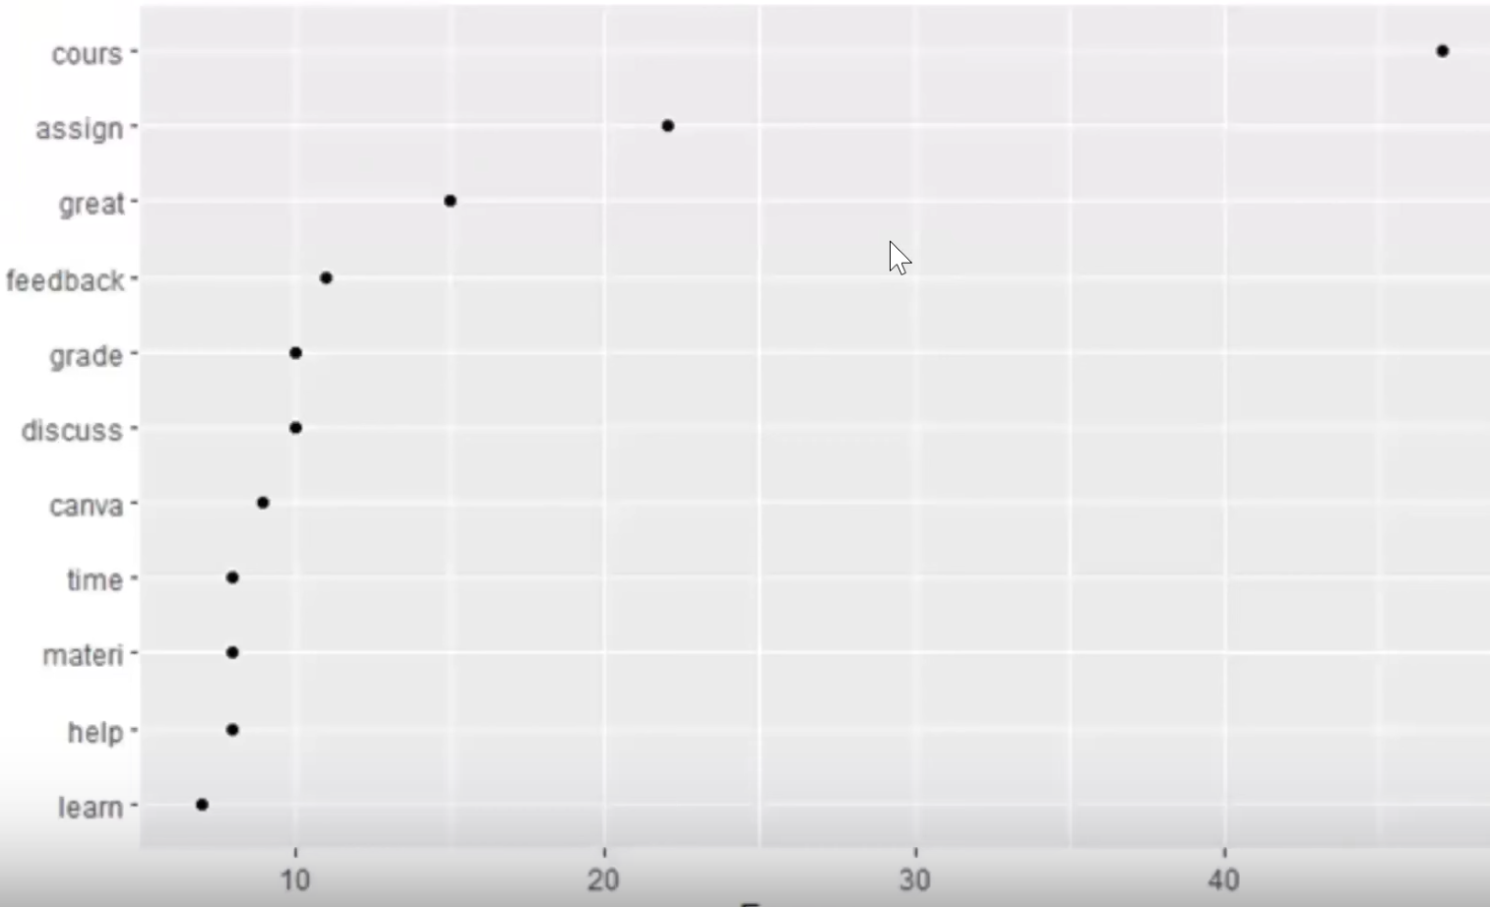
Most Frequently-Used Words in the 2019 CSUB Student Survey

Slide 36
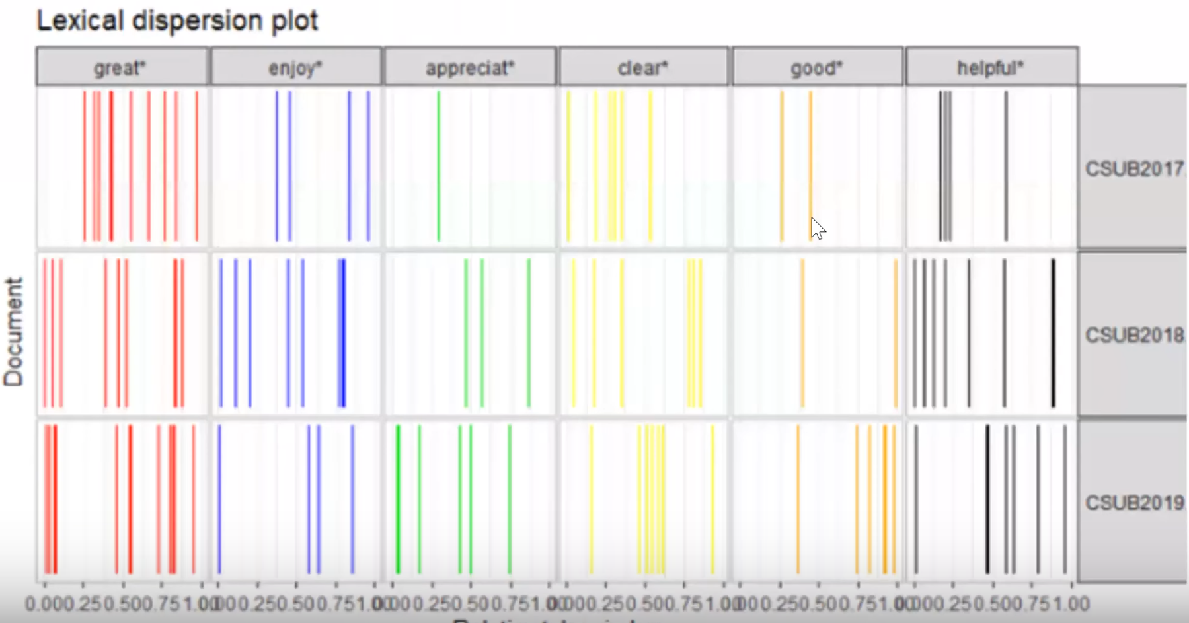
Lexical Dispersion Plot of Positive Word Choice

Slide 37
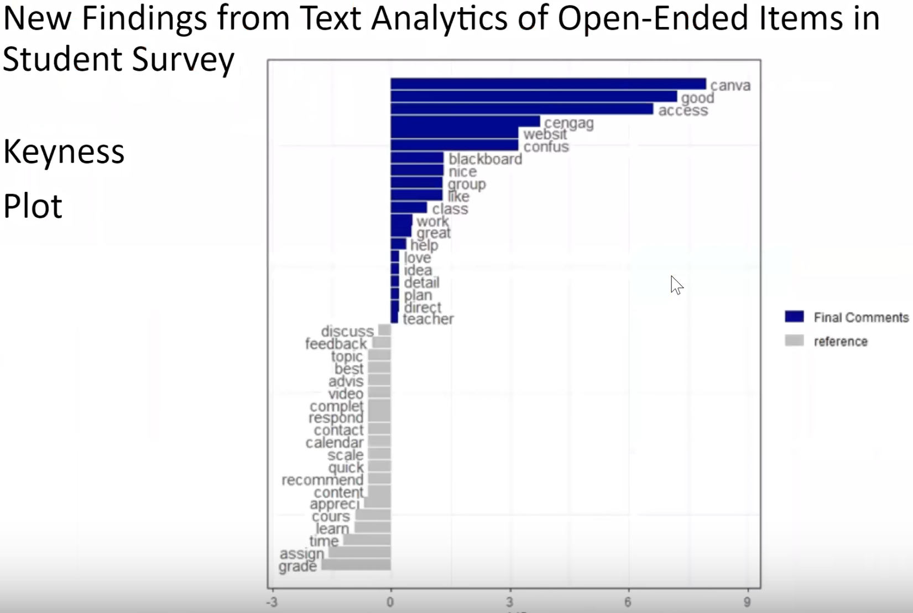

Slide 38
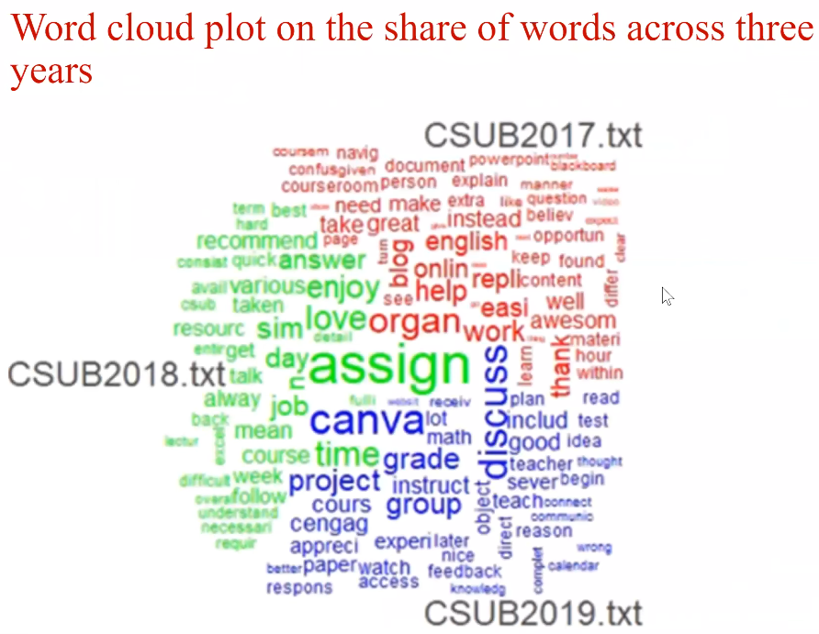

Slide 39
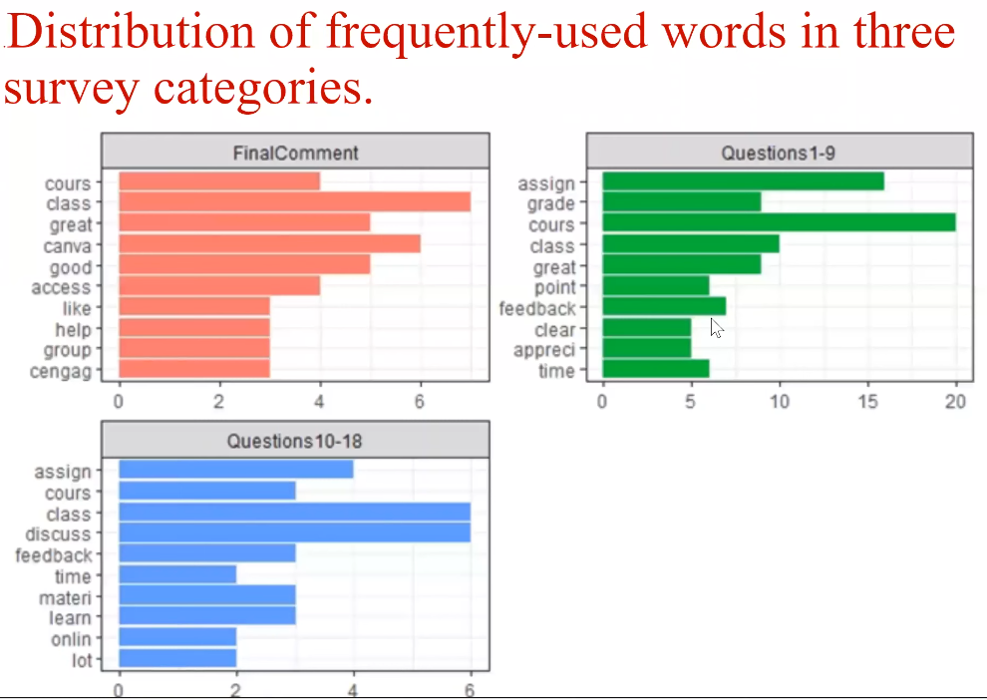

Slide 40
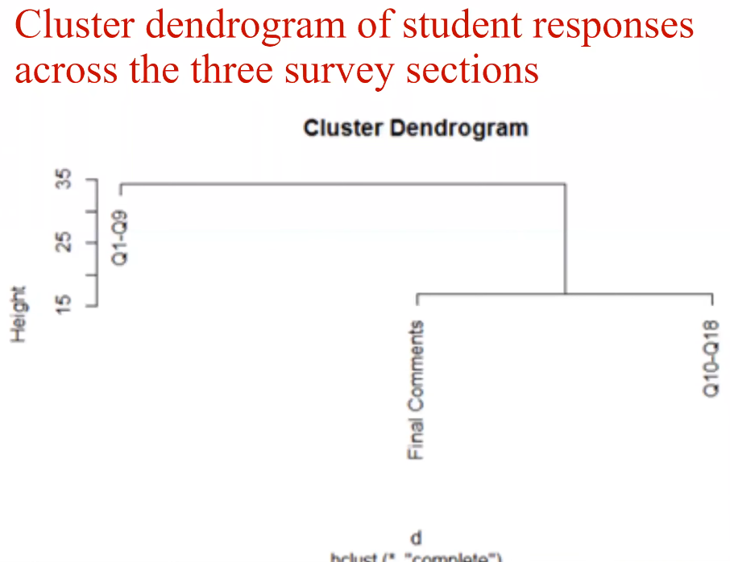

Slide 41
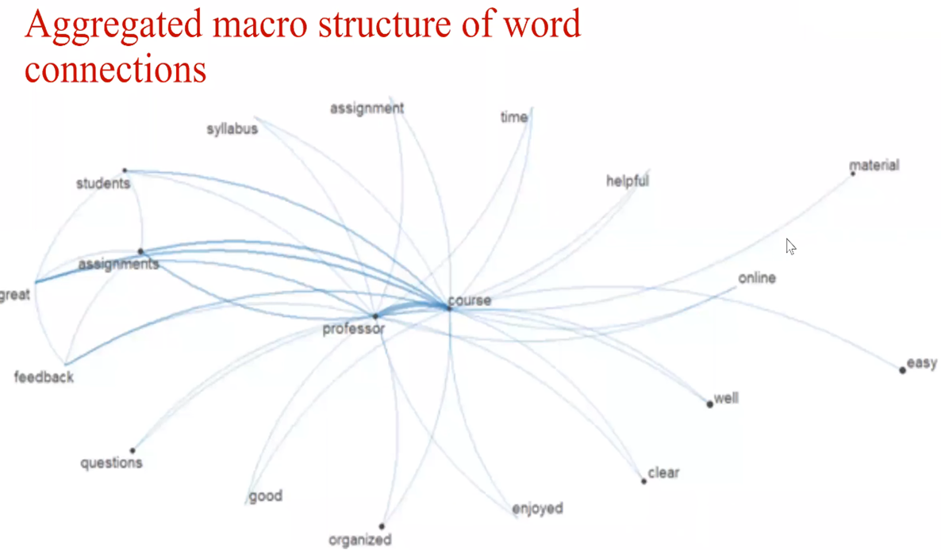

Slide 42

Mary Bennett, MA
Instructional Designer
Center for Faculty Excellence
QLT Course Manager
CSU Office of the Chancellor
Notes:
Introduction
Focus on policy that drove training
How our campus addressed the COVID transition
Training opportunities

Slide 43

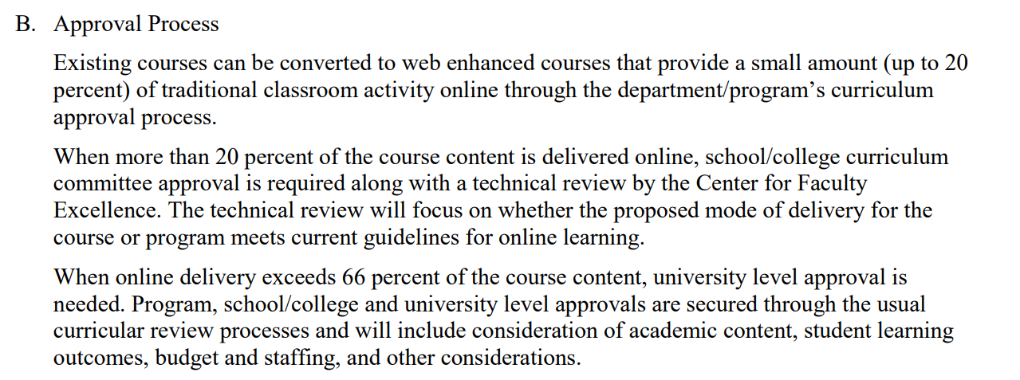
APM 206: Policies and Procedures on Technology Mediated Courses and Programs
Approved Spring 2018
  Faculty who will be teaching online or blended courses (beyond 20% of the entire course) must successfully complete the required online training
Course Categories
  Blended I (20 - 66%)
  Blended II (67 - 99%)
  Online (100%)
Adoption of the QLT Instrument
Notes:
Policy that drove training
B is the section of the policy that defines course categories
Tagged in PeopleSoft
APM 206 suspended due to COVID

Slide 44

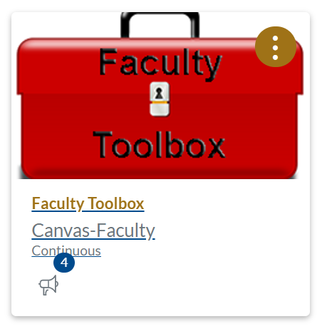
Notes:
What we already had in place to quickly offer faculty
Just in time resources
Brief description of the templates
Aligned to the QLT Rubric

Slide 45

Q1-S Introduction to Teaching Online for Summer Sessions
April and May
18 sections
Notes:
Intentional in how faculty were selected to participate Summer and Intersession
Q1 light 8-10 hours
Equity Minded Practices embedded
reduced the number of reflections
# of students

Slide 46

Faculty Survey Outcomes
Option 1
Canvas
Equity Minded Teaching
Course Building
UDL & Accessibility
Introduction to Technology Tools for Engagement
Sharing Content
Reflection and Instructional Redesign
Option 2
Reflection on Teaching
Equity Minded Teaching
Technology Tools for Engagement
Sharing Content
Reflection and Instructional Redesign
Q1 for Certification
Notes:
Faculty were asked what they wanted/needed to know to be successful with virtual instruction as the base for the development of the FVI SVI
ID’s developed the course with faculty facilitators over a 2 week period
Highlight was was the same and what was different

Slide 47
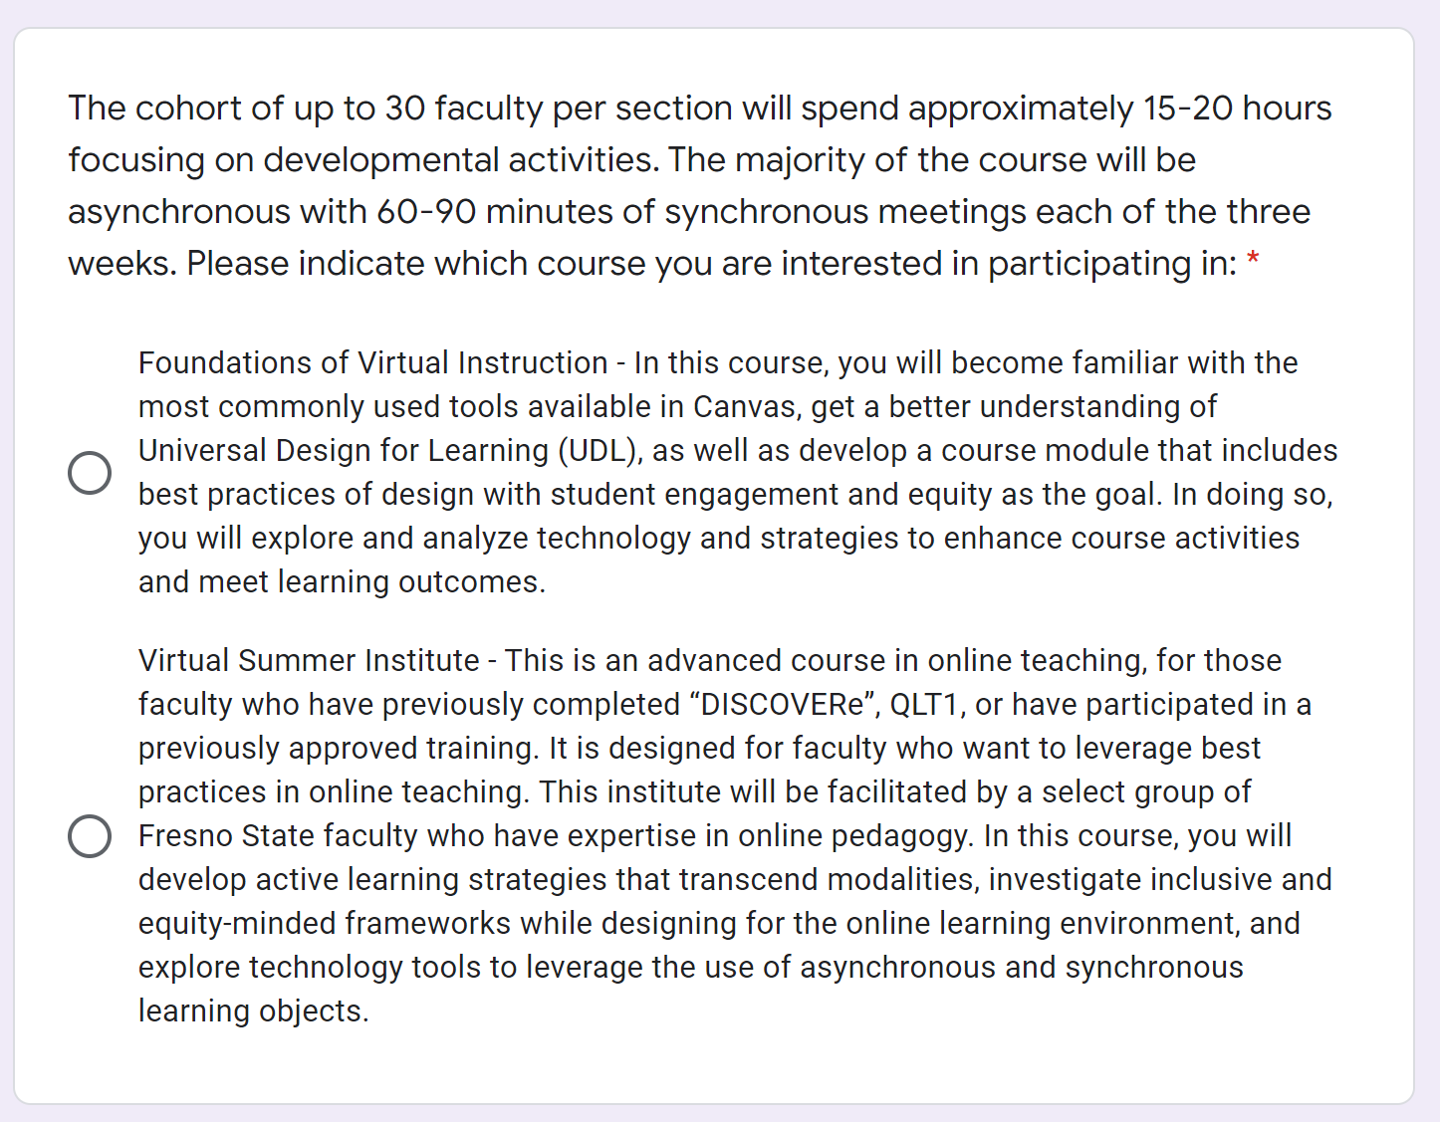
Summer 2020 Faculty Cohorts
Self-identified the course
22 sections
Notes:
Snapshot of the courses that were developed based on the survey
Self identified into the course they felt they needed

Slide 48




Summer 2020 Course Offerings
Notes:
Based on a survey - three options
All courses had to be the same in number of hours (15-20) over 3 weeks
Q1-S Bridge Course - content all who completed Q1-S completed the bridge course, course tour and final reflection to get stipend
Foundations of Virtual Instruction - focused on faculty who were new to Canvas
Virtual Summer Institute - focused on faculty who previously completed Growing with Canvas, DISCOVERe, and/or QLT 1 and who want to leverage best practices in teaching pedagogy while utilizing technology
Q1 Meets APM 206 requirements for online and blended teaching
Equity and Accessibility embedded into all courses
Zoom Sessions
stipend $1200.00

Slide 49


Faculty Facilitators
Notes:
22 facilitators grouped by college into 22 section in June, July, and August
3 faculty experts in each section (UDL, OERs)
Application
Stipend

Slide 50
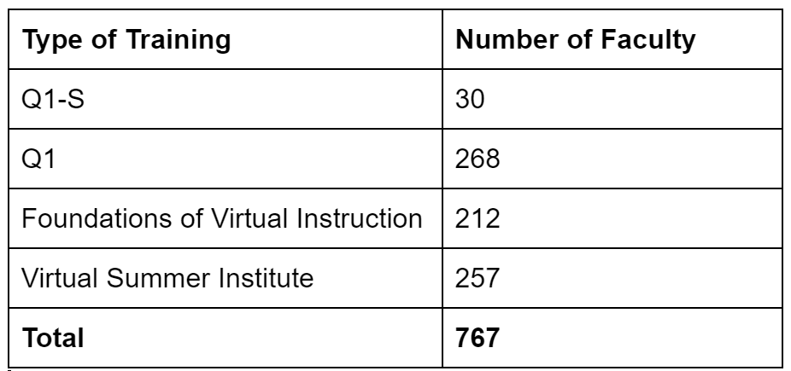
Overall QA Trainings at Fresno State Summer 2020
Notes:
Fresno State specific trainings in response to COVID
61% of all faculty have been trained
12% of those enrolled did not complete

Slide 51
The Takeaway FVI and SVI
"You can't just take your material you've provided in class and put it online, as one teacher in the study said. We must adapt our instruction for the online format, choosing our content carefully and then building rich activities that keep students engaged while they're working on their own."
What stood out for you in creating a week of learning for your course?
Were you able to glean any UDL best practices to incorporate in your course(s)?
In what ways might some of the ideas around "presence" be woven into your course?
How do you plan on addressing issues of equity and culture in your course?
What did you learn from creating your 1-minute video? Did your experience align with your expectations?
What tech tools will you focus on exploring for your virtual course?
Notes:
Teaching Strategies of Award-Winning Online Instructors. The full article was recently published in OLJ: The Official Journal of the Online Learning Consortium.
Include comments from SVI and FVI

Slide 52

Notes:
Comments from FVI and SVI

Slide 53
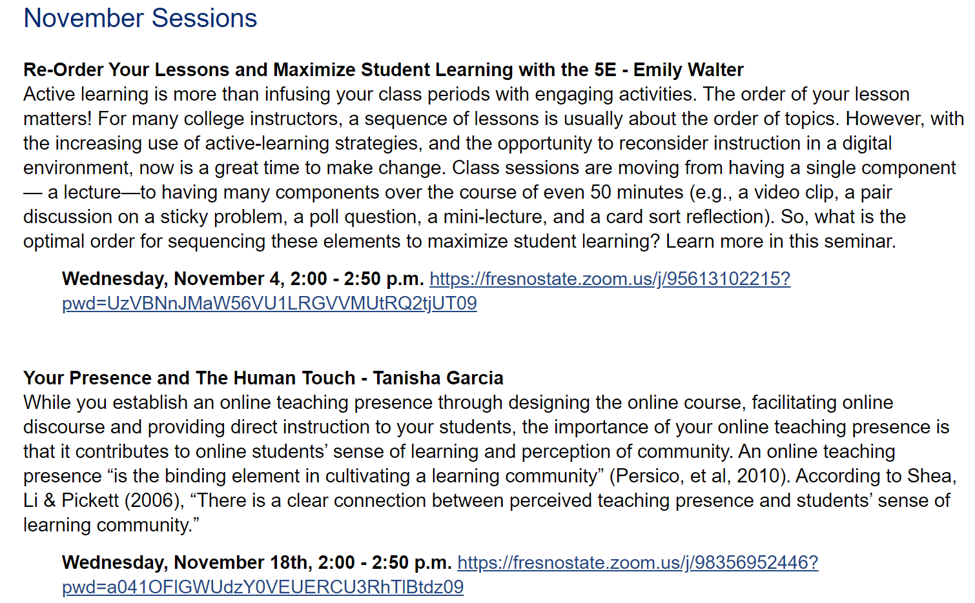


Other Training Opportunities
Canvas Training
GSuite Training
Just in Time Videos
Mini Learning Modules in Canvas
Faculty Led Synchronous Workshops - Spring Seminars
ACUE Effective Online Teaching Practices
Notes:
Move from Canvas to Blackboard - Canvas Certificates
number of trainings
Mini Learning Modules - self-paced and Badged through Badgr Getting Started with Panopto, Getting Started with Ally
ACUE 2 cohorts 60 faculty Fall 2020

Slide 54
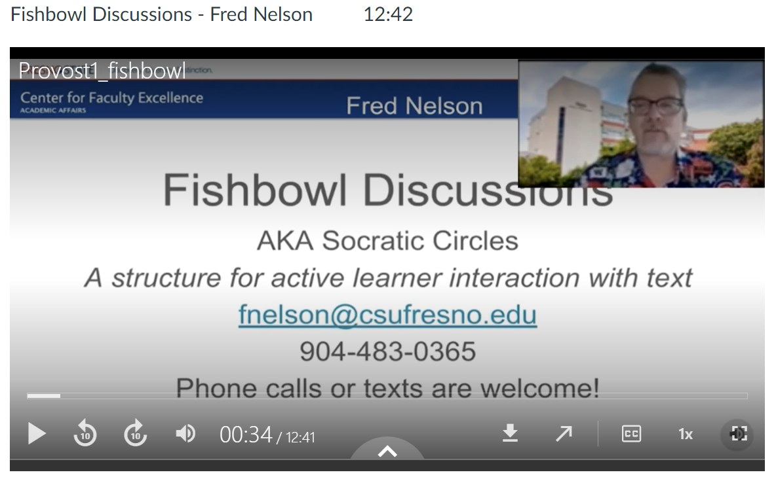
Provost Forum: Best Practices for Virtual Instruction
Fishbowl Discussions
Developing my Pedagogy in the Coronapocalypse
Using Panopto Video with Quiz Feature
Using Flipgrid and Online Media to Teach to the Moment
Service Learning
Student Video Tutorials
Notes:
Faculty shared the outcomes of the summer training opportunities and how they implemented the practices
Recordings available in Canvas Faculty Toolbox
Highlight Student Video Tutorials - music course
Highlight Service Learning - connecting with Community Members

Slide 55
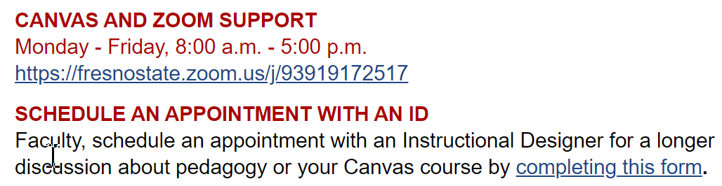
Ongoing Support
Notes:
ID Consultations 300 since summer
Zoom support shifts - 2 hour shifts in a Zoom breakout room

Slide 56
Hypotheses #1: “Instructors completing CSU QA professional development are able (than non-trained peers) to design and deliver online courses more effectively”
“This training really helps especially in a time like this! I would feel much more stressed right now if it was not for taking this course.”
“All of a sudden, it all became very real, and so I am "feeling" the Q1 and Q2 work in a more urgent and immediate way. I will say this: watching so many of my colleagues panic at the prospect of a new online reality has made me grateful for the training I have received and eager to share it with others"
Notes:
Quotes
How the comments are an indicator of training and align with SQuAIR data

Slide 57
Closing - Contacts
Ashley Skylar, CSU Office of the Chancellor, askylar@calstate.edu
Mary Bennett, Fresno State, mbennett@mail.fresnostate.edu
Jianjun Wang, CSU Bakersfield, jwang@csub.edu
http://qa.csuprojects.org

