Slide 1

A Case at Their Own Pace:
Staging Case-Based Scenarios
Erin Hagar, Instructional Designer
Office of Academic Innovation and Distance Education
The Graduate School, University of Maryland, Baltimore
ehagar@umaryland.edu
Notes:
MSHS Courses

Slide 2

Session Outcomes
Describe how the appropriate use of case scenarios can increase learner motivation, meet course outcomes, and achieve QM standards
Explain why a faculty member might present a case in stages, rather than have students work through it all at once
Describe how the adaptive release feature in most LMSs can be used to create staggered case scenarios online

Slide 3


^{UMB:} 86% graduate and professional students in 7 schools:
Medicine
Law
Dentistry
Pharmacy
Nursing
Graduate School
Social Work
The Graduate School:
Administers all non-professional degrees
Partners with AACC to offer a PA degree
Offers the MSHS with several concentrations
  approx. 70 courses,
  100% online,
  QM compliant within 3 iterations
Notes:
Mention Kevin’s presentation

Slide 4
Cases Vs. Scenarios: Terminology
Scenarios
“…fictionalized account of a situation set in realistic settings…Scenarios usually do not have too much data or information to be analyzed.” (Valiathan, 2015.)
Case Studies
“use narrative to provide intriguing background and generate open-ended questions in an attempt to arouse curiosity and motivate students to critically apply disciplinary concepts in an authentic context.” (White, 2009)
“high on facts, mostly supported by actual data and figures.” (Valiathan, 2015)
Notes:
“Case studies often use narrative to provide intriguing background and generate open-ended questions in an attempt to arouse curiosity and motivate students to critically apply disciplinary concepts in an authentic context.” (White, et al., 2009)
At UMB, our MSHS courses are grounded in the health sciences but often use an interdisciplinary perspective. Example: MJ’s epi course with a case study of a outbreak on a college campus; Lynn’s 11 step case on pain assessment.

Slide 5
A
R
C
A
S
John Keller’s “ARCS” Model of Learner Motivation and Instructional Design (1986)
Notes:
ARCS model was developed to think systematically about motivation to learn, synthesizing research on human motivation into a practical for making instructional materials and methods more appealing. I think it’s a useful framework to explore case studies/

Slide 6
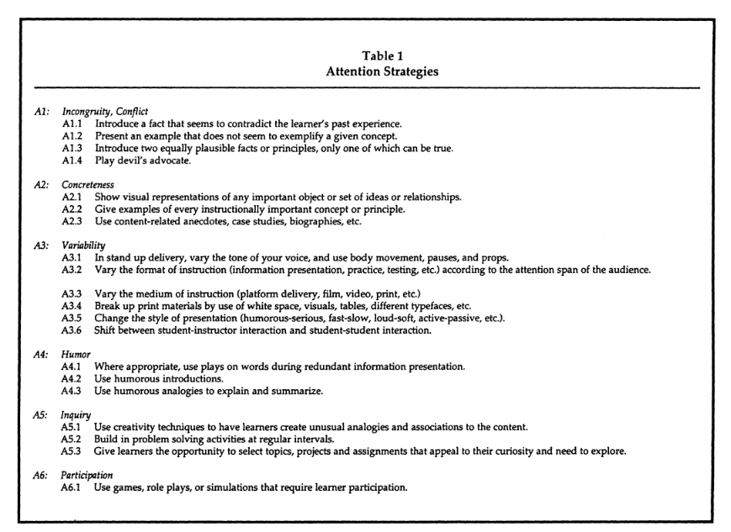
A
R
C
A
S
Attention: “Use games, role plays, or simulations that require learner participation.”

Slide 7
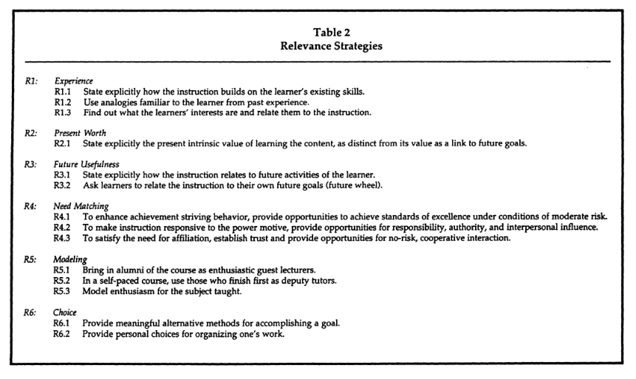
A
R
C
A
S
Relevance: building on existing skills, relating to future activities, opportunities to experience risk and responsibility

Slide 8
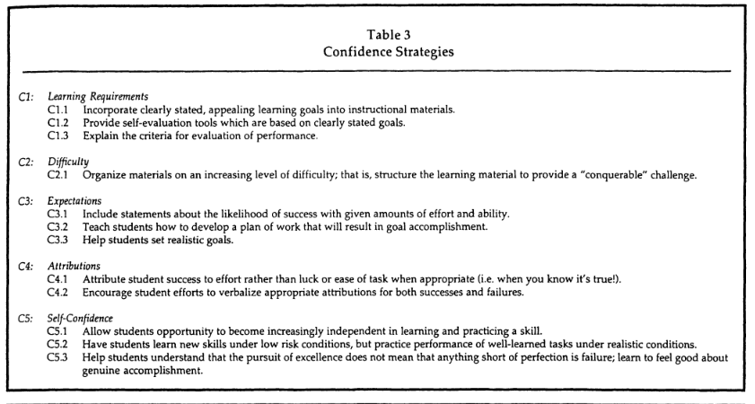
A
R
C
A
S
Confidence: clear goals, increasing level of difficulty, increasing independence, low-risk but realistic situations, understanding the role of failure

Slide 9
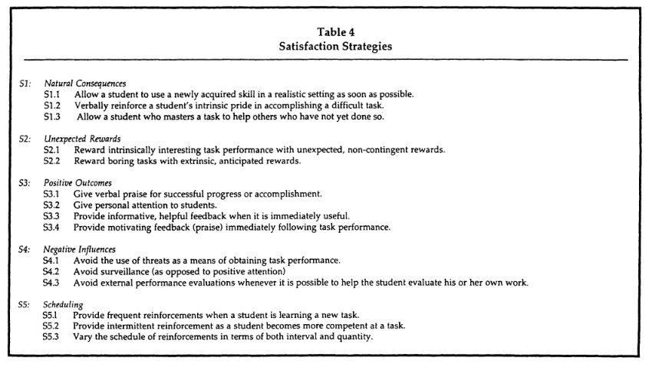
A
R
C
A
S
Satisfaction: clear goals, increasing level of difficulty, increasing independence, low-risk but realistic situations, understanding the role of failure

Slide 10
What does the research say?
Faculty perceptions of student engagement and critical thinking
increase (Yadav et al. 2007)
Evidence of student misconceptions about content is made apparent (White et al, 2009)
In one study, “small but significant increase in number of students capable of critically evaluating selected aspects of experimental study design.” (White et al, 2009).
More well-designed research studies are needed (Lundeberg and Yadav, 2006)

Slide 11

Why Present a Case Study in Stages?
Notes:
Define “stagger” or “interrupted”: working through part of the case before being asked to make a decision or do an instructional task (quiz, discussion, etc.) before receiving the next section of the case. Also “Branching”
Mirrors the real-world nature of incomplete information and testing
Provides a chance to remediate
Ensures individual mastery before asking students to work together
Helps meet QM standards 3.4 (“The Assessment instruments selected are sequenced, varied, and suited to the learner work being assessed.” , 4.1 (“The instructional materials contribute to the achievement of the stated course/module/unit learning objectives or competencies.” and 5.2 (“

Slide 12


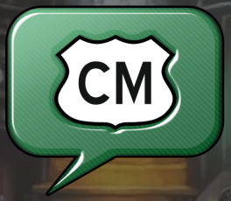





Slide 13

Replicating the “Staggered”
Experience Using Adaptive Release
Notes:
Mention that you could use software like Branch Track etc, but might not be scalable.

Slide 14
Don’t Recreate the Wheel
National Center for Case Study Teaching in Science: http://sciencecases.lib.buffalo.edu/cs/collection/ (free, can get a instructors’ guide for a fee)
University of Delaware Problem Based Learning Clearinghouse: http://www1.udel.edu/pblc/ (free to adapt and use; many disciplines)
Electronic Hallway, Evans School of Public Policy and Governance, University of Washington https://hallway.evans.washington.edu/ (public policy focus; can read abstracts for free, $50 fee for access to cases)

Slide 15
Sources
Keller, J. (1987). Development and use of the ARCS model of instructional design. Journal of Instructional Development 10(3):2-10.
Lundeberg, M. and Yadav, A. (2006). Assessment of case study teaching: Where do we go from here? Part I. National Science Teachers Association. Journal of College Science Teaching. http://www.nsta.org/publications/news/story.aspx?id=51633
Pinchevsky-Font, T. and Dunbar S. (2015). Best practices for online teaching and learning in health care related programs. The Internet Journal of Allied Health Sciences and Practice 13(1): 1-7.
White, T., Whitaker, P., Gonya, T. et al. (2009). The use of interrupted case studies to enhance critical thinking skills in biology. Journal of Microbiology and Biology Education 10: 25-31.
Yadav, A., Lundeberg, M., DeSchryver, M., Dirkin, K., et al. (2007). Teaching science with case studies: A national survey of faculty perceptions of the benefits and challenges of using case studies. Journal of College Science Teaching 37(1):34-38.

