Slide 1
According to the Numbers, Templates are Good For You
Dr. Ben Hollis
Executive Director, Kent State Online

Slide 2




Templates are good for you
Data for informing & promoting change
Overview
Communication strategies
Establishing success & navigating change

Slide 3

Templates are good for you
Data for informing & promoting change
Overview
Communication strategies
Establishing success & navigating change

Slide 4

Templates are good for you
Data for informing & promoting change
Overview
Communication strategies
Establishing success & navigating change

Slide 5

Templates are good for you
Data for informing & promoting change
Overview
Communication strategies
Establishing success & navigating change

Slide 6

Templates are good for you
Data for informing & promoting change
Overview
Communication strategies
Establishing success & navigating change

Slide 7




Not prescriptive
Saves time
Templates are good for you
Consistent
Foundational with QM in mind

Slide 8

Not prescriptive
Saves time
Templates are good for you
Consistent
Foundational with QM in mind

Slide 9

Not prescriptive
Saves time
Templates are good for you
Consistent
Foundational with QM in mind

Slide 10

Not prescriptive
Saves time
Templates are good for you
Consistent
Foundational with QM in mind

Slide 11

Not prescriptive
Saves time
Templates are good for you
Consistent
Foundational with QM in mind

Slide 12



Party like it's 2017
Help Desk analysis of Blackboard tickets in first 3 months of the semester
According to the numbers ...
66.7% of tickets could be negated with better training and/or course standardization

Slide 13

Party like it's 2017
Help Desk analysis of Blackboard tickets in first 3 months of the semester
According to the numbers ...
66.7% of tickets could be negated with better training and/or course standardization

Slide 14

Party like it's 2017
Help Desk analysis of Blackboard tickets in first 3 months of the semester
According to the numbers ...
66.7% of tickets could be negated with better training and/or course standardization

Slide 15

Party like it's 2017
Help Desk analysis of Blackboard tickets in first 3 months of the semester
According to the numbers ...
66.7% of tickets could be negated with better training and/or course standardization

Slide 16




Communication Ecosystems
Listservs / Faculty Meetings / Email
How do you get everyone to know something?
Pop-Up Messages
Training / Workshops

Slide 17

Communication Ecosystems
Listservs / Faculty Meetings / Email
How do you get everyone to know something?
Pop-Up Messages
Training / Workshops

Slide 18

Communication Ecosystems
Listservs / Faculty Meetings / Email
How do you get everyone to know something?
Pop-Up Messages
Training / Workshops

Slide 19

Communication Ecosystems
Listservs / Faculty Meetings / Email
How do you get everyone to know something?
Pop-Up Messages
Training / Workshops

Slide 20

Communication Ecosystems
Listservs / Faculty Meetings / Email
How do you get everyone to know something?
Pop-Up Messages
Training / Workshops

Slide 21
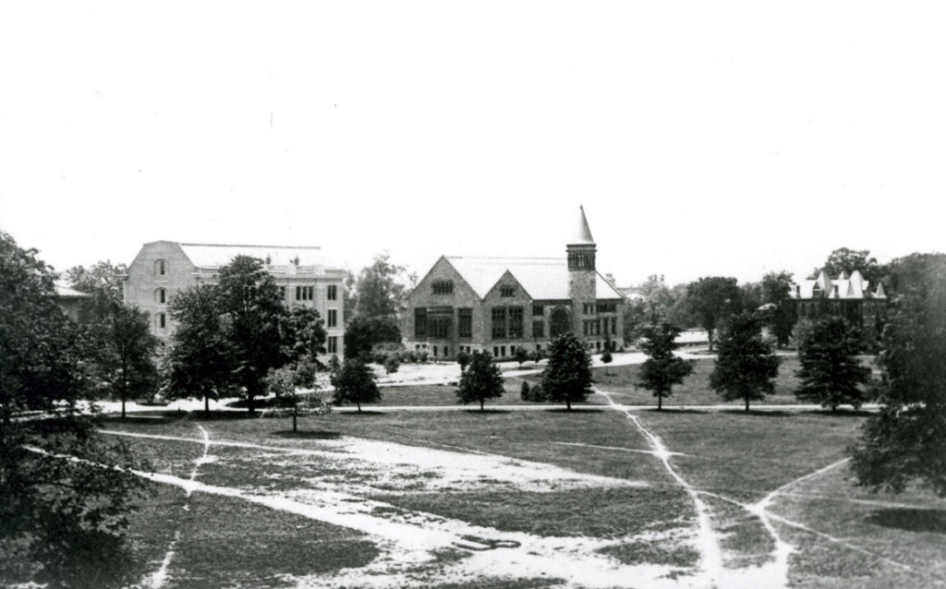
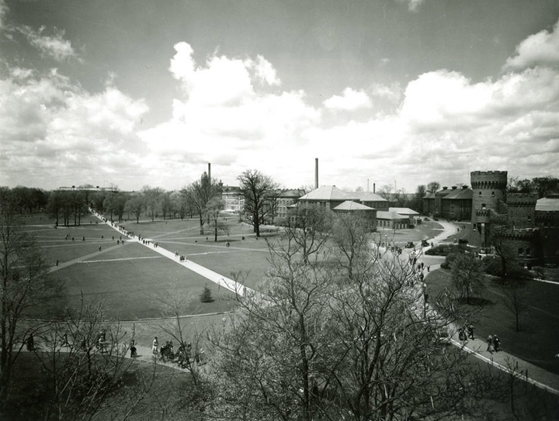
Faculty pathways & wayfinding
Source: The Oval’s Long Walk has paved way for students for a century

Slide 22
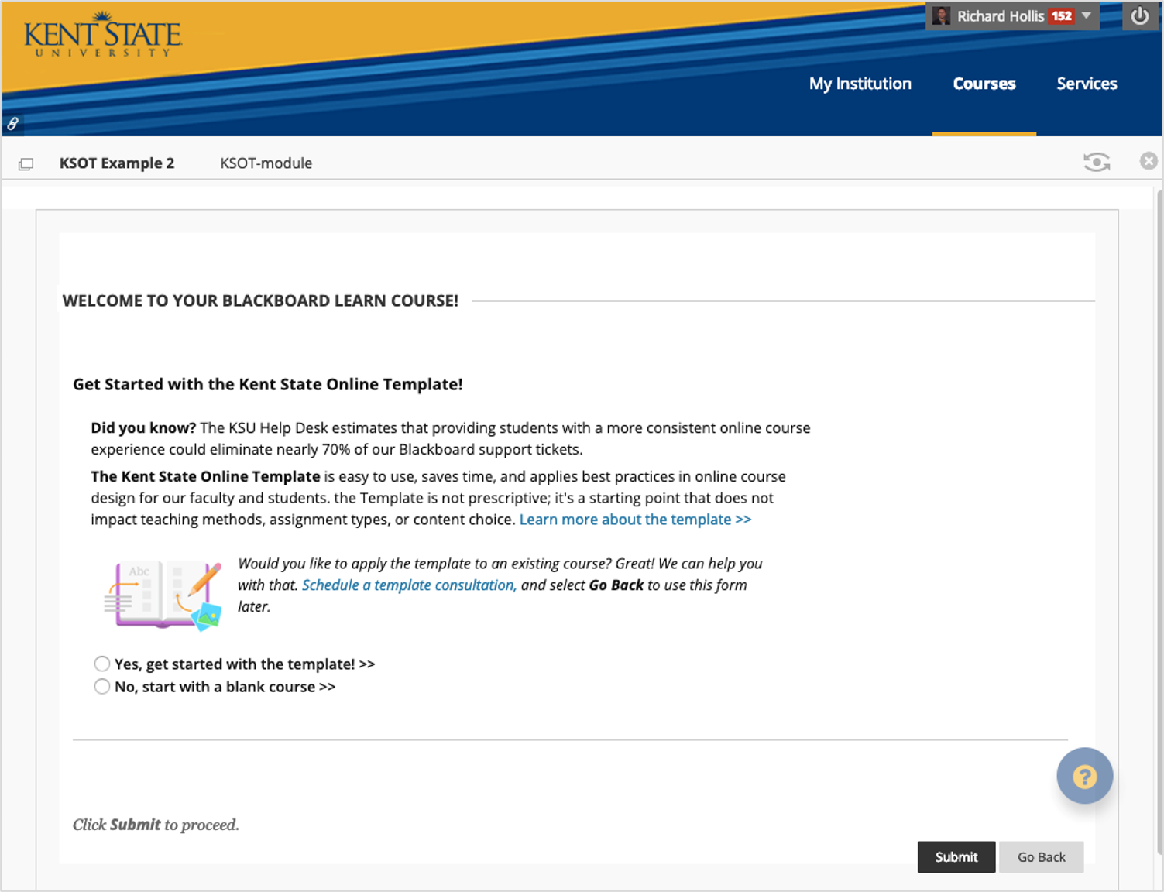
Bb Learn
Building Block

Slide 23



203 faculty members
template added to 278 sections of 235 courses
One semester later ...
52% of tickets could be negated with better training and/or course standardization

Slide 24

203 faculty members
template added to 278 sections of 235 courses
One semester later ...
52% of tickets could be negated with better training and/or course standardization

Slide 25

203 faculty members
template added to 278 sections of 235 courses
One semester later ...
52% of tickets could be negated with better training and/or course standardization

Slide 26

203 faculty members
template added to 278 sections of 235 courses
One semester later ...
52% of tickets could be negated with better training and/or course standardization

Slide 27




Building Block vs Commons
Course Migration / Carpe Diem! Seize the Design!!
Training / Start with the Template
Making the switch from Blackboard to Canvas
Provost Leadership Academy
Do you think a university-wide template would make online classes easier for students? 88% Yes (n = 77)

Slide 28

Building Block vs Commons
Course Migration / Carpe Diem! Seize the Design!!
Training / Start with the Template
Making the switch from Blackboard to Canvas
Provost Leadership Academy
Do you think a university-wide template would make online classes easier for students? 88% Yes (n = 77)

Slide 29

Building Block vs Commons
Course Migration / Carpe Diem! Seize the Design!!
Training / Start with the Template
Making the switch from Blackboard to Canvas
Provost Leadership Academy
Do you think a university-wide template would make online classes easier for students? 88% Yes (n = 77)

Slide 30

Building Block vs Commons
Course Migration / Carpe Diem! Seize the Design!!
Training / Start with the Template
Making the switch from Blackboard to Canvas
Provost Leadership Academy
Do you think a university-wide template would make online classes easier for students? 88% Yes (n = 77)

Slide 31

Building Block vs Commons
Course Migration / Carpe Diem! Seize the Design!!
Training / Start with the Template
Making the switch from Blackboard to Canvas
Provost Leadership Academy
Do you think a university-wide template would make online classes easier for students? 88% Yes (n = 77)

Slide 32
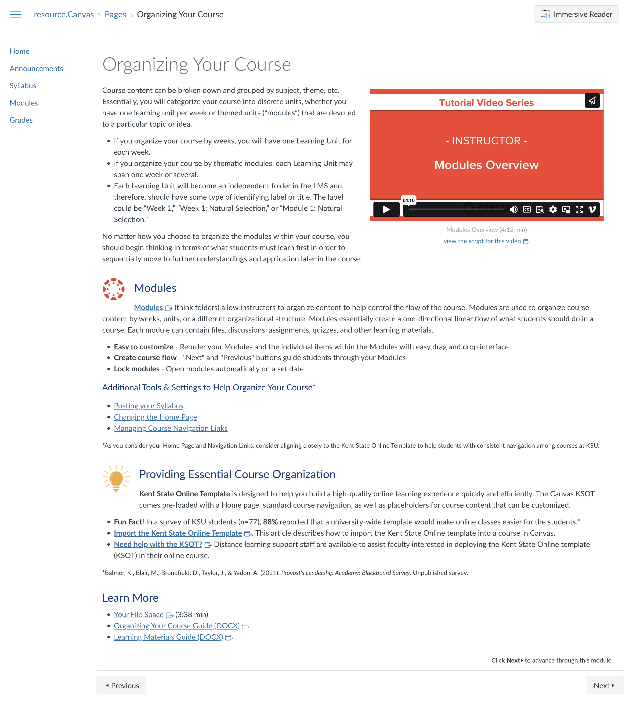
Canvas in a Flash

Slide 33


Party like it's 2023
4,900 imports & counting ...
Template today
Need a consistent student experience

Slide 34
Party like it's 2023
4,900 imports & counting ...
Template today
Need a consistent student experience

Slide 35

Party like it's 2023
4,900 imports & counting ...
Template today
Need a consistent student experience

Slide 36

Party like it's 2023
4,900 imports & counting ...
Template today
Need a consistent student experience

Slide 37
Questions?
Dr. Ben Hollis
Executive Director, Kent State Online

