Slide 1
How Colleges Prepare Students & Faculty for Online Learning … or Not!
Ron Legon, Co-Director of the CHLOE Project
Bethany Simunich, QM Director of Research & Innovation

Slide 2
Growth in CHLOE Survey Participation
Year | Public 2Y | Public 4Y | Private 4Y | For-Profit | TOTAL
CHLOE 3 | 76 | 91 | 98 | 11 | 280*
CHLOE 4 | 99 | 135 | 123 | 8 | 367*
% Increase CHLOE 4 vs. CHLOE 3 | 30% | 48% | 26% | -27% | 31%
* Including a handful of other institutional types
Statistical reliability: margin of error of 5% at 95% confidence.

Slide 3
Multi-factor (Type x Online enrollment) Institutional Models
Enterprise: 4-year public, private nonprofit, and for-profit institutions with more than 7,500 fully and partly online students
Regional Public: 4-year public institutions (excluding state flagships) with between 1,000 and 7,500 fully and partly online students
Regional Private: 4-year private nonprofits with between 1,000 and 7,500 fully and partly online students
Low Enrollment: 4-year public and private nonprofits with fewer than 1,000 fully and partly online students
Flagship: NEW - The leading 4-year public universities, with research and public service roles as designated by their home states and recognized by the Association of American Universities, with fewer than 7,500 fully and partly online students. The CHLOE 4 Survey included 20 out of 60 flagship school in the U.S. – 33%.
Community College : 2-year public institutions with fewer than 7,500 fully and partly online students

Slide 4
Past CHLOE Findings Shed Light on Higher Education’s Response to the COVID-19 Pandemic
CHLOE has explored how well online learning is establishing itself alongside face-to-face learning.
CHLOE has focused on a “glass half full”, but COVID-19 forces us to consider the consequences of a ”glass half empty”.
CHLOE has not explored the degree to which online learning capabilities have penetrated the non-participating segment of the faculty & student body.

Slide 5
COVID-19 Focused Questions:
How prepared & supported are faculty & students for online learning?
How is that preparation & support level impacting institutional response to the remote pivot?
Do institutions have the experience, capability & resources to transition large numbers of remote instruction courses into fully online courses?

Slide 6
Faculty support & development for online teaching
CHLOE 2, CHLOE 3 and CHLOE 4

Slide 7
Faculty Preparation for Online Teaching
Online teaching requires different/new pedagogical strategies and methods, as well as design considerations.
Online instructors must also have minimum competencies in technology and using the LMS.
CHLOE 4 revealed four main training areas:
Online Pedagogy LMS & Technology
Institutional online policies Quality Assurance & Standards
Notes:
Online pedagogy
LMS/technology
Institutional online policies
Quality assurance standards

Slide 8
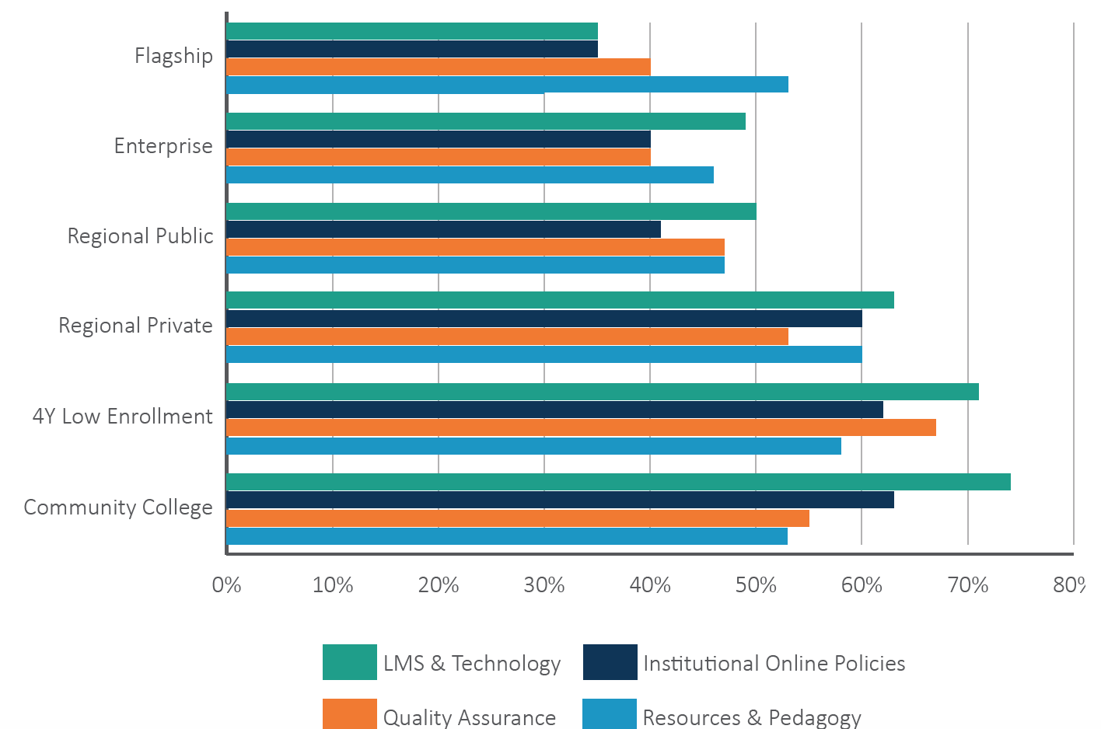
60% of Schools Require Faculty Preparation
How common are the types of faculty development?
LMS and tech. - 57% Quality standards -50% Rules & policies – 50% Pedagogy & Resources – 49%
Notes:
~60% of COOs report some required training for faculty
Community colleges (61%) and 4-Year low online enrollment schools (64.5%) are most likely to require faculty training
Flagships (35%) are least likely to require faculty training
Training typically encompasses the following areas:
LMS and technology (57%)
Quality standards and assurance measures (50%)
Institutional rules and policies (50%)
Resources and pedagogy (49%)

Slide 9
Potential Impact
Even minimal LMS and online teaching training may help ease a quick shift in modality.
Past research has shown that faculty development in online teaching and online design positively impact faculty’s face-to-face teaching practices (Kearns & Mancilla, 2015; Koepke & O’Brien, 2012; McQuiggan, 2012).

Slide 10
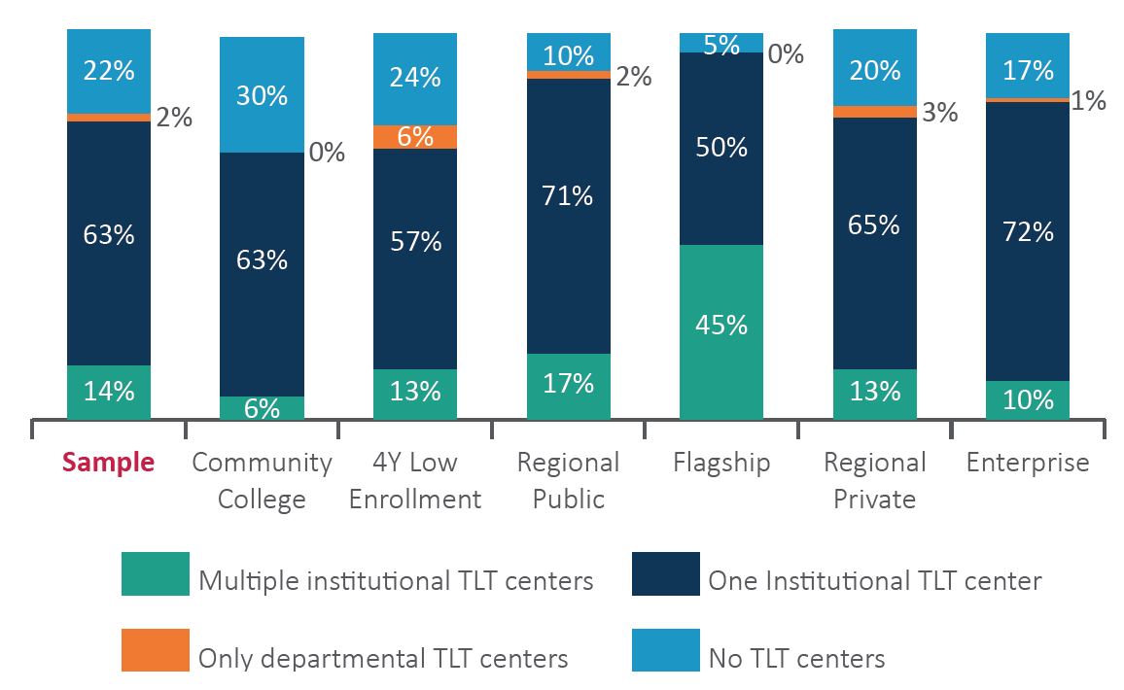
78% of Surveyed Schools Have One or More
Teaching/Learning/Tech Centers
Notes:
TLT Centers are playing a key role in shifting classroom courses online during Covid-19 pandemic.
At least one TLT center in 78% of surveyed institutions
14% of surveyed schools have more than one
Available to play a key role in preparing faculty for online teaching
Worthy of more detailed study of impact on faculty readiness

Slide 11
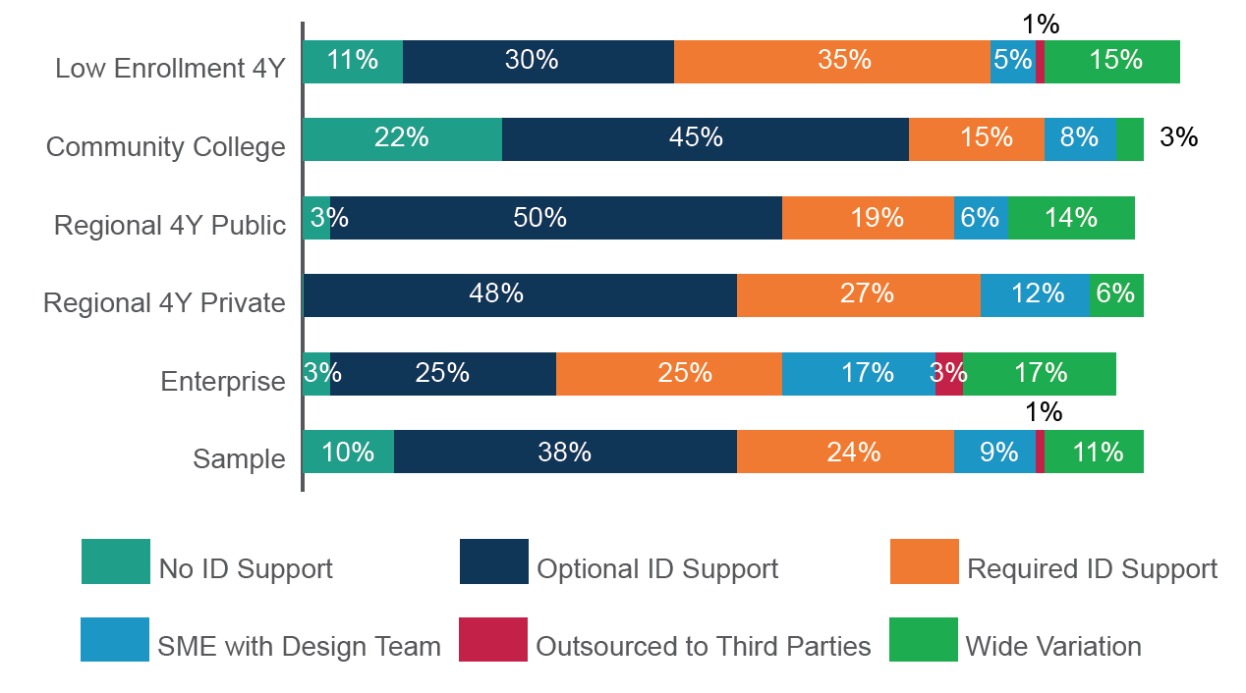
Instructional Design Support by Sector (CHLOE 3)
Notes:
Research University Results are similar to Flagship results, which are unavailable in CHLOE 3:
No ID Support 1% Optional ID Support 26% Required ID Support 29%
SME with Design Team 9% Outsourced to 3rd party 0% Wide Variation 28%

Slide 12
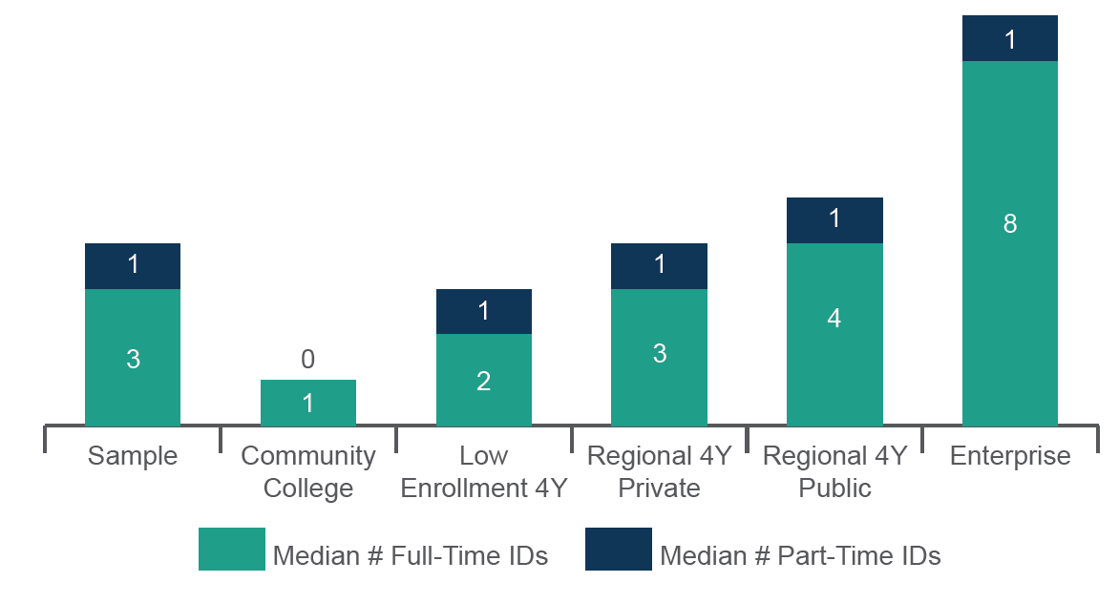
Median Number of ID’s by Sector (CHLOE 3)

Slide 13
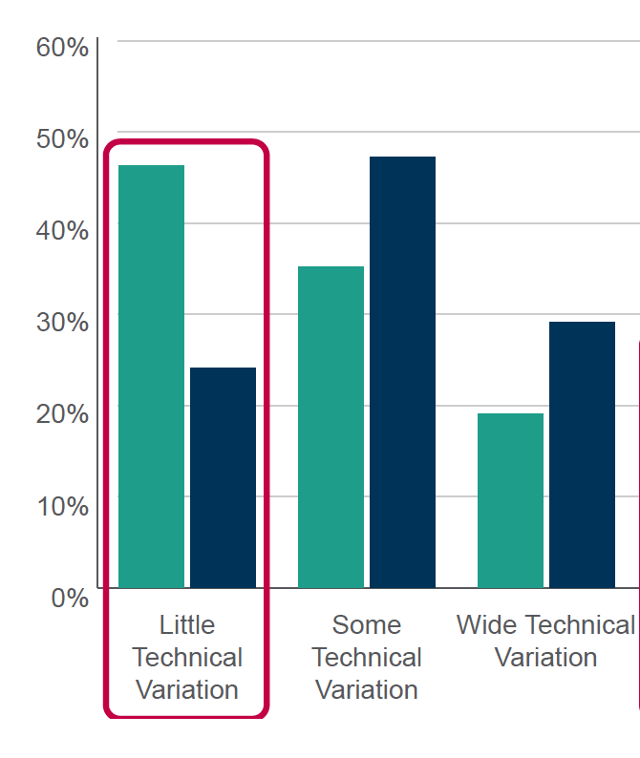

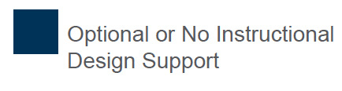
ID Input Ensures Course to Course Consistency of Course Structure, Navigation, etc. (CHLOE 2)

Slide 14
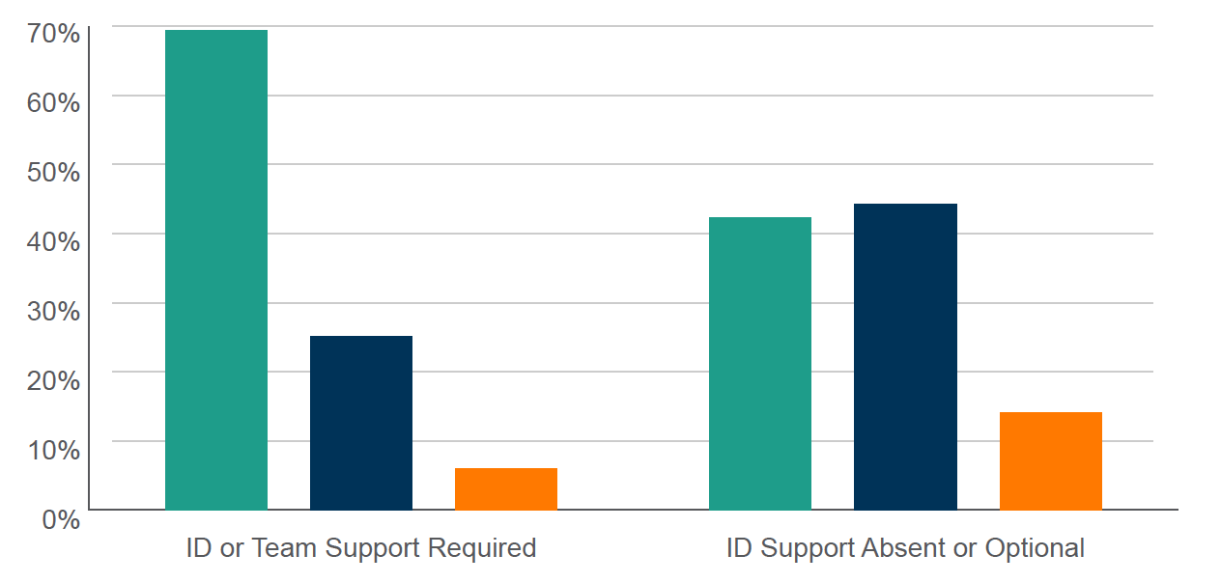
ID Input Increases Online Student Interaction (CHLOE 2)

Slide 15
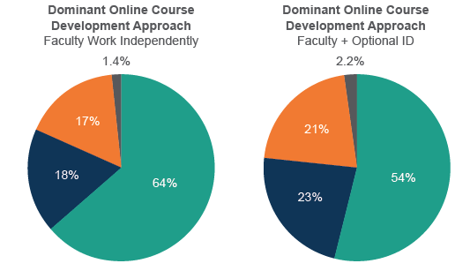
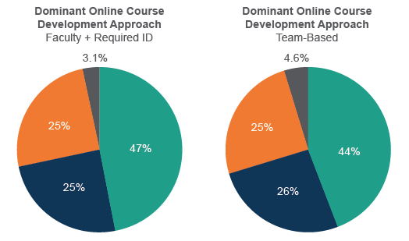
ID Input Increases Variety of Student Interaction
(CHLOE 3)

Slide 16
Impact of ID Support for Course Design on Online Student Performance (CHLOE 3)

Slide 17
Potential Impact
Support staff, such as instructional designers, and TLT-type offices played key roles in the quick pivot to remote instruction.
Collaborating with instructional designers can increase course design quality. [Hart, 2018]

Slide 18
Preparing students for online learning
CHLOE 4

Slide 19
Online Learner Readiness
Students must meet institutional requirements for technology and tech skills.
Additional skills needed: time-management, digital communication, becoming a self-directed learner
Online orientation courses or workshops facilitate student acquisition of these skills

Slide 20
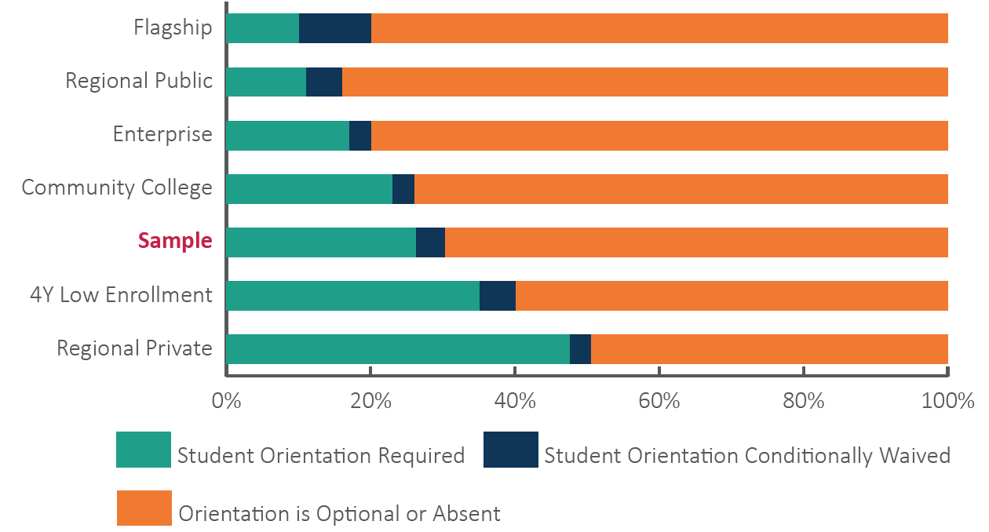
Only 30% of Schools Require Online Student Orientation
Notes:
Most common in sectors claiming that online students outperform on-ground students
Least common in sectors claiming equivalent results for online and on-ground students
Other factors clearly influence student outcomes
e.g., student selectivity, faculty preparedness, course design, etc.

Slide 21
Alternatives to Formal Student Orientation
Some institutions require online orientation for certain categories of students (e.g., new undergraduates).
Others point to such measures as:
  orientation modules built into credit-based online courses
  requirements for online instructors to orient students to their courses (methods unspecified)
  student-initiated one-on-one meetings with support staff on an as-needed basis.
  available videos that students may watch on their own.

Slide 22
Alternatives to Formal Student Orientation
required online orientation for certain categories of students (e.g., freshman, etc).
orientation modules built into credit-based online courses
requirements for online instructors to orient students to their courses (methods unspecified)
student-initiated one-on-one meetings with support staff on an as-needed basis
available videos that students may watch on their own

Slide 23
Potential Impact
Online orientations typically include basic LMS training, using online tools, where to go for help, and time management skills.
Online orientation positively impacts course completion and performance (Koehnke, 2014)

Slide 24
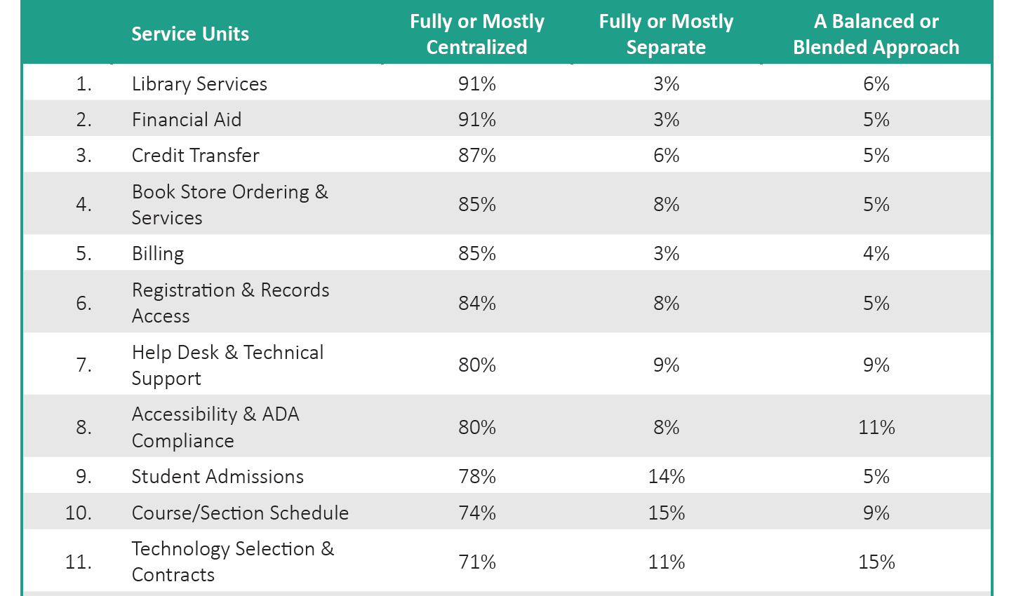
Some Good News: Centralized Support Services May Be Able to Pivot Smoothly To Serve The Entire Student Body Remotely
Notes:
Centralized services supporting both campus and remote students seem poised to pivot toward serving all students remotely, but this may involve retraining some staff and changing the work routine for many.

Slide 25
Potential Impact
Centralization of support operations (e.g., course design, faculty development, LMS and library operations, etc.) can bring consistency and often better collaboration across campus offices.
While decentralization often consumes more resources by having multiple operations within departments and colleges, it does allow for customized resources based on needs and usage. One possible barrier to decentralization, however, is extending online quality assurance standards to classroom-based courses.

Slide 26
CHLOE 5 – Looking Ahead
COVID-19 Upends CHLOE 5 Plans
  The Online Market Survey postponed
Focus shifts to assessment of online learning’s readiness to assume the entire instructional burden
  Brief survey focused on scale and scope of the challenge
  Re-analysis of CHLOE 1-4 findings on relevant resources
  Mid-Summer CHLOE 5 Report on the challenges ahead

Slide 27
Your Questions and Comments
Thank You!

