Slide 1
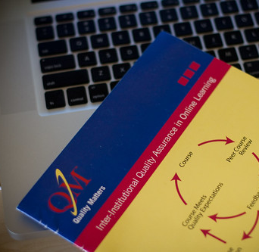
Inclusivity, Engagement, Differentiation—Have It all Using AGILE
Kat Biacindo
California State University, Fresno
QM
November, 2021
This Photo by Unknown author is licensed under CC BY.

Slide 2

Online is the ideal environment for full inclusion
Connectivism theory (Siemens, 2007) Through a network, web, or internet, learners can (a) acquire new content that is continually updated, (b) identify credible resources, and (c) draw distinctions between opposing facts and figures. In connectivist theory, one view of learning is knowing where to locate information may be as valuable as the information itself.

Slide 3

How to design—AGILE (software development program)
A = ALIGN (goals-objs)
G = GET SET
I = ITERATE/INTEGRATE
L = LEVERAGE
E = EVALUATE/ENGAGE

Slide 4
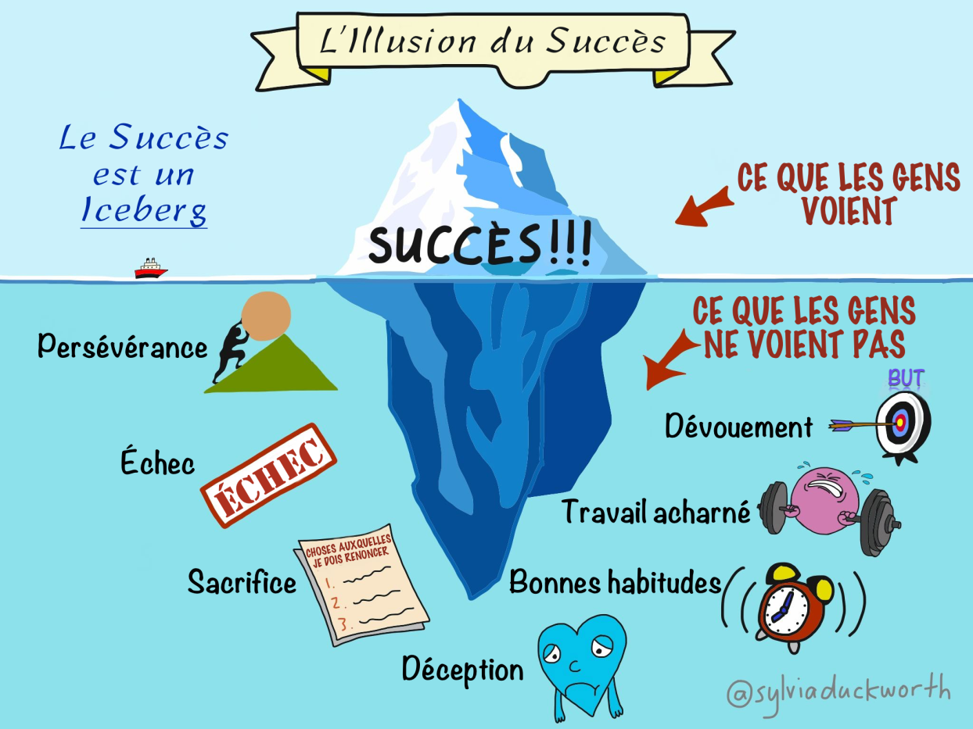
Educational adaptation of AGILE
Individuals and Interactions OVER Process and Tools
Working Products OVER Comprehensive Documentation
Student Collaboration OVER Work Contracting
Responding to Changes OVER Following a Plan
This Photo by Unknown author is licensed under CC BY-SA-NC.

Slide 5
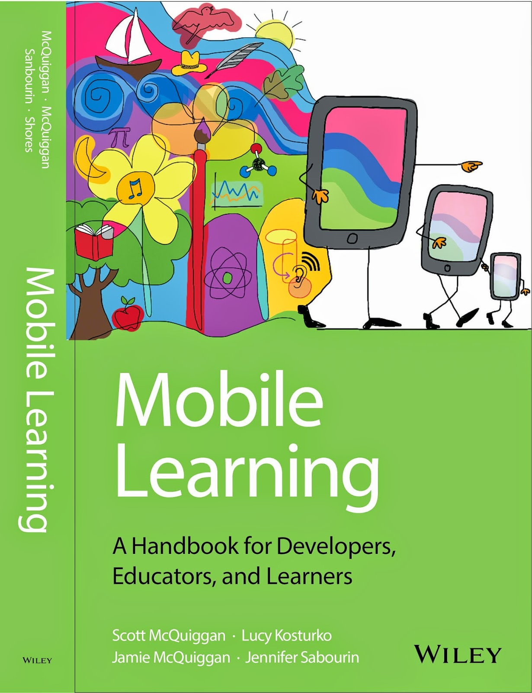
All content has multiple forms of representation
Student-paced (recommended due dates only; not required)
24/7 tech support instructor and LMS through multiple communication channels
HTML content for mobile/adaptive devices
Videos must be captioned (no talking head)
Images have dual-purposed doc support, with image and text highlighting to emphasize (tagged)
Use gaming for all core content consumption
Allow content browsing through use of folders opened in multiple tabs
Navigation guides + rubrics foundational to inclusion
Have content published in ecosystems (commonly found in mobile first course design)
Allow revise and resubmit for all working products from students
Use both audio and text feedback (for example, Office 365 Sharepoint and immersive reader)
BB SCORM analysis to revise course during active course deployment
This Photo by Unknown author is licensed under CC BY.

Slide 6
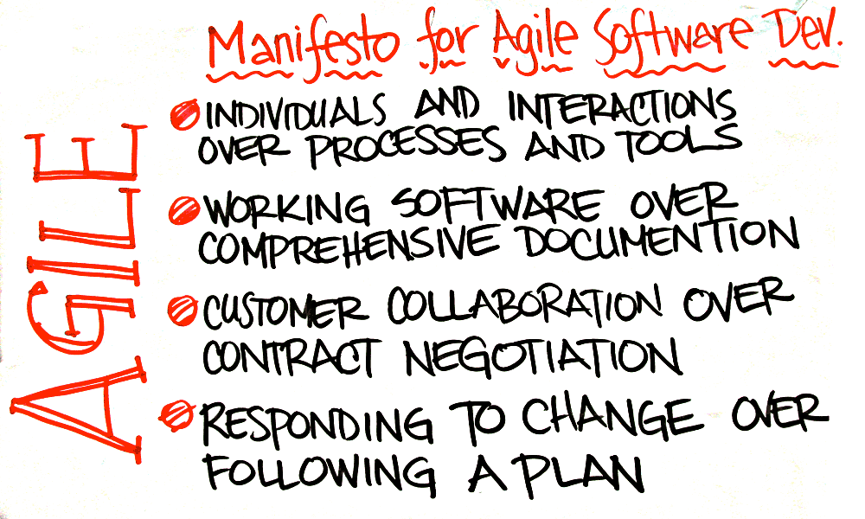
AGILE MANIFESTO education adaptation
Our highest priority is to satisfy the student through early and continuous delivery of valuable course content and apps and links.
Welcome changing requirements, even late in course development. Agile processes harness change for the student’s competitive advantage.
Deliver working updates frequently, from a couple of weeks to a couple of months, with a preference to the shorter timescale.
Educators and technology developers must work together daily throughout the project.
Build projects around motivated individuals. Give them the environment and support they need (self pacing and differentiation), and trust them to get the work done.
The most efficient and effective method of conveying information to and within students’ is one on one sync and async communication.
Working products are the primary measure of progress.
AGILE processes promote sustainable development. The educators, course developers, and students should be able to maintain a constant pace indefinitely.
Continuous attention to technical excellence and good design enhances agility.
Simplicity–the art of maximizing the amount of work not done–is essential.
The best architectures, requirements, and designs emerge from self-organizing course cyberlibraries and ecosystems.
At regular intervals, the course designer reflects on how to become more effective, then tunes and adjusts its online course delivery accordingly.
This Photo by Unknown author is licensed under CC BY-SA.

Slide 7

Video description of course (NO talking head)
Vyond link https://app.vyond.com/videos/ad536f08-633e-4840-ab0b-e7facc3310d9

Slide 8
How can you apply AGILE?
Ideas and adaptations consultations

Slide 9

And on to even better—Mobile first learning + Office 365—all you need is a cell phone!

Slide 10

TAKE aways
Gift for you for considering moving outside the box ; from Canva
https://mailfresnostate-my.sharepoint.com/:w:/g/personal/kbiacindo_mail_fresnostate_edu/EbWlszofAiFHh4A2umHBISsBRpXeSl00eMVvqvbkRm6oSw?e=BXawcY
AGILE brochure--365 https://mailfresnostate-my.sharepoint.com/:w:/g/personal/kbiacindo_mail_fresnostate_edu/EbWlszofAiFHh4A2umHBISsBRpXeSl00eMVvqvbkRm6oSw?e=BXawcY

