Slide 1

Indiana University Online
Using QM to Further Encourage Ownership through IU Online Student Onboarding
INDIANA UNIVERSITY

Slide 2
Background
LMS-based resource
Needed to serve multiple campuses and programs
Prioritization by “phase” of topics for online students
No existing resource – V1 launched in less than 6 months
QM standards were intentionally incorporated throughout V2

Slide 3
Background (cont’d)
QM standards are being used to
  Introduce the purpose and provide a self-paced onboarding resource
  Emphasize the learning objectives
  Identify available student services and learner supports
  Outline required proficiencies and tools
  Provide accessible content to better serve our students

Slide 4
Ownership
Delivering QM practices through onboarding empowers students to take ownership of their online education by:
  Recognizing their educational autonomy
  Establishing them as the experts of their success
  Allowing self-paced, repeatable experiences
  Explaining technical needs and expectation for online courses
  Encouraging use of university resources and support structures

Slide 5
Course Overview and Introduction
General Standard 1

Slide 6
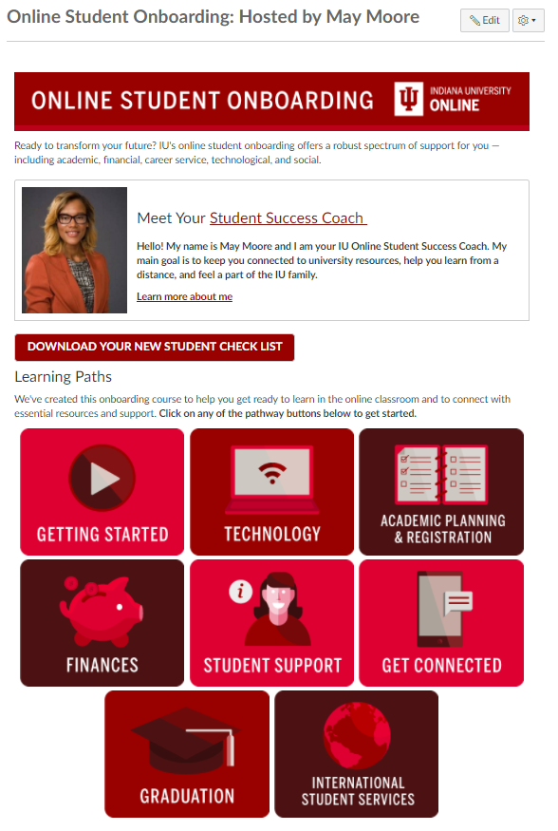
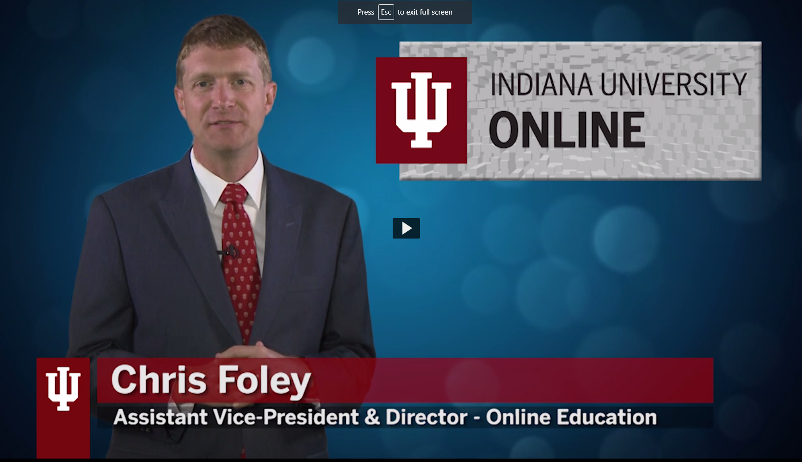
1.2 Learners are introduced to the purpose and structure of the course.

Slide 7



1.4 Course and/or institutional policies with which the learner is expected to comply are clearly stated, or a link to current policies is provided.

Slide 8

1.5 Minimum technology requirements are clearly stated and instructions for use provided.

Slide 9
Learning Objectives (Competencies)
General Standard 2

Slide 10
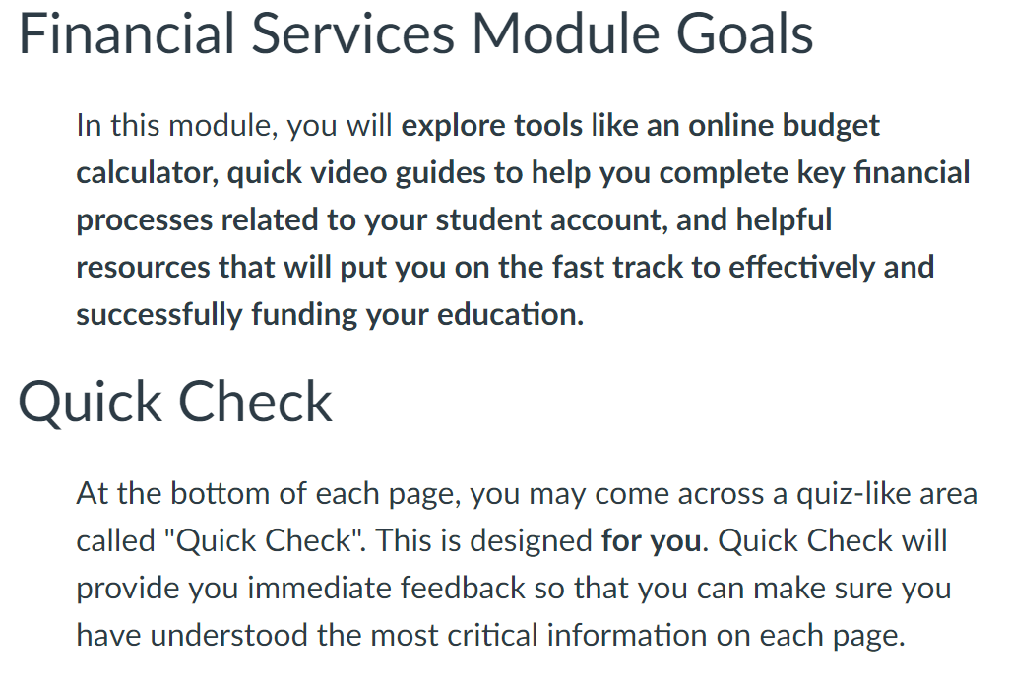
2.3 All learning objectives or competencies are stated clearly and written from the learner’s perspective.
2.5 The learning objectives or competencies are suited to the level of the course.

Slide 11
Instructional Materials
General Standard 4

Slide 12
Fall
Spring
Summer
4.1 The instructional materials contribute to the achievement of the stated course and module/unit learning objectives or competencies.
4.4 The instructional materials are current.

Slide 13
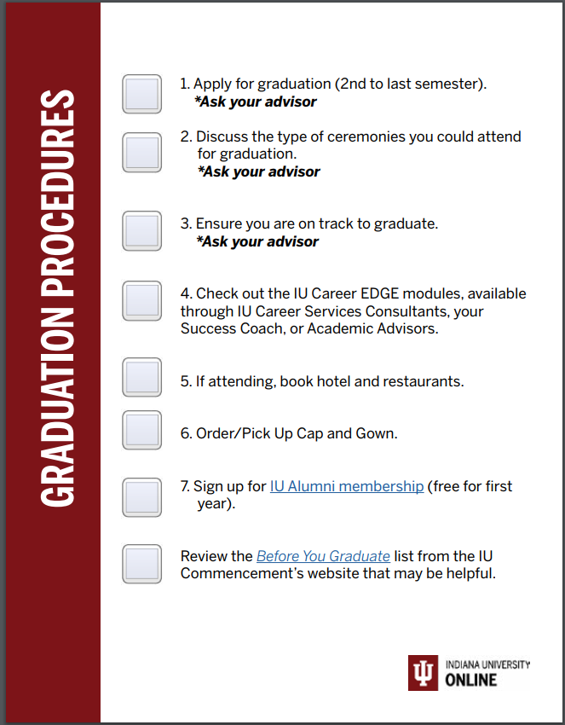
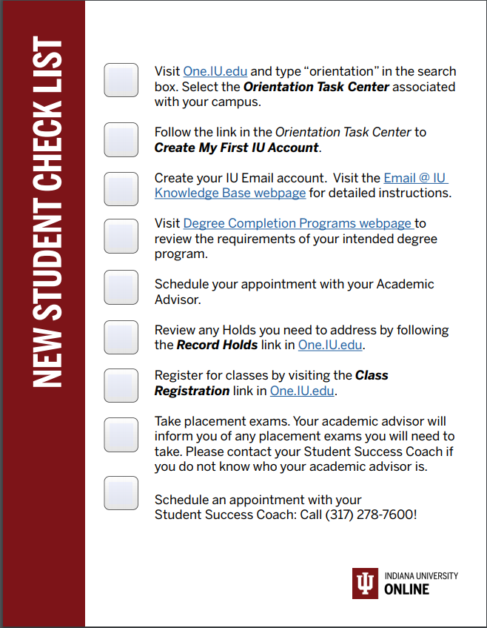
4.5 A variety of instructional materials is used in the course.

Slide 14
Course Technology
General Standard 6

Slide 15
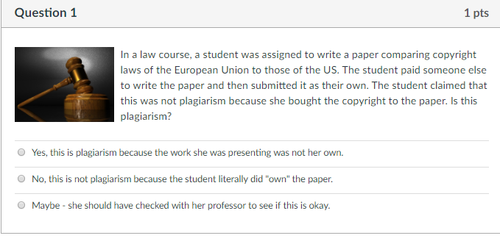

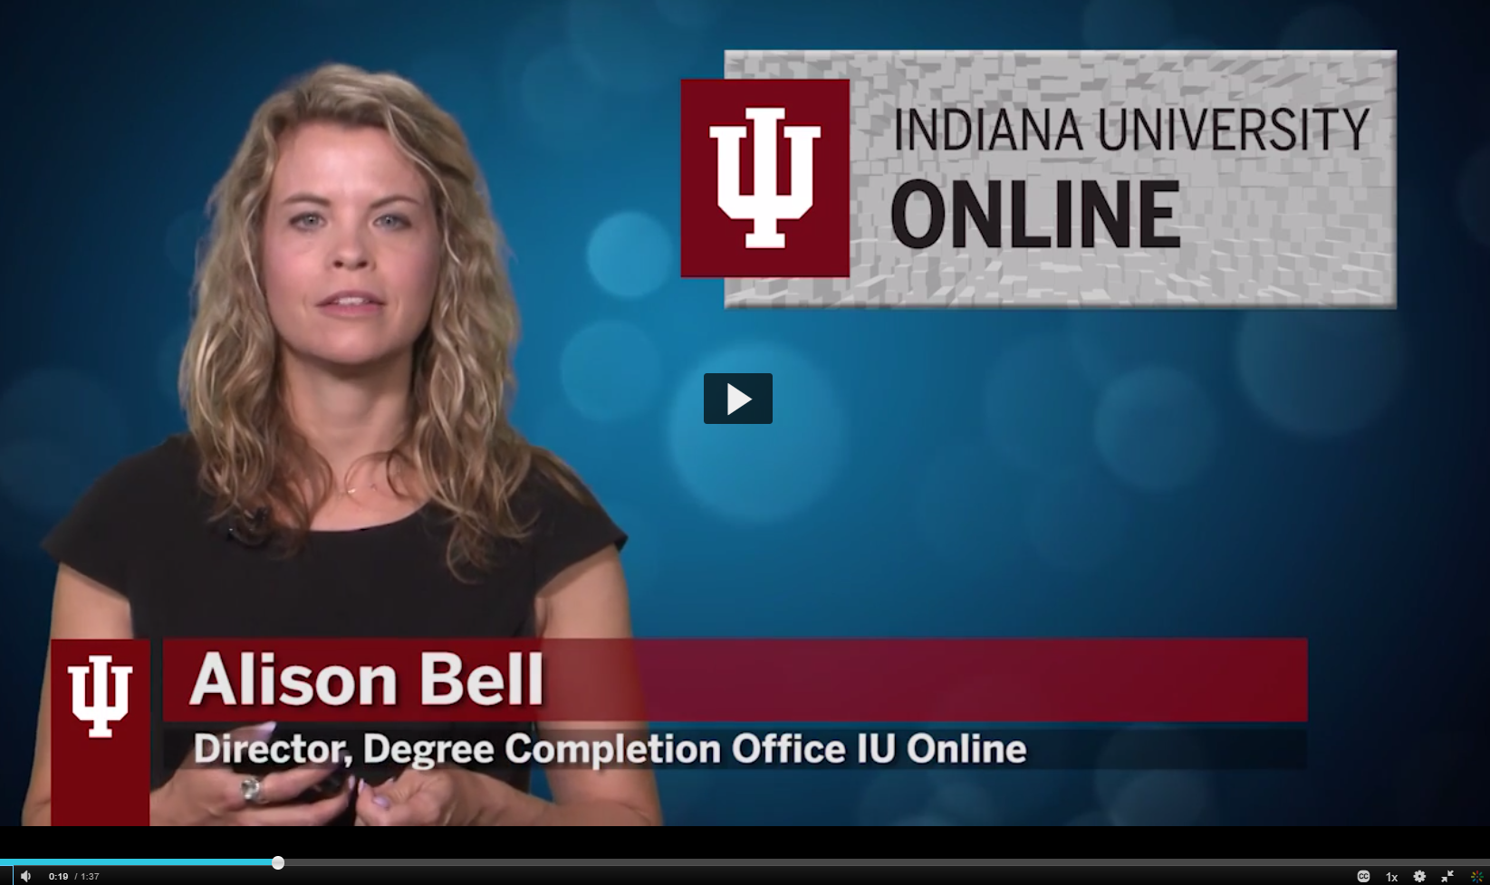
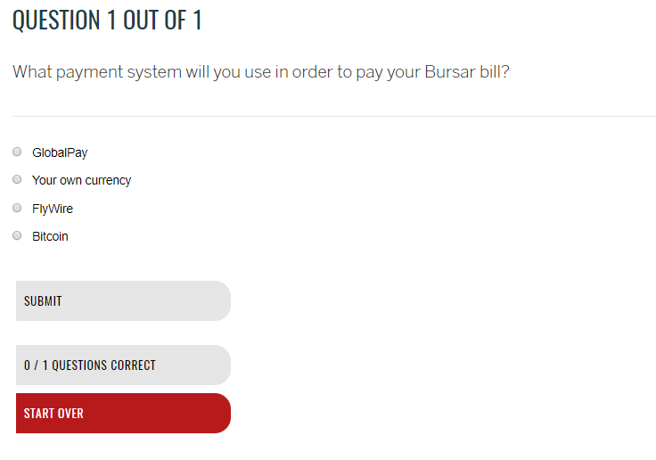
6.2 Course tools promote learner engagement and active learning.
6.3 Technologies required in the course are readily obtainable.
6.4 The course technologies are current.

Slide 16
Learner Support
General Standard 7

Slide 17
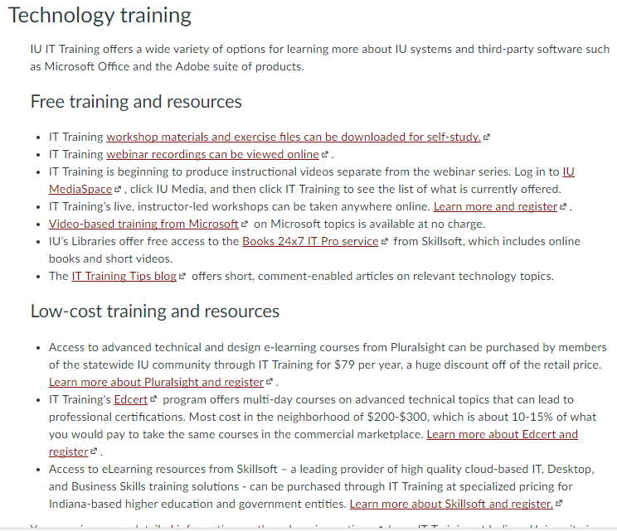
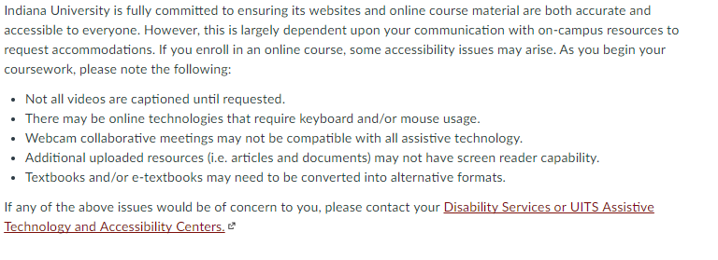
7.1 The course instructions articulate or link to a clear description of the technical support offered and how to obtain it.
7.2 Course instructions articulate or link to the institution’s accessibility policies and services.

Slide 18
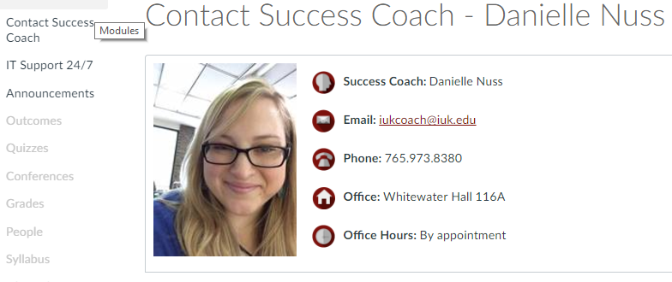
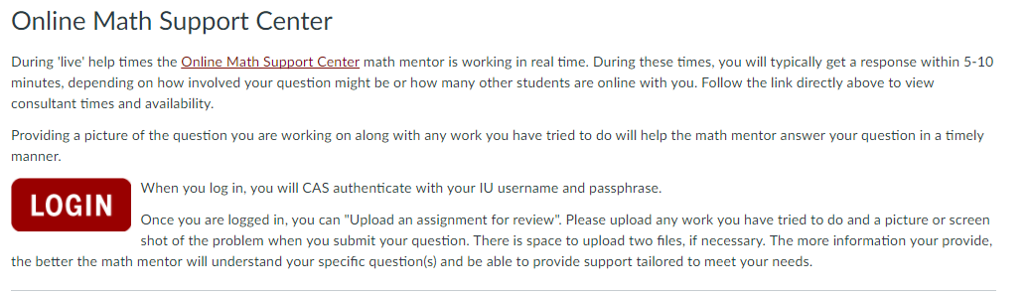
7.3 Course instructions articulate or link to an explanation of how the institution’s academic support services and resources can help learners succeed in the course and how learners can obtain them.
7.4 Course instructions articulate or link to an explanation of how the institution’s student services and resources can help learners succeed and how learners can obtain them.

Slide 19
Accessibility and Usability
General Standard 8

Slide 20
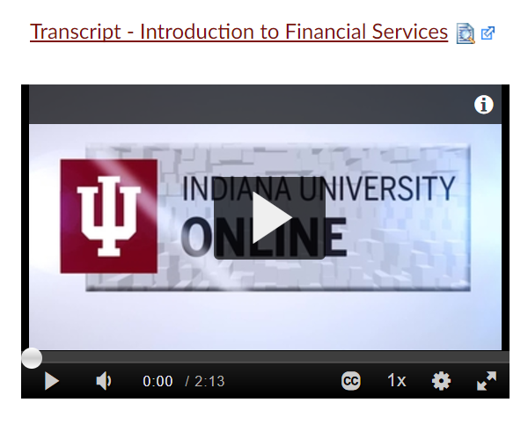
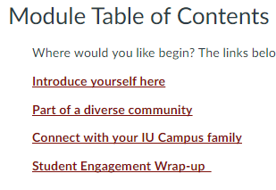
8.1 Course navigation facilitates ease of use.
8.2 Information is provided about the accessibility of all technologies required in the course.
8.3 The course provides alternative means of access to course materials in formats that meet the needs of diverse learners.
8.4 The course design facilitates readability.
8.5 Course multimedia facilitate ease of use.

Slide 21
Discussion

Slide 22
Similar Initiatives
Others who have tackled this concept
Recommendations / Suggestions

Slide 23
Orneal A. Brown
Design and Development Consultant
Office of Online Education
Indiana University
orbrown@ iu.edu
Julia Sanders
Principal eLearn Instructional Designer
Indiana University
juasande@iu.edu
Alison Bell
Director of Degree Completion Office
IU Online
Indiana University
naabell@iupui.edu
Mitchell Farmer
Assistant Director
Campus Partner Programs
Office of Online Education
Indiana University
mgf@ iu.edu

