Slide 1


Individualizing Faculty Development on Effective Use of LMS Using TPACK Model
Swati Ramani
Director of Faculty Development & Curriculum Management
Southern California University of Health Sciences

Slide 2
Link to PPT slides
https://tinyurl.com/qmconnectsession

Slide 3
Learning Outcomes
Apply the TPACK model for LMS training at their own institutions
Use samples of LMS training materials that implement the TPACK model
Learn to use TPACK model for faculty/teacher development efforts

Slide 4
Agenda
Brainstorming/Discussion
Introduction-TPACK Model
Past Experiences- Application of TPACK Model
Access to Project Repository
Browse through the Canvas Course
Audience Reflection

Slide 5
Activity 1: Brainstorming/Discussion
Are faculty at your institutions making effective use of LMS?
How do you train your faculty on how to use LMS?
Is your training effective?

Slide 6
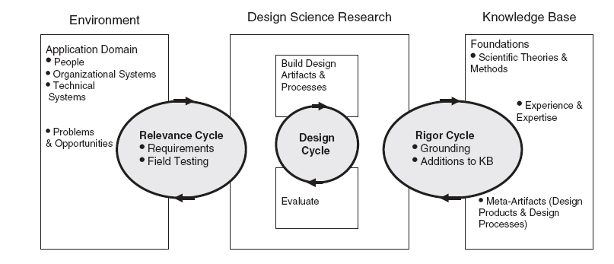
Past Experiences- Theory into Practice
Design Research Project
Design Science Research is a research paradigm in which a designer answers questions relevant to human problems via the creation of innovative artifacts, thereby contributing new knowledge to the body of scientific evidence. The designed artifacts are both useful and fundamental in understanding that problem. The fundamental principle of Design Science Research is that knowledge and understanding of a design problem and its solutions are acquired in the building and application of an artifact.
Source: Hevner, A. (2010). Design Research in Information Systems: Theory and Practice. Boston, MA: Springer Science+Business Media, LLC

Slide 7
Past Experiences- Theory into Practice
Design Research Project
Problem Definition:
Information communication technologies such as Learning Management Systems (LMS) play an important role in the world of education. The problem I identified is that faculty members are not effectively using all features of the Canvas LMS for in-class instruction.

Slide 8
Past Experiences- Theory into Practice
Design Research Project
Needs assessment and analysis:
Semi-Structured interviews with faculty at two universities
Tenure-track faculty, Adjunct faculty, and educational administrators in the field of research, instructional design, Information Technology, and teaching and learning

Slide 9
Past Experiences- Theory into Practice
Design Research Project
Results of needs assessment and analysis:
lack of technical background
lack of motivation and interest to use LMS
how to merge technology with their content and pedagogy (most important)

Slide 10
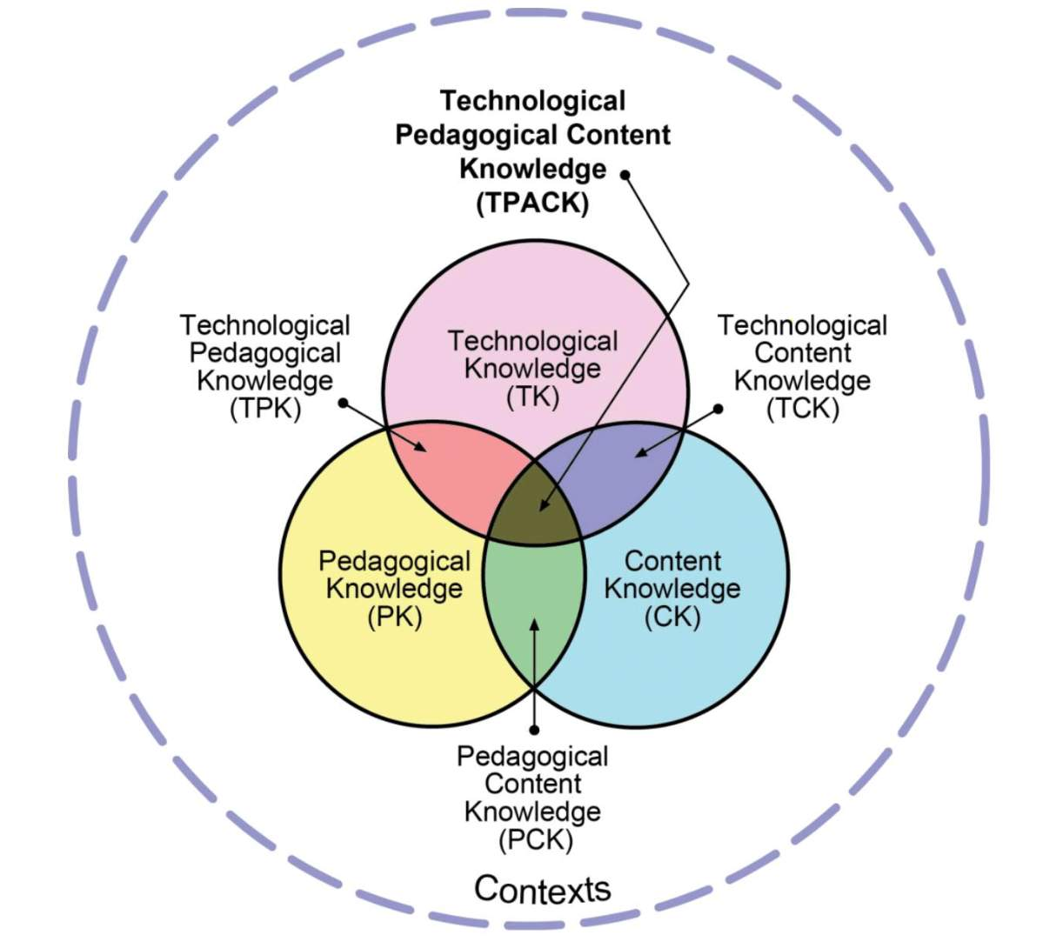
TPACK MODEL
Source: http://tpack.org/

Slide 11
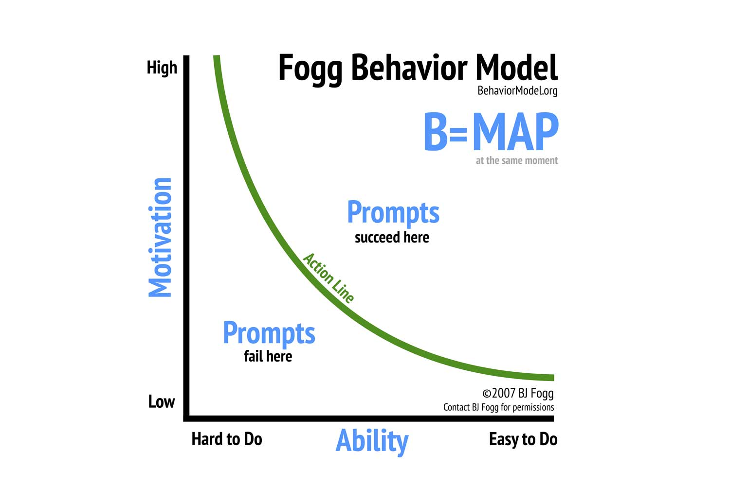
BJ Fogg’s Behavioral Model
Source: BJ Fogg. (2020, September 23). Behavior Model. Retrieved October 26, 2020, from https://behaviormodel.org/

Slide 12
Past Experiences- Theory into Practice
Design Research Project
Artifact Design
Mobile App Prototype Design- Canvas Me!
Connecting with Preparing Future Faculty (like staff from the Center for Teaching & Learning)

Slide 13
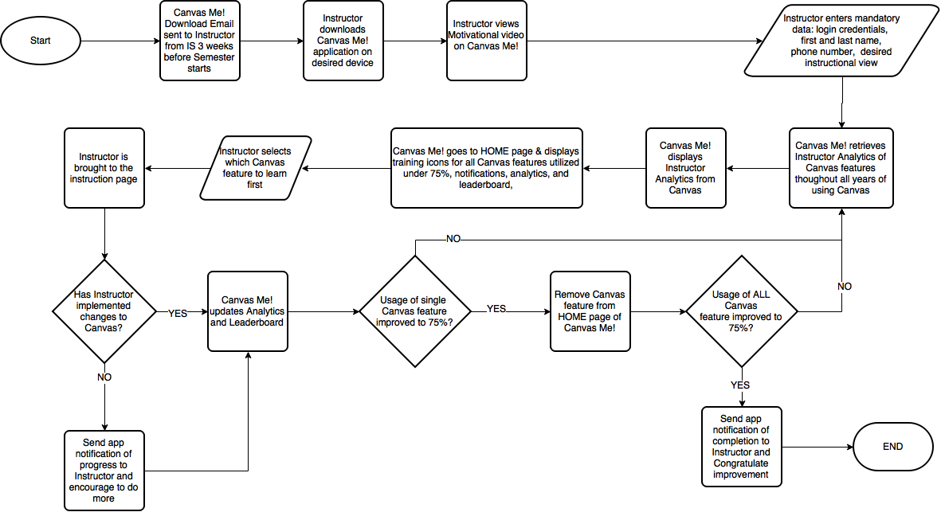
Mobile App- Canvas Me!

Slide 14
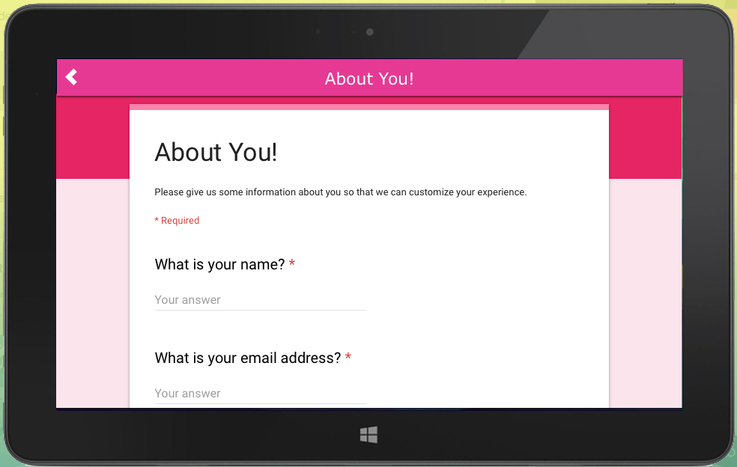
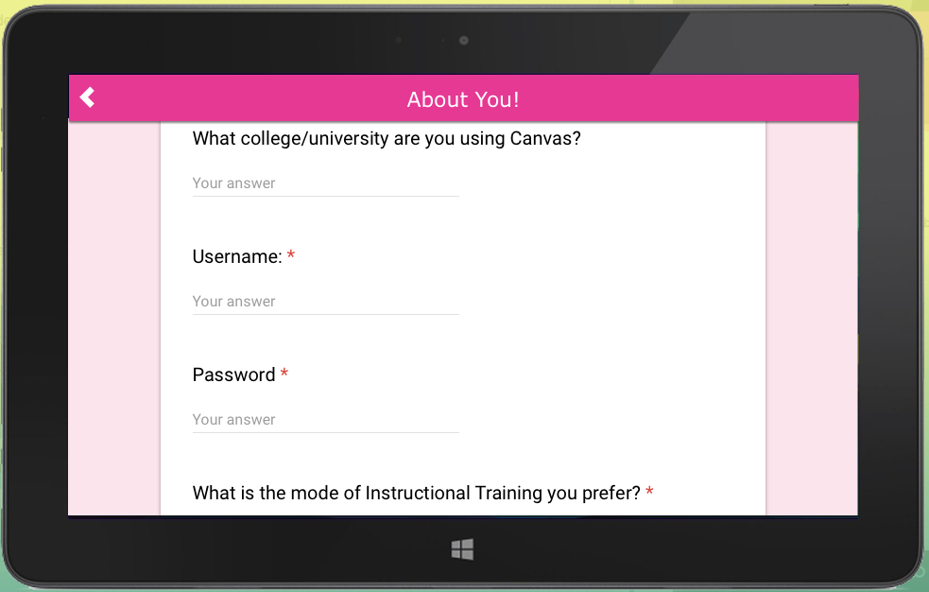
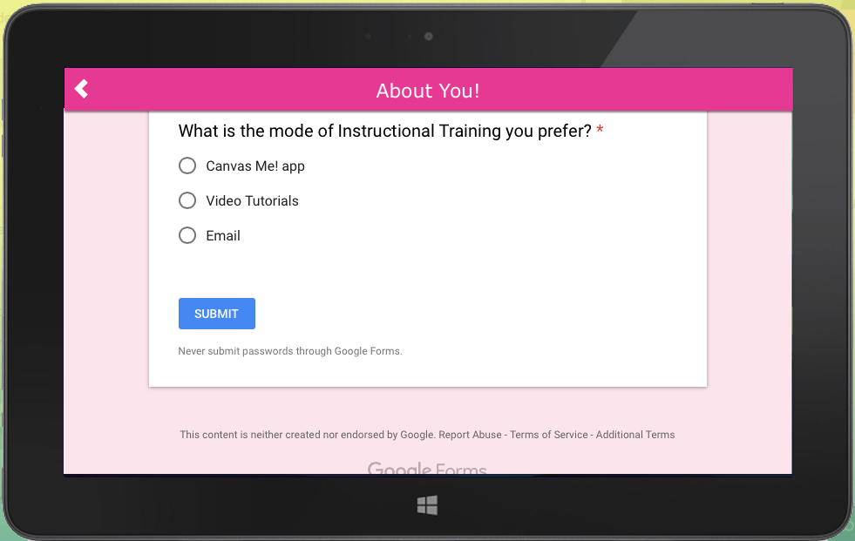
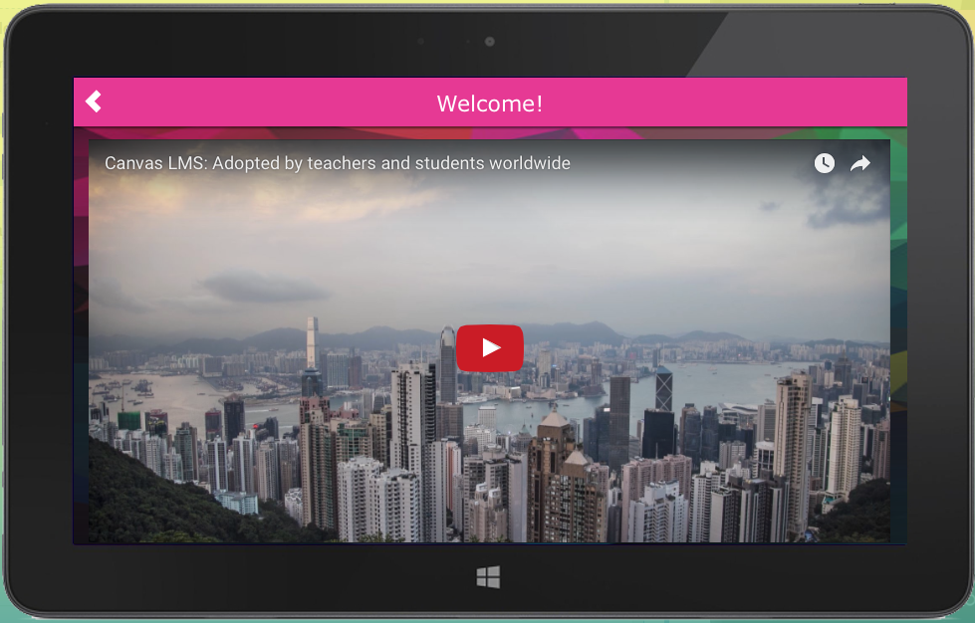
Mobile App- Canvas Me!

Slide 15
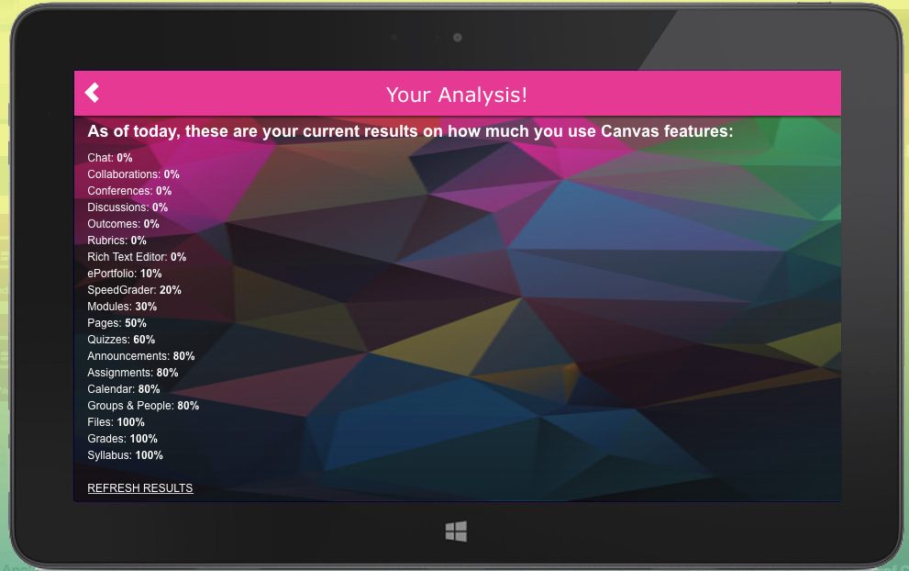
Mobile App- Canvas Me!

Slide 16
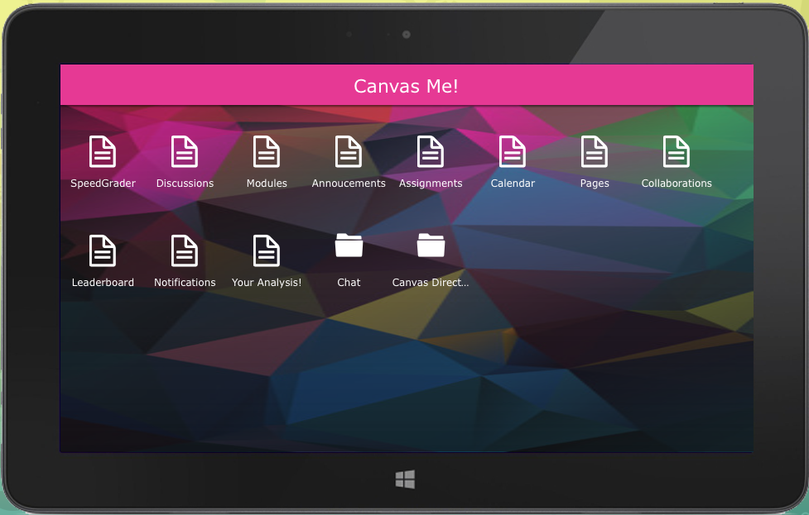
Mobile App- Canvas Me!

Slide 17
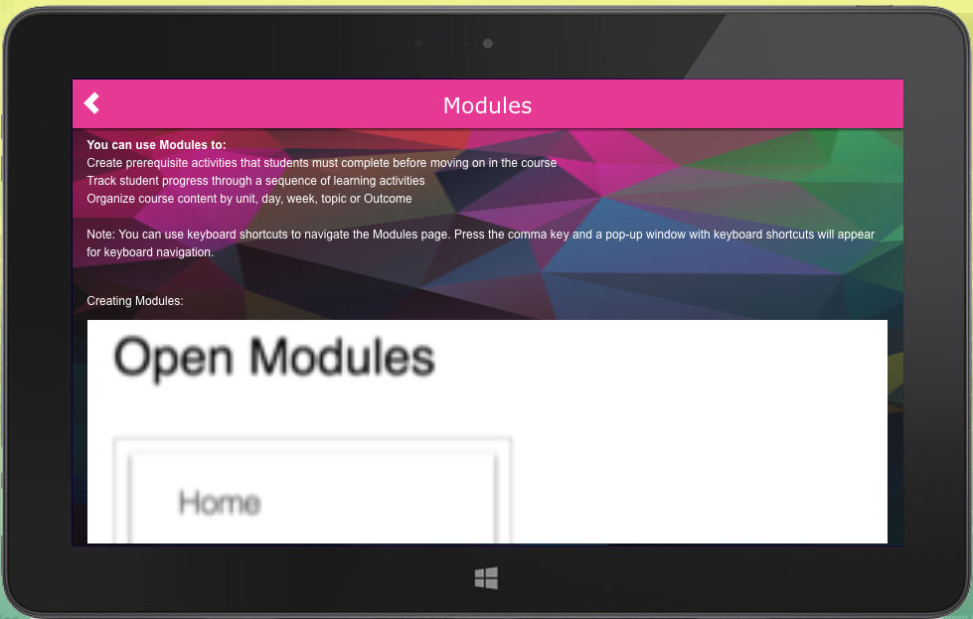
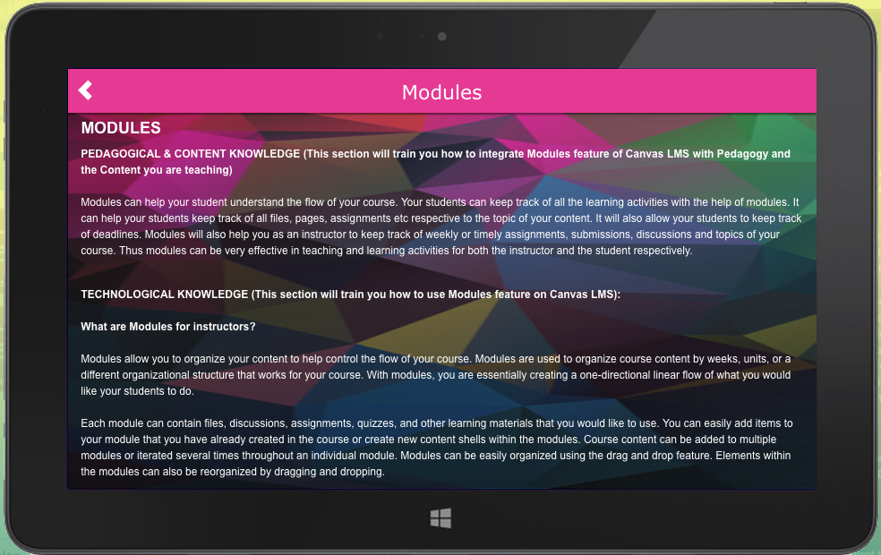
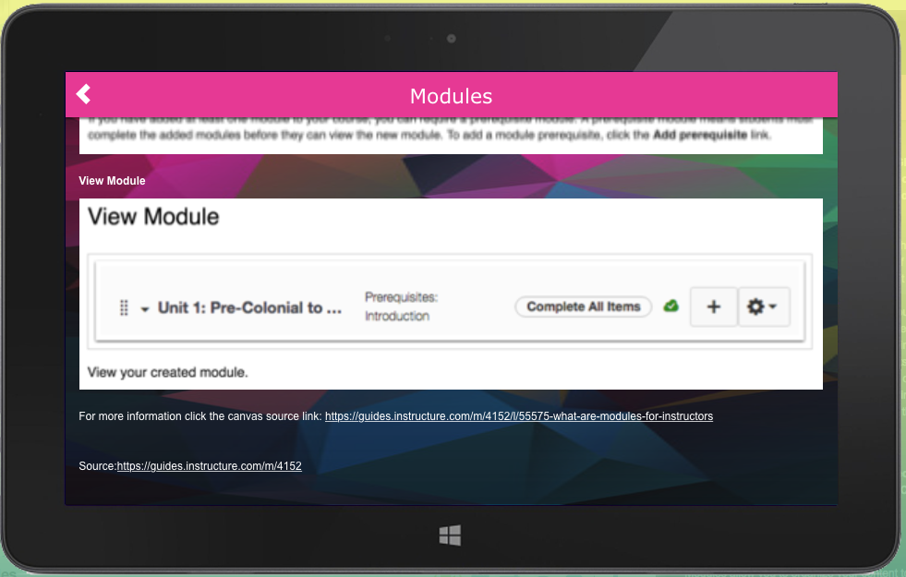
Mobile App- Canvas Me!

Slide 18
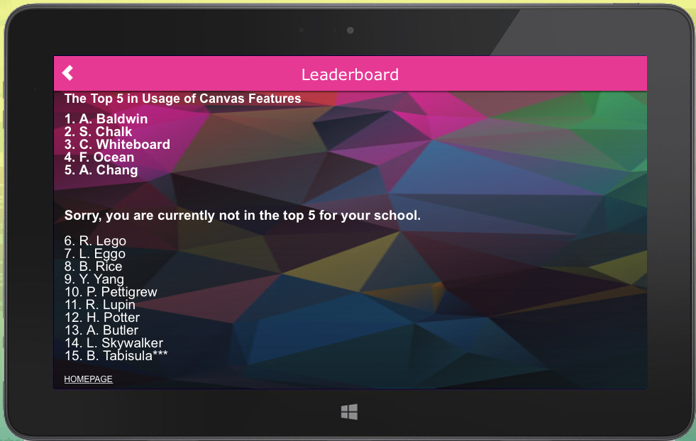
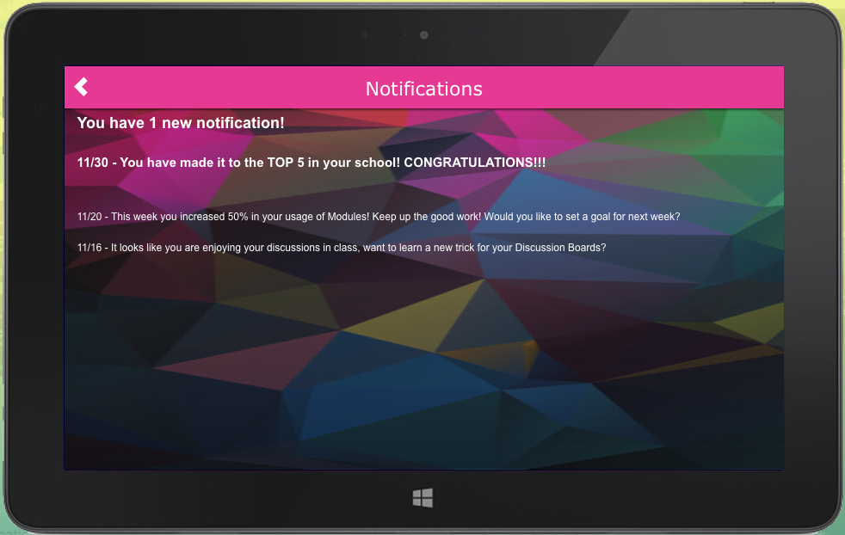
Mobile App- Canvas Me!

Slide 19
Past Experiences- Theory into Practice
Website Training links
Workshops

Slide 20
Current- Optimizing Canvas for Student Learning Faculty Development Program
Training on each feature of Canvas LMS
Training not only on how to use the feature in LMS but also how to integrate in course design and/or pedagogy
Using Canvas LMS for training—asynchronously within the Canvas course shell

Slide 21
Activity 2: Access to Project Repository
https://tinyurl.com/qmconnecttpacklms

Slide 22
Activity 3: Browse through the Canvas Course
https://scuhs.instructure.com/courses/4214

Slide 23
Activity 3: Audience Reflection
Share your plans- How do you think this same approach can be implemented at your own institutions?

Slide 24
Questions?

Slide 25
Contact
Email: swatiramani@scuhs.edu
Center for Faculty Development & Excellence (CFDE)
Southern California University of Health Sciences
16200 Amber Valley Drive, Whittier, CA 90604

Slide 26
References
BJ Fogg. (2020, September 23). Behavior Model. Retrieved October 26, 2020, from https://behaviormodel.org/
Hevner, A. (2010). Design Research in Information Systems: Theory and Practice. Boston, MA: Springer Science+Business Media, LLC.
Koehler, M. J., & Mishra, P. (2005). What happens when teachers design educational technology? The development of technological pedagogical content knowledge. Journal of educational computing research, 32(2), 131-152. doi: https://doi.org/10.2190/0EW7-01WB-BKHL-QDYV
Koehler, M. J., & Mishra, P. (2008). Introducing TPACK. In AACTE. (Ed.), Handbook of technological pedagogical content knowledge (TPACK) for educators (pp. 3–29). New York: Routledge.
Koehler, M. J., & Mishra, P. (2009). What is technological pedagogical content knowledge? Contemporary Issues in Technology and Teacher Education, 9(1). Retrieved from http://www.citejournal.org/volume-9/issue-1-09/general/what-is-technological-pedagogicalcontent-knowledge
Mishra, P., & Koehler, M. J. (2006). Technological Pedagogical Content Knowledge: A new framework for teacher knowledge. Teachers College Record 108 (6), 1017-1054.
Shulman, L.S. (1986). Those who understand: Knowledge growth in teaching. Educational Researcher, 15(2), 4-14.
TPACK.ORG. (2020). TPACK Explained Retrieved June 1, 2020, from http://tpack.org/

