Slide 1
Overcoming Roadblocks to QM Adoption
James Smrikarov
Instructional Designer/QMC
Saint Paul, MN
CC BY 4.0

Slide 2
Objectives
Identify QM roadblocks at your institution
Analyze problem-solving tactics to counter them
Apply relevant strategies to your institution

Slide 3
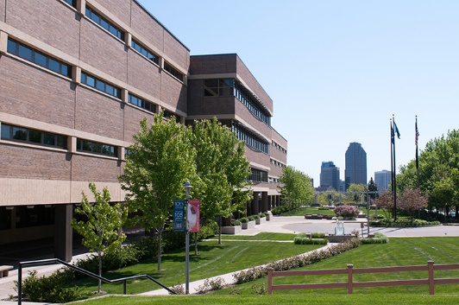
About Saint Paul College
2-year community & technical college part of the Minnesota State system
132 FT and 240 PT faculty
Diverse student body
Brand new ‘Academic Effectiveness and Innovation' unit formed to support faculty in 2018!
Two new QMC's certified in Fall 2018

Slide 4
QM Implementation – September 2018
Institutional Change
Benchmarking
Continuous Improvement
Dep’t committees
QM integrated into other T & L training
Program Review
Use full rubrics
Official plan for all or certain classes
Quality Assurance
Ad-Hoc
Process built into course dev
Higher # of reviews
Use CRMS
Systematic process
Schedule all for 3 yr plan
Familiarization
Informal review

Slide 5
Initial Roadblocks
Finances | Faculty | Time
Limited investment | Low awareness | No culture of professional development

Slide 6
Identifying Positives
Finances | Faculty | Time
Limited investment… | Low awareness… | No culture of professional development…
…but support from state (MOQI) | …but no opposition either | …but happy to finally have support

Slide 7
Our Strategy
Best bang for the buck:
Prioritize & subsidize workshop attendance
  Hosted in-person APPQMR in March, 2019
Piloted an internal peer review cohort in Jan, 2019
Incorporate QM standards into all faculty training, both face-to-face and online*
    (*starting March 2019)

Slide 8
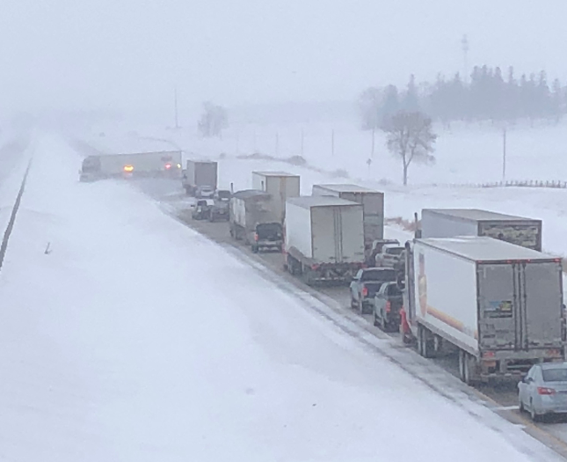
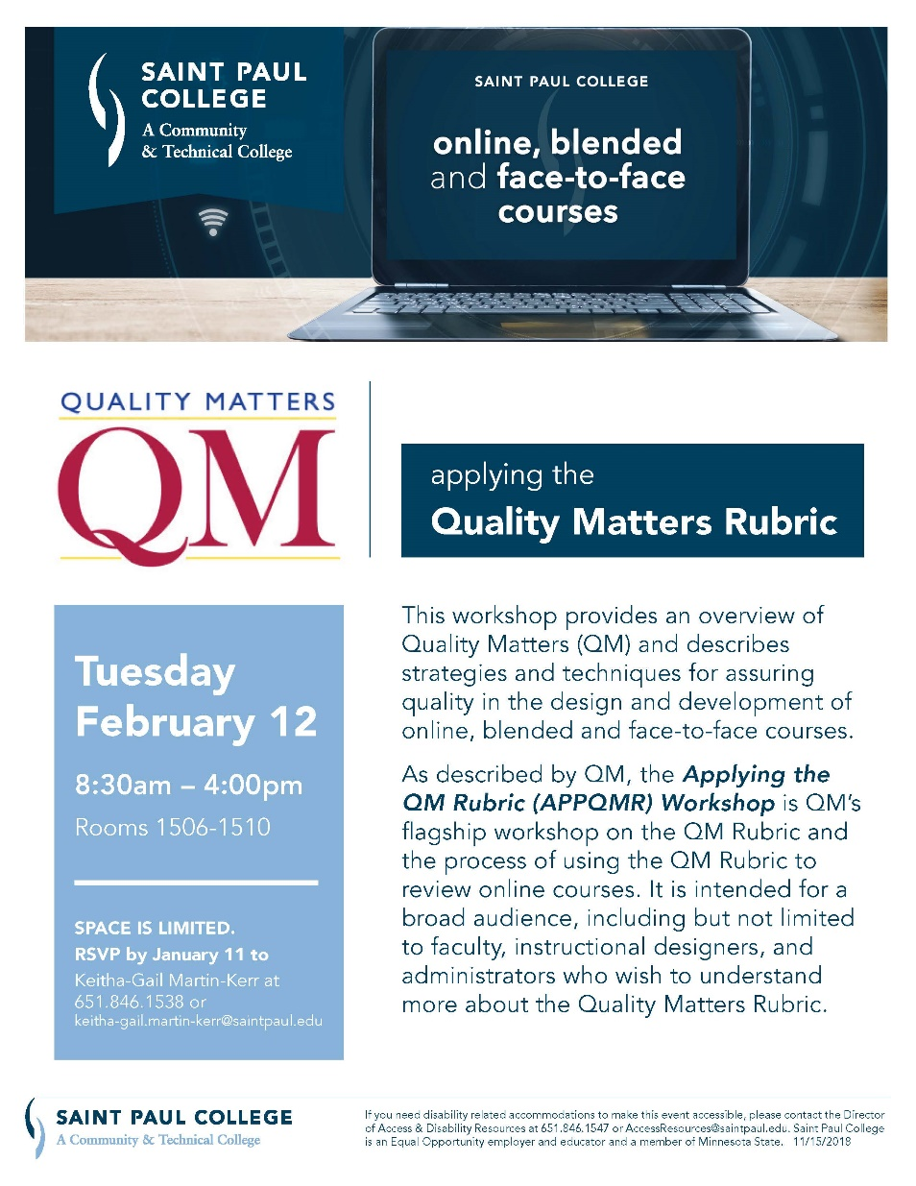

Slide 9
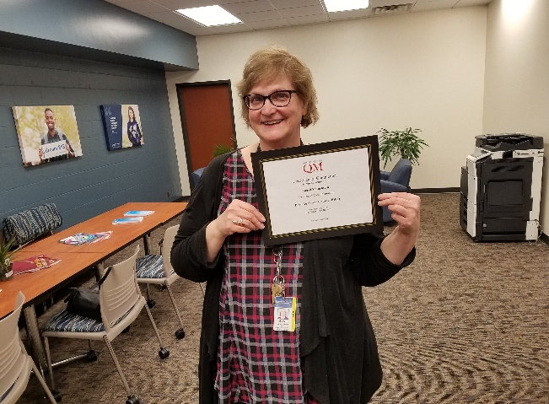
Results: Workshop Attendance
Quality Matters:
IYOC
APPQMR
PRC/MRC
QM Rubric Updates
QMC
In-House (Saint Paul College):
Course design
Online course engagement
Accessibility online

Slide 10
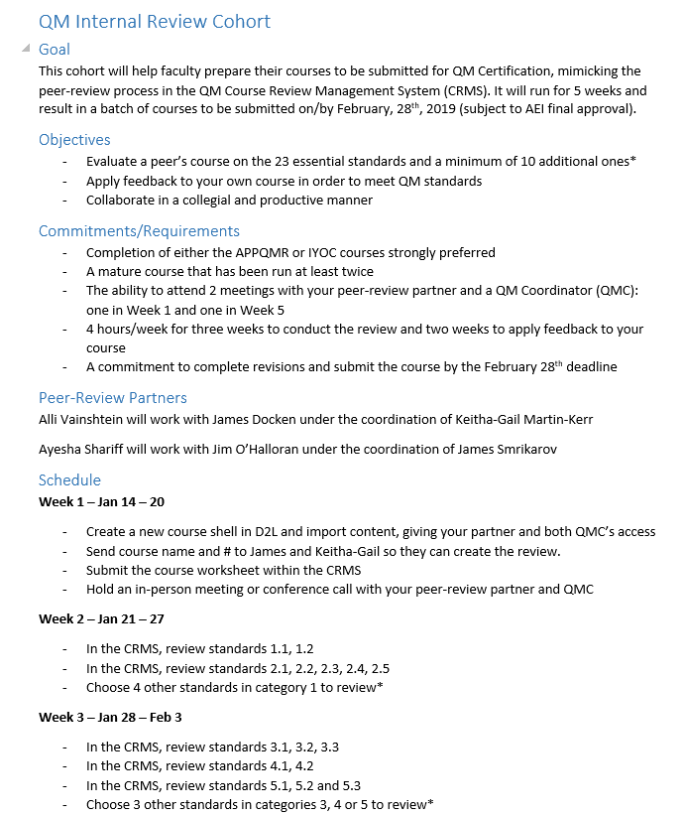
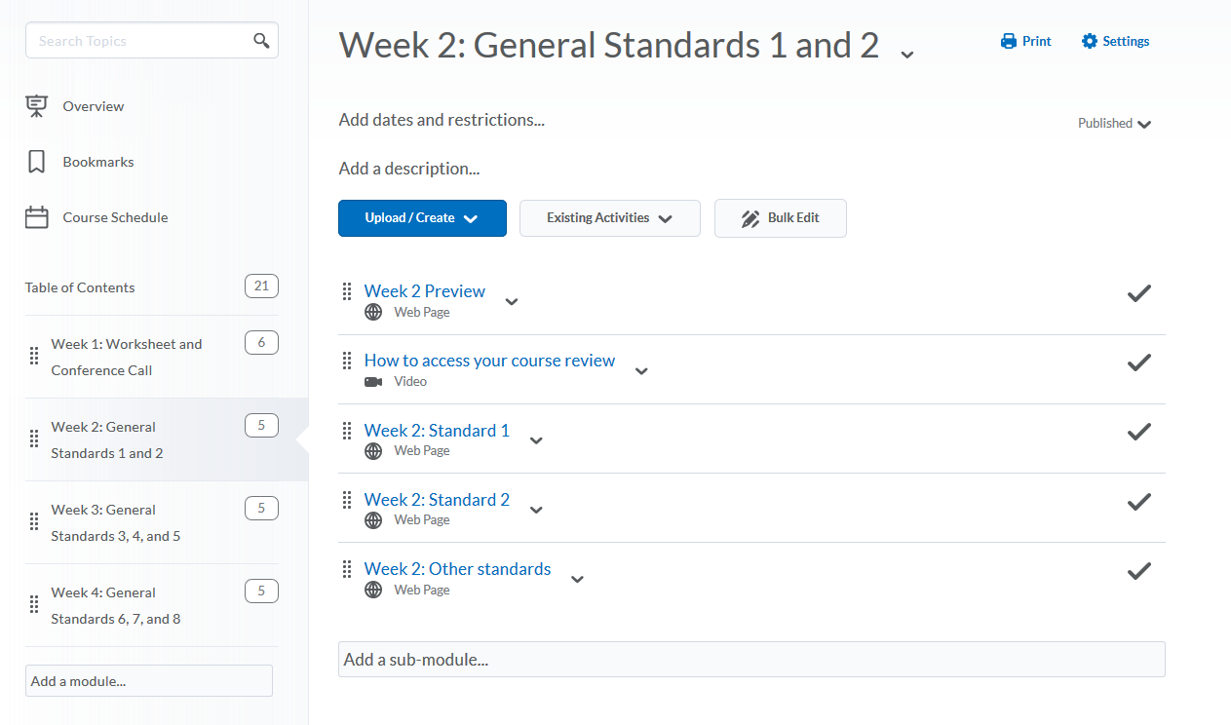
Results: QM Internal Review Cohort
6-week process using CRMS
Each pair of faculty supervised by a QMC with pre/post meeting
Accompanying LMS module with videos guiding each week and explaining standards
May lead to QM certification application if possible/desired
*Tip: leave time to pre-verify SRS 2.1/2.2 first!

Slide 11
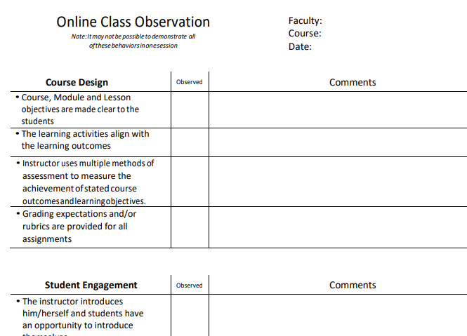
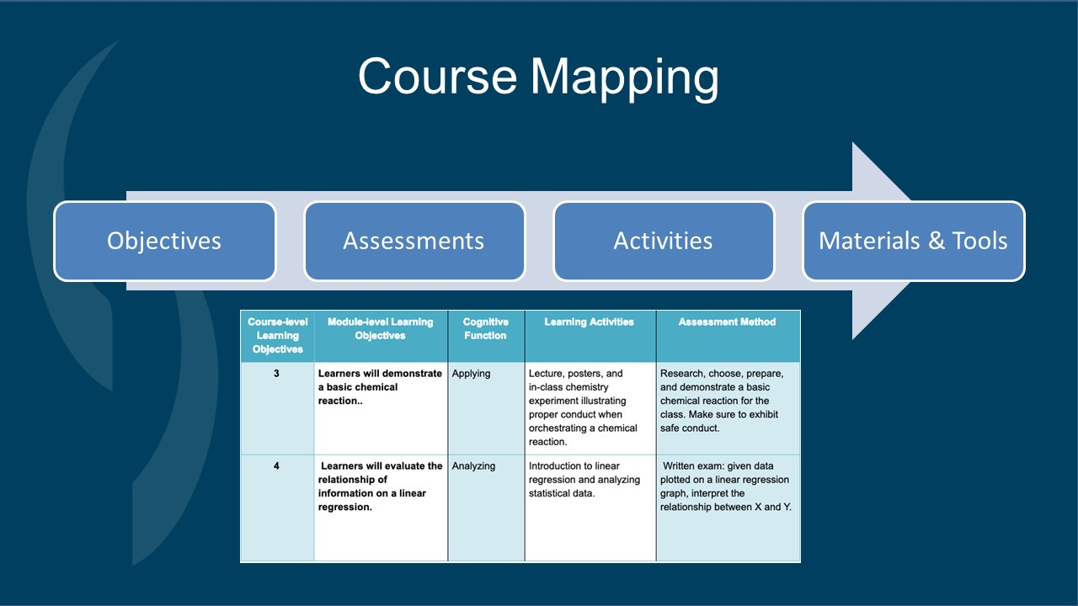
Results: Stealthy QM Standards
1 course design workshop*
1 online course delivery* webinar
Series of accessibility* workshops
Many on-demand consultations
Piloting an online peer observation form
Free rubrics to all who ask
*We plan to turn these into a set of core trainings offered bimonthly beginning Fall 2019

Slide 12
QM Implementation – April 2019
Institutional Change
Benchmarking
Continuous Improvement
Dep’t committees
QM integrated into other T & L training
Program Review
Use full rubrics
Official plan for all or certain classes
Quality Assurance
Ad-Hoc
Process built into course dev
Higher # of reviews
Use CRMS
Systematic process
Schedule all for 3 yr plan
Familiarization
Informal review

Slide 13
Workshop Activity
Work in your group to identify roadblocks you have experienced in one of the four categories
Finances | Faculty | Time | Other

Slide 14
Small Group Activity
Work in your group to identify solutions you have used or would use in one of the four categories
Finances | Faculty | Time | Other

Slide 15
Your Plan
Institutional Change
Benchmarking
Continuous Improvement
Dep’t committees
QM integrated into other T & L training
Program Review
Use full rubrics
Official plan for all or certain classes
Quality Assurance
Ad-Hoc
Process built into course dev
Higher # of reviews
Use CRMS
Systematic process
Schedule all for 3 yr plan
Familiarization
Informal review
Action Steps: | 1. 2. 3. | 1. 2. 3. | 1. 2. 3. | 1. 2. 3. | 1. 2. 3.
Timeline:

