Slide 1

Keep Calm, Build On:
Towards a Learning Accessible Campus
Phylis Zimmermann, Instructional Designer III
Instructional Technology & Distance Education
Texas A&M International University

Slide 2

In a time when accessibility in education is highlighted, especially in distance and hybrid learning, we will present how Texas A&M International University has implemented accessibility standards, universal design principles, and diversity appreciation to enable learning for all. We will walk through the process steps used on our campus demonstrating the utilization of various technologies providing captions and transcripts for audio and video files.
The presentation goal is to share our progression, and methods used to handle diversity needs in a Universal Design for Learning fashion. This unique session will address the course of action taken —from start to finish—from receiving standalone audio/video files, ultimately integrating fully captioned/transcribed files to the Learning Management System.
Keep Calm, Build On:
Towards a Learning Accessible Campus

Slide 3

On Thursday, February 5, 2015, the National Association of the Deaf (NAD) filed a federal class action lawsuit against both Massachusetts Institute of Technology (MIT) and Harvard University. The NAD cited violations of the Americans with Disabilities Act (ADA) and the Rehabilitation Act in the universities’ failure to provide appropriately accurate and comprehensive captioning for online course materials.
Keep Calm, Build On:
Towards a Learning Accessible Campus

Slide 4
No concrete starting point other than a homegrown HTML product.
Began by volunteering our services to other school offices to transcribe and caption in-house videos.
No big deal – Right? Wrong.
Keep Calm, Build On:
Towards a Learning Accessible Campus

Slide 5
Decided to try voice recognition. Unsuccessful.
Audio visual co-workers had some knowledge of transcribing and especially of captioning.
Processes were very time consuming and drawn-out sometimes taking days/weeks for an hour long video.
Listening, Typing, Listening, Typing – Very Monotonous.
Keep Calm, Build On:
Towards a Learning Accessible Campus

Slide 6
Our next challenge – YouTube Videos.
Still the same drawn-out process.
Camtasia - License
Amara - License
Name of the game was trial and error.
Keep Calm, Build On:
Towards a Learning Accessible Campus

Slide 7
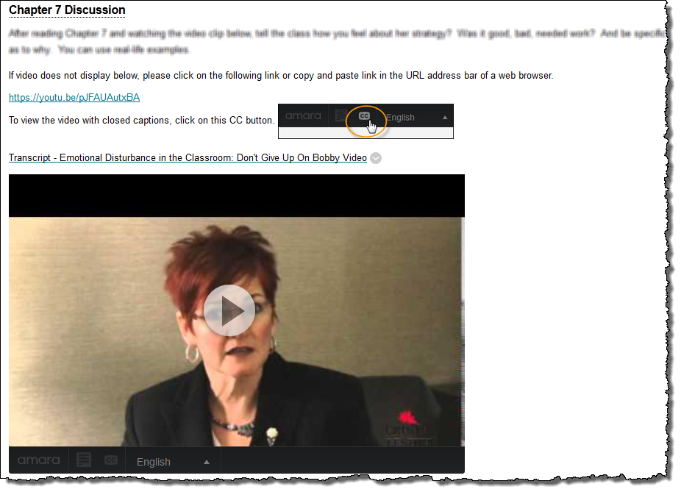

Keep Calm, Build On:
Towards a Learning Accessible Campus
Amara
CC button
YouTube URL
Transcript

Slide 8

REV.com
Fast, Efficient, Affordable,
Reliable, Precise…
Took transcribing from days/weeks to less than 48 hours for an hour long video.
Gave us .srt & .txt but still no way to marry .srt to .mp4 other than Camtasia.
Keep Calm, Build On:
Towards a Learning Accessible Campus
.txt .srt .scc .mcc .ttml .qt.txt .vvt .dfxp .cap .stl
Guarantee: FCC compliance, ADA requirement compliant, meets Section 508 requirements

Slide 9

Submerge
The Game Changer.
Marries the .srt & .mp4 – creates a single .mp4 file
Able to complete process in a few short minutes, compared to days.
Keep Calm, Build On:
Towards a Learning Accessible Campus

Slide 10
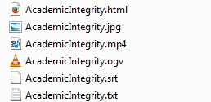
Storage
Media Drive – Media Storage
Allows us to quickly find and access all files types related to a particular video.
Keep Calm, Build On:
Towards a Learning Accessible Campus

Slide 11
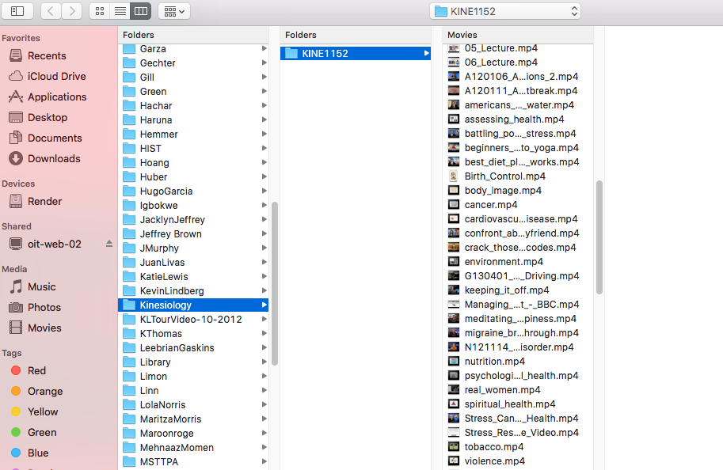
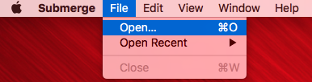
Submerge & the Mac 1
Keep Calm, Build On:
Towards a Learning Accessible Campus

Slide 12
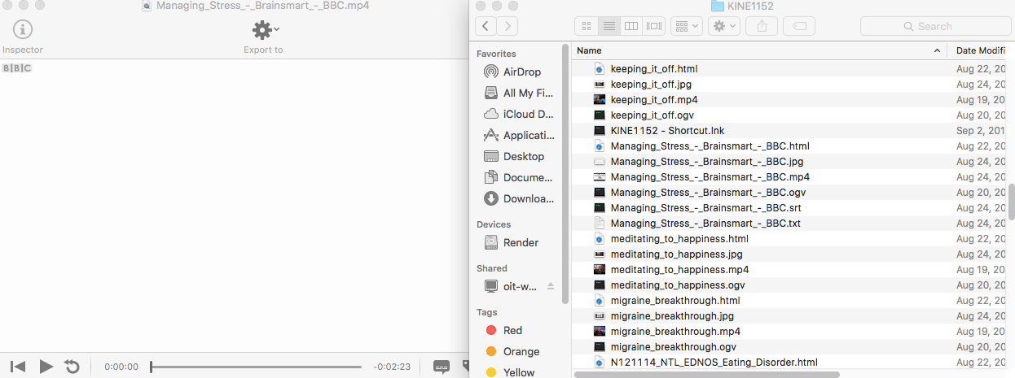
Submerge & the Mac 2
Keep Calm, Build On:
Towards a Learning Accessible Campus

Slide 13

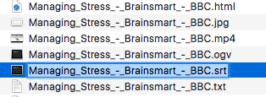
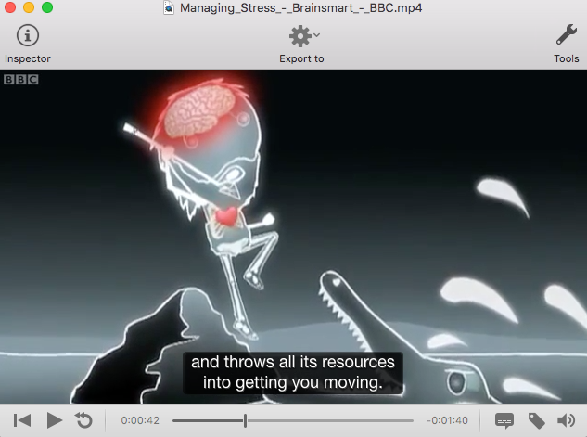
Submerge & the Mac 3
Keep Calm, Build On:
Towards a Learning Accessible Campus

Slide 14
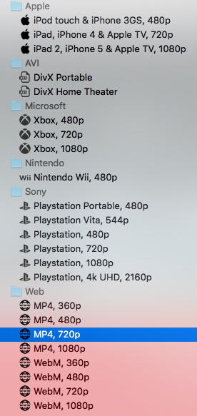
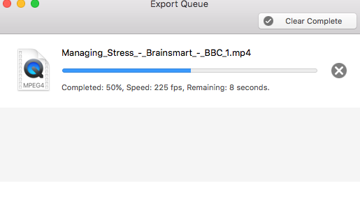
Submerge & the Mac 4
Keep Calm, Build On:
Towards a Learning Accessible Campus

Slide 15
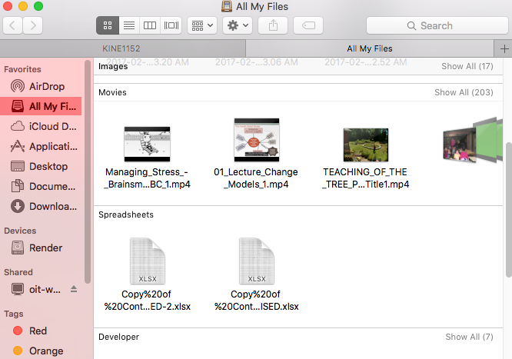

Submerge & the Mac 5
Keep Calm, Build On:
Towards a Learning Accessible Campus

Slide 16

DVDFab
The final piece to the puzzle.
Able to burn DVDs with the captions already embedded (No Transcripts).
Able to complete process of burning DVD and adding captions within an hour.
Keep Calm, Build On:
Towards a Learning Accessible Campus

Slide 17
Blackboard
Once we figured out the process, we looked at the best way we could put the content into Blackboard.
Content Space.
Keep Calm, Build On:
Towards a Learning Accessible Campus

Slide 18
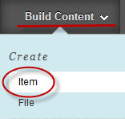


Keep Calm, Build On:
Towards a Learning Accessible Campus
Build Content >>Item
HTML Code for the video
(Web) Link for the transcript: linking to the media drive

Slide 19
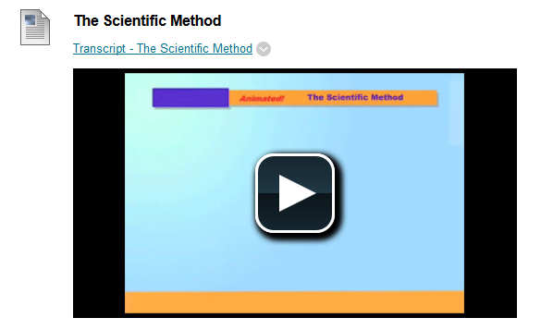
Keep Calm, Build On:
Towards a Learning Accessible Campus

Slide 20
Captioning Prioritization
Disability
Online/Hybrid
Quality Matters
Professor request upon verification of use
(Any combination)
Keep Calm, Build On:
Towards a Learning Accessible Campus

Slide 21
We do not limit ourselves to one way of doing business.
Voice Thread
ECHO Lecture Capture
Films on Demand/New York Times
In-house videos
Commencement Exercises
IBC Lecture Series
TAMIU’s Killam Library
Keep Calm, Build On:
Towards a Learning Accessible Campus

Slide 22
Questions?
Keep Calm, Build On:
Towards a Learning Accessible Campus
Phylis Zimmermann, Instructional Designer III
Instructional Technology & Distance Education
Texas A&M International University

