Slide 1


Let Me Introduce Myself…
Different ways to meet Standard 1.8 and Standard 1.9
Reba-Anna Lee| reba-anna.lee@northwestern.edu|RebaAnna2
Notes:
Hi!
My name is Reba-Anna Lee. I am the Director of Online Program Development in the School of Professional Studies at Northwestern University.
Today we I will share with you a few interesting and traditional ways to met Standard 1.7 and Standard 1.8

Slide 2

Standard 1.8
The self-introduction by the instructor is appropriate and is available online.
Notes:
Standard 1.8 states: The self-introduction by the instructor is appropriate and is available online. “The initial introduction creates a sense of connection between the instructor and the learners. ” Six Different types of instructor introductions will be shared in eth following slides

Slide 3

Creates online community
Establishes instructor engagement
Sets tone of class
Notes:
Standard 1.8 is essential to the development of a solid online community. It establishes instructor engagement and gives students a taste of the instructor’s presence in the course.
Six Different styles of instructor introductions will be shared in eth following slides

Slide 4
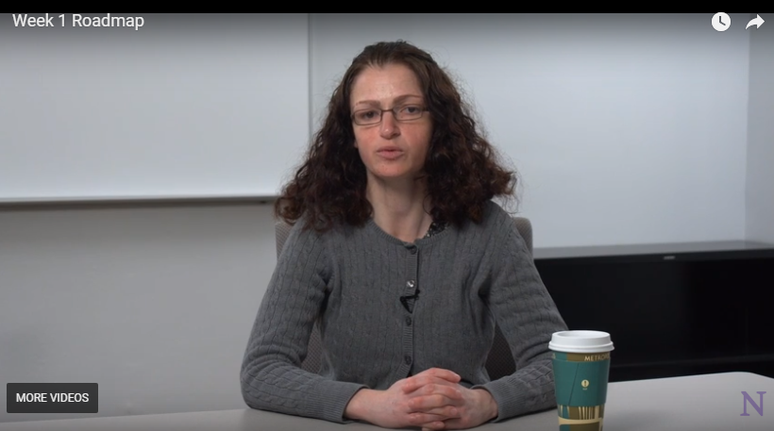
College professors are not actors!
Notes:
Style #1
College Professors are not actors! However, there are often opportunities for instructors to create polished, professional”talking head” introduction videos

Slide 5
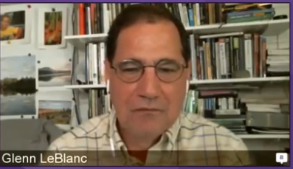
Instructors can make videos at home or in their office
Notes:
Style #2
At home/work Video/Can be more informal
These could be done with a script and within the comfort zone of the instructor

Slide 6
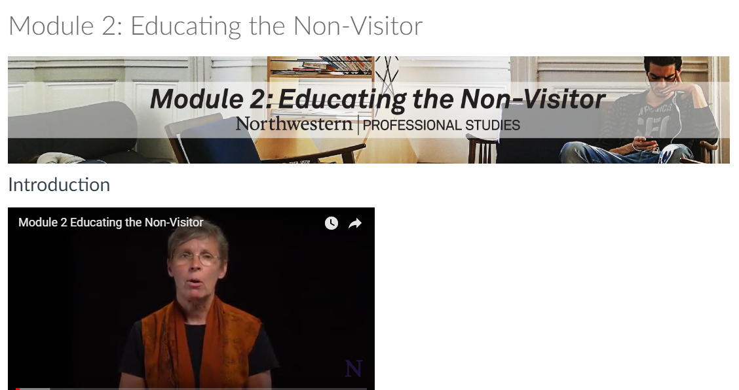
Walkthrough of course overview
Combined with instructor introduction
Notes:
Style #3 Short walkthrough of course which can introduce the purpose of the course or at the beginning of a new module/topic

Slide 7

Professors in their natural habitat
Notes:
Style #4 Instructors who are practitioners can take pictures on their smartphone while in the field. This can show students how they apply what they are teaching.

Slide 8
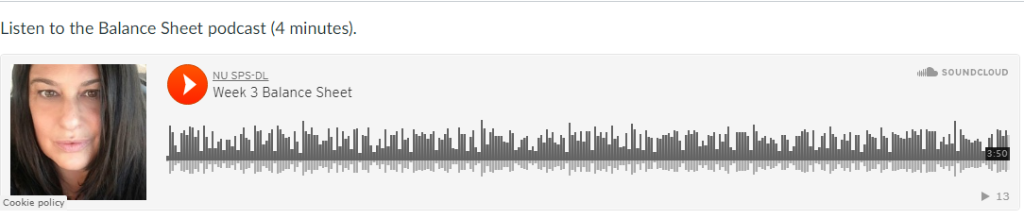
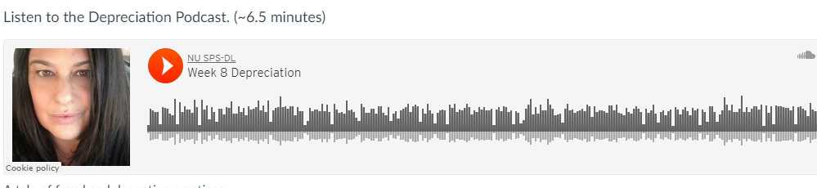
Camera shy instructors
Notes:
Style #5
Podcast/ Audio only with static headshot is great for instructors who may be camera shy

Slide 9
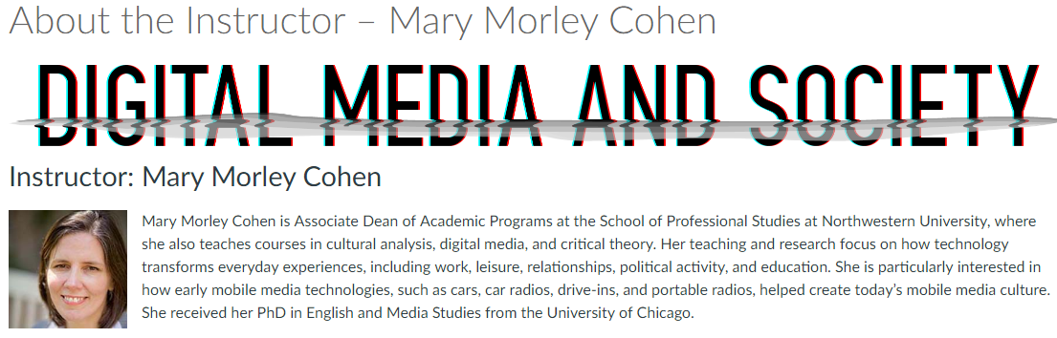
Utilitarian
Notes:
Style #6
When in a time crunch or if you have an instructor who may have more videos during the course, a short text bio with a photo can be a short but sweet intrioduction

Slide 10

1.9 Learners are asked to introduce themselves to the class.
Notes:
1.9 Learners are asked to introduce themselves to the class.
Learner introductions at the beginning of the class help to create a welcoming learning environment and a sense of community. Learners are asked to introduce themselves and given guidance on where and how they should do so.
Six examples follow:

Slide 11
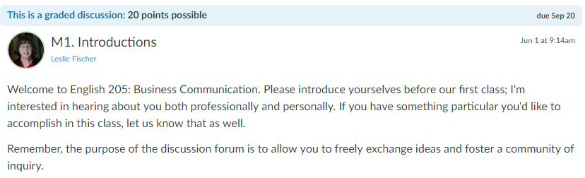
Tradition!
Notes:
Example 1ATraditional Student introductions—Student may become tired of redundancy throughout a program
Where are you from
Why are in this class
What do you do
Name a hobby

Slide 12
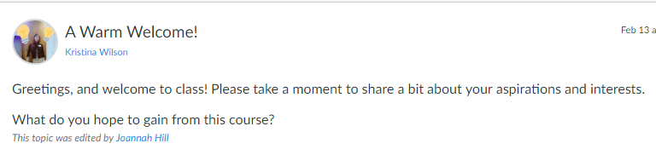
Just say hi!
Notes:
Example 1BDirections are a key part of successful creation of an online community. A freeform introduction can be usfula several courses into a program but newer students may need more guidance.

Slide 13
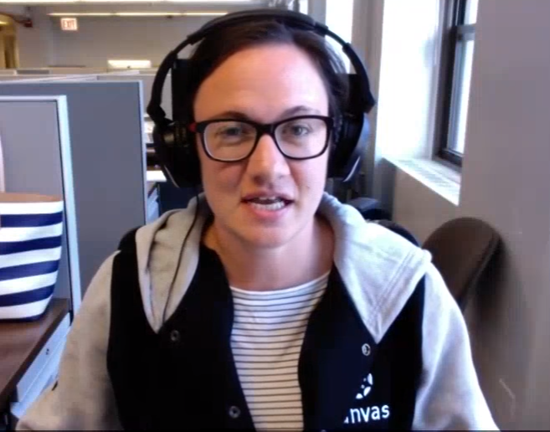
Student produced videos through their own web cams or smartphones
Notes:
Example 3
Many Learning Management systems offer in line video or on the spot video capabilties for students

Slide 14
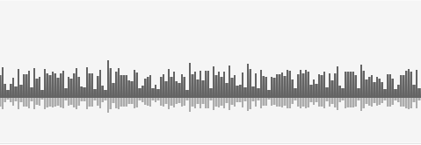
Students can be camera shy too!
Notes:
Example 4
Podcasts for students if they are camera shy is also a possibility

Slide 15



Alternatives for cohorts or students with prior course contact
Two truths & a lie
Favorite childhood food
Spirit animal
Desert island scenario
Try something new!
Notes:
Example 5
Not all studenst are new and by their third or fourth course, they may crave something new!

Slide 16
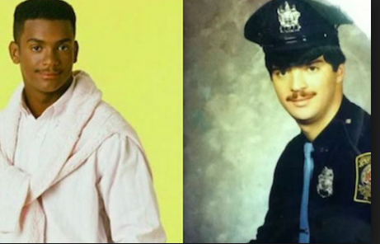
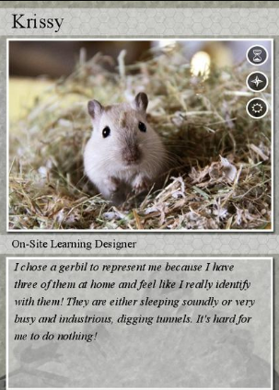
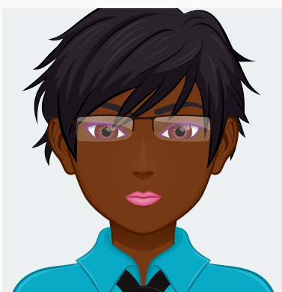
Just Creative!
Avatar ( avatar builder) then upload
Trading card
Word cloud to describe themselves
Celebrity birthday match/doppelganger/twin
Notes:
Example 6
Sometimes it is just fun to have a creative way of greeting a new classmate!

Slide 17
Small group introductions
  Group charter
  Communication plan for the course
  Choose topics to discuss
Notes:
Small groups
Group charter
Communication plan for the course
Choose topics to discuss

Slide 18

Instructor response to introductions
Notes:
Make a connection to what they will learn in the course
Match the style if possible

Slide 19

Peer responses
Notes:
Remember to have students respond to their peers

Slide 20

Thank You!
Reba-Anna Lee| reba-anna.lee@northwestern.edu|RebaAnna2
Notes:
It’s been a pleasure to speak to you today, and I hope you’ll take these design strategies into consideration as you develop or revise your online course. If you have any questions, please feel free to reach out to me by e-mail via Twitter, or on LinkedIn

