Slide 1
Leveling Up Learning
Exploring Gamification with IDLA

Slide 2
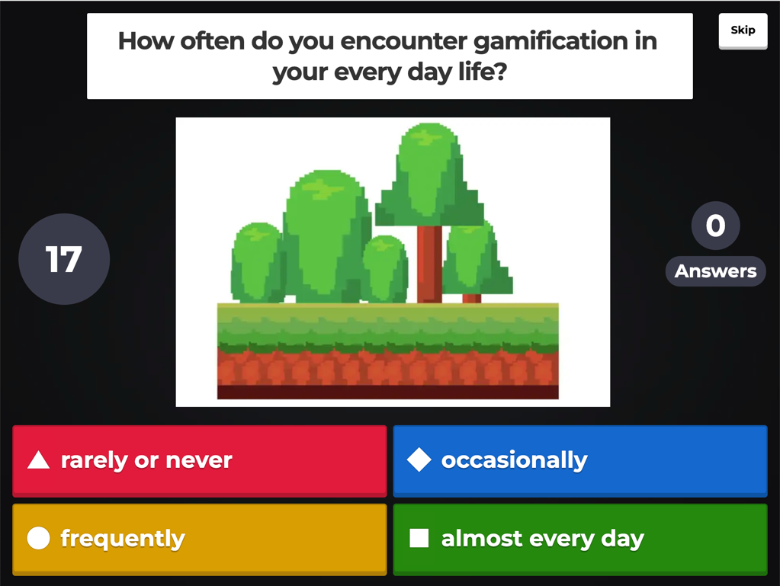
Principles of Gamification
Objective 1: Apply the principles of gamification to educational contexts, incorporating game mechanics, dynamics, and aesthetics.
Kahoot: Gamification
Notes:
https://create.kahoot.it/share/gamification/7fa7dd84-fbeb-416f-a331-c543592822b0
Presentation notes: Kahoot>https://docs.google.com/document/d/1UnUpMcGo4Zx8gCZmNtpI6ruU6einfTmbaPu_LdiRh_E/edit?usp=sharing
Backup Google Slide Deck> https://docs.google.com/presentation/d/17P3xzZ6iGhA_h5QyzLeW_WzF0ecDP5KSQ6zDGHTtHbA/edit?usp=sharing

Slide 3
Examples of Gamification
Objective 2 - Explore successful examples of gamification in education.
Gamified Lesson Activities
Gamified Course Units
Gamified Course
1
2
3
Notes:
This graphic depicts the progression in implementing gamification in our courses. In this presentation we will look at some examples of gamification at the following levels:
Gamified Lesson Activities:
Gamified Course Units.
Gamified Course.

Slide 4



Gamification: Lesson Activity Level
Notes:
We started by building single-game activities within lessons. We've used gamification tools such as…
Kahoot
Quizlet
H5P
framing assessments as real-life challenge scenarios/role-playing.

Slide 5


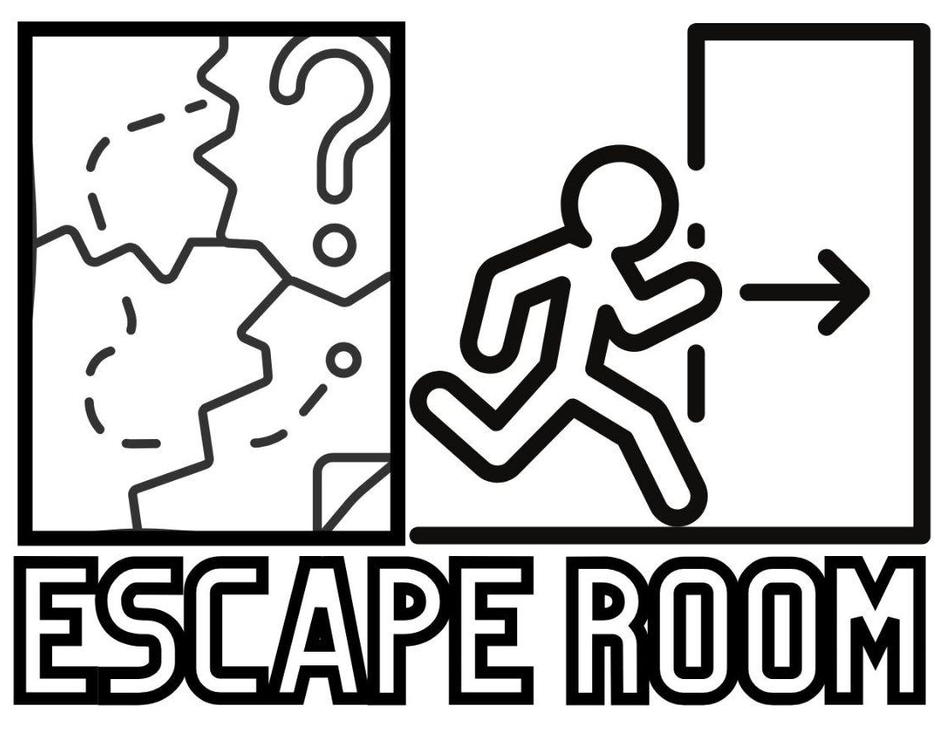
Gamification: Course Unit Level
Treasure Hunt
Secret Spy Mission
Notes:
We then began to develop gamified scenarios that span an entire course unit. The first unit of a standard IDLA middle school course uses gamification to engage students in the content by placing them in a game scenario, such as an Escape Room, a Treasure Hunt, or a Secret Spy Mission, in which they collect clues to complete their quest as they review learning skills and lesson content.

Slide 6
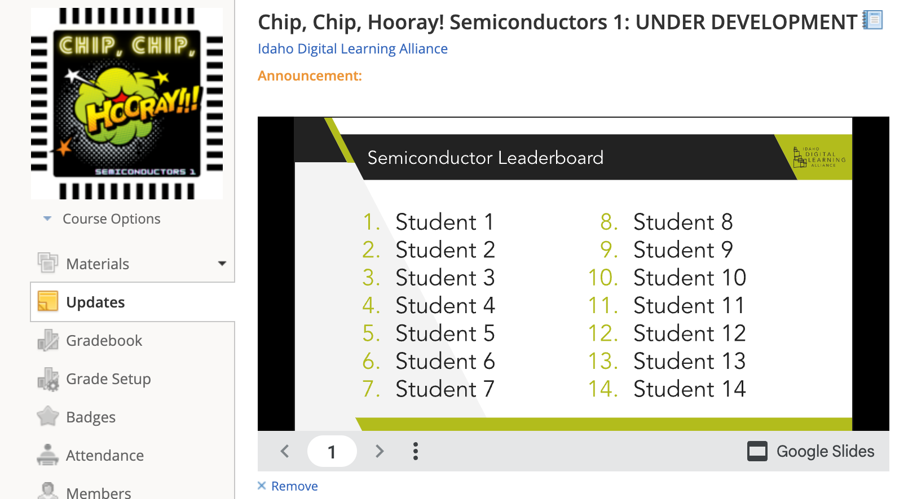
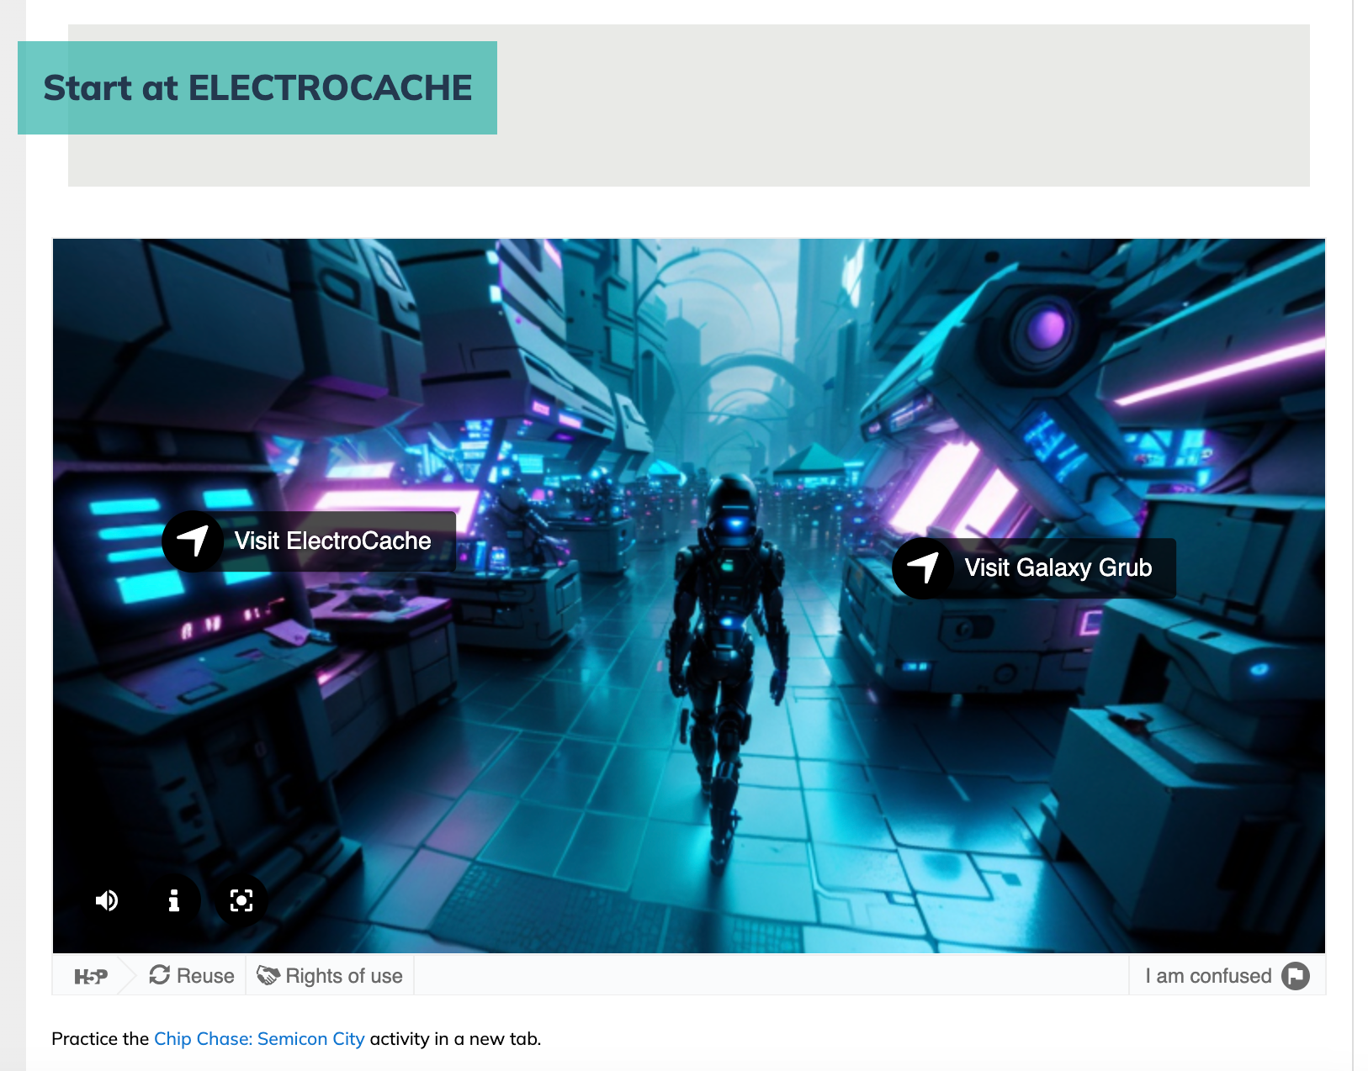
Gamification: Whole Course Level
Notes:
Currently we are working on a gamified scenario that spans an entire course.
Semiconductor course integrates a variety of games throughout the entire course, utilizing a leaderboard and other gamified elements.
The course is targeted at students in grades 8-10 and introduces them to semiconductor science. The whole course is built around the idea of gamification.
The image on the left shows a sample leaderboard that will always be visible when students first enter their class (we utilize Schoology as our LMS).
The image on the right is an example of a game the students will see when they are in their lessons. This particular game drops students into the capital city of Semicon on the planet Semiconia. Students will explore the city through each linked location. At locations like Galaxy Grub, they will learn about the course content and then demonstrate their understanding, leveling up their knowledge as they progress through the game. They earn codes that are entered back in the course, which is how the teacher tracks progress on the leaderboard. Other games in the course have students choosing their own tech adventure, learning about the types of semiconductor devices and matchmaking those devices to solve technological problems, and escaping a rival factory to learn the secrets of semiconductor manufacturing.
You may notice that our title is “Chip, Chip, Hooray! Semiconductors 1.” We even gamified how we got the title by holding a course name contest open to students around the state of Idaho. Chip, Chip, Hooray was the big winner! We also have names for the proposed future courses in our semiconductor pathway: The Spark of Innovation: Semiconductors 2 and The Heart of Modern Technology: Semiconductors 3.
The goal is for students to earn an industry certification upon completion of all 3 courses.

Slide 7
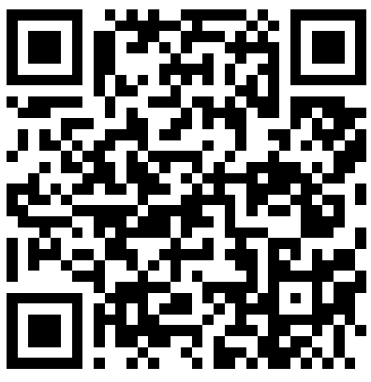
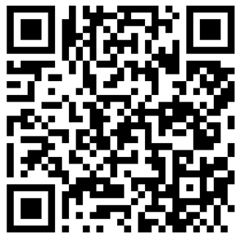
Try It Out!
Treasure Hunt Activity Demonstration
Secret Spy Mission Activity Demonstration
Notes:
Take a few minutes to explore one of these gamified unit activities. These are abbreviated demonstrations of the Treasure Hunt activity that is used in IDLA's 7th-grade courses and the Secret Spy Mission activity that is used in IDLA's 8th-grade courses.
In the Treasure Hunt activity, two students Ellen and Nadia learn how to navigate their online course as they use a treasure map and search for unknown objects that will enable them to retrieve a hidden treasure.
In the Secret Spy Mission activity, students learn how to navigate their online course as they play the role of a secret agent and search for clues that will enable them to complete a clandestine mission.

Slide 8
Gamification Resources
Objective 3: Gain practical strategies and tools for designing and implementing gamified learning experiences.
Templates for interactive game creation
  H5P–interactive video
  H5P–360 interactive
  H5P–branching scenario
  H5P–interactive presentation
Genially–escape rooms, quizzes
Kahoot
Quizlet
Mentimeter
Notes:
One of the challenges in gamifying content is the complexity of designing the game itself combined with creating the instructional and assessment content to enter into the game. The first link on this slide will take you to some Google Doc templates that can be shared with content experts and used to outline the instructional materials and assessment content. Instructional designers can then apply the information from the template within the gaming environment to create the game. The templates are tied to H5P interactives, linked below the templates.
Genially has game templates and escape rooms to fit a variety of contexts. It is easy to use and looks very similar to PowerPoint or Google Slides. The nice part about starting with a Genially template is that the interactions are already built into the presentation for you.
We already demonstrated some of the possibilities of Kahoot.
Quizlet is a great tool, especially for vocabulary content. It includes a variety of gamified, matching, and quiz-style options for practicing content.
Mentimeter is another tool that can be used to gamify presentations when they are delivered live.
All of these tools have free versions with various restrictions as well as paid versions that expand the available options. But a lot can be done with the free versions!

Slide 9
Your Turn!
In a group or individually, brainstorm ideas for taking the next step toward gamification.
Share out!
  How have you included gamification already, or how do you intend to use gamification moving forward?
  Share how you might incorporate this online or face-to-face.

Slide 10
Resources
Analysis of Gamification Models in Education Using MDA Framework from Procedia Computer Science
Game Mechanics for Learning from University XP (may need to sign in for a free account in order to access the article)

Slide 11
Q&A
Contact information:
Lisa Kabel - lisa.kabel@idla.k12.id.us
RaeLynn Kelley - raelynn.kelley@idla.k12.id.us
Greg Rockwood - greg.rockwood@idla.k12.id.us

